Slide 1

Unit – 4 Dynamic Programming
Gopi Sanghani
 9825621471
→ gopi.sanghani@darshan.ac.in
Analysis and Design of Algorithms (2170703) Darshan Institute of Engineering & Technology

Slide 2
Topics to be covered
Introduction
The Principle of Optimality
Problem Solving using Dynamic Programming – Calculating the Binomial Coefficient
Making Change Problem
Assembly Line-Scheduling
Knapsack problem
All Points Shortest path
Matrix chain multiplication
Longest Common Subsequence

Slide 3
Introduction
A dynamic-programming algorithm solves every sub problem just once and then saves its answer in a table.
It avoids the work of re-computing the answer every time the sub problem is encountered.
The development of a dynamic-programming algorithm can be broken into a sequence of four steps.
Characterize the structure of an optimal solution.
Recursively defines the value of an optimal solution.
Compute the value of an optimal solution in a bottom-up fashion.
Construct an optimal solution from computed information.

Slide 4
Principle of optimality
The dynamic programming algorithm obtains the solution using principle of optimality.
The principle of optimality states that “in an optimal sequence of decisions or choices, each subsequence must also be optimal.
When it is not possible to apply the principle of optimality it is almost impossible to obtain the solution using the dynamic programming approach.

Slide 5
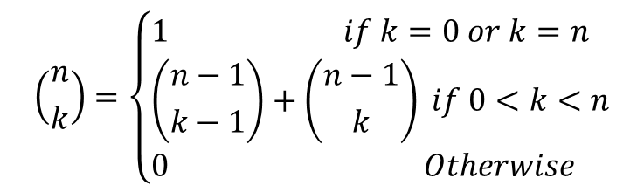
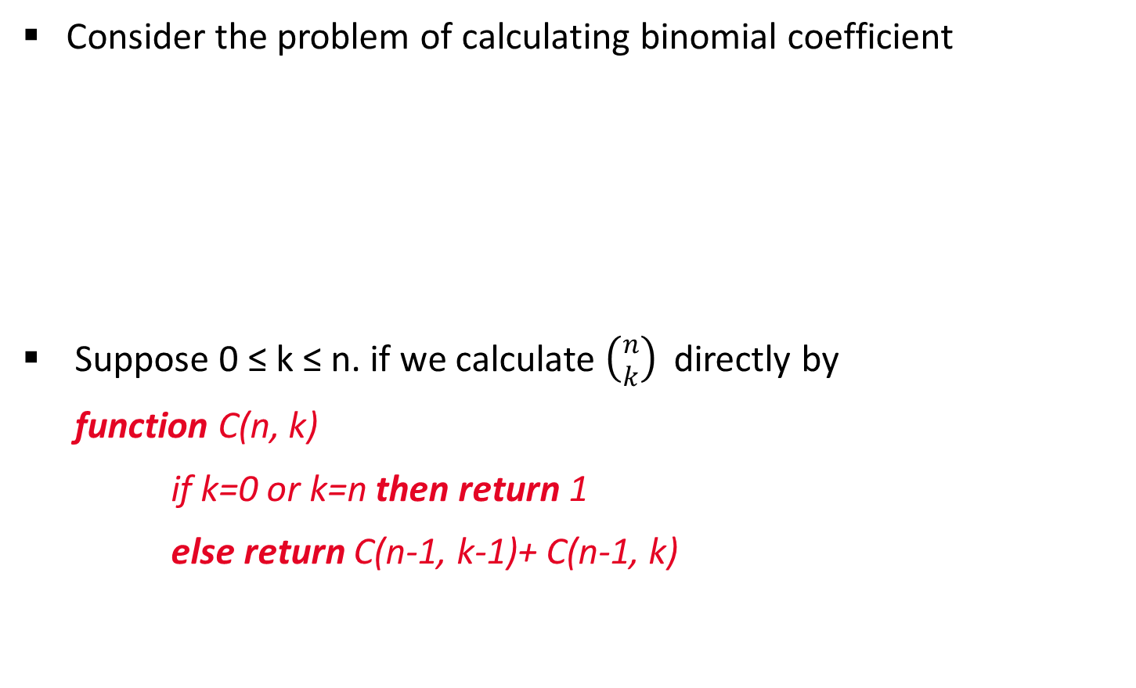
Binomial coefficient
Consider the problem of calculating binomial coefficient
Suppose 0 ≤ k ≤ n. if we calculate $\left({n \atop k}\right)$ directly by
function C(n, k)
if k=0 or k=n then return 1
else return C(n-1, k-1)+ C(n-1, k)
$$\left({n \atop k}\right)=\left\{\begin{aligned}&1 if k=0 or k=n \\ &\left({n−1 \atop k−1}\right)+\left({n−1 \atop k}\right) if 0<k<n \\ &0 Otherwise\end{aligned}\right.$$

Slide 6
Binomial coefficient
0 | 1 | 2 | 3 | 4 | 5 | .. | .. | k
0 | 1
1 | 1 | 1
2 | 1 | 2 | 1
3 | 1 | 3 | 3 | 1
4 | 1 | 4 | 6 | 4 | 1
..
..
n
C(n-1, k-1)+ C(n-1, k)
C(n, k)
Pascal’s triangle

Slide 7
Making change problem
Making change problem using dynamic programming
We need to generate table c[n][N]. Where,
n= number of denominations.
N= number of units that you need to make change.
To generate table c[i][j] use following steps
Step-1: Make c[i][0]=0 for 0 < i ≤n
Step-2: Repeat step-2 to step-4 for remaining matrix Values
if i=1 then c[i][j] = 1+c[1][j-d₁], here d₁=1
Step-3: if j<d_{i} then c[i][j] = c[i-1][j]
Step-4 otherwise c[i][j] = min(c[i-1][j],1+c[i][j-d_{i}]
Optimal Substructure

Slide 8
Making change problem
Example: Denominations: d₁=1, d₂=4, d₃=6. Make a change of Rs. 8.
if j<d_{i} then c[i][j] = c[i-1][j]
O/w c[i][j] = min(c[i-1][j],1+c[i][j-d_{i}])
j
Amount
d₁=1
d₂=4
d₃=6
0 | 1 | 2 | 3 | 4 | 5 | 6 | 7 | 8
i = 1
0
1
2
3
4
5
6
7
8
i = 2
0
1
2
3
1
2
3
4
2
i = 3
0
1
2
3
1
2
1
2
2
min(c[1,4],1+c[2,0]) = min(4,1+0) = min(4,1) = 1
min(c[1,5],1+c[2,1]) = min(5,1+1) = min(4,2) = 2

Slide 9
Making change problem
Example 1: Solve make a change problem using dynamic programming:
Coin denominations: 1, 4, 10
Amount to pay: 13

Slide 10
0/1 knapsack problem
We need to generate table V(1…n,0…W)
where, n= number of objects. Here n=5
W= capacity of knapsack.
Here W=11
To generate table V[i][j] use following steps
Step-1: Make V[i][0] = 0 for 0 < i ≤n
Step-2: if j < w _{i} then take V[i][j] = V[i-1][j]
Step-3: if j ≥ w _{i} then take V[i][j] = max(V[i-1][j], V[i-1][j- w _{i}]+v_{i})
Object i | 1 | 2 | 3 | 4 | 5
v_{i} | 1 | 6 | 18 | 22 | 28
w_{i} | 1 | 2 | 5 | 6 | 7

Slide 11
0/1 knapsack problem
V[3][5], here i=3,j=5, w₃= 5, v₃=18 so j>=w₃
use V[i][j]=max(V[i-1][j], V[i-1][j- w_{i}]+v_{i})
V[3][5] =max(V[2][5],V[2][0]+v₃)
=max(7,0+18) = 18
V[2][3], here i=2,j=3, w₂=2, v₂=6 so j>=w₂
use V[i][j]=max(V[i-1][j], V[i-1][j- w_{i}]+v_{i})
V[2][3] =max(V[1][3],V[1][1]+v₂)
=max(1,1+6) = 7
Step-1: Make V[i][0] = 0 for 0 < i ≤n
Step-2: if j < w _{i} then take V[i][j] = V[i-1][j]
Step-3: if j ≥ w _{i} then take V[i][j] = max(V[i-1][j], V[i-1][j- w _{i}]+v_{i})
Knapsack weight carrying capacity
Weight limit
w₁=1, v₁=1
w₂=2, v₂=6
w₃=5, v₃=18
w₄=6, v₄=22
w₅=7, v₅=28
0 | 1 | 2 | 3 | 4 | 5 | 6 | 7 | 8 | 9 | 10 | 11
0
1
1
1
1
1
1
1
1
1
1
1
0
1
6
7
7
7
7
7
7
7
7
7
0
1
6
7
7
18
19
24
25
25
25
25
0
1
6
7
7
18
22
24
28
29
29
40
0
1
6
7
7
18
22
28
29
34
35
40

Slide 12
0/1 knapsack problem
We can also find the objects to be carried in the knapsack as follows,
Start looking at V[5, 11] = V[4, 11]
So not to include object 5
V[4, 11] ≠ V[3, 11] but V[3,11-w₄]+v₄
So include object 4
V[3,5] ≠ V[2,5] but V[2,5-w₃]+v₃
So include object 3
Now V[2,0] = V[1, 0] and V[1,0] = V[0,0]
So objects 2 and 1 are not included.
Answer: The optimal value we can have is 40. The objects included are 3 and 4.
V[i][j]=max(V[i-1][j], V[i-1][j- w_{i}]+v_{i})

Slide 13
0/1 knapsack problem
Solve the following knapsack problem using dynamic programming. W = 10
Object i | 1 | 2 | 3 | 4
v_{i} | 10 | 40 | 30 | 50
w_{i} | 5 | 4 | 6 | 3

Slide 14
0/1 knapsack problem
V[i][j]=max(V[i-1][j], V[i-1][j - w_{i}]+v_{i})
V[4][10] = max(V[3][10], V[3][7] + 50) = max(70, 40+50)
V[3][7] = max(V[2][7], V[2][1] + 30) = max(40, 30)
V[2][7] = max(V[1][7], V[1][3] + 40) = max(10, 40)
Knapsack weight carrying capacity
Weight limit
w₁=5, v₁=10
w₂=4, v₂=40
w₃=6, v₃=30
w₄=3, v₄=50
0 | 1 | 2 | 3 | 4 | 5 | 6 | 7 | 8 | 9 | 10
0
0
0
0
0
10
10
10
10
10
10
0
0
0
0
40
40
40
40
40
50
50
0
0
0
0
40
40
40
40
40
50
70
0
0
0
50
50
50
50
90
90
90
90
Include object 4.
Include object 2.

Slide 15
Assembly line scheduling
An automobile chassis enters each assembly line, has parts added to it at a number of stations, and a finished auto exits at the end of the line.
Each assembly line has n stations, numbered j = 1, 2,...,n.
We denote the j^{th} station on line i ( where i is 1 or 2) by S_{i,j}.
The j^{th} station on line 1 (S_{1,j}) performs the same function as the j^{th} station on line 2 (S_{2,j}).

Slide 16
Assembly line scheduling
Each line has n stations: S_{1,1}, . . . , S_{1,n} and S_{2,1}, . . . , S_{2,n}
Corresponding stations S_{1,j} and S_{2,j} perform the same function but can take different amounts of time a_{1, j} and a_{2, j}
Entry times are: e₁ and e₂; exit times are: x₁ and x₂
After going through a station, can either:
stay on same line at no cost, or
transfer to other line: cost after S_{i,j} is T_{i,j} for j = 1, . . . , n – 1

Slide 17
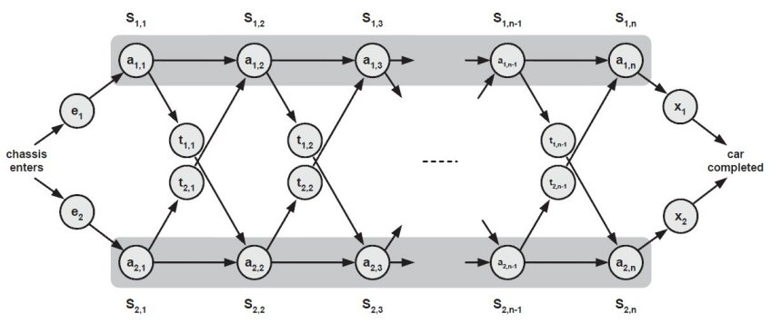
Assembly line scheduling

Slide 18
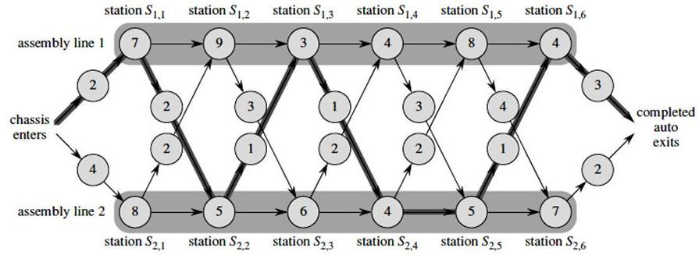
Assembly line scheduling

Slide 19
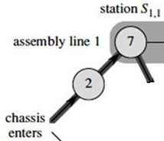
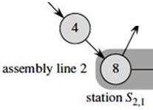
Optimal Substructure
Step 1:
f* : the fastest time to get through the entire factory
f_{i}[j] : the fastest time to get from the starting point through station S_{i,j}
Base case: j = 1, i=1,2 (getting through station 1)
f₁[1] = e₁ + a_{1,1}
f₂[1] = e₂ + a_{2,1}

Slide 20

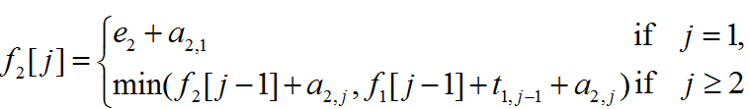
Optimal Substructure
General Case: j = 2, 3, …,n, and i = 1, 2 - Recursive solution

Slide 21
Assembly line scheduling
f₁[j]
f₂[j]
1 | 2 | 3 | 4 | 5 | 6
9
18
f₁[2] here, j=2 so,
f₁[2] = min(f₁[j - 1] + a_{1,j} ,f₂[j -1] + t_{2,j-1} + a_{1,j})
= min(9+9, 12+2+9) = 18
f₁[1] here, j=1
So, f₁[1] = e₁ + a_{1,1}
f₁[1] = 2 + 7 = 9
12
16

Slide 22
Assembly line scheduling
f₁[j]
f₂[j]
1 | 2 | 3 | 4 | 5 | 6
9
18
20
24
32
35
12
16
22
25
30
37
Min (18+3, 16+1+3) = 20
Min ( 18+3+6, 16+6) = 22

Slide 23
Assembly line scheduling
f₁[j]
f₂[j]
1 | 2 | 3 | 4 | 5 | 6
9
18
20
24
32
35
12
16
22
25
30
37
f*= min (35+3, 37+2) = 38

Slide 24
Floyd algorithm
Algorithm
function Floyd(L[1..n, 1..n]) :array [1..n, 1..n]
array D[1..n, 1..n]
D ← L
for k ← 1 to n do
for i ← 1 to n do
for j ← 1 to n do
D[i,j] ← min(D[i,j], D[i,k]+ D[k,j])
return D

Slide 25
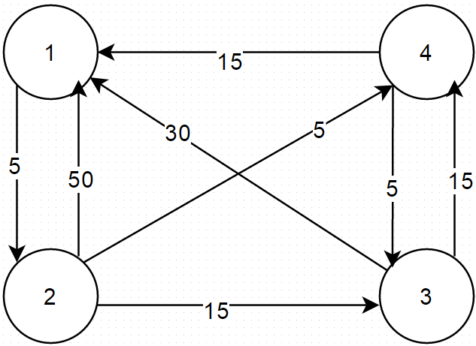
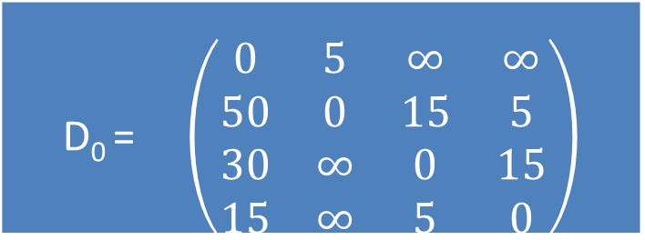
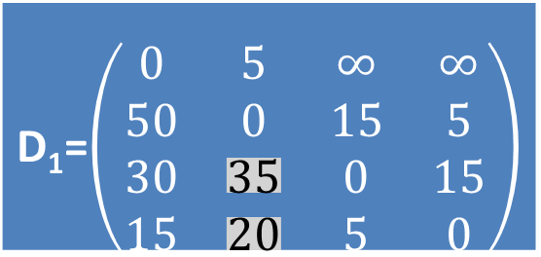
Floyd algorithm
Step 1
Step 2
Example
1
2
3
4
D₀ = $\left(\begin{matrix}0 & 5 & ∞ & ∞ \\ 50 & 0 & 15 & 5 \\ 30 & ∞ & 0 & 15 \\ 15 & ∞ & 5 & 0\end{matrix}\right)$
1
2
3
4
D₁=$\left(\begin{matrix}0 & 5 & ∞ & ∞ \\ 50 & 0 & 15 & 5 \\ 30 & 35 & 0 & 15 \\ 15 & 20 & 5 & 0\end{matrix}\right)$
Calculate distance between each node with as intermediate node.
1

Slide 26
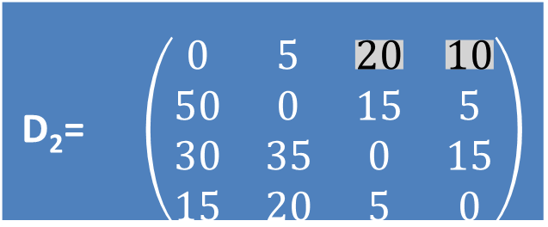
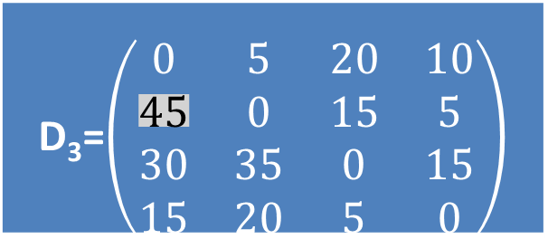
Floyd algorithm
Step 3
Step 4
Example
1
2
3
4
D₂= $\left(\begin{matrix}0 & 5 & 20 & 10 \\ 50 & 0 & 15 & 5 \\ 30 & 35 & 0 & 15 \\ 15 & 20 & 5 & 0\end{matrix}\right)$
1
2
3
4
D₃=$\left(\begin{matrix}0 & 5 & 20 & 10 \\ 45 & 0 & 15 & 5 \\ 30 & 35 & 0 & 15 \\ 15 & 20 & 5 & 0\end{matrix}\right)$
Calculate distance between each node with as intermediate node.
3
2

Slide 27
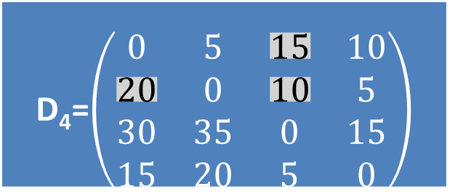
Floyd algorithm
Step 5
Example
D₄=$\left(\begin{matrix}0 & 5 & 15 & 10 \\ 20 & 0 & 10 & 5 \\ 30 & 35 & 0 & 15 \\ 15 & 20 & 5 & 0\end{matrix}\right)$
Calculate distance between each node with as intermediate node.
4

Slide 28
Floyd algorithm
Apply Floyd’s algorithm to find shortest path between each pair of nodes.
1
3
v₁
v₂
9
5
1
2
3
v₅
3
2
v₄
v₃
4

Slide 29
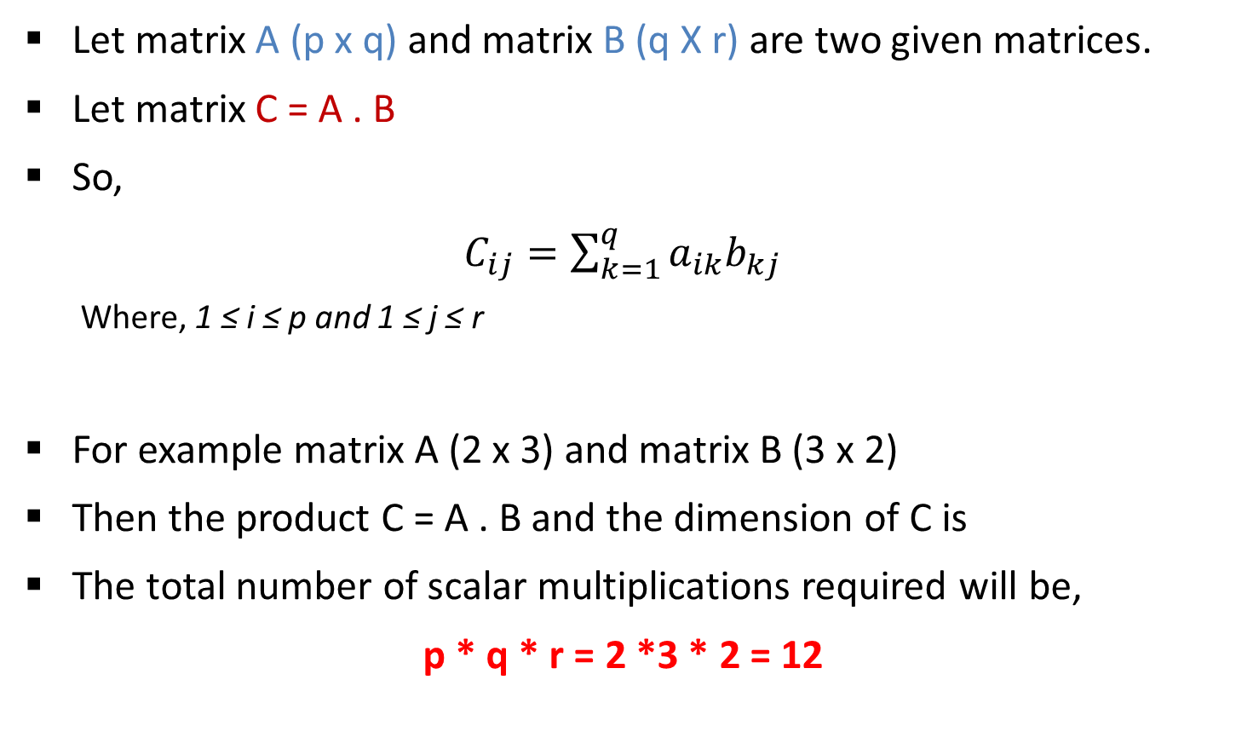
Matrix chain multiplication
Let matrix A (p x q) and matrix B (q X r) are two given matrices.
Let matrix C = A . B
So,
$C_{ij}=\sum_{k=1}^{q}{a_{ik}b_{kj}}$
Where, 1 ≤ i ≤ p and 1 ≤ j ≤ r
For example matrix A (2 x 3) and matrix B (3 x 2)
Then the product C = A . B and the dimension of C is
The total number of scalar multiplications required will be,
p * q * r = 2 *3 * 2 = 12
2 x 2

Slide 30
Matrix chain multiplication
Suppose now we want to calculate the product of more than two matrices.
Matrix multiplication is associative.
The product of four matrices A, B, C, D can be fully parenthesized in 5 distinct ways.
1. ((AB)C)D
10582
R1 = A.B
(13x5) . (5x89)
R1 (13 x 89)
R2 = R1 . C
(13 x 89).(89 x 3)
R2 (13 x 3)
R3 = R2 . D
(13 x 3). (3 x 34 )
R3 (13 x 34)
A = 13 x 5 , B = 5 x 89
C = 89 x 3, D = 3 x 34
2. (AB)(CD)
54201
MAXIMUM
3. (A(BC))D
2856
MINIMUM
13 * 5 * 89 = 5785
13 * 89 * 3 = 3471
13 * 3 * 34 = 1326
10582
4. A((BC)D)
4055
5. A(B(CD))
26418

Slide 31
Matrix chain multiplication
Matrix table M[i][j] stores cost of multiplications.
Matrix chain orders table S[i][j] stores order of multiplication.
To generate M[i][j] use following steps,
Step-1
Ste-2
Step-3 (else)
if i = j then M[i][j] = 0
if j = i+1 then M[i][j] = P_{i-1} . P_{i} . P_{i+1}
if i < j then M[i][j] = min( M[i][k]+M[k+1][j]+P_{[i-1]}* P _{[k]}* P _{[j]})
with i ≤ k < j

Slide 32
Matrix chain multiplication
Example: Here dimensions are P₀=5,P₁=4,P₂=6,P₃=2,P₄=7.
There would be 4 matrices ABCD, where A is 5 x 4, B is 4 x 6, C is 6 x 2 and D is 2 x 7.
if i = j then M[i][j] = 0
So, M[1][1] = M[2][2] = M[3][3] = M[4][4] = 0
 | 1 2 3 4
1
2 | --
3 | -- | --
4 | -- | -- | --
0
0
0
0

Slide 33
Matrix chain multiplication
Example: Here dimensions are P₀=5,P₁=4,P₂=6,P₃=2,P₄=7.
There would be 4 matrices ABCD, where A is 5 x 4, B is 4 x 6, C is 6 x 2 and D is 2 x 7.
if j = i+1 then M[i][j] = P_{i-1} . P_{i} . P_{i+1}
M[1][2] = P₀ * P₁ * P₂ = 5 * 4 * 6 = 120
M[2][3] = P₁ * P₂ * P₃ = 4 * 6 * 2 = 48
M[3][4] = P₂ * P₃ * P₄ = 6 * 2 * 7 = 84
 | 1 2 3 4
1
2 | --
3 | -- | --
4 | -- | -- | --
0
120
0
48
0
84
0

Slide 34
Matrix chain multiplication
Example: Here dimensions are P₀=5,P₁=4,P₂=6,P₃=2,P₄=7.
M[i][j] = min( M[i][k]+M[k+1][j]+P_{[i-1]}* P _{[k]}* P _{[j]}) with i ≤ k < j
M[1][3], here i < j for i=1,j=3
k=1 or 2 because i ≤ k ≤ j-1
For k=1
M[1][3]=M[1][1]+M[2][3]+P₀*P₁*P₃
= 0+48+5*4*2
=88
For k=2
M[1][3]=M[1][2]+M[3][3]+P₀*P₂*P₃
=120+0+5*6*2
=180
Put value of minimum value of M[1][3] in table M[i][j]
 | 1 2 3 4
1
2 | --
3 | -- | --
4 | -- | -- | --
0
120
88
0
48
0
84
0

Slide 35
Matrix chain multiplication
Example: Here dimensions are P₀=5,P₁=4,P₂=6,P₃=2,P₄=7.
M[i][j] = min( M[i][k]+M[k+1][j]+P_{[i-1]}* P _{[k]}* P _{[j]}) with i ≤ k < j
M[2][4], here i < j for i=2,j=4
k=2 or 3 because i ≤ k ≤ j-1
For k=2
M[2][4]=M[2][2]+M[3][4]+P₁*P₂*P₄
= 0+84+4*6*7
=252
For k=3
M[2][4]=M[2][3]+M[4][4]+P₁*P₃*P₄
= 48+0+4*2*7
=104
Put value of minimum value of M[1][3] in table M[i][j]
 | 1 2 3 4
1
2 | --
3 | -- | --
4 | -- | -- | --
0
120
88
0
48
104
0
84
0

Slide 36
Matrix chain multiplication
Example: Here dimensions are P₀=5,P₁=4,P₂=6,P₃=2,P₄=7.
M[i][j] = min( M[i][k]+M[k+1][j]+P_{[i-1]}* P _{[k]}* P _{[j]}) with i ≤ k < j
M[1][4], here i < j for i=1,j=4
k=1 or 2 or 3 because i ≤ k ≤ j-1
For k=1
M[1][4]=M[1][1]+M[2][4]+P₀*P₁*P₄
= 0+104+5*4*7 = 244
For k=2
M[1][4]=M[1][2]+M[3][4]+P₀*P₂*P₄
= 120+84+5*6*7 = 414
For k=3
M[1][4]=M[1][3]+M[4][4]+P₀*P₃*P₄
= 88+0+5*2*7 = 158
 | 1 2 3 4
1
2 | --
3 | -- | --
4 | -- | -- | --
0
120
88
158
0
48
104
0
84
0

Slide 37
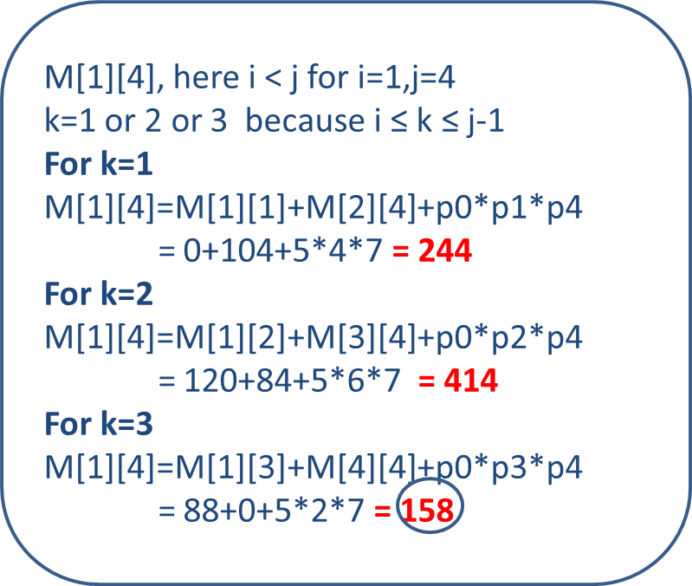
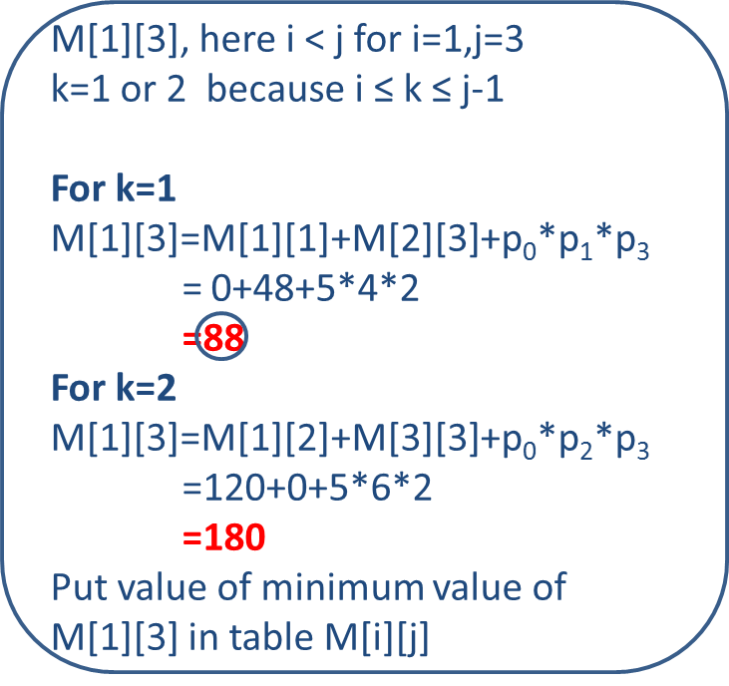
Matrix chain multiplication
How to parenthesize matrices?
A B C D

Slide 38
Matrix chain multiplication
How to parenthesize matrices?
Where A is 5 x 4, B is 4 x 6, C is 6 x 2 and D is 2 x 7.
Multiplying B.C = 4 x 6 x 2 = 48
Resultant matrix R1 has dimension 4 x 2.
Multiplying A . R1 = 5 x 4 x 2 = 40
Resultant matrix R2 has dimension 5 x 2.
Multiplying R2 . D = 5 x 2 x 7 = 70
Total multiplications required = 48 + 40 + 70 = 158
A B C D

Slide 39
Matrix chain multiplication
Write equation for Chained matrix multiplication using Dynamic programming. Find out optimal sequence for multiplication:
A [13 × 5], B [5 × 89], C [89 × 3], and D [3 × 34].
Also give the optimal parenthesization of matrices.
 | j = 1 2 3 4
i =
2 | --
3 | -- | --
4 | -- | -- | --
0
5785
1530
2856
0
1335
1845
0
9078
0

Slide 40
Matrix chain multiplication
How to parenthesize matrices?
M[1][4] → k = 3 is selected minimum value.
M[1][3] → k = 1 is selected minimum value.
A B C D
1. ((AB)C)D
10582
 | j = 1 2 3 4
i =
2 | --
3 | -- | --
4 | -- | -- | --
2. (AB)(CD)
54201
0
5785
1530
2856
3. (A(BC))D
2856
0
1335
1845
4. A((BC)D)
4055
0
9078
5. A(B(CD))
26418
0

Slide 41
Matrix chain multiplication
Write equation for Chained matrix multiplication using Dynamic programming. Find out optimal sequence for multiplication:
A1 [18 × 4], A2 [4 × 13], A3 [13 × 7], and A4 [7 × 15].
Also give the optimal parenthesization of matrices.

Slide 42
Longest common subsequence
A subsequence is a sequence that appears in the same relative order, but not necessarily contiguous.
Given two sequences X and Y , we say that a sequence Z is a common subsequence of X and Y if Z is a subsequence of both X and Y .
For example, if X = < A, B, C, B, D, A, B> AND Y = <B, D, C, A, B, A> then <B, C, A> is a subsequence.

Slide 43
Longest common subsequence
We need to generate table c(1..m, 1..n)
where m=length of string S1 and n= length of string S2.
b[i][j] stores directions like(←, ↑, ↖)
To generate table c[i][j] use following steps
Step-1: Make c[i][0]=0 and c[0][j]=0
Step-2: if xi = yj then c[i,j] ← c[i-1,j-1]+1
Step-3: else if c[i-1,j] ≥ c[i,j-1] then c[i,j] ← c[i-1,j]
Step-4: else c[i,j] ← c[i,j-1]

Slide 44
LCS
Example: Find any one Longest Common Subsequence of given two strings using Dynamic Programming.
X = < A, B, C, B, D, A, B> and
Y = <B, D, C, A, B, A>
0
1
2
3
4
5
6
x_{i}
A
B
C
B
D
A
B
y_{j} | B | D | C | A | B | A
0
0
0
0
0
0
0
0
+1
1
0
0
0
0
1
1
1
2
0
1
1
1
1
2
2
3
0
1
1
2
2
2
2
4
0
1
1
2
2
3
3
5
0
1
2
2
2
3
3
6
0
1
2
2
3
3
4
7
0
1
2
2
3
4
4

Slide 45
LCS
Example: Find any one Longest Common Subsequence of given two strings using Dynamic Programming.
X = < A, B, C, B, D, A, B> and
Y = <B, D, C, A, B, A>
0
1
2
3
4
5
6
x_{i}
A
B
C
B
D
A
B
y_{j} | B | D | C | A | B | A
0
0
0
0
0
0
0
0
1
0
0
0
0
1
1
1
2
0
1
1
1
1
2
2
3
0
1
1
2
2
2
2
4
0
1
1
2
2
3
3
5
0
1
2
2
2
3
3
6
0
1
2
2
3
3
4
7
0
1
2
2
3
4
4

Slide 46
Longest common subsequence
LCS of X and Y is <B, C, B, A>
0
1
2
3
4
5
6
x_{i}
A
B
C
B
D
A
B
y_{j} | B | D | C | A | B | A
0
0
0
0
0
0
0
0
0
0
0
0
1
1
1
1
0
0
1
1
2
1
1
1
1
2
2
0
1
2
2
2
3
1
2
2
2
0
1
2
2
3
4
1
3
3
0
1
2
2
3
5
2
3
3
0
1
2
3
3
4
6
2
4
0
1
2
3
4
4
7
2
4

Slide 47
Longest common subsequence
Find any one Longest Common Subsequence of given two strings using Dynamic Programming.
S1=abbacdcba S2=bcdbbcaa
Determine an LCS of
A = [ 0; 0; 1; 0; 1; 0; 1] and B =[ 1; 0; 1; 1; 0; 1; 1; 0].

Slide 48
Solution: S1=abbacdcba S2=bcdbbcaa
 |  | 0 | 1 | 2 | 3 | 4 | 5 | 6 | 7 | 8
 |  | Yj | b | c | d | b | b | c | a | a
0 | Xi | 0 | 0 | 0 | 0 | 0 | 0 | 0 | 0 | 0
1 | a | 0 | 0↑ | 0↑ | 0↑ | 0↑ | 0↑ | 0↑ | ↖1 | ↖1
2 | b | 0 | ↖1 | 1← | 1← | ↖1 | ↖1 | 1← | 1↑ | 1↑
3 | b | 0 | ↖1 | 1↑ | 1↑ | ↖2 | ↖2 | 2← | 2← | 2←
4 | a | 0 | 1↑ | 1↑ | 1↑ | 2↑ | 2↑ | 2↑ | ↖3 | ↖3
5 | c | 0 | 1↑ | ↖2 | 2← | 2↑ | 2↑ | ↖3 | 3↑ | 3↑
6 | d | 0 | 1↑ | 2↑ | ↖3 | 3← | 3← | 3↑ | 3↑ | 3↑
7 | c | 0 | 1↑ | ↖2 | 3↑ | 3↑ | 3↑ | ↖4 | 4← | 4←
8 | b | 0 | ↖1 | 2↑ | 3↑ | ↖4 | ↖4 | 4↑ | 4↑ | 4↑
9 | a | 0 | 1↑ | 2↑ | 3↑ | 4↑ | 4↑ | 4↑ | ↖5 | ↖5
 |  |  | b | c | d |  |  | c |  | a

