Slide 1

Unit – 5 Greedy Algorithm
Gopi Sanghani
 9825621471
→ gopi.sanghani@darshan.ac.in
Analysis and Design of Algorithms (2170703) Darshan Institute of Engineering & Technology

Slide 2
Topics to be covered
General Characteristics of greedy algorithms
Problem solving using Greedy Algorithm
Activity selection problem
Elements of Greedy Strategy
Minimum Spanning trees (Kruskal’s algorithm, Prim’s algorithm)
The Knapsack Problem
Job Scheduling Problem
Huffman code.

Slide 3
Characteristics of greedy algorithms
Greedy Algorithm works by making the decision that seems most promising at any moment; it never reconsiders this decision.
Greedy algorithms and the problems that can be solved by greedy algorithms are characterized by most or all of the following features.
Greedy approach forms a set or list of candidates C.
Once a candidate is selected in the solution, it is there forever: once a candidate is excluded from the solution, it is never reconsidered.
To construct the solution in an optimal way, Greedy Algorithm maintains two sets.
One set contains candidates that have already been considered and chosen, while the other set contains candidates that have been considered but rejected.

Slide 4
Elements of Greedy Strategy
The greedy algorithm consists of four functions.
Solution Function:- A function that checks whether chosen set of items provides a solution.
Feasible Function:- A function that checks the feasibility of a set.
Selection Function:- The selection function tells which of the candidates is the most promising.
Objective Function:- An objective function, which does not appear explicitly, but gives the value of a solution.

Slide 5
Greedy algorithm
The prototype for generalized greedy algorithm is given below:
Function greedy(C : set): set
{C is the set of candidates.}
S ← Ø {S is a set that will hold the solution}
while C ≠ Ø and not solution(S) do
x ← select (C)
C ← C \ {x}
if feasible ( S U {x}) then S ← S U { x}
if solution (S) then return S
else return "no solution found"

Slide 6
Make change problem
Suppose following coins are available:
dollars (100 cents),
quarters (25 cents),
dimes (10 cents),
nickels (5 cents) and
penny (1 cent).
Our problem is to devise an algorithm for paying a given amount to a customer using the smallest possible number of coins.

Slide 7
Make change problem
For instance, if we must pay $2.89 (289 cents)
The greedy solution:
Candidate set C = {100, 25, 10, 5, 1}
Selected coins
Amount
100
10
289
189
0
89
14
100
1
25
1
25
1
Total 10 coins
25
1

Slide 8
Make change algorithm
Function make-change(n): set of coins
const C = {100, 25, 10, 5, 1} {C is the candidate set}
S ← Ø {S is a set that will hold the solution}
sum ← 0 {sum is the sum of the items in solution set S}
while sum ≠ n do
x ← the largest item in C such that s + x ≤ n
if there is no such item then
return "no solution found"
S ← S U {a coin of value x)
sum ← sum + x
return S

Slide 9
Make change problem
The algorithm is "greedy" because at every step it chooses the largest coin it can, without worrying whether this will prove to be a correct decision later.
Furthermore it never changes its mind: once a coin has been included in the solution, it is there forever.
Example 1: Some coin denominations say : 50, 20, 10, 5, 1
How many minimum coins required to make change for 37 cents
How many minimum coins required to make change for 91 cents
Denominations: d₁=6, d₂=4, d₃=1. Make a change of Rs. 8.
5
4
3
2

Slide 10
Minimum spanning tree
Let G = ‹N, A› be a connected, undirected graph where,
N is the set of nodes and
A is the set of edges.
Each edge has a given non-negative length.
A spanning tree of a graph G is a sub-graph which is basically a tree and it contains all the vertices of G but does not contain cycle.
A minimum spanning tree of a weighted connected graph G is a spanning tree with minimum or smallest weight of edges.

Slide 11
Kruskal’s algorithm
Example: Find the minimum spanning tree for the following graph using Kruskal’s Algorithm.
1
1
2
2
3
4
6
4
5
6
4
5
6
3
8
7
4
3
7

Slide 12
Kruskal’s algorithm
Step 1: Sort the edges by increasing edge weight.
edge | d_{v}
{1, 2} | 1
{2, 3} | 2
{4, 5} | 3
{6, 7} | 3
{1, 4} | 4
{2, 5} | 4
{4, 7} | 4
{3, 5) | 5
{2, 4} | 6
{3, 6} | 6
{5, 7} | 7
{5, 6} | 8
√
1
1
2
2
3
√
√
√
4
6
5
6
4
√
χ
4
5
6
√
3
8
χ
7
χ
4
3
χ
χ
7
χ
Total Cost = 17

Slide 13
Kruskal’s Algorithm
Function Kruskal(G = (N, A): graph; length: A → R⁺): set of edges
Sort A by increasing length
n ← the number of nodes in N
T ← Ø {Solution Set that will contain the edges of the minimum spanning tree}
Initialize n sets, each containing a different element of set N
repeat
e ← {u, v} ← such that e is the shortest edge not yet considered
ucomp ← find(u)
vcomp ← find(v)
if ucomp ≠ vcomp then merge(ucomp, vcomp)
T ← T U {e}
until T contains n - 1 edges
return T
find(u) tells in which connected component, node u is found
merge(ucomp, vcomp) is used to merge two connected components.

Slide 14
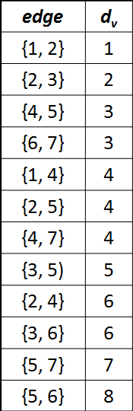
Kruskal’s Algorithm
Step | Edges considered - {u, v} | Connected Components
Init. | - | {1} {2} {3} {4} {5} {6} {7}
1 | {1,2} | {1,2} (3} {4} {5} {6} {7}
2 | {2,3} | {1,2,3} {4} {5} {6} {7}
3 | {4,5} | {1,2,3} {4,5} {6} {7}
4 | {6,7} | {1,2,3} {4,5} {6,7}
5 | {1,4} | {1,2,3,4,5} {6,7}
6 | {2,5} | Rejected
7 | {4,7} | {1,2,3,4,5,6,7}

Slide 15
Kruskal’s Algorithm
Write the kruskal’s Algorithm to find out Minimum Spanning Tree. Apply the same and find MST for the graph given below.
F
3
C
10
A
4
3
8
4
5
B
6
D
4
4
H
2
1
3
G
E
3

Slide 16
Kruskal’s Algorithm
Sort the edges by increasing edge weight
F
3
C
edge | d_{v}
(D,E) | 1
(D,G) | 2
(E,G) | 3
(C,D) | 3
(G,H) | 3
(C,F) | 3
(B,C) | 4
edge | d_{v}
(B,E) | 4
(B,F) | 4
(B,H) | 4
(A,H) | 5
(D,F) | 6
(A,B) | 8
(A,F) | 10
10
A
4
3
8
4
5
B
6
D
4
4
H
2
1
3
G
E
3

Slide 17
Kruskal’s Algorithm
Select first |V|–1 edges which do not generate a cycle
F
3
C
edge | d_{v}
(D,E) | 1 | √
(D,G) | 2
(E,G) | 3
(C,D) | 3
(G,H) | 3
(C,F) | 3
(B,C) | 4
edge | d_{v}
(B,E) | 4
(B,F) | 4
(B,H) | 4
(A,H) | 5
(D,F) | 6
(A,B) | 8
(A,F) | 10
10
A
4
3
8
4
5
B
6
D
4
4
H
2
1
3
G
E
3

Slide 18
Kruskal’s Algorithm
Select first |V|–1 edges which do not generate a cycle
F
3
C
edge | d_{v}
(D,E) | 1 | √
(D,G) | 2 | √
(E,G) | 3
(C,D) | 3
(G,H) | 3
(C,F) | 3
(B,C) | 4
edge | d_{v}
(B,E) | 4
(B,F) | 4
(B,H) | 4
(A,H) | 5
(D,F) | 6
(A,B) | 8
(A,F) | 10
10
A
4
3
8
4
5
B
6
D
4
4
H
2
1
3
G
E
3

Slide 19
Kruskal’s Algorithm
Select first |V|–1 edges which do not generate a cycle
F
3
C
edge | d_{v}
(D,E) | 1 | √
(D,G) | 2 | √
(E,G) | 3 | χ
(C,D) | 3
(G,H) | 3
(C,F) | 3
(B,C) | 4
edge | d_{v}
(B,E) | 4
(B,F) | 4
(B,H) | 4
(A,H) | 5
(D,F) | 6
(A,B) | 8
(A,F) | 10
10
A
4
3
8
4
5
B
6
D
4
4
H
2
1
3
G
E
3
Accepting edge (E,G) would create a cycle

Slide 20
Kruskal’s Algorithm
Select first |V|–1 edges which do not generate a cycle
F
3
C
edge | d_{v}
(D,E) | 1 | √
(D,G) | 2 | √
(E,G) | 3 | χ
(C,D) | 3 | √
(G,H) | 3
(C,F) | 3
(B,C) | 4
edge | d_{v}
(B,E) | 4
(B,F) | 4
(B,H) | 4
(A,H) | 5
(D,F) | 6
(A,B) | 8
(A,F) | 10
10
A
4
3
8
4
5
B
6
D
4
4
H
2
1
3
G
E
3

Slide 21
Kruskal’s Algorithm
Select first |V|–1 edges which do not generate a cycle
F
3
C
edge | d_{v}
(D,E) | 1 | √
(D,G) | 2 | √
(E,G) | 3 | χ
(C,D) | 3 | √
(G,H) | 3 | √
(C,F) | 3
(B,C) | 4
edge | d_{v}
(B,E) | 4
(B,F) | 4
(B,H) | 4
(A,H) | 5
(D,F) | 6
(A,B) | 8
(A,F) | 10
10
A
4
3
8
4
5
B
6
D
4
4
H
2
1
3
G
E
3

Slide 22
Kruskal’s Algorithm
Select first |V|–1 edges which do not generate a cycle
F
3
C
edge | d_{v}
(D,E) | 1 | √
(D,G) | 2 | √
(E,G) | 3 | χ
(C,D) | 3 | √
(G,H) | 3 | √
(C,F) | 3 | √
(B,C) | 4
edge | d_{v}
(B,E) | 4
(B,F) | 4
(B,H) | 4
(A,H) | 5
(D,F) | 6
(A,B) | 8
(A,F) | 10
10
A
4
3
8
4
5
B
6
D
4
4
H
2
1
3
G
E
3

Slide 23
Kruskal’s Algorithm
Select first |V|–1 edges which do not generate a cycle
F
3
C
edge | d_{v}
(D,E) | 1 | √
(D,G) | 2 | √
(E,G) | 3 | χ
(C,D) | 3 | √
(G,H) | 3 | √
(C,F) | 3 | √
(B,C) | 4 | √
edge | d_{v}
(B,E) | 4
(B,F) | 4
(B,H) | 4
(A,H) | 5
(D,F) | 6
(A,B) | 8
(A,F) | 10
10
A
4
3
8
4
5
B
6
D
4
4
H
2
1
3
G
E
3

Slide 24
Kruskal’s Algorithm
Select first |V|–1 edges which do not generate a cycle
F
3
C
edge | d_{v}
(D,E) | 1 | √
(D,G) | 2 | √
(E,G) | 3 | χ
(C,D) | 3 | √
(G,H) | 3 | √
(C,F) | 3 | √
(B,C) | 4 | √
edge | d_{v}
(B,E) | 4 | χ
(B,F) | 4
(B,H) | 4
(A,H) | 5
(D,F) | 6
(A,B) | 8
(A,F) | 10
10
A
4
3
8
4
5
B
6
D
4
4
H
2
1
3
G
E
3

Slide 25
Kruskal’s Algorithm
Select first |V|–1 edges which do not generate a cycle
F
3
C
edge | d_{v}
(D,E) | 1 | √
(D,G) | 2 | √
(E,G) | 3 | χ
(C,D) | 3 | √
(G,H) | 3 | √
(C,F) | 3 | √
(B,C) | 4 | √
edge | d_{v}
(B,E) | 4 | χ
(B,F) | 4 | χ
(B,H) | 4
(A,H) | 5
(D,F) | 6
(A,B) | 8
(A,F) | 10
10
A
4
3
8
4
5
B
6
D
4
4
H
2
1
3
G
E
3

Slide 26
Kruskal’s Algorithm
Select first |V|–1 edges which do not generate a cycle
F
3
C
edge | d_{v}
(D,E) | 1 | √
(D,G) | 2 | √
(E,G) | 3 | χ
(C,D) | 3 | √
(G,H) | 3 | √
(C,F) | 3 | √
(B,C) | 4 | √
edge | d_{v}
(B,E) | 4 | χ
(B,F) | 4 | χ
(B,H) | 4 | χ
(A,H) | 5
(D,F) | 6
(A,B) | 8
(A,F) | 10
10
A
4
3
8
4
5
B
6
D
4
4
H
2
1
3
G
E
3

Slide 27
Kruskal’s Algorithm
Select first |V|–1 edges which do not generate a cycle
F
3
C
edge | d_{v}
(D,E) | 1 | √
(D,G) | 2 | √
(E,G) | 3 | χ
(C,D) | 3 | √
(G,H) | 3 | √
(C,F) | 3 | √
(B,C) | 4 | √
edge | d_{v}
(B,E) | 4 | χ
(B,F) | 4 | χ
(B,H) | 4 | χ
(A,H) | 5 | √
(D,F) | 6
(A,B) | 8
(A,F) | 10
10
A
4
3
8
4
5
B
6
D
4
4
H
2
1
3
G
E
3

Slide 28
Kruskal’s Algorithm
Select first |V|–1 edges which do not generate a cycle
F
3
C
edge | d_{v}
(D,E) | 1 | √
(D,G) | 2 | √
(E,G) | 3 | χ
(C,D) | 3 | √
(G,H) | 3 | √
(C,F) | 3 | √
(B,C) | 4 | √
edge | d_{v}
(B,E) | 4 | χ
(B,F) | 4 | χ
(B,H) | 4 | χ
(A,H) | 5 | √
(D,F) | 6
(A,B) | 8
(A,F) | 10
A
3
4
5
B
D
H
2
1
}
3
G
E
not
considered
Done Total Cost = Σ d_{v} = 21
The complexity for the Kruskal’s algorithm is in Θ(a log n) where a is total number of edges and n is the total number of nodes in the graph G.

Slide 29
Prim’s Algorithm
In Prim's algorithm, the minimum spanning tree grows in a natural way, starting from an arbitrary root.
At each stage we add a new branch to the tree already constructed; the algorithm stops when all the nodes have been reached.
The complexity for the Prim’s algorithm is Θ(n²) where n is the total number of nodes in the graph G.

Slide 30
Prim’s Algorithm
Example: Find the minimum spanning tree for the following graph using Prim’s Algorithm.
1
1
2
2
3
4
6
4
5
6
4
5
6
3
8
7
4
3
7

Slide 31
Prim’s Algorithm
Node | Edges
1 | {1,2} {1,4}
1, 2 | {1,4} {2,3} {2,4} {2,5}
1
1
2
2
3
1, 2, 3 | {1,4} {2,4} {2,5} {3,5} {3,6}
4
6
1,2,3,4 | {2,4} {2,5} {3,5} {3,6} {4,5} {4,7}
6
4
5
1,2,3,4,5 | {2,4} {2,5} {3,5} {3,6} {4,7} {5,6} {5,7}
4
5
6
3
8
1,2,3,4,5,6 | {2,4} {2,5} {3,5} {3,6} {5,6} {5,7} {6,7}
7
{1, 2, 3, 4, 5, 6, 7}
4
3
7

Slide 32
Prim’s Algorithm
Node | Edges
1 | {1,2} {1,4}
1, 2 | {1,4} {2,3} {2,4} {2,5}
1
1
2
2
3
1, 2, 3 | {1,4} {2,4} {2,5} {3,5} {3,6}
4
1,2,3,4 | {2,4} {2,5} {3,5} {3,6} {4,5} {4,7}
1,2,3,4,5 | {2,4} {2,5} {3,5} {3,6} {4,7} {5,6} {5,7}
4
5
6
3
1,2,3,4,5,6 | {2,4} {2,5} {3,5} {3,6} {5,6} {5,7} {6,7}
{1, 2, 3, 4, 5, 6, 7}
4
3
7
Total Cost = 17

Slide 33
Prim’s Algorithm
Function Prim(G = (N, A): graph; length: A — R+): set of edges
{initialization}
T ← Ø
B ← {an arbitrary member of N}
while B ≠ N do
find e = {u, v} of minimum length such that
u ε B and v ε N \ B
T ← T U {e}
B ← B U {v}
return T

Slide 34
Prim’s Algorithm
Solution
Step 1: We arbitrarily choose node 1 as the starting node.
Step 2:
Step | Edge Selected {u, v} | Set B | Edges Considered
Init. | - | {1} | --
1 | {1, 2} | {1,2} | {1,2} {1,4}
2 | {2, 3} | {1,2,3} | {1,4} {2,3} {2,4} {2,5}
3 | {1, 4} | {1,2,3,4} | {1,4} {2,4} {2,5} {3,5} {3,6}
4 | {4, 5} | {1,2,3,4,5} | {2,4} {2,5} {3,5} {3,6} {4,5} {4,7}
5 | {4, 7} | {1,2,3,4,5,7} | {2,4} {2,5} {3,5} {3,6} {4,7} {5,6} {5,7}
6 | {6,7} | {1,2,3,4,5,6,7} | {2,4} {2,5} {3,5} {3,6} {5,6} {5,7} {6,7}

Slide 35
Prim’s Algorithm
Write the Prim’s Algorithm to find out Minimum Spanning Tree. Apply the same and find MST for the graph given below.
2
F
3
C
10
A
7
3
8
4
4
B
18
D
9
10
H
2
25
3
G
E
7

Slide 36
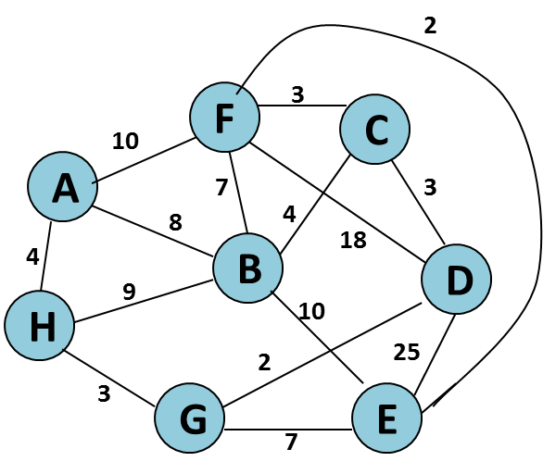
Step | Edge {u, v} | Set B | Edges Considered
Init. | - | {A} | --
1 | {A,H} | {A,H} | {A,B} {A,H} {A,F}
2 | {H,G} | {A,H,G} | {A,B} {A,F} {H,B} {H,G}
3 | {G,D} | {A,H,G, D} | {A,B} {A,F} {H,B} {G,D} {G,E}
4 | {D,C} | {A,H,G, D, C} | {A,B} {A,F} {H,B} {G,E} {D,C} {D,E} {D,F}
5 | {C,F} | {A,H,G, D, C, F} | {A,B} {A,F} {H,B} {G,E} {D,E} {D,F} {C,F} {C,B}
6 | {F,E} | {A,H,G, D, C, F, E} | {A,B} {A,F} {H,B} {G,E} {D,E} {D,F} {C,B} {F,B} {F,E}
7 | {C,B} | {A,H,G, D, C, F, E, B} | {A,B} {A,F} {H,B} {G,E} {D,E} {D,F} {C,B}{F,B} {B,E}

Slide 37
Prim’s Algorithm
Cost of Minimum Spanning Tree = Σ d_{v} = 21
2
F
3
C
A
3
4
4
B
D
H
2
3
G
E

Slide 38
Dijkstra’s algorithm
Consider now a directed graph G = (N, A) where N is the set of nodes of graph G and A is the set of directed edges.
Each edge has a positive length.
One of the nodes is designated as the source node.
The problem is to determine the length of the shortest path from the source to each of the other nodes of the graph.
The algorithm maintains a matrix L which gives the length of each directed edge:
L[i, j] ≥ 0 if the edge (i, j) ϵ A, and L[i, j] = ∞ otherwise.
The time required by the Dijkstra’s algorithm is Θ(n²).

Slide 39
Dijkstra’s algorithm
1
Single source shortest path algorithm
10
50
5
2
100
30
10
5
Source node = 1
20
4
3
Step
v
c
2
3
4
5
50
Init
--
{2, 3, 4, 5}
50
30
100
10
Is there path from 1 - 5 - 4
1
5
{2, 3, 4}
50
30
20
10
Is there path from 1 - 5 - 2
Is there path from 1 - 5 - 3
2
4
{2, 3}
40
30
20
10
No
Yes
3
3
{2}
35
30
20
10
Compare cost of 1 – 5 – 4 and 1- 4

Slide 40
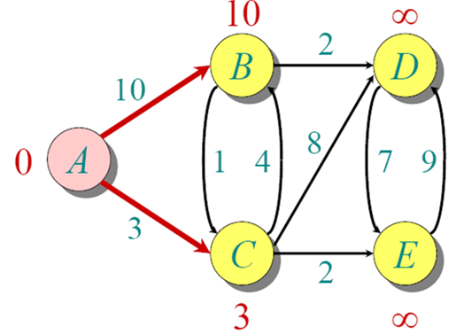
Dijkstra’s algorithm
Source node = A
Step
v
c
B
C
D
E
Init
--
{B, C, D, E}
10
3
∞
∞
1
C
{B, D, E}
7
3
11
5
2
E
{B, D}
7
3
11
5
3
B
{D}
7
3
9
5

Slide 41
Dijkstra’s algorithm
Example
0
∞
A
2
B
4
1
3
10
∞
C
2
D
2
E
∞
5
8
∞
4
6
F
1
G
∞
∞

Slide 42
Dijkstra’s algorithm
Dijkstra’s algorithm for finding shortest path. OR Single source shortest path algorithm
Function Dijkstra(L[1 .. n, 1 .. n]): array [2.. n]
array D[2.. n]
{initialization}
C ← {2,3,…, n} {S = N \ C exists only implicitly}
for i ← 2 to n do D[i] ← L[1, i]
repeat n - 2 times
v ← some element of C minimizing D[v]
C ← C \ {v} {and implicitly S ← S U {v}}
for each w ϵ C do
D[w] ← min(D[w], D[v] + L[v, w])
return D

Slide 43
Fractional Knapsack problem
We are given n objects and a knapsack.
Object i has a positive weight w_{i} and a positive value v_{i} for i = 1, 2... n.
The knapsack can carry a weight not exceeding W.
Our aim is to fill the knapsack in a way that maximizes the value of the included objects, while respecting the capacity constraint.

Slide 44
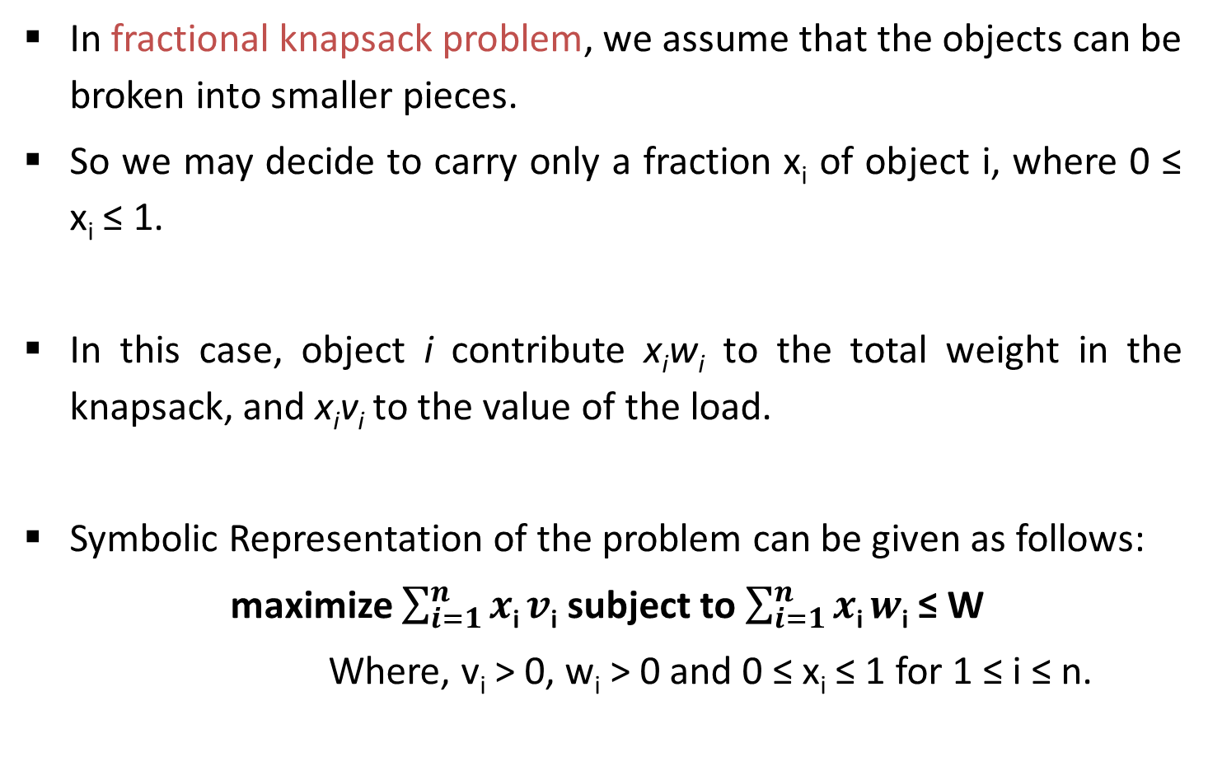
Fractional Knapsack problem
In fractional knapsack problem, we assume that the objects can be broken into smaller pieces.
So we may decide to carry only a fraction x_{i} of object i, where 0 ≤ x_{i} ≤ 1.
In this case, object i contribute x_{i}w_{i} to the total weight in the knapsack, and x_{i}v_{i} to the value of the load.
Symbolic Representation of the problem can be given as follows:
maximize $\sum_{i=1}^{n}{x\text{i}}v\text{i}$ subject to $\sum_{i=1}^{n}{x\text{i}}w\text{i}$ ≤ W
Where, v_{i} > 0, w_{i} > 0 and 0 ≤ x_{i} ≤ 1 for 1 ≤ i ≤ n.

Slide 45
Fractional Knapsack problem
Example: We are given 5 objects and weight carrying capacity of knapsack W = 100.
For each object, weight w_{i} and value v_{i} are given in the following table.
Object i | 1 | 2 | 3 | 4 | 5
v_{i} | 20 | 30 | 66 | 40 | 60
w_{i} | 10 | 20 | 30 | 40 | 50

Slide 46
Fractional Knapsack problem
Solution:
Object i | 1 | 2 | 3 | 4 | 5
v_{i} | 20 | 30 | 66 | 40 | 60
w_{i} | 10 | 20 | 30 | 40 | 50
v_{i} / w_{i} | 2.0 | 1.5 | 2.2 | 1.0 | 1.2
Profit = 66 + 60 + (40 * 0.5) = 146
Max Weight = 100
Selection | 1 2 3 4 5 |  |  |  |  | Value
Max v_{i}
Min w_{i}
Max v_{i} / w_{i}
0
0
1
0.5
1
146
30
50
20
1
1
1
1
0
156
10
20
30
40
1
1
1
0
0.8
164
30
10
20
40

Slide 47
Fractional Knapsack problem
Consider Knapsack capacity W=50, w = (10, 20, 40) and v = (60, 80,100) find the maximum profit using greedy approach.
Consider Knapsack capacity W = 10, w = (4, 8, 2, 6, 1) and v = (12, 32, 40, 30, 50) find the maximum profit using greedy approach.

Slide 48
Activity Selection problem
An activity-selection is the problem of scheduling a resource among several competing activities.
We are given a set S of n activities with start time s_{i} and finish time f_{i}, of an i^{th} activity. Find the maximum size set of mutually compatible activities.
Activities i and j are compatible if the half-open internal [s_{i}, f_{i}) and [s_{j}, f_{j}) do not overlap, that is, i and j are compatible if s_{i} ≥ f_{j} and s_{j} ≥ f_{i}.

Slide 49
Activity Selection problem
Example: Let 11 activities given as,
Solution: Here, we sort the activities of set S as per increasing finish time so that we can directly identify mutually compatible activity by comparing finish time of first activity and start time of next activity.
Sr. | Activity | (s_{i}, f_{i})
1 | P | (1, 4)
2 | Q | (3, 5)
3 | R | (0, 6)
4 | S | (5, 7)
5 | T | (3, 8)
6 | U | (5, 9)
7 | V | (6, 10)
8 | W | (8, 11)
9 | X | (8, 12)
10 | Y | (2, 13)
11 | Z | (12, 14)

Slide 50
Activity Selection problem
Solution:
A = {P}
A = {P, S}
A = {P, S, W}
A = {P, S, W, Z}
Answer A = {P, S, W, Z}
Sr. | Activity | (s_{i}, f_{i})
1 | P | (1, 4)
2 | Q | (3, 5)
3 | R | (0, 6)
4 | S | (5, 7)
5 | T | (3, 8)
6 | U | (5, 9)
7 | V | (6, 10)
8 | W | (8, 11)
9 | X | (8, 12)
10 | Y | (2, 13)
11 | Z | (12, 14)

Slide 51
Greedy Algorithm for Activity Selection
Step I: Sort the input activities by increasing finishing time. f₁ ≤ f₂ ≤ . . . ≤ f_{n}
Step II: Call GREEDY-ACTIVITY-SELECTOR (s, f)
n = length [s]
A={i}
j = 1
for i = 2 to n
do if s_{i} ≥ f_{j}
then A= A U {i}
j = i
return set A

Slide 52
Greedy Algorithm for Activity Selection
Analysis :
Step I requires O(n log n) time (by using merge of heap sort).
Step II requires Θ (n) time assuming that activities were already sorted in step I by their finish time.
So, the total time required by algorithm is Θ (nlogn).

Slide 53
Job scheduling with deadlines
We have set of n jobs to execute, each of which takes unit time.
At any point of time we can execute only one job.
Job i earns profit g_{i} > 0 if and only if it is executed no later than time d_{i}.
We have to find an optimal sequence of jobs such that our total profit is maximized.
Feasible jobs: A set of job is feasible if there exits at least one sequence that allows all the jobs in the set to be executed no later than their respective deadlines.

Slide 54
Job scheduling with deadlines
Example: Using greedy algorithm find an optimal schedule for following jobs with n=6.
Profits: (P1, P2, P3, P4, P5, P6) = (20,15,10,7,5,3) &
deadline (d1, d2, d3, d4, d5, d6) = (3, 1, 1, 3, 1, 3).
Solution:
Step 1: Here jobs are already sorted in decreasing order of their profit.
Job i | 1 | 2 | 3 | 4 | 5 | 6
Profit g_{i} | 20 | 15 | 10 | 7 | 5 | 3
Deadline d_{i} | 3 | 1 | 1 | 3 | 1 | 3

Slide 55
Job scheduling with deadlines
Step 2: Find total position P = min(n, max(d_{i})). So, let P = min(6, 3) = 3
Step 3: d₁ = 3 : assign job 1 to position 3
Job i | 1 | 2 | 3 | 4 | 5 | 6
Profit g_{i} | 20 | 15 | 10 | 7 | 5 | 3
Deadline d_{i} | 3 | 1 | 1 | 3 | 1 | 3
P
0
1
2
3
Job selected
0
0
0
0
P
0
1
2
3
Job selected
0
0
0
J1

Slide 56
Job scheduling with deadlines
Step 4: d₂ = 1 : assign job 2 to position 1
Step 5: d₃ = 1 : No free position so reject the job J3.
Job i | 1 | 2 | 3 | 4 | 5 | 6
Profit g_{i} | 20 | 15 | 10 | 7 | 5 | 3
Deadline d_{i} | 3 | 1 | 1 | 3 | 1 | 3
P
0
1
2
3
Job selected
0
J2
0
J1

Slide 57
Job scheduling with deadlines
Step 6: d₄ = 3 : assign job 4 to position 2 as position 3 is not free but position 2 is free.
Now no more free position is left so no more jobs can be scheduled.
The final optimal sequence: Execute the job in order 2, 4, 1 with total profit value 42.
Job i | 1 | 2 | 3 | 4 | 5 | 6
Profit g_{i} | 20 | 15 | 10 | 7 | 5 | 3
Deadline d_{i} | 3 | 1 | 1 | 3 | 1 | 3
P
0
1
2
3
Job selected
0
J2
J4
J1

Slide 58
Job scheduling with deadlines
Algorithm
Sort all the n jobs in decreasing order of their profit.
Let total position P = min(n, max(d_{i}))
Each position 0, 1, 2…, P is in different set and T({i}) = i, for 0 ≤ i ≤ P.
Find the set that contains d, let this set be K. if T(K) = 0 reject the job; otherwise:
Assign the new job to position T(K).
Find the set that contains T(K) – 1. Call this set L.
Merge K and L. the value for this new set is the old value of T(L).

Slide 59
Huffman codes
Huffman invented a greedy algorithm that constructs an optimal prefix code called a Huffman code.
Huffman coding is a lossless data compression algorithm. It assigns variable-length codes to input characters.
Lengths of the assigned codes are based on the frequencies of corresponding characters.
The most frequent character gets the smallest code and the least frequent character gets the largest code.

Slide 60
Huffman codes
The variable-length codes assigned to input characters are Prefix Codes.
In Prefix codes, the codes are assigned in such a way that the code assigned to one character is not a prefix of code assigned to any other character.
For example,
a = 01, b = 010 and c = 11
Not a prefix code

Slide 61
Huffman codes
This is how Huffman Coding makes sure that there is no ambiguity when decoding the generated bit stream.
There are mainly two major parts in Huffman Coding
Build a Huffman Tree from input characters.
Traverse the Huffman Tree and assign codes to characters.

Slide 62
Huffman codes
Example
Step-1: Arrange elements in ascending order:-
Characters | a | b | c | d | e | f
Frequency (in thousand) | 45 | 13 | 12 | 16 | 9 | 5
f:5
e:9
c:12
b:13
d:16
a:45

Slide 63
Huffman codes
Step 2:
Step 3:
c:12
b:13
14
d:16
a:45
0
1
f:5
e:9
14
d:16
25
a:45
0
1
0
1
f:5
e:9
c:12
b:13

Slide 64
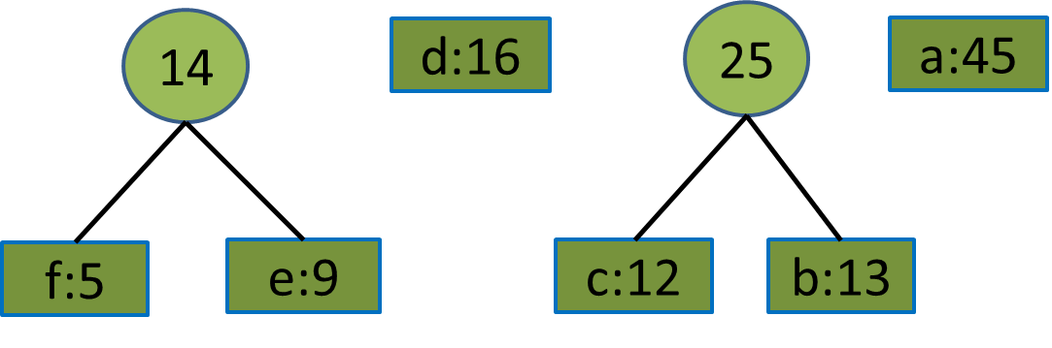
Huffman codes
Step 4:
25
30
a:45
0
1
0
1
14
d:16
c:12
b:13
0
1
f:5
e:9

Slide 65
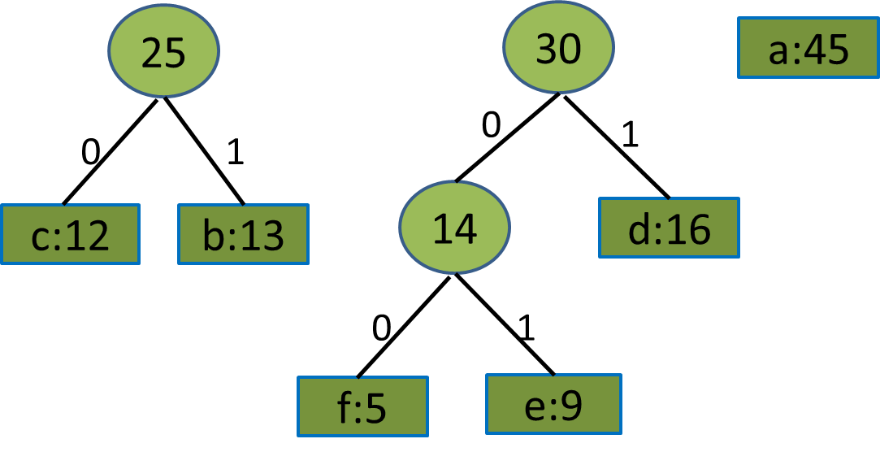
Huffman codes
Step 5:
55
a:45
0
1
25
30
0
1
0
1
14
d:16
c:12
b:13
0
1
f:5
e:9

Slide 66
Huffman codes
100
Step 6:
0
1
a:45
55
0
1
25
30
0
0
1
1
c:12
b:13
14
d:16
0
1
f:5
e:9

Slide 67
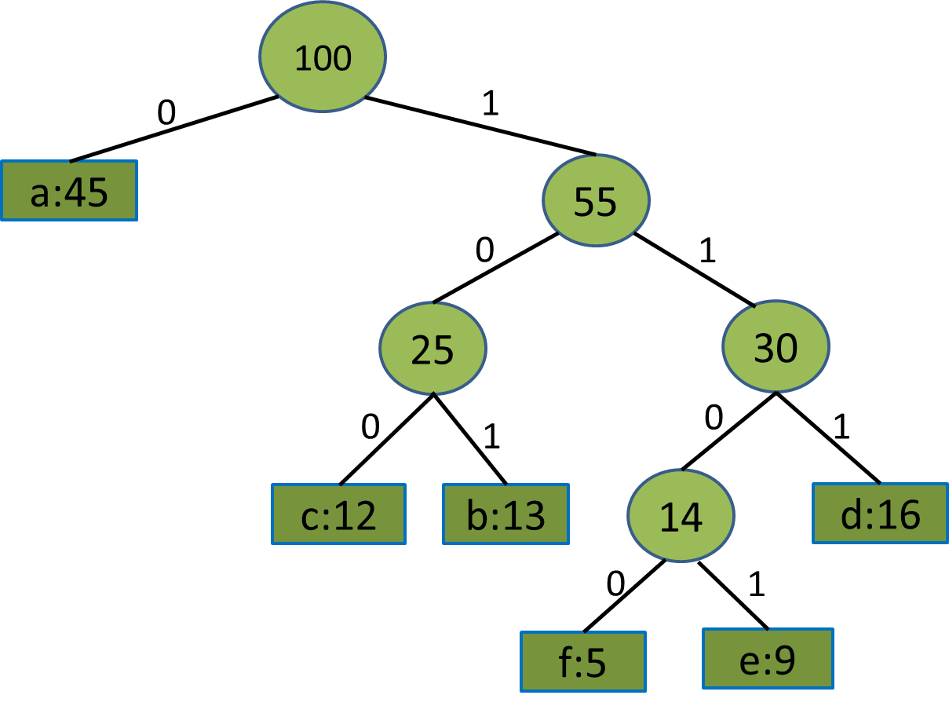
Huffman Codes
Characters | a | b | c | d | e | f
Frequency (in thousand) | 45 | 13 | 12 | 16 | 9 | 5
0
101
100
111
1101
1100

Slide 68
Huffman codes algorithm
HUFFMAN(C)
n = |C|
Q = C
for i = 1 to n-1
allocate a new node z
z.left = x = EXTRACT-MN(Q)
z.right = y = EXTRACT-MIN(Q)
z.freq = x.freq + y.freq
INSERT(Q,z)
return EXTRACT-MIN(Q) // return the root of the tree

Slide 69
Huffman code examples
Find an optimal Huffman code for the following set of frequency.
a : 50, b : 20, c : 15, d : 30.
Frequency
Frequency
Characters | A | B | C | D | E | F
Frequency (in thousand) | 24 | 12 | 10 | 8 | 8 | 5
Characters | a | b | c | d | e | f | g
Frequency (in thousand) | 37 | 28 | 29 | 13 | 30 | 17 | 6

