Slide 1
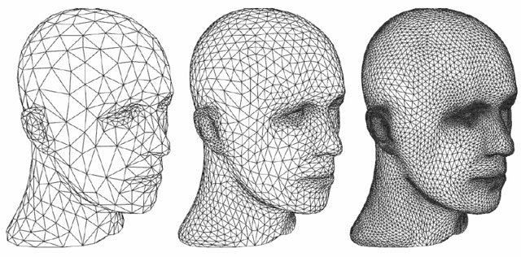
Unit-5 3D Transformation & Viewing
Computer Graphics
(2160703)
Prof. Vijay Shekhat
M: 9727235778
E-mail: vijay.shekhat@darshan.ac.in
Computer Engineering Darshan Institute of Engineering & Technology

Slide 2
Outline
3D Translation
3D Rotation
3D Scaling
Other Transformation
Viewing Pipeline
Viewing Co-ordinates
Projections
View Volume and General Projection Transformation

Slide 3
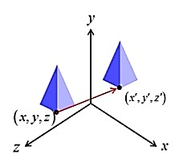
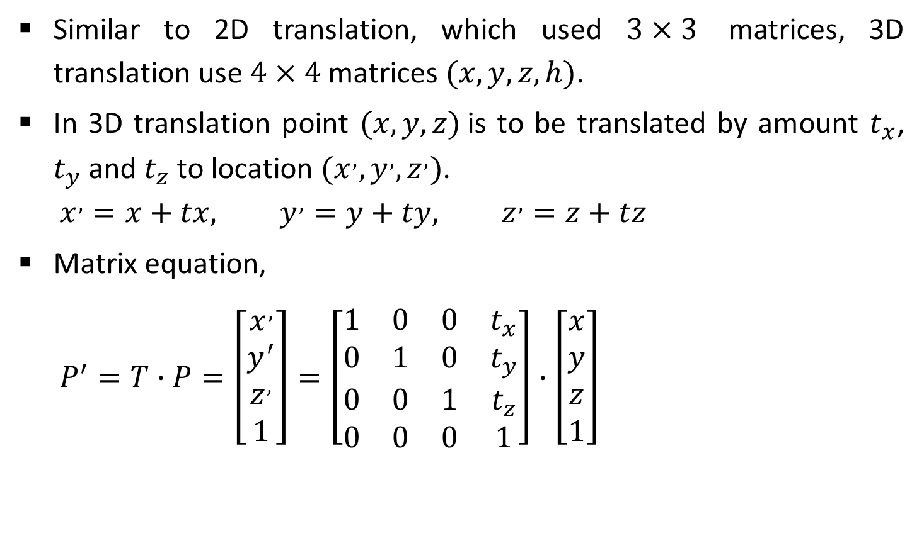
3D Translation
Similar to 2D translation, which used $3×3$ matrices, 3D translation use $4×4$ matrices $(x, y, z, h)$.
In 3D translation point $(x, y, z)$is to be translated by amount $t_{x}$, $t_{y}$ and $t_{z}$ to location $(x^{,},y^{,},z^{,})$.
$$x^{,}=x+tx, y^{,}=y+ty, z^{,}=z+tz$$
Matrix equation,
$$P^{′}=T∙P=\left[\begin{matrix}x^{,} \\ y^{′} \\ z^{,} \\ 1\end{matrix}\right]=\left[\begin{matrix}1 & 0 & 0 & t_{x} \\ 0 & 1 & 0 & t_{y} \\ 0 & 0 & 1 & t_{z} \\ 0 & 0 & 0 & 1\end{matrix}\right]∙\left[\begin{matrix}x \\ y \\ z \\ 1\end{matrix}\right]$$

Slide 4
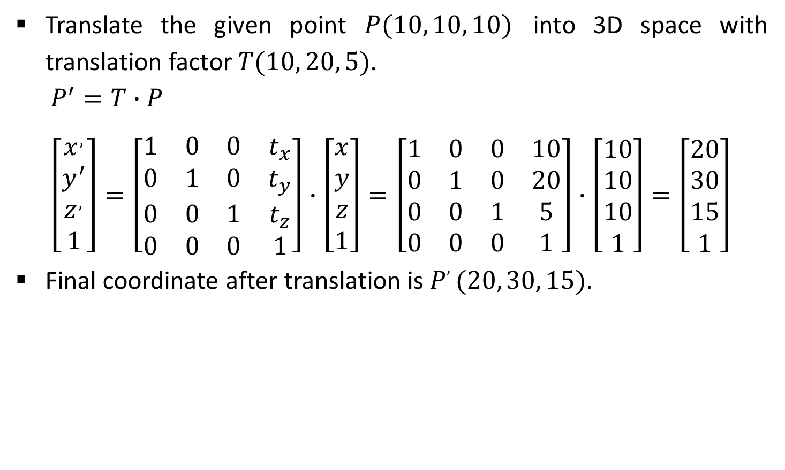
Example- 3D Translation
Translate the given point $P(10, 10, 10)$ into 3D space with translation factor $T(10, 20, 5)$.
$$P^{′}=T∙P$$
$$\left[\begin{matrix}x^{,} \\ y^{′} \\ z^{,} \\ 1\end{matrix}\right]=\left[\begin{matrix}1 & 0 & 0 & t_{x} \\ 0 & 1 & 0 & t_{y} \\ 0 & 0 & 1 & t_{z} \\ 0 & 0 & 0 & 1\end{matrix}\right]∙\left[\begin{matrix}x \\ y \\ z \\ 1\end{matrix}\right]=\left[\begin{matrix}1 & 0 & 0 & 10 \\ 0 & 1 & 0 & 20 \\ 0 & 0 & 1 & 5 \\ 0 & 0 & 0 & 1\end{matrix}\right]∙\left[\begin{matrix}10 \\ 10 \\ 10 \\ 1\end{matrix}\right]=\left[\begin{matrix}20 \\ 30 \\ 15 \\ 1\end{matrix}\right]$$
Final coordinate after translation is $P, (20, 30, 15)$.

Slide 5
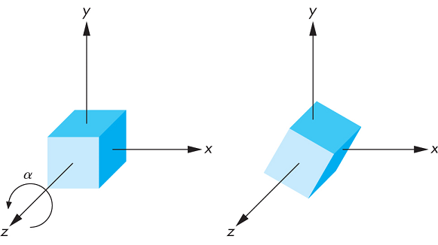

Rotation
For 3D rotation we need to pick an axis to rotate about.
The most common choices are the $X−axis$, the $Y−axis$, and the $Z−axis$, it is known as coordinate axis rotation.
We can also chose other arbitrary axis for rotation.
Source: http://www.c-jump.com

Slide 6
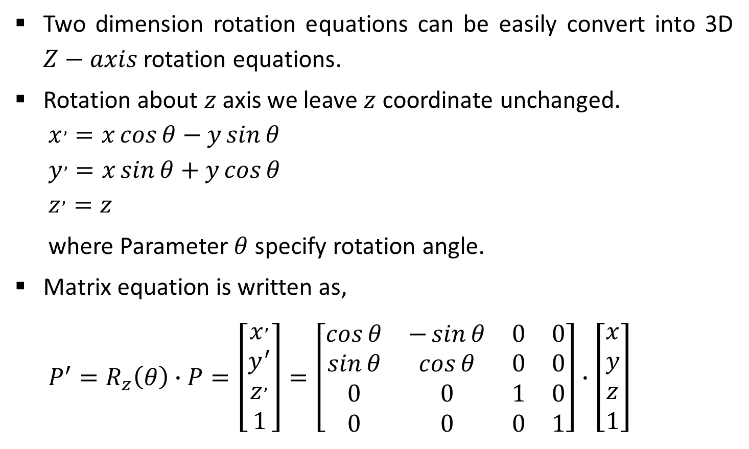
Z-Axis Rotation
Two dimension rotation equations can be easily convert into 3D $Z−axis$ rotation equations.
Rotation about $z$ axis we leave $z$ coordinate unchanged.
$$x^{,}=x\cos{θ}−y\sin{θ}$$
$$y^{,}=x\sin{θ}+y\cos{θ}$$
$$z^{,}=z$$
where Parameter $θ$specify rotation angle.
Matrix equation is written as,
$$P^{′}=R_{z}\left(θ\right)∙P=\left[\begin{matrix}x^{,} \\ y^{′} \\ z^{,} \\ 1\end{matrix}\right]=\left[\begin{matrix}\cos{θ} & −\sin{θ} & 0 & 0 \\ \sin{θ} & \cos{θ} & 0 & 0 \\ 0 & 0 & 1 & 0 \\ 0 & 0 & 0 & 1\end{matrix}\right]∙\left[\begin{matrix}x \\ y \\ z \\ 1\end{matrix}\right]$$
Y
X
Z

Slide 7
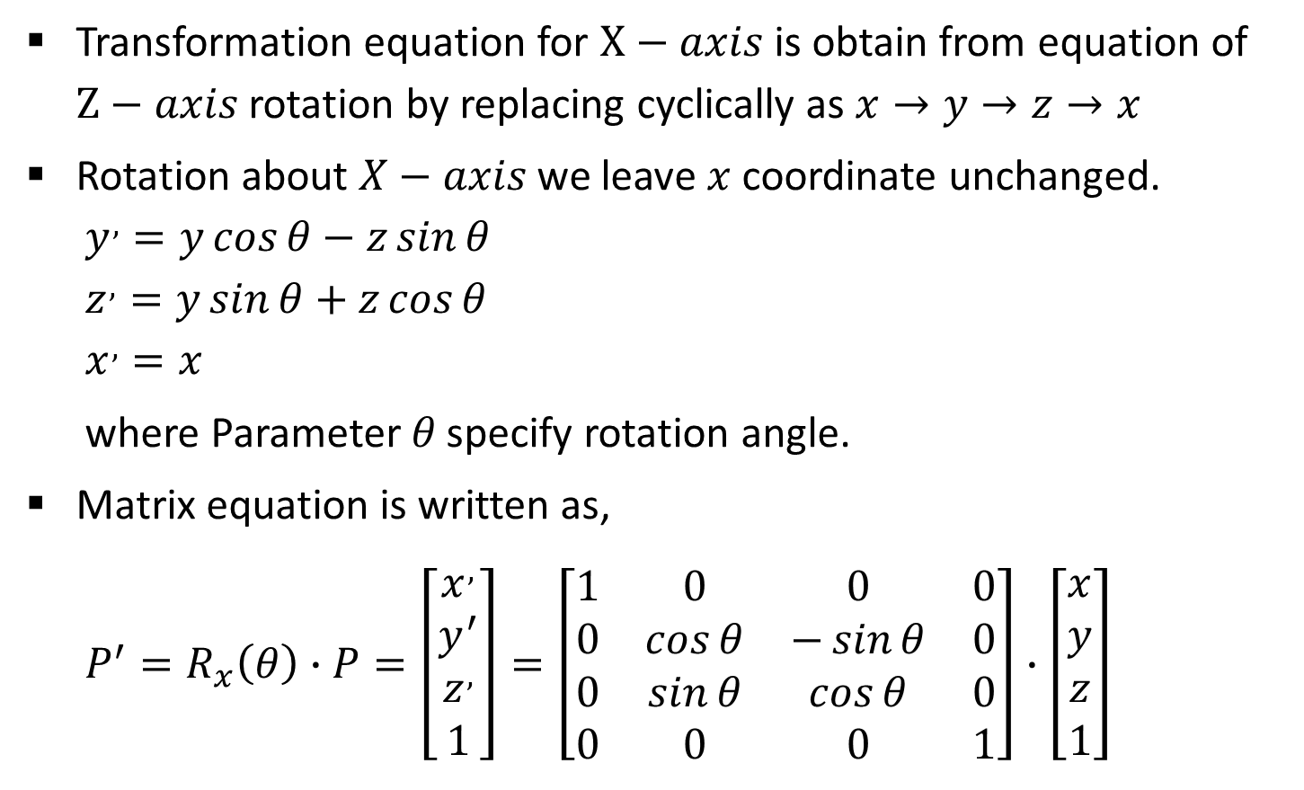
X-Axis Rotation
Transformation equation for $X−axis$ is obtain from equation of $Z−axis$ rotation by replacing cyclically as $x→y→z→x$
Rotation about $X−axis$ we leave $x$ coordinate unchanged.
$$y^{,}=y\cos{θ}−z\sin{θ}$$
$$z^{,}=y\sin{θ}+z\cos{θ}$$
$$x^{,}=x$$
where Parameter $θ$specify rotation angle.
Matrix equation is written as,
$$P^{′}=R_{x}\left(θ\right)∙P=\left[\begin{matrix}x^{,} \\ y^{′} \\ z^{,} \\ 1\end{matrix}\right]=\left[\begin{matrix}1 & 0 & 0 & 0 \\ 0 & \cos{θ} & −\sin{θ} & 0 \\ 0 & \sin{θ} & \cos{θ} & 0 \\ 0 & 0 & 0 & 1\end{matrix}\right]∙\left[\begin{matrix}x \\ y \\ z \\ 1\end{matrix}\right]$$
Y
X
Z

Slide 8
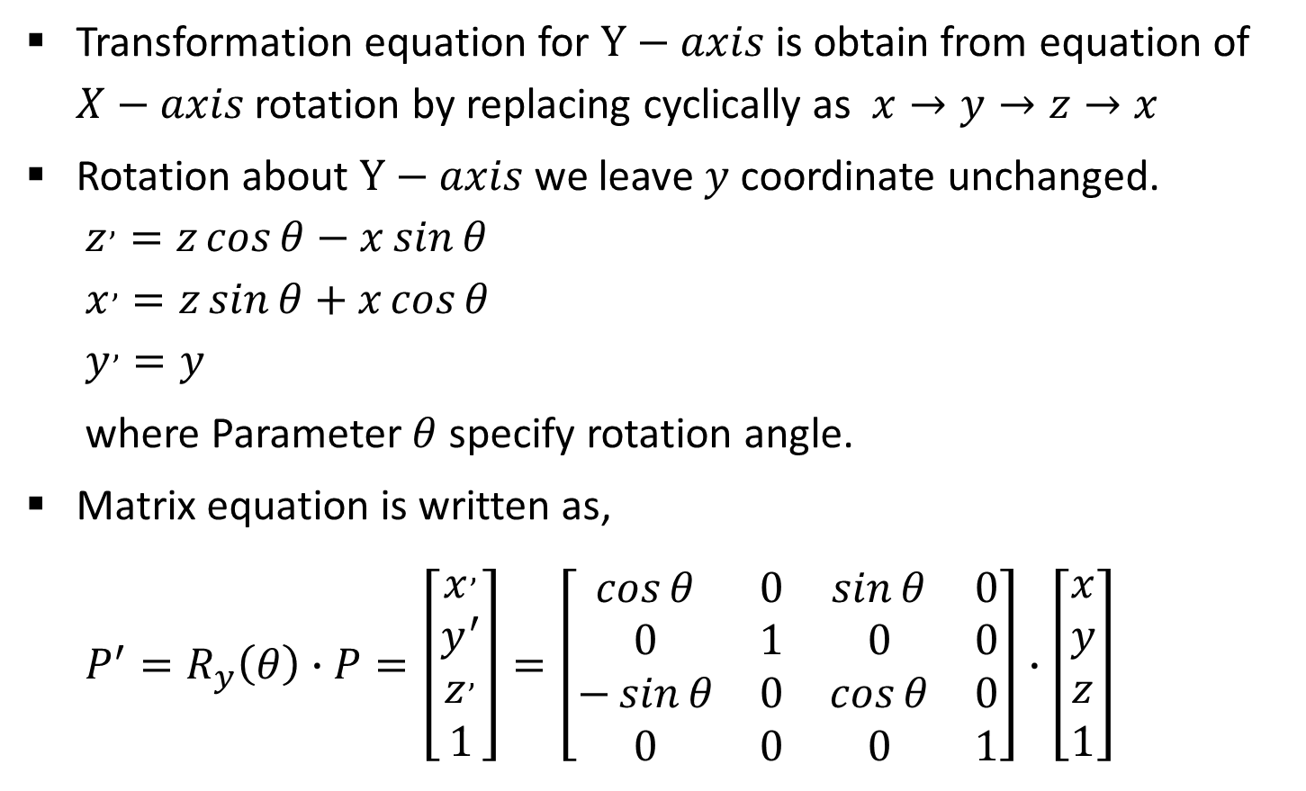
Y-Axis Rotation
Transformation equation for $Y−axis$ is obtain from equation of $X−axis$ rotation by replacing cyclically as $x→y→z→x$
Rotation about $Y−axis$ we leave $y$ coordinate unchanged.
$$z^{,}=z\cos{θ}−x\sin{θ}$$
$$x^{,}=z\sin{θ}+x\cos{θ}$$
$$y^{,}=y$$
where Parameter $θ$specify rotation angle.
Matrix equation is written as,
$$P^{′}=R_{y}\left(θ\right)∙P=\left[\begin{matrix}x^{,} \\ y^{′} \\ z^{,} \\ 1\end{matrix}\right]=\left[\begin{matrix}\cos{θ} & 0 & \sin{θ} & 0 \\ 0 & 1 & 0 & 0 \\ −\sin{θ} & 0 & \cos{θ} & 0 \\ 0 & 0 & 0 & 1\end{matrix}\right]∙\left[\begin{matrix}x \\ y \\ z \\ 1\end{matrix}\right]$$
Y
X
Z

Slide 9
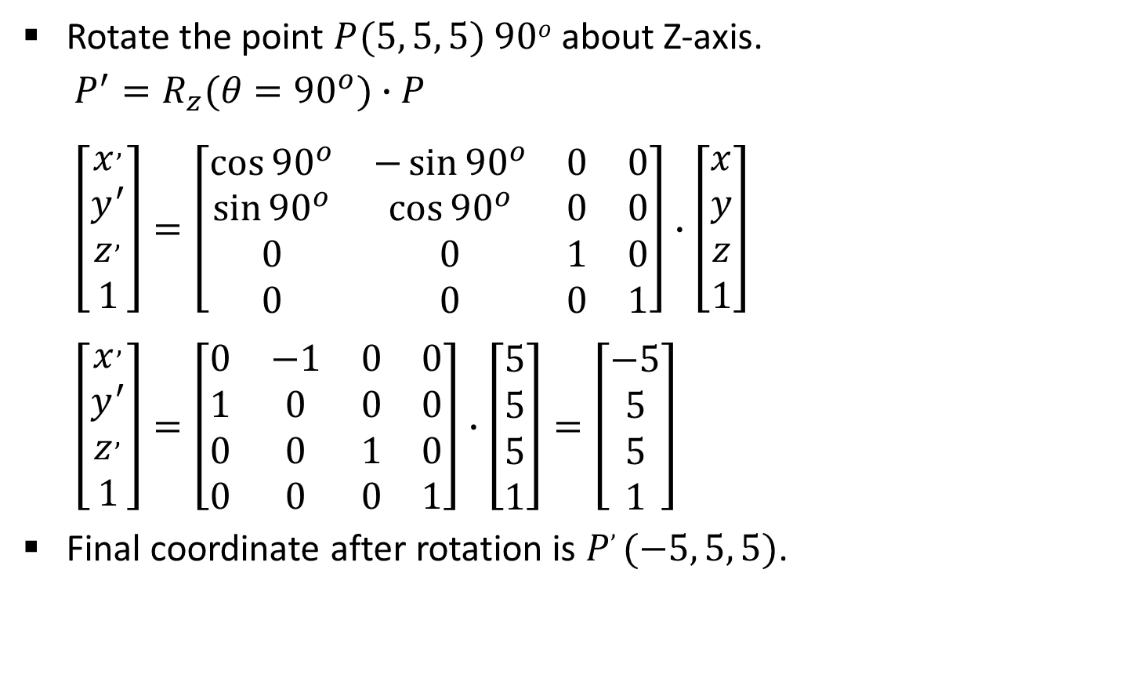
Example- Coordinate Axis Rotation
Rotate the point $P(5, 5, 5)$ $90o$ about Z-axis.
$$P^{′}=R_{z}(θ={90}^{o})∙P$$
$$\left[\begin{matrix}x^{,} \\ y^{′} \\ z^{,} \\ 1\end{matrix}\right]=\left[\begin{matrix}\cos{{90}^{o}} & −\sin{{90}^{o}} & 0 & 0 \\ \sin{{90}^{o}} & \cos{{90}^{o}} & 0 & 0 \\ 0 & 0 & 1 & 0 \\ 0 & 0 & 0 & 1\end{matrix}\right]∙\left[\begin{matrix}x \\ y \\ z \\ 1\end{matrix}\right]$$
$$\left[\begin{matrix}x^{,} \\ y^{′} \\ z^{,} \\ 1\end{matrix}\right]=\left[\begin{matrix}0 & −1 & 0 & 0 \\ 1 & 0 & 0 & 0 \\ 0 & 0 & 1 & 0 \\ 0 & 0 & 0 & 1\end{matrix}\right]∙\left[\begin{matrix}5 \\ 5 \\ 5 \\ 1\end{matrix}\right]=\left[\begin{matrix}−5 \\ 5 \\ 5 \\ 1\end{matrix}\right]$$
Final coordinate after rotation is $P, (−5, 5, 5)$.

Slide 10
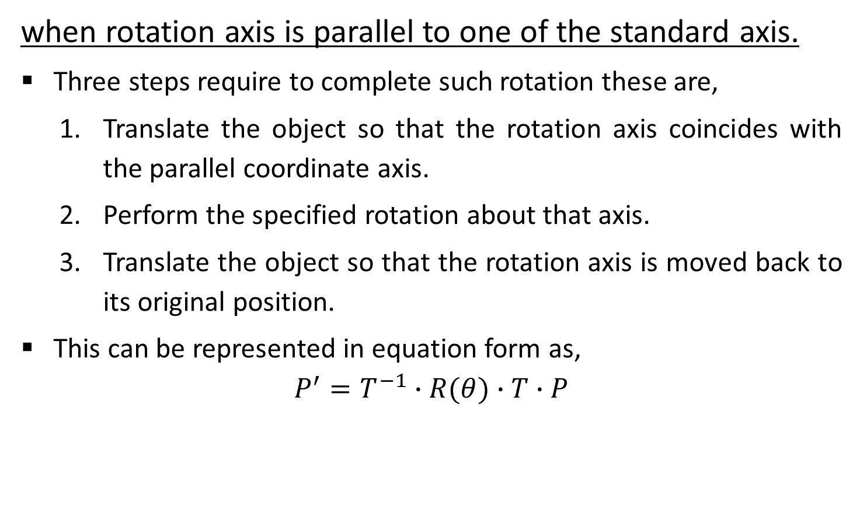
General 3D Rotations
when rotation axis is parallel to one of the standard axis.
Three steps require to complete such rotation these are,
Translate the object so that the rotation axis coincides with the parallel coordinate axis.
Perform the specified rotation about that axis.
Translate the object so that the rotation axis is moved back to its original position.
This can be represented in equation form as,
$$P^{′}=T^{−1}∙R(θ)∙T∙P$$

Slide 11
General 3D Rotations
when rotation axis is inclined in arbitrary direction.
First we need rotations to align the axis with a selected coordinate axis and to bring the axis back to its original orientation.
Five steps require to complete such rotation these are,
Translate the object so that the rotation axis passes through the coordinate origin.
Rotate the object so that the axis of rotation coincides with one of the coordinate axes.
Perform the specified rotation about that coordinate axis.
Apply inverse rotations to bring the rotation axis back to its original orientation.
Apply the inverse translation to bring the rotation axis back to its original position.

Slide 12

Contd.
We can transform rotation axis onto any of the three coordinate axes. The $Z−axis$ is a reasonable choice.
We are given line in the form of two end points $p_{1} (x_{1},y_{1},z_{1})$, and${ p}_{2} (x_{2},y_{2},z_{2})$.
Let’s discuss procedure step by step.

Slide 13



1. Translate the Object so that the Rotation Axis Passes Through the Coordinate Origin
For translation of step one we will bring first end point at origin and transformation matrix for the same is as below
$$T=\left[\begin{matrix}1 & 0 & 0 & {−x}_{1} \\ 0 & 1 & 0 & {−y}_{1} \\ 0 & 0 & 1 & {−z}_{1} \\ 0 & 0 & 0 & 1\end{matrix}\right]$$
Y
$$p_{2}$$
$$p_{1}$$
X
Z

Slide 14
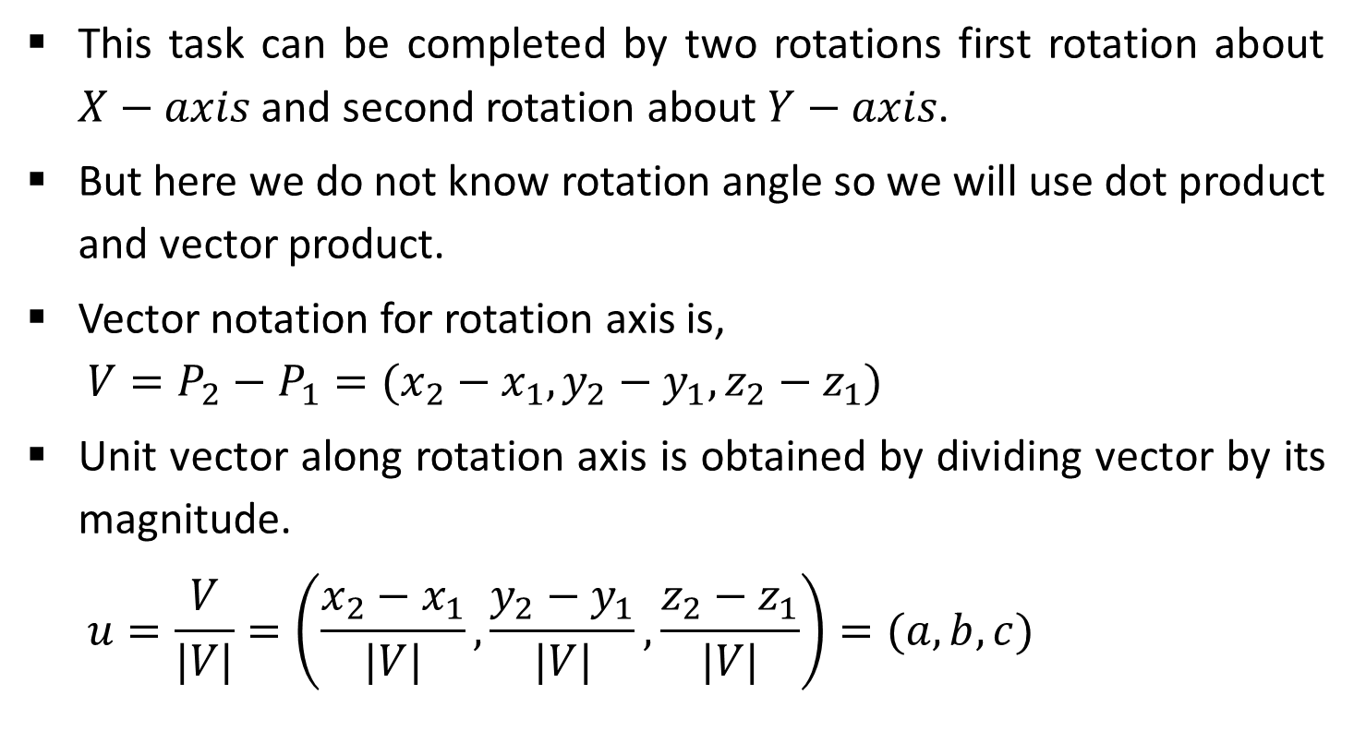
2. Rotate the Object so that the Axis of Rotation Coincides with One of the Coordinate Axes
This task can be completed by two rotations first rotation about $X−axis$ and second rotation about $Y−axis$.
But here we do not know rotation angle so we will use dot product and vector product.
Vector notation for rotation axis is,
$$V=P_{2}−P_{1}=(x_{2}−x_{1},y_{2}−y_{1},z_{2}−z_{1})$$
Unit vector along rotation axis is obtained by dividing vector by its magnitude.
$$u=\frac{V}{|V|}=\left(\frac{x_{2}−x_{1}}{|V|},\frac{y_{2}−y_{1}}{|V|},\frac{z_{2}−z_{1}}{|V|}\right)=(a,b,c)$$

Slide 15



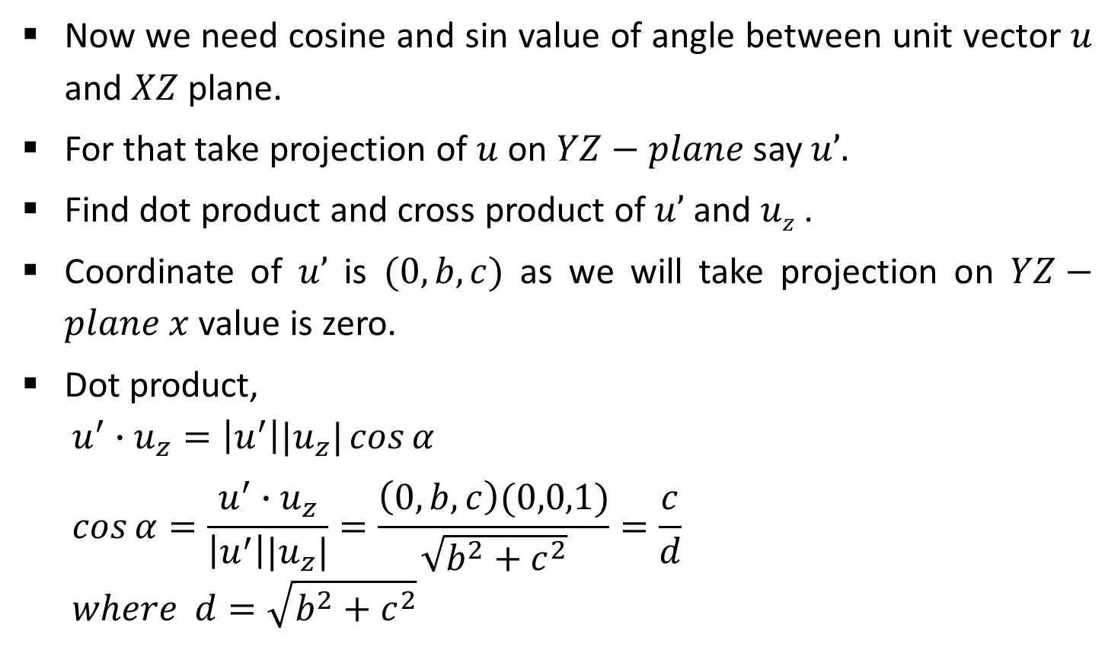




Contd.
Now we need cosine and sin value of angle between unit vector $u$ and $XZ$ plane.
For that take projection of $u$ on $YZ−plane$ say $u’.$
Find dot product and cross product of $u’$ and $uz$ .
Coordinate of $u’$ is $(0,b,c)$ as we will take projection on $YZ−plane$ $x$ value is zero.
Dot product,
$$u^{′}∙u_{z}=\left|u^{′}\right||u_{z}|\cos{α}$$
$$\cos{α}=\frac{u^{′}∙u_{z}}{\left|u^{′}\right||u_{z}|}=\frac{\left(0,b,c\right)(0,0,1)}{\sqrt{b^{2}+c^{2}}}=\frac{c}{d}$$
$$where d=\sqrt{b^{2}+c^{2}}$$
$$Y$$
$$u’$$
$$u$$
$$α$$
$$X$$
$$uz$$
$$Z$$

Slide 16
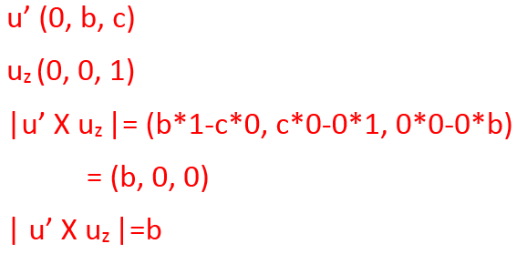

Contd.
Cross product,
$u^{′}×u_{z}=u_{x}\left|u^{′}\right||u_{z}|\sin{α}$ …(1)
$$u^{′}×u_{z}=u_{x}∙b …(2)$$
From (1) and (2),
$$u_{x}\left|u^{′}\right||u_{z}|\sin{α=}u_{x}∙b$$
Comparing magnitude
$$\left|u^{′}\right||u_{z}|\sin{α=}b$$
$$\sqrt{b^{2}+c^{2}}∙(1)\sin{α=}b$$
$$d\sin{α=}b$$
$$\sin{α=}\frac{b}{d}$$
$$Y$$
$$u’$$
$$u$$
$$α$$
$$X$$
$$uz$$
$$Z$$

Slide 17
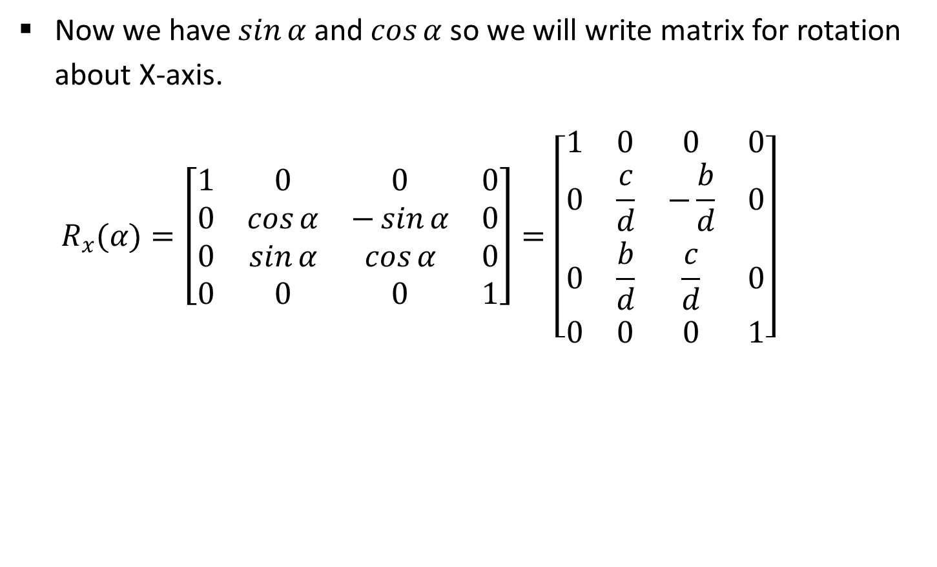
Contd.
Now we have $\sin{α}$ and $\cos{α}$ so we will write matrix for rotation about X-axis.
$$R_{x}(α)=\left[\begin{matrix}1 & 0 & 0 & 0 \\ 0 & \cos{α} & −\sin{α} & 0 \\ 0 & \sin{α} & \cos{α} & 0 \\ 0 & 0 & 0 & 1\end{matrix}\right]=\left[\begin{matrix}1 & 0 & 0 & 0 \\ 0 & \frac{c}{d} & −\frac{b}{d} & 0 \\ 0 & \frac{b}{d} & \frac{c}{d} & 0 \\ 0 & 0 & 0 & 1\end{matrix}\right]$$

Slide 18



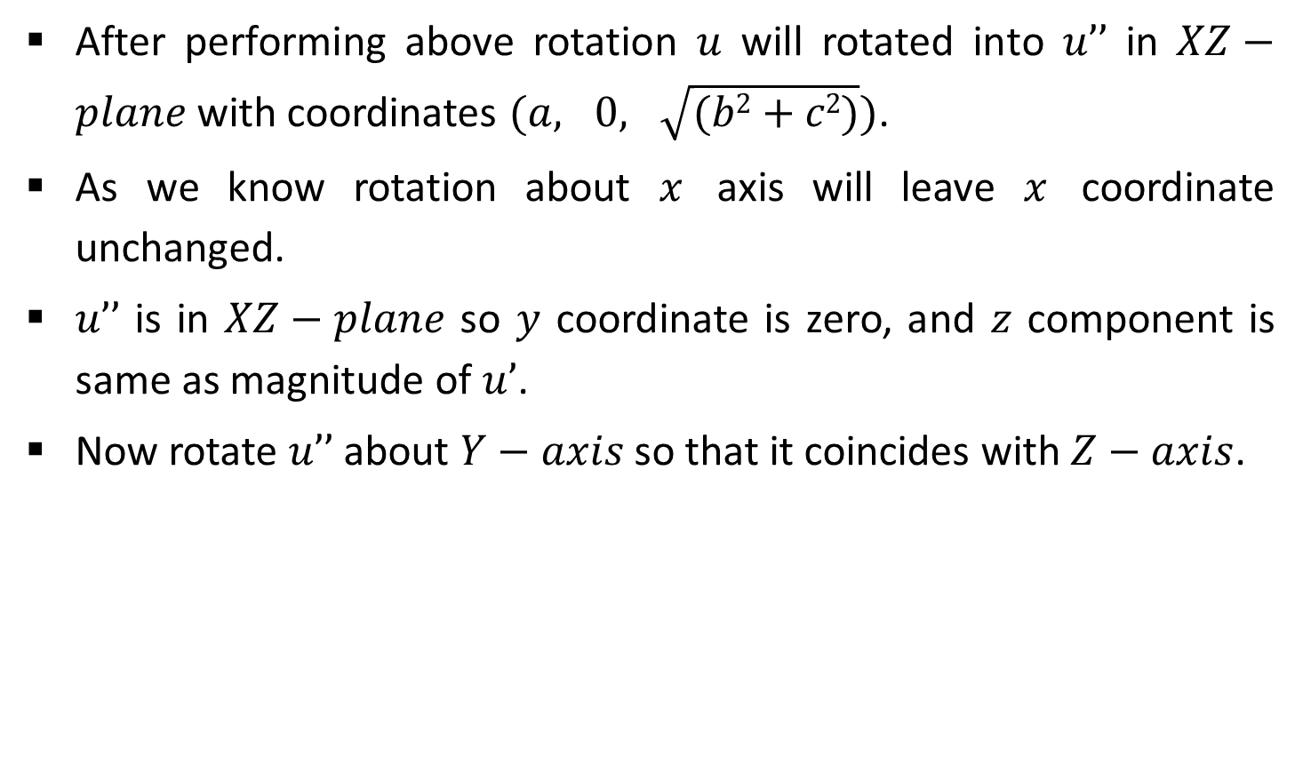




Contd.
After performing above rotation $u$ will rotated into $u’’$ in $XZ−plane$ with coordinates $(a, 0, \sqrt{(b2+c2)})$.
As we know rotation about $x$ axis will leave $x$ coordinate unchanged.
$u’’$ is in $XZ−plane$ so $y$ coordinate is zero, and $z$ component is same as magnitude of $u’$.
Now rotate $u’’$ about $Y−axis$ so that it coincides with $Z−axis$.
$$Y$$
$$u$$
$$u_{z}$$
$$X$$
$$β$$
$$u^{′′}$$
$$Z$$

Slide 19
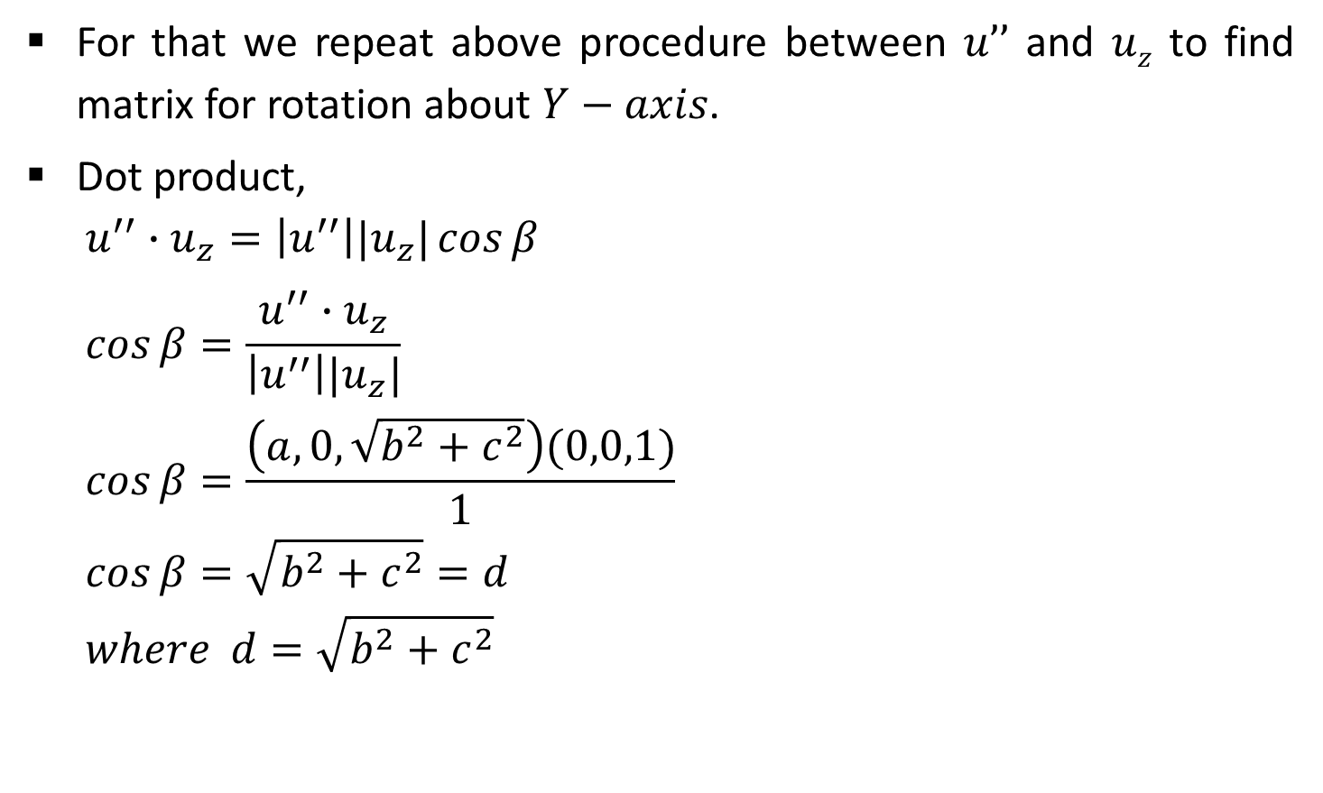
Contd.
For that we repeat above procedure between $u’’$ and $uz$ to find matrix for rotation about $Y−axis$.
Dot product,
$$u^{′′}∙u_{z}=\left|u^{′′}\right||u_{z}|\cos{β}$$
$$\cos{β}=\frac{u^{′′}∙u_{z}}{\left|u^{′′}\right||u_{z}|}$$
$$\cos{β}=\frac{\left(a,0,\sqrt{b^{2}+c^{2}}\right)(0,0,1)}{1}$$
$$\cos{β}=\sqrt{b^{2}+c^{2}}=d$$
$$where d=\sqrt{b^{2}+c^{2}}$$
$$Y$$
$$u$$
$$u_{z}$$
$$X$$
$$β$$
$$u^{′′}$$
$$Z$$

Slide 20

Contd.
Cross product,
$$u^{′′}×u_{z}=u_{y}\left|u^{′′}\right|\left|u_{z}\right|\sin{β} …(1)$$
$$u^{′′}×u_{z}=u_{y}∙\left(−a\right)…(2)$$
From (1) and (2),
$$u_{y}\left|u^{′′}\right|\left|u_{z}\right|\sin{β=}u_{y}∙(−a)$$
Comparing magnitude
$$\left|u^{′′}\right|\left|u_{z}\right|\sin{β=}\left(−a\right)$$
$$\left(1\right)\sin{β=}−a$$
$$\sin{β=}−a$$
$$Y$$
$$u$$
$$u_{z}$$
$$X$$
$$β$$
$$u^{′′}$$
$$Z$$

Slide 21
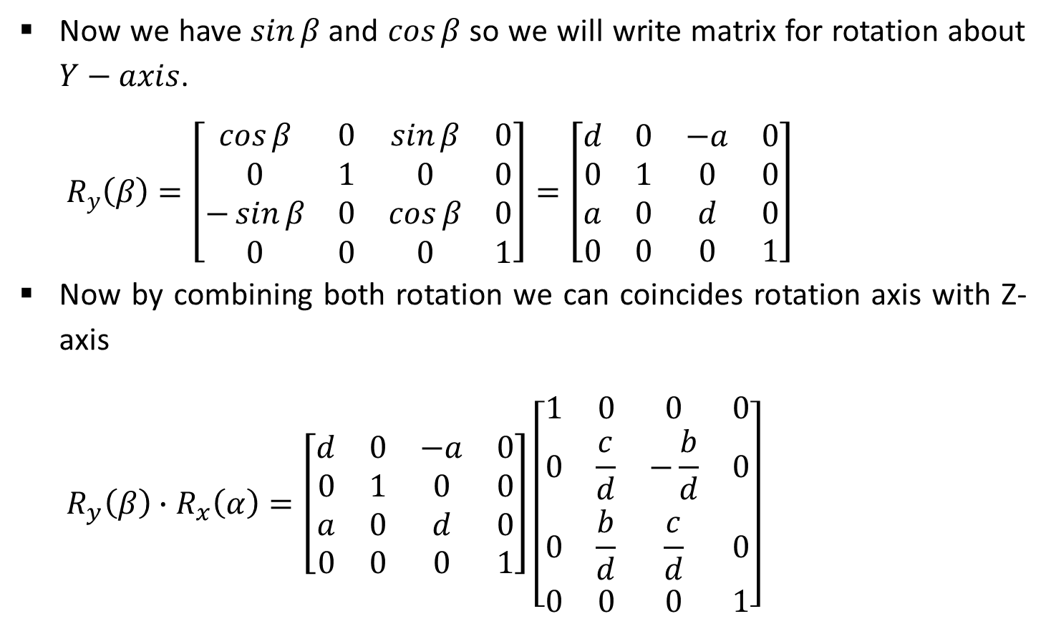
Contd.
Now we have $\sin{β}$ and $\cos{β}$ so we will write matrix for rotation about $Y−axis$.
$$R_{y}\left(β\right)=\left[\begin{matrix}\cos{β} & 0 & \sin{β} & 0 \\ 0 & 1 & 0 & 0 \\ −\sin{β} & 0 & \cos{β} & 0 \\ 0 & 0 & 0 & 1\end{matrix}\right]=\left[\begin{matrix}d & 0 & −a & 0 \\ 0 & 1 & 0 & 0 \\ a & 0 & d & 0 \\ 0 & 0 & 0 & 1\end{matrix}\right]$$
Now by combining both rotation we can coincides rotation axis with Z-axis
$$R_{y}\left(β\right)∙R_{x}\left(α\right)=\left[\begin{matrix}d & 0 & −a & 0 \\ 0 & 1 & 0 & 0 \\ a & 0 & d & 0 \\ 0 & 0 & 0 & 1\end{matrix}\right]\left[\begin{matrix}1 & 0 & 0 & 0 \\ 0 & \frac{c}{d} & −\frac{b}{d} & 0 \\ 0 & \frac{b}{d} & \frac{c}{d} & 0 \\ 0 & 0 & 0 & 1\end{matrix}\right]$$

Slide 22
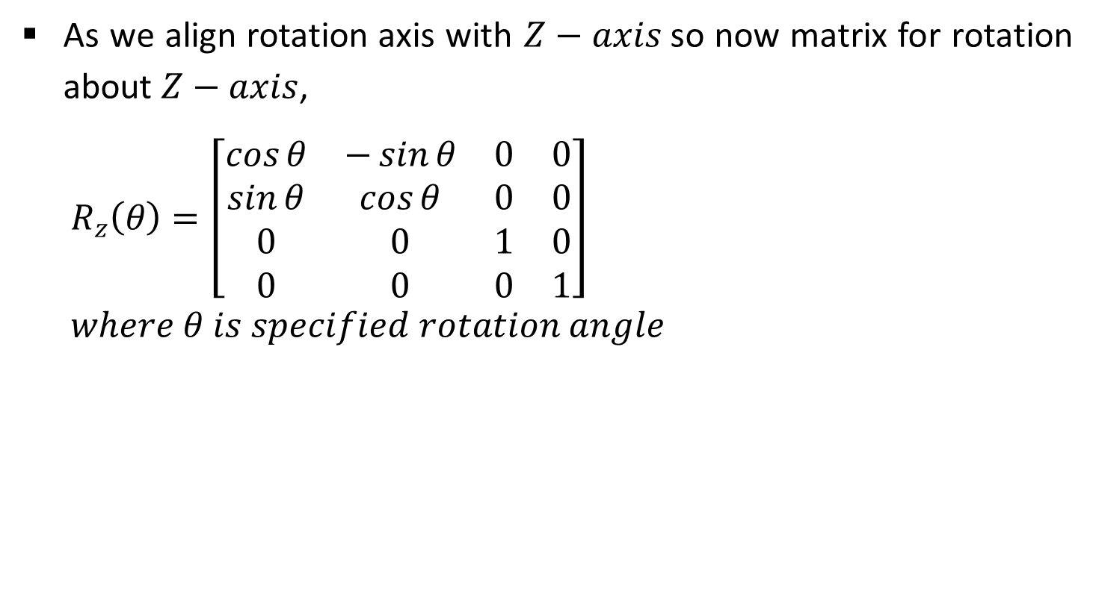
3. Perform the Specified Rotation About that Coordinate Axis
As we align rotation axis with $Z−axis$so now matrix for rotation about $Z−axis$,
$$R_{z}\left(θ\right)=\left[\begin{matrix}\cos{θ} & −\sin{θ} & 0 & 0 \\ \sin{θ} & \cos{θ} & 0 & 0 \\ 0 & 0 & 1 & 0 \\ 0 & 0 & 0 & 1\end{matrix}\right]$$
$$where θ is specified rotation angle$$

Slide 23

4. Apply Inverse Rotations to Bring the Rotation Axis Back to it’s Original Orientation
This step is inverse of step number 2,
$$R_{x}^{−1}\left(α\right)∙R_{y}^{−1}\left(β\right)$$

Slide 24
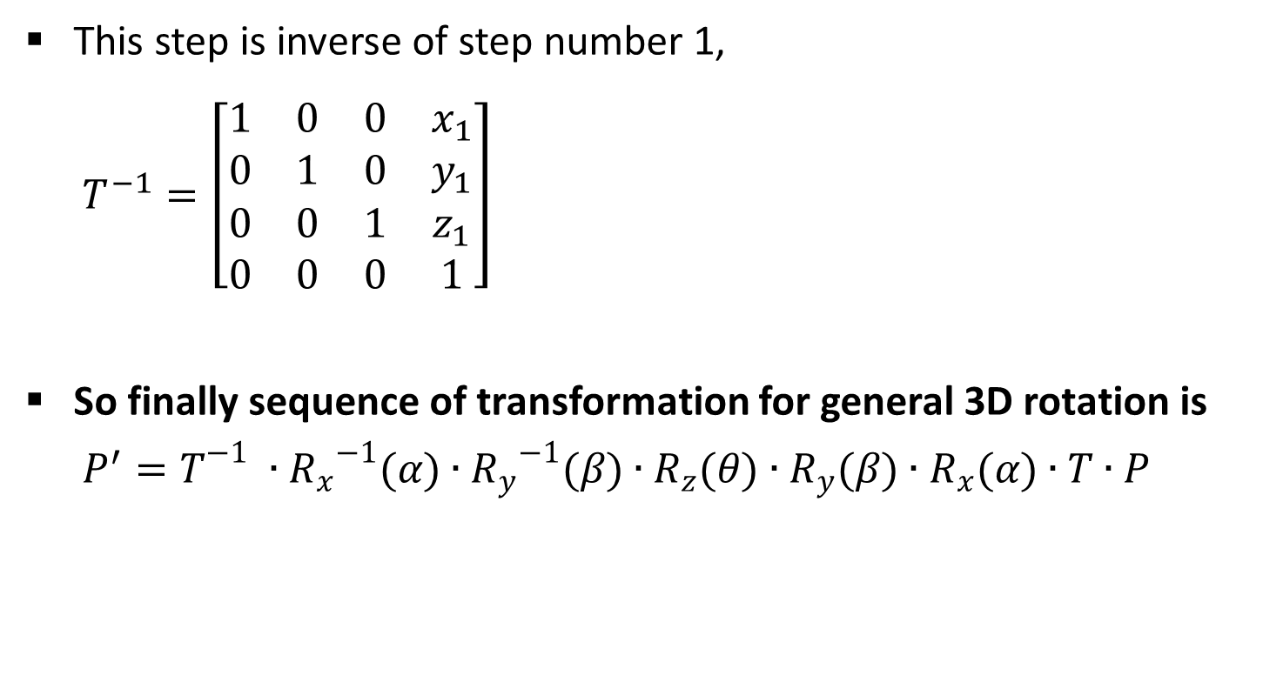
5. Apply the Inverse Translation to Bring the Rotation Axis Back to it’s Original Position
This step is inverse of step number 1,
$$T^{−1}=\left[\begin{matrix}1 & 0 & 0 & x_{1} \\ 0 & 1 & 0 & y_{1} \\ 0 & 0 & 1 & z_{1} \\ 0 & 0 & 0 & 1\end{matrix}\right]$$
So finally sequence of transformation for general 3D rotation is
$$P^{′}=T^{−1}∙{R_{x}}^{−1}(α)∙{R_{y}}^{−1}(β)∙R_{z}(θ)∙R_{y}(β)∙R_{x}(α)∙T∙P$$

Slide 25
Scaling
It is used to resize the object in 3D space.
We can apply uniform as well as non uniform scaling by selecting proper scaling factor.
Scaling in 3D is similar to scaling in 2D. Only one extra coordinate need to consider into it.

Slide 26


Coordinate Axes Scaling
Simple coordinate axis scaling can be performed as below,
$$P^{′}=S∙P$$
$$\left[\begin{matrix}x^{,} \\ y^{′} \\ z^{,} \\ 1\end{matrix}\right]=\left[\begin{matrix}s_{x} & 0 & 0 & 0 \\ 0 & s_{y} & 0 & 0 \\ 0 & 0 & s_{z} & 0 \\ 0 & 0 & 0 & 1\end{matrix}\right]∙\left[\begin{matrix}x \\ y \\ z \\ 1\end{matrix}\right]$$
$$Y$$
Scaling
X
Z

Slide 27
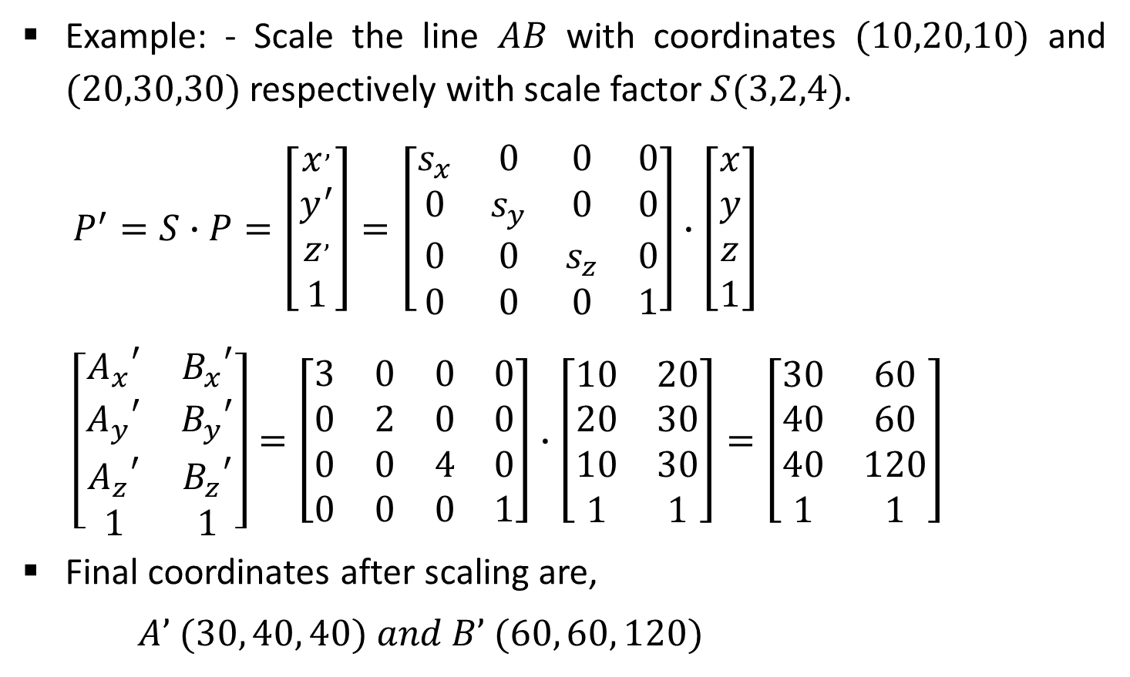
Example-Coordinate Axes Scaling
Example: - Scale the line $AB$ with coordinates $(10,20,10)$ and $(20,30,30)$ respectively with scale factor $S(3,2,4)$.
$$P^{′}=S∙P=\left[\begin{matrix}x^{,} \\ y^{′} \\ z^{,} \\ 1\end{matrix}\right]=\left[\begin{matrix}s_{x} & 0 & 0 & 0 \\ 0 & s_{y} & 0 & 0 \\ 0 & 0 & s_{z} & 0 \\ 0 & 0 & 0 & 1\end{matrix}\right]∙\left[\begin{matrix}x \\ y \\ z \\ 1\end{matrix}\right]$$
$$\left[\begin{matrix}{A_{x}}^{′} & {B_{x}}^{′} \\ {A_{y}}^{′} & {B_{y}}^{′} \\ {A_{z}}^{′} & {B_{z}}^{′} \\ 1 & 1\end{matrix}\right]=\left[\begin{matrix}3 & 0 & 0 & 0 \\ 0 & 2 & 0 & 0 \\ 0 & 0 & 4 & 0 \\ 0 & 0 & 0 & 1\end{matrix}\right]∙\left[\begin{matrix}10 & 20 \\ 20 & 30 \\ 10 & 30 \\ 1 & 1\end{matrix}\right]=\left[\begin{matrix}30 & 60 \\ 40 & 60 \\ 40 & 120 \\ 1 & 1\end{matrix}\right]$$
Final coordinates after scaling are,
$A’ (30, 40, 40) and B’ (60, 60, 120)$

Slide 28

Fixed Point Scaling
Fixed point scaling is used when we require scaling of object but particular point must be at its original position.
Three steps require to complete such fixed point scaling these are,
Translate the fixed point to the origin.
Scale the object relative to the coordinate origin using coordinate axes scaling.
Translate the fixed point back to its original position.
$$Y$$
Fixed Point
X
Z

Slide 29
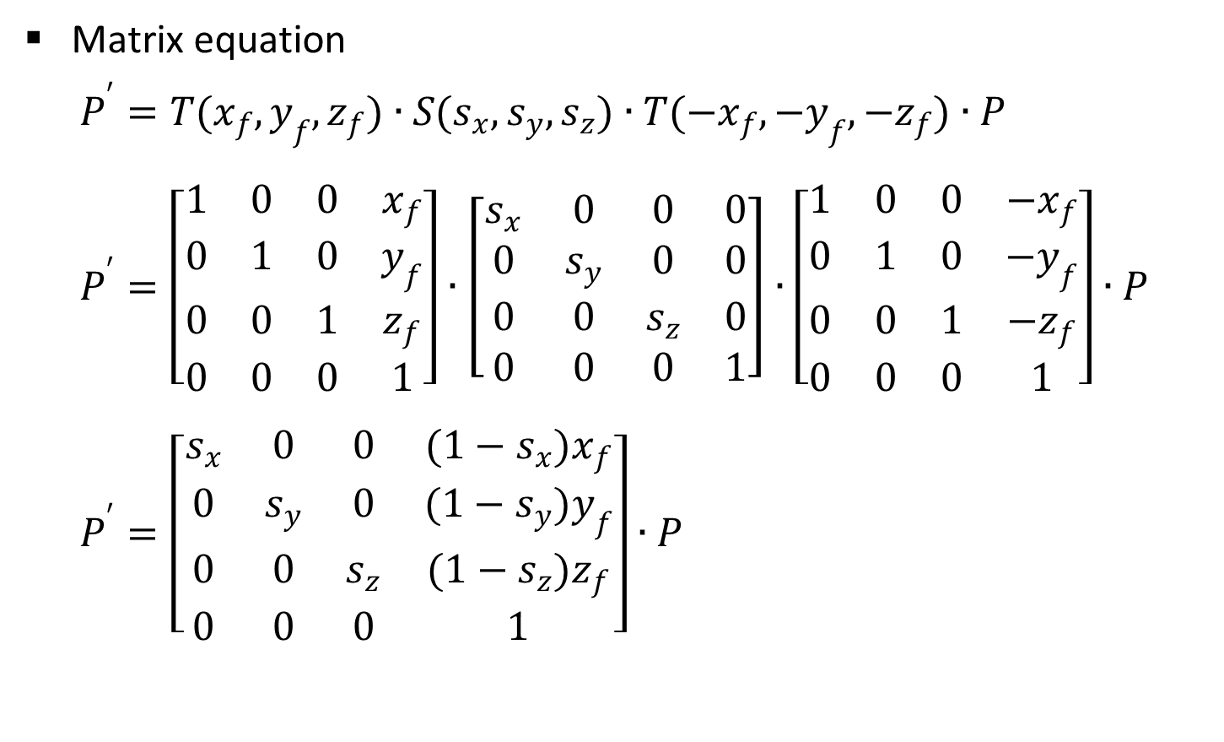
Contd.
Matrix equation
$$P^{′}=T(x_{f},y_{f},z_{f})∙S(s_{x},s_{y},s_{z})∙T({−x}_{f},{−y}_{f},{−z}_{f})∙P$$
$$P^{′}=\left[\begin{matrix}1 & 0 & 0 & x_{f} \\ 0 & 1 & 0 & y_{f} \\ 0 & 0 & 1 & z_{f} \\ 0 & 0 & 0 & 1\end{matrix}\right]∙\left[\begin{matrix}s_{x} & 0 & 0 & 0 \\ 0 & s_{y} & 0 & 0 \\ 0 & 0 & s_{z} & 0 \\ 0 & 0 & 0 & 1\end{matrix}\right]∙\left[\begin{matrix}1 & 0 & 0 & {−x}_{f} \\ 0 & 1 & 0 & {−y}_{f} \\ 0 & 0 & 1 & {−z}_{f} \\ 0 & 0 & 0 & 1\end{matrix}\right]∙P$$
$$P^{′}=\left[\begin{matrix}s_{x} & 0 & 0 & (1−s_{x})x_{f} \\ 0 & s_{y} & 0 & (1−s_{y})y_{f} \\ 0 & 0 & s_{z} & (1−s_{z})z_{f} \\ 0 & 0 & 0 & 1\end{matrix}\right]∙P$$

Slide 30
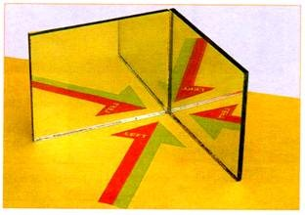
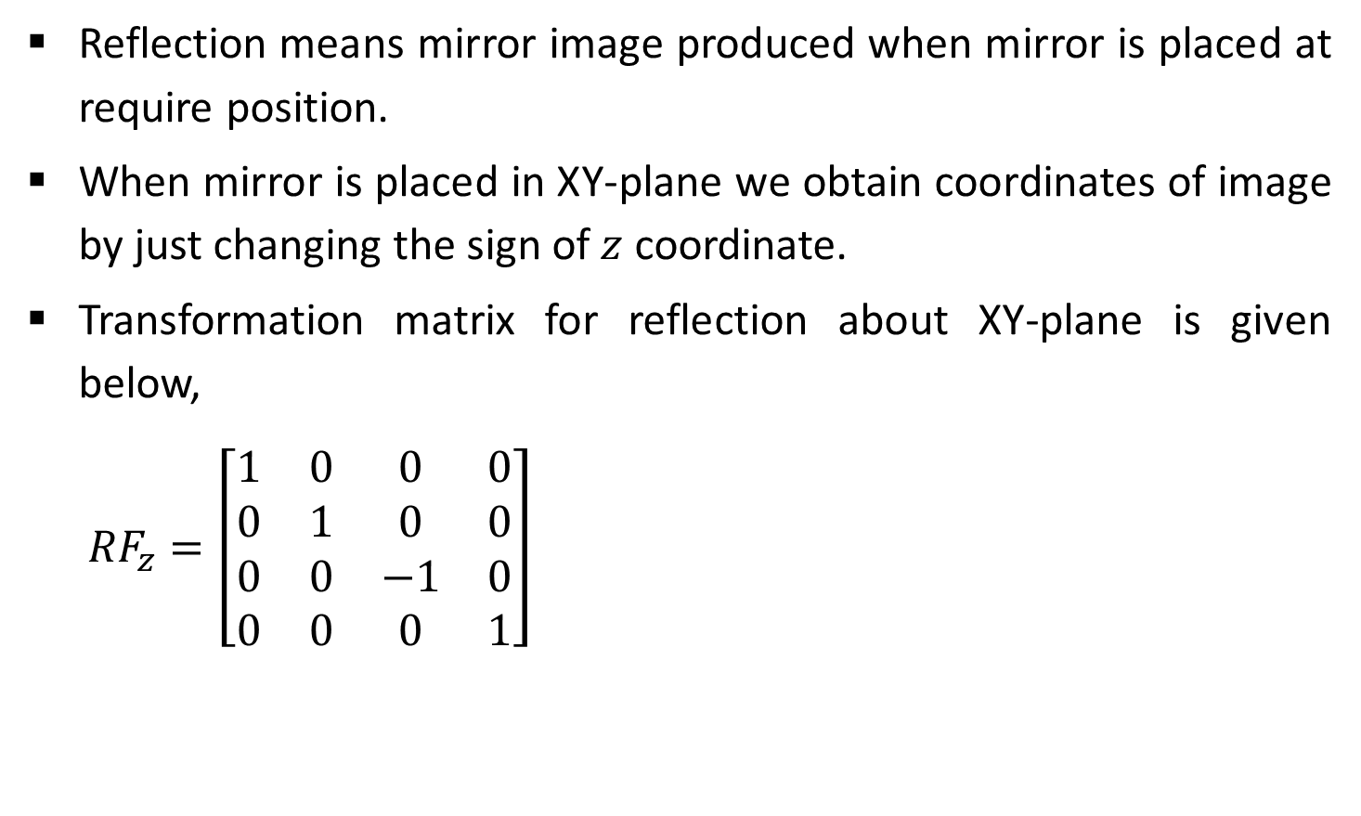
Other Transformations-Reflection
Reflection means mirror image produced when mirror is placed at require position.
When mirror is placed in XY-plane we obtain coordinates of image by just changing the sign of $z$ coordinate.
Transformation matrix for reflection about XY-plane is given below,
$${RF}_{z}=\left[\begin{matrix}1 & 0 & 0 & 0 \\ 0 & 1 & 0 & 0 \\ 0 & 0 & −1 & 0 \\ 0 & 0 & 0 & 1\end{matrix}\right]$$
Source: http://www.yourarticlelibrary.com

Slide 31
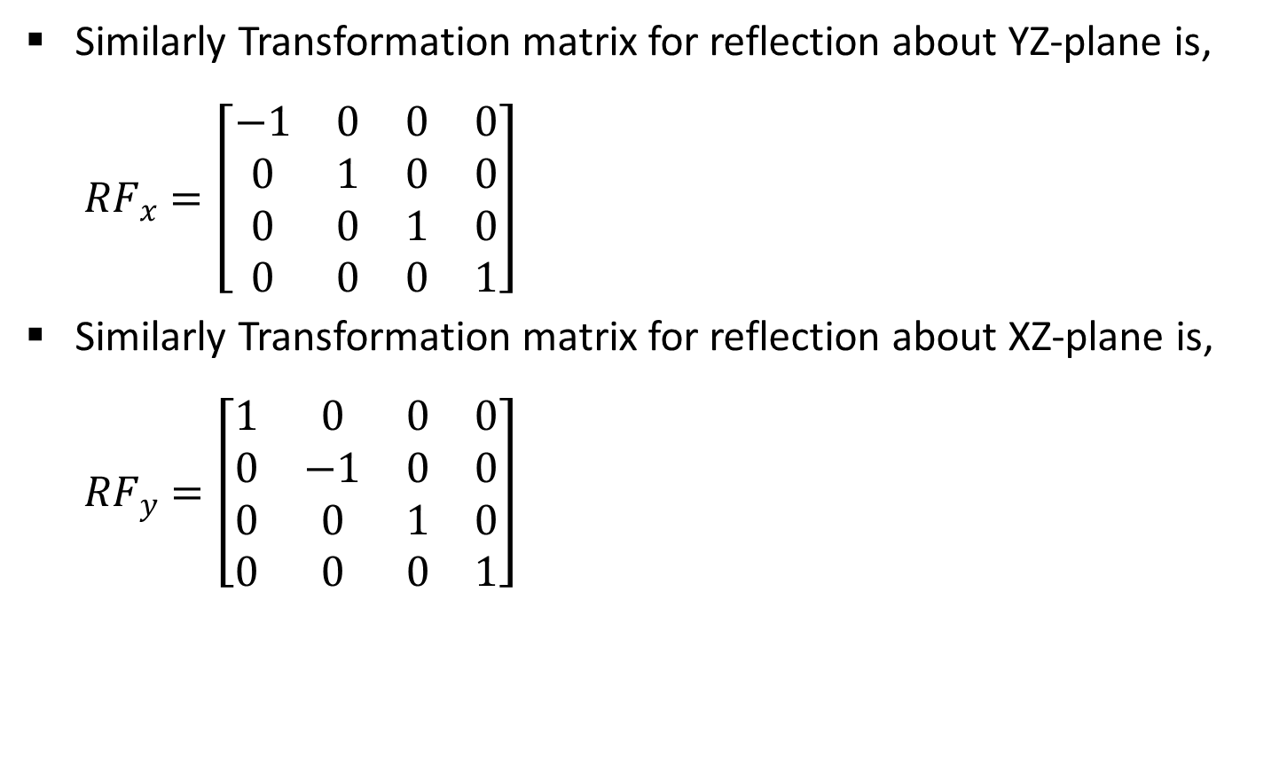
Contd.
Similarly Transformation matrix for reflection about YZ-plane is,
$${RF}_{x}=\left[\begin{matrix}−1 & 0 & 0 & 0 \\ 0 & 1 & 0 & 0 \\ 0 & 0 & 1 & 0 \\ 0 & 0 & 0 & 1\end{matrix}\right]$$
Similarly Transformation matrix for reflection about XZ-plane is,
$${RF}_{y}=\left[\begin{matrix}1 & 0 & 0 & 0 \\ 0 & −1 & 0 & 0 \\ 0 & 0 & 1 & 0 \\ 0 & 0 & 0 & 1\end{matrix}\right]$$

Slide 32
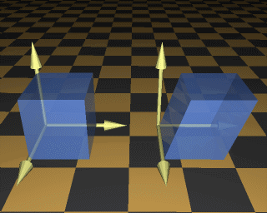
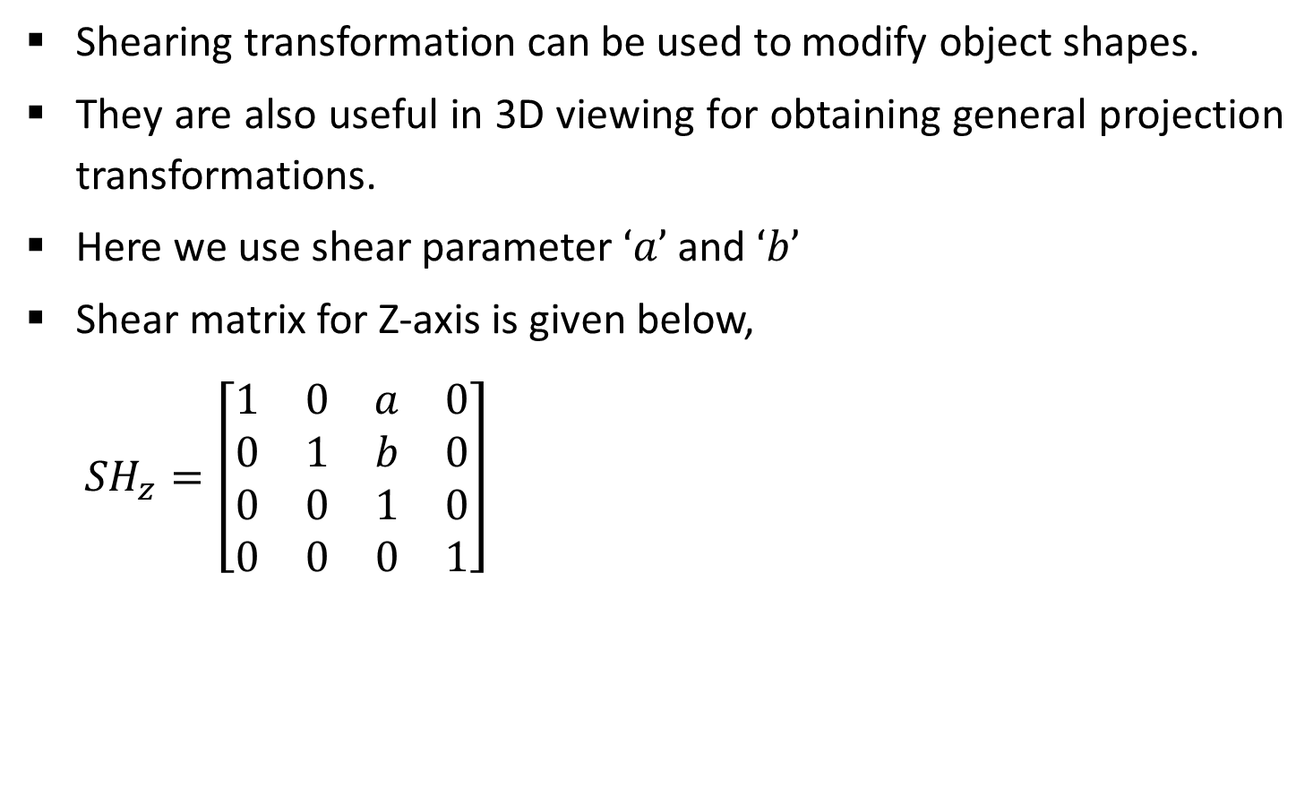
Other Transformations-Shear
Shearing transformation can be used to modify object shapes.
They are also useful in 3D viewing for obtaining general projection transformations.
Here we use shear parameter $‘a’$ and $‘b’$
Shear matrix for Z-axis is given below,
$${SH}_{z}=\left[\begin{matrix}1 & 0 & a & 0 \\ 0 & 1 & b & 0 \\ 0 & 0 & 1 & 0 \\ 0 & 0 & 0 & 1\end{matrix}\right]$$
Source: http://140.129.20.249/~jmchen/cg

Slide 33

Other Transformations-Shear
Similarly Shear matrix for X-axis is,
$${SH}_{x}=\left[\begin{matrix}1 & 0 & 0 & 0 \\ a & 1 & 0 & 0 \\ b & 0 & 1 & 0 \\ 0 & 0 & 0 & 1\end{matrix}\right]$$
Similarly Shear matrix for X-axis is,
$${SH}_{y}=\left[\begin{matrix}1 & a & 0 & 0 \\ 0 & 1 & 0 & 0 \\ 0 & b & 1 & 0 \\ 0 & 0 & 0 & 1\end{matrix}\right]$$

Slide 34
Viewing Pipeline
Modeling Transformation
Viewing Transformation
MC
WC
VC
Projection Transformation
Workstation Transformation
PC
DC

Slide 35
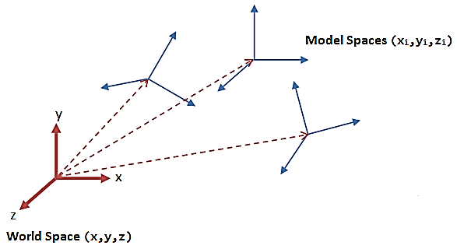
Viewing Co-ordinates
Generating a view of an object is similar to photographing the object.
We can take photograph from any side with any angle & orientation of camera.
Similarly we can specify viewing coordinate in ordinary direction.

Slide 36
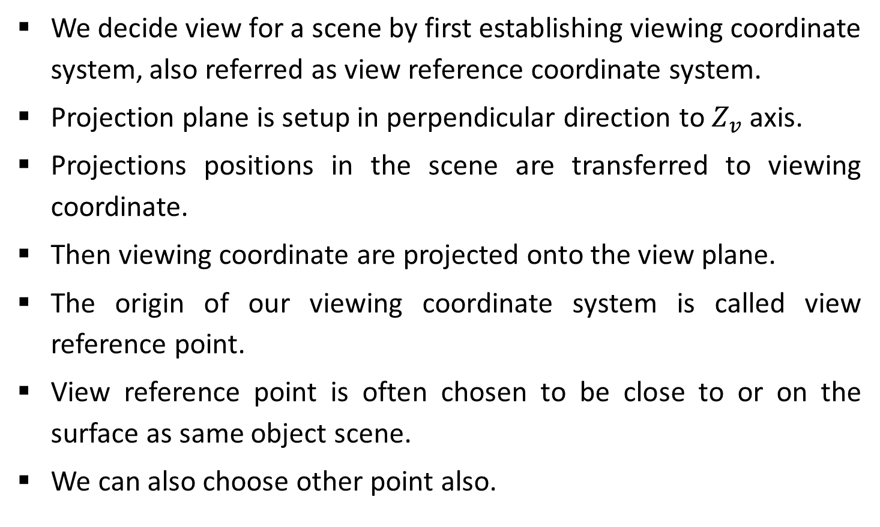
Specifying the View Plan
We decide view for a scene by first establishing viewing coordinate system, also referred as view reference coordinate system.
Projection plane is setup in perpendicular direction to $Z_{v}$ axis.
Projections positions in the scene are transferred to viewing coordinate.
Then viewing coordinate are projected onto the view plane.
The origin of our viewing coordinate system is called view reference point.
View reference point is often chosen to be close to or on the surface as same object scene.
We can also choose other point also.

Slide 37
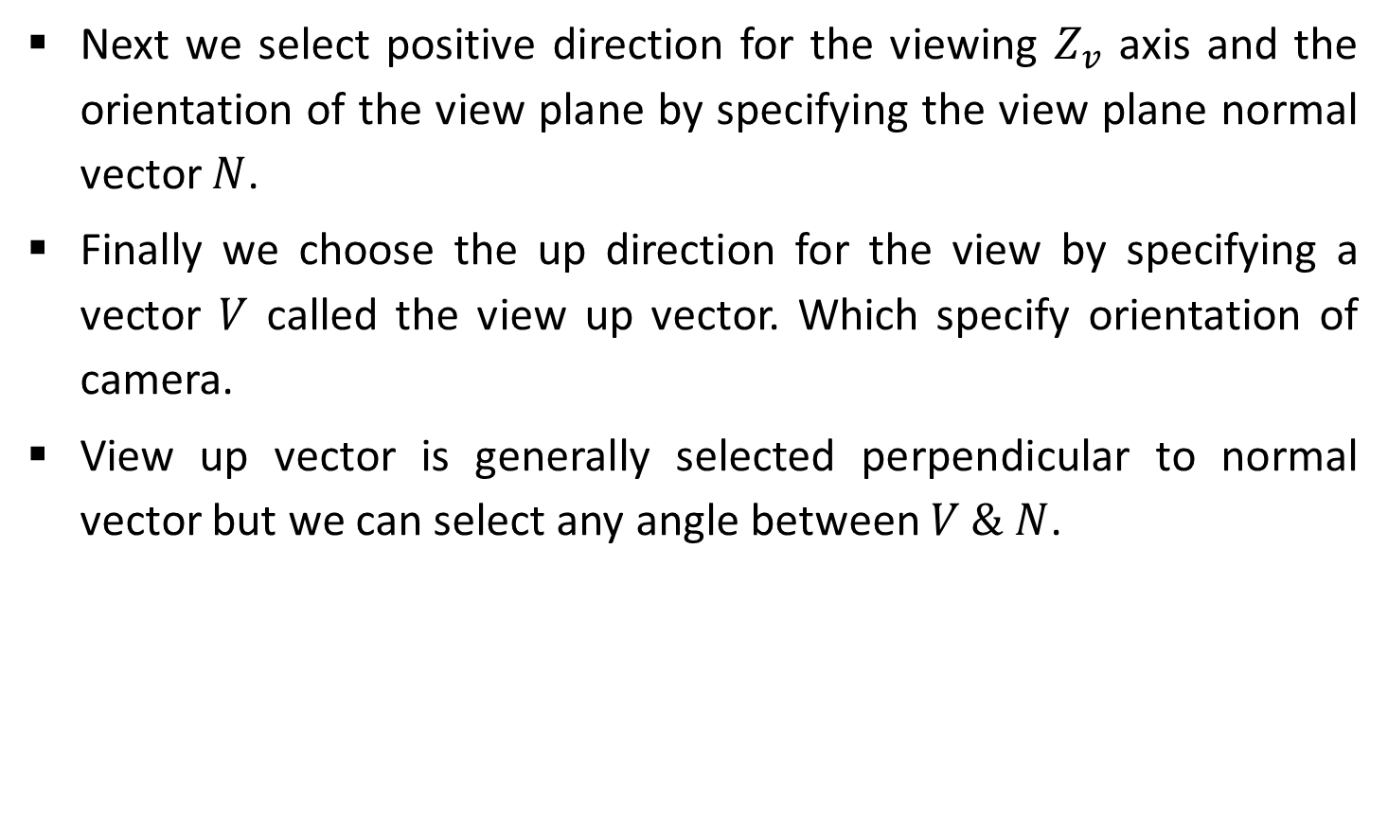
Contd.
Next we select positive direction for the viewing $Z_{v}$ axis and the orientation of the view plane by specifying the view plane normal vector $N$.
Finally we choose the up direction for the view by specifying a vector $V$ called the view up vector. Which specify orientation of camera.
View up vector is generally selected perpendicular to normal vector but we can select any angle between $V \& N$.

Slide 38
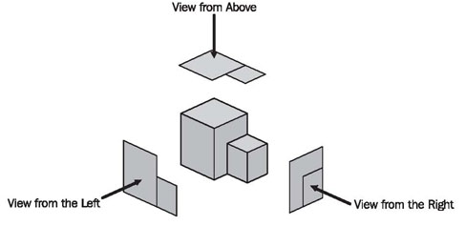

Contd.
By fixing view reference point and changing direction of normal vector $N$ we get different views of same object.
Source: https://sourcemaking.com

Slide 39
World to Viewing Coordinates Transformation
Before taking projection of view plane object description is need to transfer from world to viewing coordinate.
It is same as transformation that superimposes viewing coordinate system to world coordinate system.
It requires following basic transformation.
Translate view reference point to the origin of the world coordinate system.
Apply rotation to align.

Slide 40
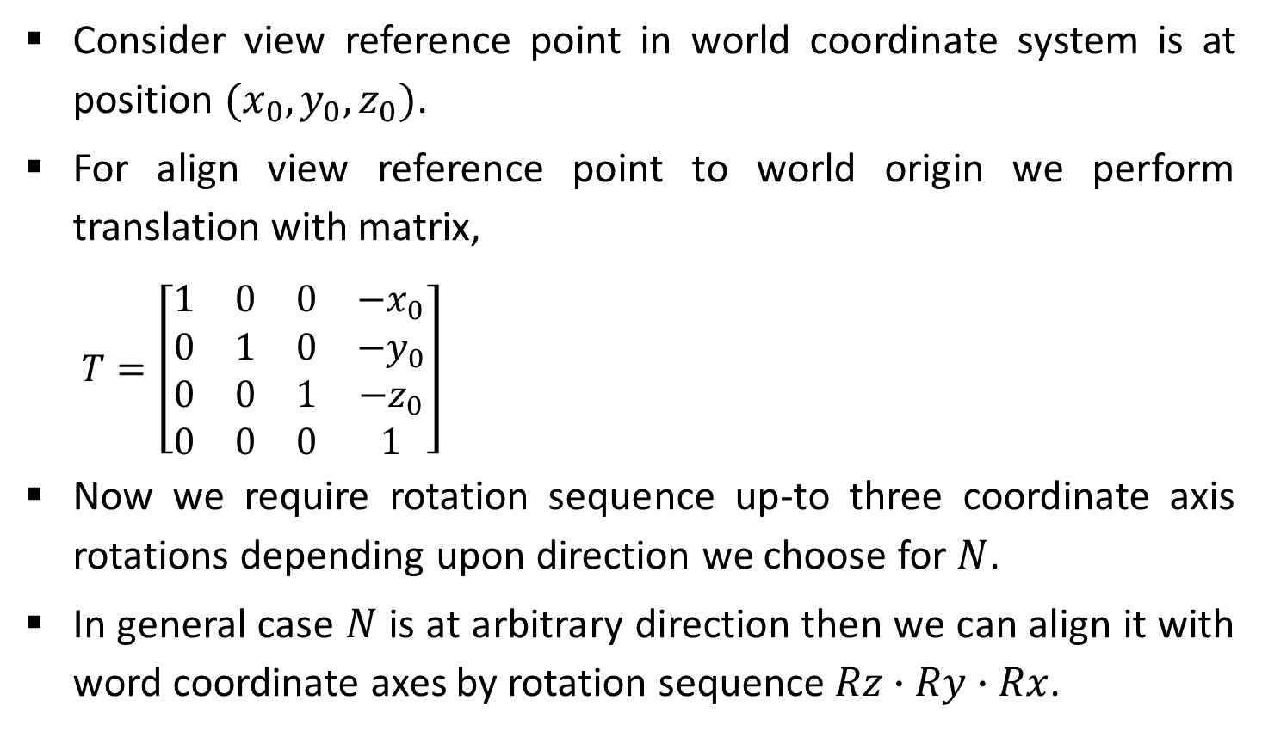
Contd.
Consider view reference point in world coordinate system is at position $(x_{0},y_{0},z_{0})$.
For align view reference point to world origin we perform translation with matrix,
$$T=\left[\begin{matrix}1 & 0 & 0 & −x_{0} \\ 0 & 1 & 0 & −y_{0} \\ 0 & 0 & 1 & −z_{0} \\ 0 & 0 & 0 & 1\end{matrix}\right]$$
Now we require rotation sequence up-to three coordinate axis rotations depending upon direction we choose for $N$.
In general case $N$ is at arbitrary direction then we can align it with word coordinate axes by rotation sequence$Rz∙Ry∙Rx$.

Slide 41
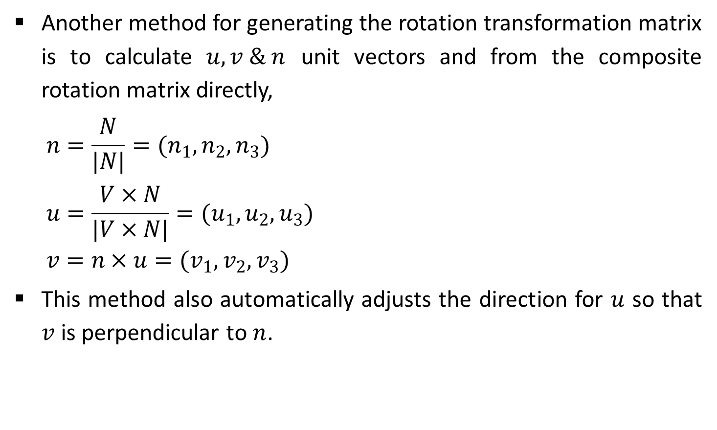
Contd.
Another method for generating the rotation transformation matrix is to calculate $u,v \& n$ unit vectors and from the composite rotation matrix directly,
$$n=\frac{N}{|N|}=(n_{1},n_{2},n_{3})$$
$$u=\frac{V×N}{|V×N|}=(u_{1},u_{2},u_{3})$$
$$v=n×u=(v_{1},v_{2},v_{3})$$
This method also automatically adjusts the direction for $u$ so that $v$ is perpendicular to $n$.

Slide 42
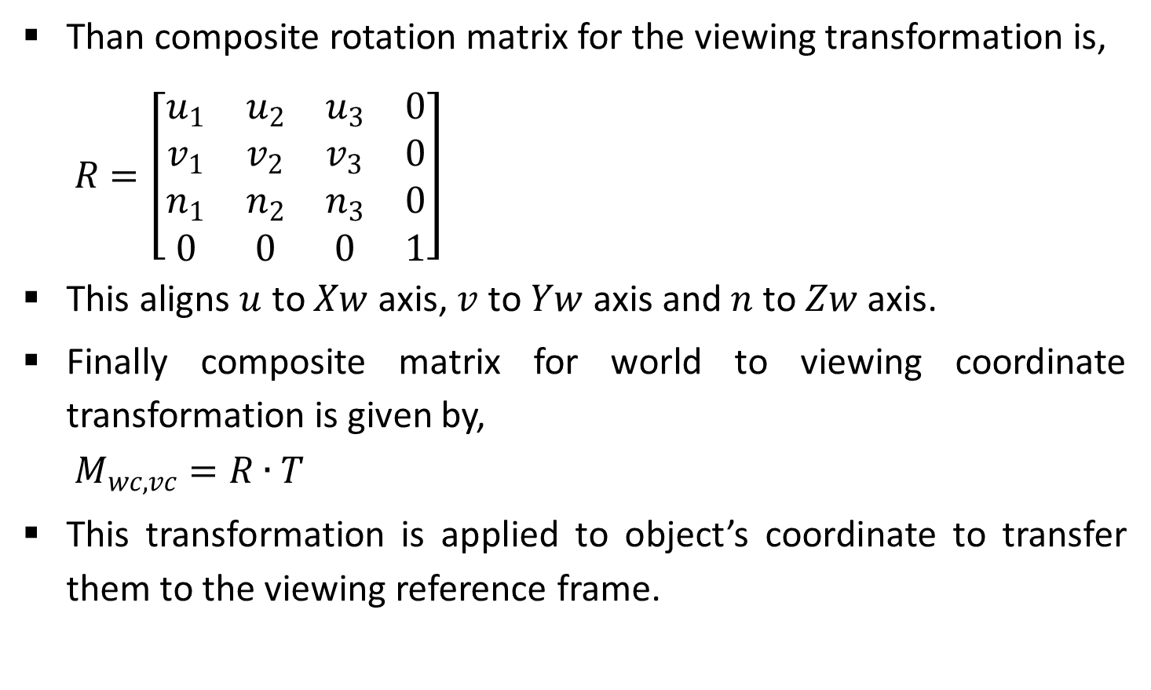
Contd.
Than composite rotation matrix for the viewing transformation is,
$$R=\left[\begin{matrix}u_{1} & u_{2} & u_{3} & 0 \\ v_{1} & v_{2} & v_{3} & 0 \\ n_{1} & n_{2} & n_{3} & 0 \\ 0 & 0 & 0 & 1\end{matrix}\right]$$
This aligns $u$ to $Xw$ axis, $v$ to $Yw$ axis and $n$ to $Zw$ axis.
Finally composite matrix for world to viewing coordinate transformation is given by,
$$M_{wc,vc}=R∙T$$
This transformation is applied to object’s coordinate to transfer them to the viewing reference frame.

Slide 43
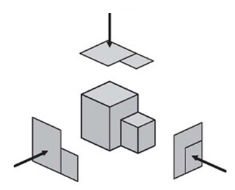
Projections
Process of converting three-dimensional coordinates into two-dimensional scene is known as projection.
There are two projection methods namely,
Parallel Projection.
Perspective Projection.

Slide 44




Parallel Projections
In a parallel projection, coordinate positions are transformed to the view plane along parallel lines.
We can specify a parallel projection with a projection vector that defines the direction for the projection lines.
It is further divide into two types,
Orthographic parallel projection.
Oblique parallel projection.
View Plane
$$p_{1}$$
$${p_{1}}^{′}$$
$$p_{2}$$
$${p_{2}}^{′}$$

Slide 45
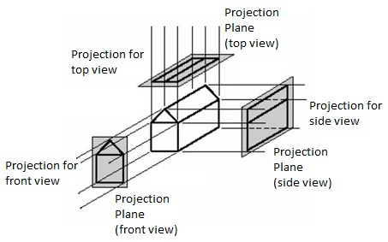
Orthographic Parallel Projection
When the projection lines are perpendicular to the view plane, we have an orthographic parallel projection.
Orthographic projections are most often used to produce the front, side, and top views of an object.

Slide 46
Contd.
Engineering and architectural drawings commonly use orthographic projections.
We can also form orthographic projections that display more than one face of an object.
Such view are called axonometric orthographic projections. Very good example of it is Isometric projection.
Transformation equations for an orthographic parallel projection are straight forward.

Slide 47


Contd.
If the view plane is placed at position $zvp$ along the $zv$ axis.
Then any point $(x, y, z)$in viewing coordinates is transformed to projection coordinates as,
$$x_{p}=x, y_{p}=y$$
Original $z$-coordinate value is preserved for the depth information.
$$(X, Y, Z)$$
Yv
(X,Y)
Xv
Zv

Slide 48


Oblique Parallel Projection
An oblique projection is obtained by projecting points along parallel lines that are not perpendicular to the projection plane.
$(X,Y,Z)$ is a point of which we are taking oblique projection $(Xp,Yp)$ on the view plane and point $(X,Y)$ on view plane is orthographic projection of $(X,Y,Z)$.
Now from figure using trigonometric rules we can write,
$$x_{p}=x+L\cos{∅}$$
$$y_{p}=y+L\sin{∅}$$
Yv
(Xp, Yp)
$$(X,Y,Z)$$
α
L
Φ
Xv
(X,Y)
Zv

Slide 49


Contd.
Length $L$ depends on the angle $α$ and the $z$ coordinate of the point to be projected,
$$\tan{α}=\frac{Z}{L}$$
$$L=\frac{Z}{\tan{α}}$$
$$L=ZL_{1 }, Where L_{1 }=\frac{1}{\tan{α}}$$
Now put the value of $L$ in projection equation.
$$x_{p}=x+ZL_{1 }\cos{∅}$$
$$y_{p}=y+ZL_{1 }\sin{∅}$$
Yv
(Xp, Yp)
$$(X,Y,Z)$$
α
L
Φ
Xv
(X,Y)
Zv

Slide 50

Contd.
Transformation matrix for this equation,
$M_{parallel}=\left[\begin{matrix}1 & 0 & L_{1 }\cos{∅} & 0 \\ 0 & 1 & L_{1 }\sin{∅} & 0 \\ 0 & 0 & 0 & 0 \\ 0 & 0 & 0 & 1\end{matrix}\right]$
This equation can be used for any parallel projection.
For orthographic projection L₁=0 and so whole term which is multiply with z component is zero.
When value of $\tan{α}=1$ projection is known as Cavalier projection.
When value of $\tan{α}=2$ projection is known as Cabinet projection.

Slide 51




Perspective Projection
In perspective projection object positions are transformed to the view plane along lines that converge to a point called the projection reference point (or center of projection or vanishing point).
View Plane
$$p_{1}$$
$${p_{1}}^{′}$$
$$p_{2}$$
$${p_{2}}^{′}$$
Projection Reference Point

Slide 52






Contd.
Suppose we set the projection reference point at position $zprp$ along the $zv$ axis.
We place the view plane at $zvp$ as shown in Figure above.
We can write equations describing coordinate positions along this perspective projection line in parametric form as,
$$x^{′}=x−xu$$
$$y^{′}=y−yu$$
$$z^{′}=z−(z−z_{prp})u$$
Here parameter $u$ takes the value from $0 to 1$, which is depends on the position of object, view plane, and projection reference point.
$$P=(x,y,z)$$
$$(x_{p},y_{p},z_{vp})$$
$$z_{vp}$$
$$z_{prp}$$
$$z_{v}$$
View Plane

Slide 53

Contd.
For obtaining value of $u$ we will put $z’=zvp$and solve equation of $z’$.
$$z^{′}=z−(z−z_{prp})u$$
$$z_{vp}=z−(z−z_{prp})u$$
$$u=\frac{z_{vp}−z}{z_{prp}−z}$$
Now substituting value of $u$ in equation of $x’$ and $y’$ we will obtain,
$$x_{p}=x\left(\frac{z_{prp}−z_{vp}}{z_{prp}−z}\right)=x\left(\frac{d_{p}}{z_{prp}−z}\right)$$
$$y_{p}=y\left(\frac{z_{prp}−z_{vp}}{z_{prp}−z}\right)=y\left(\frac{d_{p}}{z_{prp}−z}\right), Where d_{p}=z_{prp}−z_{vp}$$

Slide 54

Contd.
Using 3D homogeneous-coordinate representations, we can write the perspective projection transformation matrix form as,
$$\left[\begin{matrix}x_{h} \\ y_{h} \\ z_{h} \\ h\end{matrix}\right]=\left[\begin{matrix}1 & 0 & 0 & 0 \\ 0 & 1 & 0 & 0 \\ 0 & 0 & −{z_{vp}}/{d_{p}} & z_{vp}\left({z_{prp}}/{d_{p}}\right) \\ 0 & 0 & −1/{d_{p}} & {z_{prp}}/{d_{p}}\end{matrix}\right]∙\left[\begin{matrix}x \\ y \\ z \\ 1\end{matrix}\right]$$
In this representation, the homogeneous factor is,
$$h=\frac{z_{prp}−z}{d_{p}} and$$
$$x_{p}={x_{h}}/h and y_{p}={y_{h}}/h$$

Slide 55

Contd.
There are number of special cases for the perspective transformation equations.
If view plane is taken to be $uv$ plane, then $z_{vp}=0$and the projection coordinates are,
$$x_{p}=x\left(\frac{z_{prp}}{z_{prp}−z}\right)=x\left(\frac{1}{1−z/{z_{prp}}}\right)$$
$$y_{p}=y\left(\frac{z_{prp}}{z_{prp}−z}\right)=y\left(\frac{1}{1−z/{z_{prp}}}\right)$$

Slide 56

Contd.
If we take projection reference point at origin than $z_{prp}=0$ and the projection coordinates are,
$$x_{p}=x\left(\frac{z_{vp}}{z}\right)=x\left(\frac{1}{z/{z_{vp}}}\right)$$
$$y_{p}=y\left(\frac{z_{vp}}{z}\right)=y\left(\frac{1}{z/{z_{vp}}}\right)$$

Slide 57
Contd.
The vanishing point for any set of lines that are parallel to one of the principal axes of an object is referred to as a principal vanishing point.
With the orientation of the projection plane, and perspective projections are accordingly classified as,
One-point
Two-point
Three-point projections.
The number of principal vanishing points in a projection is determined by the number of principal axes intersecting the view plane.

Slide 58


View Volumes and General Projection Transformations
Parallelpiped View Volume
Frustum View Volume
$$Zv$$
Window
Window
$$Zv$$
Back Plane
Front Plane
Back Plane
Projection Reference Point
Front Plane
(a) Parallel Projection
(b) Perspective Projection

Slide 59
Contd.
Based on view window we can generate different image of the same scene.
Volume which is appears on the display is known as view volume.
Given the specification of the view window, we can set up a view volume using the window boundaries.
Only those objects within the view volume will appear in the generated display on an output device, all others are clipped from the display.
The size of the view volume depends on the size of the window.
Shape of the view volume depends on the type of projection to be used to generate the display.

Slide 60

Contd.
A finite view volume is obtained by limiting the extent of the volume in the $zv$ direction.
This is done by specifying positions for one or two additional boundary planes.
These $zv$-boundary planes are referred to as the front plane and back plane, or the near plane and the far plane, of the viewing volume.
Orthographic parallel projections are not affected by view-plane positioning.
Because the projection lines are perpendicular to the view plane regardless of its location.

Slide 61

General Parallel-Projection Transformation
Oblique projections may be affected by view-plane positioning, depending on how the projection direction is to be specified.
Obtain transformation matrix for parallel projection which is applicable to both orthographic as well as oblique projection.
parallel projection is specified with a projection vector from the projection reference point to the view window.
Window
N
$$Zv$$
View Volume
Vp

Slide 62



Contd.
Now we will apply shear transformation
View volume will convert into regular parallelepiped and projection vector will become parallel to normal vector $N$.
Let’s consider projection vector $V_{p}=(p_{x},p_{y},p_{z})$.
We need to determine the elements of a shear matrix
That will align the projection vector $V_{p}$ with the view plane normal vector $N$. This transformation can be expressed as,
$${V_{p}}^{′}=M_{parallel}∙V_{p}$$
Window
N
$$Zv$$
View Volume
$$V’p$$

Slide 63

Contd.
$${V_{p}}^{′}=\left[\begin{matrix}0 \\ 0 \\ p_{z} \\ 1\end{matrix}\right]$$
where$M_{parallel}$is equivalent to the parallel projection matrix and represents a $z−axis$ shear of the form,
$$M_{parallel}=\left[\begin{matrix}1 & 0 & a & 0 \\ 0 & 1 & b & 0 \\ 0 & 0 & 1 & 0 \\ 0 & 0 & 0 & 1\end{matrix}\right]$$

Slide 64

Contd.
Now from above equation we can write,
$$\left[\begin{matrix}0 \\ 0 \\ p_{z} \\ 1\end{matrix}\right]=\left[\begin{matrix}1 & 0 & a & 0 \\ 0 & 1 & b & 0 \\ 0 & 0 & 1 & 0 \\ 0 & 0 & 0 & 1\end{matrix}\right]∙\left[\begin{matrix}p_{x} \\ p_{y} \\ p_{z} \\ 1\end{matrix}\right]$$
From matrix we can write,
$$0=p_{x}+ap_{z}$$
$$0=p_{y}+bp_{z}$$
So
$$a=\frac{−p_{x}}{p_{z}} , b=\frac{−p_{y}}{p_{z}}$$

Slide 65

Contd.
Thus, we have the general parallel-projection matrix in terms of the elements of the projection vector as,
$$M_{parallel}=\left[\begin{matrix}1 & 0 & \frac{−p_{x}}{p_{z}} & 0 \\ 0 & 1 & \frac{−p_{y}}{p_{z}} & 0 \\ 0 & 0 & 1 & 0 \\ 0 & 0 & 0 & 1\end{matrix}\right]$$
For an orthographic parallel projection, $px = py = 0$, and is the identity matrix.

Slide 66


General Perspective-Projection Transformations
The projection reference point can be located at any position in the viewing system, except on the view plane or between the front and back clipping planes.
Frustum Centerline
$$Zv$$
View Volume
View Plane
Center of Window
$$(Xprp, Yprp, Zprp)$$

Slide 67



Contd.
We can obtain the general perspective-projection transformation with the following two operations,
Shear the view volume so that the center line of the frustum is perpendicular to the view plane.
Scale the view volume with a scaling factor that depends on $1/z$.
Frustum Centerline
$$(X’’, Y’’, Z’’)$$
(X’, Y’, Z’)
View Plane ($z=zvp$)
Center of Window
(Xprp, Yprp, Zprp)

Slide 68

Contd.
With the projection reference point at a general position $(Xprp, Yprp, Zprp)$the transformation involves a combination of $z−axis$ shear and a translation,
$$M_{shear}=\left[\begin{matrix}1 & 0 & a & −az_{prp} \\ 0 & 1 & b & −bz_{prp} \\ 0 & 0 & 1 & 0 \\ 0 & 0 & 0 & 1\end{matrix}\right]$$
Where the shear parameters are,
$$a=−\frac{x_{prp}−\frac{{xw}_{min}+{xw}_{max}}{2}}{z_{prp}}, \& b=−\frac{y_{prp}−\frac{{yw}_{min}+{yw}_{max}}{2}}{z_{prp}}$$

Slide 69

Contd.
Points within the view volume are transformed by this operation as,
$$x^{′}=x+a(z−z_{prp})$$
$$y^{′}=y+b(z−z_{prp})$$
$$z^{′}=z$$
After shear we apply scaling operation. Equation for that are,
$$x^{′′}=x^{′}\left(\frac{z_{prp}−z_{vp}}{z_{prp}−z}\right)+x_{prp}\left(\frac{z_{vp}−z}{z_{prp}−z}\right)$$
$$y^{′′}=y^{′}\left(\frac{z_{prp}−z_{vp}}{z_{prp}−z}\right)+y_{prp}\left(\frac{z_{vp}−z}{z_{prp}−z}\right)$$

Slide 70

Contd.
Homogeneous matrix for this transformation is,
$$M_{scale}=\left[\begin{matrix}1 & 0 & \frac{−x_{prp}}{z_{prp}−z_{vp}} & \frac{x_{prp}z_{vp}}{z_{prp}−z_{vp}} \\ 0 & 1 & \frac{−y_{prp}}{z_{prp}−z_{vp}} & \frac{y_{prp}z_{vp}}{z_{prp}−z_{vp}} \\ 0 & 0 & 1 & 0 \\ 0 & 0 & \frac{−1}{z_{prp}−z_{vp}} & \frac{z_{prp}}{z_{prp}−z_{vp}}\end{matrix}\right]$$
Therefore the general perspective-projection transformation is obtained by equation,
$$M_{perspective}=M_{scale}∙M_{shear}$$

Slide 71
Thank You

