Slide 1
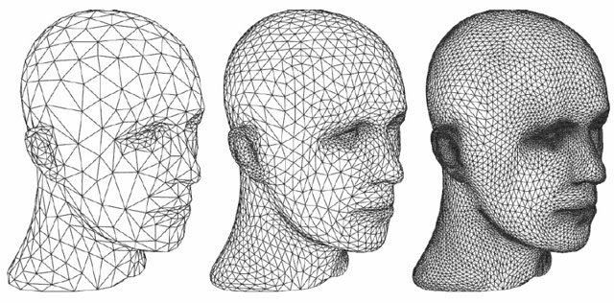
Unit-6 Advance Topics
Computer Graphics
(2160703)
Prof. Vijay Shekhat
M: 9727235778
E-mail: vijay.shekhat@darshan.ac.in
Computer Engineering Darshan Institute of Engineering & Technology

Slide 2
Outline
Classification of Visible-Surface Detection Algorithms
Back-Face Detection
Depth Buffer Method/ Z Buffer Method
Light source
Basic Illumination Models/ Shading Model/ Lighting Model
Ambient Light
Diffuse Reflection
Specular Reflection and the Phong Model
Properties of Light
Color Model

Slide 3
Classification of Visible-Surface Detection Algorithms
It is broadly divided into two parts,
Object-Space methods
Image-Space methods
Object space method compares objects and parts of objects to each other within the scene definition to determine which surface is visible.
Image space algorithm visibility is decided point by point at each pixel position on the projection plane.

Slide 4
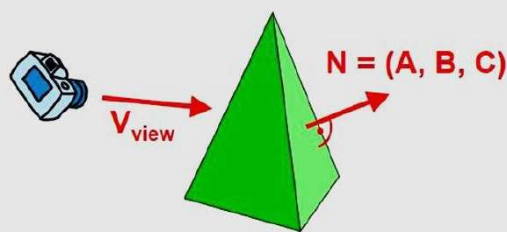
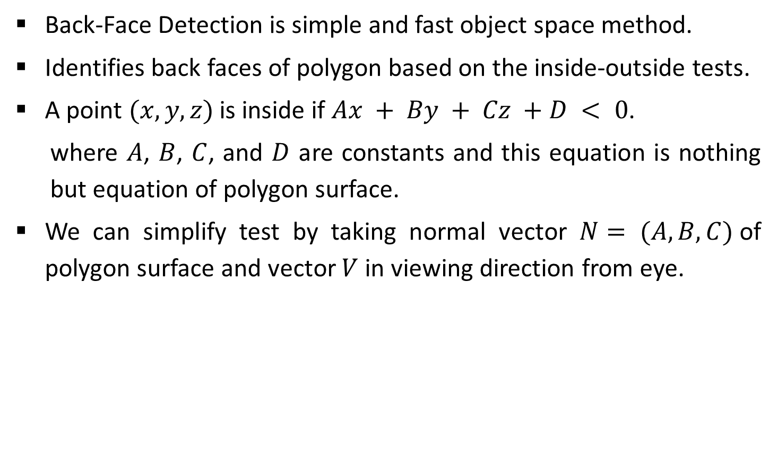
Back-Face Detection
Back-Face Detection is simple and fast object space method.
Identifies back faces of polygon based on the inside-outside tests.
A point $(x, y, z)$is inside if $Ax + By + Cz +D < 0$.
where $A$, $B$, $C$, and $D$ are constants and this equation is nothing but equation of polygon surface.
We can simplify test by taking normal vector $N= (A, B, C)$of polygon surface and vector $V$ in viewing direction from eye.
Source: www.tutorialspoint.com

Slide 5
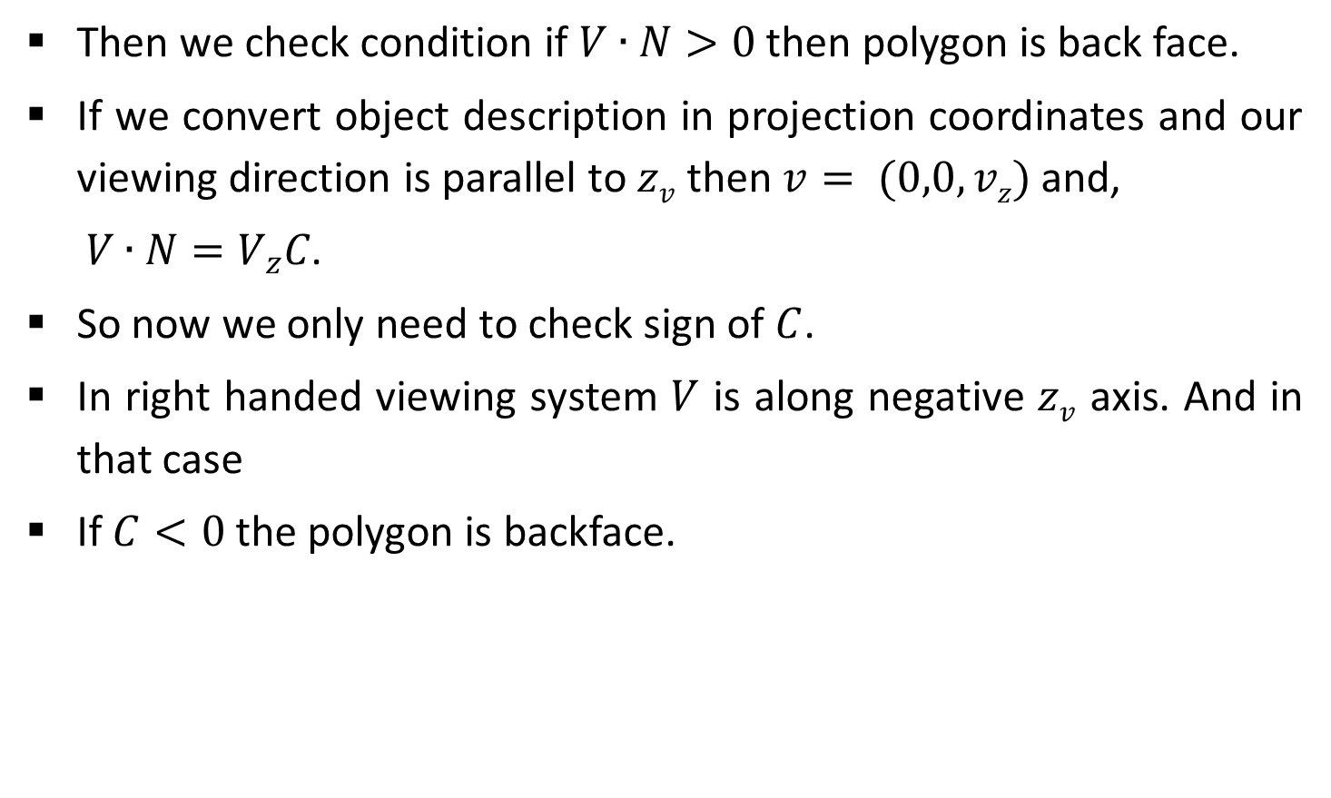
Contd.
Then we check condition if $V∙N>0$ then polygon is back face.
If we convert object description in projection coordinates and our viewing direction is parallel to $zv$ then $v= (0,0,vz)$and,
$V∙N=V_{z}C$.
So now we only need to check sign of $C$.
In right handed viewing system $V$ is along negative $zv$ axis. And in that case
If $C<0$ the polygon is backface.
Source: www.tutorialspoint.com

Slide 6
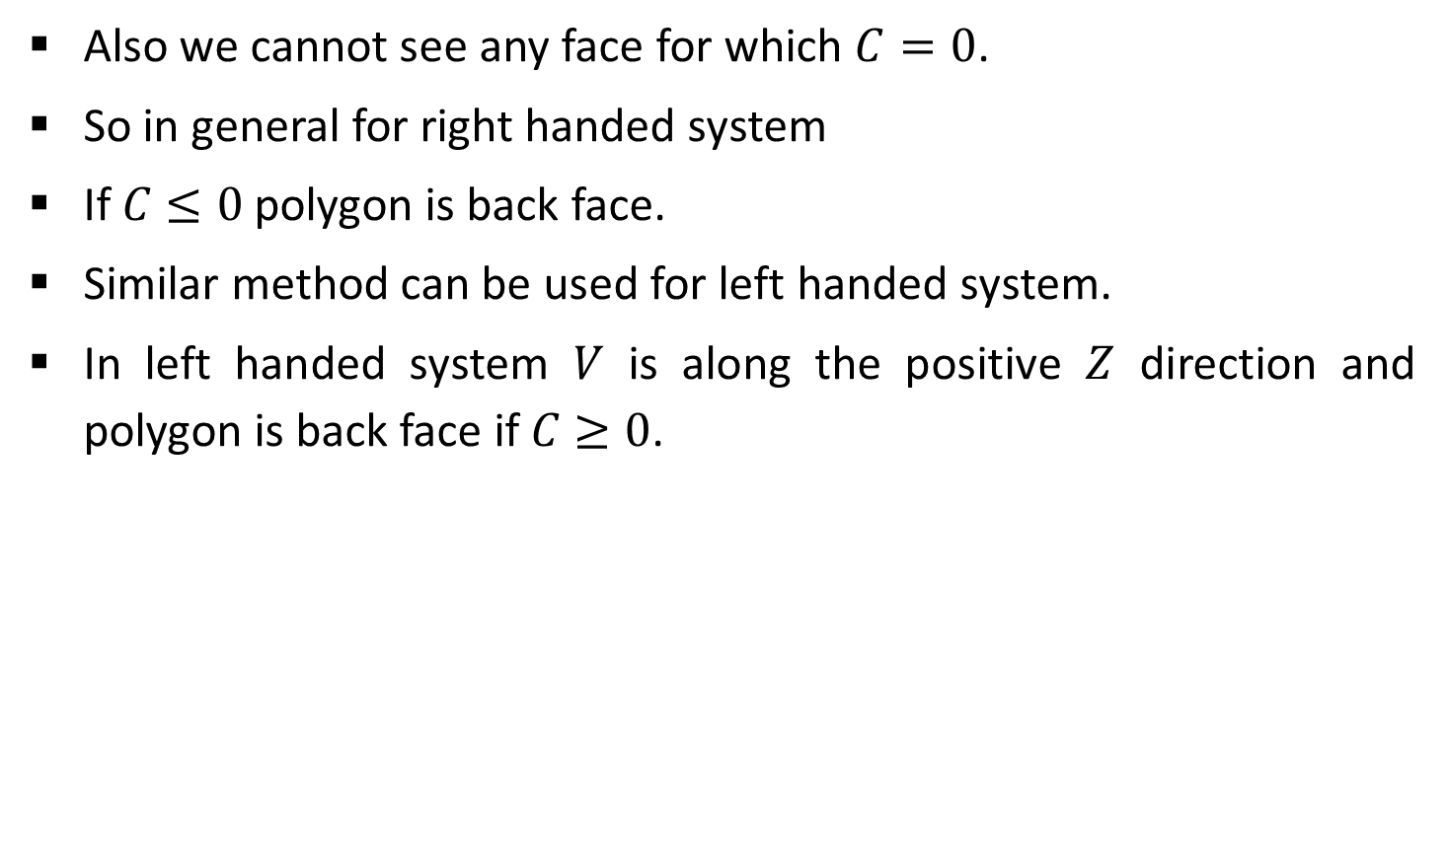
Contd.
Also we cannot see any face for which $C=0$.
So in general for right handed system
If $C≤0$ polygon is back face.
Similar method can be used for left handed system.
In left handed system $V$ is along the positive $Z$ direction and polygon is back face if$C≥0$.
Source: www.tutorialspoint.com

Slide 7
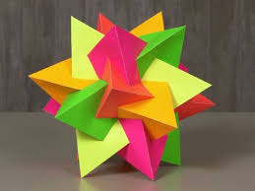

Contd.
For a single convex polyhedron such as the pyramid by examining parameter $C$ for the different plane we identify back faces.
So far the scene contains only non overlapping convex polyhedral, back face method works properly.
For other object such as concave polyhedron we need to do more tests for determining back face.
Source: www.pinterest.com

Slide 8
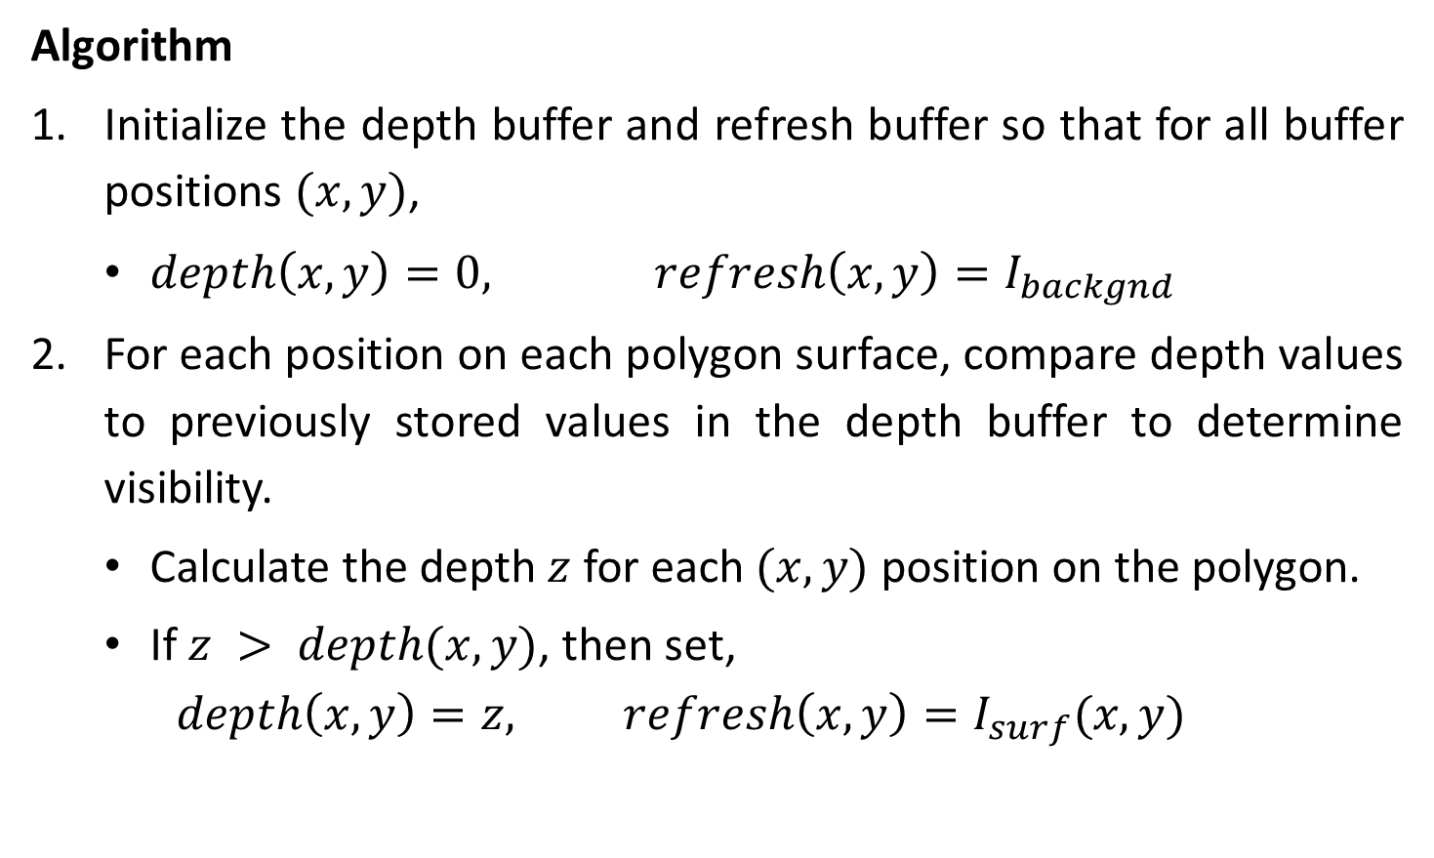
Depth Buffer Method/ Z Buffer Method
Algorithm
Initialize the depth buffer and refresh buffer so that for all buffer positions $(x, y)$,
$depth\left(x,y\right)=0, refresh\left(x,y\right)=I_{backgnd}$
For each position on each polygon surface, compare depth values to previously stored values in the depth buffer to determine visibility.
Calculate the depth $z$ for each $(x, y)$ position on the polygon.
If $z > depth(x, y)$, then set,
$$depth\left(x,y\right)=z, refresh\left(x,y\right)=I_{surf}(x,y)$$

Slide 9







Contd.
It is image space approach.
It compares surface depth at each pixel position on the projection plane.
It is also referred to as $z$-buffer method since generally depth is measured in z-direction.
Each surface of the scene is process separately one point at a time across the surface.
$$S_{3}$$
$$S_{2}$$
$$S_{1}$$
$$Y_{v}$$
(X, Y)
$$X_{v}$$
$$Z_{v}$$

Slide 10
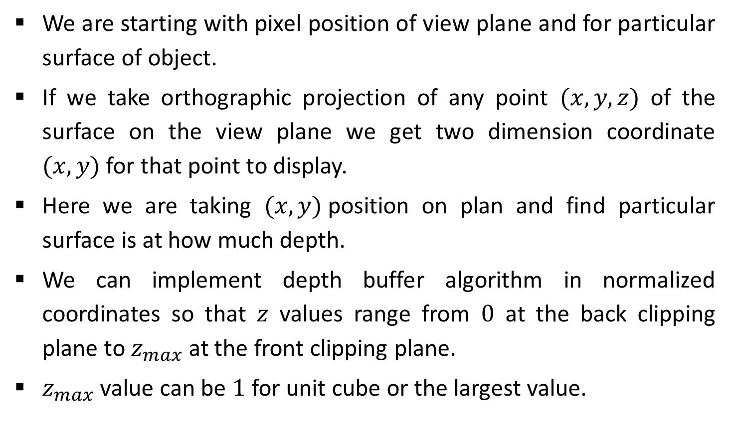
Contd.
We are starting with pixel position of view plane and for particular surface of object.
If we take orthographic projection of any point $(x,y,z)$ of the surface on the view plane we get two dimension coordinate $(x,y)$for that point to display.
Here we are taking $(x, y)$position on plan and find particular surface is at how much depth.
We can implement depth buffer algorithm in normalized coordinates so that $z$ values range from $0$ at the back clipping plane to $z_{max}$ at the front clipping plane.
$z_{max}$ value can be $1$ for unit cube or the largest value.

Slide 11
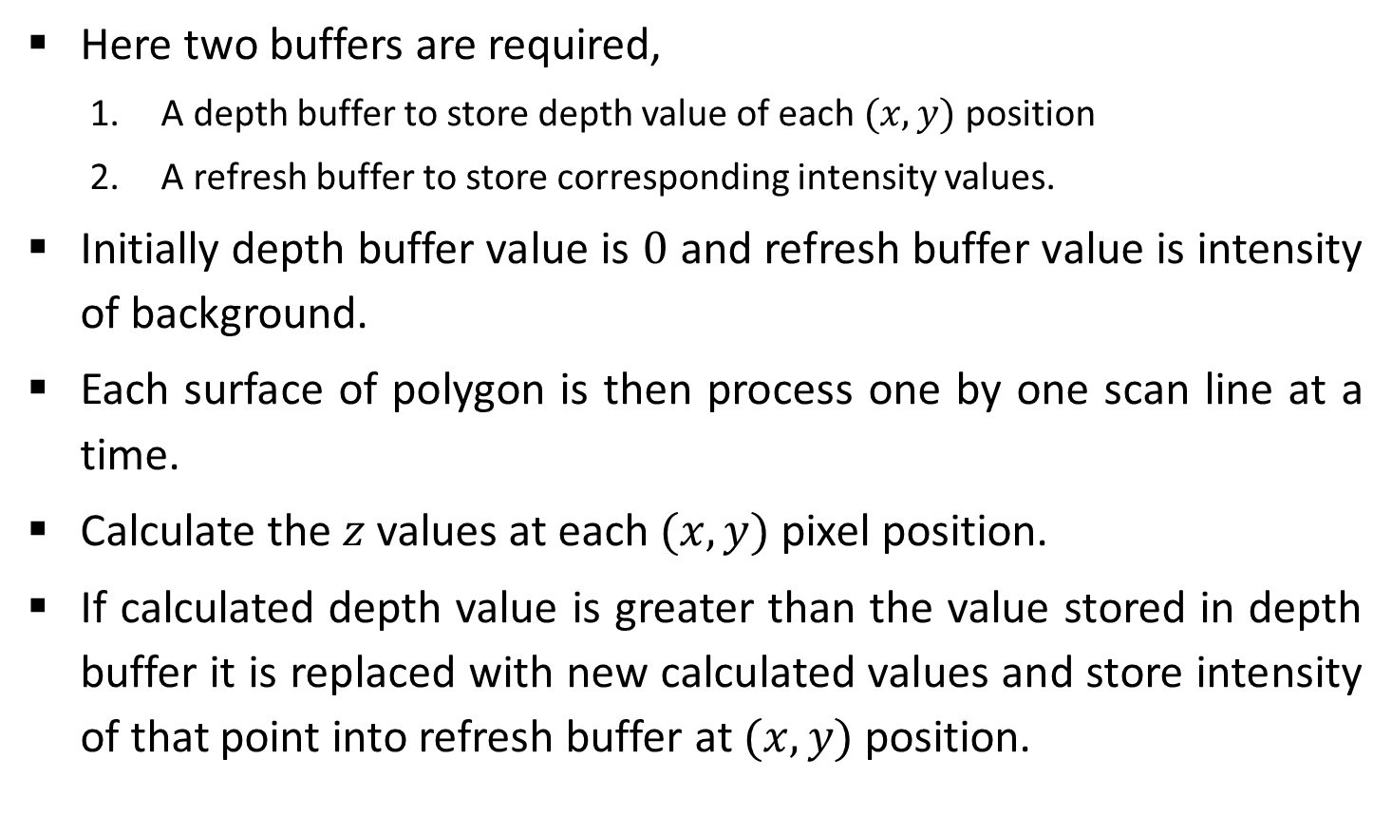
Contd.
Here two buffers are required,
A depth buffer to store depth value of each $(x,y)$position
A refresh buffer to store corresponding intensity values.
Initially depth buffer value is $0$ and refresh buffer value is intensity of background.
Each surface of polygon is then process one by one scan line at a time.
Calculate the $z$ values at each $(x,y)$ pixel position.
If calculated depth value is greater than the value stored in depth buffer it is replaced with new calculated values and store intensity of that point into refresh buffer at $(x,y)$position.

Slide 12



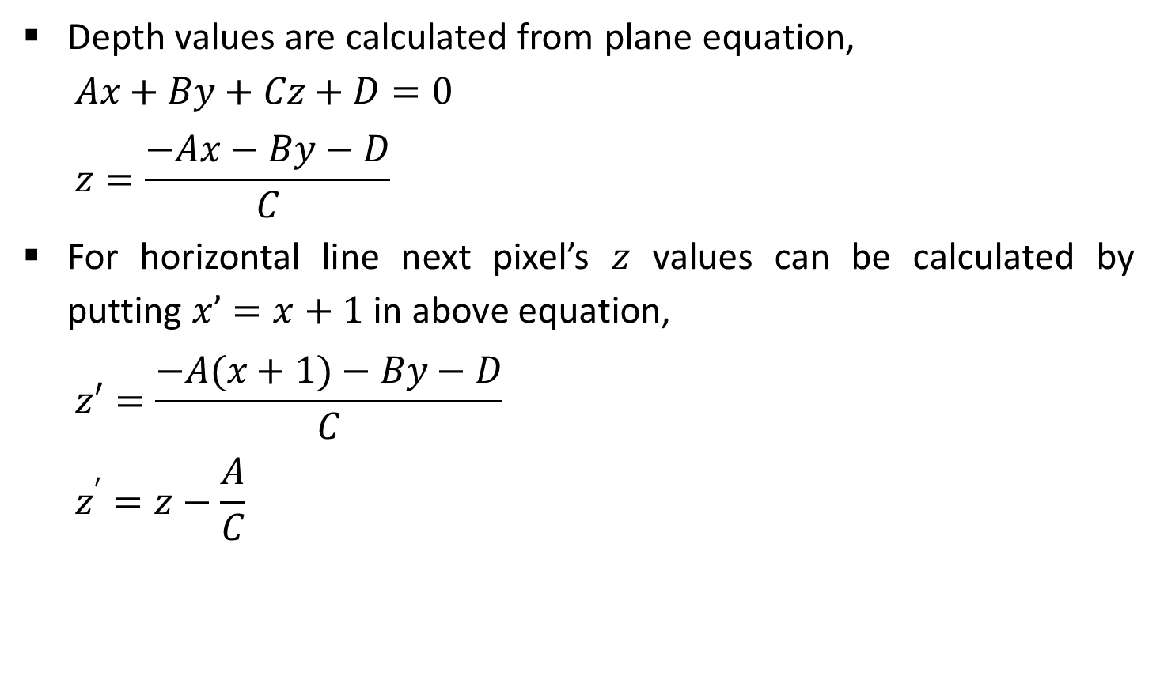



Contd.
Depth values are calculated from plane equation,
$$Ax+By+Cz+D=0$$
$$z=\frac{−Ax−By−D}{C}$$
For horizontal line next pixel’s $z$ values can be calculated by putting $x’=x+1$in above equation,
$$z′=\frac{−A(x+1)−By−D}{C}$$
$$z^{′}=z−\frac{A}{C}$$
$$Y axis$$
$$y$$
$$y−1$$
$$X axis$$
$$x$$
$x$+1

Slide 13

Contd.
For vertical line pixel below the current pixel has $y’=y−1$so it’s $z$ values can be calculated as follows,
$$z′=\frac{−Ax−B(y−1)−D}{C}$$
$$z^{′}=z+\frac{B}{C}$$
$$Y axis$$
$$y$$
$$y−1$$
$$X axis$$
$$x$$
$x$+1

Slide 14
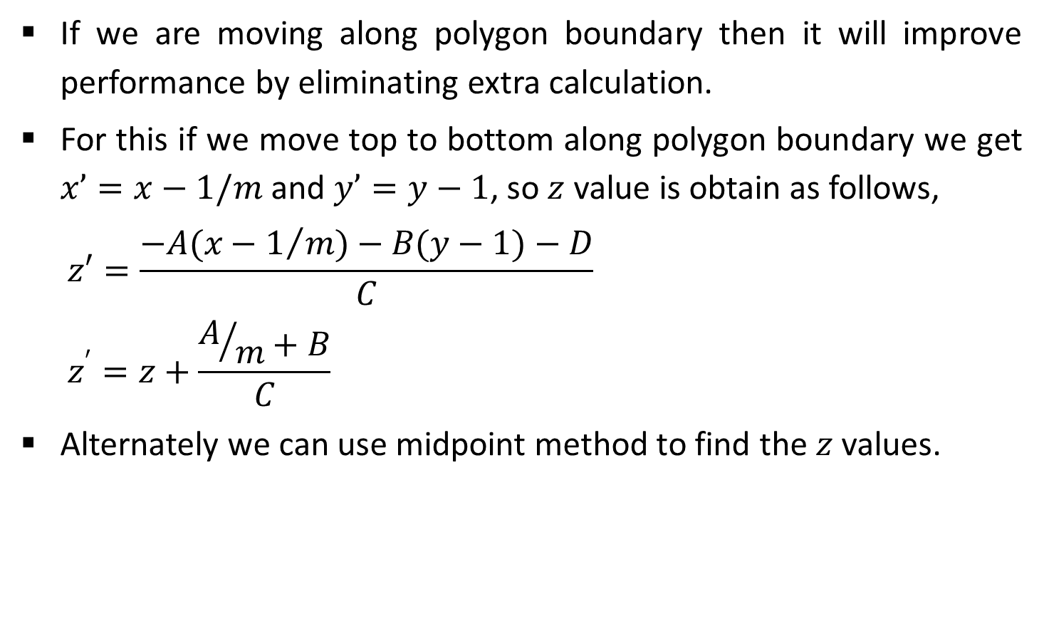
Contd.
If we are moving along polygon boundary then it will improve performance by eliminating extra calculation.
For this if we move top to bottom along polygon boundary we get $x’=x−1/m$and $y’=y−1$, so $z$ value is obtain as follows,
$$z′=\frac{−A(x−1/m)−B(y−1)−D}{C}$$
$$z^{′}=z+\frac{A/m+B}{C}$$
Alternately we can use midpoint method to find the $z$ values.

Slide 15
Light Source
When we see any object we see reflected light from that object.
Total reflected light is the sum of contribution from all sources and reflected light from other object that falls on the object.
So that the surface which is not directly exposed to light may also visible if nearby object is illuminated.
The simplest model for light source is point source.
Rays from the source then follows radial diverging paths from the source position.

Slide 16
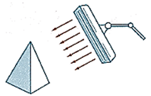
Contd.
This light source model is reasonable approximation for source,
whose size is small compared to the size of object
may be at sufficient distance so that we can see it as point source.
For example sun can be taken as point source on earth.
A nearby source such as the long fluorescent light is more accurately modelled as a distributed light source.
In this case the illumination effects cannot be approximated with point source because the area of the source is not small compare to the size of object.

Slide 17
Contd.
When light is falls on the surface the part of the light is reflected and part of the light is absorbed.
Amount of reflected and absorbed light is depends on the property of the object surface.
For example shiny surface reflect more light while dull surface reflect less light.

Slide 18
Basic Illumination Models
It is also known as Shading Model or Lighting Model.
These models give simple and fast method for calculating the intensities of light for various reflections.
Three models we discuss here for light intensity.
Ambient Light
Diffuse Reflection
Specular Reflection

Slide 19
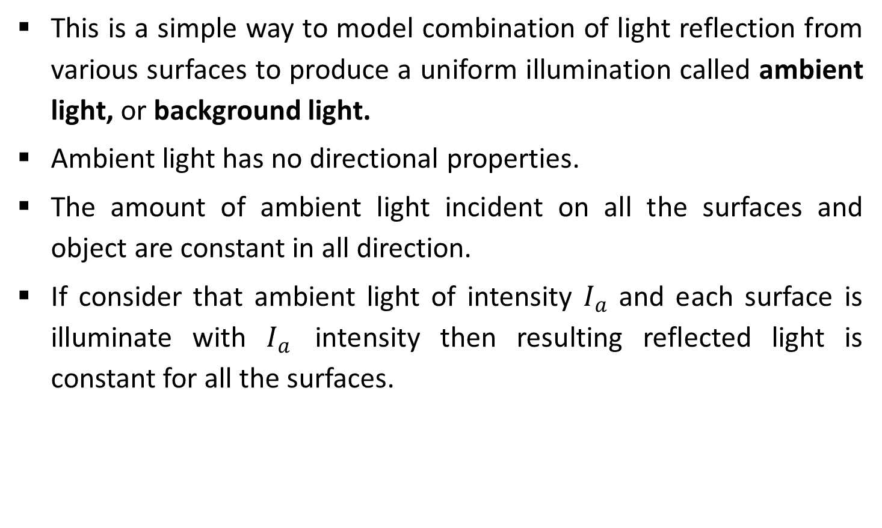
Ambient Light
This is a simple way to model combination of light reflection from various surfaces to produce a uniform illumination called ambient light, or background light.
Ambient light has no directional properties.
The amount of ambient light incident on all the surfaces and object are constant in all direction.
If consider that ambient light of intensity $I_{a}$ and each surface is illuminate with $I_{a}$ intensity then resulting reflected light is constant for all the surfaces.

Slide 20
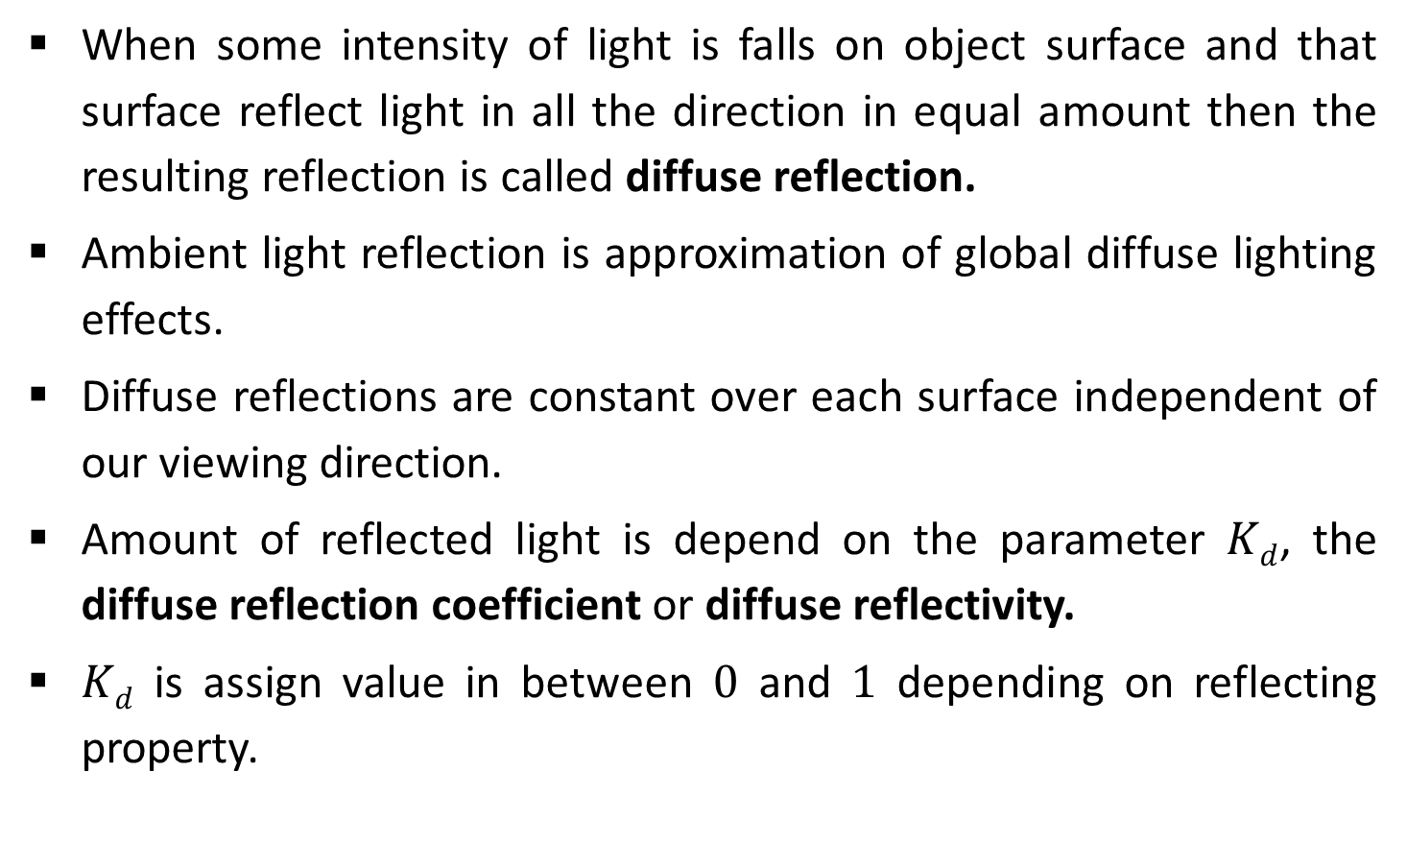
Diffuse Reflection
When some intensity of light is falls on object surface and that surface reflect light in all the direction in equal amount then the resulting reflection is called diffuse reflection.
Ambient light reflection is approximation of global diffuse lighting effects.
Diffuse reflections are constant over each surface independent of our viewing direction.
Amount of reflected light is depend on the parameter $Kd$, the diffuse reflection coefficient or diffuse reflectivity.
$Kd$ is assign value in between $0$ and $1$ depending on reflecting property.

Slide 21
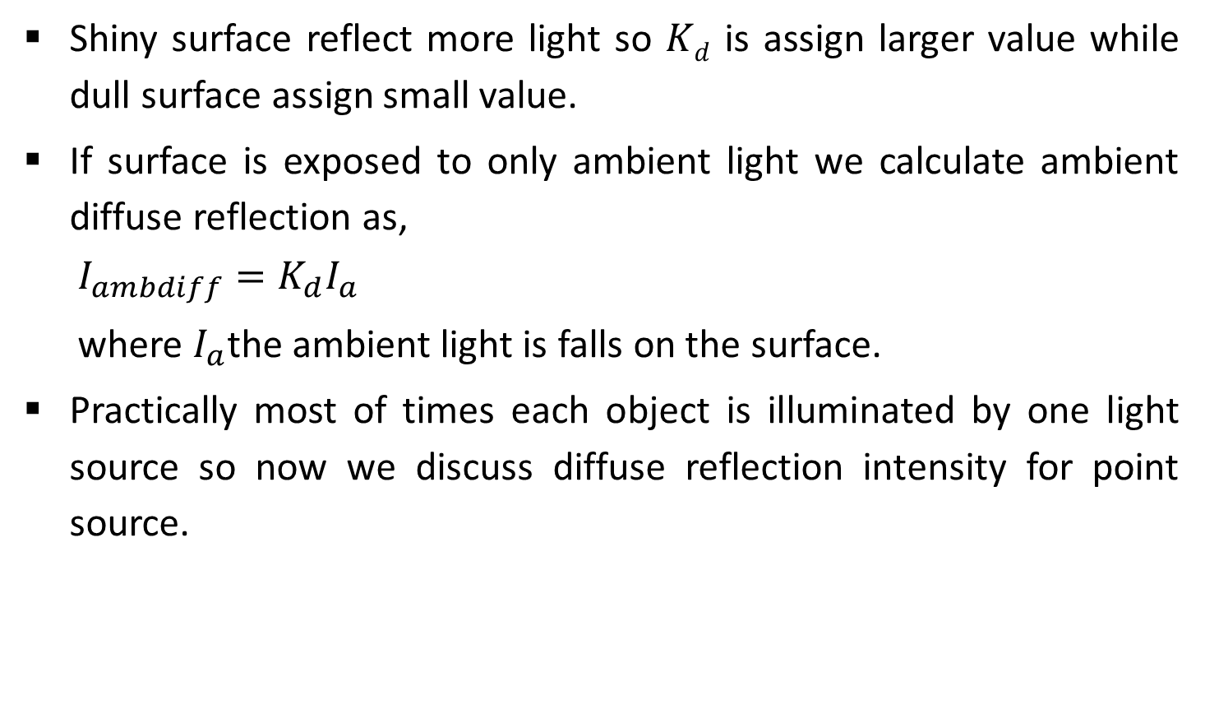
Contd.
Shiny surface reflect more light so $Kd$ is assign larger value while dull surface assign small value.
If surface is exposed to only ambient light we calculate ambient diffuse reflection as,
$$I_{ambdiff}=K_{d}I_{a}$$
where $I_{a}$the ambient light is falls on the surface.
Practically most of times each object is illuminated by one light source so now we discuss diffuse reflection intensity for point source.

Slide 22

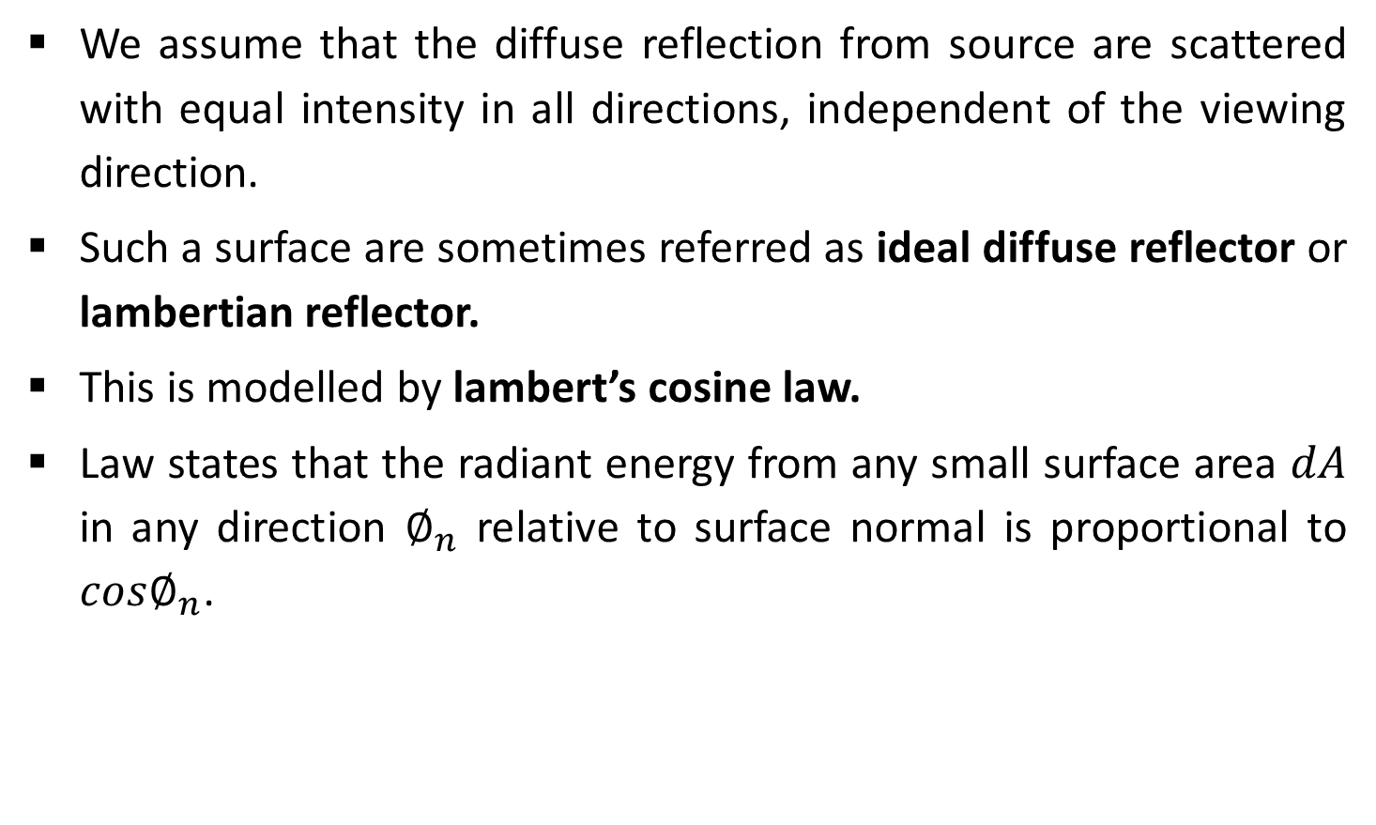
Contd.
We assume that the diffuse reflection from source are scattered with equal intensity in all directions, independent of the viewing direction.
Such a surface are sometimes referred as ideal diffuse reflector or lambertian reflector.
This is modelled by lambert’s cosine law.
Law states that the radiant energy from any small surface area $dA$ in any direction $∅_{n}$ relative to surface normal is proportional to $cos∅_{n}$.
N
Φ_{n}
Radiant energy direction
$$dA$$

Slide 23




Contd.
Reflected light intensity is does not depends on viewing direction.
For lambertian reflection, the intensity of light is same in all viewing direction.
Even though light distribution is equal in all direction for perfect reflector the brightness of a surface does depend on the orientation of the surface relative to light source.
As the angle between surface normal and incidence light direction increases light falls on the surface is decreases
$$N$$
$$θ$$
$$A cosθ$$
Incident Light
$$θ$$

Slide 24

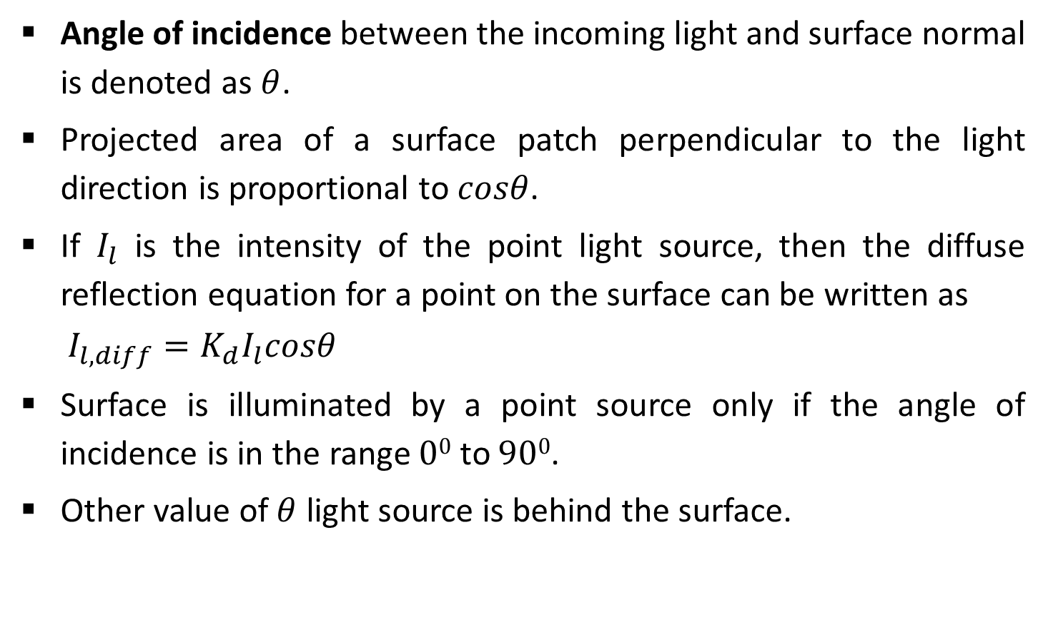



Contd.
Angle of incidence between the incoming light and surface normal is denoted as$θ$.
Projected area of a surface patch perpendicular to the light direction is proportional to $cosθ$.
If $I_{l}$ is the intensity of the point light source, then the diffuse reflection equation for a point on the surface can be written as
$$I_{l,diff}=K_{d}I_{l}cosθ$$
Surface is illuminated by a point source only if the angle of incidence is in the range $00$ to $900$.
Other value of $θ$ light source is behind the surface.
$$N$$
Incident Light
$$θ$$
$$A cosθ$$
$$θ$$

Slide 25

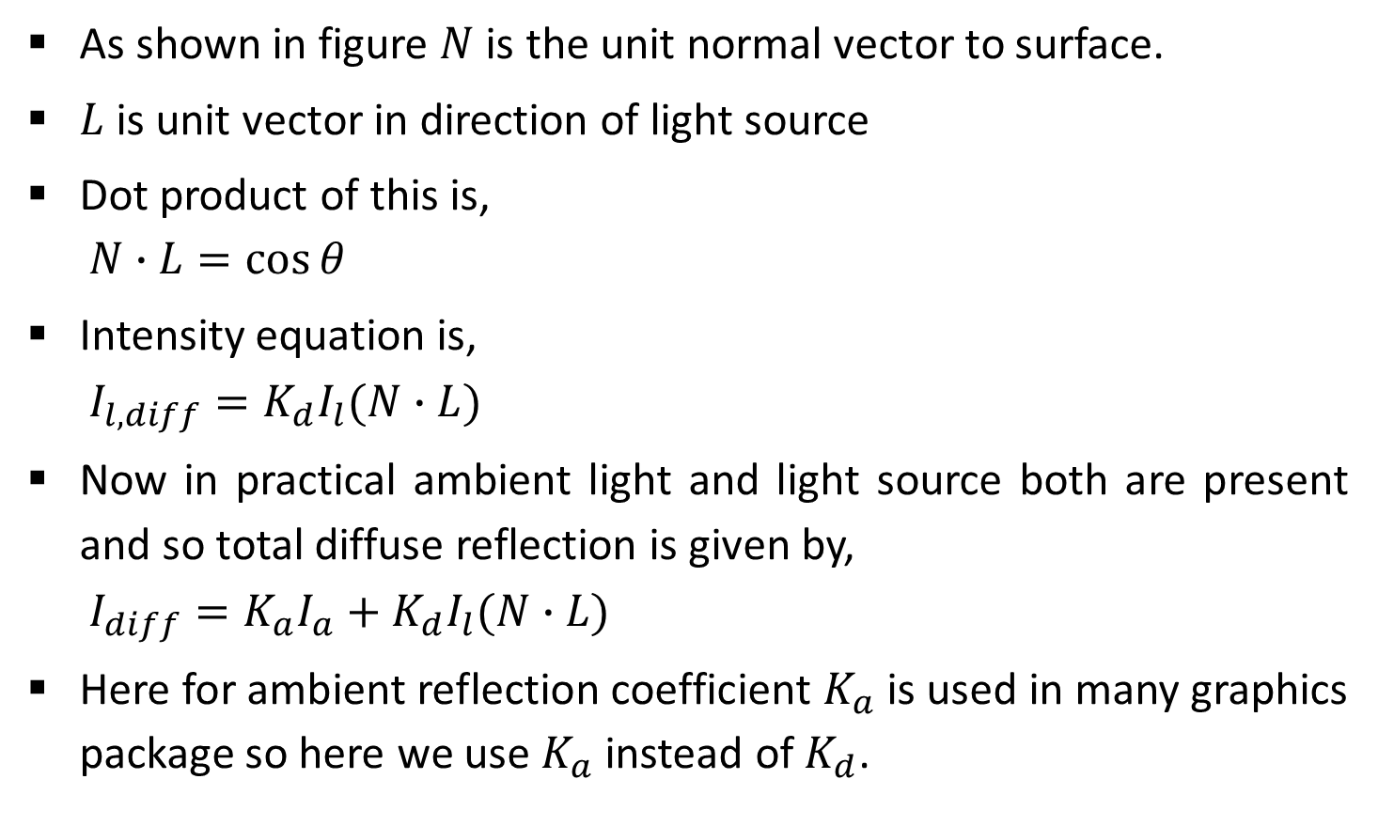


Contd.
As shown in figure $N$ is the unit normal vector to surface.
$L$ is unit vector in direction of light source
Dot product of this is,
$$N∙L=\cos{θ}$$
Intensity equation is,
$$I_{l,diff}=K_{d}I_{l}(N∙L)$$
Now in practical ambient light and light source both are present and so total diffuse reflection is given by,
$$I_{diff}=K_{a}I_{a}+K_{d}I_{l}(N∙L)$$
Here for ambient reflection coefficient $K_{a}$ is used in many graphics package so here we use $K_{a}$ instead of $K_{d}$.
To Light Source
$$N$$
$$L$$
$$θ$$

Slide 26



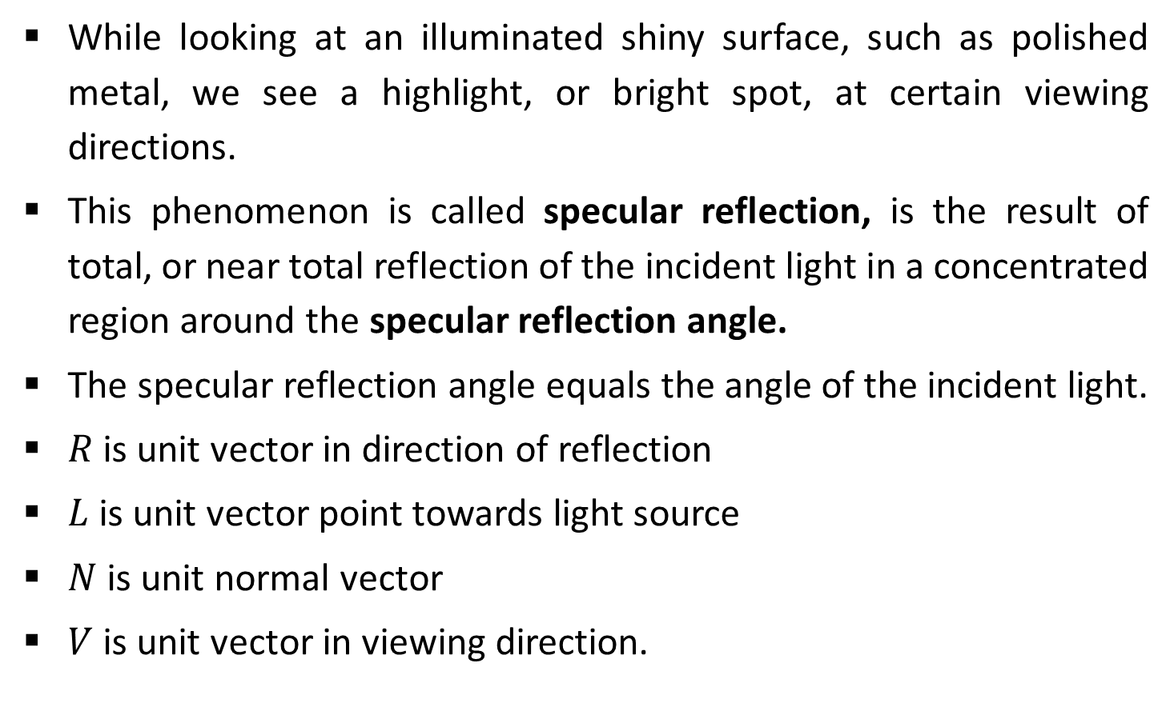




Specular Reflection and the Phong Model
While looking at an illuminated shiny surface, such as polished metal, we see a highlight, or bright spot, at certain viewing directions.
This phenomenon is called specular reflection, is the result of total, or near total reflection of the incident light in a concentrated region around the specular reflection angle.
The specular reflection angle equals the angle of the incident light.
$R$ is unit vector in direction of reflection
$L$ is unit vector point towards light source
$N$ is unit normal vector
$V$ is unit vector in viewing direction.
$$N$$
$$L$$
$$R$$
$$θ$$
$$θ$$
$$∅$$
$$V$$

Slide 27



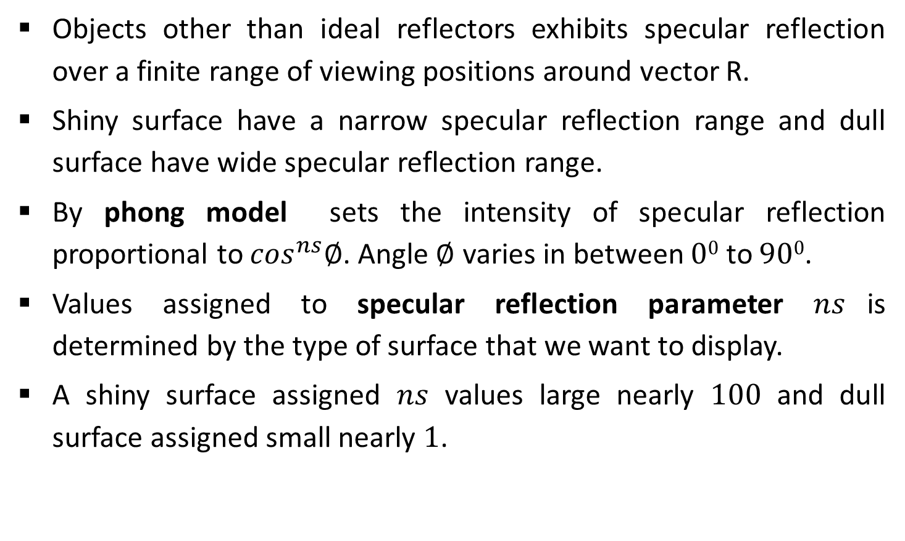




Contd.
Objects other than ideal reflectors exhibits specular reflection over a finite range of viewing positions around vector R.
Shiny surface have a narrow specular reflection range and dull surface have wide specular reflection range.
By phong model sets the intensity of specular reflection proportional to $\cos^{ns}∅$. Angle $∅$ varies in between $00$ to $900$.
Values assigned to specular reflection parameter $ns$is determined by the type of surface that we want to display.
A shiny surface assigned $ns$ values large nearly $100$ and dull surface assigned small nearly $1$.
$$N$$
$$R$$
$$L$$
$$θ$$
$$θ$$
$$∅$$
$$V$$

Slide 28



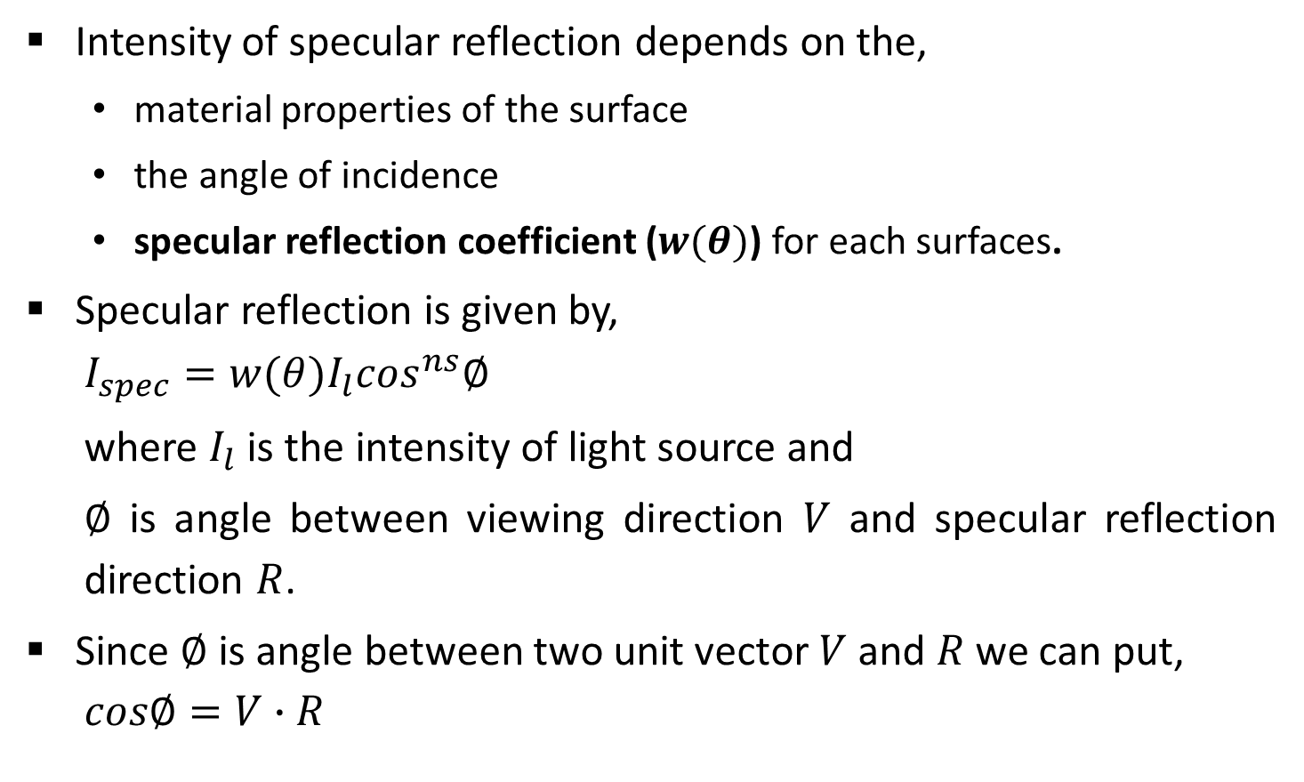




Contd.
Intensity of specular reflection depends on the,
material properties of the surface
the angle of incidence
specular reflection coefficient ($w(θ)$) for each surfaces.
Specular reflection is given by,
$$I_{spec}=w(θ)I_{l}\cos^{ns}∅$$
where $I_{l}$ is the intensity of light source and
$∅$ is angle between viewing direction $V$ and specular reflection direction $R$.
Since $∅$ is angle between two unit vector $V$ and $R$ we can put,
$$cos∅=V∙R$$
$$N$$
$$L$$
$$R$$
$$θ$$
$$θ$$
$$∅$$
$$V$$

Slide 29


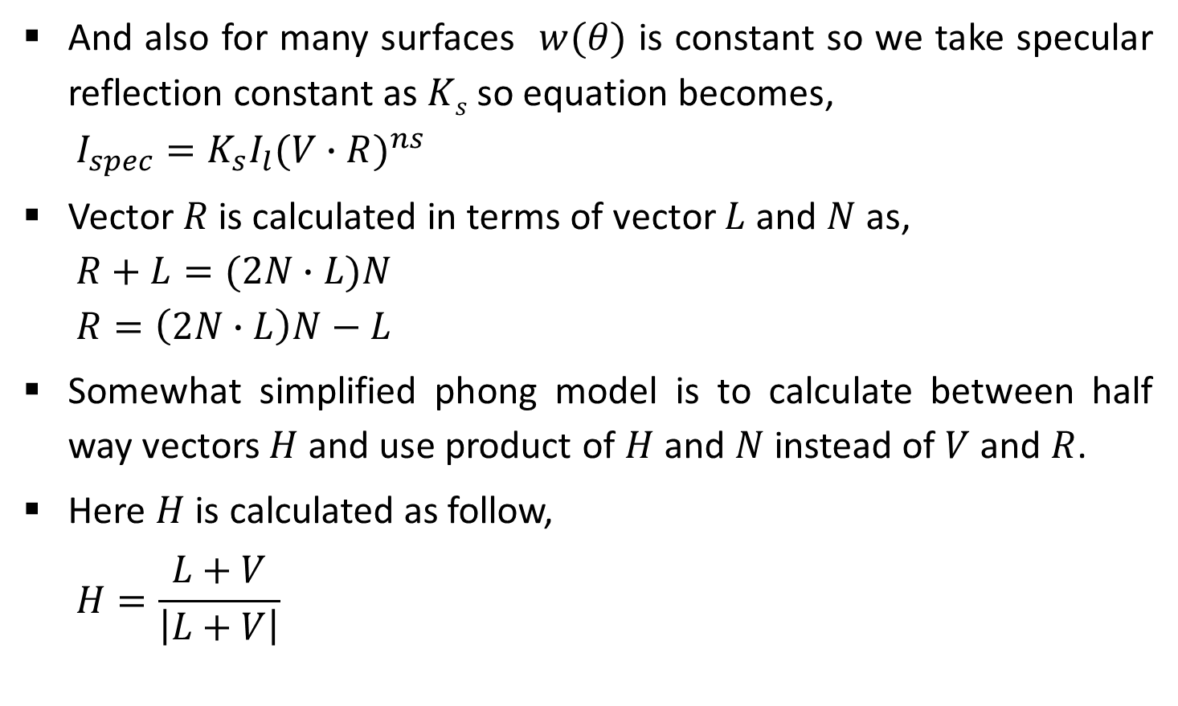



Contd.
And also for many surfaces $w(θ)$ is constant so we take specular reflection constant as $Ks$ so equation becomes,
$$I_{spec}=K_{s}I_{l}{(V∙R)}^{ns}$$
Vector $R$ is calculated in terms of vector $L$ and $N$ as,
$$R+L=(2N∙L)N$$
$$R=\left(2N∙L\right)N−L$$
Somewhat simplified phong model is to calculate between half way vectors $H$ and use product of $H$ and $N$ instead of $V$ and $R$.
Here $H$ is calculated as follow,
$$H=\frac{L+V}{\left|L\right.+\left.V\right|}$$
$$L$$
$$L$$
$$N$$
$$R$$
$$N∙L$$

Slide 30
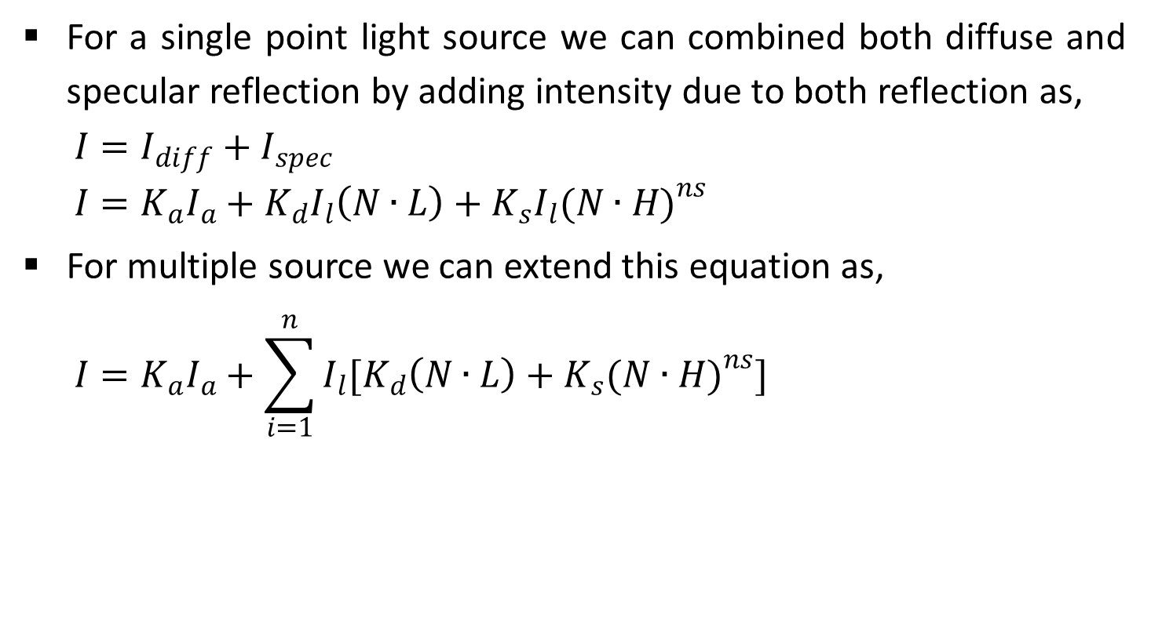
Combined Diffuse and Specular Reflections with Multiple Light Sources
For a single point light source we can combined both diffuse and specular reflection by adding intensity due to both reflection as,
$$I=I_{diff}+I_{spec}$$
$$I=K_{a}I_{a}+K_{d}I_{l}\left(N∙L\right)+K_{s}I_{l}{(N∙H)}^{ns}$$
For multiple source we can extend this equation as,
$$I=K_{a}I_{a}+\sum_{i=1}^{n}{I_{l}[K_{d}\left(N∙L\right)+K_{s}{(N∙H)}^{ns}]}$$

Slide 31
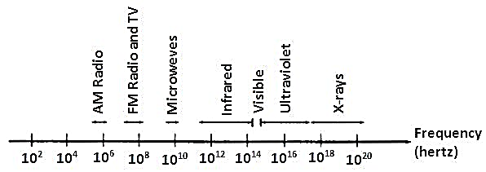
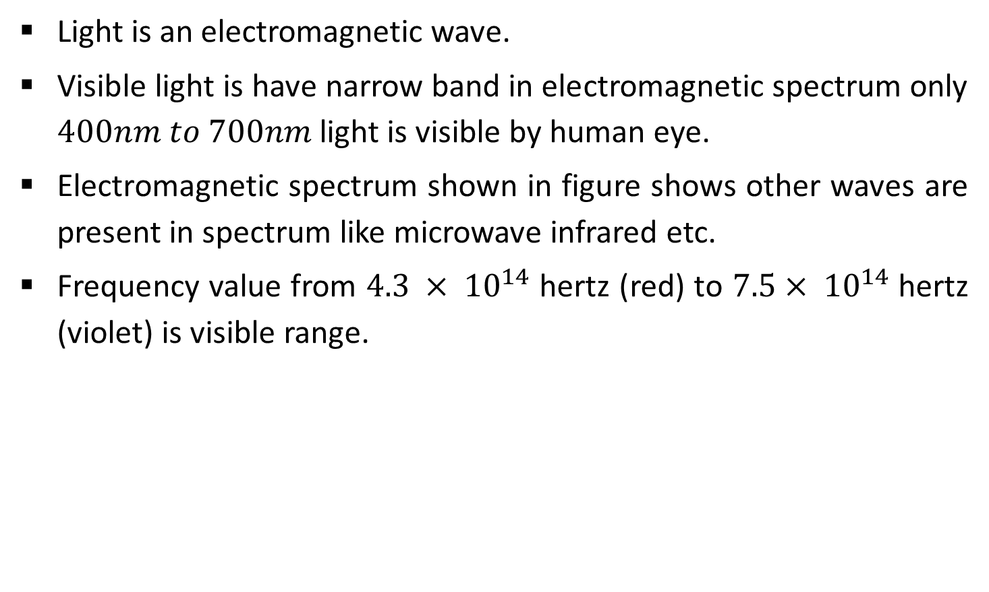
Properties of Light
Light is an electromagnetic wave.
Visible light is have narrow band in electromagnetic spectrum only $400nm to 700nm$ light is visible by human eye.
Electromagnetic spectrum shown in figure shows other waves are present in spectrum like microwave infrared etc.
Frequency value from $4.3 × {10}^{14}$ hertz (red) to $7.5× {10}^{14}$ hertz (violet) is visible range.

Slide 32
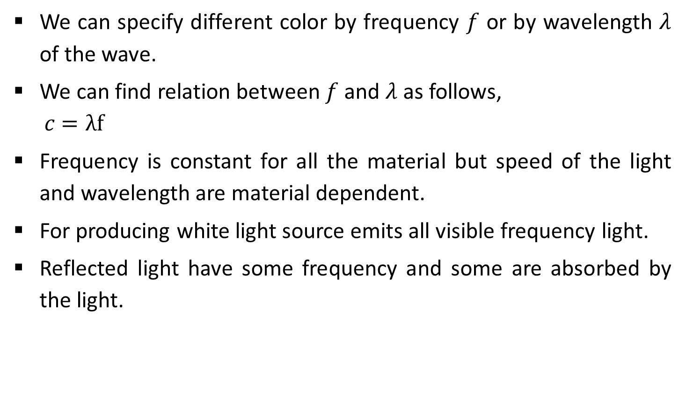
Contd.
We can specify different color by frequency $f$ or by wavelength $λ$ of the wave.
We can find relation between $f$ and $λ$ as follows,
$$c=λf$$
Frequency is constant for all the material but speed of the light and wavelength are material dependent.
For producing white light source emits all visible frequency light.
Reflected light have some frequency and some are absorbed by the light.

Slide 33
Contd.
Frequency reflected back is decide the color we see and this frequency is called as dominant frequency (hue).
Corresponding reflected wavelength is called dominant wavelength.
Other property are purity and brightness. Brightness is perceived intensity of light.
Intensity is the radiant energy emitted per unit time, per unit solid angle and per unit projected area of the source.
Purity or saturation of the light describes how washed out or how “pure” the color of the light appears.
Dominant frequency and purity both collectively refers as chromaticity.

Slide 34
Contd.
If two color source combined to produce white light they are called complementary color of each other.
For example red and cyan are complementary color.
Typical color models that are uses to describe combination of light in terms of dominant frequency.
Color models use three colors to obtain reasonable wide range of colors, called the color gamut for that model.
Two or three colors are used to obtain other colors in the range are called primary colors.

Slide 35
Color Models
In practice we use variety of colors.
For represent color, in display devices, or in hard copy different color models are used.
Few color models we discuss are,
XYZ color model
RGB color model
YIQ color model
CMY color model

Slide 36
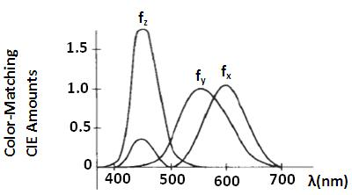
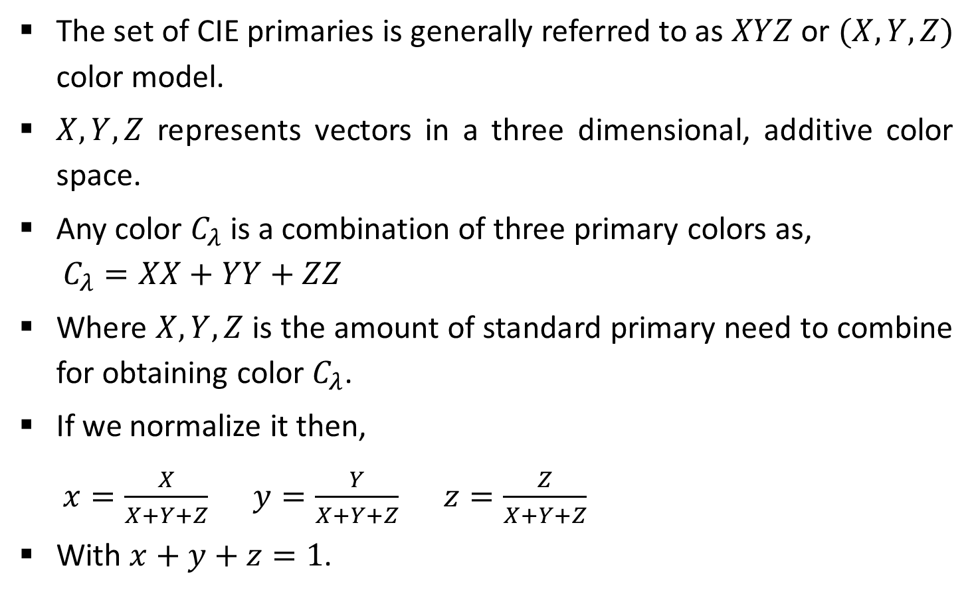
XYZ Color Model
The set of CIE primaries is generally referred to as $XYZ$ or $(X, Y, Z)$ color model.
$X, Y, Z$ represents vectors in a three dimensional, additive color space.
Any color $C_{λ}$ is a combination of three primary colors as,
$$C_{λ}=XX+YY+ZZ$$
Where $X, Y, Z$ is the amount of standard primary need to combine for obtaining color $C_{λ}$.
If we normalize it then,
$x=\frac{X}{X+Y+Z}$ $y=\frac{Y}{X+Y+Z}$ $z=\frac{Z}{X+Y+Z}$
With $x+y+z=1$.

Slide 37
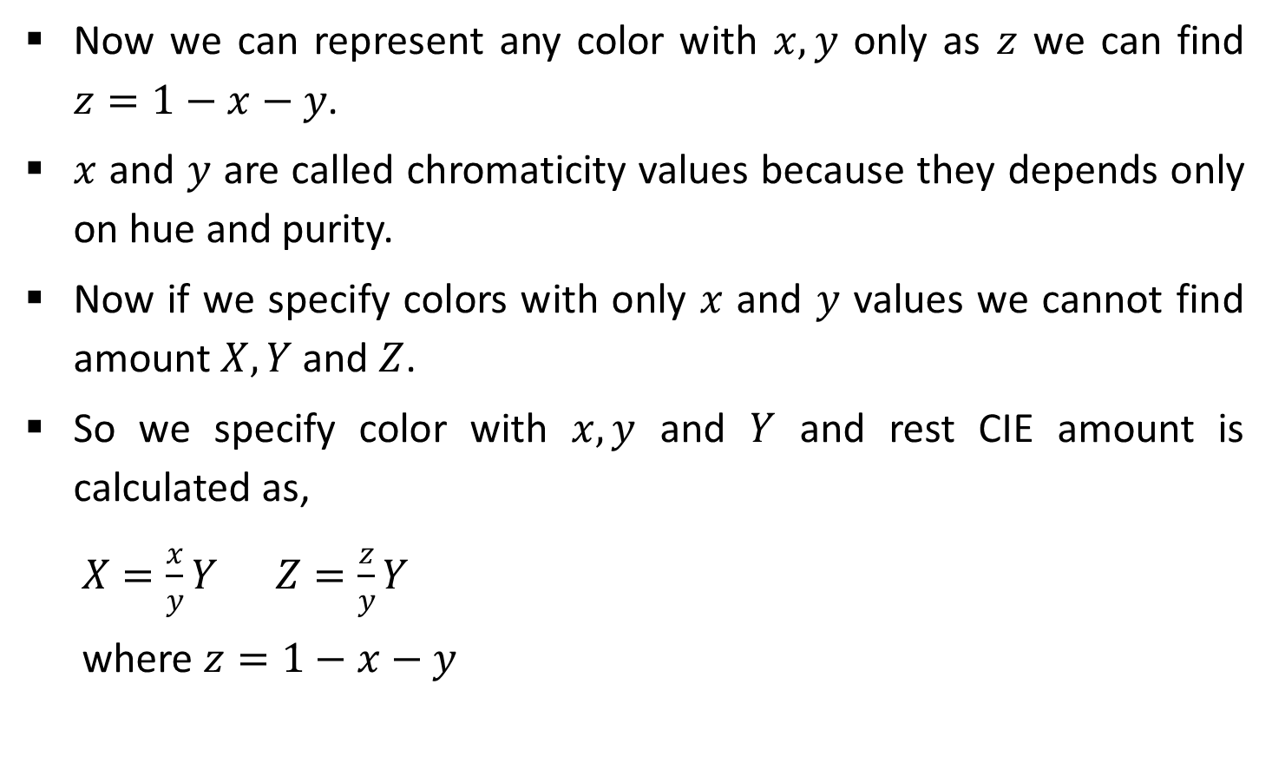
Contd.
Now we can represent any color with $x,y$ only as $z$ we can find $z=1−x−y$.
$x$ and $y$ are called chromaticity values because they depends only on hue and purity.
Now if we specify colors with only $x$ and $y$ values we cannot find amount $X, Y$ and $Z$.
So we specify color with $x, y$ and $Y$ and rest CIE amount is calculated as,
$X=\frac{x}{y}Y$ $Z=\frac{z}{y}Y$
where $z=1−x−y$

Slide 38
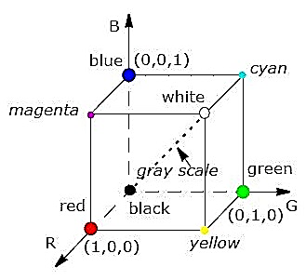
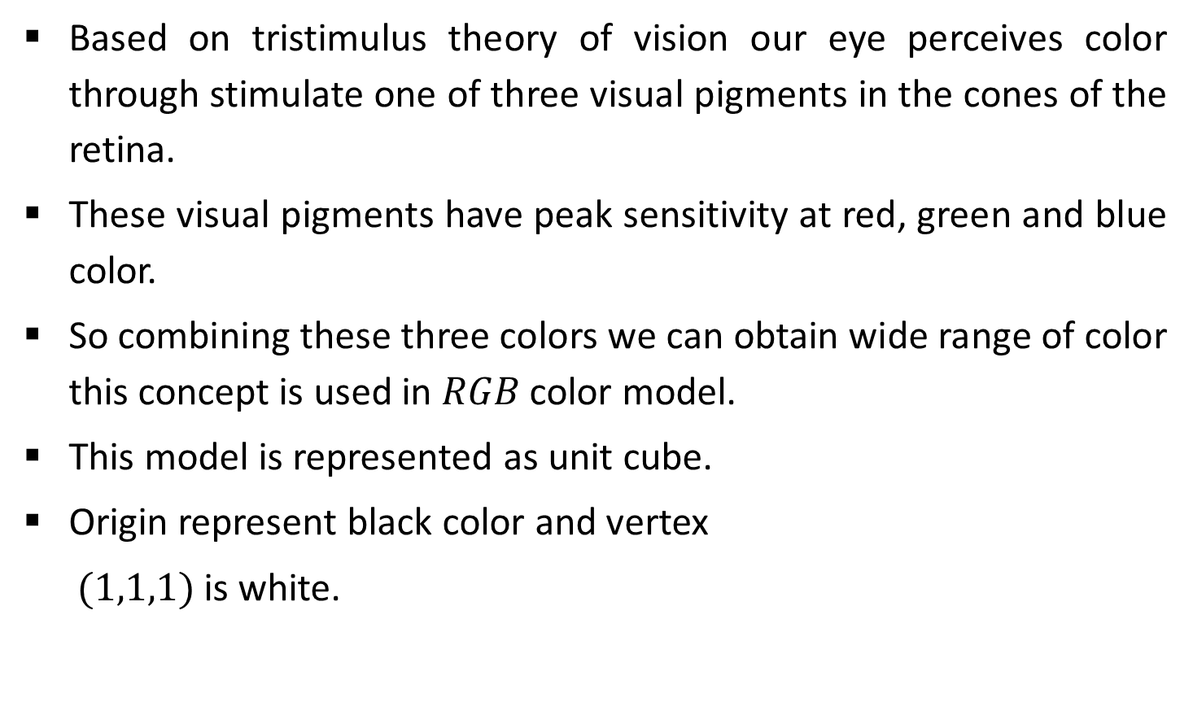
RGB Color Model
Based on tristimulus theory of vision our eye perceives color through stimulate one of three visual pigments in the cones of the retina.
These visual pigments have peak sensitivity at red, green and blue color.
So combining these three colors we can obtain wide range of color this concept is used in $RGB$ color model.
This model is represented as unit cube.
Origin represent black color and vertex
$(1,1,1)$ is white.

Slide 39

Contd.
Vertex of the cube on the axis represents primary color $R, G,B$.
In $XYZ$ color model any color intensity is obtained by addition of primary color,
$$C_{λ}=RR+GG+BB$$
where $R, G,B$ is amount of corresponding primary color.

Slide 40
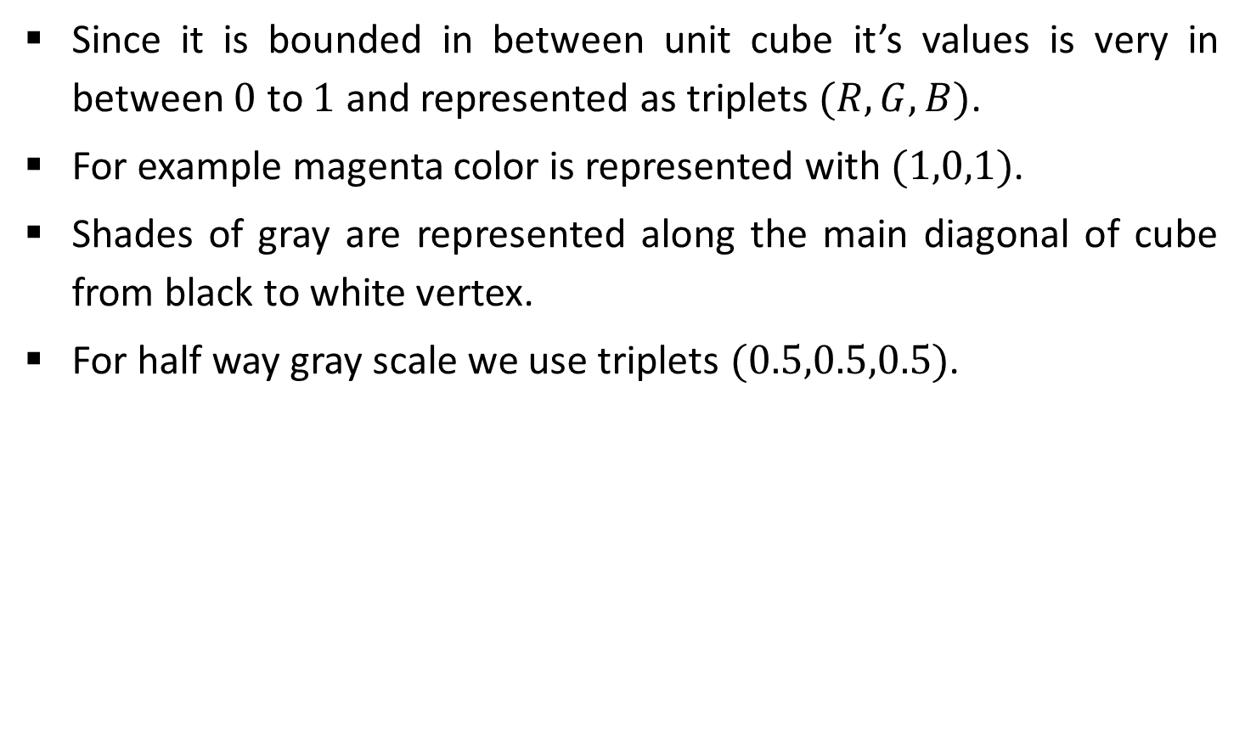
Contd.
Since it is bounded in between unit cube it’s values is very in between $0$ to $1$ and represented as triplets $(R,G,B)$.
For example magenta color is represented with $(1,0,1)$.
Shades of gray are represented along the main diagonal of cube from black to white vertex.
For half way gray scale we use triplets $(0.5,0.5,0.5)$.

Slide 41
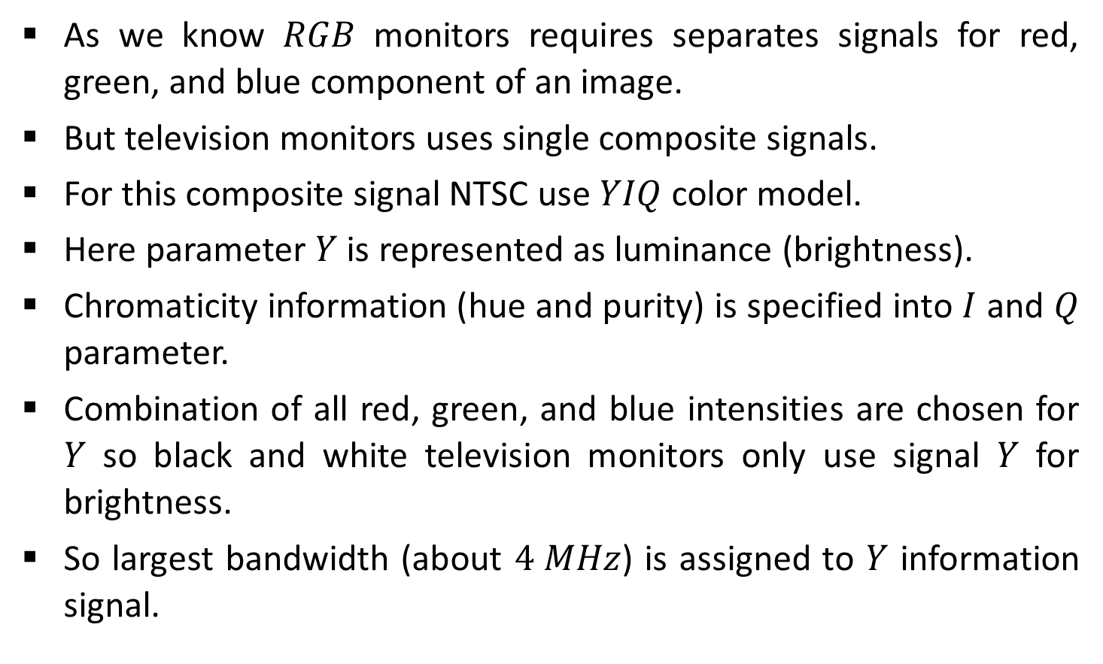
YIQ Color Model
As we know $RGB$ monitors requires separates signals for red, green, and blue component of an image.
But television monitors uses single composite signals.
For this composite signal NTSC use $YIQ$ color model.
Here parameter $Y$ is represented as luminance (brightness).
Chromaticity information (hue and purity) is specified into $I$ and $Q$ parameter.
Combination of all red, green, and blue intensities are chosen for $Y$ so black and white television monitors only use signal $Y$ for brightness.
So largest bandwidth (about $4 MHz$) is assigned to $Y$ information signal.

Slide 42
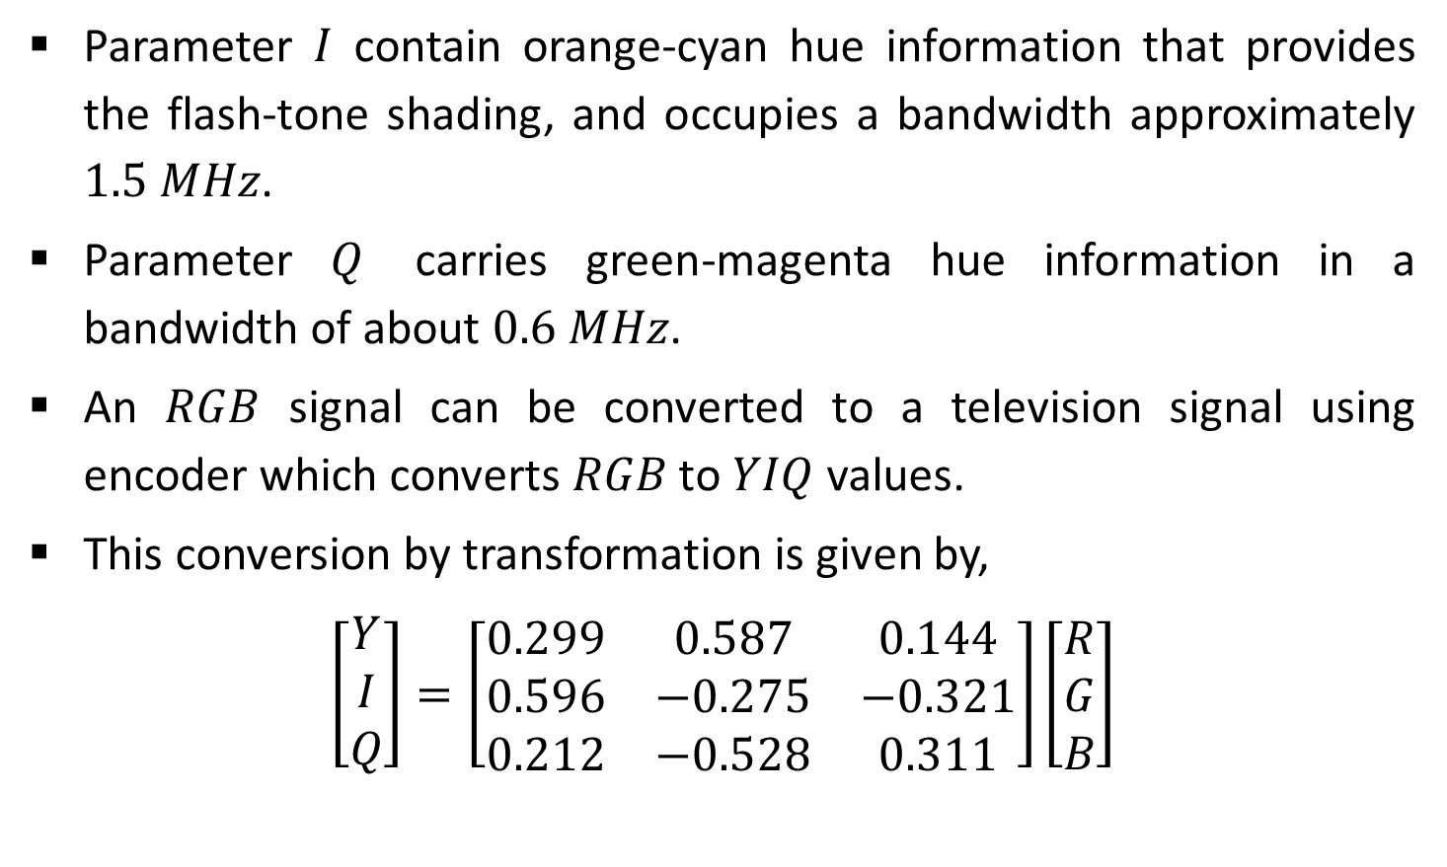
Contd.
Parameter $I$ contain orange-cyan hue information that provides the flash-tone shading, and occupies a bandwidth approximately $1.5 MHz$.
Parameter $Q$ carries green-magenta hue information in a bandwidth of about $0.6 MHz$.
An $RGB$ signal can be converted to a television signal using encoder which converts $RGB$ to $YIQ$ values.
This conversion by transformation is given by,
$$\left[\begin{matrix}Y \\ I \\ Q\end{matrix}\right]=\left[\begin{matrix}0.299 & 0.587 & 0.144 \\ 0.596 & −0.275 & −0.321 \\ 0.212 & −0.528 & 0.311\end{matrix}\right]\left[\begin{matrix}R \\ G \\ B\end{matrix}\right]$$

Slide 43

Contd.
Similarly reverse of this is performed by decoder and by transformation using inverse of above matrix as,
$$\left[\begin{matrix}R \\ G \\ B\end{matrix}\right]=\left[\begin{matrix}1.000 & 0.956 & 0.620 \\ 1.000 & −0.272 & −0.647 \\ 1.000 & −1.108 & 1.705\end{matrix}\right]\left[\begin{matrix}Y \\ I \\ Q\end{matrix}\right]$$

Slide 44
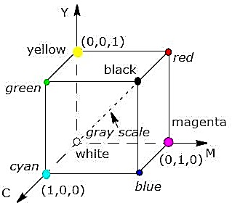
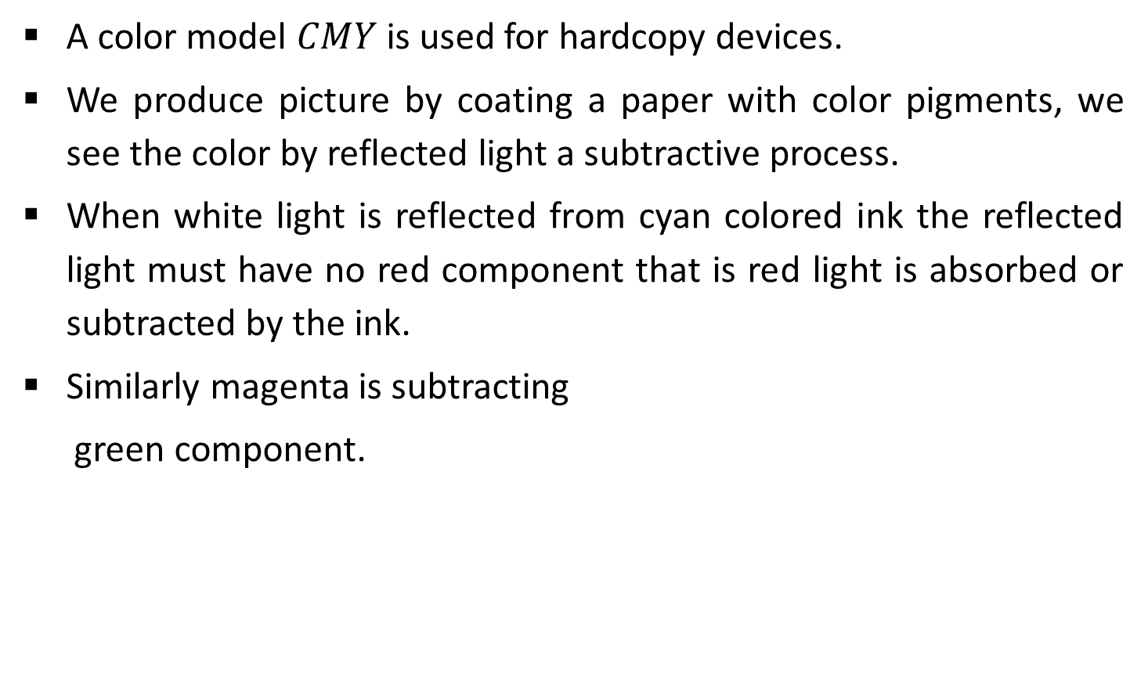
CMY Color Model
A color model $CMY$ is used for hardcopy devices.
We produce picture by coating a paper with color pigments, we see the color by reflected light a subtractive process.
When white light is reflected from cyan colored ink the reflected light must have no red component that is red light is absorbed or subtracted by the ink.
Similarly magenta is subtracting
green component.

Slide 45
Contd.
Point (1,1,1) represents black because all components are subtracts and origin represents white light.
Gray can be produce among main diagonal by using all three color in equal amount.
Printing process often use CMY model generates a color points with a collection of four ink dots, one for each primary color C, M, and Y and one dot is black.

Slide 46

Contd.
Conversion of RGB to CMY is done by,
$$\left[\begin{matrix}C \\ M \\ Y\end{matrix}\right]=\left[\begin{matrix}1 \\ 1 \\ 1\end{matrix}\right]−\left[\begin{matrix}R \\ G \\ B\end{matrix}\right]$$
And similarly reverse is done by,
$$\left[\begin{matrix}R \\ G \\ B\end{matrix}\right]=\left[\begin{matrix}1 \\ 1 \\ 1\end{matrix}\right]−\left[\begin{matrix}C \\ M \\ Y\end{matrix}\right]$$

Slide 47
Thank You

