Slide 1

Unit – 1 Introduction
Prof. Arjun V. Bala
 9624822202
→ arjun.bala@darshan.ac.in
OO Programming with JAVA (2150704) Darshan Institute of Engineering & Technology

Slide 2
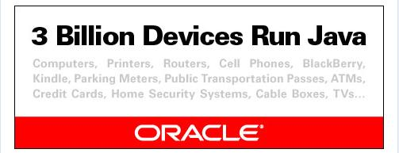

Slide 3
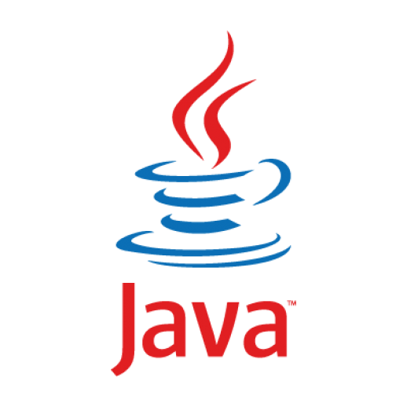
JAVA
Java is a general-purpose computer-programming language that is open source, platform independent, object-oriented and specifically designed to have as few implementation dependencies as possible.
Java was originally developed by James Gosling at Sun Microsystems and released in 1995.

Slide 4
Current Version
Current Version | Java SE 10
Future Release | Java SE 11 (LTS)
Setup size | 306 MB (Linux), 390 MB (Windows)
Required Size | 520 MB
Download Link | http://www.oracle.com/technetwork/java/javase/downloads/jdk10-downloads-4416644.html
Official Website | https://java.com
Integrated Development Environment (IDE) | Eclipse (going to use this IDE in later chapters) NetBeans IntelliJ IDEA Community Edition BlueJ

Slide 5
Hello World Java Program
File must be saved as HelloWorld.java
public class HelloWorld
{
public static void main(String[] args)
{
System.out.println("Hello World");
}
}
We have to save this in HelloWorld.java file as it has public class named HelloWorld.
String and System are inbuilt Java Classes.
Classes in java are always written in Camel case.
Main method from where execution will start
String must start with capital letter
System must start with capital letter

Slide 6
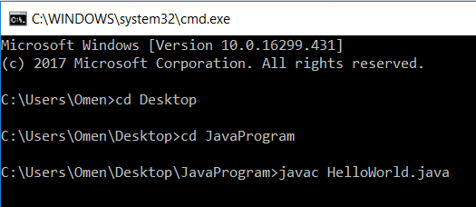
How to Compile a Java Program
we can compile java code using “javac” command in Command Prompt.
Steps:
Open Command Prompt
Goto the program directory (using cd command)
Use javac command followed by filename (Ex: javac HelloWorld.java)

Slide 7
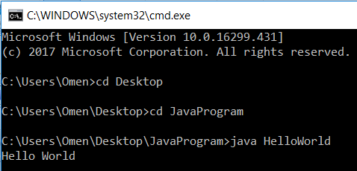
How to Run Java Program
We can run java compiled file (.class file) using “java” command in command prompt.
Steps :
Open Command Prompt
Goto the program directory (using cd command)
Use java command followed by Class Name (without extension)
(Ex: java HelloWorld)

Slide 8
JDK, JVM & JRE
JDK
Compiler (javac.exe)
Java Application
Launcher (java.exe), AppletViewer, etc..)
Java Packages
(math, util, awt etc…)
JVM
Runtime Libraries
Development tools
JRE

Slide 9
Java Development Kit (JDK)
JDK contains tools needed ,
To develop the Java programs and
JRE to run the programs.
The tools include
compiler (javac.exe),
Java application launcher (java.exe),
Appletviewer, etc…
Java application launcher (java.exe),
Opens a JRE, loads the class, and invokes its main method.

Slide 10
Java Runtime Environment (JRE)
The JRE is required to run java applications.
It combines the Java Virtual Machine (JVM), platform core classes and supporting libraries.
JRE is part of the Java Development Kit (JDK), but can be downloaded separately.
It does not contain any development tools such as compiler, debugger, etc.

Slide 11
Byte code
Java Bytecode is the instruction set of the Java virtual machine (JVM).
Byte code is intermediate representation of java source code.
Java compiler provides byte code by compiling Java Source Code.
Extension for java class file or byte code is ‘.class’.
It is platform independent.

Slide 12
Java Virtual Machine (JVM)
JVM is a virtual machine that enables a computer to run Java programs as well as programs written in other languages and compiled to Java Bytecode.
JVM is virtual because ,
It provides a machine interface that does not depend on the operating system and machine hardware architecture.
JVM interprets the byte code into the machine code.
JVM itself is platform dependent, but Java is Not.

Slide 13
How Java become Platform Independent?
Java Code (.java)
JAVAC Compiler
Byte Code (.class)
JVM
for
Windows
JVM
for
Linux
JVM
for
Mac

Slide 14
Features of JAVA
Simple
Secure
Portable
Object-oriented
Robust
Multithreaded
Architecture-neutral
Interpreted
High Performance
Distributed
Dynamic
Platform Independent

Slide 15
Features of JAVA (Cont.)
Simple
It’s simple because it has similar syntax like other programming languages (C and C++), It also removed complexities like pointers, Storage classes, goto statement and multiple Inheritance.
Secure
Java is secured because:
No explicit pointer
Java Programs run inside virtual machine sandbox
Bytecode Verifier
Using Java we can develop virus free system.

Slide 16
Features of JAVA (Cont.)
Portable
Java is portable because it facilitates you to carry the java bytecode to any platform.
Object oriented
Java is Object-oriented programming language as it supports encapsulation, inheritance and polymorphism.
Robust
Robust simply means strong. Java is robust because:
It uses strong memory management.
There is no pointers in JAVA that avoids security problem.
There is automatic garbage collection in java.
There is exception handling and type checking mechanism in java.

Slide 17
Features of JAVA (Cont.)
Multithreaded
A thread is like a separate program, executing concurrently.
We can write Java programs that deal with many tasks at once by defining multiple threads.
The main advantage of multi-threading is that it doesn't occupy memory for each thread.
It shares a common memory area. Threads are important for multi-media, Web applications etc…
Architecture-neutral
Java is architecture neutral because there is no implementation dependent features e.g. size of primitive types is fixed.
Example : in C language int occupy 2 byte for 32 bit OS and 4 bytes for 64 bit OS whereas in JAVA it occupy 4 byte for int both in 32 bit and 64 bit OS.

Slide 18
Features of JAVA (Cont.)
Interpreted
Java enables the creation of cross-platform programs by compiling into an intermediate representation called Java bytecode.
This code can be executed on any system that implements the Java Virtual Machine.
High-Performance
Java bytecode was carefully designed so that it would be easy to translate directly into native machine code for very high performance by using a just-in-time compiler.

Slide 19
Features of JAVA (Cont.)
Dynamic
Java programs carry with them substantial amounts of run-time type information that is used to verify and resolve accesses to objects at run time.
This makes it possible to dynamically link code in a safe and expedient manner.
Distributed
Java is distributed because it facilitates us to create distributed applications in java.
RMI and EJB are used for creating distributed applications.
We may access files by calling the methods from any machine on the internet.

Slide 20
Features of JAVA (Cont.)
Platform Independent
For every operating system separate JVM is available which is capable to read the .class file or byte code.
When we compile Java code then .class file is generated by java compiler (javac) these codes are readable by the JVM and every operating system have its own JVM so JVM is platform dependent but due to JVM java is platform independent

Slide 21
Primitive Data Types
Data Type | Size | Range | Example
byte | 1 Byte | -128 to 127 | byte a = 10;
short | 2 Bytes | -32768 to 32767 | short a = 200;
int | 4 Bytes | -2147483648 to 2147483647 | int a = 50000;
long | 8 Bytes | -9,223,372,036,854,775,808 to 9,223,372,036,854,775,807 | long a = 20;
char | 2 Bytes | 0 to 65536 (Stores ASCII of character) | char a = ‘a’;
float | 4 Bytes | approximately ±3.40282347E+38F (6-7 significant decimal digits) | float a = 10.2f;
double | 8 Bytes | approximately ±1.79769313486231570E+308 (15 significant decimal digits) | double a = 10.2;
boolean | Not defined | true or false | boolean a = true;

Slide 22
Character Escape Sequences
Escape Sequence | Description
\’ | Single quote
\” | Double quote
\\ | Backslash
\r | Carriage return
\n | New Line
\t | Tab

Slide 23
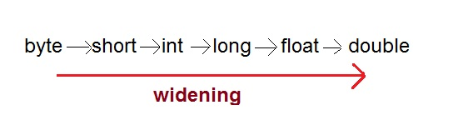
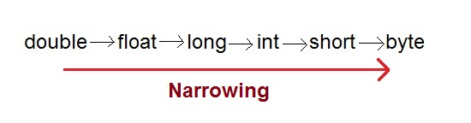
Type Casting
Assigning a value of one type to a variable of another type is known as Type Casting.
In Java, type casting is classified into two types,
Widening/Automatic Type Casting(Implicit)
Narrowing Type Casting(Explicitly done)

Slide 24
Automatic Type Casting
When one type of data is assigned to other type of variable , an automatic type conversion will take place if the following two conditions are meet:
The two types are compatible
The destination type is larger than the source type
Such type is called “widening conversion”.
Example:
int can always hold values of byte and short
public static void main(String[] args) {
byte b = 5;
// √ this is correct
int a = b;
}

Slide 25
Casting Incompatible Types
To create a conversion between two incompatible types, you must use a cast
A cast is an explicit type conversion.
Such type is called “narrowing conversion”.
Syntax:
(target-type) value
Example:
public static void main(String[] args) {
int a = 5;
// × this is not correct
byte b = a;
// √ this is correct
byte b = (byte)a ;
}

Slide 26
Operators
Arithmetic Operators
Relational Operators
Bitwise Operators
Logical Operators
Assignment Operators
Ternary Operator
Instance of Operator

Slide 27
Arithmetic Operator
Note : A = 10 & B = 20
Operator | Description | Example
+ | Addition | A + B = 30
- | Subtraction | A - B = -10
* | Multiplication | A * B = 200
/ | Division | B / A = 2
% | Modulus | B % A = 0
++ | Increment | B++ = 21
-- | Decrement | B-- = 19

Slide 28
Relational Operators
Note : A = 10 & B = 20
Operator | Description | Example
== | Equals | (A == B) is not true.
!= | Not Equals | (A != B) is true.
> | Grater than | (A > B) is not true.
< | Less than | (A < B) is true.
>= | Grater than equals | (A >= B) is not true.
<= | Less than equals | (A <= B) is true.

Slide 29
Bitwise Operators
Note : A = 60 & B = 13
Operator | Description | Example
& | Binary AND Operator | A & B = 12 which is 0000 1100
| | Binary OR Operator | A | B = 61 which is 0011 1101
^ | Binary XOR Operator | A ^ B = 49 which is 0011 0001
~ | Binary Ones Complement Operator | ~A = -61 which is 1100 0011 in 2's complement form due to a signed binary number.
<< | Binary Left Shift Operator | A << 2 = 240 which is 1111 0000
>> | Binary Right Shift Operator. | A >> 2 = 15 which is 1111
>>> | Shift right zero fill operator. | A >>>2 = 15 which is 0000 1111

Slide 30
Logical Operators
Note : A = true & B = false
Operator | Description | Example
&& | Logical AND operator | (A && B) is false.
|| | Called Logical OR Operator | (A || B) is true.
! | Called Logical NOT Operator | !(A && B) is true.

Slide 31
Assignment Operators
Operator | Description | Example
= | Simple assignment operator | C = A + B will assign value of A + B into C
+= | Add AND assignment operator | C += A is equivalent to C = C + A
-= | Subtract AND assignment operator | C -= A is equivalent to C = C - A
*= | Multiply AND assignment operator | C *= A is equivalent to C = C * A
/= | Divide AND assignment operator | C /= A is equivalent to C = C / A
%= | Modulus AND assignment operator | C %= A is equivalent to C = C % A
<<= | Left shift AND assignment operator | C <<= 2 is same as C = C << 2
>>= | Right shift AND assignment operator | C >>= 2 is same as C = C >> 2
&= | Bitwise AND assignment operator | C &= 2 is same as C = C & 2
^= | bitwise exclusive OR and assignment operator | C ^= 2 is same as C = C ^ 2
|= | bitwise inclusive OR and assignment operator | C |= 2 is same as C = C | 2

Slide 32
Conditional Operator (Ternary)
Conditional Operator ( ? : )
Syntax:
variable x = (expression) ? value if true : value if false
Example:
b = (a == 1) ? 20: 30;

Slide 33
instanceof Operator
instanceof Operator
Syntax:
( Object reference variable ) instanceof (class/interface type)
Example:
boolean result = name instanceof String;

Slide 34
Operator Precedence & Associativity
How does java evaluate 1 + 10 * 9 ?
(1 + 10 ) * 9 = 99 OR 1 + (10 * 9) = 91
To get the correct answer for the given problem Java came up with Operator precedence. ( multiplication have higher precedence than addition so correct answer will be 91 in this case)
For Operator, associativity means that when the same operator appears in a row, then to which direction the expression will be evaluated. (It would be from Left to Right)
How does java evaluate 1 * 2 + 3 * 4 / 5 ???
2 + 12 / 5
2 + 2.4
4.4

Slide 35
Precedence of Java Operators
Category | Operator | Associativity
Postfix | () [] . (dot operator) | Left to right
Unary | ++ - - ! ~ | Right to left
Multiplicative | * / % | Left to right
Additive | + - | Left to right
Shift | >> >>> << | Left to right
Relational | > >= < <= | Left to right
Equality | == != | Left to right
Bitwise AND | & | Left to right
Bitwise XOR | ^ | Left to right
Bitwise OR | | | Left to right
Logical AND | && | Left to right
Logical OR | || | Left to right
Conditional | ?: | Right to left
Assignment | = += -= *= /= %= >>= <<= &= ^= |= | Right to left
Comma | , | Left to right

Slide 36
Control Statements
if statement
if-else statement
if-else ladder statement
switch statement

Slide 37
if Statement
if statement tests the condition. It executes the if block if condition is true.
public class IfStatementDemo{
public static void main(String[] ar)
{
int a = 10, b = 20;
if(a<b) {
System.out.println("A is smaller than B");
}
}
}

Slide 38
if-else Statement
if-else statement also tests the condition. It executes the if block if condition is true otherwise else block is executed.
public class IfElseStatementDemo{
public static void main(String[] ar)
{
int a = 10, b = 20;
if(a<b) {
System.out.println("A is smaller than B");
}
else {
System.out.println(“A is not smaller than B");
}
}
}

Slide 39
if-else Statement
if-else-if ladder statement executes one condition from multiple statements.
int marks = 65;
if (marks < 60) {
System.out.println("fail");
} else if (marks >= 60 && marks < 80) {
System.out.println("B grade");
} else if (marks >= 80 && marks < 90) {
System.out.println("A grade");
} else if (marks >= 90 && marks < 100) {
System.out.println("A+ grade");
} else {
System.out.println("Invalid!");
}

Slide 40
switch Statement
switch statement executes one statement from multiple conditions. It is like if-else-if ladder statement.
public class SwitchExampleDemo {
public static void main(String[] args)
{
int number = 20;
switch (number) {
case 10:
System.out.println("10");
break;
case 20:
System.out.println("20");
break;
default:
System.out.println("Not 10 or 20");
}
}
}

Slide 41
Looping Statement
while
do-while
for
foreach (will cover this after array)

Slide 42
While Loop
while loop is used to iterate a part of the program several times. while is entry control loop.
If the number of iteration is not fixed, it is recommended to use while loop.
//code will print 1 to 9
public class WhileLoopDemo {
public static void main(String[] args) {
int number = 1;
while(number < 10) {
System.out.println(number);
number++;
}
}
}

Slide 43
Do-while Loop
do-while loop is executed at least once because condition is checked after loop body.
//code will print 1 to 9
public class DoWhileLoopDemo {
public static void main(String[] args) {
int number = 1;
do {
System.out.println(number);
number++;
}while(number < 10) ;
}
}

Slide 44
For Loop
for loop is used to iterate a part of the program several times.
If the number of iteration is fixed, it is recommended to use for loop.
//code will print 1 to 9
public class ForLoopDemo {
public static void main(String[] args)
{
for(int number=1;number<10;number++)
{
System.out.println(number);
}
}
}

Slide 45
Break statement
When a break statement is encountered inside a loop, the loop is immediately terminated and the program control resumes at the next statement following the loop.
//code will print 1 to 4 followed by “After Loop”
public class BreakDemo{
public static void main(String[] args)
{
for(int number=1;number<10;number++)
{
if(number==5) {
break;
}
System.out.println(number);
}
System.out.println(“After Loop”);
}
}

Slide 46
Continue statement
The continue statement is used in loop control structure when you need to immediately jump to the next iteration of the loop. It can be used with for loop or while loop.
//code will print 1 to 9 but not 5, followed by “After Loop”
public class ContinueDemo {
public static void main(String[] args)
{
for(int number=1;number<10;number++)
{
if(number==5) {
continue;
}
System.out.println(number);
}
System.out.println(“After Loop”);
}
}

