Slide 1

Unit - 10 Networking with java.net package
Prof. Arjun V. Bala
9624822202
arjun.bala@darshan.ac.in
OOP JAVA
2150704
Semester 5
Computer Engineering Darshan Institute of Engineering & Technology

Slide 2

Classes in java.net package
This class represents an Internet Protocol (IP) address.
Classes in java.net package
Class represents a Uniform Resource Locator, a pointer to a "resource" on the World Wide Web.
Represent the communications link between the application and a URL
 | Java.net Package
 |  | InetAddress
 |  | URL
 |  | URLConnection
 |  | ServerSocket
 |  | Socket
 |  | DatagramPacket
 |  | DatagramSocket
Used to create a server socket. This object is used to establish communication with the clients.
This class implements client sockets.
import java.net.*
This class represents a datagram packet.
Represents a socket for sending and receiving datagram packets.
TCP
UDP

Slide 3
InetAddress
This class represents an IP address. It represents both the 32 bit IPv4 address and 128 bit IPv6 address.
It is the superclass of Inet6Address and Inet4Address classes.
An instance of this class consists of an IP address and usually a hostname depending on whether hostname resolution was performed during the creation.
There are no constructors for this class but static methods which returns instances of InetAddress class for general use.
static InetAddress getLocalHost()
static InetAddress getByName(String hostName)
static InetAddress[] getAllByName(String hostName)

Slide 4
Methods of InetAddress
Method | Description
public static InetAddress getByName(String host) throws UnknownHostException | it returns the instance of InetAddress by the host name provided
Public static InetAddress getByAddress (byte[] ar) throws UnknownHostException | it returns the instance of InetAddress by the address provided.
public static InetAddress getLocalHost() throws UnknownHostException | it returns the instance of InetAdddress containing local host name and address.
public String getHostName() | it returns the host name of the IP address.
public String getHostAddress() | it returns the IP address in string format.

Slide 5
Example of InetAddress
public class IPDemo {
public static void main(String ar[]) throws Exception {
InetAddress ip1 = InetAddress.getByName("www.google.com");
System.out.println(ip1.getHostAddress());
byte[] arr =
{ (byte) 106, (byte) 10, (byte) 138, (byte) 240 };
InetAddress ip2 = InetAddress.getByAddress(arr);
System.out.println(ip2.getHostName());
}
}
Output :
172.217.26.228
ir2.fp.vip.sg3.yahoo.com

Slide 6
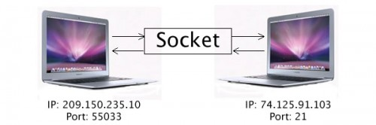
Socket overview
Socket
“A socket is one endpoint of a two-way communication link between two programs running on the network.”
An Socket is combination of an IP address and a port number.

Slide 7
Client – Server Communication
Two machines must connect
Server waits for connection
Client initiates connection
Server responds to the client request
Server
Client
Response
socket
socket
Request
Waits

Slide 8
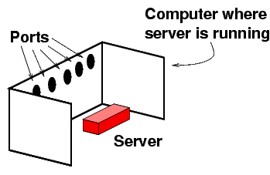
Socket overview
The server is just like any ordinary program running in a computer.
Each computer is equipped with some ports.
Reference: isinotes/javatut/net

Slide 9
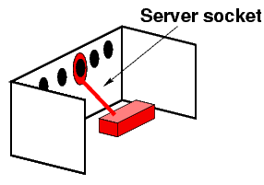
Socket overview
The server connects to one of the ports.
This process is called binding to a port.
The connection is called a server socket.
The Java server code that does this is:
ServerSocket ss = new ServerSocket(1234);//1234 is port number
Reference: isinotes/javatut/net

Slide 10
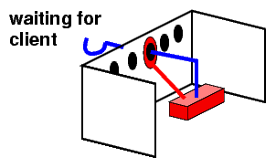
Socket overview
Server is waiting for client machine to connect.
Reference: isinotes/javatut/net

Slide 11
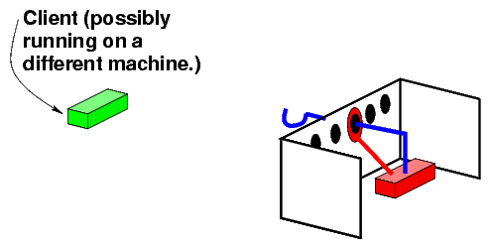
Socket overview
Reference: isinotes/javatut/net

Slide 12
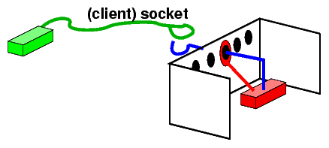
Socket overview
In the next step the client connects to this port of the server's computer.
The connection is called a (client) socket.
Socket sock = new Socket("www.darshan.ac.in",80);
/* The client knows the number 80 */
Reference: isinotes/javatut/net

Slide 13
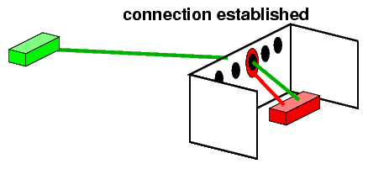
Socket overview
Now, connection is established between client and server.
Reference: isinotes/javatut/net

Slide 14
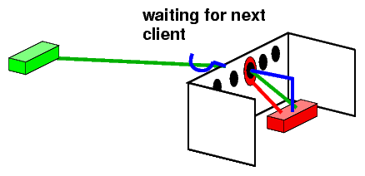
Socket overview
Reference: isinotes/javatut/net

Slide 15
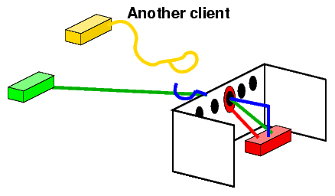
Socket overview
Everytime a client is found, its Socket is extracted, and the loop again waits for the next client.
Reference: isinotes/javatut/net

Slide 16
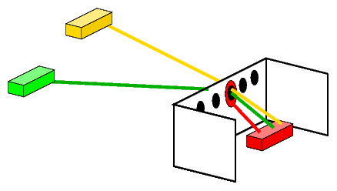
Socket overview
Client 2
Server
Client 1
Reference: isinotes/javatut/net

Slide 17
Socket class
The java.net.Socket class allows you to perform all four fundamental socket operations.
we can connect to remote machines
we can send data
we can receive data
we can close the connection.
Each Socket object is associated with exactly one remote host.
To connect to a different host, you must create a new Socket object.
There are 2 important constructor to create Socket
Socket(String host, int port) throws UnknownHostException, IOException
Socket(InetAddress address, int port) throws IOException

Slide 18
Socket (Cont.)
Sending and receiving data is accomplished with output and input streams.
There are methods to get an input stream for a socket and an output stream for the socket.
public InputStream getInputStream() throws IOException
Returns an input stream for this socket.
public OutputStream getOutputStream() throws IOException
Returns an output stream for this socket.
There's a method to close a socket.
public void close() throws IOException
This method will close the socket

Slide 19
ServerSocket class
A server socket waits for requests to come in over the network.
It performs some operation based on that request, and then possibly returns a result to the requester.
The actual work of the server socket is performed by an instance of the SocketImpl class.
An application can change the socket factory that creates the socket implementation to configure itself to create sockets appropriate to the local firewall.
There are 2 important constructor to create ServerSocket
ServerSocket() Creates an unbound server socket.
ServerSocket(int port) Creates a server socket, bound to the specified port.

Slide 20
ServerSocket methods
There are two methods which provide the basic functionality of a server socket.
public Socket accept() throws IOException
public void close() throws IOException
There are 2 methods to set and get timeout
public void setSoTimeout(int timeout)
public int getSoTimeout()

Slide 21
Example for Socket/ServerSocket
import java.net.*;
import java.util.Scanner;
public class MyServer {
public static void main(String[] args) {
try {
ServerSocket ss = new ServerSocket(6666);
Socket s = ss.accept();
Scanner dis = new Scanner(s.getInputStream());
String str = (String) dis.nextLine();
System.out.println("message= " + str);
ss.close();
} catch (Exception e) {
e.printStackTrace();
}
}
}

Slide 22
Example (Cont.) Socket/ServerSocket
import java.io.*;
import java.net.*;
public class MyClient {
public static void main(String[] args) {
try {
Socket s = new Socket("localhost", 6666);
DataOutputStream dout =
new DataOutputStream(s.getOutputStream());
dout.writeUTF("Hello Server");
dout.flush();
dout.close();
s.close();
} catch (Exception e) {
e.printStackTrace();
}
}
}

Slide 23
DatagramSocket class
Datagram socket is a type of network socket which provides connection-less point for sending and receiving packets.
Every packet sent from a datagram socket is individually routed and delivered.
It can also be used for sending and receiving broadcast messages.
Datagram Sockets is the java’s mechanism for providing network communication via UDP instead of TCP.
There are 2 important constructor to create DatagramSocket
DatagramSocket() : Creates a datagramSocket and binds it to any available
port on local machine.
DatagramSocket(int port) : Creates and binds the datagram socket to the
specified port.

Slide 24
DatagramSocket methods
There are two methods which provide the basic functionality of a datagram sockets.
public void send(DatagramPacket p) : Sends a datagram packet from this socket. It should be noted that the information about the data to be sent, the address to which it is sent etc are all handled by packet itself.
public void receive(DatagramPacket p) : It is used to receive the packet from a sender. When a packet is successfully received, the buffer of the packet is filled with received message.
There are 2 methods to set and get timeout
public void setSoTimeout(int timeout)
public int getSoTimeout()

Slide 25
DatagramPacket class
This class provides facility for connection less transfer of messages from one system to another.
Each message is routed only on the basis of information contained within the packet and it may be possible for different packets to route differently.
There is also no guarantee as to whether the message will be delivered or not, and they may also arrive out of order.
This class provides mechanisms for creation of datagram packets for connectionless delivery using datagram socket class.

Slide 26
DatagramPacket constructors
DatagramPacket(byte[] buf, int offset, int length, InetAddress address, int port)
buf : byte array
offset : offset into the array
length : length of message to deliver
address : address of destination
port : port number of destination
DatagramPacket(byte[] buf, int length, InetAddress address, int port)
DatagramPacket(byte[] buf, int length)
To receive packets.

Slide 27
Example for DatagramSocket/Packet
import java.net.*;
public class MyReceiver {
public static void main(String[] args) throws Exception {
DatagramSocket ds = new DatagramSocket(3000);
byte[] buf = new byte[1024];
DatagramPacket dp = new DatagramPacket(buf, 1024);
ds.receive(dp);
String str = new String(dp.getData(), 0, dp.getLength());
System.out.println(str);
ds.close();
}
}

Slide 28
Example (Cont.)
import java.net.*;
public class MySender {
public static void main(String[] args) throws Exception {
DatagramSocket ds = new DatagramSocket();
String str = "Welcome to Darshan";
InetAddress ip = InetAddress.getByName("127.0.0.1");
DatagramPacket dp = new DatagramPacket(str.getBytes(), str.length(), ip, 3000);
ds.send(dp);
ds.close();
}
}

