Slide 1

Unit - 11 Introduction to Object Orientation
Prof. Arjun V. Bala
9624822202
arjun.bala@darshan.ac.in
OOP JAVA
2150704
Semester 5
Computer Engineering Darshan Institute of Engineering & Technology

Slide 2
Object-Orientation (OO)
Object-oriented (OO) means that we organize software as a collection of isolated objects that incorporate both data structure and behavior
Object Orientation is about viewing and modeling the world/system as a set of interacting and interrelated objects
Characteristics of OO approach :
Identity
Classification
Inheritance
polymorphism

Slide 3
1 . Identity
Identity means data is quantized into discrete and distinguishable entities.
Each object is having its own inherent identity.
e.g. identity of Pen object is very different with an identity of Table object
Objects are distinct even if all their attribute values (i.e. name and size) are identical.
In programming language each object has unique handle by which it can be referenced.

Slide 4
2 . Classification
Abstract entities with the same structure (attributes) and behavior (operations) are grouped into classes.
Example: Paragraph, Chess Piece etc.
A class is an abstraction that describes properties important to an application and ignores the rest.
Each class describes a possibly infinite set of individual objects.
Choice of class is arbitrary and depends on application.

Slide 5
3 . Inheritance
Sharing of attributes and operations based on a hierarchical relationship.
Each subclass inherits all features of super class and adds its unique features.
A super class has general information that subclasses refine and elaborate.
Example, Scrolling Window, and Fixed Window are subclasses of Window.

Slide 6



4 . Polymorphism
Polymorphism means that the same operation may behave differently for different classes.
Example, the move operation behaves differently for a pawn than for the queen in a chess game.
One more interesting example would be…

Slide 7
OO Methodology
OO Development and Graphical notation represents OO concept.
Methodology consists of building a model of an application and then adding details to it during analysis phase.
The same seamless notation is used from analysis to design to implementation.
Therefore information used in one stage can be reused in the next stage.

Slide 8
Methodology Stages
System Conception
Analysis
System Design
Class Design
Implementation

Slide 9
I . System Conception
System Conception means origin of the system.
Software development begins with business analyst or users conceiving an application and formulating tentative requirement.

Slide 10
II . Analysis
The analyst scrutinizes and rigorously restates the requirements from system conception by constructing models.
The analyst must work with the requestor to understand the problem, because problem statements are rarely complete or correct.
The analysis model is a concise, precise abstraction of what the desired system must do, not how it will be done.
The analysis model should not contain implementation decisions.

Slide 11
II . Analysis (Cont.)
The analysis model has two parts:
the domain model, a description of the real-world objects reflected within the system;
and the application model, a description of the parts of the application system itself that visible to the user.
Task of Analyst:
Must work with the requester (client) to understand the problem, because problem statements are rarely complete or correct.
To design the Analysis model which demonstrates what the desired system must do, not how it will be done.
Analyst is not concerned about implementation decision.

Slide 12
III . System Design
The development team devises a high-level strategy – the system architecture – for solving the application problem.
They also establish policies that will serve as a default for the subsequent, more detailed portions of design.
The system designer must decide what performance characteristics to optimize, choose a strategy of attacking the problem, and make tentative resource allocations.

Slide 13
III . System Design (Cont.)
Logical Design of the System
Objects Identified
Database Designed
Program Specification drawn up
Implementation plan drawn up
Task of system designer:
Must decide what performance characteristics to optimize.
Making tentative resource allocation.
Designer should choose an appropriate communication protocol and memory buffering strategy.

Slide 14
IV . Class Design
The class designer adds details to the analysis model in accordance with the system design strategy.
The class designer expands both domain and application objects using the same OO concepts and notation, although they exist on different conceptual (theoretical/abstract) planes.
The focus of class design is the data structures and algorithms needed to implement each class.
Task of class designer
add details to analysis model
They determine data structures and algorithm for each of the operation of window class.
They elaborate both domain and application objects using same OO concept and notation, although they exist on different conceptual planes.

Slide 15
V . Implementation
Implementers translate the classes and relationships developed during class design into a particular programming language, database, or hardware.
During implementation, it is important to follow good software engineering practice so that traceability to the design is apparent and so that the system remains flexible and extensible.
Implementation states:
Write Programs
Create Database
Document System
Train Users
Trial run of the system
Test and Accept

Slide 16
V . Implementation (Cont.)
Task of Implementers
Translates the classes and relationships developed during class design into particular programming language, database or hardware.
Programming should be straight forward, because all the hard decision has already been made.
During implementation, it is important to follow good software engineering practice so that traceability to the design is apparent (clear).

Slide 17
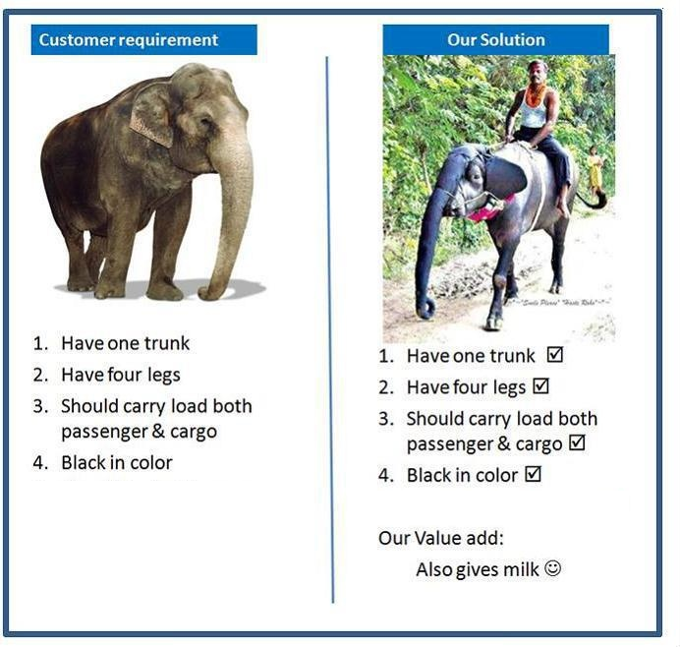

Slide 18
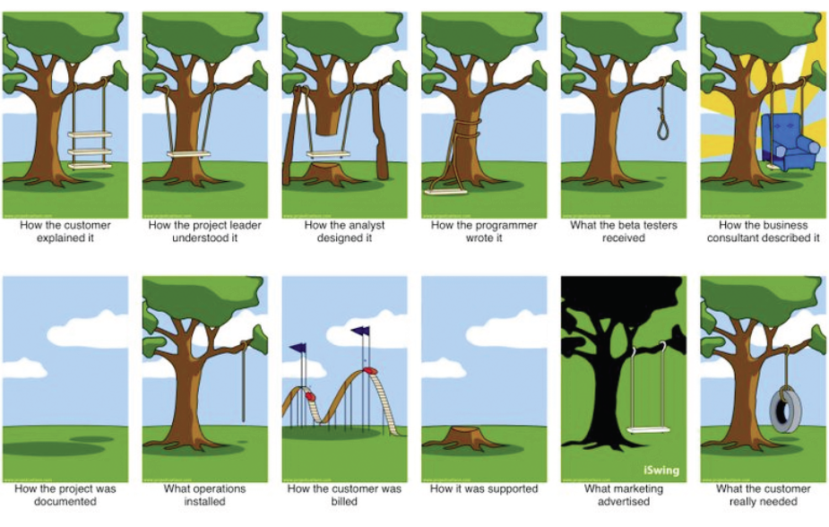

Slide 19
The Three Models
Class Model
State Model
Interaction Model

Slide 20
1. Class Model
The structure of an object in system includes:
Identity
Relationship to other object
Attributes
Operations
This model provides context for state and interaction model.
The goal in constructing class model is to capture those concepts from real world that are important to application.

Slide 21
2. State Model
Describes history and behavior of a system with respect to time.
Explains context of events and organization of events with states.
Actions and events in state model become operations on object in class model.

Slide 22
3. Interaction Model
Explains interactions between objects.
It also explains, how individual object collaborate to achieve behavior of system as a whole.
Use Case Model: Document major theme for interactions between system and outside actors.
Sequence Model: Describes object that interact and time sequence of their interactions.
Activity Model: shows flow of control among processing steps of a computation.

Slide 23
Relationship among the Models
Each model describes one aspect of the system but contains references to the other models, The class model describes data structure on which the state and interaction models operate.
The operations in the class model correspond to events and actions.
The state model describes the control structure of objects. It shows decision that depends on object values causes actions that change object values and state.
The interaction models focuses on the exchanges between objects and provide a complete overview of the operation of a system.

