Slide 1

Unit – 12,13 Class Modeling
Prof. Arjun V. Bala
9624822202
arjun.bala@darshan.ac.in
OOP JAVA
2150704
Semester 5
Computer Engineering Darshan Institute of Engineering & Technology

Slide 2
Class Modeling
A class modeling captures static structure of a system by characterizing the objects in the system, the relationships between the objects, and the attributes and operations for each class of objects.
Class model is most important among three models.
Emphasizes on building a system around objects rather than functionality.
Class Model closely corresponds to the real world and is consequently more flexible with respect to the change.
The purpose of class modeling is to describe objects.

Slide 3
Class Diagram
Class Diagram provides a Graphical notation for modeling classes and their relationships, thereby describing possible objects.
The most widely used diagram of UML.
Models the static design view of a system.
Useful in modeling business objects.
Used to specify the structure, interfaces and relationships between classes that underlie the system architecture.
Primary diagram for generating codes from UML models.

Slide 4
Class Diagram Notations
Class
Class is an entity of the class diagram. It describes a group of objects with same properties & behavior.
Object
An object is an instance or occurrence of a class.
Class Name
attributes
operations
Object name : class

Slide 5
Class Diagram Notations (Cont.)
Association
An association is a description of a links with common structure & common semantics.
Multiplicity
Multiplicity specifies the number of instances of one class that may relate to a single instance of an associated class.
Class1
Class2
Ex. 1 to 1
1 to *
* to *
* to 1
1 to 0….2
Class1
Class2

Slide 6
Class Diagram Notations (Cont.)
Generalization
Generalization organizes classes by their superclass and sub-class relationship.
SubClass1
SubClass1
SubClass2

Slide 7
Simple Class Diagram Example
Student
+ name : String + rollNo : int - enrollment_number : String # department : String + division : String
viewStudentDetails() attendExam() getAttendance() fillAttendance()
College
+ name : String + address : String - contact_number : String
getCollegeName() getAddress() getAllStudents()
*
1

Slide 8
Class Diagram Notations (Cont.)
Association Class
It is an association that is a class which describes the association with attributes.
Ordering
It is used to indicate an ordered set of objects with no duplication allowed.
Association Class name
Class1
Class2
{ordered}

Slide 9
Class Diagram Notations (Cont.)
bag
A bag is collection of unordered elements with Duplicates allowed.
sequence
A sequence is an ordered collection of elements with duplicates allowed.
Class1
Class2
{bag}
Class1
Class2
{sequence}

Slide 10
Class Diagram Notations (Cont.)
Qualified Association
Qualification increases the precision of a model. It is used to avoid many to many multiplicities and it converts into one to one multiplicity.
Enumeration
An enumeration is a data type that has a finite set of values.
Class1
Class2
qualifier
<< enumeration >>

Slide 11
Class Diagram Notations (Cont.)
Aggregation
It is a strong form of association in which an aggregate object is made of constituent parts.
Aggregation implies a relationship where the child can exist independently of the parent. Example: Class (parent) and Student (child). Delete the Class and the Students still exist.
Class1
Class2
Class3

Slide 12
Class Diagram Notations (Cont.)
Composition
It is a form of aggregation. Composition implies ownership of the parts by the whole.
Composition implies a relationship where the child cannot exist independent of the parent. Example: House (parent) and Room (child). Rooms don't exist separate to a House
Class1
Class2
Class3

Slide 13
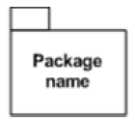
Class Diagram Notations (Cont.)
Abstract class
Represents a abstract class in Class Diagram
Package
A package is a group of elements with common theme
<< abstract class >>

Slide 14
Example : Person/Address
Address
+Street: Char +City : Char +State : Char +Country : Char +PostalCode : Char
+validate() +outputAsLabel()
Person
+name: Char -phoneno : Char -email : char
+purhaseParkingPass()
*
1
Student
+StudentNumber -averageMarks
+isElegibleToEnroll
Professor
+salary : Long

Slide 15
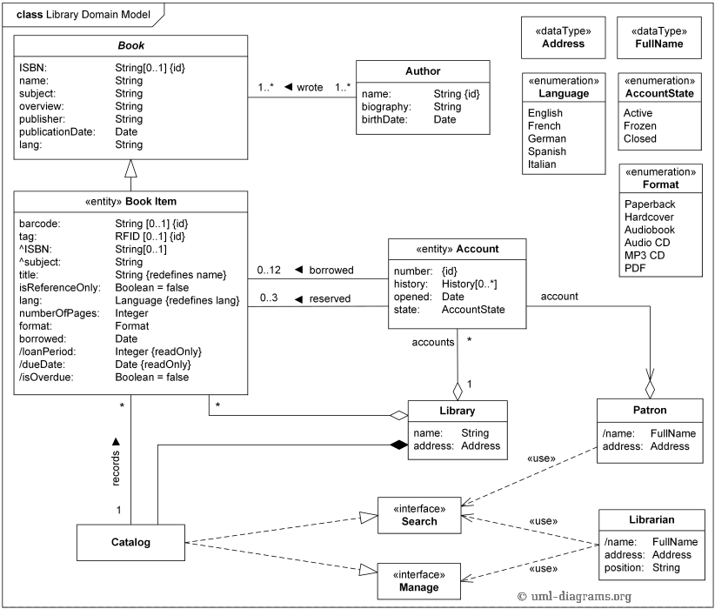

Slide 16
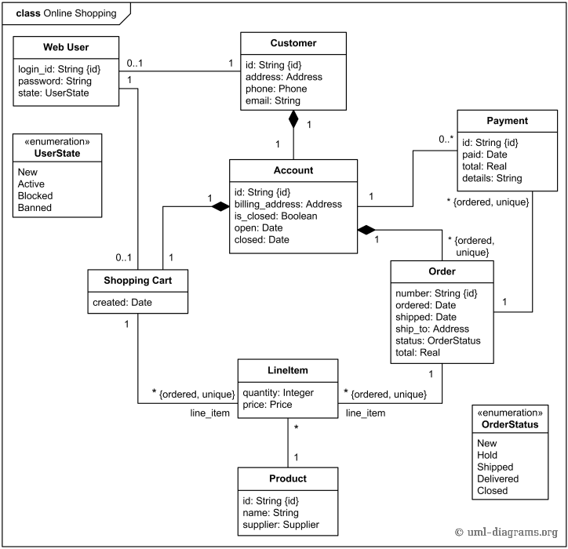

Slide 17
