Slide 1

Unit – 15 Interaction Modeling
Prof. Arjun V. Bala
9624822202
arjun.bala@darshan.ac.in
OOP JAVA
2150704
Semester 5
Computer Engineering Darshan Institute of Engineering & Technology

Slide 2
Use Case Diagram
A use case diagram describes how a system interacts with outside actors.
It is a graphical representation of the interaction among the elements and system.
Each use case represents a piece of functionality that a system provides to its user.
Use case identifies the functionality of a system.
Use case diagram allows for the specification of higher level user goals that the system must carry out.
These goals are not necessarily to tasks or actions, but can be more general required functionality of the system.

Slide 3
Use Case Diagram (Cont.)
You can apply use case to capture the intended behavior of the system you are developing, without having to specify how that behavior is implemented.
A use case diagram at its simplest is a representation of a user's interaction with the system and depicting the specifications of a use case.
A use case diagram contains four components.
The boundary, which defines the system of interest in relation to the world around it.
The actors, usually individuals involved with the system defined according to their roles.
The use cases, which the specific roles are played by the actors within and around the system.
The relationships between and among the actors and the use cases.

Slide 4
Use Case Diagram (Cont.)
Purpose:
The main purpose of the use case diagram is to capture the dynamic aspect of a system.
Use case diagram shows, what software is suppose to do from user point of view.
It describes the behavior of system from user’s point.
It provides functional description of system and its major processes.
Use case diagram defines the scope of the system you are building.
When to Use
Use cases are used in almost every project.
They are helpful in exposing requirements and planning the project.
During the initial stage of a project most use cases should be defined

Slide 5
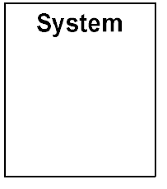
Use Case Notations
System boundary
The scope of a system can be represented by a system boundary.
The use cases of the system are placed inside the system boundary, while the actors who interact with the system are put outside the system.
The use cases in the system make up the total requirements of the system.

Slide 6

Use Case Notations (Cont.)
Use case
A use case represents a user goal that can be achieved by accessing the system or software application.
Actor
Actors are the entities that interact with a system.
Although in most cases, actors are used to represent the users of system, actors can actually be anything that needs to exchange information with the system.
So an actor may be people, computer hardware, other systems, etc.
Note that actor represent a role that a user can play, but not a specific user.
Use Case

Slide 7


Name | Notation | Description
Association |  | Actor and use case can be associated to indicate that the actor participates in that use case. Therefore, an association corresponds to a sequence of actions between the actor and use case in achieving the use case.
Generalization |  | A generalization relationship is used to represent inheritance relationship between model elements of same type.
Include |  | An include relationship specifies how the behavior for the inclusion use case is inserted into the behavior defined for the base use case.
Extends |  | An extend relationship specifies how the behavior of the extension use case can be inserted into the behavior defined for the base use case.
Constraint |  | Show condition exists between actors an activity.
Package |  | Package is defined as collection of classes. Classes are unified together using a package.
Interface |  | Interface is used to connect package and use-case. Head is linked with package and tail linked with usecase
Note |  | Note is generally used to write comment in use-case diagram.
Anchor |  | Anchor is used to connect a note the use case in use case diagram.
<< include >>
<< extends >>
{condition}
x

Slide 8
Usecase Diagram (Airport Check-in System)
Airport Check-in System
Group
Check-in
Tour Guide
Counter
Check-in
<<extends>>
<<include>>
Baggage Handling
Individual
Check-in
Minor Passenger
Kiosk
Check-in
<<extends>>
<<extends>>
Passenger
Baggage
Check-in
Security Screening
Passenger
With special
needs

Slide 9
Usecase Diagram (Library Mgmt System)
Library Management System
Issue Book
Maintain Record
Registration
Return Book
<<include>>
Modifies Record
Librarian
Login
User
Enter username and password for login
Search Book
Check
Book Condition
Supplier
Demand New Book
Collect
Fine
Faculty
Student
Gives Review
Supply Books
University
Interface
Peon
Pay Fine
Manage Books

Slide 10
Sequence models
Sequence diagrams model the dynamic aspects of a software system.
The emphasis is on the “sequence” of messages rather than relationship between objects.
A sequence diagram maps the flow of logic or flow of control within a usage scenario into a visual diagram enabling the software architect to both document and validate the logic during the analysis and design stages.
Sequence diagrams provide more detail and show the message exchanged among a set of objects over time.
Sequence diagrams are good for showing the behavior sequences seen by users of a diagram shows only the sequence of messages not their exact timing.
Sequence diagrams can show concurrent signals.

Slide 11
Sequence models (Cont.)
Purpose
The main purpose of this diagram is to represent how different business objects interact.
A sequence diagram shows object interactions arranged in time sequence.
It depicts the objects and classes involved in the scenario and the sequence of messages exchanged between the objects needed to carry out the functionality of the scenario.

Slide 12
Sequence Diagram Notations
Object
It represents the existence of an object of a particular time
Life line
Lifeline represents the duration during which an object is alive and interacting with other objects in the system. It is represented by dashed lines
[Instance]: Class
[Instance]: Class

Slide 13
Sequence Diagram Notations (Cont.)
Scope
It shows the time period during which an object or actor is performing an action
[Instance]: Class

Slide 14
Sequence Diagram Notations (Cont.)
Message transition
To send message from one object to another.
Message with attribute
To send message with some particular Attribute
Message with constraint
To send message from one object to other with some constraint.
message
(attribute)
{constraint}

Slide 15
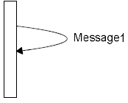
Sequence Diagram Notations (Cont.)
Acknowledgement
It represent communication between objects conveys acknowledgement
Self message
Self message occurs when an object sends a message to itself
Acknowledgement

Slide 16
Sequence Diagram for registration/login process
: User
System
Request for registration
fill form()
Display registration form()
Submit form
{ verify details }
Give Login ID
Enter Login ID
Send message {successfully login}
Logout

Slide 17
Sequence Diagram for Issue book in library
: User
: System
login
Send message {successfully login}
Request for search form
fill form()
Display Request form
Submit form
Fill details(name,enroll)
Print message {book available}
{ verify details }
Request for issue book
{ Check for availability }
Book assigned {successful}
Modify book &
Member status
Logout

Slide 18
Sequence Diagram for Online Railway Reservation System
: Traveller
: System
login
Send message {successfully login}
Request for Train Routes
fill form()
Display Train Routes
Submit form
pay(amount)
Process for Payment (amount) {Seats available}
{ check for availability }
Payment using Payment Gateway
{ Verify fund transfer }
Seat assigned {successful}
Modify seat
status
Logout

Slide 19
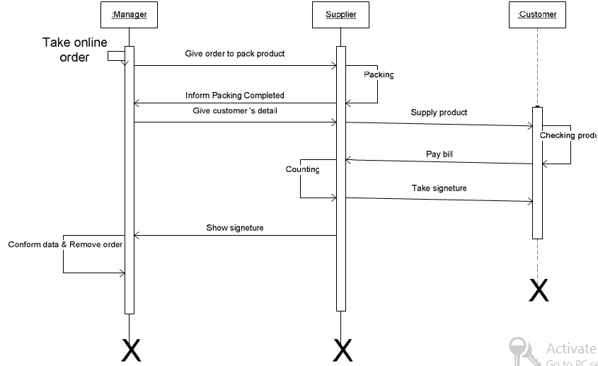
Sequence Diagram for Supply order

Slide 20


Book not available

Slide 21
Activity Diagram
An activity diagram is a type of flow chart with additional support for parallel behavior.
Activity diagram is another important diagram in UML to describe dynamic aspects of the system.
Activity diagram is basically a flow chart to represent the flow from one activity to another activity
The activity can be described as an operation of the system.
The control flow is drawn from one operation to another.
This flow can be sequential, branched or concurrent. This distinction is important for a distributed system.
Activity diagrams deals with all type of flow control by using different elements like fork, join etc.

Slide 22
Activity Diagram (Notations)
Activity
Represent individual activity of system.
Transition
Represents flow of data from one activity to another.
Decision
Decision node is a control node that accepts tokens on one or more incoming edges and selects outgoing edge from two or more outgoing flows. The notation for a decision node is a diamond-shaped symbol.
Activity

Slide 23
Activity Diagram (Notations) (Cont.)
Initial activity
Initial node is a control node at which flow starts when the activity is invoked. Activity may have more than one initial node. Initial nodes are shown as a small solid circle.
Final activity
Final node is a control final node that stops all flows in an activity. Activity final nodes are shown as a solid circle with a hollow circle inside. It can be thought of as a goal notated as "bull’s eye," or target.

Slide 24
Activity Diagram (Notations) (Cont.)
Fork
A fork in the activity diagram has a single incoming transition and multiple outgoing transitions exhibiting parallel behavior. The incoming transition triggers the parallel outgoing transitions.
Join
A join in the activity diagram synchronizes the parallel behavior started at a fork. Join ascertains that all the parallel sets of activities (irrespective of the order) are completed before the next activity starts. It is a synchronization point in the diagram. Each fork in an activity diagram has a corresponding join where the parallel behavior terminates.

Slide 25
Activity Diagram for Login
Enter Username & Password
Verify Details
[verify = false]
[verify = true]
Show Home Screen

Slide 26
Activity Diagram for Book Issue in Library
Login
[verify = false]
[verify = true]
Search Book
[book= not found]
[book= found]
Search Other Book
Issue Book
[search other= true]
Update Record
[search other= false]
Logout

