Slide 1

Unit – 2 Array, String
Prof. Arjun V. Bala
 9624822202
→ arjun.bala@darshan.ac.in
OO Programming with JAVA (2150704) Darshan Institute of Engineering & Technology

Slide 2
Array
An array is a collection of similar type of elements that have contiguous memory location and shares a common name.
Syntax : data_type variable_name[] = new type[size_of_array];
Example : int a[] = new int[10];
The data_type specifies the type of the elements that can be stored in an array, like int, float, char etc...
The size_of_array indicates the maximum number of elements that can be stores inside the array.
In the example, data type of an array is int and maximum elements that can be stored in an array are 10.
35
13
28
106
a
35
42
5
83
97
14
a[0]
a[1]
a[2]
a[3]
a[4]
a[5]
a[6]
a[7]
a[8]
a[9]

Slide 3
Array (Cont.)
Important point about Java array.
An array is derived datatype.
An array is dynamically allocated.
The individual elements of an array is refereed by their index/subscript value.
The subscript for an array always begins with 0.

Slide 4
One-Dimensional Array
An array using one subscript to represent the list of elements is called one dimensional array.
A One-dimensional array is essentially a list of like-typed variables.
Array declaration: type var-name[];
Example: int student_marks[];
Above example will represent array with no value (null).
To link student_marks with actual array of integers, we must allocate one using new keyword.
Example: int student_marks[] = new int[20];

Slide 5
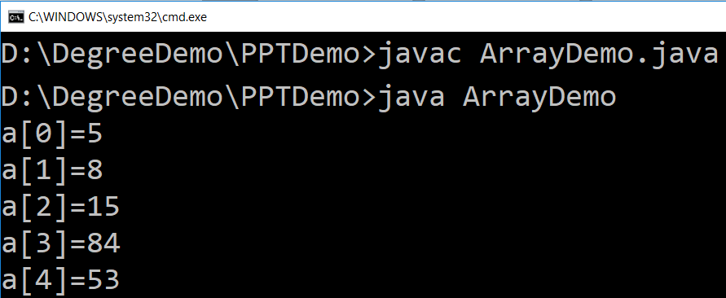
Example (Array)
public class ArrayDemo{
public static void main(String[] args) {
int a[]; // or int[] a
// till now it is null as it does not assigned any memory
a = new int[5]; // here we actually create an array
a[0] = 5;
a[1] = 8;
a[2] = 15;
a[3] = 84;
a[4] = 53;
/* in java we use length property to determine the length
* of an array, unlike c where we used sizeof function */
for (int i = 0; i < a.length; i++) {
System.out.println("a["+i+"]="+a[i]);
}
}
}

Slide 6
Multi-Dimensional Array
In java, multidimensional array is actually array of arrays.
Example: int runPerOver[][] = new int[3][6];
length field:
If we use length field with multidimensional array, it will return length of first dimension.
Here, if runPerOver.length is accessed it will return 3
Also if runPerOver[0].length is accessed it will be 6
First Over (a[0])
4
0
1
3
6
1
a[0][0]
a[0][1]
a[0][2]
a[0][3]
a[0][4]
a[0][5]
1
1
0
6
0
4
Second Over (a[1])
a[1][0]
a[1][1]
a[1][2]
a[1][3]
a[1][4]
a[1][5]
2
1
1
0
1
1
Third Over (a[2])
a[2][0]
a[2][1]
a[2][2]
a[2][3]
a[2][4]
a[2][5]

Slide 7
Multi-Dimensional Array (Example)
Scanner s = new Scanner(System.in);
int runPerOver[][] = new int[3][6];
for (int i = 0; i < 3; i++) {
for (int j = 0; j < 6; j++) {
System.out.print("Enter Run taken" +
" in Over numner " + (i + 1) +
" and Ball number " + (j + 1) + " = ");
runPerOver[i][j] = s.nextInt();
}
}
int totalRun = 0;
for (int i = 0; i < 3; i++) {
for (int j = 0; j < 6; j++) {
totalRun += runPerOver[i][j];
}
}
double average = totalRun / (double) runPerOver.length;
System.out.println("Total Run = " + totalRun);
System.out.println("Average per over = " + average);

Slide 8
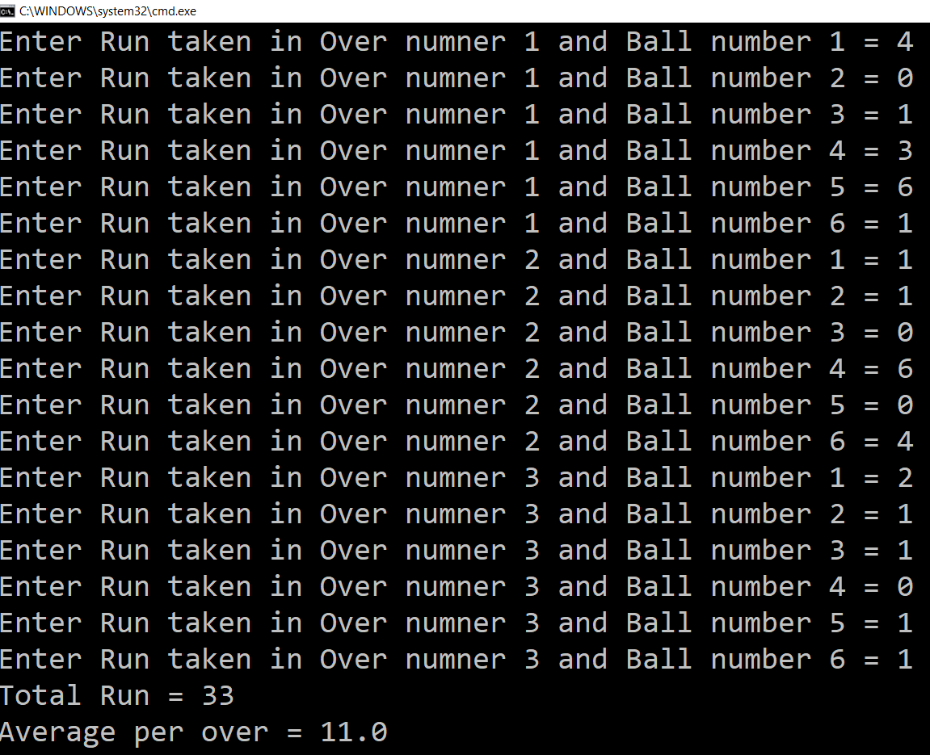
Output : Multi-Dimensional Array (Example)

Slide 9
Multi-Dimensional Array (Cont.)
manually allocate different size:
int runPerOver[][] = new int[3][];
runPerOver[0] = new int[6];
runPerOver[1] = new int[7];
runPerOver[2] = new int[6];
initialization:
int runPerOver[][] = {
{0,4,2,1,0,6},
{1,-1,4,1,2,4,0},
{6,4,1,0,2,2},
}
Note : here to specify extra runs (Wide, No Ball etc.. ) negative values are used

Slide 10
Math class
The Java Math class provides more advanced mathematical calculations other than arithmetic operator.
The java.lang.Math class contains methods which performs basic numeric operations such as the elementary exponential, logarithm, square root, and trigonometric functions.
All the methods of class Math are static.
Fields :
Math class comes with two important static fields
E : returns double value of Euler's number (i.e 2.718281828459045).
PI : returns double value of PI (i.e. 3.141592653589793).

Slide 11
Methods of class Math
Method | description | Example
double Math.abs(x) | Returns the absolute value of x | double a = -10; // value is negative 10 double ans = Math.abs(a); System.out.println(ans); //Output will be positive 10.0
double Math.min(x, y) | Returns the smaller from x and y | double a = 10, b=5; double ans = Math.min(a, b); System.out.println(ans); // Output will be 5.0
double Math.max(x, y) | Returns the larger from x and y | double a = 10, b = 5; double ans = Math.max(a, b); System.out.println(ans); // Output will be 10.0
double Math.sqrt(x) | Returns the square root of x | double a = 9; double ans = Math.sqrt(a); System.out.println(ans); // Output will be 3.0

Slide 12
Methods of class Math (Cont.)
Method | description | Example
double Math.log(x) | Returns the natural logarithm of x (log_{e} x ) | double a = Math.E; double ans = Math.log(a); System.out.println(ans); // Output will be 1.0
double Math.log10(x) | Returns the natural logarithm of x (log₁₀ x ) | double a = 10; double ans = Math.log10(a); System.out.println(ans); // Output will be 1.0
double Math.pow(x, y) | Returns the value of x raised to the y power (x ^{y} ) | double a = 5,b=2; double ans = Math.pow(a,b); System.out.println(ans); // Output will be 25.0
double Math.sin(theta) | Returns the sine of theta, measured in radians | double a = Math.sin(Math.PI/2); System.out.println(a); // Output will be 1.0

Slide 13
Methods of class Math (Cont.)
Method | description | Example
double Math.cos(theta) | Returns the cosine of theta | double a = Math.cos(Math.PI/2); System.out.println(a); // Output will be 0.0
double Math.tan(theta) | Returns the tangent of theta | double a = Math.tan(Math.PI); System.out.println(a); // Output will be 0.0
double Math.asin(x) | Returns the angle whose sine is x, returns in radians | double a = Math.asin(0); System.out.println(a); // Output will be 0.0
double Math.acos(x) | Returns the angle whose cosine is x, returns in radians | double a = Math.acos(0); System.out.println(a); // Output will be 1.57 (PI/2)
double Math.atan(x) | Returns the angle whose tangent is x, returns in radians | double a = Math.atan(0); System.out.println(a); // Output will be 0.0

Slide 14
Methods of class Math (Cont.)
Method | description | Example
double Math.toRadians(degrees) | Converts an angle from degrees to radians | double a = 180; double ans = Math.toRadians(a); System.out.println(ans); // Output will be 3.14... (PI)
double Math.toDegrees(radians) | Converts an angle from radians to degrees | double a = Math.PI; double ans = Math.toDegrees(a); System.out.println(ans); // Output will be 180.0
double Math.floor(x) | Returns the floor integer number of the given double | double a = 9.6; double ans = Math.floor(a); System.out.println(ans); // Output will be 9.0
double Math.ceil(x) | Returns the ceil integer number of the given double | double a = 9.6; double ans = Math.ceil(a); System.out.println(ans); // Output will be 10.0

Slide 15
Methods of class Math (Cont.)
Method | description | Example
double Math.round(x) | Returns the round value of the given double | double a = 9.6; double ans = Math.toRadians(a); System.out.println(ans); // Output will be 10
double Math.random() | Returns random double number between 0 & 1 | double ans = Math.random(); System.out.println(ans); // Output will be 0.3123 (random)

Slide 16
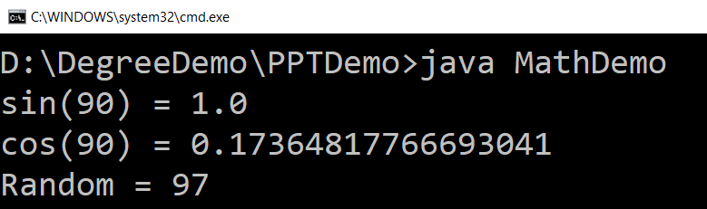
Math Example
public class MathDemo {
public static void main(String[] args) {
double sinValue = Math.sin(Math.PI / 2);
double cosValue = Math.cos(Math.toRadians(80));
int randomNumber = (int)(Math.random() * 100);
// values in Math class must be given in Radians
// (not in degree)
System.out.println("sin(90) = " + sinValue);
System.out.println("cos(90) = " + cosValue);
System.out.println("Random = " + randomNumber);
}
}

Slide 17
String Class Introduction
An object of the String class represents a string of characters.
The String class belongs to the java.lang package, which does not require an import statement.
Like other classes, String has constructors and methods.
String class has two operators, + and += (used for concatenation).

Slide 18
String Immutability
Advantage
Disadvantage
Convenient — Immutable objects are convenient because several references can point to the same object safely.
Less efficient — you need to create a new string and throw away the old one even for small changes.
String name="DIET - Rajkot";
foo(name);
//Some operations on String name
name.substring(7,13);
bar(name);
/* we will be sure that the value of name will be same for foo() as well as bar() as String is immutable its value will be same for both the functions.
*/
String word = "java";
char ch =
Character.toUpperCase(
word.charAt (0));
word = ch + word.substring (1);
word
"java"
"Java"

Slide 19
Empty String
An empty String has no characters. It’s length is 0.
Not the same as an uninitialized String.
String word1 = "";
String word2 = new String();
Empty strings
String word1;
This is null

Slide 20
String Initialization
Copy constructor creates a copy of an existing String.
Copy Constructor: Each variable points to a different copy of the String.
String word = new String("Java");
String word2 = new String(word);
word
"Java"
word2
"Java"
Assignment: Both variables point to the same String.
String word = "Java";
String word2 = word;
word
"Java"
word2

Slide 21
String Methods — length, charAt
int length();
Returns the number of characters in the string
Returns:
"Problem".length();
7
int charAt(i);
Returns the char at position i.
Character positions in strings starts from 0 – just like arrays.
Returns:
"Window".charAt (2);
'n'

Slide 22
String Methods — substring
We can obtain a portion of a string by use of substring(), It has two forms
String subs = word.substring (i, k);
returns the substring of chars in positions from i to k-1
String subs = word.substring (i);
returns the substring from the i-th char to the end
television
i k
immutable
i
Returns:
"television".substring (2,5);
"immutable".substring (2);
"rajkot".substring (9);
“lev"
“mutable"
"" (empty string)

Slide 23
String Methods — Concatenation
public class ConcatenationExample{
public static void main(String[] args) {
String word1 = "re";
String word2 = "think";
String word3 = "ing";
int num = 2;
String result = word1 + word2;
// concatenates word1 and word2 "rethink"
result = word1.concat(word2);
// the same as word1 + word2 "rethink"
result += word3;
// concatenates word3 to result "rethinking"
result += num;
// converts num to String & joins it to result "rethinking2"
}
}

Slide 24
String Methods — Find (indexOf)
String name = " ";
name.indexOf ('P');
name.indexOf ('e');
name.indexOf ("Minister");
name.indexOf ('e', 8);
name.indexOf (“xyz");
name.lastIndexOf ('e');
P | r | i | m | e |  | M | i | n | i | s | t | e | r
0 | 1 | 2 | 3 | 4 | 5 | 6 | 7 | 8 | 9 | 10 | 11 | 12 | 13
0
4
6
12
(starts searching at position 8)
-1
(not found)
18
Notes:
String has four overloaded versions of indexOf and four versions of lastIndexOf.
lastIndexOf(ch, fromPos) starts looking at fromPos and goes backward towards the beginning of the string.

Slide 25
String Methods — Equality
boolean b = word1.equals(word2);
returns true if the string word1 is equal to word2
boolean b = word1.equalsIgnoreCase(word2);
returns true if the string word1 matches word2, ignoring the case of the string.
b = "Raiders".equals("Raiders"); // will return true
b = "Raiders".equals("raiders"); // will return false
b = "Raiders".equalsIgnoreCase("raiders"); // will return true
Notes:
You cannot use relational operators for comparing the contents of strings.
word1.compareTo(word2) returns an int. Basically if word1 is “smaller” than word2, the result is negative, and if word1 is “larger” the result is positive. compareTo returns 0 whenever equals returns true.
Here is how Java docs describe compareTo:
Compares two strings lexicographically. The comparison is based on the Unicode value of each character in the strings. The character sequence represented by this String object is compared lexicographically to the character sequence represented by the argument string. The result is a negative integer if this String object lexicographically precedes the argument string. The result is a positive integer if this String object lexicographically follows the argument string. The result is zero if the strings are equal; compareTo returns 0 exactly when the equals(Object) method would return true.
This is the definition of lexicographic ordering. If two strings are different, then either they have different characters at some index that is a valid index for both strings, or their lengths are different, or both. If they have different characters at one or more index positions, let k be the smallest such index; then the string whose character at position k has the smaller value, as determined by using the < operator, lexicographically precedes the other string. In this case, compareTo returns the difference of the two character values at position k in the two string — that is, the value:
this.charAt(k)-anotherString.charAt(k)
If there is no index position at which they differ, then the shorter string lexicographically precedes the longer string. In this case, compareTo returns the difference of the lengths of the strings — that is, the value:
this.length()-anotherString.length()

Slide 26
String Methods — Comparisons
int diff = word1.compareTo(word2);
returns the “difference” word1 - word2
int diff = word1.compareToIgnoreCase(word2);
returns the “difference” word1 - word2, ignoring the case of the string.s
Usually programmers don’t care what the numerical “difference” of word1 - word2 is, what matter is if
the difference is negative (word1 less than word2),
zero (word1 and word2 are equal)
or positive (word1 grater than word2).
Often used in conditional statements.
if(word1.compareTo(word2) > 0){
//word1 grater than word2…
}
Notes:
You cannot use relational operators for comparing the contents of strings.
word1.compareTo(word2) returns an int. Basically if word1 is “smaller” than word2, the result is negative, and if word1 is “larger” the result is positive. compareTo returns 0 whenever equals returns true.
Here is how Java docs describe compareTo:
Compares two strings lexicographically. The comparison is based on the Unicode value of each character in the strings. The character sequence represented by this String object is compared lexicographically to the character sequence represented by the argument string. The result is a negative integer if this String object lexicographically precedes the argument string. The result is a positive integer if this String object lexicographically follows the argument string. The result is zero if the strings are equal; compareTo returns 0 exactly when the equals(Object) method would return true.
This is the definition of lexicographic ordering. If two strings are different, then either they have different characters at some index that is a valid index for both strings, or their lengths are different, or both. If they have different characters at one or more index positions, let k be the smallest such index; then the string whose character at position k has the smaller value, as determined by using the < operator, lexicographically precedes the other string. In this case, compareTo returns the difference of the two character values at position k in the two string — that is, the value:
this.charAt(k)-anotherString.charAt(k)
If there is no index position at which they differ, then the shorter string lexicographically precedes the longer string. In this case, compareTo returns the difference of the lengths of the strings — that is, the value:
this.length()-anotherString.length()

Slide 27
Comparison Examples
//negative differences
diff = "apple".compareTo("berry"); // a less than b
diff = "Zebra".compareTo("apple"); // Z less than a
diff = "dig".compareTo("dug"); // i less than u
diff = "dig".compareTo("digs"); // dig is shorter
//zero differences
diff = "apple".compareTo("apple"); // equal
diff = "dig".compareToIgnoreCase("DIG"); // equal
//positive differences
diff = "berry".compareTo("apple"); // b grater than a
diff = "apple".compareTo("Apple"); // a grater than A
diff = "BIT".compareTo("BIG"); // T grater than G
diff = "application".compareTo("app"); // application is longer

Slide 28
String Methods — trim
String word2 = word1.trim();
returns a new string formed from word1 by removing white space at both ends,
it does not affect whites space in the middle.
String word1 = " Hello From Darshan ";
String word2 = word1.trim();
//word2 is "Hello From Darshan" – no spaces on either end
Notes:
Note that these methods do not change the string word1 but create and return a new string.
trim() only removes whitespace at the ends of the string, not in the middle.

Slide 29
String Methods — replace
String word2 = word1.replace(oldCh, newCh);
returns a new string formed from word1 by replacing all occurrences of oldCh with newCh
String word1 = "late";
String word2 = word1.replace('l', 'h');
System.out.println(word2);
//Output : "hate"
String str1 = "Hello World";
String str2 = str1.replace("World","Everyone");
System.out.println(str2);
// Output : "Hello Everyone"
Notes:
Note that these methods do not change the string word1 but create and return a new string.
trim() only removes whitespace at the ends of the string, not in the middle.

Slide 30
String Methods — Changing Case
String word2 = word1.toUpperCase();
String word3 = word1.toLowerCase();
returns a new string formed from word1 by converting its characters to upper (lower) case
String word1 = "HeLLo";
String word2 = word1.toUpperCase(); // "HELLO"
String word3 = word1.toLowerCase(); // "hello"
Notes:
Note that these methods do not change the string word1 but create and return a new string.
trim() only removes whitespace at the ends of the string, not in the middle.

Slide 31
Remember : “String” is immutable
To “convert” word1 to upper case, replace the reference with a new reference.
Common Mistake : As String is Immutable you can not change it by directly applying functions to it.
word1 = word1.toUpperCase();
word1
“java"
“JAVA"
word1 remains unchanged
word1.toUpperCase();
Notes:
word1.toUpperCase();
doesn’t do anything. The correct statement is:
word1 = word1.toUpperCase();
The variable word1 is changed to refer to the new string returned by word1.toUpperCase(); the old string is disposed of.

Slide 32
StringBuffer Class
The java.lang.StringBuffer class is a thread-safe, mutable sequence of characters.
Following are the important points about StringBuffer:
A string buffer is like a String, but can be modified (mutable).
It contains some particular sequence of characters, but the length and content of the sequence can be changed through certain method calls.
They are safe for use by multiple threads.

Slide 33
StringBuffer Constructor
S.N | Constructor & Description
1 | StringBuffer() This constructs a string buffer with no characters in it and an initial capacity of 16 characters.
2 | StringBuffer(CharSequence seq) This constructs a string buffer that contains the same characters as the specified CharSequence.
3 | StringBuffer(int capacity) This constructs a string buffer with no characters in it and the specified initial capacity.
4 | StringBuffer(String str) This constructs a string buffer initialized to the contents of the specified string.

Slide 34
StringBuffer Methods
Addition to some methods of String class there are many other methods provided by StringBuffer class.
Method | description
append(String s) | is used to append the specified string with this string.
insert(int offset, String s) | is used to insert the specified string with this string at the specified position.
replace(int startIndex, int endIndex, String str) | is used to replace the string from specified startIndex and endIndex.
delete(int startIndex, int endIndex) | is used to delete the string from specified startIndex and endIndex.
reverse() | is used to reverse the string.

Slide 35
Remember : “StringBuffer” is mutable
As StringBuffer class is mutable we need not to replace the reference with a new reference as we have to do it with String class.
StringBuffer str1 = new StringBuffer("Hello Everyone");
str1.reverse();
// as it is mutable can not write str1 = str1.reverse();
// it will change to value of the string itself
System.out.println(str1);
// Output will be “enoyrevE olleH”

Slide 36
StringBuffer Methods : reverse
The reverse() method of StringBuffer class reverses the current string.
Simple Example to find whether a string is palindrome or not using reverse method of StringBuffer class
String str1 = "radar";
StringBuffer str2 = new StringBuffer(str1);
str2.reverse();
if(str1.equals(str2.toString())) {
System.out.println("String is Palindrome");
}
else {
System.out.println("String is not Palindrome");
}

Slide 37
StringBuffer Methods : append
Append is used to append the specified string with given string.
The append() method is overloaded like
append(char)
append(boolean)
append(int)
append(float)
append(double) etc.
StringBuffer str1 = new StringBuffer("Hello");
str1.append(" World");
System.out.println(str1); // Output will be "Hello World"

Slide 38
StringBuffer Methods : insert, delete
The insert() method inserts the given string with this string at the given position.
The delete() method of StringBuffer class deletes the string from the specified beginIndex to endIndex.
StringBuffer str1 = new StringBuffer("Hello World");
str1.insert(5, " My");
System.out.println(str1);
// Output will be "Hello My World"
StringBuffer str1 = new StringBuffer("Hello My World");
str1.delete(5, 8);
System.out.println(str1);
// Output will be "Hello World"

Slide 39
StringBuffer Methods : replace
The replace() method replaces the given string from the specified beginIndex and endIndex.
StringBuffer str1 = new StringBuffer("Hello World");
str1.replace(6, 11,"Everyone");
System.out.println(str1);
// Output will be "Hello Everyone"

Slide 40
Wrapper classes
A Wrapper class is a class whose object wraps or contains a primitive datatypes.
When we create an object to a wrapper class, it contains a field and in this field, we can store a primitive datatypes.
In other words, we can wrap a primitive value into a wrapper class object.
Use of wrapper class :
They convert primitive datatypes into objects.
The classes in java.util package handles only objects and hence wrapper classes help in this case also.
Data structures in the Collection framework, such as ArrayList and Vector, store only objects (reference types) and not primitive types.
An object is needed to support synchronization in multithreading.

Slide 41
Wrapper classes (Cont.)
Primitive datatype | Wrapper class | Example
byte | Byte | Byte b = new Byte((byte) 10);
short | Short | Short s = new Short((short) 10);
int | Integer | Integer i = new Integer(10);
long | Long | Long l = new Long(10);
float | Float | Float f = new Float(10.0);
double | Double | Double d = new Double(10.2);
char | Character | Character c = new Character('a');
boolean | Boolean | Boolean b = new Boolean(true);
Common Fields (Except Boolean):
MIN_VALUE : will return the minimum value it can store.
MAX_VALUE : will return the maximum value it can store.

Slide 42
Parsing the String
Using wrapper class we can parse string to any primitive datatype (Except char).
byte b1 = Byte.parseByte("10");
short s = Short.parseShort("10");
int i = Integer.parseInt("10");
long l = Long.parseLong("10");
float f = Float.parseFloat("10.5");
double d = Double.parseDouble("10.5");
boolean b2 = Boolean.parseBoolean("true");
char c = Character.parseCharacter('a');
Note : for Integer class we have parseInt not parseInteger

