Slide 1

Unit – 3 Classes, Objects & Methods
Prof. Arjun V. Bala
 9624822202
→ arjun.bala@darshan.ac.in
OO Programming with JAVA (2150704) Darshan Institute of Engineering & Technology

Slide 2
Class
Class is derived datatype, it combines members of different datatypes into one.
Defines new datatype (primitive ones are not enough). For Example : Car
This new datatype can be used to create objects.
A class is a template for an object .
Example :
class Car{
String company;
String model;
double price;
double milage;
………
}

Slide 3

Class: Car
Properties (Describe)
Company
Model
Color
Mfg. Year
Price
Fuel Type
Mileage
Gear Type
Power Steering
Anti-Lock braking system
Methods (Functions)
Start
Drive
Park
On_break
On_lock
On_turn

Slide 4
Object
An object is an instance of a class.
An object has a state and behavior.
Example: A dog has
states - color, name, breed as well as
behaviors – wagging the tail, barking, eating.
The state of an object is stored in fields (variables), while methods (functions) display the object's behavior.

Slide 5





Objects of a class Car
Honda City
Hyundai i20
Sumo Grand
Mercedes E class
Swift Dzire

Slide 6
Creating Object & Accessing members
new keyword creates new object
Syntax:
ClassName objName = new ClassName();
Example :
SmartPhone iPhone = new SmartPhone();
Object variables and methods can be accessed using the dot (.) operator
Example:
iPhone.storage = 8000;

Slide 7
Introducing methods
Methods represents the behavior of a class.
Remember : a Method is always invoked relative to an object. (except ….)
Syntax:
access_specifier return_type method_name(argument_list)
{
// code
}

Slide 8
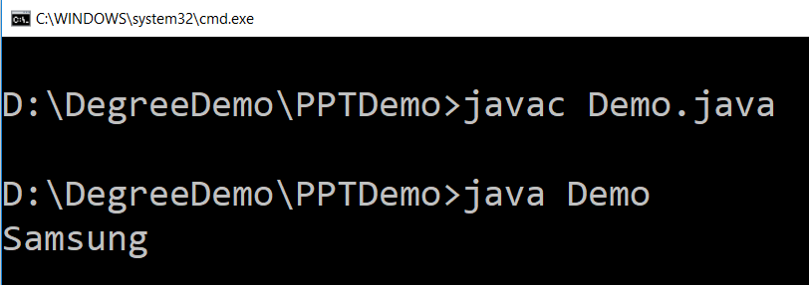
Example (method)
public class SmartPhone {
String manufacturer;
String model;
double storage;
double screenSize;
public String getManufacturer(){
return manufacturer;
}
public void setManufacturer(String a){
manufacturer = a;
}
}
public class Demo {
public static void main(String args[]) {
SmartPhone sp = new SmartPhone();
sp.setManufacturer("Samsung");
String name = sp.getManufacturer();
System.out.println(name);
}
}

Slide 9
Example (method) using this operator
public class SmartPhone {
String manufacturer;
String model;
double storage;
double screenSize;
public String getManufacturer()
{
return manufacturer;
}
public void setManufacturer(String manufacturer)
{
this.manufacturer = manufacturer;
}
}

Slide 10
Method Overloading
Overloading allows different methods to have same name, but different signatures.
Signature can differ by number of input parameters or type of input parameters or both.
Overloading is related to compile time (or static) polymorphism.

Slide 11
Example (Method Overloading)
public class OverloadingMethods {
public static void main(String[] ar) {
int ans1 = sum(5,2); // will return 7
int ans2 = sum(5,2,6); // will return 13
double ans3 = sum(5.8,6.4); // will return 12.2
// print ans1,ans2,ans3 in order to see the result
}
// Overloaded sum(). This sum takes two int parameters
public static int sum(int x, int y) {
return (x + y);
}
// Overloaded sum(). This sum takes three int parameters
public static int sum(int x, int y, int z) {
return (x + y + z);
}
// Overloaded sum(). This sum takes two double parameters
public static double sum(double x, double y) {
return (x + y);
}
}

Slide 12
Constructor
A constructor is a method that is called automatically when an instance of an object is created.
Here are the key differences between a constructor and a method:
A constructor doesn’t have a return type.
The name of the constructor must be same as the name of the class.
Unlike methods, constructors are not considered members of a class.
A constructor is called automatically when a new instance of an object is created.
Syntax :
public ClassName (parameter-list)
{
statements...
}

Slide 13
Constructor Overloading
public class Human {
double noOfBreath;
double luck;
String name;
public Human()
{
noOfBreath = 1000;
luck = 0.5;
}
public Human(String name)
{
this();
this.name = name;
}
}

Slide 14
static keyword
The static keyword is mainly used for memory management.
The static keyword belongs to the class rather than instance of the class.
The static can be:
variable (also known as class variable)
method (also known as class method)
block
nested class
The static variable can be used to refer the common property of all objects (that is not unique for each object).
The static variable gets memory only once in class area at the time of class loading.
Advantage : It makes your program memory efficient (i.e it saves memory).

Slide 15
Example without static variable
class Student{
int rollNo;
String name;
String college="darshan";
}
Student class
S1
Rollno = 101
Name = abc
College = darshan
S2
Rollno = 102
Name = xyz
College = darshan
S3
Rollno = 103
Name = bcd
College = darshan

Slide 16
Example with static variable
class Student{
int rollNo;
String name;
static String college="darshan";
}
Student class
college = darshan
S1
Rollno = 101
Name = abc
S2
Rollno = 102
Name = xyz
S3
Rollno = 103
Name = bcd

Slide 17
static methods
If you apply static keyword with any method, it is known as static method.
A static method belongs to the class rather than object of a class.
A static method can be invoked without the need for creating an instance of a class.
static method can access static data member and can change the value of it.
The static method can not use non static data member or call non-static method directly.
this and super cannot be used in static context.

Slide 18
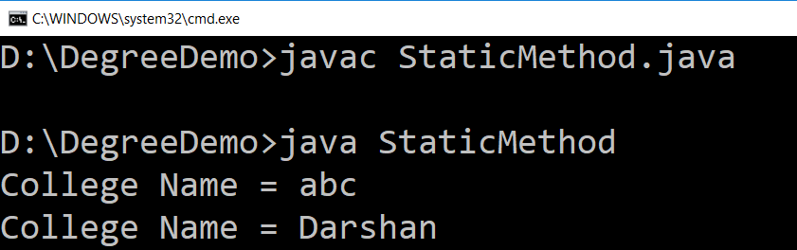
static method (Example)
public class StaticMethod {
static String college = "abc";
int rollNo ;
public void displayCollege(){
System.out.println("College Name = "+this.college);
}
public static void setCollege(String col){
StaticMethod.college = col;
rollNo = 10; // we can not use non static in static method
}
public static void main(String[] ar){
StaticMethod s1 = new StaticMethod();
StaticMethod s2 = new StaticMethod();
s1.displayCollege();
StaticMethod.setCollege("Darshan");
s2.displayCollege();
}
}

Slide 19
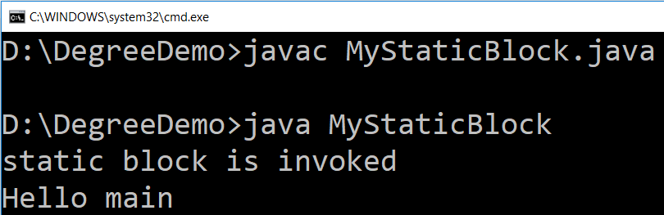
static block
Java supports a special block, called static block (also called static clause) which can be used for static initializations of a class.
This code inside static block is executed only once when the first time you make an object of that class or, the first time you access a static member of that class
public class MyStaticBlock
{
public static void main(String args[]){
System.out.println("Hello main");
}
static{
System.out.println("static block is invoked");
}
}

Slide 20
finalize() method
The finalize() is belong to java.lang.Object class.
finalize() method is called by the garbage collector on an object when garbage collector determines that there are no more references to the object.
finalize() might be used to make sure that some system resource not managed by the JRE is properly released.
A subclass overrides the finalize method to dispose of system resources or to perform other cleanup.
protected void finalize() throws Exception
{
// code to dispose resources here
}

Slide 21
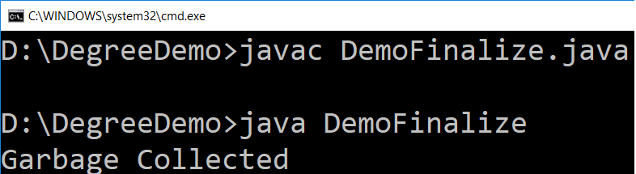
Example – finalize() method
We can also manually call finalize method by activating garbage collector using System.gc() method.
public class DemoFinalize
{
public static void main(String[] args)
{
DemoFinalize obj = new DemoFinalize();
obj=null; // to remove the reference of the object
System.gc();
}
public void finalize()
{
System.out.println("Garbage Collected");
}
}

Slide 22
Nested Class / Inner Class
Java inner class or nested class is a class which is declared inside the class or interface.
Inner classes are used to logically group classes and interfaces in one place so that it can be more readable and maintainable.
Additionally, it can access all the members of outer class including private data members and methods.
Advantages of Inner Class
It can access all the members of Outer Class
It is more readable and maintainable
It requires less code (Code Optimization)

Slide 23
Example (Inner Class)
public class DemoInnerClass{
private int a = 10;
class InnerOne
{
public void printMe()
{
System.out.println("Hello "+ a);
}
}
public static void main(String[] ar)
{
DemoInnerClass d = new DemoInnerClass();
InnerOne i = d.new InnerOne();
i.printMe();
}
}
File Name
DemoInnerClass.java

Slide 24
Abstraction
As per dictionary, abstraction is the quality of dealing with ideas rather than events.
For example, when you consider the case of WhatsApp, complex details such as what happens as soon as you send message and the protocol WhatsApp uses are hidden from the user. Therefore, to send message you just need to select the receiver, type the content and click send.
In short,
आम खाओ, गुठलियाँ मत गिनो

Slide 25
Abstraction in Java
Likewise in Object-oriented programming, abstraction is a process of hiding the implementation details from the user, only the functionality will be provided to the user.
In other words, the user will have the information on what the object does instead of how it does it.
Abstraction is achieved using Abstract classes and interfaces.

Slide 26
Abstract Class
A class which contains the abstract keyword in its declaration is known as abstract class.
Abstract classes may or may not contain abstract methods, i.e., methods without body ( public void get(); )
But, if a class has at least one abstract method, then the class must be declared abstract.
If a class is declared abstract, it cannot be instantiated.
To use an abstract class, you have to inherit it to another class and provide implementations of the abstract methods in it.

Slide 27
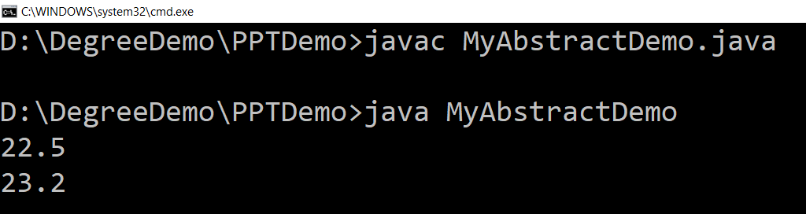
Abstract Class (Example)
abstract class Car {
public abstract double getAverage();
}
class Swift extends Car{
public double getAverage(){
return 22.5;
}
}
class Baleno extends Car{
public double getAverage(){
return 23.2;
}
}
public class MyAbstractDemo{
public static void main(String ar[]){
Swift b1 = new Swift();
Baleno b2 = new Baleno();
System.out.println(b1.getAverage());
System.out.println(b2.getAverage());
}
}
File Name
MyAbstractDemo.java

Slide 28
Lab Programs
Write a program to create circle class to find area of the circle.
Define time class with hour and minute, also define addition method to add two time object.
It is required to compute SPI (semester performance index) of n students of a class for their registered subjects in a semester. Assume that all students register for 6 subjects and each subject carry 5 credits. Also, follow GTU convention and method for computation of SPI. Declare a class called student having following data members: id_no, grades_obtained and spi. Define constructor, display and calculate_spi methods. Define main to process data of n students.
SPI = ∑(c[i]*g[i]) / ∑c[i]

