Slide 1

Unit – 4 Inheritance & Interfaces
Prof. Arjun V. Bala
 9624822202
→ arjun.bala@darshan.ac.in
OO Programming with JAVA (2150704) Darshan Institute of Engineering & Technology

Slide 2
Inheritance
Inheritance is one of the key feature of Object Oriented Programming.
Inheritance provided mechanism that allowed a class to inherit property of another class.
When a Class extends another class it inherits all non-private members including fields and methods.
Inheritance in Java can be best understood in terms of Parent and Child relationship, also known as Super class(Parent) and Sub class(Child).

Slide 3
“IS-A” relationship
Inheritance defines IS-A relationship between a Super class and its Sub class.
For Example :
Car IS A Vehicle
Bike IS A Vehicle
EngineeringCollege IS A College
MedicalCollege IS A College
MCACollege IS A College

Slide 4
“extends” keyword
extends is the keyword used to implement inheritance.
Syntax :
Example :
class A {
// code
}
class B extends A{
// code
}
class Vehicle {
. . . . . .
}
class Car extends Vehicle{
. . . . . .
}

Slide 5
Example
Vehicle
noOfPassanger
maxSpeed
noOfWheels
noOfGears
noOfPassanger
maxSpeed
noOfWheels
noOfGears
noOfPassanger
maxSpeed
noOfWheels
noOfGears
noOfPassanger
maxSpeed
noOfWheels
noOfGears
extends
extends
extends
Bike
cubicCapacity
isMoped
Bike
cubicCapacity
isMoped
Car
horsePower
noOfAirBags
tollTaxAmount()
Car
horsePower
noOfAirBags
tollTaxAmount()
Truck
horsePower
loadingCapacity
payTollTax()
Truck
horsePower
loadingCapacity
payTollTax()

Slide 6
Example (Cont.)
class Vehicle {
int noOfPassanger;
int maxSpeed;
public void display() {
System.out.println("Passangers = " + noOfPassanger);
System.out.println("Max Speed = " + maxSpeed);
}
}
class Car extends Vehicle {
double horsePower;
int noOfAirbags;
public void display() {
System.out.println("Passangers = " + noOfPassanger);
System.out.println("Max Speed = " + maxSpeed);
System.out.println("Hourse Power = " + horsePower);
System.out.println("Airbags = " + noOfAirbags);
}
}

Slide 7
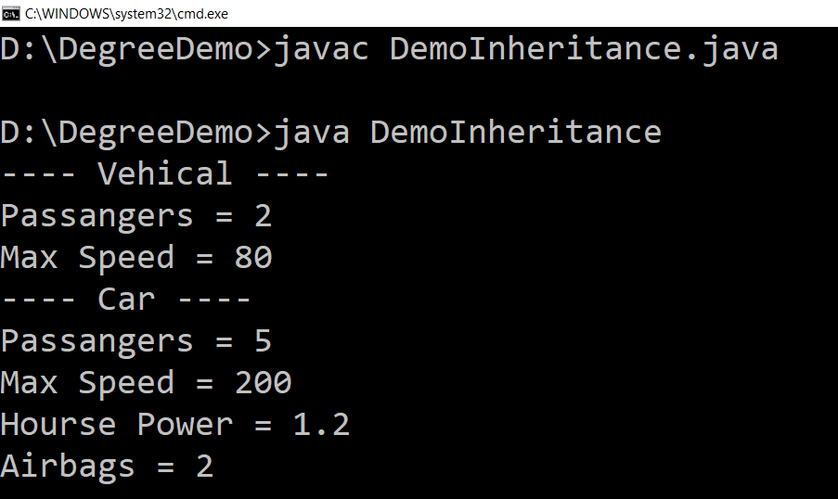
Example (DemoInheritance.java)
public class DemoInheritance {
public static void main(String ar[]) {
Vehicle v = new Vehicle();
v.maxSpeed = 80;
v.noOfPassanger = 2;
System.out.println("---- Vehical ----");
v.display();
Car c = new Car();
c.maxSpeed = 200;
c.noOfPassanger = 5;
c.horsePower = 1.2;
c.noOfAirbags = 2;
System.out.println("---- Car ----");
c.display();
}
}

Slide 8
Inheritance (Cont.)
Each Java class has one (and only one) superclass.
C++ allows multiple inheritance
BUT
Java does not support multiple inheritance
There is no limit to the number of subclasses a class can have
Inheritance creates a class hierarchy
Classes higher in the hierarchy are more
general and more abstract
Classes lower in the hierarchy are more
specific and concrete
There is no limit to the depth of the class tree.
Class
Class
Class
Class
Class
Class
Class
Class
Class
Class
Class

Slide 9
Object class
Object class is super class of all the classes.
The Object class is defined in the java.lang package
Object
….
….
….
….
….
….
….
….
….
….
….
….
….

Slide 10
Constructors in Inheritance
Classes use constructors to initialize instance variables
When a subclass object is created, its constructor is called.
It is the responsibility of the subclass constructor to invoke the appropriate superclass constructors so that the instance variables defined in the superclass are properly initialized
Superclass constructors can be called using the "super" keyword in a manner similar to "this"
It must be the first line of code in the constructor
If a call to super is not made, the system will automatically invoke the no-argument constructor of the superclass.

Slide 11
Constructor Example
import java.util.Date;
class Person
{
public String name;
public Date dateOfBirth;
public Person()
{
this.name = "Not Set";
this.dateOfBirth = new Date();
}
public Person(String name,Date dateOfBirth)
{
this.name = name;
this.dateOfBirth = dateOfBirth;
}
}

Slide 12
Constructor Example (Cont.)
import java.util.Date;
class Employe extends Person{
public int employeID;
public double salary;
public Date dateOfJoining;
public Employe(){
this.employeID = 0;
this.salary = 0;
this.dateOfJoining = new Date();
}
public Employe(String name,Date dateOfBirth,double salary,Date dateOfJoining,int employeID){
super(name,dateOfBirth);
this.employeID = employeID;
this.salary = salary;
this.dateOfJoining = dateOfJoining;
}
}

Slide 13
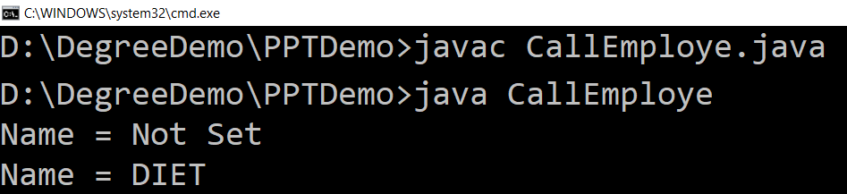
Constructor Example (Cont.)
import java.util.Date;
public class CallEmploye {
public static void main(String[] ar) {
Employe e1 = new Employe();
System.out.println("Name = " + e1.name);
Employe e2 =
new Employe("DIET",new Date(1988,10,20),1000.0,new Date(),1);
System.out.println("Name = " + e2.name);
}
}

Slide 14
Method Overriding
Subclasses inherit all methods from their superclass
Sometimes, the implementation of the method in the superclass does not provide the functionality required by the subclass.
In these cases, the method must be overridden.
Rules for Method overriding
Method signature must be same as of Super Class method.
The return type should be the same.
The access level cannot be more restrictive than the overridden method's access level.
Example :
protected -> public // is allowed
protected -> private // is not allowed

Slide 15
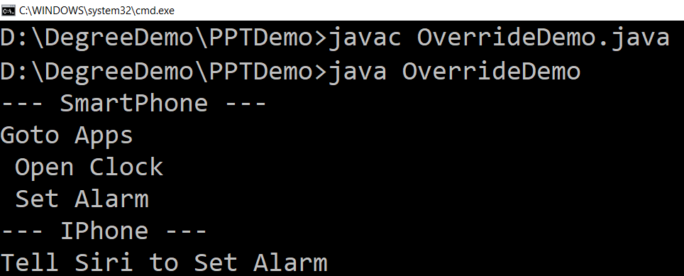
Overriding (Example)
class SmartPhone{
public void setAlarm(){
System.out.println
("Goto Apps\n
Open Clock\n
Set Alarm");
}
}
class IPhone extends SmartPhone
{
public void setAlarm()
{
System.out.println
("Tell Siri to Set Alarm");
}
}
public class OverrideDemo {
public static void main(String[] ar) {
SmartPhone s = new SmartPhone();
System.out.println("--- SmartPhone ---");
s.setAlarm();
IPhone i = new IPhone();
System.out.println("--- IPhone ---");
i.setAlarm();
}
}

Slide 16
“final” keyword
The final keyword is used for restriction.
final keyword can be used in many context
Final can be:
Variable
If you make any variable as final, you cannot change the value of final variable(It will be constant).
Method
If you make any method as final, you cannot override it.
Class
If you make any class as final, you cannot extend it.

Slide 17
1) “final” as a variable
Can not change the value of final variable.
public class FinalDemo {
final int speedlimit=90;//final variable
void run(){
speedlimit=400;
}
public static void main(String args[]){
FinalDemo obj=new FinalDemo();
obj.run();
}
}
final

Slide 18
2) “final” as a method
If you make any method as final, you cannot override it.
class BikeClass{
final void run(){System.out.println("Running Bike");}
}
class Pulsar extends BikeClass{
void run(){System.out.println("Running Pulsar");}
public static void main(String args[]){
Pulsar p= new Pulsar();
p.run();
}
}
final

Slide 19
3) “final” as a Class
If you make any class as final, you cannot extend it.
final class BikeClass{
void run(){System.out.println("Running Bike");}
}
class Pulsar extends BikeClass
{
void run(){System.out.println("Running Pulsar");}
public static void main(String args[]){
Pulsar p= new Pulsar();
p.run();
}
}
final

Slide 20
Interface
An interface is similar to an abstract class with the following exceptions
All methods defined in an interface are abstract. Interfaces can contain no implementation
Interfaces cannot contain instance variables. However, they can contain public static final variables (ie. constant class variables)
Interfaces are declared using the "interface" keyword
If an interface is public, it must be contained in a file which has the same name
Interfaces are more abstract than abstract classes
Interfaces are implemented by classes using the "implements" keyword

Slide 21
Example (Interface)
interface VehicalInterface {
int a = 10;
public void turnLeft();
public void turnRight();
public void accelerate();
public void slowDown();
}
class CarClass implements VehicalInterface
{
public void turnLeft() {
// Code to turn left
}
public void turnRight() {
// Code to turn right
}
public void accelerate() {
// Code to accelerate
}
public void slowDown() {
// Code for break
}
}
Variable in interface are by default
public, static, final

Slide 22
Interface V/S Abstract Class
Interface | Abstract Class
Interface support multiple inheritance | Abstract class does not support multiple inheritance
Interface does not contains Constructor | Abstract class contains Constructor
An interface contains only incomplete member (signature of member) | An abstract class contains both incomplete and complete member
An interface cannot have access modifiers by default everything is assumed as public | an abstract class can contain access modifiers for the stubs, functions, properties
Methods of interface can not be static | Only Complete Methods of abstract class can be static

Slide 23
Dynamic Method Dispatch
Method overriding is one of the ways in which Java supports Runtime Polymorphism.
Dynamic method dispatch is the mechanism by which a call to an overridden method is resolved at run time, rather than compile time.
A superclass reference variable can refer to a subclass object, This is also known as upcasting.

Slide 24
Example (Dynamic Method Dispatch)
class Game {
public void type() {
System.out.println("Indoor & outdoor");
}
}
class Cricket extends Game {
public void type() {
System.out.println("outdoor game");
}
}
class Badminton extends Game {
public void type() {
System.out.println("indoor game");
}
}
class Tennis extends Game {
public void type() {
System.out.println("Mix game");
}
}

Slide 25
Example (Cont.) (MyProg.java)
public class MyProg {
public static void main(String[] args) {
Game g = new Game();
Cricket c = new Cricket();
Badminton b = new Badminton();
Tennis t = new Tennis();
Scanner s = new Scanner(System.in);
String op = s.nextLine();
if (op.equals("cricket")) {
g = c;
} else if (op.equals("badminton")) {
g = b;
} else if (op.equals("tennis")) {
g = t;
}
g.type();
}
}

Slide 26
Dynamic Method Dispatch (Conclusion)
When an overridden method is called through a superclass reference, Java determines which version(superclass/subclasses) of that method is to be executed based upon the type of the object being referred to at the time the call occurs.
Thus, this determination is made at run time.

Slide 27
Static v/s Dynamic Binding
Static Binding | Dynamic Binding
Occurs during compile time | Occurs during runtime
It uses type(Class) information for binding | It uses instance of class(Object) to resolve calling of method
Overloaded methods are bonded using static binding | Overridden methods are bonded using dynamic binding
Static binding means when the type of object which is invoking the method is determined at compile time by the compiler | Dynamic binding means when the type of object which is invoking the method is determined at run time by the compiler

Slide 28
Understanding System.out.println()
System is a class in java which is in the java.lang package
out is a static member of PrintStream in the System class.
println() is a method of PrintStream Class

Slide 29
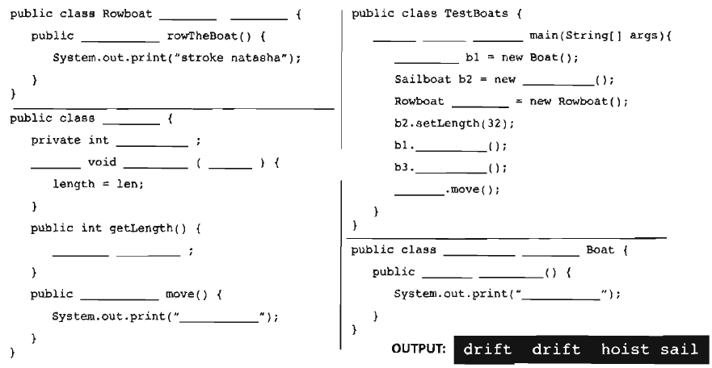
Puzzle

Slide 30
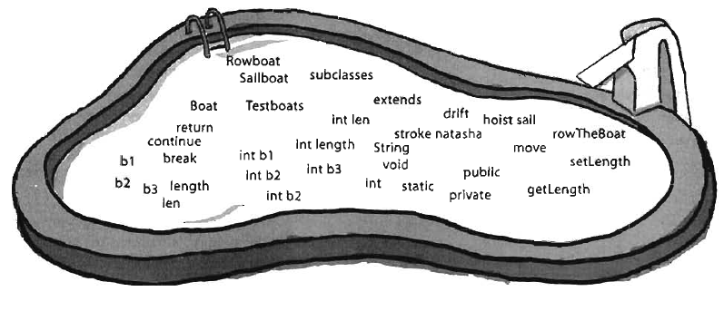
Puzzle (Cont.)

