Slide 1

Unit – 4 Pushdown Automata
Unit – 6
Scanning & Parsing
Prof. Dixita Kagathara
dixita.kagathara@darshan.ac.in

Slide 2
Topics to be covered
Programming language grammar
Classification of grammar
Ambiguity in grammatic specification
Scanning
Parsing & classification of parsing
Top down parsing
Bottom up parsing
Language processor development tools (LEX, YACC)

Slide 3
Programming language grammar

Slide 4
Formal language
Graphical symbols
{ a,b,c,d,e,f,g,h,i...........0,1,2,3.............}
words
{the, system, welcome, hello, computer, to, programming }
sentence
“hello to system programming”
A formal language is a collection of valid sentences, where each sentence is a sequence of words, and each word is a sequence of graphic symbols acceptable in a language.
Set of rules that specify the construction of words and sentences is called formal language grammar.

Slide 5
Formal language grammar
Write sentence of simple tense.
Sentence type | Rules | Example
Affirmative | subject + verb + object | She eats a fruit
Negative | subject + do/does + not + verb + object | She does not eat a fruit
Interrogative | do/does + subject + verb + object + ? | Does she eat a fruit?

Slide 6
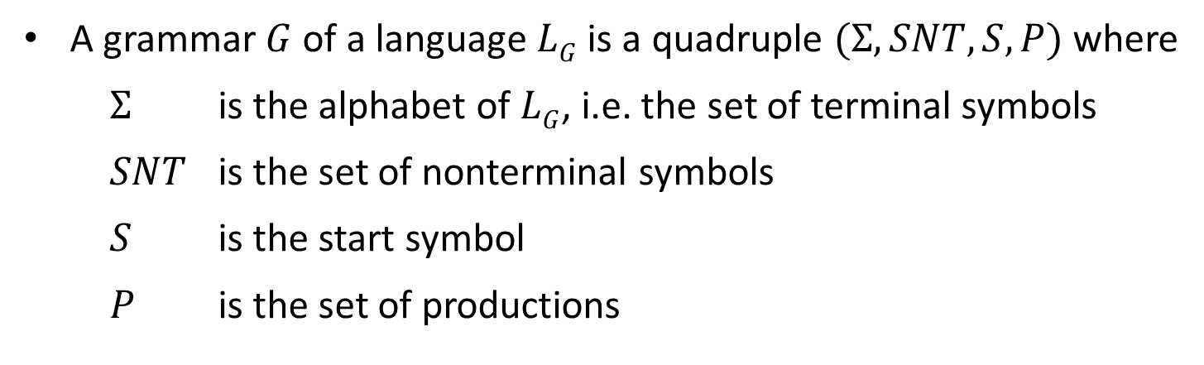
Grammar
A grammar $G$ of a language $LG$ is a quadruple $(Σ, SNT, S, P)$where
$Σ$ is the alphabet of $LG$, i.e. the set of terminal symbols
$SNT$ is the set of nonterminal symbols
$S$ is the start symbol
$P$ is the set of productions
Terminal symbol:
A symbol in the alphabet.
It is denoted by lower case letter and punctuation marks used in language.
<Noun Phrase> → <Article><Noun>
<Article> → a | an | the
<Noun> → boy | apple

Slide 7
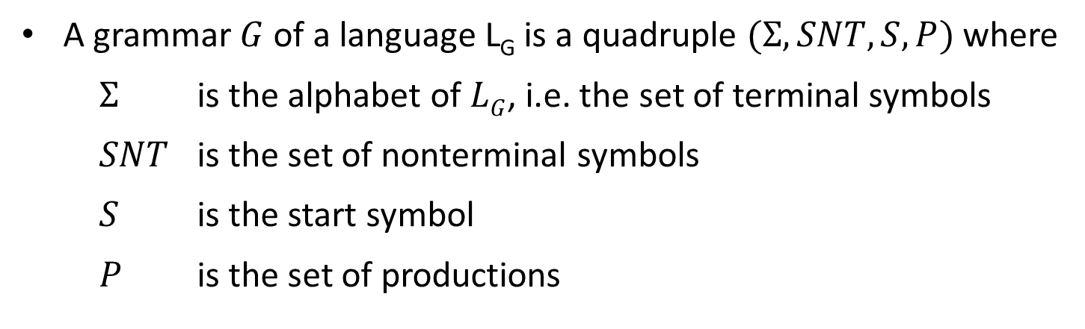
Grammar
A grammar $G$ of a language L_{G} is a quadruple $(Σ, SNT, S, P)$where
$Σ$ is the alphabet of $LG$, i.e. the set of terminal symbols
$SNT$ is the set of nonterminal symbols
$S$ is the start symbol
$P$ is the set of productions
Nonterminal symbol:
The name of syntax category of a language, e.g., noun, verb, etc.
It is written as a single capital letter, or as a name enclosed between < … >, e.g., A or <Noun>
<Noun Phrase> → <Article><Noun>
<Article> → a | an | the
<Noun> → boy | apple

Slide 8
Grammar
A grammar $G$ of a language $LG$ is a quadruple $(Σ, SNT, S, P)$where
$Σ$ is the alphabet of $LG$, i.e. the set of terminal symbols
$SNT$ is the set of nonterminal symbols
$S$ is the start symbol
$P$ is the set of productions
Start symbol: First nonterminal symbol of the grammar is called start symbol.
<Noun Phrase> → <Article><Noun>
<Article> → a | an | the
<Noun> → boy | apple

Slide 9
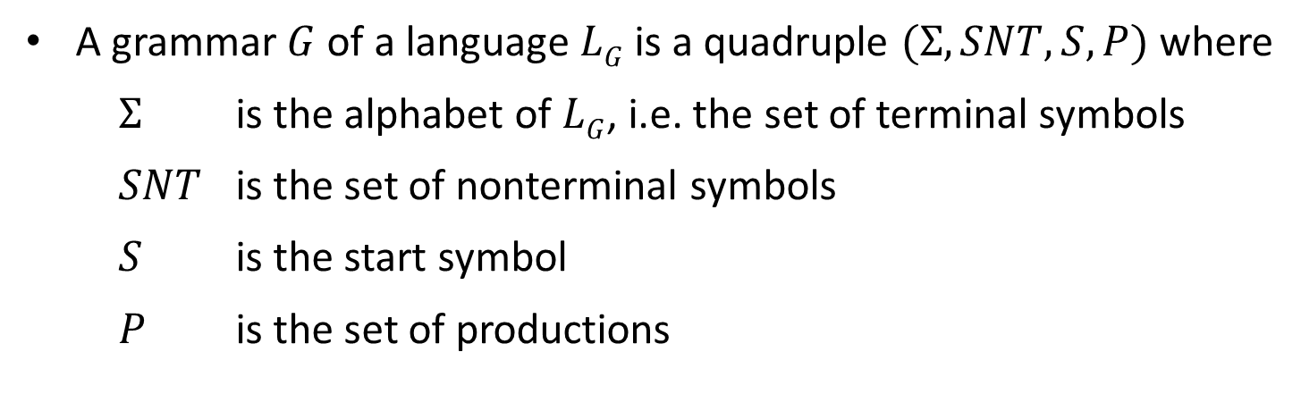
Grammar
A grammar $G$of a language $LG$ is a quadruple $(Σ, SNT, S, P)$where
$Σ$ is the alphabet of $LG$, i.e. the set of terminal symbols
$SNT$ is the set of nonterminal symbols
$S$ is the start symbol
$P$ is the set of productions
Production: A production, also called a rewriting rule, is a rule of grammar. It has the form of
A nonterminal symbol → String of terminal and nonterminal symbols
<Noun Phrase> → <Article><Noun>
<Article> → a | an | the
<Noun> → boy | apple

Slide 10
Example: Grammar
Write terminals, non terminals, start symbol, and productions for following grammar.
E → E O E| (E) | -E | id
O → + | - | * | / | ↑
Terminals: id + - * / ↑ ( )
Non terminals: E, O
Start symbol: E
Productions: E → E O E| (E) | -E | id
O → + | - | * | / | ↑

Slide 11
Exercise
Find out terminals, non terminals, start symbol and productions for following grammar:
S→A1B
A→0A | 0
B→0B | 1B | 1
E→E+E | E*E | id | (E) | -E
S→A | B
A→ABC | Acd | a
B→Bee | b
S→iEtS | iEtSeS | a
<exp>→<exp> + <term> | <term>
<term>→<term> * <factor> | <id>
<id>→ a | b | c | d

Slide 12
Classification of grammar

Slide 13
Classification of grammar (Chomsky hierarchy)
Grammar
Unrestricted grammar (type 0)
Restricted grammar
Context sensitive grammar (type 1)
Context free grammar(type 2)
Regular grammar(type 3)

Slide 14
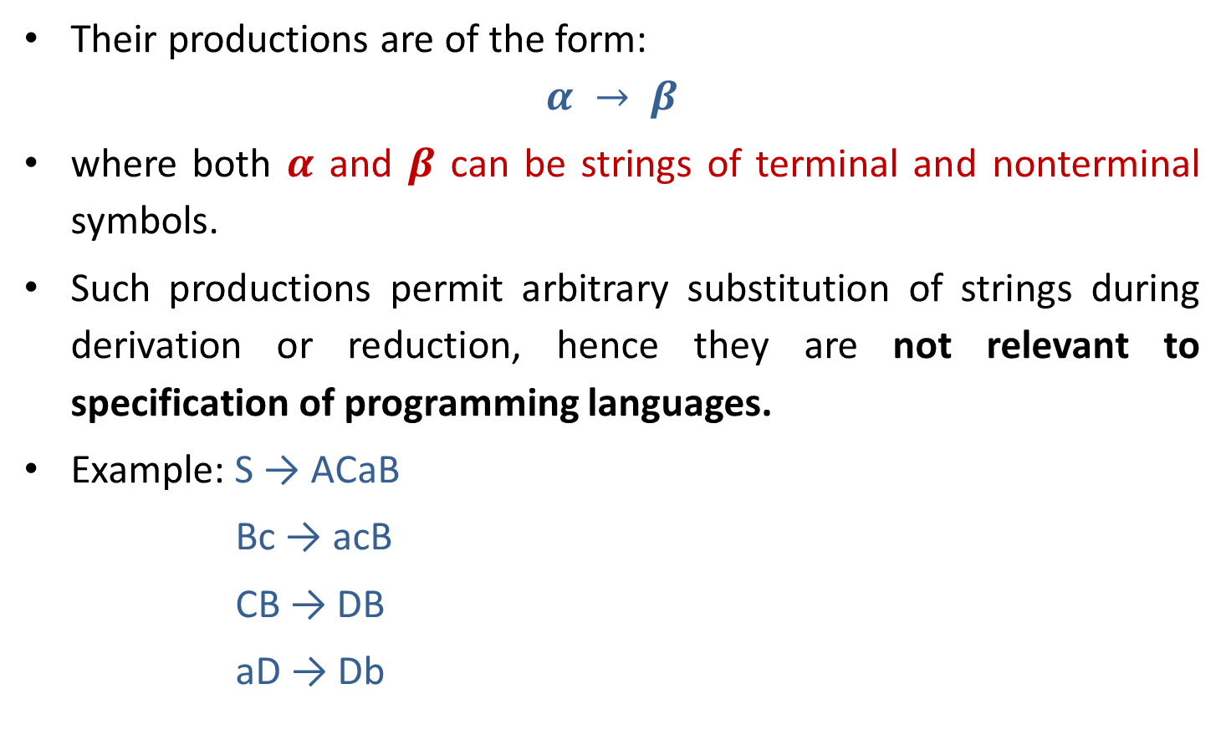
Type 0 grammar (Phrase Structure Grammar)
Their productions are of the form:
$$α → β$$
where both $α$ and $β$ can be strings of terminal and nonterminal symbols.
Such productions permit arbitrary substitution of strings during derivation or reduction, hence they are not relevant to specification of programming languages.
Example: S → ACaB
Bc → acB
CB → DB
aD → Db

Slide 15
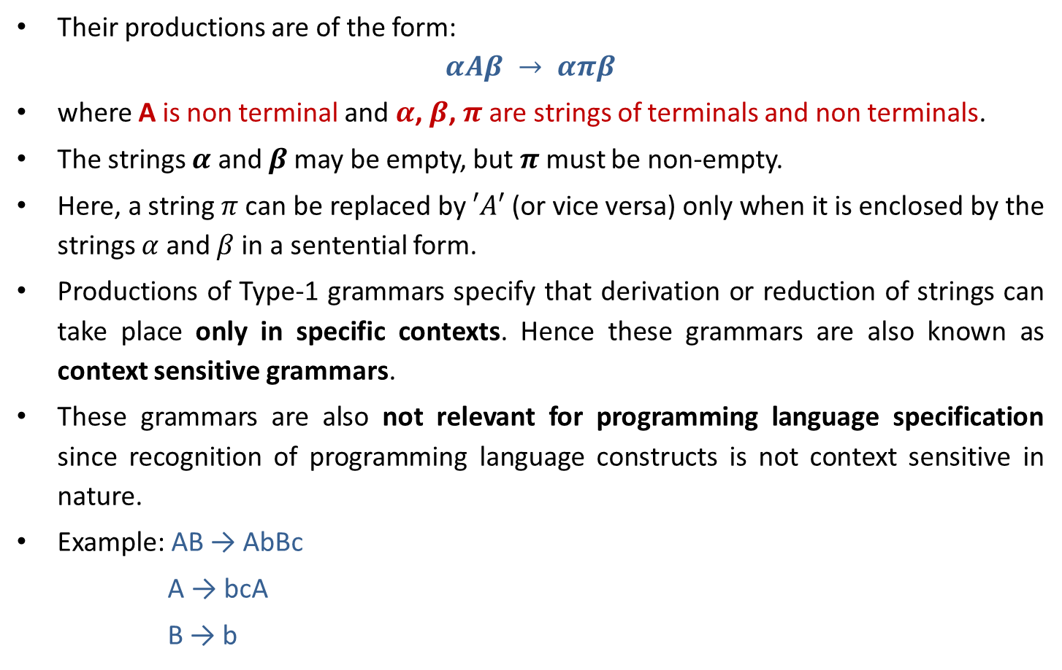
Type 1 grammar (Context Sensitive Grammar)
Their productions are of the form:
$$αAβ → απβ$$
where A is non terminal and $α$, $β$, $π$ are strings of terminals and non terminals.
The strings $α$ and $β$may be empty, but $π$ must be non-empty.
Here, a string $π$ can be replaced by $′A′$ (or vice versa) only when it is enclosed by the strings $α$ and $β$ in a sentential form.
Productions of Type-1 grammars specify that derivation or reduction of strings can take place only in specific contexts. Hence these grammars are also known as context sensitive grammars.
These grammars are also not relevant for programming language specification since recognition of programming language constructs is not context sensitive in nature.
Example: AB → AbBc
A → bcA
B → b

Slide 16
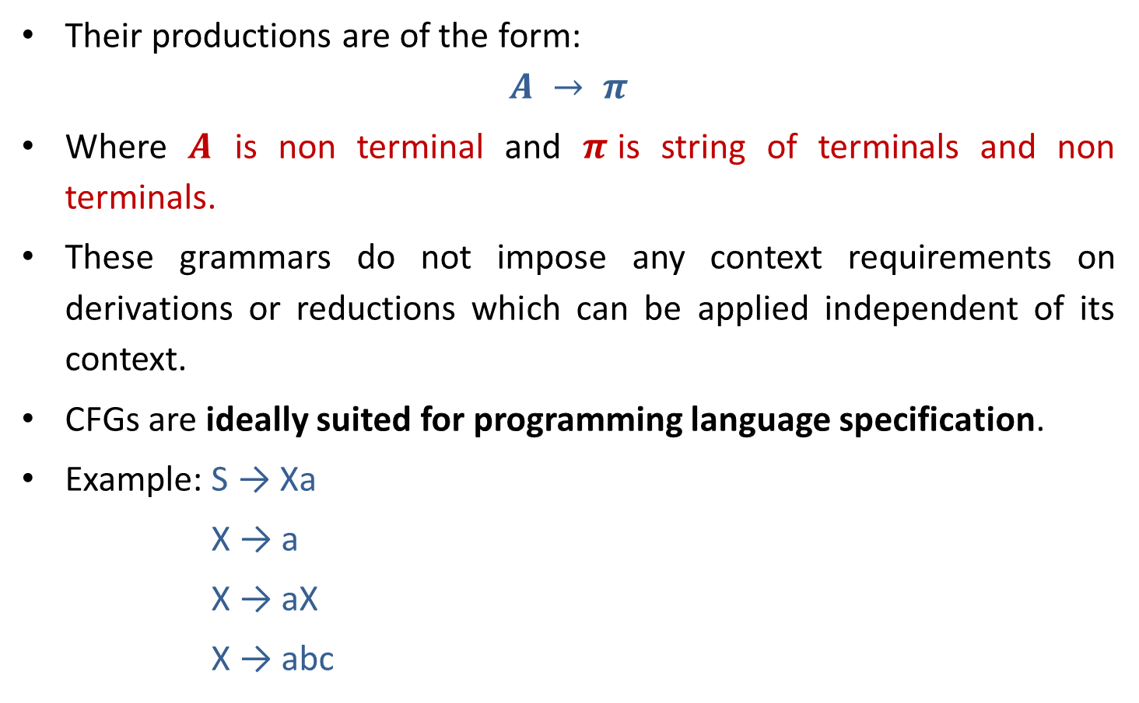
Type 2 grammar (Context Free Grammar)
Their productions are of the form:
$$A → π$$
Where $A$ is non terminal and $π$is string of terminals and non terminals.
These grammars do not impose any context requirements on derivations or reductions which can be applied independent of its context.
CFGs are ideally suited for programming language specification.
Example: S → Xa
X → a
X → aX
X → abc

Slide 17
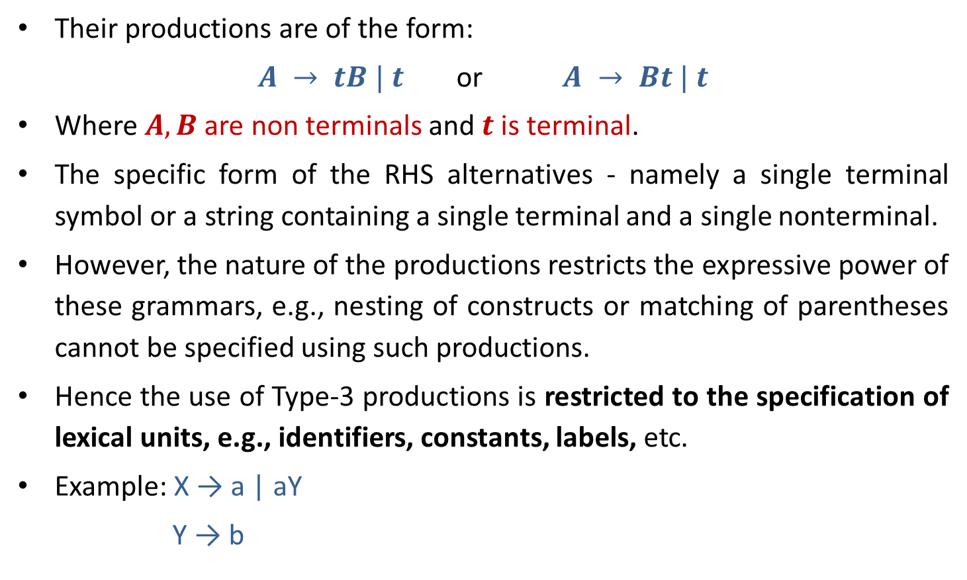
Type 3 grammar (Linear or Regular grammar)
Their productions are of the form:
$A → tB | t$ or $A → Bt | t$
Where $A, B$are non terminals and $t$ is terminal.
The specific form of the RHS alternatives - namely a single terminal symbol or a string containing a single terminal and a single nonterminal.
However, the nature of the productions restricts the expressive power of these grammars, e.g., nesting of constructs or matching of parentheses cannot be specified using such productions.
Hence the use of Type-3 productions is restricted to the specification of lexical units, e.g., identifiers, constants, labels, etc.
Example: X → a | aY
Y → b

Slide 18
Hierarchy of grammar
Type 0(Phrase structure)
Type 1(Context sensitive)
Type 2(Context free)
Type 3 (Regular)

Slide 19
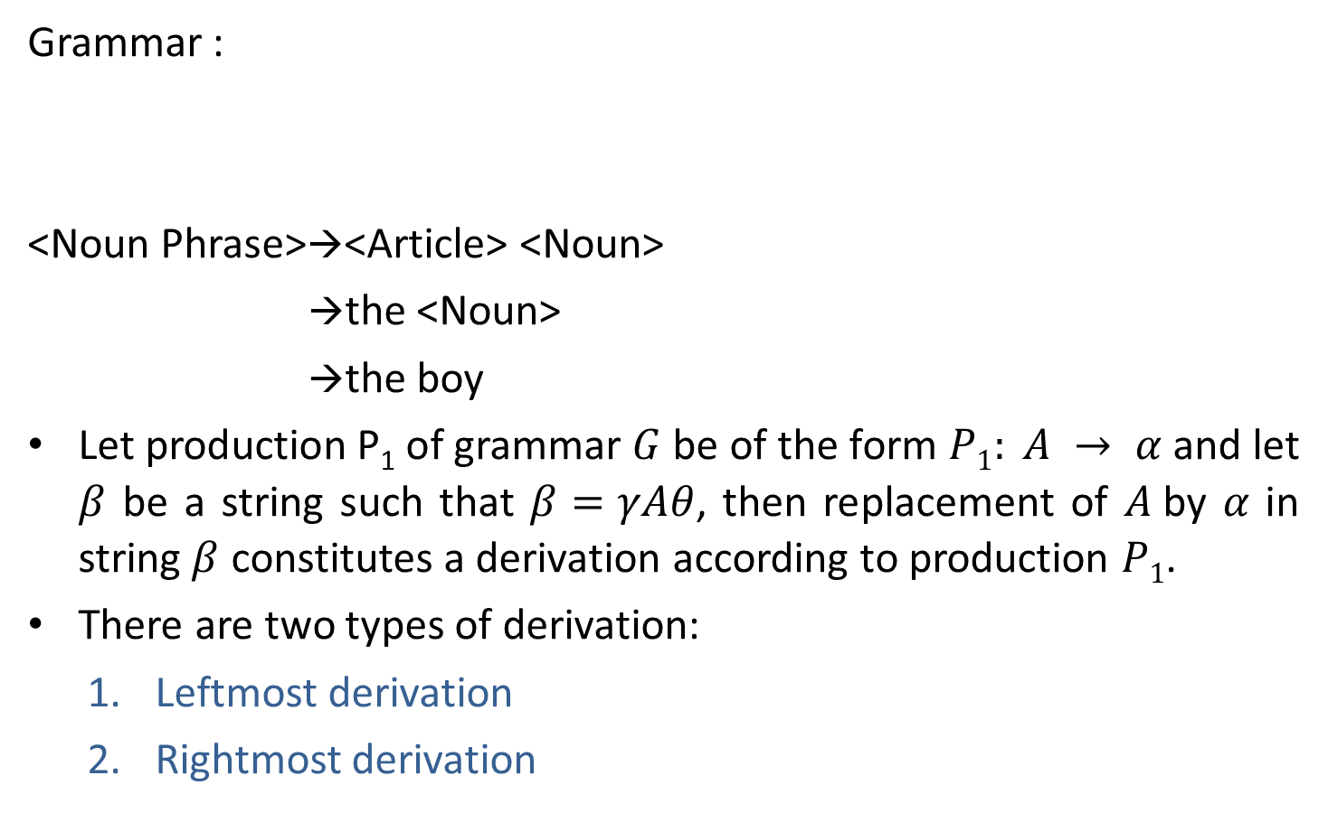
Derivation
Grammar :
<Noun Phrase>→<Article> <Noun>
→the <Noun>
→the boy
Let production P₁ of grammar $G$ be of the form $P1: A → α$and let $β$ be a string such that $β=γAθ$, then replacement of $A$by $α$ in string $β$ constitutes a derivation according to production $P1$.
There are two types of derivation:
Leftmost derivation
Rightmost derivation
<Noun Phrase> → <Article><Noun>
<Article> → a | an | the
<Noun> → boy | apple

Slide 20
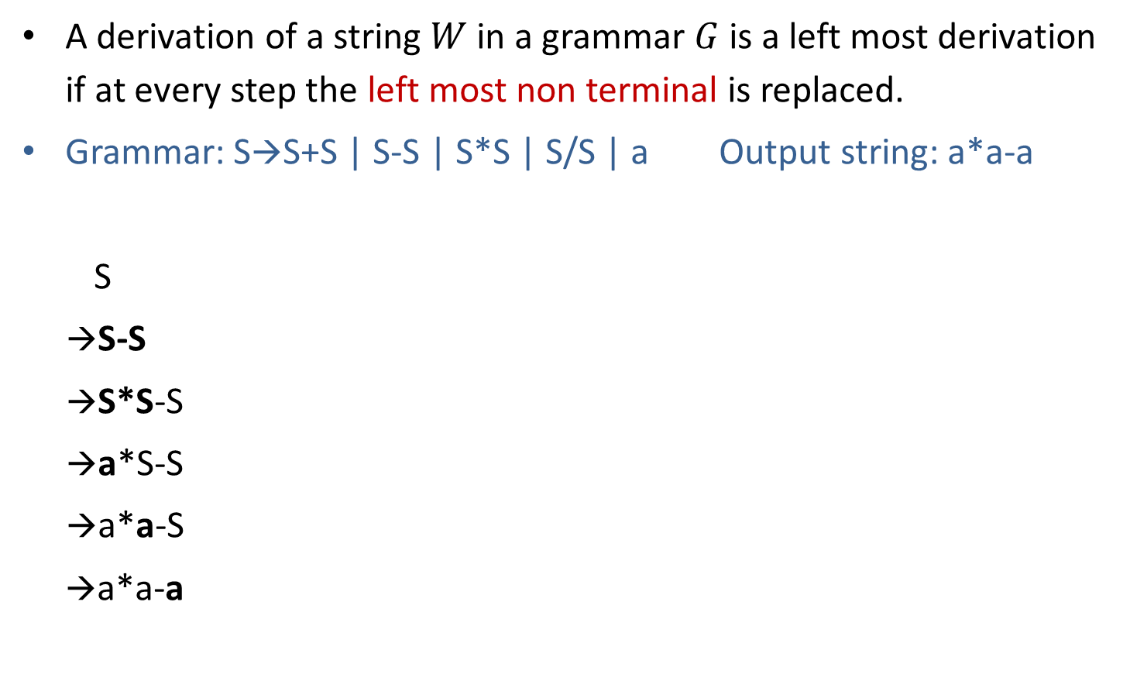
Leftmost derivation
A derivation of a string $W$ in a grammar $G$ is a left most derivation if at every step the left most non terminal is replaced.
Grammar: S→S+S | S-S | S*S | S/S | a Output string: a*a-a
S
→S-S
→S*S-S
→a*S-S
→a*a-S
→a*a-a
S
S
-
S
Parse tree represents the structure of derivation
S
*
S
a
a
a
Parse tree
Leftmost Derivation

Slide 21
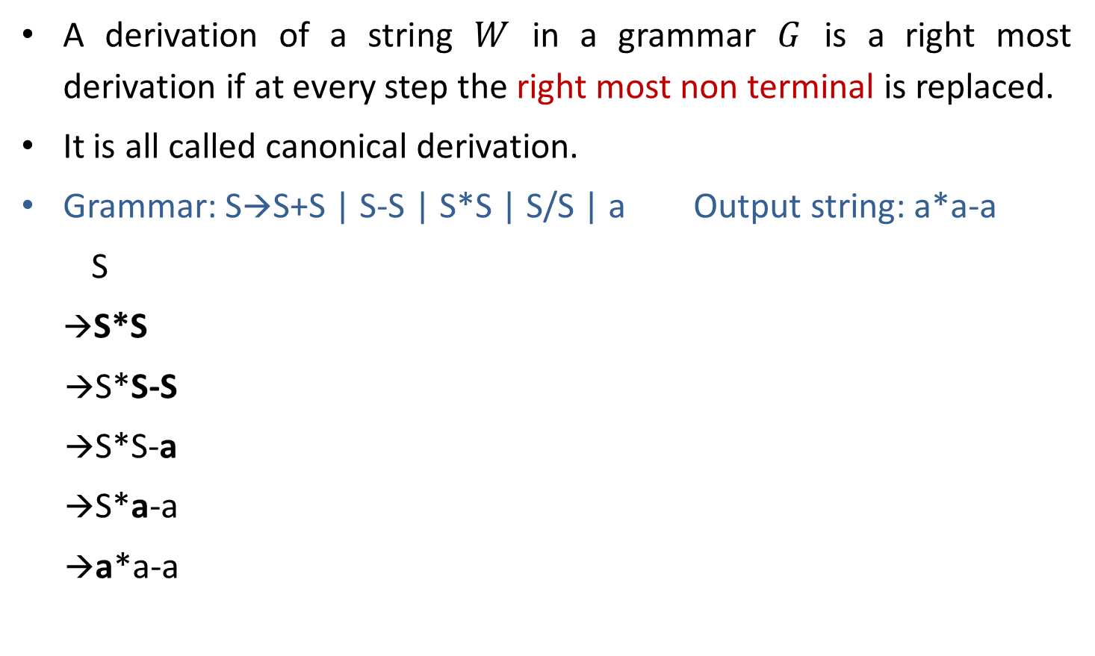
Rightmost derivation
A derivation of a string $W$ in a grammar $G$ is a right most derivation if at every step the right most non terminal is replaced.
It is all called canonical derivation.
Grammar: S→S+S | S-S | S*S | S/S | a Output string: a*a-a
S
→S*S
→S*S-S
→S*S-a
→S*a-a
→a*a-a
S
S
*
S
a
S
-
S
a
a
Parse Tree
Rightmost Derivation

Slide 22
Exercise
Perform leftmost derivation and draw parse tree.
S→A1B
A→0A | 𝜖
B→0B | 1B | 𝜖
Output string: 1001.
Perform rightmost derivation and draw parse tree.
E→E+E | E*E | id | (E) | -E
Output string : id + id * id.

Slide 23
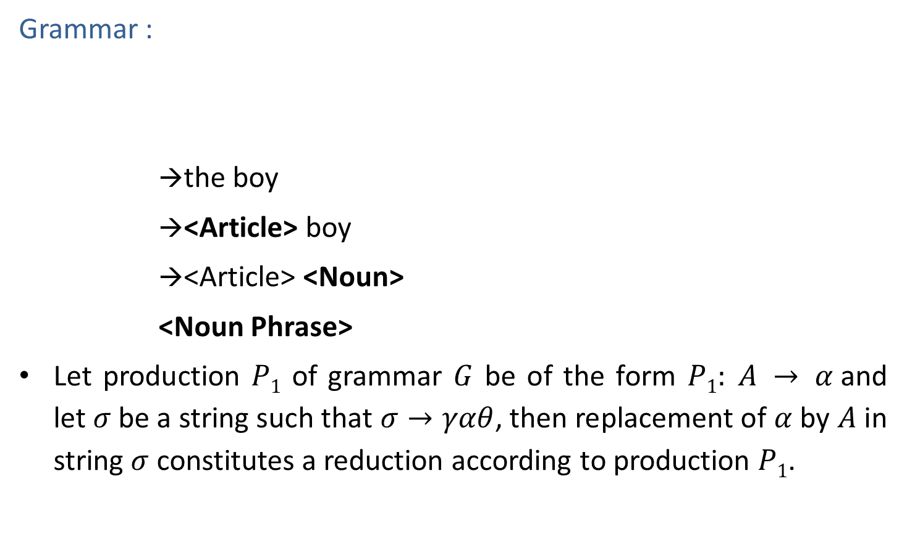
Reduction
Grammar :
→the boy
→<Article> boy
→<Article> <Noun>
<Noun Phrase>
Let production $P1$ of grammar $G$ be of the form $P1: A → α$and let $σ$be a string such that $σ→γαθ$, then replacement of $α$ by $A$ in string $σ$ constitutes a reduction according to production $P1$.
<Noun Phrase> → <Article><Noun>
<Article> → a | an | the
<Noun> → boy | apple

Slide 24
Current sentential form
Current sentential form is any string derivable from start symbol.
Grammar: S→S+S | S-S | S*S | S/S | a Output string: a*a-a
S
→S*S
→S*S-S
→S*S-a
→S*a-a
→a*a-a
Current sentential forms
(CSF)

Slide 25
Ambiguity in grammatic specification

Slide 26



Ambiguity
Ambiguity, is a word, phrase, or statement which contains more than one meaning.
A long thin piece of potato
Chip
organ
A small piece of silicon

Slide 27

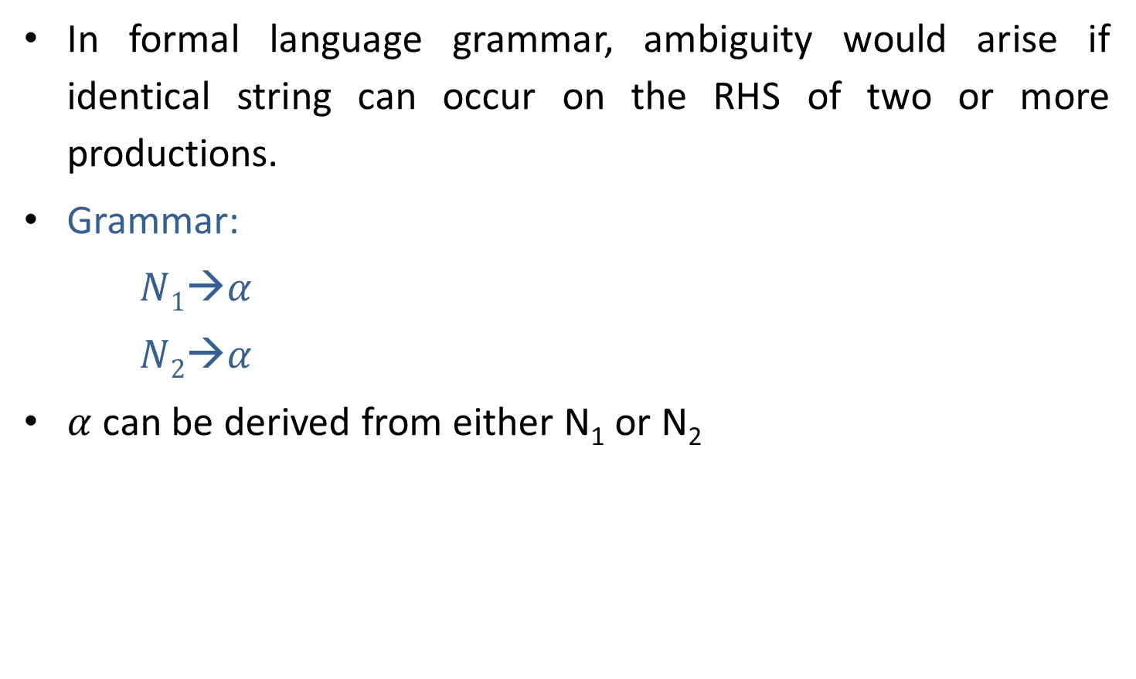



Ambiguity
In formal language grammar, ambiguity would arise if identical string can occur on the RHS of two or more productions.
Grammar:
$N1→α$
$N2→α$
$α$ can be derived from either N₁ or N₂
$$N1$$
$$N2$$
Replaced by
$N1$ or $N2$ ?
$$α$$

Slide 28
Ambiguous grammar
Ambiguous grammar is one that produces more than one leftmost or more then one rightmost derivation for the same sentence.
Grammar: S→S+S | S*S | (S) | a Output string: a+a*a
S S
→S*S →S+S
→S+S*S →a+S
→a+S*S →a+S*S
→a+a*S →a+a*S
→a+a*a →a+a*a
Here, Two leftmost derivation for string a+a*a is possible hence, above grammar is ambiguous.
S
S
S
*
S
S
+
S
S
+
S
a
a
S
*
S
a
a
a
a

Slide 29
Exercise
Check whether following grammars are ambiguous or not:
S→ aS | Sa | 𝜖 (output string: aaaa)
S→ aSbS | bSaS | 𝜖 (output string: abab)
S→ SS+ | SS* | a (output string: aa+a*)
<exp> → <exp> + <term> | <term>
<term> → <term> * <letter> | <letter>
<letter> → a|b|c|…|z (output string: a+b*c)
Prove that the CFG with productions: S → a | Sa | bSS | SSb | SbS is ambiguous (Hint: consider output string yourself)
S S
SbS Sa
abS SbSa
abSa abSa
abaa abaa
String: abaa

Slide 30
Eliminating ambiguity
Grammar: S→ S+S | S*S | (S) | a
Equivalent unambiguous grammar is
S→ S + T | T
T→ T * F | F
F→ (S) | a
Equivalent
unambiguous
grammar
Output string: a+a*a
S
→ S+T
→ T+T
→ F+T
→ a+T
→ a+T*F
→ a+F*F
→ a+a*F
→ a+a*a
Try for second leftmost derivation
Not possible????
Here, two left most derivation is not possible for string a+a*a hence, grammar is unambiguous.

Slide 31
Scanning

Slide 32

Regular expression
A regular expression is a sequence of characters that define a pattern.
Notational shorthand's
One or more occurrences: $+$
Zero or more occurrences: $∗$
Alphabets: $Σ$

Slide 33
Regular expression
a*
L = Zero or More Occurrences of a =
*
𝜖
a
aa
aaa
Infinite …..
aaaa
aaaaa…..

Slide 34
Regular expression
a⁺
L = One or More Occurrences of a =
+
a
aa
aaa
Infinite …..
aaaa
aaaaa…..

Slide 35
Precedence and associativity of operators
Operator | Precedence | Associative
Kleene * | 1 | left
Concatenation | 2 | left
Union | | 3 | left

Slide 36













Regular expression examples
0 or 1
0 or 11 or 111
String having zero or more a.
String having one or more a.
Regular expression over $Σ=\{a,b,c\}$ that represent all string of length 3.
All binary string.
$$Strings: 0, 1$$
$$R.E. =0 | 1$$
$$Strings: 0, 11, 111$$
$$R.E. =0 \left| 11 \right| 111$$
$$Strings: ε,a, aa, aaa, aaaa…..$$
$$R.E. =a∗$$
$$Strings:a, aa, aaa, aaaa…..$$
$$R.E. =a+$$
$$Strings:abc, bca, bbb, cab, aba….$$
$$R.E. =\left(a\left|b\right|c\right) \left(a\left|b\right|c\right) (a\left|b\right|c)$$
$$Strings: 0, 11, 101, 10101, 1111…$$
$$R.E. =(0 | 1)+$$

Slide 37












Regular expression examples
0 or more occurrence of either a or b or both
1 or more occurrence of either a or b or both
Binary no. ends with 0
Binary no. ends with 1
Binary no. starts and ends with 1
String starts and ends with same character
$$Strings:ε,a, aa, abab, bab…$$
$$R.E. =(a | b)∗$$
$$Strings:a, aa, abab, bab, bbbaaa…$$
$$R.E. =(a | b)+$$
$$Strings: 0, 10, 100, 1010, 11110…$$
$R.E. =(0 | 1)∗$ $0$
$$Strings:1, 101, 1001, 10101, …$$
$$R.E. =(0 | 1)∗1$$
$$Strings: 11, 101, 1001, 10101, …$$
$R.E. =1 (0 | 1)∗$ $1$
$$Strings:00, 101, aba, baab…$$
$$R.E. =1 (0 | 1)∗1 or 0 (0 | 1)∗0$$
$$a (a | b)∗a or b (a | b)∗b$$

Slide 38













Regular expression examples
All string of a and b starting with a
String of 0 and 1 ends with 00
String ends with abb
String starts with 1 and ends with 0
All binary string with at least 3 characters and 3rd character should be zero
Language which consist of exactly two b’s over the set $Σ=\{a,b\}$
$Strings:a,ab,aab,abb$…
$$R.E. =a(a | b)∗$$
$Strings:00,100,000,1000,1100$…
$$R.E. =(0 | 1)∗00$$
$Strings:abb,babb, ababb$…
$$R.E. =(a | b)∗abb$$
$Strings:10,100,110,1000,1100$…
$$R.E. =1(0 | 1)∗0$$
$Strings:000,100,1100,1001$…
$$R.E. =\left(0 | 1\right)\left(0 | 1\right)0(0 | 1)∗$$
$Strings:bb,bab,aabb,abba$…
$$R.E. =a∗b a∗b a∗$$

Slide 39













Regular expression examples
The language with $Σ=\{a,b\}$ such that 3rd character from right end of the string is always
Any no. of $a$ followed by any no. of $b$ followed by any no. of $c$
String should contain at least three $1$
String should contain exactly two $1$
Length of string should be at least 1 and at most 3
No. of zero should be multiple of 3
$Strings:aaa,aba,aaba,abb$…
$$R.E. =(a | b)∗a(a|b)(a|b)$$
$Strings:ε,abc,aabbcc,aabc,abb$…
$$R.E. =a∗b∗c∗$$
$Strings:111,01101,0101110$….
$$R.E. ={(0|1)}^{∗}1{ (0|1)}^{∗}1{ (0|1)}^{∗}1 {(0|1)}^{∗}$$
$Strings:11,0101,1100,010010,100100$….
$$R.E. =0^{∗}10^{∗}10^{∗}$$
$Strings:0,1,11,01,111,010,100$….
$$R.E. =\left(0|1\right) \left| \left(0|1\right)\left(0|1\right) \right| \left(0|1\right)\left(0|1\right)\left(0|1\right)$$
$Strings:000,010101,110100,000000,100010010$….
$$R.E. ={(1^{∗}01^{∗}01^{∗}01^{∗})}^{∗}$$

Slide 40













Regular expression examples
The language with $Σ=\{a,b,c\}$ where $a$ should be multiple of 3
Even no. of 0
String should have odd length
String should have even length
String start with 0 and has odd length
String start with 1 and has even length
$$Strings:aaa, baaa,bacaba,aaaaaa..$$
$$R.E. ={({\left(b|c\right)}^{∗}a{\left(b|c\right)}^{∗}a{\left(b|c\right)}^{∗}a{\left(b|c\right)}^{∗})}^{∗}$$
$Strings:00,0101,0000,100100$….
$$R.E. ={(1^{∗}01^{∗}01^{∗})}^{∗}$$
$Strings:0,010,110,000,10010$….
$$R.E. ={\left(0|1\right) (\left(0 | 1\right)(0|1))}^{∗}$$
$Strings:00,0101,0000,100100$….
$$R.E. ={ (\left(0 | 1\right)(0|1))}^{∗}$$
$Strings:0,010,010,000,00010$….
$$R.E. ={\left(0\right) (\left(0 | 1\right)(0|1))}^{∗}$$
$Strings:10,1100,1000,100100$….
$$R.E. ={ 1(0|1)(\left(0 | 1\right)(0|1))}^{∗}$$

Slide 41








Regular expression examples
All string begins or ends with 00 or 11
Language of all string containing both 11 and 00 as substring
String ending with 1 and not contain 00
Language of C identifier
$$Strings: 00101, 10100,110,01011…$$
$$R.E. =(00|11)(0 | 1)∗| \left(0 | 1\right)∗(00|11)$$
$$Strings: 0011, 1100,100110,010011…$$
$$R.E. ={((0|1)}^{∗}00{(0|1)}^{∗}11{(0|1)}^{∗}) |{ ((0|1)}^{∗}11{(0|1)}^{∗}00{(0|1)}^{∗})$$
$$Strings: 011, 1101,1011….$$
$$R.E. =\left(1 | 01\right)+$$
$$Strings:area, i, redious, grade1….$$
$$R.E. ={(_+L)(_ + L +D)}^{∗}$$
$$where L is Letter \& D is digit$$

Slide 42
Finite state automata

Slide 43
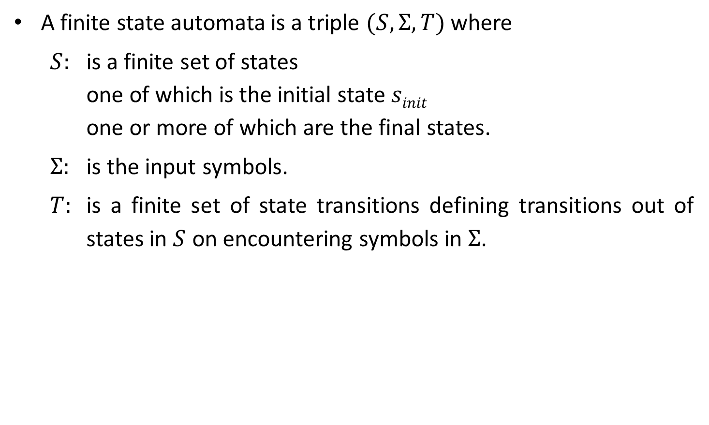
Finite state automata
A finite state automata is a triple $(S, Σ, T)$where
$S:$ is a finite set of states one of which is the initial state $sinit$ one or more of which are the final states.
$Σ:$ is the input symbols.
$T:$ is a finite set of state transitions defining transitions out of states in $S$ on encountering symbols in $Σ$.

Slide 44
Finite state automata notations
is a state
is a transition
is a start state
is a final state

Slide 45

Types of finite automata
Types of finite automata:
Deterministic finite automata (DFA): In DFA for each state exactly one edge leaving out for each symbol.
Nondeterministic finite automata (NFA): In NFA there are no restrictions on the edges leaving a state. There can be several with the same symbol as label and some edges can be labeled with $ε$.
b
a
1
a
2
b
3
b
4
1
a
2
b
3
b
4
a
a
b
a
b
DFA
NFA

Slide 46





Exercise
Identify whether it's NFA or DFA?
𝜖
b
0,1
a
B
$$a$$
B
1
a
D
1
𝜖
2
3
𝜖
$$4$$
0
b
1
A
b
C
0
0
0
1
𝜖
0
1
1
$$A$$
b
$$B$$
b
$$C$$
A
a
1
C
a
E
1
0
1
E
a
D

Slide 47
Regular expression to NFA using Thompson's rule

Slide 48





Regular expression to NFA (Thompson’s construction)
For $∈$ , construct the NFA
For $a$ in $Σ$, construct the NFA
start
$$i$$
𝜖
$$f$$
start
$$i$$
a
$$f$$

Slide 49



Regular expression to NFA (Thompson’s construction)
For regular expression $s|t$
Ex: (a|b)
N(s)
𝜖
𝜖
start
$$i$$
$$f$$
N(t)
𝜖
𝜖
2
a
3
𝜖
𝜖
1
6
𝜖
4
5
𝜖
b

Slide 50



Regular expression to NFA (Thompson’s construction)
For regular expression $st$
Ex: ab
start
N(s)
N(t)
$$i$$
$$f$$
1
a
2
b
3

Slide 51





Regular expression to NFA (Thompson’s construction)
For regular expression $s$*
Ex: a*
𝜖
start
$$i$$
𝜖
N(s)
𝜖
$$f$$
𝜖
𝜖
1
𝜖
2
$$a$$
3
𝜖
$$4$$
𝜖

Slide 52









Regular expression to NFA examples
a*b
b*ab
𝜖
1
𝜖
2
$$a$$
3
𝜖
$$4$$
$$b$$
$$5$$
𝜖
𝜖
1
𝜖
2
$$b$$
3
𝜖
$$4$$
$$a$$
5
$$b$$
$$6$$
𝜖

Slide 53
Regular expression to NFA examples
(c|d)
(c|d)*
2
c
3
𝜖
𝜖
1
6
𝜖
4
5
𝜖
d
𝜖
2
c
3
𝜖
𝜖
𝜖
𝜖
0
1
6
7
𝜖
4
5
𝜖
d
𝜖

Slide 54
Exercise
Convert following regular expression to NFA:
abba
bb(a)*
(a|b)*
a* | b*
a(a)*ab
aa*+ bb*
(a+b)*abb
10(0+1)*1
(a+b)*a(a+b)
(0+1)*010(0+1)*
(010+00)*(10)*
100(1)*00(0+1)*

Slide 55
Conversion from NFA to DFA using subset construction method

Slide 56
Conversion from NFA to DFA
(a|b)
abb
*
𝜖
a
2
3
𝜖
𝜖
𝜖
𝜖
7
a
8
b
9
b
10
0
1
6
𝜖
4
5
𝜖
b
𝜖
ε – closure (0)

Slide 57
Conversion from NFA to DFA
(a|b)
abb
*
𝜖
a
2
3
𝜖
𝜖
𝜖
𝜖
7
a
8
b
9
b
10
0
1
6
𝜖
4
5
𝜖
b
𝜖
𝜖- Closure(0)=
{0, 1, 7, 2, 4}
= {0,1,2,4,7}
---- A
ε – closure (0)

Slide 58
Conversion from NFA to DFA
𝜖
a
2
3
𝜖
𝜖
𝜖
𝜖
7
a
8
b
9
b
10
0
1
6
𝜖
4
5
𝜖
b
States | a | b
𝜖
A = {0,1,2,4,7} | B
A= {0, 1, 2, 4, 7}
B = {1,2,3,4,6,7,8}
Move(A,a)
= {3,8}
𝜖- Closure(Move(A,a))
= {3, 6, 7, 1, 2, 4, 8}
= {1,2,3,4,6,7,8}
---- B

Slide 59
Conversion from NFA to DFA
𝜖
a
2
3
𝜖
𝜖
𝜖
𝜖
7
a
8
b
9
b
10
0
1
6
𝜖
4
5
𝜖
b
States | a | b
𝜖
A = {0,1,2,4,7} | B | C
A= {0, 1, 2, 4, 7}
B = {1,2,3,4,6,7,8}
Move(A,b) =
C = {1,2,4,5,6,7}
{5}
𝜖- Closure(Move(A,b)) =
{5, 6, 7, 1, 2, 4}
= {1,2,4,5,6,7}
---- C

Slide 60
Conversion from NFA to DFA
𝜖
a
2
3
𝜖
𝜖
𝜖
𝜖
7
a
8
b
9
b
10
0
1
6
𝜖
4
5
𝜖
b
States | a | b
𝜖
A = {0,1,2,4,7} | B | C
B = {1, 2, 3, 4, 6, 7, 8}
B = {1,2,3,4,6,7,8} | B
Move(B,a)
= {3,8}
C = {1,2,4,5,6,7}
𝜖- Closure(Move(B,a))
= {3, 6, 7, 1, 2, 4, 8}
= {1,2,3,4,6,7,8}
---- B

Slide 61
Conversion from NFA to DFA
𝜖
a
2
3
𝜖
𝜖
𝜖
𝜖
7
a
8
b
9
b
10
0
1
6
𝜖
4
5
𝜖
b
States | a | b
𝜖
A = {0,1,2,4,7} | B | C
B= {1, 2, 3, 4, 6, 7, 8}
B = {1,2,3,4,6,7,8} | B | D
Move(B,b)
= {5,9}
C = {1,2,4,5,6,7}
𝜖- Closure(Move(B,b))
= {5, 6, 7, 1, 2, 4, 9}
D = {1,2,4,5,6,7,9}
= {1,2,4,5,6,7,9}
---- D

Slide 62
Conversion from NFA to DFA
𝜖
a
2
3
𝜖
𝜖
𝜖
𝜖
7
a
8
b
9
b
10
0
1
6
𝜖
4
5
𝜖
b
States | a | b
𝜖
A = {0,1,2,4,7} | B | C
C= {1, 2, 4, 5, 6 ,7}
B = {1,2,3,4,6,7,8} | B | D
Move(C,a)
= {3,8}
C = {1,2,4,5,6,7} | B
𝜖- Closure(Move(C,a))
D = {1,2,4,5,6,7,9}
= {3, 6, 7, 1, 2, 4, 8}
= {1,2,3,4,6,7,8}
---- B

Slide 63
Conversion from NFA to DFA
𝜖
a
2
3
𝜖
𝜖
𝜖
𝜖
7
a
8
b
9
b
10
0
1
6
𝜖
4
5
𝜖
b
States | a | b
𝜖
A = {0,1,2,4,7} | B | C
C= {1, 2, 4, 5, 6, 7}
B = {1,2,3,4,6,7,8} | B | D
Move(C,b) =
{5}
C = {1,2,4,5,6,7} | B | C
𝜖- Closure(Move(C,b))=
D = {1,2,4,5,6,7,9}
{5, 6, 7, 1, 2, 4}
= {1,2,4,5,6,7}
---- C

Slide 64
Conversion from NFA to DFA
𝜖
a
2
3
𝜖
𝜖
𝜖
𝜖
7
a
8
b
9
b
10
0
1
6
𝜖
4
5
𝜖
b
States | a | b
𝜖
A = {0,1,2,4,7} | B | C
D= {1, 2, 4, 5, 6, 7, 9}
B = {1,2,3,4,6,7,8} | B | D
Move(D,a)
= {3,8}
C = {1,2,4,5,6,7} | B | C
𝜖- Closure(Move(D,a))
D = {1,2,4,5,6,7,9} | B
= {3, 6, 7, 1, 2, 4, 8}
= {1,2,3,4,6,7,8}
---- B

Slide 65
Conversion from NFA to DFA
𝜖
a
2
3
𝜖
𝜖
𝜖
𝜖
7
a
8
b
9
b
10
0
1
6
𝜖
4
5
𝜖
b
States | a | b
𝜖
A = {0,1,2,4,7} | B | C
D= {1, 2, 4, 5, 6, 7, 9}
B = {1,2,3,4,6,7,8} | B | D
Move(D,b)
= {5,10}
C = {1,2,4,5,6,7} | B | C
𝜖- Closure(Move(D,b))
= {5, 6, 7, 1, 2, 4, 10}
D = {1,2,4,5,6,7,9} | B | E
E = {1,2,4,5,6,7,10}
= {1,2,4,5,6,7,10}
---- E

Slide 66
Conversion from NFA to DFA
𝜖
a
2
3
𝜖
𝜖
𝜖
𝜖
7
a
8
b
9
b
10
0
1
6
𝜖
4
5
𝜖
b
States | a | b
𝜖
A = {0,1,2,4,7} | B | C
E= {1, 2, 4, 5, 6, 7, 10}
B = {1,2,3,4,6,7,8} | B | D
Move(E,a)
= {3,8}
C = {1,2,4,5,6,7} | B | C
𝜖- Closure(Move(E,a))
D = {1,2,4,5,6,7,9} | B | E
= {3, 6, 7, 1, 2, 4, 8}
E = {1,2,4,5,6,7,10} | B
= {1,2,3,4,6,7,8}
---- B

Slide 67
Conversion from NFA to DFA
𝜖
a
2
3
𝜖
𝜖
𝜖
𝜖
7
a
8
b
9
b
10
0
1
6
𝜖
4
5
𝜖
b
States | a | b
𝜖
A = {0,1,2,4,7} | B | C
E= {1, 2, 4, 5, 6, 7, 10}
B = {1,2,3,4,6,7,8} | B | D
Move(E,b)=
C = {1,2,4,5,6,7} | B | C
{5}
𝜖- Closure(Move(E,b))=
{5,6,7,1,2,4}
D = {1,2,4,5,6,7,9} | B | E
E = {1,2,4,5,6,7,10} | B | C
= {1,2,4,5,6,7}
---- C

Slide 68



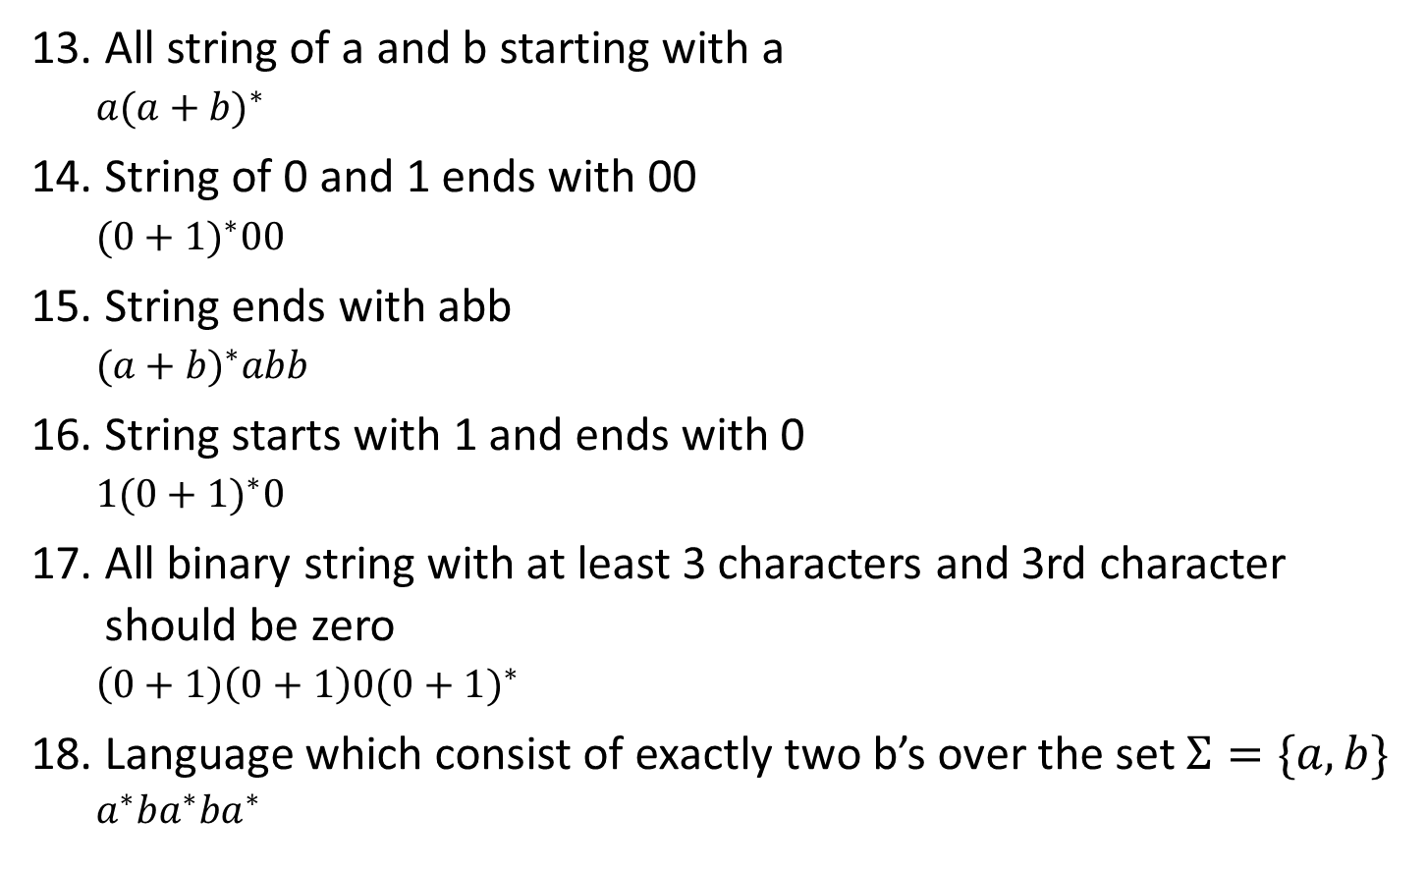

DFA
a
b
States | a | b
$$B$$
$$D$$
a
A = {0,1,2,4,7} | B | C
a
B = {1,2,3,4,6,7,8} | B | D
$$A$$
a
a
b
C = {1,2,4,5,6,7} | B | C
D = {1,2,4,5,6,7,9} | B | E
b
$$C$$
$$E$$
E = {1,2,4,5,6,7,10} | B | C
b
Transition Table
b
Note:
Accepting state in NFA is 10
10 is element of E
So, E is acceptance state in DFA
DFA

Slide 69
Exercise
Convert following regular expression to DFA using subset construction method:
(a+b)*a(a+b)
(a+b)*ab*a

Slide 70
DFA Optimization

Slide 71




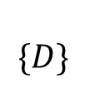
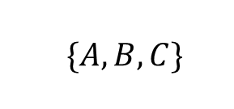

DFA Optimization
$$\{A,B,C,D,E\}$$
States | a | b
A | B | C
Nonaccepting States $\{A,B,C,D\}$
Accepting States
$$\{E\}$$
B | B | D
C | B | C
$\{A,B,C\}$
D | B | E
$$\{D\}$$
E | B | C
$\{A,C\}$
$\{B\}$
States | a | b
A | B | A
B | B | D
Now no more splitting is possible.
D | B | E
If we chose A as the representative for group (AC), then we obtain reduced transition table
E | B | A
Optimized Transition Table

Slide 72
Parsing

Slide 73
Parsing
Parsing is a technique that takes input string and produces output either as a parse tree if string is valid sentence of grammar, or an error message indicating that string is not valid.
Types of parsing are:
Top down parsing: Top down parser starts from the root and works up to the leaves.
Bottom up parsing: Bottom up parser starts from leaves and works up to the root.

Slide 74
Classification of parsing methods
Parsing
Top down parsing
Bottom up parsing (Shift reduce)
Naïve top down (Back tracking)
Naïve bottom up
Parsing without backtracking (predictive parsing)
Operator precedence
LL(1)
Recursive
descent

Slide 75



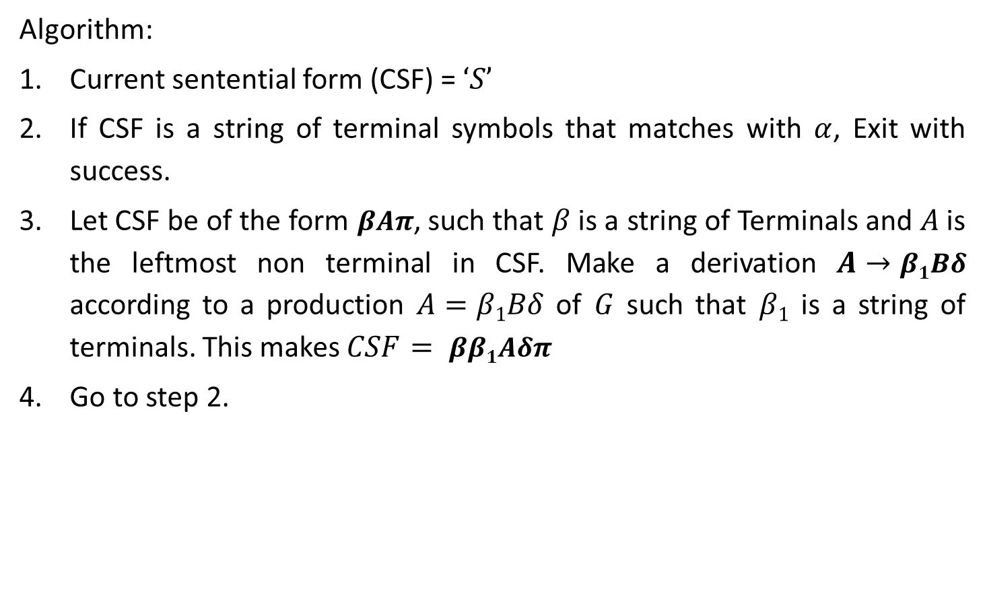





Naïve top down parsing
Algorithm:
Current sentential form (CSF) = $‘S’$
If CSF is a string of terminal symbols that matches with $α$, Exit with success.
Let CSF be of the form $βAπ$, such that $β$ is a string of Terminals and $A$ is the leftmost non terminal in CSF. Make a derivation $A→β1Bδ$ according to a production $A=β1Bδ$ of $G$ such that $β1$ is a string of terminals. This makes $CSF= ββ1Aδπ$
Go to step 2.
S
S
$$β$$
A
$$π$$
$$CSF=βAπ$$
$$CSF=ββ1Aδπ$$
$$β$$
A
$$π$$
$$β1$$
B
$$δ$$

Slide 76
Backtracking
In backtracking, expansion of nonterminal symbol we choose one alternative and if any mismatch occurs then we try another alternative.
Grammar: S→ cAd Input string: cad
A→ ab | a
S
S
S
c
A
d
c
A
d
c
A
d
Make prediction
Make prediction
a
b
Backtrack
a
Parsing done

Slide 77
Exercise
Perform backtracking on following grammar:
E→ 3+T | 3-T
T→ V | V*V | V+V
V→ a | b
(Input String: 3-a+b)

Slide 78
Parsing methods
Parsing
Top down parsing
Bottom up parsing (Shift reduce)
Back tracking
Naïve bottom up
Parsing without backtracking (predictive parsing)
Operator precedence
LL(1)
Recursive
descent

Slide 79
LL(1) parser (predictive parser)
LL(1) is non recursive top down parser.
First L indicates input is scanned from left to right.
The second L means it uses leftmost derivation for input string.
1 means it uses only input symbol to predict the parsing process.
a | + | b | $
INPUT
X
Y
Z
$
Predictive parsing program
Stack
OUTPUT
Parsing table M

Slide 80
LL(1) parsing (predictive parsing)
Steps to construct LL(1) parser
Remove left recursion / Perform left factoring (if any).
Compute FIRST and FOLLOW of non terminals.
Construct predictive parsing table.
Parse the input string using parsing table.

Slide 81









Left recursion elimination
Removal of recursive specification
$$A→Aα |$$
$A→$
$$β$$
$$A’$$
$$α$$
$$β$$
$|$𝜖
$A’$ $→$
$$A’$$

Slide 82
Examples: Left recursion elimination
E→E+T | T
E→TE’
E’→+TE’ | 𝜖
T→T*F | F
T→FT’
T’→*FT’ | 𝜖
X→X%Y | Z
X→ZX’
X’→%YX’ | 𝜖

Slide 83
Examples: Left recursion elimination
S→ Aa | b
A→ Ac | Sd | ε
Here, Non terminal S is left recursive because:
S→ Aa → Sda
S→ Aa | b
A→ Ac
A→
A→ ε
Now, remove left recursion
S→ Aa | b
A→ bdA’ | A’
A’→ cA’ | adA’ | ε
To remove indirect left recursion replace S with productions of S
Aad | bd
A→Ac | Aad | bd | ε
Sd
S→ Aa | b
A→Ac | Aad | bd | ε

Slide 84
Exercise
Remove left recursion from following grammar:
A→Abd | Aa | a
B→Be | b
A→AB | AC | a | b
S→A | B
A→ABC | Acd | a | aa
B→Bee | b
Exp→Exp+term | Exp-term | term

Slide 85










Left factoring
$A→$
$A→$
$A^{′}$
$$α$$
$$α$$
$$α$$
$$β$$
$$α$$
$$β$$
|
δ
δ
$A^{′}→ |$

Slide 86
Example: Left factoring
S→aAB | aCD
S→aS’
S’→AB | CD
A→ xByA | xByAzA | a
A→ xByAA’ | a
A’→ 𝜖 | zA
A→ aAB | aA |a
A→aA’
A’→AB | A | 𝜖
A’→AA’’ | 𝜖
A’’→B | 𝜖

Slide 87
Exercise
Perform left factoring on following grammar:
S→ iEtS | iEtSeS | a
A→ ad | a | ab | abc | x

Slide 88
First character of R.H.S.
A→
terminal
Ex: A→aAb
A→
𝜖
Ex: A→𝜖
A→
Non terminal
Ex: A→Bba

Slide 89
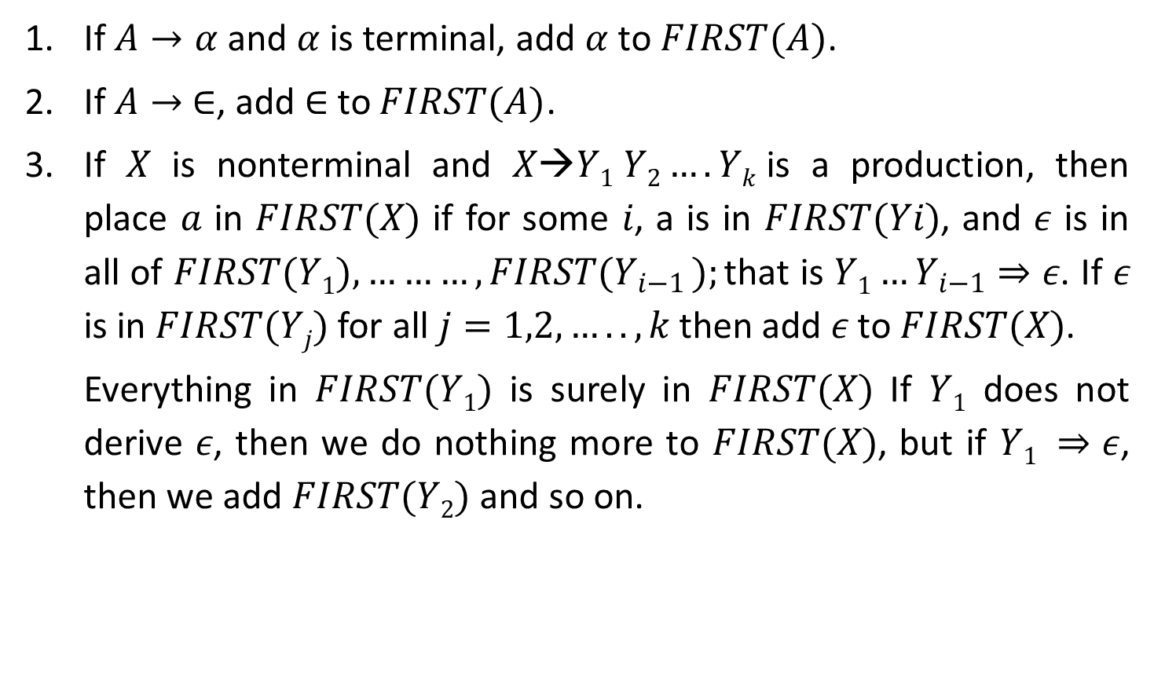
Rules to compute first of non terminal
If $A→α$and $α$ is terminal, add $α$ to $FIRST(A)$.
If $A→ ∈$, add $∈$to $FIRST(A)$.
If $X$ is nonterminal and $X→Y1 Y2….Yk$is a production, then place $a$ in $FIRST(X)$ if for some $i$, a is in $FIRST(Yi)$, and 𝜖 is in all of $FIRST(Y1),………,FIRST(Y_{i−1} );$that is $Y1…Y_{i−1}⇒ε$. If 𝜖 is in $FIRST(Yj)$ for all $j=1,2,…..,k$then add 𝜖 to $FIRST(X)$.
Everything in $FIRST(Y1)$ is surely in $FIRST(X)$ If $Y1$ does not derive 𝜖, then we do nothing more to $FIRST(X)$, but if $Y1 ⇒ε$, then we add $FIRST(Y2)$ and so on.
*
*

Slide 90
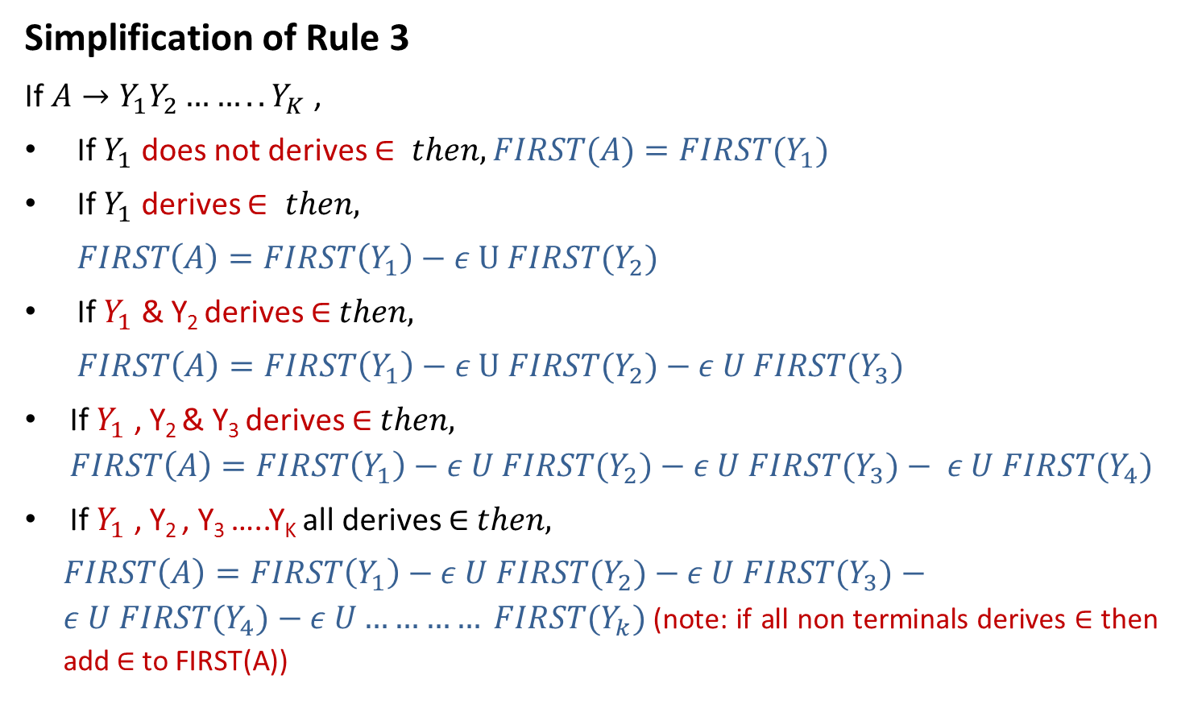
Rules to compute first of non terminal
Simplification of Rule 3
If $A→Y_{1}Y_{2}……..Y_{K}$ ,
If $Y_{1}$ does not derives $∈ then, FIRST(A)=FIRST{(Y}_{1})$
If $Y_{1}$ derives $∈ then,$
$FIRST\left(A\right)=FIRST\left(Y_{1}\right)−ε U FIRST{(Y}_{2})$
If $Y_{1}$ & Y₂ derives ∈$then,$
$FIRST\left(A\right)=FIRST\left(Y_{1}\right)−ε U FIRST{(Y}_{2})$ $− ε U FIRST{(Y}_{3})$
If $Y_{1}$ , Y₂ & Y₃ derives ∈$then,$
$$FIRST\left(A\right)=FIRST\left(Y_{1}\right)−ε U FIRST{(Y}_{2})−ε U FIRST{(Y}_{3})− ε U FIRST{(Y}_{4})$$
If $Y_{1}$ , Y₂ , Y₃ …..Y_{K} all derives ∈ $then,$
$FIRST\left(A\right)=FIRST\left(Y_{1}\right)−ε U FIRST{(Y}_{2})−ε U FIRST{(Y}_{3})−ε U FIRST{(Y}_{4})−ε U………… FIRST{(Y}_{k})$(note: if all non terminals derives ∈ then add ∈ to FIRST(A))

Slide 91

Rules to compute FOLLOW of non terminal
Place $\$ in follow\left(S\right). ($S is start symbol)
If $A→αBβ ,$then everything in $FIRST(β)$ except for 𝜖 is placed in $FOLLOW(B)$
If there is a production$A→αB$ or a production $A→αBβ$ where $FIRST(β)$ contains $ε$ then everything in $FOLLOW\left(A\right)=FOLLOW\left(B\right)$

Slide 92











How to apply rules to find FOLLOW of non terminal?
$$A→αBβ$$
$$β is absent$$
$$β is present$$
$$Rule 3$$
$$β is terminal$$
$$β is Nonterminal$$
$$Rule 2$$
$β does not derives$ 𝜖
$β derives$ 𝜖
$$Rule 2$$
$$Rule 2+Rule 3$$

Slide 93
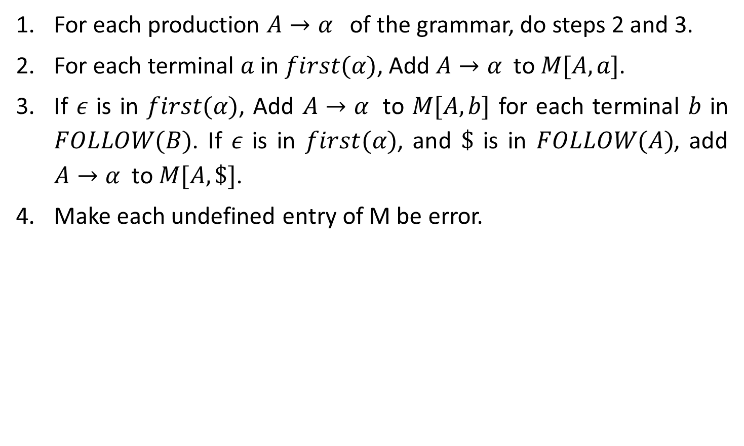
Rules to construct predictive parsing table
For each production $A→α$ of the grammar, do steps 2 and 3.
For each terminal $a$ in $first(α)$, Add $A→α$ to $M[A,a]$.
If $ε$ is in $first(α)$, Add $A→α$ to $M[A,b]$ for each terminal $b$ in $FOLLOW(B)$. If $ε$ is in $first(α)$, and $\$$ is in $FOLLOW(A)$, add $A→α$ to $M[A,\$]$.
Make each undefined entry of M be error.

Slide 94




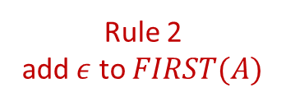

Example-1: LL(1) parsing
S→aBa
B→bB | ϵ
Step 1: Not required
Step 2: Compute FIRST
First(S)
S→aBa
First(B)
B→bB B→𝜖
NT | First
S | { a }
S | → | a | B | a
Rule 1
add $α$ to $FIRST(A)$
B | {b,𝜖}
A | → | $$α$$
FIRST(S)={ a }
B | → | b | B
B | → | 𝜖
Rule 1
add $α$ to $FIRST(A)$
A | → | $$α$$
A | → | $$ε$$
Rule 2
add $ε$ to $FIRST(A)$
FIRST(B)={ b
, 𝜖 }

Slide 95


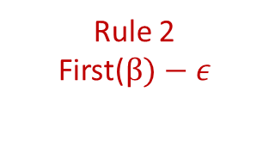
Example-1: LL(1) parsing
S→aBa
B→bB | ϵ
Step 2: Compute FOLLOW
Follow(S)
Follow(B)
S→aBa B→bB
NT | First | Follow
S | {a} | {$}
B | {b,𝜖} | {a}
Rule 1: Place $ in FOLLOW(S)
Follow(S)={ $ }
S | → | a | B | a
B | → | b | B
Rule 3
Follow(A)=follow(B)
A | → | $$α$$ | B | $$β$$
Rule 2
First($β)−ε$
A | → | $$α$$ | B
Follow(B)={ a
}

Slide 96

Example-1: LL(1) parsing
S→aBa
B→bB | ϵ
Step 3: Prepare predictive parsing table
S→aBa
a=FIRST(aBa)={ a }
M[S,a]=S→aBa
NT | First | Follow
S | {a} | {$}
B | {b,𝜖} | {a}
NT | Input Symbol
 | a | b | $
S | S→aBa
B
Rule: 2
A→ $α$
a = first($α$)
M[A,a] = A→ $α$

Slide 97
Example-1: LL(1) parsing
S→aBa
B→bB | ϵ
Step 3: Prepare predictive parsing table
B→bB
a=FIRST(bB)={ b }
M[B,b]=B→bB
NT | First | Follow
S | {a} | {$}
B | {b,𝜖} | {a}
NT | Input Symbol
 | a | b | $
S | S→aBa
B |  | B→bB
Rule: 2
A→ $α$
a = first($α$)
M[A,a] = A→ $α$

Slide 98

Example-1: LL(1) parsing
S→aBa
B→bB | ϵ
Step 3: Prepare predictive parsing table
B→𝜖
b=FOLLOW(B)={ a }
M[B,a]=B→𝜖
NT | First | Follow
S | {a} | {$}
B | {b,𝜖} | {a}
NT | Input Symbol
 | a | b | $
S | S→aBa | Error | Error
B | B→𝜖 | B→bB | Error
Rule: 3
A→ $α$
b = follow(A)
M[A,b] = A→ $α$

Slide 99




Example-2: LL(1) parsing
S→aB | ϵ
B→bC | ϵ
C→cS | ϵ
Step 1: Not required
Step 2: Compute FIRST
First(S)
S→aB S→𝜖
NT | First
S | { a, 𝜖 }
B | {b,𝜖}
C | {c,𝜖}
S | → | a | B
S | → | 𝜖
Rule 1
add $α$ to $FIRST(A)$
Rule 2
add $ε$ to $FIRST(A)$
A | → | $$α$$
A | → | $$ε$$
FIRST(S)={ a
, 𝜖 }

Slide 100
Example-2: LL(1) parsing
S→aB | ϵ
B→bC | ϵ
C→cS | ϵ
Step 1: Not required
Step 2: Compute FIRST
First(B)
B→bC B→𝜖
NT | First
S | { a, 𝜖 }
B | { b, 𝜖 }
C | {c,𝜖}
B | → | b | C
B | → | 𝜖
Rule 1
add $α$ to $FIRST(A)$
Rule 2
add $ε$ to $FIRST(A)$
A | → | $$α$$
A | → | 𝜖
FIRST(B)={ b
, 𝜖 }

Slide 101
Example-2: LL(1) parsing
S→aB | ϵ
B→bC | ϵ
C→cS | ϵ
Step 1: Not required
Step 2: Compute FIRST
First(C)
C→cS C→𝜖
NT | First
S | { a, 𝜖 }
B | { b, 𝜖 }
C | { c, 𝜖 }
C | → | c | S
C | → | 𝜖
Rule 1
add $α$ to $FIRST(A)$
Rule 2
add $ε$ to $FIRST(A)$
A | → | $$α$$
A | → | 𝜖
FIRST(B)={ c
, 𝜖 }

Slide 102



Example-2: LL(1) parsing
Step 2: Compute FOLLOW
Follow(S)
C→cS
B→bC S→aB
S→aB | ϵ
B→bC | ϵ
C→cS | ϵ
Rule 1: Place $ in FOLLOW(S)
Follow(S)={ $ }
C | → | c | S
Rule 3
Follow(A)=follow(B)
NT | First | Follow
S | {a} | {$}
B | {b,𝜖} | {$}
C | {c,𝜖} | {$}
A | → | $$α$$ | B
Follow(S)=Follow(C)
={$}
B | → | b | C
Rule 3
Follow(A)=follow(B)
S | → | a | B
Rule 3
Follow(A)=follow(B)
A | → | $$α$$ | B
A | → | $$α$$ | B
Follow(C)=Follow(B)
={$}
Follow(B)=Follow(S)
={$}

Slide 103

Example-2: LL(1) parsing
S→aB | ϵ
B→bC | ϵ
C→cS | ϵ
Step 3: Prepare predictive parsing table
S→aB
a=FIRST(aB)={ a }
M[S,a]=S→aB
NT | First | Follow
S | {a} | {$}
B | {b,𝜖} | {$}
C | {c,𝜖} | {$}
NT | Input Symbol
 | a | b | c | $
S | S→aB
B
C
Rule: 2
A→ $α$
a = first($α$)
M[A,a] = A→ $α$

Slide 104

Example-2: LL(1) parsing
S→aB | ϵ
B→bC | ϵ
C→cS | ϵ
Step 3: Prepare predictive parsing table
S→𝜖
b=FOLLOW(S)={ $ }
M[S,$]=S→𝜖
NT | First | Follow
S | {a} | {$}
B | {b,𝜖} | {$}
C | {c,𝜖} | {$}
NT | Input Symbol
 | a | b | c | $
S | S→aB |  |  | S→𝜖
B
C
Rule: 3
A→ $α$
b = follow(A)
M[A,b] = A→ $α$

Slide 105
Example-2: LL(1) parsing
S→aB | ϵ
B→bC | ϵ
C→cS | ϵ
Step 3: Prepare predictive parsing table
B→bC
a=FIRST(bC)={ b }
M[B,b]=B→bC
NT | First | Follow
S | {a} | {$}
B | {b,𝜖} | {$}
C | {c,𝜖} | {$}
NT | Input Symbol
 | a | b | c | $
S | S→aB |  |  | S→𝜖
B |  | B→bC
C
Rule: 2
A→ $α$
a = first($α$)
M[A,a] = A→ $α$

Slide 106
Example-2: LL(1) parsing
S→aB | ϵ
B→bC | ϵ
C→cS | ϵ
Step 3: Prepare predictive parsing table
B→𝜖
b=FOLLOW(B)={ $ }
M[B,$]=B→𝜖
NT | First | Follow
S | {a} | {$}
B | {b,𝜖} | {$}
C | {c,𝜖} | {$}
NT | Input Symbol
 | a | b | c | $
S | S→aB |  |  | S→𝜖
B |  | B→bC |  | B→𝜖
C
Rule: 3
A→ $α$
b = follow(A)
M[A,b] = A→ $α$

Slide 107
Example-2: LL(1) parsing
S→aB | ϵ
B→bC | ϵ
C→cS | ϵ
Step 3: Prepare predictive parsing table
C→cS
a=FIRST(cS)={ c }
M[C,c]=C→cS
NT | First | Follow
S | {a} | {$}
B | {b,𝜖} | {$}
C | {c,𝜖} | {$}
NT | Input Symbol
 | a | b | c | $
S | S→aB |  |  | S→𝜖
B |  | B→bC |  | B→𝜖
C |  |  | C→cS
Rule: 2
A→ $α$
a = first($α$)
M[A,a] = A→ $α$

Slide 108
Example-2: LL(1) parsing
S→aB | ϵ
B→bC | ϵ
C→cS | ϵ
Step 3: Prepare predictive parsing table
C→𝜖
b=FOLLOW(C)={ $ }
M[C,$]=C→𝜖
NT | First | Follow
S | {a} | {$}
B | {b,𝜖} | {$}
C | {c,𝜖} | {$}
NT | Input Symbol
 | a | b | c | $
S | S→aB | Error | Error | S→𝜖
B | Error | B→bC | Error | B→𝜖
C | Error | Error | C→cS | C→𝜖
Rule: 3
A→ $α$
b = follow(A)
M[A,b] = A→ $α$

Slide 109
Example-3: LL(1) parsing
E→E+T | T
T→T*F | F
F→(E) | id
Step 1: Remove left recursion
E→TE’
E’→+TE’ | ϵ
T→FT’
T’→*FT’ | ϵ
F→(E) | id

Slide 110




Example-3: LL(1) parsing
Step 2: Compute FIRST
First(E)
E→TE’
First(T)
T→FT’
First(F)
F→(E) F→id
E→TE’
E’→+TE’ | ϵ
T→FT’
T’→*FT’ | ϵ
F→(E) | id
E | → | T | E’
Rule 3
First(A)=First(Y1)
A | → | Y₁ | Y₂
FIRST(E)=FIRST(T)
= {(, id }
NT | First
E | { (,id }
E’
T | → | F | T’
Rule 3
First(A)=First(Y1)
T | { (,id }
A | → | Y₁ | Y₂
T’
FIRST(T)=FIRST(F)
= {(, id }
F | { (,id }
F | → | ( | E | )
F | → | id
A | → | $$α$$
Rule 1
add $α$ to $FIRST(A)$
A | → | $$α$$
Rule 1
add $α$ to $FIRST(A)$
FIRST(F)={ (
, id }

Slide 111


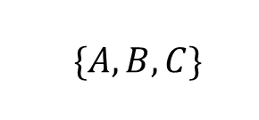


Example-3: LL(1) parsing
Step 2: Compute FIRST
First(E’)
E’→+TE’
E’→𝜖
E→TE’
E’→+TE’ | ϵ
T→FT’
T’→*FT’ | ϵ
F→(E) | id
E’ | → | + | T | E’
Rule 1
add $α$ to $FIRST(A)$
NT | First
A | → | $$α$$
E | { (,id }
E’ | { +, 𝜖 }
T | { (,id }
T’
E’ | → | $$ε$$
Rule 2
add $ε$ to $FIRST(A)$
F | { (,id }
A | → | $$ε$$
FIRST(E’)={ +
, 𝜖 }

Slide 112



Example-3: LL(1) parsing
Step 2: Compute FIRST
First(T’)
T’→*FT’
T’→𝜖
E→TE’
E’→+TE’ | ϵ
T→FT’
T’→*FT’ | ϵ
F→(E) | id
T’ | → | * | F | T’
Rule 1
add $α$ to $FIRST(A)$
NT | First
A | → | $$α$$
E | { (,id }
E’ | { +, 𝜖 }
T | { (,id }
T’ | { *, 𝜖 }
T’ | → | $$ε$$
Rule 2
add $ε$ to $FIRST(A)$
F | { (,id }
A | → | $$ε$$
FIRST(T’)={ *
, 𝜖 }

Slide 113

Example-3: LL(1) parsing
Step 2: Compute FOLLOW
FOLLOW(E)
F→(E)
E→TE’
E’→+TE’ | ϵ
T→FT’
T’→*FT’ | ϵ
F→(E) | id
Rule 1: Place $ in FOLLOW(E)
NT | First | Follow
E | { (,id } | { $,) }
E’ | { +, 𝜖 }
F | → | ( | E | )
Rule 2
T | { (,id }
A | → | $$α$$ | B | $$β$$
T’ | { *, 𝜖 }
F | { (,id }
FOLLOW(E)={ $,
) }

Slide 114


Example-3: LL(1) parsing
Step 2: Compute FOLLOW
FOLLOW(E’)
E→TE’
E’→+TE’
E→TE’
E’→+TE’ | ϵ
T→FT’
T’→*FT’ | ϵ
F→(E) | id
NT | First | Follow
E | → | T | E’
Rule 3
E | { (,id } | { $,) }
A | → | $$α$$ | B
E’ | { +, 𝜖 } | { $,) }
T | { (,id }
T’ | { *, 𝜖 }
F | { (,id }
E’ | → | +T | E’
Rule 3
A | → | $$α$$ | B
}
FOLLOW(E’)={ $,)

Slide 115


Example-3: LL(1) parsing
Step 2: Compute FOLLOW
FOLLOW(T)
E→TE’
E→TE’
E’→+TE’ | ϵ
T→FT’
T’→*FT’ | ϵ
F→(E) | id
NT | First | Follow
E | → |  | T | E’
Rule 2
E | { (,id } | { $,) }
A | → | $$α$$ | B | $$β$$
E’ | { +, 𝜖 } | { $,) }
T | { (,id }
T’ | { *, 𝜖 }
F | { (,id }
E | → |  | T | E’
Rule 3
A | → | $$α$$ | B | $$β$$
FOLLOW(T)={ +,
$, )

Slide 116


Example-3: LL(1) parsing
Step 2: Compute FOLLOW
FOLLOW(T)
E’→+TE’
E→TE’
E’→+TE’ | ϵ
T→FT’
T’→*FT’ | ϵ
F→(E) | id
NT | First | Follow
E’ | → | + | T | E’
Rule 2
E | { (,id } | { $,) }
A | → | $$α$$ | B | $$β$$
E’ | { +, 𝜖 } | { $,) }
T | { (,id } | { +,$,) }
T’ | { *, 𝜖 }
F | { (,id }
E’ | → | + | T | E’
Rule 3
A | → | $$α$$ | B | $$β$$
}
FOLLOW(T)={ +,
$, )

Slide 117
Example-3: LL(1) parsing
Step 2: Compute FOLLOW
FOLLOW(T’)
T→FT’
T’→*FT’
E→TE’
E’→+TE’ | ϵ
T→FT’
T’→*FT’ | ϵ
F→(E) | id
NT | First | Follow
T | → | F | T’
Rule 3
E | { (,id } | { $,) }
A | → | $$α$$ | B
E’ | { +, 𝜖 } | { $,) }
T | { (,id } | { +,$,) }
T’ | { *, 𝜖 } | { +,$,) }
F | { (,id }
T’ | → | *F | T’
Rule 3
A | → | $$α$$ | B
}
FOLLOW(T’)={+ $,)

Slide 118

Example-3: LL(1) parsing
Step 2: Compute FOLLOW
FOLLOW(F)
T→FT’
E→TE’
E’→+TE’ | ϵ
T→FT’
T’→*FT’ | ϵ
F→(E) | id
NT | First | Follow
T | → |  | F | T’
Rule 2
E | { (,id } | { $,) }
A | → | $$α$$ | B | $$β$$
E’ | { +, 𝜖 } | { $,) }
T | { (,id } | { +,$,) }
T’ | { *, 𝜖 } | { +,$,) }
F | { (,id }
T | → |  | F | T’
Rule 3
A | → | $$α$$ | B | $$β$$
FOLLOW(F)={ *,
+ ,$ , )

Slide 119
Example-3: LL(1) parsing
Step 2: Compute FOLLOW
FOLLOW(F)
T’→*FT’
E→TE’
E’→+TE’ | ϵ
T→FT’
T’→*FT’ | ϵ
F→(E) | id
NT | First | Follow
T’ | → | * | F | T’
Rule 2
E | { (,id } | { $,) }
A | → | $$α$$ | B | $$β$$
E’ | { +, 𝜖 } | { $,) }
T | { (,id } | { +,$,) }
T’ | { *, 𝜖 } | { +,$,) }
F | { (,id } | {*,+,$,)}
T’ | → | * | F | T’
Rule 3
A | → | $$α$$ | B | $$β$$
}
FOLLOW(F)={ *,+,
$, )

Slide 120
Example-3: LL(1) parsing
Step 3: Construct predictive parsing table
E→TE’
a=FIRST(TE’)={ (,id }
M[E,(]=E→TE’
M[E,id]=E→TE’
NT | Input Symbol
 | id | + | * | ( | ) | $
E | E→TE’ |  |  | E→TE’
E’
T
T’
F
NT | First | Follow
E | { (,id } | { $,) }
E’ | { +, 𝜖 } | { $,) }
T | { (,id } | { +,$,) }
T’ | { *, 𝜖 } | { +,$,) }
F | { (,id } | {*,+,$,)}
Rule: 2
A→ $α$
a = first($α$)
M[A,a] = A→ $α$
E→TE’
E’→+TE’ | ϵ
T→FT’
T’→*FT’ | ϵ
F→(E) | id

Slide 121
Example-3: LL(1) parsing
Step 3: Construct predictive parsing table
E’→+TE’
a=FIRST(+TE’)={ + }
M[E’,+]=E’→+TE’
NT | Input Symbol
 | id | + | * | ( | ) | $
E | E→TE’ |  |  | E→TE’
E’ |  | E’→+TE’
T
T’
F
NT | First | Follow
E | { (,id } | { $,) }
E’ | { +, 𝜖 } | { $,) }
T | { (,id } | { +,$,) }
T’ | { *, 𝜖 } | { +,$,) }
F | { (,id } | {*,+,$,)}
Rule: 2
A→ $α$
a = first($α$)
M[A,a] = A→ $α$
E→TE’
E’→+TE’ | ϵ
T→FT’
T’→*FT’ | ϵ
F→(E) | id

Slide 122
Example-3: LL(1) parsing
Step 3: Construct predictive parsing table
E’→𝜖
b=FOLLOW(E’)={ $,) }
M[E’,$]=E’→𝜖
M[E’,)]=E’→𝜖
NT | Input Symbol
 | id | + | * | ( | ) | $
E | E→TE’ |  |  | E→TE’
E’ |  | E’→+TE’ |  |  | E’→𝜖 | E’→𝜖
T
T’
F
NT | First | Follow
E | { (,id } | { $,) }
E’ | { +, 𝜖 } | { $,) }
T | { (,id } | { +,$,) }
T’ | { *, 𝜖 } | { +,$,) }
F | { (,id } | {*,+,$,)}
Rule: 3
A→ $α$
b = follow(A)
M[A,b] = A→ $α$
E→TE’
E’→+TE’ | ϵ
T→FT’
T’→*FT’ | ϵ
F→(E) | id

Slide 123
Example-3: LL(1) parsing
Step 3: Construct predictive parsing table
T→FT’
a=FIRST(FT’)={ (,id }
M[T,(]=T→FT’
M[T,id]=T→FT’
NT | Input Symbol
 | id | + | * | ( | ) | $
E | E→TE’ |  |  | E→TE’
E’ |  | E’→+TE’ |  |  | E’→𝜖 | E’→𝜖
T | T→FT’ |  |  | T→FT’
T’
F
NT | First | Follow
E | { (,id } | { $,) }
E’ | { +, 𝜖 } | { $,) }
T | { (,id } | { +,$,) }
T’ | { *, 𝜖 } | { +,$,) }
F | { (,id } | {*,+,$,)}
Rule: 2
A→ $α$
a = first($α$)
M[A,a] = A→ $α$
E→TE’
E’→+TE’ | ϵ
T→FT’
T’→*FT’ | ϵ
F→(E) | id

Slide 124
Example-3: LL(1) parsing
Step 3: Construct predictive parsing table
T’→*FT’
a=FIRST(*FT’)={ * }
M[T’,*]=T’→*FT’
NT | Input Symbol
 | id | + | * | ( | ) | $
E | E→TE’ |  |  | E→TE’
E’ |  | E’→+TE’ |  |  | E’→𝜖 | E’→𝜖
T | T→FT’ |  |  | T→FT’
T’ |  |  | T’→*FT’
F
NT | First | Follow
E | { (,id } | { $,) }
E’ | { +, 𝜖 } | { $,) }
T | { (,id } | { +,$,) }
T’ | { *, 𝜖 } | { +,$,) }
F | { (,id } | {*,+,$,)}
Rule: 2
A→ $α$
a = first($α$)
M[A,a] = A→ $α$
E→TE’
E’→+TE’ | ϵ
T→FT’
T’→*FT’ | ϵ
F→(E) | id

Slide 125
Example-3: LL(1) parsing
Step 3: Construct predictive parsing table
T’→𝜖
b=FOLLOW(T’)={ +,$,) }
M[T’,+]=T’→𝜖
M[T’,$]=T’→𝜖
M[T’,)]=T’→𝜖
NT | Input Symbol
 | id | + | * | ( | ) | $
E | E→TE’ |  |  | E→TE’
E’ |  | E’→+TE’ |  |  | E’→𝜖 | E’→𝜖
T | T→FT’ |  |  | T→FT’
T’ |  | T’→𝜖 | T’→*FT’ |  | T’→𝜖 | T’→𝜖
F
NT | First | Follow
E | { (,id } | { $,) }
E’ | { +, 𝜖 } | { $,) }
T | { (,id } | { +,$,) }
T’ | { *, 𝜖 } | { +,$,) }
F | { (,id } | {*,+,$,)}
Rule: 3
A→ $α$
b = follow(A)
M[A,b] = A→ $α$
E→TE’
E’→+TE’ | ϵ
T→FT’
T’→*FT’ | ϵ
F→(E) | id

Slide 126
Example-3: LL(1) parsing
Step 3: Construct predictive parsing table
F→(E)
a=FIRST((E))={ ( }
M[F,(]=F→(E)
NT | Input Symbol
 | id | + | * | ( | ) | $
E | E→TE’ |  |  | E→TE’
E’ |  | E’→+TE’ |  |  | E’→𝜖 | E’→𝜖
T | T→FT’ |  |  | T→FT’
T’ |  | T’→𝜖 | T’→*FT’ |  | T’→𝜖 | T’→𝜖
F |  |  |  | F→(E)
NT | First | Follow
E | { (,id } | { $,) }
E’ | { +, 𝜖 } | { $,) }
T | { (,id } | { +,$,) }
T’ | { *, 𝜖 } | { +,$,) }
F | { (,id } | {*,+,$,)}
Rule: 2
A→ $α$
a = first($α$)
M[A,a] = A→ $α$
E→TE’
E’→+TE’ | ϵ
T→FT’
T’→*FT’ | ϵ
F→(E) | id

Slide 127
Example-3: LL(1) parsing
Step 3: Construct predictive parsing table
F→id
a=FIRST(id)={ id }
M[F,id]=F→id
NT | Input Symbol
 | id | + | * | ( | ) | $
E | E→TE’ |  |  | E→TE’
E’ |  | E’→+TE’ |  |  | E’→𝜖 | E’→𝜖
T | T→FT’ |  |  | T→FT’
T’ |  | T’→𝜖 | T’→*FT’ |  | T’→𝜖 | T’→𝜖
F | F→id |  |  | F→(E)
NT | First | Follow
E | { (,id } | { $,) }
E’ | { +, 𝜖 } | { $,) }
T | { (,id } | { +,$,) }
T’ | { *, 𝜖 } | { +,$,) }
F | { (,id } | {*,+,$,)}
Rule: 2
A→ $α$
a = first($α$)
M[A,a] = A→ $α$
E→TE’
E’→+TE’ | ϵ
T→FT’
T’→*FT’ | ϵ
F→(E) | id

Slide 128
Example-3: LL(1) parsing
Step 4: Make each undefined entry of table be Error
NT | Input Symbol
 | id | + | * | ( | ) | $
E | E→TE’ | Error | Error | E→TE’ | Error | Error
E’ | Error | E’→+TE’ | Error | Error | E’→𝜖 | E’→𝜖
T | T→FT’ | Error | Error | T→FT’ | Error | Error
T’ | Error | T’→𝜖 | T’→*FT’ | Error | T’→𝜖 | T’→𝜖
F | F→id | Error | Error | F→(E) | Error | Error
NT | First | Follow
E | { (,id } | { $,) }
E’ | { +, 𝜖 } | { $,) }
T | { (,id } | { +,$,) }
T’ | { *, 𝜖 } | { +,$,) }
F | { (,id } | {*,+,$,)}
E→TE’
E’→+TE’ | ϵ
T→FT’
T’→*FT’ | ϵ
F→(E) | id

Slide 129
Example-3: LL(1) parsing
Step 4: Parse the string : id + id * id $
STACK | INPUT | OUTPUT
NT | Input Symbol
 | id | + | * | ( | ) | $
E | E→TE’ | Error | Error | E→TE’ | Error | Error
E’ | Error | E’→+TE’ | Error | Error | E’→𝜖 | E’→𝜖
T | T→FT’ | Error | Error | T→FT’ | Error | Error
T’ | Error | T’→𝜖 | T’→*FT’ | Error | T’→𝜖 | T’→𝜖
F | F→id | Error | Error | F→(E) | Error | Error
E$ | id+id*id$
TE’$ | id+id*id$ | E→TE’
FT’E’$ | id+id*id$ | T→FT’
idT’E’$ | id+id*id$ | F→id
T’E’$ | +id*id$
E’$ | +id*id$ | T’→𝜖
+TE’$ | +id*id$ | E’→+TE’
TE’$ | id*id$
FT’E’$ | id$
FT’E’$ | id*id$ | T→FT’
idT’E’$ | id$ | F→id
idT’E’$ | id*id$ | F→id
T’E’$ | $
T’E’$ | *id$
E’$ | $ | T’→𝜖
*FT’E’$ | *id$ | T→*FT’
$ | $ | E’→𝜖

Slide 130
Exercise
Prepare predictive parsing table for following grammar:
S→1AB | 𝜖
A→1AC | 0C
B→0S
C→1
S→iCtSeS | iCtS | a (GTU: Summer 17)
C→b
E→BA (GTU: Winter 17)
A→&BA | 𝜖
B→ true | false
E→TA (GTU: Winter 16, Summer 18)
A→+TA | 𝜖
T→VB
B→*VB | 𝜖
V→id | (E)

Slide 131
Parsing methods
Parsing
Top down parsing
Bottom up parsing (Shift reduce)
Back tracking
Naïve bottom up
Parsing without backtracking (predictive parsing)
Operator precedence
LL(1)
Recursive
descent

Slide 132
Recursive descent parsing
A top down parsing that executes a set of recursive procedure to process the input without backtracking is called recursive descent parser.
There is a procedure for each non terminal in the grammar.
Consider RHS of any production rule as definition of the procedure.
As it reads expected input symbol, it advances input pointer to next position.

Slide 133
Example: Recursive descent parsing
Procedure E
{
If lookahead=num
{
Match(num);
T();
}
Else
Error();
If lookahead=$
{
Declare success;
}
Else
Error();
}
Procedure T
{
If lookahead=’*’
{
Match(‘*’);
If lookahead=num
{
Match(num);
T();
}
Else
Error();
}
Else
NULL
}
Proceduce Match(token t)
{
If lookahead=t
lookahead=next_token;
Else
Error();
}
Procedure Error
{
Print(“Error”);
}
E→
T→
num
T
num
| 𝜖
*
T
3 | * | 4 | $
Success

Slide 134
Example: Recursive descent parsing
Procedure E
{
If lookahead=num
{
Match(num);
T();
}
Else
Error();
If lookahead=$
{
Declare success;
}
Else
Error();
}
Procedure T
{
If lookahead=’*’
{
Match(‘*’);
If lookahead=num
{
Match(num);
T();
}
Else
Error();
}
Else
NULL
}
Proceduce Match(token t)
{
If lookahead=t
lookahead=next_token;
Else
Error();
}
Procedure Error
{
Print(“Error”);
}
E→
T→
num
T
num
| 𝜖
*
T
3 | * | 4 | $
Success
3 | 4 | * | $
Error

Slide 135
Parsing methods
Parsing
Top down parsing
Bottom up parsing (Shift reduce)
Back tracking
Naïve bottom up
Parsing without backtracking (predictive parsing)
Operator precedence
LL(1)
Recursive
descent

Slide 136
Naïve bottom up parsing algorithm
Step 1: SSM := 2; n := 1;
Step 5: r:=r-1;
if (r > 0), then goto step 3;
Step 2: r := n;
Step 3: Compare the string of r symbols to the left of SSM with all RHS alternatives in G which have length of r symbols.
Step 6: If no more symbols exist to the right of SSM then
If current string form = ‘S’ then exit with success;
else report error and exit with failure;
Step 4: If a match is found with a production A→α, then
reduce the string of r symbols to NT A;
n := n – r + 1;
Goto step 2;
Step 7: SSM := SSM + 1;
n := n + 1;
goto step 2;

Slide 137
Example: Naïve bottom up parsing
Grammar: E→ E+T | T Input string: id + id
T→ id
SSM | n | r
SSM=2 | n=1 | r=n=1
 | n=n-r+1 1-1+1 =1 | r=n=1
 | n=n-r+1 1-1+1 =1 | r=n=1
E
id | + | id
$
T
r symbols
SSM
Replace T with E (E→T)
Replace id with T (T→id)
Step 1: SSM := 2; n := 1;
Step 4: If a match is found with a production A→α, then
reduce the string of r symbols to NT A;
n := n – r + 1;
Goto step 2;
Step 2: r := n;
Step 3: Compare the string of r symbols to the left of SSM with all RHS alternatives in G which have length of r symbols.

Slide 138
Example: Naïve bottom up parsing
Grammar: E→ E+T | T Input string: id + id
T→ id
SSM | n | r
SSM=2 | n=1 | r=n=1
 | n=n-r+1 1-1+1 =1 | r=n=1
 | n=n-r+1 1-1+1 =1 | r=n=1
 |  | r=r-1 1-1=0
id | + | id
$
E
T
r symbols
SSM
Step 4: If a match is found with a production A→α, then
reduce the string of r symbols to NT A;
n := n – r + 1;
Goto step 2;
Step 5: r:=r-1;
if (r > 0), then goto step 3;

Slide 139
Example: Naïve bottom up parsing
Grammar: E→ E+T | T Input string: id + id
T→ id
SSM | n | r
SSM=2 | n=1 | r=n=1
 | n=n-r+1 1-1+1 =1 | r=n=1
 | n=n-r+1 1-1+1 =1 | r=n=1
 |  | r=r-1 1-1=0
SSM=SSM+1 =2+1=3 | n=n+1 =1+1=2
id | + | id
$
E
T
SSM
Increment SSM by 1
Step 6: If no more symbols exist to the right of SSM then
If current string form = ‘S’ then exit with success;
else report error and exit with failure;
Step 7: SSM := SSM + 1;
n := n + 1;
goto step 2;

Slide 140
Example: Naïve bottom up parsing
Grammar: E→ E+T | T Input string: id + id
T→ id
SSM | n | r
SSM=2 | n=1 | r=n=1
 | n=n-r+1 1-1+1 =1 | r=n=1
 | n=n-r+1 1-1+1 =1 | r=n=1
 |  | r=r-1 1-1=0
SSM=SSM+1 =2+1=3 | n=n+1 =1+1=2 | r=n=2
id | + | id
$
E
T
r symbols
SSM
Step 2: r := n;
Step 3: Compare the string of r symbols to the left of SSM with all RHS alternatives in G which have length of r symbols.
Step 4: If a match is found with a production A→α, then
reduce the string of r symbols to NT A;
n := n – r + 1;
Goto step 2;

Slide 141
Example: Naïve bottom up parsing
Grammar: E→ E+T | T Input string: id + id
T→ id
SSM | n | r
SSM=2 | n=1 | r=n=1
 | n=n-r+1 1-1+1 =1 | r=n=1
 | n=n-r+1 1-1+1 =1 | r=n=1
 |  | r=r-1 1-1=0
SSM=SSM+1 =2+1=3 | n=n+1 =1+1=2 | r=n=2
 |  | r=r-1 2-1=1
id | + | id
$
E
T
r symbols
SSM
Step 5: r:=r-1;
if (r > 0), then goto step 3;
Step 3: Compare the string of r symbols to the left of SSM with all RHS alternatives in G which have length of r symbols.

Slide 142
Example: Naïve bottom up parsing
Grammar: E→ E+T | T Input string: id + id
T→ id
SSM | n | r
SSM=2 | n=1 | r=n=1
 | n=n-r+1 1-1+1 =1 | r=n=1
 | n=n-r+1 1-1+1 =1 | r=n=1
 |  | r=r-1 1-1=0
SSM=SSM+1 =2+1=3 | n=n+1 =1+1=2 | r=n=2
 |  | r=r-1 2-1=1
 |  | r=r-1 1-1=0
id | + | id
$
E
T
r symbols
SSM
Step 4: If a match is found with a production A→α, then
reduce the string of r symbols to NT A;
n := n – r + 1;
Goto step 2;
Step 5: r:=r-1;
if (r > 0), then goto step 3;

Slide 143
Example: Naïve bottom up parsing
Grammar: E→ E+T | T Input string: id + id
T→ id
SSM | n | r
SSM=2 | n=1 | r=n=1
 | n=n-r+1 1-1+1 =1 | r=n=1
 | n=n-r+1 1-1+1 =1 | r=n=1
 |  | r=r-1 1-1=0
SSM=SSM+1 =2+1=3 | n=n+1 =1+1=2 | r=n=2
 |  | r=r-1 2-1=1
 |  | r=r-1 1-1=0
id | + | id
$
E
T
SSM
Step 6: If no more symbols exist to the right of SSM then
If current string form = ‘S’ then exit with success;
else report error and exit with failure;

Slide 144
Example: Naïve bottom up parsing
Grammar: E→ E+T | T Input string: id + id
T→ id
SSM | n | r
SSM=2 | n=1 | r=n=1
 | n=n-r+1 1-1+1 =1 | r=n=1
 | n=n-r+1 1-1+1 =1 | r=n=1
 |  | r=r-1 1-1=0
SSM=SSM+1 =2+1=3 | n=n+1 =1+1=2 | r=n=2
 |  | r=r-1 2-1=1
 |  | r=r-1 1-1=0
SSM=SSM+1 =3+1=4 | n=n+1 2+1=3
id | + | id
$
E
T
SSM
Increment SSM by 1
Step 7: SSM := SSM + 1;
n := n + 1;
goto step 2;

Slide 145
Example: Naïve bottom up parsing
Grammar: E→ E+T | T Input string: id + id
T→ id
SSM | n | r
SSM=2 | n=1 | r=n=1
 | n=n-r+1 1-1+1 =1 | r=n=1
 | n=n-r+1 1-1+1 =1 | r=n=1
 |  | r=r-1 1-1=0
SSM=SSM+1 =2+1=3 | n=n+1 =1+1=2 | r=n=2
 |  | r=r-1 =1
 |  | r=r-1 =0
SSM=SSM+1 =3+1=4 | n=n+1 2+1=3 | r=n=3
id | + | id
$
E
T
r symbols
SSM
Step 7: SSM := SSM + 1;
n := n + 1;
goto step 2;
Step 2: r := n;
Step 3: Compare the string of r symbols to the left of SSM with all RHS alternatives in G which have length of r symbols.

Slide 146
Example: Naïve bottom up parsing
Grammar: E→ E+T | T Input string: id + id
T→ id
SSM | n | r
SSM=2 | n=1 | r=n=1
 | n=n-r+1 1-1+1 =1 | r=n=1
 | n=n-r+1 1-1+1 =1 | r=n=1
 |  | r=r-1 1-1=0
SSM=SSM+1 =2+1=3 | n=n+1 =1+1=2 | r=n=2
 |  | r=r-1 2-1=1
 |  | r=r-1 1-1=0
SSM=SSM+1 =3+1=4 | n=n+1 2+1=3 | r=n=3
id | + | id
$
E
T
r symbols
SSM
Stepa4: If a match is found with a production A→α, then
reduce the string of r symbols to NT A;
n := n – r + 1;
Goto step 2;

Slide 147
Example: Naïve bottom up parsing
Grammar: E→ E+T | T Input string: id + id
T→ id
SSM | n | r
SSM=SSM+1 =2+1=3 | n=n+1 =1+1=2 | r=n=2
 |  | r=r-1 2-1=1
 |  | r=r-1 1-1=0
SSM=SSM+1 =3+1=4 | n=n+1 2+1=3 | r=n=3
 |  | r=r-1 =3-1=2
id | + | id
$
E
T
r symbols
SSM
Step 5: r:=r-1;
if (r > 0), then goto step 3;
Step 3: Compare the string of r symbols to the left of SSM with all RHS alternatives in G which have length of r symbols.

Slide 148
Example: Naïve bottom up parsing
Grammar: E→ E+T | T Input string: id + id
T→ id
SSM | n | r
SSM=SSM+1 =2+1=3 | n=n+1 =1+1=2 | r=n=2
 |  | r=r-1 =1
 |  | r=r-1 =0
SSM=SSM+1 =3+1=4 | n=n+1 2+1=3 | r=n=3
 |  | r=r-1 =3-1=2
 |  | r=r-1 =2-1=1
id | + | id
$
E
T
r symbols
SSM
Stepa4: If a match is found with a production A→α, then
reduce the string of r symbols to NT A;
n := n – r + 1;
Goto step 2;
Step 5: r:=r-1;
if (r > 0), then goto step 3;
Step 3: Compare the string of r symbols to the left of SSM with all RHS alternatives in G which have length of r symbols.

Slide 149
Example: Naïve bottom up parsing
Grammar: E→ E+T | T Input string: id + id
T→ id
SSM | n | r
SSM=SSM+1 =2+1=3 | n=n+1 =1+1=2 | r=n=2
 |  | r=r-1 =1
 |  | r=r-1 =0
SSM=SSM+1 =3+1=4 | n=n+1 2+1=3 | r=n=3
 |  | r=r-1 =3-1=2
 |  | r=r-1 =2-1=1
 | n=n-r+1 =3-1+1 =3 | r=n=3
id | + | id
$
E
T
T
r symbols
SSM
Replace id with T (T→id)
Stepa4: If a match is found with a production A→α, then
reduce the string of r symbols to NT A;
n := n – r + 1;
Goto step 2;
Step 2: r := n;

Slide 150
Example: Naïve bottom up parsing
Grammar: E→ E+T | T Input string: id + id
T→ id
SSM | n | r
SSM=SSM+1 =3+1=4 | n=n+1 2+1=3 | r=n=3
 |  | r=r-1 =3-1=2
 |  | r=r-1 =2-1=1
 | n=n-r+1 =3-1+1=3 | r=n=3
 | n=n-r+1 =3-3+1=1
id | + | id
T
E
E
$
T
r symbols
SSM
Replace E+T with E (E→E+T)
Step 3: Compare the string of r symbols to the left of SSM with all RHS alternatives in G which have length of r symbols.
Stepa4: If a match is found with a production A→α, then
reduce the string of r symbols to NT A;
n := n – r + 1;
Goto step 2;

Slide 151
Example: Naïve bottom up parsing
Grammar: E→ E+T | T Input string: id + id
T→ id
SSM | n | r
SSM=SSM+1 =3+1=4 | n=n+1 2+1=3 | r=n=3
 |  | r=r-1 =3-1=2
 |  | r=r-1 =2-1=1
 | n=n-r+1 =3-1+1=3 | r=n=3
 | n=n-r+1 =3-3+1=1 | r=n=1
T
E
$
r symbols
SSM
Step 2: r := n;
Step 3: Compare the string of r symbols to the left of SSM with all RHS alternatives in G which have length of r symbols.

Slide 152
Example: Naïve bottom up parsing
Grammar: E→ E+T | T Input string: id + id
T→ id
SSM | n | r
SSM=SSM+1 =3+1=4 | n=n+1 2+1=3 | r=n=3
 |  | r=r-1 =3-1=2
 |  | r=r-1 =2-1=1
 | n=n-r+1 =3-1+1=3 | r=n=3
 | n=n-r+1 =3-3+1=1 | r=n=1
 |  | r=r-1=0
T
E
$
r symbols
SSM
Step 4: If a match is found with a production A→α, then
reduce the string of r symbols to NT A;
n := n – r + 1;
Step 5: r:=r-1;
if (r > 0), then goto step 3;

Slide 153
Example: Naïve bottom up parsing
Grammar: E→ E+T | T Input string: id + id
T→ id
SSM | n | r
SSM=SSM+1 =3+1=4 | n=n+1 2+1=3 | r=n=3
 |  | r=r-1 =3-1=2
 |  | r=r-1 =2-1=1
 | n=n-r+1 =3-1+1=3 | r=n=3
 | n=n-r+1 =3-3+1=1 | r=n=1
 |  | r=r-1=0
T
E
$
SSM
Success
Step 6: If no more symbols exist to the right of SSM then
If current string form = ‘S’ then exit with success;
else report error and exit with failure;

Slide 154
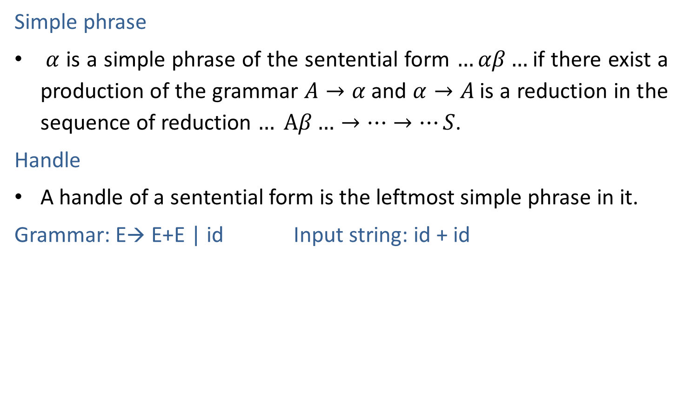
Simple Phrase & Handle
Simple phrase
$α$ is a simple phrase of the sentential form $…αβ…$if there exist a production of the grammar $A→α$and $α→A$is a reduction in the sequence of reduction $… Αβ…→…→…S$.
Handle
A handle of a sentential form is the leftmost simple phrase in it.
Grammar: E→ E+E | id Input string: id + id
Sentential form | Handle | Production
id1+id2 | id1 | E→id
E+id2 | id2 | E→id
E+E | E+E | E→E+E
E | - | -

Slide 155
Parsing methods
Parsing
Top down parsing
Bottom up parsing (Shift reduce)
Back tracking
Naïve bottom up
Parsing without backtracking (predictive parsing)
Operator precedence
LL(1)
Recursive
descent

Slide 156

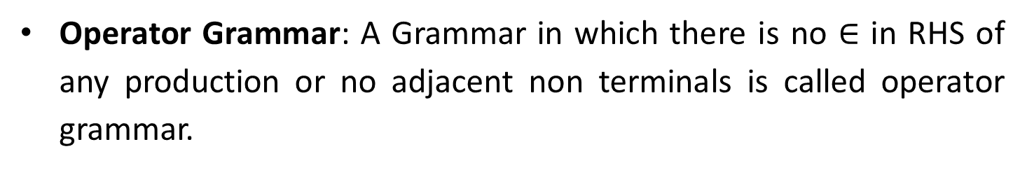
Operator precedence parsing
Operator Grammar: A Grammar in which there is no $∈$ in RHS of any production or no adjacent non terminals is called operator grammar.
Grammar: E→ E+E | (E) | id
Above grammar is operator grammar because in right side there is no $∈$ or no adjacent non terminals.
Grammar: E→ EAE | (E) | id
A→ + | * | -
Above grammar is not operator grammar because right side EAE has adjacent non terminals.

Slide 157
Operator precedence parsing
In operator precedence parsing we define following disjoint relations:
Relation | Meaning
a<.b | a “yields precedence to” b
.
a=b | a “has the same precedence as” b
a.>b | a “takes precedence over” b

Slide 158
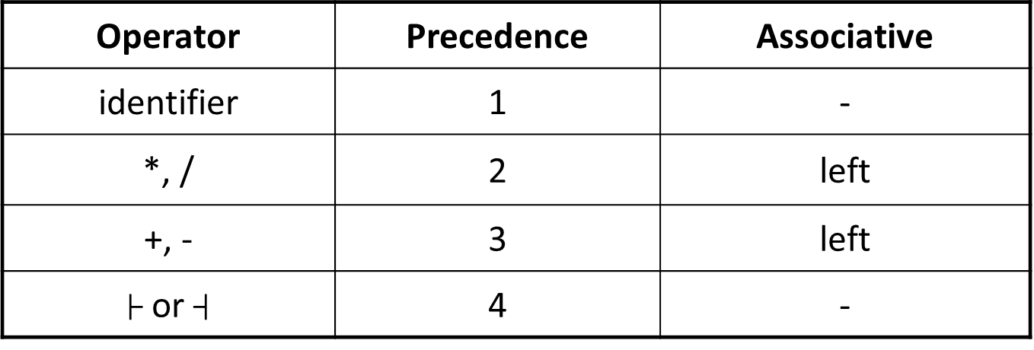
Precedence & associativity of operators
Operator | Precedence | Associative
identifier | 1 | -
*, / | 2 | left
+, - | 3 | left
├ or $┤$ | 4 | -

Slide 159

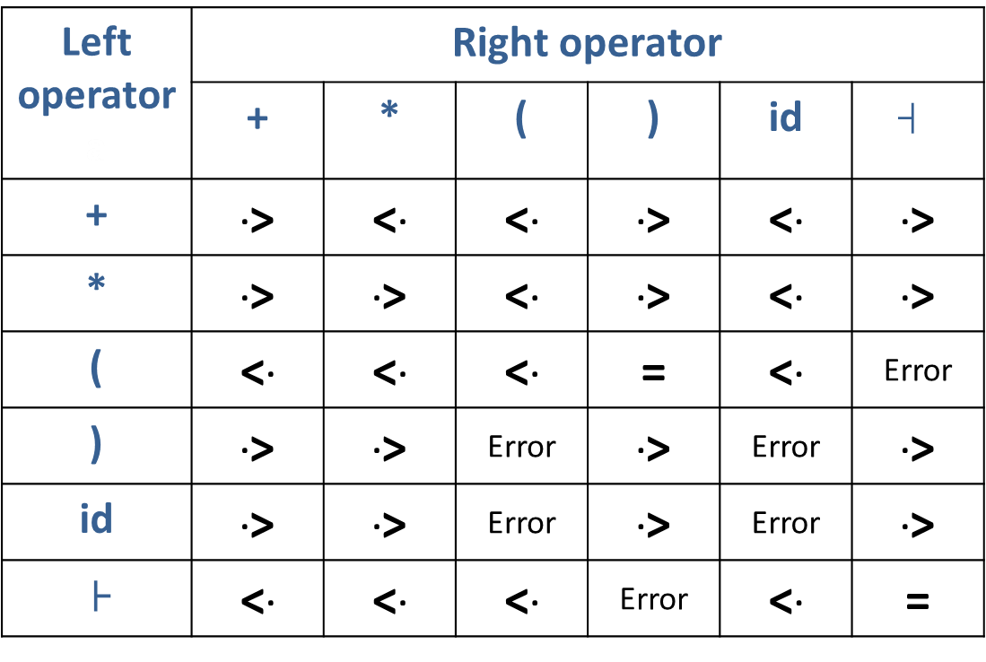
Example: Operator precedence parsing
Left operator a | Right operator
 | + | * | ( | ) | id | $$┤$$
+ | .> | <. | <. | .> | <. | .>
* | .> | .> | <. | .> | <. | .>
( | <. | <. | <. | = | <. | Error
) | .> | .> | Error | .> | Error | .>
id | .> | .> | Error | .> | Error | .>
├ | <. | <. | <. | Error | <. | =
.
.
2*5+7
2*(5+7)+6
2*(5*7)*6
(2*(5+7)+6)
2+5+7
2*(5+7)+6
2+(5+7)+6
├ & $┤$ having lowest priority
2*5*7
id having highest priority
2+(5*7)+6
(2*(5+7)+6)
2+(5+7)+6
2+5*7

Slide 160
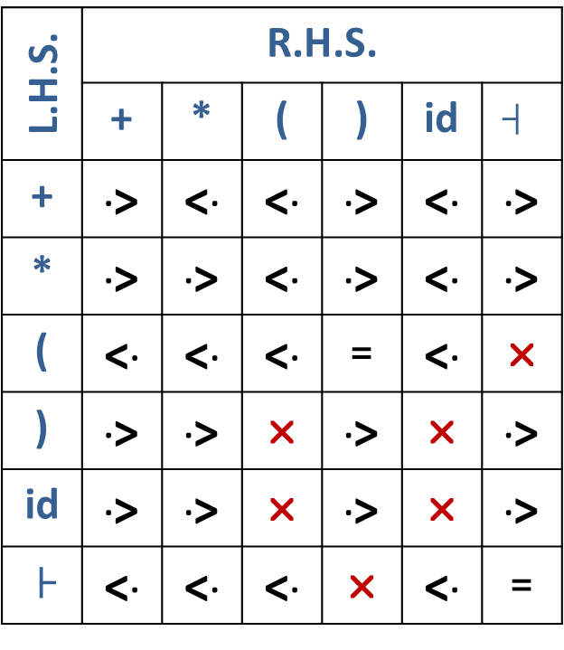

Example: Operator precedence parsing
Assign precedence operator between terminals
String: id+id*id
├ id+id*id $┤$
├ <. id+id*id $┤$
├ <. id .> +id*id $┤$
├ <. id .> + <. id*id $┤$
├ <. id .> + <. id .> *id $┤$
├ <. id .> + <. id .> *<. id $┤$
├ <. id .> + <. id .> *<. id .> $┤$
Parse the string using precedence table
L.H.S. | R.H.S.
 | + | * | ( | ) | id | $$┤$$
+ | .> | <. | <. | .> | <. | .>
* | .> | .> | <. | .> | <. | .>
( | <. | <. | <. | = | <. | ❒
) | .> | .> | ❒ | .> | ❒ | .>
id | .> | .> | ❒ | .> | ❒ | .>
├ | <. | <. | <. | ❒ | <. | =
.
.

Slide 161
Example: Operator precedence parsing
Parse the string using precedence table
E→ E+T | T
T→ T*F | F
F→ id
Scan the input string until first .> is encountered.
Scan backward until <. is encountered.
The handle is string between <. and .>.
├ <. id .> + <. id .> * <. id .>$┤$ | Handle id is obtained between <. and .> Reduce this by F→id
├ F + <. id .> * <. id .> $┤$ | Handle id is obtained between <. and .> Reduce this by F→id
├ F + F * <. id .> $┤$ | Handle id is obtained between <. and .> Reduce this by F→id
├ F + F * F $┤$ | Perform appropriate reductions of all nonterminals.
├ E + T * F $┤$ | Remove all non terminals.
F+F*F
F+T*F
T+T*F
E+T*F
├ + * $┤$ | Place relation between operators
├ <. + <. * > $┤$ | The * operator is surrounded by <. and .>. This indicates * becomes handle so reduce by T→T*F.
├ <. + > $┤$ | + becomes handle. Hence reduce by E→E+T.
├ $┤$ | Parsing Done

Slide 162
Language processor development tools

Slide 163
Language processor development tools
The two widely used language processor development tools are the lexical analyzer generator LEX and the parser generator YACC.
The input to these tools are specifications of the lexical and syntactic constructs of a programming language L.
Figure shows a schematic for developing the analysis phase of a compiler for language L by using LEX and YACC.
Source Program in L
Lexical Specification
LEX
Scanner
IR_{lex}
Syntax Specification
YACC
Parser
Specification of L
Intermediate representation or Target code

Slide 164
LEX
The input to LEX consists of two components.
The first component is a specification of strings that represents the lexical units in L.
This specification is in the form of regular expressions.
The second component is a specification of semantic actions that are aimed at building the intermediate representation.
The intermediated representation produced by a scanner would consist of a set of tables of lexical units and a sequence of tokens for the lexical units occurring in a source statement.
The scanner generated by LEX would be invoked by a parser whenever the parser needs the next token.
Accordingly, each semantic action would perform some table building actions and return a single token.

Slide 165
YACC
The parser would operate as follows:
For a shift action, it would invoke the scanner to obtain the next token and continue the parse by using that token. While performing a reduce action in accordance with a production, it would perform the semantic action associated with that production.
The semantic actions associated with productions achieve building of an intermediate representation or target code as follows:
Every nonterminal symbol in the parser has an attribute.
The semantic action associated with a production can access attributes of nonterminal symbols used in that production - a symbol '$n' in the semantic action, where n is an integer, designates the attribute of the n^{th} nonterminal symbol in the RHS of the production and the symbol '$$' designates the attribute of the LHS nonterminal symbol of the production.
The semantic action uses the values of these attributes for building the intermediate representation or target code.

Slide 166
End of Unit - 6

