Slide 1

Subject: | Advanced Java
Subject Code: | 2160707
Subject Credit: | 6
Semester: | VIth Computer Engineering
Swati Sharma
swati.sharma@darshan.ac.in

Slide 2
Advanced Java
JAVA Platform
Java SE
Java EE
Java ME
Java Standard Edition
Java Enterprise Edition
Java Mobile Edition

Slide 3
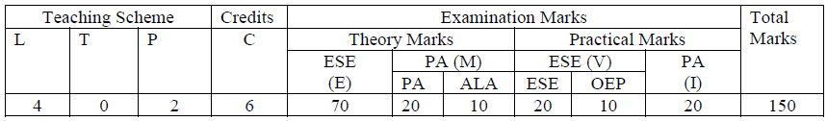
Subject Overview
Teaching and Examination Scheme:

Slide 4
Subject Overview
Sr. No. | Unit | % Weightage
1 | Java Networking | 5
2 | JDBC Programming | 10
3 | Servlet API and Overview | 25
4 | Java Server Pages | 25
5 | Java Server Faces | 10
6 | Hibernate | 15
7 | Java Web Frameworks: Spring MVC | 10
Reference Book:
Complete Reference J2EE by James Keogh mcgraw publication
Black Book “ Java server programming” J2EE, 1st ed., Dream Tech Publishers, 2008. Kathy walrath ”
Professional Java Server Programming by Subrahmanyam Allamaraju, Cedric Buest Wiley Publication

Slide 5
Subject Overview :Unit Mapping
Sr. No. | Unit | Reference Book | Chapter
1 | Java Networking | The Complete Reference, Java (Seventh Edition), Herbert Schild - Osbrone. | 20
2 | JDBC Programming | Complete Reference J2EE by James Keogh mcgraw publication | 6,7
3 | Servlet API and Overview | Professional Java Server Programming by Subrahmanyam Allamaraju, Cedric Buest Wiley Publication | 7,8
4 | Java Server Pages |  | 10,11
5 | Java Server Faces | Black Book “ Java server programming” J2EE, 1st ed., Dream Tech Publishers, 2008. 3. Kathy walrath ” | 11
6 | Hibernate |  | 15
7 | Java Web Frameworks: Spring MVC |  | 21

Slide 6
Unit-1 Java Networking
Reference Book
The Complete Reference, Java (Seventh Edition), Herbert Schild - Osbrone. CHAPTER : 20

Slide 7
Unit-1: Java Networking
Topic
Network Basics and Socket overview
InetAddress
TCP/IP server sockets
TCP/IP client sockets
Datagrams
URL
URLConnection

Slide 8
Unit-1: Java Networking
Topic
Network Basics and Socket overview
InetAddress
TCP/IP server sockets
TCP/IP client sockets
Datagrams
URL
URLConnection

Slide 9

Network Basics: java.net pacakage
The term network programming refers to writing programs that execute across multiple devices (computers), in which the devices are all connected to each other using a network.
This class represents an Internet Protocol (IP) address.
Class represents a Uniform Resource Locator, a pointer to a "resource" on the World Wide Web.
Represent the communications link between the application and a URL
 | Java.net Package
 |  | InetAddress
 |  | URL
 |  | URLConnection
 |  | ServerSocket
 |  | Socket
 |  | DatagramPacket
 |  | DatagramSocket
Used to create a server socket. This object is used to establish communication with the clients.
This class implements client sockets.
import java.net.*
This class represents a datagram packet.
Represents a socket for sending and receiving datagram packets.
TCP
UDP

Slide 10
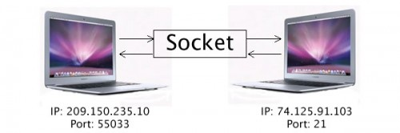
Socket overview
Socket
“A socket is one endpoint of a two-way communication link between two programs running on the network.”
An Socket is combination of an IP address and a port number.

Slide 11
Client – Server Communication
Two machines must connect
Server waits for connection
Client initiates connection
Server responds to the client request
Server
Client
Response
socket
socket
Request
Waits

Slide 12
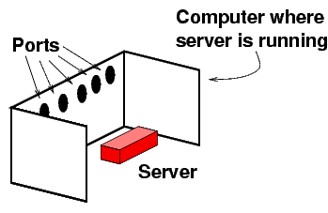
Socket overview
The server is just like any ordinary program running in a computer.
Each computer is equipped with some ports.
Reference: isinotes/javatut/net

Slide 13
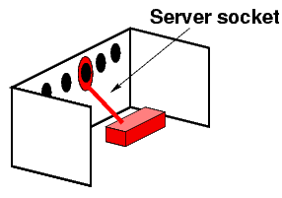
Socket overview
The server connects to one of the ports.
This process is called binding to a port.
The connection is called a server socket.
The Java server code that does this is:
ServerSocket ss = new ServerSocket(1234);//1234 is port number
Reference: isinotes/javatut/net

Slide 14
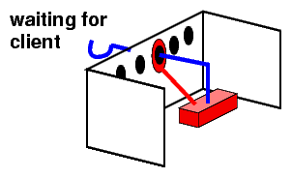
Socket overview
Server is waiting for client machine to connect.
Reference: isinotes/javatut/net

Slide 15
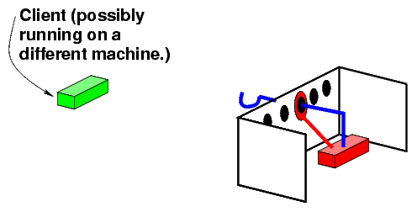
Socket overview
Reference: isinotes/javatut/net

Slide 16
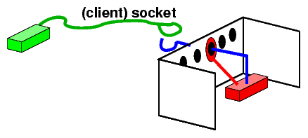
Socket overview
In the next step the client connects to this port of the server's computer.
The connection is called a (client) socket.
Socket sock = new Socket("www.darshan.ac.in",80);
/* The client knows the number 80 */
Reference: isinotes/javatut/net

Slide 17
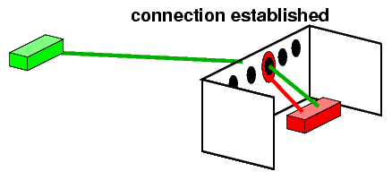
Socket overview
Now, connection is established between client and server.
Reference: isinotes/javatut/net

Slide 18
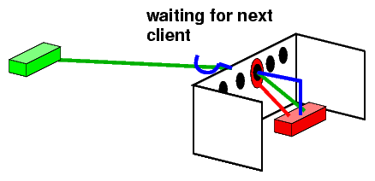
Socket overview
Reference: isinotes/javatut/net

Slide 19
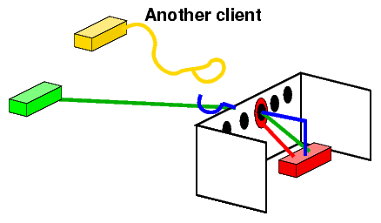
Socket overview
Everytime a client is found, its Socket is extracted, and the loop again waits for the next client.
Reference: isinotes/javatut/net

Slide 20
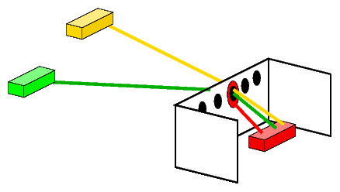
Socket overview
Client 2
Server
Client 1
Reference: isinotes/javatut/net

Slide 21
Unit-1: Java Networking
Topic
Network Basics and Socket overview
InetAddress
TCP/IP server sockets
TCP/IP client sockets
Datagrams
URL
URLConnection

Slide 22
InetAddress
java.net package
This class represents an Internet Protocol (IP) address.
The java.net.InetAddress class provides methods to get an IP of host name.
Example
InetAddress ip =InetAddress.getByName("www.darshan.ac.in");
System.out.println(“ip:“+ ip);
Output:
ip: www.darshan.ac.in/89.238.188.50

Slide 23
InetAddress : Method
Method | Description
public static InetAddress getByName(String host) throws UnknownHostException | Determines the IP address of a given host's name.
Example
InetAddress ip =InetAddress.getByName("www.darshan.ac.in");
System.out.println(“ip:“+ ip);
Output:
ip: www.darshan.ac.in/89.238.188.50

Slide 24
InetAddress : Method
Method | Description
public static InetAddress getLocalHost() throws UnknownHostException | Returns the address of the local host.
Example
InetAddress ip=InetAddress.getLocalHost();
System.out.println(“LocalHost:“+ip);
Output:
LocalHost:swati-PC/10.254.3.34

Slide 25
InetAddress : Method
Method | Description
public String getHostName() | it returns the host name of the IP address.
Example
InetAddress ip=InetAddress.getByName("10.254.3.34");
System.out.println(“Hostname:”+ip.getHostName());
Output:
Hostname:swati-PC

Slide 26
InetAddress : Method
Method | Description
public String getHostAddress() | it returns the IP address in string format.
Example
InetAddress ip=InetAddress.getByName("www.darshan.ac.in");
System.out.println(“HostAddress:”+ip.getHostAddress());
Output:
HostAddress:89.238.188.50

Slide 27
InetAddress: Program
import java.net.*; //required for InetAddress Class
public class InetDemo{
public static void main(String[] args){
try{
InetAddress ip =InetAddress.getByName("www.darshan.ac.in");
System.out.println("Host Name: "+ip.getHostName());
System.out.println("IP Address:"+ip.getHostAddress());
}
catch(Exception e){System.out.println(e);}
}
}
Output:
Host Name: www.darshan.ac.in
IP Address: 89.238.188.50

Slide 28
InetAddress: Method Summary
static InetAddress getByName(String host) | Determines the IP address of a given host's name.
static InetAddress getLocalHost() | Returns the address of the local host.
public String getHostName() | it returns the host name of the IP address.
public String getHostAddress() | it returns the IP address in string format.
String toString() | Converts this IP address to a String.
boolean equals(Object obj) | Compares this object against the specified object.
static InetAddress[] getAllByName(String host) | Returns an array of its IP addresses, based on the configured name service on the system.
static InetAddress getLoopbackAddress() | Returns the loopback address.

Slide 29
Assignment
Write a java program to demonstrate methods of java.net.

Slide 30
Unit-1: Java Networking
Topic
Network Basics and Socket overview
InetAddress
TCP/IP server sockets
TCP/IP client sockets
Datagrams
URL
URLConnection

Slide 31
TCP/IP Client-Server sockets
This class implements Server sockets
 | Java.net
 |  | InetAddress
 |  | URL
 |  | URLConnection
 |  | ServerSocket
 |  | Socket
 |  | DatagramPacket
 |  | DatagramSocket
 |  | MulticastSocket
This class implements Client sockets.
TCP

Slide 32
TCP/IP ServerSocket Class
The ServerSocket class (java.net) can be used to create a server socket.
This object is used to establish communication with the clients.
Constructor
Method
ServerSocket(int port) | Creates a server socket, bound to the specified port.
public Socket accept() | returns the socket and establish a connection between server and client.

Slide 33
TCP/IP Server Sockets
Syntax
ServerSocket ss;
ss=new ServerSocket(Port_no);
Example
ServerSocket ss=new ServerSocket(1111);

Slide 34
TCP/IP Server program
MyServer.java
import java.io.*; // required data input/output stream
import java.net.*; //required for Socket Class
public class MyServer {
public static void main(String[] args){
try{
ServerSocket ss=new ServerSocket(1111);
Socket s=ss.accept();//establishes connection
DataInputStream dis=
new DataInputStream (s.getInputStream());
String str=(String)dis.readUTF();
System.out.println("message= "+str);
ss.close();
}
catch(Exception e){System.out.println(e);}
}
}
Output
message= Hello Server
Server
socket

Slide 35
TCP/IP Client Sockets: Socket Class
The client in socket programming must know two information:
IP Address of Server
Port number.
Constructor
Socket() | Creates an unconnected socket
Socket(InetAddress address, int port) | Creates a stream socket and connects it to the specified port number at the specified IP address.
Method
public InputStream getInputStream() | returns the InputStream attached with this socket
public OutputStream getOutputStream() | returns the OutputStream attached with this socket.

Slide 36
TCP/IP Client Sockets
Syntax
Socket myClient; //Creates object of Socket Class
myClient = new Socket("Machine name", PortNumber);
Example
Socket s;
s=new Socket("localhost",1111);
DNS or IP Address
Port Number is the port (a number) on which the server you are trying to connect.

Slide 37
TCP/IP Client Sockets: Program
import java.net.*; //required for Socket Class
import java.io.*; // required data input/output stream
public class MyClient {
public static void main(String[] args)
{ try{
Socket s = new Socket("localhost",1111);
DataOutputStream dout= new DataOutputStream(s.getOutputStream());
dout.writeUTF("Hello Server");// Writes a string to the underlying output stream
}catch(Exception e)
{System.out.println(e);}
}
}
Object of Socket class

Slide 38
TCP/IP Client-Server program
MyServer.java
MyClient.java
import java.io.*;
import java.net.*;
public class MyServer {
public static void main(String[] args){try{
ServerSocket ss=new ServerSocket(1111);
Socket s=ss.accept();
DataInputStream dis=new DataInputStream (s.getInputStream());
String str=(String)dis.readUTF();
System.out.println("message= "+str);
ss.close();
}catch(Exception e)
{System.out.println(e);}
}//psvm
}//class
Output
message= Hello Server
import java.net.*;
import java.io.*;
public class MyClient {
public static void main(String[] args){
try {
Socket s=new Socket("localhost",1111);
DataOutputStream dout=new DataOutputStream(s.getOutputStream());
dout.writeUTF("Hello Server");
//Writes string to underlying o/p stream
}//try
catch(Exception e)
{System.out.println(e);}
} //psvm
}//class

Slide 39
Assignment
Write a java program for TCP Client/Server Chat Application.

Slide 40
Unit-1: Java Networking
Topic
Network Basics and Socket overview
InetAddress
TCP/IP server sockets
TCP/IP client sockets
Datagrams
URL
URLConnection

Slide 41
Datagrams
 | Java.net
 |  | InetAddress
 |  | URL
 |  | URLConnection
 |  | ServerSocket
 |  | Socket
 |  | DatagramPacket
 |  | DatagramSocket
This class represents a datagram packet.
Represents a socket for sending and receiving datagram packets.
UDP

Slide 42
Datagrams: DatagramSocket class
DatagramSocket class represents a connection-less socket for sending and receiving datagram packets.
A datagram is basically an information but there is no guarantee of its content, arrival or arrival time.
Constructor
DatagramSocket() | it creates a datagram socket and binds it with the available Port Number on the localhost machine.
DatagramSocket(int port) | it creates a datagram socket and binds it with the given Port Number.
DatagramSocket(int port, InetAddress address) | it creates a datagram socket and binds it with the specified port number and host address.

Slide 43
Datagrams: DatagramPacket class
Java DatagramPacket is a message that can be sent or received.
If you send multiple packet, it may arrive in any order.
Additionally, packet delivery is not guaranteed.
Constructor
number of bytes to read.
buffer for holding the incoming datagram.
DatagramPacket(byte[] barr, int length) | It creates a datagram packet. This constructor is used to receive the packets.
DatagramPacket(byte[] barr, int length, InetAddress address, int port) | It creates a datagram packet. This constructor is used to send the packets.

Slide 44
Example of Sending DatagramPacket by DatagramSocket
import java.net.*; //required for Datagram Class
public class DSender{
public static void main(String[] args)
throws Exception
{
DatagramSocket ds = new DatagramSocket();
String str = "Message sent by Datagram socket";
InetAddress ip = InetAddress.getByName("127.0.0.1");
DatagramPacket dp = new DatagramPacket
(str.getBytes(), str.length(), ip, 3000);
ds.send(dp);
ds.close();
}
}

Slide 45
Example of Receiving DatagramPacket by DatagramSocket
import java.net.*;
public class DReceiver{
public static void main(String[] args) throws Exception
{
DatagramSocket ds = new DatagramSocket(3000);
byte[] buf = new byte[1024];
DatagramPacket dp = new DatagramPacket(buf, 1024);
ds.receive(dp);
String str = new String(dp.getData(), 0,dp.getLength());
System.out.println(str);
ds.close();
}
}
Output
Message sent by Datagram socket

Slide 46
Example of Sending and Receiving DatagramPacket
DSender.java
DReceiver.java
import java.net.*;
public class DSender{
public static void main(String[] args)throws Exception{
DatagramSocket ds=
new DatagramSocket();
String str = "Message sent by Datagram socket";
InetAddress ip =
InetAddress.getByName("127.0.0.1");
DatagramPacket dp = new DatagramPacket
(str.getBytes(),str.length(),ip,3000);
ds.send(dp);
ds.close();
}
}
import java.net.*;
public class DReceiver{
public static void main(String[] args) throws Exception {
DatagramSocket ds =
new DatagramSocket(3000);
byte[] buf = new byte[1024];
DatagramPacket dp =
new DatagramPacket(buf, 1024);
ds.receive(dp);
String str = new String
(dp.getData(), 0,dp.getLength());
System.out.println(str);
ds.close();
}
}
Output
Message sent by Datagram socket

Slide 47
Unit-1: Java Networking
Topic
Network Basics and Socket overview
InetAddress
TCP/IP client sockets
TCP/IP server sockets
Datagrams
URL
URLConnection

Slide 48
URL: Uniform Resource Locator
The Java URL class represents an URL.
This class is pointer to “resource” on the World Wide Web.
E.g.
http://10.255.1.1:8090/httpclient.html
Port Number
http is the protocol.
Server name or IP Address
File Name or directory name

Slide 49
URL
Constructor
Example
URL url=new URL("http://www.darshan.ac.in");
Method
Example
URLConnection urlcon=url.openConnection();
URL(String url) | Creates a URL object from the String representation.
public URLConnection openConnection() throws IOException | This method of URL class returns the object of URLConnection class

Slide 50
Unit-1: Java Networking
Topic
Network Basics and Socket overview
InetAddress
TCP/IP client sockets
TCP/IP server sockets
Datagrams
URL
URLConnection

Slide 51
URLConnection
URLConnection is the superclass of all classes that represent a communications link between the application and a URL.
Instances of this class can be used both to read from and to write to the resource referenced by the URL.
Constructor
URLConnection(URL url) | Constructs a URL connection to the specified URL

Slide 52
URLConnection
Method
public InputStream getInputStream() throws IOException | Returns an input stream that reads from this open connection.
public OutputStream getOutputStream() throws IOException | Returns an output stream that writes to this connection.

Slide 53
URLConnection : Program
import java.io.*; //required for input stream
import java.net.*; //required for URL & URLConnection
public class URLConnectionDemo {
public static void main(String[] args){
try{
URL url=new URL("http://www.darshan.ac.in");
URLConnection urlcon=url.openConnection();
InputStream stream=urlcon.getInputStream();
int i;
while((i=stream.read())!=-1){
System.out.print((char)i);
}
}catch(Exception e){System.out.println(e);}
}
}
Object of URLConnection Class

Slide 54
Important Questions: GTU
1 | What is Server Socket? Explain in detail with an example. | [Win-16]
2 | What is Datagram Socket? Explain in detail with example. | [Win-16]
3 | Write a TCP or UDP client and server program to do the following: Client send : Welcome to Gujarat Technological UNIVERSITY Response from Server: ytisrevinu LACIGOLONHCEt TARAJUg TO EMOCLEw | [Sum-16] [Win-16]
4 | Write a client-server program using TCP or UDP where the client sends 10 numbers and server responds with the numbers in sorted order. | [Sum-16]
5 | Write a TCP Client-Server program to get the Date & Time details from Server on the Client request. | [Sum-15] [Win-16]
6 | Write a client server program using TCP where client sends two numbers and server responds with sum of them. | [Win-15]

Slide 55
Summary
Basic of socket
Socket programming
Client-Server Communication
TCP Client-Server Program
UDP Sender-Receiver Program
URL Connection

Slide 56
Reference
Book Reference
The Complete Reference, Java (Seventh Edition), Herbert Schild - Osbrone.
Web Reference
https://docs.oracle.com/javase/7/docs/api/
https://www.tutorialspoint.com

Slide 57

Assignment: Unit-1
1. | Explain working of following protocol IP, IPV4, IPV6, TCP, UDP, SMTP, HTTP, HTTPS, DNS, FTP
2. | TCP vs UDP with their applications.
3. | HTTP is stateless protocol. Justify
4. | Define the following: Socket, URL, Port
5. | Write a java program to demonstrate methods of InetAddress.
6. | Write a java Connection less (UDP) Program to do the following: Sender will send : Welcome to Gujarat Technological UNIVERSITY Receiver will send back to sender: ytisrevinu LACIGOLONHCEt TARAJUg TO EMOCLEw
7. | Write a java Connection less (UDP) Program for chat application.
8. | Write a client-server program using TCP and UDP where the client sends 10 numbers and server responds with the numbers in sorted order.
9. | Write a TCP Client-Server program to get the Date & Time details from Server on the Client request.
10. | Write a client server program using TCP where client sends two numbers and server responds with sum of them.
Deadline
16th Jan 2017

