Slide 1
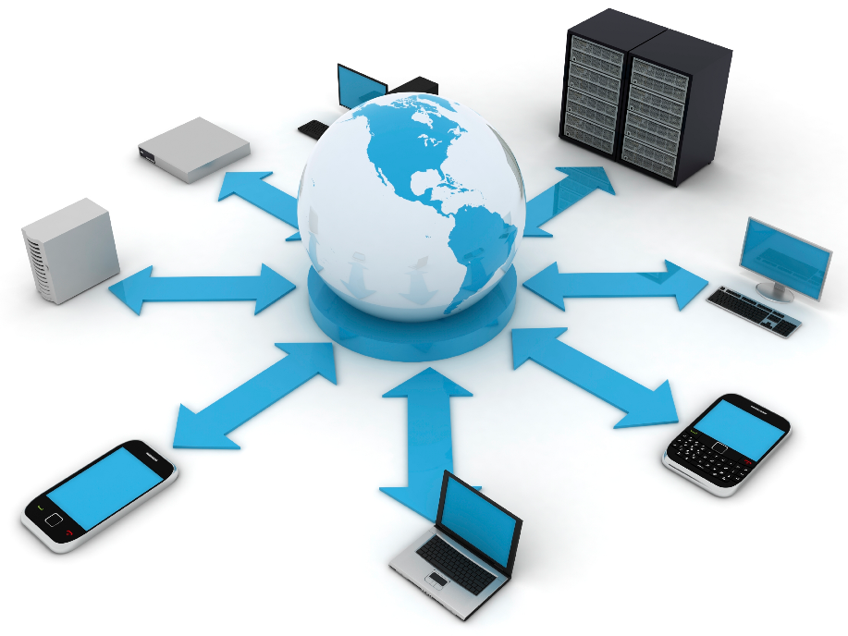

Unit: 1 Introductory Concepts of Distributed Operating System
Distributed Operating System (2160710)
Dipak Ramoliya
→ dipak.ramoliya@darshan.ac.in
Computer Engineering Darshan Institute of Engineering & Technology

Slide 2
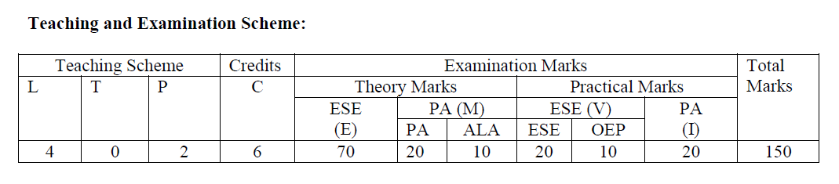
Distributed Operating System – Teaching Schemes

Slide 3
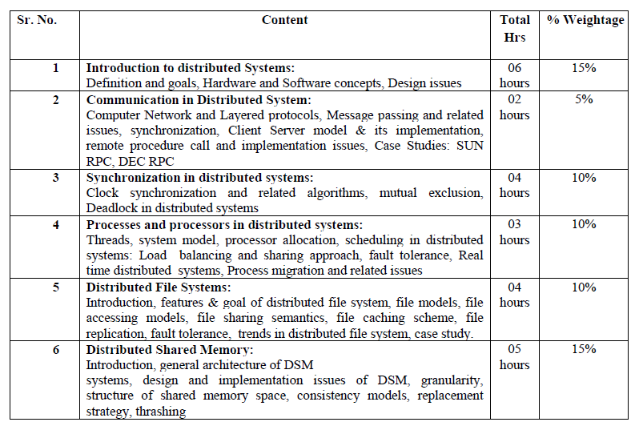
Distributed Operating System – Teaching Schemes

Slide 4
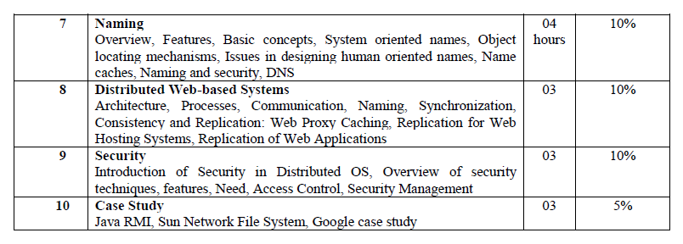
Distributed Operating System – Teaching Schemes

Slide 5
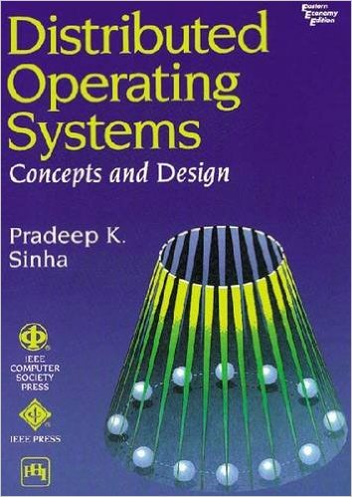
Distributed Operating System - Book

Slide 6
Unit Outline & Weightage %
1. Introduction to Distributed System 15%
Operating System
Basic Concepts of Distributed Operating System
Definition and Goal
Advantage
Hardware and Software Concepts
Design Issues

Slide 7
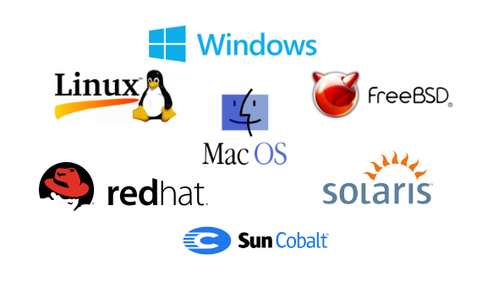
What is Operating System?
An operating system (OS) is system software that manages computer hardware and software resources and provides common services for computer programs.
Example:

Slide 8
What is Operating System?
It is a program that acts as an interface between the user and the computer hardware and controls the execution of all kinds of programs.
User
User 1
User 2
Software
System Software
Application Software
Operating System
Windows
Linux
User 3
Mac
Hardware
CPU
RAM
I/O

Slide 9
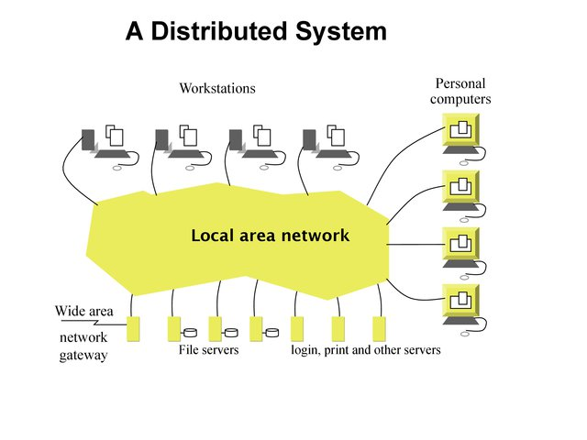
What is Distributed Operating System?
Definition by Coulouris, Dollimore, Kindberg and Blair
A distributed system is defined as one in which components at networked computers communicate and coordinate their actions only by passing messages.
This definition allows for concurrent execution of programs, but prevents the possibility of a global clock and means that components can fail independently of one another.

Slide 10
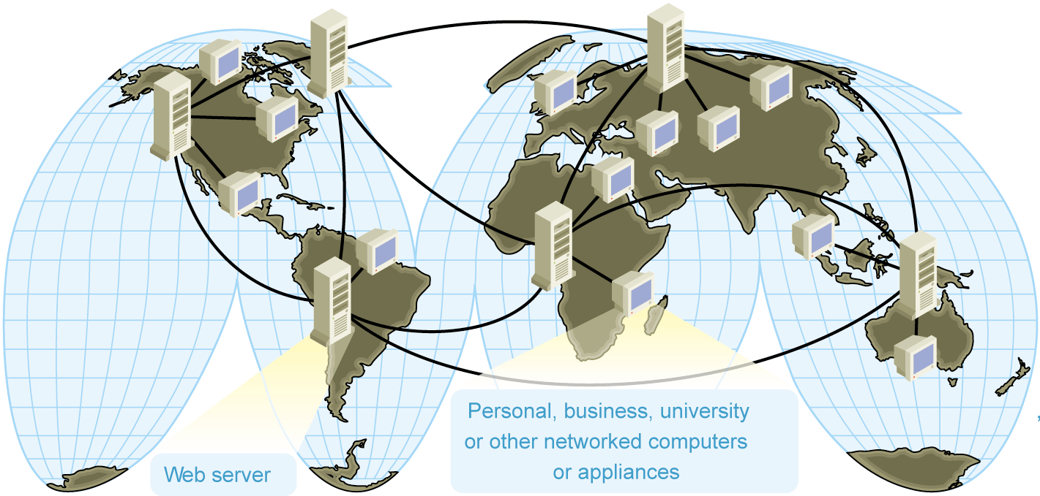
What is Distributed Operating System?
Definition by Andrew S. Tannenbaum and Maarten Van Steen
A Distributed System is
a collection of independent computers
that appears to its users
as a single coherent system. ... or ... as a single system.

Slide 11
Example of Distributed Systems
From the definition, Distributed Systems also looks the same as single system.
Let us say about Google Web Server, from users perspective while they submit the searched query, they assume google web server as a single system.
Just visit google.com, then search.
However, under the hood Google builds a lot of servers even distributes in different geographical area to give you a search result within few seconds.
So the Distributed Systems does not make any sense for normal users.
But CEO, CIO or management level should really take care of it for better giving the organizational image by providing the best and on time service to customers.

Slide 12
Examples of Distributed Systems
A typical portion of the Internet
global access to “everybody”(data, service, other actor)
enormous size (open ended)
No single authority
intranet
%
ISP
%
%
%
backbone
satellite link
desktop computer:
server:
network link:

Slide 13
Examples of Distributed Systems
A typical intranet
a single authority
protected access - a firewall - total isolation
typical services: - infrastructure services: file service, name service - application services

Slide 14
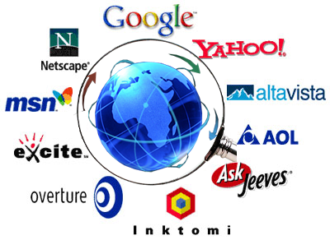
Examples of Distributed Systems
Massively multiplayer online games:
Large number of people interact through the Internet with a virtual world.
Challenges include fast response time, real-time propagation of events.
Web Search Engines:
Major growth industry in the last decade.
10 billion per month for global number of searches.
e.g. Google distributed infrastructure

Slide 15
Why Distributed Operating System?
The main answer is to cope with the extremely higher demand of users in both processing power and data storage.
For example, according to www.datacenterknowledge.com:
Facebook by the end of 2010
Total users: 500 millions
Total servers: 60, 000 servers (estimate, Oct 2009)
50 millions operations per second
1 million photos are viewed every second
Each month more than 3 billions photos are uploaded
With this extremely demand, I do believe single system could not achieve it.
That’s one reason why distributed systems comes in place.
There are many reasons that make distributed systems is viable such as high availability, scalability, resistant to failure, etc.

Slide 16
Network OS vs Distributed OS
Network Operating System | Distributed Operating System
A network operating system is made up of software and associated protocols that allow a set of computer network to be used together. | A distributed operating system is an ordinary centralized operating system but runs on multiple independent CPUs.
Environment users are aware of multiplicity of machines. | Environment users are not aware of multiplicity of machines.
Control over file placement is done manually by the user. | It can be done automatically by the system itself.
Performance is badly affected if certain part of the hardware starts malfunctioning. | It is more reliable or fault tolerant i.e. distributed operating system performs even if certain part of the hardware starts malfunctioning.
Remote resources are accessed by either logging into the desired remote machine or transferring data from the remote machine to user's own machines. | Users access remote resources in the same manner as they access local resources.

Slide 17
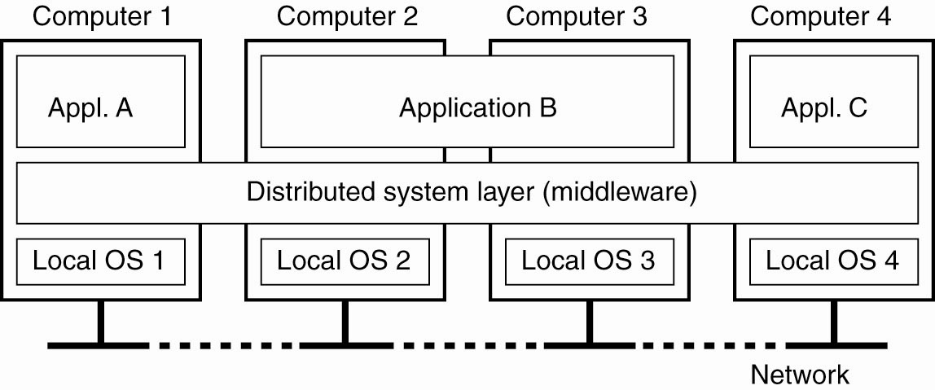
Distributed Operating System Architecture
A distributed system organized as Middleware.
The middleware layer runs on all machines, and offers a uniform interface to the system.

Slide 18
Middleware (MW)
Software that manages and supports the different components of a distributed system. In essence, it sits in the middle of the system.
Middleware is usually off-the-shelf rather than specially written software.
Examples:
Transaction processing monitors
Data converters
Communication controllers

Slide 19
Role of Middleware (MW)
In some early systems:
MW tried to provide the illusion that a collection of separate machines was a single computer.
E.g. NOW project: GLUNIX middleware (Global Layer Unix)
Today:
Clustering software allows independent computers to work together closely
MW also supports seamless access to remote services, doesn’t try to look like a general-purpose OS.
Other Middleware Examples
CORBA (Common Object Request Broker Architecture)
DCOM (Distributed Component Object Management) – being replaced by .NET
Sun’s ONC RPC (Remote Procedure Call)
RMI (Remote Method Invocation)
SOAP (Simple Object Access Protocol)

Slide 20
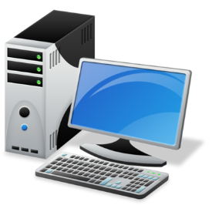

Distributed System Goals
The following are the main goals of distributed systems:
The relative simplicity of the software - each processor has a dedicated function.
Incremental growth - if we need 10 percent more computing power, we just add 10 percent more processors.
Reliability and availability - a few parts of the system can be down without disturbing people using the other parts.
Openness: Offer services according to standard rules that describe the syntax and semantics of those services.

Slide 21
Advantages of Distributed Systems over Centralized Systems
Economics: A collection of microprocessors offer a better price/performance than mainframes.
Low price/performance ratio: cost effective way to increase computing power.
Speed: A distributed system may have more total computing power than a mainframe.
Inherent distribution: Some applications are inherently distributed. Ex. a supermarket chain.
Reliability: If one machine crashes, the system as a whole can still survive. Higher availability and improved reliability.

Slide 22
Advantages of Distributed Systems over Independent PCs
Data sharing: allow many users to access to a common data base
Resource Sharing: expensive peripherals like color printers
Communication: enhance human-to-human communication, e.g., email, chat
Flexibility: spread the workload over the available machines

Slide 23
Classification of Distributed System
Based on Hardware
Based on number of instructions and DataStream

Slide 24
Classification based on Hardware
Even though all distributed system consist of multiple CPUs, there are several different ways the hardware can be organized, specially in terms of how they are interconnected and communicate.
Parallel & Distributed Computers
Multiprocessor (Shared Memory)
Multiprocessor (Private Memory)
Bus based
Switched
Bus based
Switched
Tightly Coupled
Loosely Coupled
Sequent, Encore
Ultra Computer, RP3
Workstation on LAN
Hypercube, Transputer

Slide 25
Classification based on Hardware
Loosely-coupled OS
A collection of computers each running their own OS, OS’s allow sharing of resources across machines
Manages heterogeneous multicomputer Distributed Systems.
Difference: provides local services to remote clients via remote logging
Data transfer from remote OS to local OS via FTP (File Transfer Protocols)
Network Operating System (NOS)
Tightly-coupled OS
OS tries to maintain single global view of resources it manages.
Manages multiprocessors & homogeneous multicomputer.
Similar “local access feel” as a non-distributed, standalone OS.
Data migration or computation migration modes (entire process or threads)
Distributed Operating System (DOS)

Slide 26
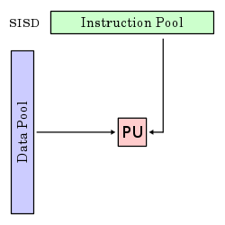
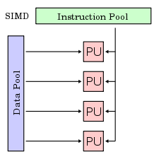
Classification based on Instruction & DataStream
According to Flynn, classification can be done based on the number of instruction streams and number of data streams.
Single instruction stream single data stream (SISD)
All traditional uniprocessor computers (those having 1 CPU) fall in this category, from personal computers to large mainframes.
Single instruction stream, multiple data streams (SIMD)
This type refers to array processors with one instruction unit that fetches an instruction and then commands many data units to carry it out in parallel, each with in its own data.

Slide 27
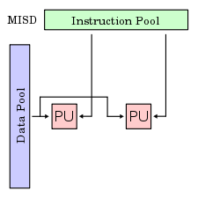
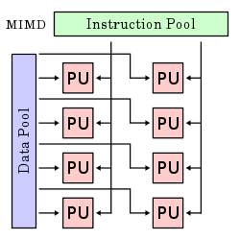
Classification based on Instruction & DataStream
Multiple instruction streams, single data stream (MISD)
No more computers fit this model.
Uncommon architecture which is generally used for fault tolerance.
Multiple instruction streams, multiple data streams (MIMD)
A group of independent computers, each with its own program counter, program, and data.
All distributed systems are MIMD, We divide all MIMD computers into two groups:
Have shared memory, usually called multiprocessors.
Do not have shared memory, called multicomputer.

Slide 28
Distributed Computing System Models
Distributed Computing system models can be broadly classified into five categories.
Minicomputer Model
Workstation Model
Hybrid Model
Processor – pool Model
Workstation – server Model

Slide 29
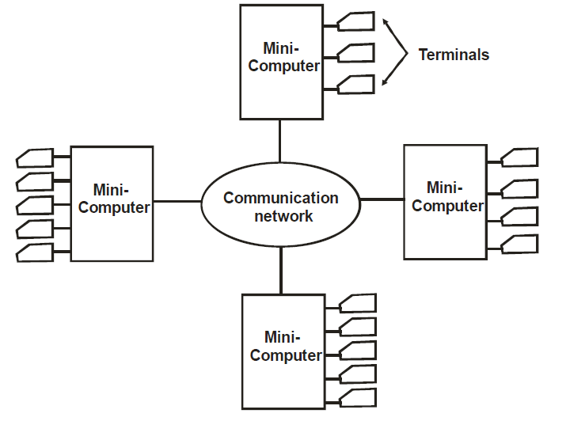
Minicomputer Model
It consists of a few minicomputers interconnected by a communication network.
Each minicomputer usually has multiple users logged on to it simultaneously.
For this several interactive terminals are connected to each mini computer.
Each user is logged onto one minicomputer, with remote access to other minicomputers.
The network allows the user to access remote resources that are available on some machine other than the user is currently logged.
Minicomputer model can be used for resource sharing like information databases.
ARPAnet is the example Distributed computing system based on the minicomputer model.

Slide 30
Workstation Model
Workstation
Workstation
Workstation
Communication
Network
Workstation
Workstation
Workstation
Workstation
Workstation

Slide 31
Workstation Model
A workstation is a high-end microcomputer designed for technical or scientific applications.
Each workstation is equipped with its own disk and is intended primarily to be used by one person at a time (single-user computer), but they are commonly connected to a local area network and run multi-user operating systems.
Large number of workstations can lie idle resulting in a waste of CPU time.
Using a high speed LAN allows idle workstations to process jobs of users who are logged onto other workstations, which have less computing powers.

Slide 32
Workstation-server Model
Workstation
Workstation
Workstation
Communication
Network
Workstation
Workstation
Mini Computer
Used as a
File Server
Mini Computer
Used as a
Print Server
Mini Computer
Used as a database Server

Slide 33
Workstation-server Model
It is a network of personal workstations each with its own disk and local file system.
Workstation with its own local disk is usually called a diskfull workstation and a workstation without a local disk is called a diskless workstation.
When diskless workstations are used, file system to be used must be implemented by a diskfull workstation or by a minicomputer equipped with a disk for file storage.
Other minicomputers are used for providing other services like database, print etc.

Slide 34
Processor-Pool Model
Terminals
Terminals
Terminals
Communication
Network
Terminals
Terminals
Run
Server
File
Server
----------
Pool of processors

Slide 35
Processor-Pool Model
When an user needs a very large amount of computing power for a short time, instead of allocating a processor to each user, processors are pooled together to be shared by the users as needed.
Pool of processors contain a large number of microcomputers and mini-computers.
Each processor in the pool has its own memory to load and run a system program or an application program of the distributed computing system.
Amoeba, Cambridge Distributed Computing system are examples of process-pool model based Distributed systems.

Slide 36
Hybrid Model
Advantages of the workstation-server and processor-pool models are combined to build a hybrid model.
It is built on the workstation-server model with a pool of processors.
Processors in the pool can be allocated dynamically for large computations, that cannot be handled by the workstations, and require several computers running concurrently for efficient execution.
This model is more expensive to implement than the hybrid or the processor-pool model.

Slide 37
Issues in Designing a Distributed System
Transparency
Reliability
Flexibility
Performance
Scalability
Heterogeneity
Security

Slide 38
Transparency
Main goal of Distributed system is to make the existence of multiple computers invisible (transparent) and provide single system image to user.
A transparency is some aspect of the distributed system that is hidden from the user (programmer, system developer, application).
A transparency is provided by including some set of mechanisms in the distributed system at a layer below the interface such that a communication system appears to its users as a virtual uniprocessor.
While users hit search in google.com…….. They never notice that their query goes through a complex process before google shows them a result.

Slide 39
Types of Transparency
Access Transparency
User should not be able to recognize whether a resource is remote or local.
Hide differences in data representation & resource access (enables interoperability)
Location Transparency
Resource should be independent of the physical connectivity or topology of the system or the current location of the resources.
Hide location of resource (can use resource without knowing its location)
Replication Transparency
The provision of create replicas (additional copies) of files and other resources on different node of the distributed system.
Hide the possibility that multiple copies of the resource exist (for reliability and/or availability)

Slide 40
Types of Transparency
Failure Transparency
It deals with the masking from the users partial failures in the system, such as a communication link failure, a machine failure, or a storage device crash.
Hide failure and recovery of the resource.
Migration Transparency
Resource object is to be moved from one place to another automatically by the system.
Hide possibility that a system may change location of resource (no effect on access)
Concurrency Transparency
Each user has the feeling that he or she is the sole user of the system and other user do not exists in the system.
Hide the possibility that the resource may be shared concurrently.

Slide 41
Types of Transparency
Performance Transparency
It allow the system to be automatically reconfigured to improve performance, as load vary dynamically in the system.
Scaling
Transparency
It allows the system to expand in scale without disrupting the activities of the users.

Slide 42
Reliability
Distributed systems are expected to be more reliable than centralized systems due to the existence of multiple instances of resources.
System failure are of two types:
Fail-stop: The system stop functioning after detecting the failure.
Byzantine failure: The system continues to function but gives wrong results.
The fault-handling mechanism must be designed properly to avoid faults, to tolerate faults and to detect and recover from faults.

Slide 43
Flexibility
The design of Distributed operating system should be flexible due to following reasons:
Ease of Modification: It should be easy to incorporate changes in the system in a user transparent manner or with minimum interruption caused to the users.
Ease of Enhancement: New functionality should be added from time to time to make it more powerful and easy to use.
A group of users should be able to add or change the services as per the comfortability of their use.

Slide 44
Performance
A performance should be better than or at least equal to that of running the same application on a single-processor system.
Some design principles considered useful for better performance are as below:
Batch if possible: Batching often helps in improving performance.
Cache whenever possible: Caching of data at clients side frequently improves over all system performance.
Minimize copying of data: Data copying overhead involves a substantial CPU cost of many operations.
Minimize network traffic: It can be improved by reducing internode communication costs.

Slide 45
Scalability
Distributed systems must be scalable as the number of user increases.
Scalability has 3 dimensions:
Size: Number of users and resources to be processed. Problem associated is overloading.
Geography: Distance between users and resources. Problem associated is communication reliability
Administration: As the size of distributed systems increases, many of the system needs to be controlled. Problem associated is administrative mess.
A system is said to be scalable if it can handle the addition of users and resources without suffering a noticeable loss of performance or increase in administrative complexity.

Slide 46
Heterogeneity
This term means the diversity of the distributed systems in terms of hardware, software, platform, etc.
Modern distributed systems will likely span different:
Hardware devices: computers, tablets, mobile phones, embedded devices, etc.
Operating System: Ms Windows, Linux, Mac, Unix, etc.
Network: Local network, the Internet, wireless network, satellite links, etc.
Programming languages: Java, C/C++, Python, PHP, etc.
Different roles of software developers, designers, system managers

Slide 47
Security
System must be protected against destruction and unauthorized access.
Enforcement of Security in a distributed system has the following additional requirements as compared to centralized system:
Sender of message should know that message is delivered.
Receiver of the message should know that the message was sent by genuine sender.
Both sender and receiver should be guaranteed that the content of message were not changed while it is in transfer.

Slide 48
Brief (Issues in Designing a Distributed System)
Transparency
Provide a single system image to its user.
Reliability
Degree of Fault tolerance should be low.
Flexibility
Ease of Modification and Enhancement.
Performance
Performance should be better than Centralized system.
Scalability
Capability of a system to adopt increased service load.
Heterogeneity
It consist of dissimilar hardware or software systems.
Security
Must be protected against destruction and unauthorized access.

Slide 49
THANK YOU
dipak.ramoliya@darshan.ac.in

