Slide 1


Unit: 2 Communication in Distributed System
Distributed Operating System (2160710)
Dipak Ramoliya
→ dipak.ramoliya@darshan.ac.in
Computer Engineering Darshan Institute of Engineering & Technology

Slide 2
Unit Outline & Weightage %
Communication in Distributed System 5%
Computer Network and Layered protocols
Message passing and related issues
Synchronization
Client Server model & its implementation
Remote procedure call and implementation issues
Case Studies: SUN RPC, DEC RPC

Slide 3
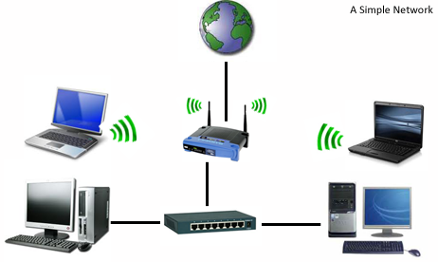
Computer Network
A computer network or data network is a telecommunications network which allows computers to exchange data.
In computer networks, networked computing devices exchange data with each other using a data link.
The connections between nodes are established using either cable media or wireless media.
The best-known computer network is the Internet.
Wireless
Wired

Slide 4
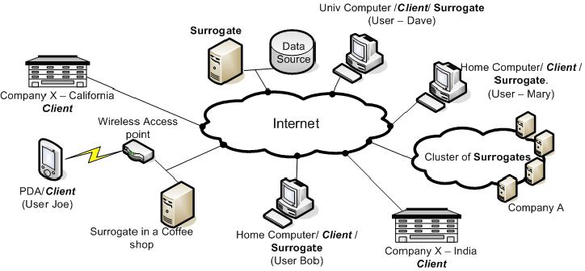
Computer Network in DOS
A Distributed System is basically a computer network whose nodes have their own local memory and may also have other hardware and software resources.
A Distributed System relies on the underlying computer network for the communication of data and control the information between nodes.
The performance and Reliability of a Distributed system depends on the underlying computer network.
Source: https://www.usenix.org

Slide 5
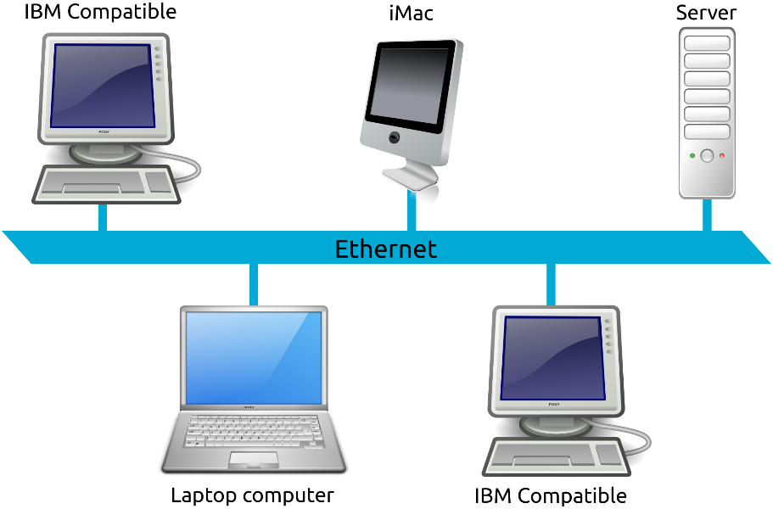
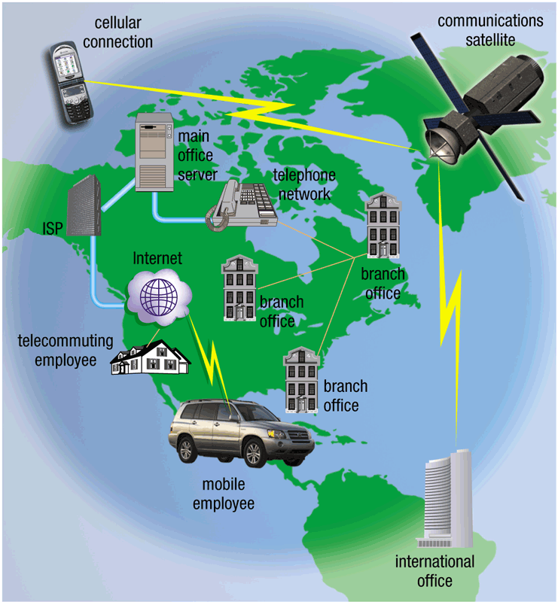
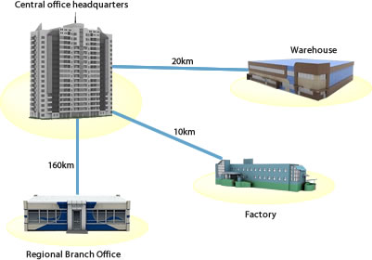
Classification of Network
LAN
MAN
WAN

Slide 6
Classification of Network
Basis Of Comparison | LAN | MAN | WAN
Expands to | Local Area Network | Metropolitan Area Network | Wide Area Network
Meaning | A network that connects a group of computers in a small geographical area | It covers relatively large region such as cities, towns | It spans large locality & connects countries together.
Ownership of Network | Private | Private or Public | Private or Public
Design and Maintenance | Easy | Difficult | Difficult
Propagation Delay | Short | Moderate | Long
Speed | High | Moderate | Low
Equipment Needed | Switch, Hub | Modem, Router | Microwave, Radio Transmitters & Receivers
Range(Approx.) | 1 to 10 km | In 100 km | Beyond 100 km
Used for | College, School, Hospital | Small towns, City | Country/Continent

Slide 7
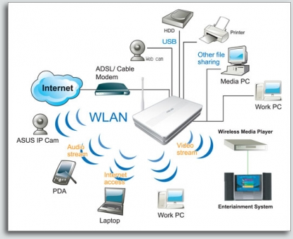
Wireless Network
A wireless LAN uses wireless transmission medium.
Wireless Network used to have
high prices
low data rates
occupational safety concerns
licensing requirements
Popularity of wireless LANs has grown rapidly.

Slide 8
Layered Protocols -OSI Model
OSI is “ Open Systems Interconnection".
OSI model was first introduced in 1984 by the International Organization for Standardization (ISO).
It outlines WHAT needs to be done to send data from one computer to another, Not HOW it should be done.
A layered protocol architecture provides a conceptual framework for dividing the complex task into simpler tasks of exchanging information between remote hosts.
Each protocol layer has a narrowly defined responsibility.
A protocol layer provides a standard interface to the next higher protocol layer.

Slide 9
OSI Model
APPLICATION
Application to Application
APPLICATION
HIGHER LAYER
PRESENTATION
Application to Application
PRESENTATION
SESSION
Application to Application
SESSION
TRANSPORT
Process to Process
TRANSPORT
MIDDLE LAYER
NETWORK
Source to Destination
Router
NETWORK
Source to Destination
DATA LINK
Hop to Hop
Switch
DATA LINK
LOWER LAYER
Hop to Hop
PHYSICAL
Hub and Repeater
PHYSICAL
Physical Medium

Slide 10
OSI Model (Layers & Activities)
OSI Layers
Activities
Application
To allow access to network resources
Presentation
To Translate, encrypt, and compress data
Session
To establish, manage, and terminate session
Transport
To Provide reliable process-to-process
Message delivery and error recovery
Network
To move packets from source to
destination; to provide internetworking
Data Link
To organize bits into frames; to provide
hop-to-hop delivery
Physical
To Transmit bits over a medium; to provide
Mechanical and electrical specifications

Slide 11
TCP/IP Reference Model
Simple Network Management Protocol
Collecting information from, and configuring network devices, such as servers, printers, hubs, switches
User Datagram Protocol
Connectionless
Sending data without establishing connection
Transmission Control Protocol
Connection oriented
Connection established before sending data
Hypertext Transfer Protocol
Browser and web server communication
Simple Mail Transfer Protocol
Send and Receive mail messages
File Transfer Protocol
Transfer Computer files between a client and server
The name stands for “teletype network”
Remote login protocol
Layer
Protocols
Application
HTTP
TELNET
FTP
SMTP
SNMP
Transport
TCP
UDP
Internet
IP
ICMP
Network Access (Host-to-network)
ETHERNET
PACKET RADIO
Internet Protocol
A set of rules governing the format of data sent over the Internet or other network.
Internet Control Message Protocol
Used by network devices, like routers, to send error messages and operational information
Network protocol that controls how data is transmitted over a LAN
Protocol of broadcasting that makes use of radio signals carrying packets of data.

Slide 12
ATM Reference Model
ATM is “Asynchronous Transfer Mode”
It is often described as a future computer networking technology.
ATM is a connection-oriented, high-speed, low-delay switching and transmission technology that uses short and fixed-size packets(called cells) to transport information.

Slide 13
ATM Reference Model
Management plane
Plane management
Control plane
User plane
Layer management
Higher layers
Higher layers
ATM adaptation layer
The lowest layer in the ATM protocol.
It describes the physical transmission media.
We can use shielded and unshielded twisted pair, coaxial cable, and fiber-optic cable.
It converts the submitted information into streams of 48-octet segments and transports these in the payload field of multiple ATM cells.
It performs all functions relating to the routing and multiplexing of cells over Virtual Channels.
It generates a header to the segment streams generated by the ATM Adaptation Layer(AAL).
ATM layer
Physical layer

Slide 14
Main Features of ATM Technology
International standard-based technology (for interoperability)
Low network latency (for voice, video, and real-time applications)
Low variance of delay (for voice and video transmission)
Guaranteed quality of service
High capacity switching (multi-giga bits per second)
Bandwidth flexibility (dynamically assigned to users)
Scalability (capacity may be increased on demand)
Medium not shared for ATM LAN (no degradation in performance as traffic load or number of users increases)
Supports a wide range of user access speeds
Supports audio, video, imagery, and data traffic (for integrated services)

Slide 15
Message Passing System
Message is a block of Information.
Message passing is a basic form of Inter process communication used in distributed systems.
In which, processes or objects can send and receive messages to other processes.
It provides a set of message-based IPC protocols and multiple heterogeneous platforms for programmers.
Send
P1
P2
Receive
The message passing approach

Slide 16
Desirable Features of a Good Message Passing system
Simplicity : A message passing system should be simple and easy to use. It should be possible to communicate with old and new applications, with different modules without the need to worry about the system and network aspects.
Uniform Semantics : Semantics of Remote communication should be as close as possible to those of local communications.
Efficiency : Less number of message exchanges, as far as practicable, during the communication process.
Reliability : Reliable IPC protocol can cope with failure problem and guarantees the delivery of messages.
Correctness : Required for Group Communication. (Every message send to group should be delivered to either all of them or none of them).

Slide 17
Desirable Features of a Good Message Passing system
Flexibility : It must have flexibility to permit any kind of control flow between the cooperating processes, including synchronous and asynchronous send/receive.
Security : Capable of providing a secure end-to-end communication. It includes as follows:
Authentication of the receiver(s) of message by the sender.
Authentication of the sender of a message by its receiver(s).
Encryption of a message before sending it over the network.
Portability : It should be possible to easily construct a new IPC facility on another system by reusing the basic design of the existing message passing system.

Slide 18
Issues in IPC by Message Passing
In the design of IPC protocol for a message passing system, the following important issues need to be considered:
Who is the sender?
Who is the receiver?
Is there one receiver or many receivers?
Is the message guaranteed to have been accepted by its receiver(s)?
Does the sender need to wait for reply?
What should be done if the catastrophic event such as a node crash or a communication link failure occurs during the course of communication?
What should be done if the receiver is not ready to accept the message: will the message be discarded or stored in buffer?
If there are several outstanding messages for a receiver, can it choose the order in which to service the outstanding messages.

Slide 19
Synchronization in Message Passing
The central issue in the communication structure is the synchronization.
The semantics used for synchronization is classified as blocking and nonblocking types.
A primitive is said to have nonblocking semantics if its invocation does not block the execution of its invoker: otherwise a primitive is said to be blocking type.

Slide 20
Synchronization in Message Passing
Blocking send primitive: Sending process blocked until it receives acknowledgement.
Nonblocking send primitive: Sending process is allowed to proceed with its execution.
Blocking Receive primitive: Receiving process blocked until it receives a message.
Nonblocking Receive primitive: Receiving process is allowed to proceed with its execution after execution of the receive statement.
Senders execution
Receivers execution
Receive(Message) Execution suspended
Send(Message) Execution suspended
Message
Execution resumed
Acknowledgement
Send
Execution resumed
Executing State
Blocked State

Slide 21
Failure in IPC
Loss of Request Message:
client
server
Request message
Send request
Lost
Loss of Response message:
client
server
Request message
Successfully Request Execution
Response
Send Response
Lost

Slide 22
Failure in IPC
Receiver’s computer crash:
client
server
Request message
Send request
Crash
Unsuccessfully Request Execution
Restarted

Slide 23
Failure Handling in IPC
client
Request message
server
Send request
Time out
Retransmit Request Message
Send request
Lost
Unsuccessfully Request Execution
Time out
Crash
Send request
Restarted
Retransmit Request Message
Time out
Response
Successful Request Execution
Lost
Retransmit Request Message
Send request
Successful Request Execution
Response

Slide 24

Client Server Model
Clients: Request servers for the completion of a task.
Generally called desktop PCs or workstations.
Servers: Receive requests from the clients and process them.
After the processing is complete, the servers send a reply to the clients who sent the request.
Client Server Network

Slide 25
Client Server Model Interaction
Two processes in client-server model can interact in various ways:
Sockets
Remote Procedure Calls (RPC)
Socket
The process acting as server opens a socket using a well-known port and waits until some client request comes.
The second process acting as a client also opens a socket but instead of waiting for an incoming request, the client processes ‘requests first’.
Server Program
Client Program
Socket
Socket
Transport
Transport
Network
Network
Data link
Data link
Physical
Physical

Slide 26
Remote Procedure Call
Remote Procedure Call (RPC) is a protocol that one program can use to request a service from a program located in another computer on a network without having to understand the network's details.
A procedure call is also sometimes known as a function call or a subroutine call.
RPC uses the client-server model.
It includes mainly five elements:
The Client
The Client stub (stub: Piece of code used for converting parameters)
The RPCRuntime (RPC Communication Package)
The Server stub
The Server

Slide 27
Functions of RPC Elements
The Client
It is user process which initiates a remote procedure call
The client makes a perfectly normal call that invokes a corresponding procedure in the client stub.
The Client stub
On receipt of a request it packs a requirements into a message and asks to RPCRuntime to send.
On receipt of a result it unpacks the result and passes it to client.
RPCRuntime
It handles transmission of messages between client and server.
The Server stub
It unpacks a call request and make a perfectly normal call to invoke the appropriate procedure in the server.
On receipt of a result of procedure execution it packs the result and asks to RPCRuntime to send.
The Server
It executes a appropriate procedure and returns the result from a server stub.

Slide 28
RPC Mechanism
Client computer
Server computer
Local
return
Local
call
Execute procedure
server
stub
Unmarshal
arguments
Marshal
results
Unmarshal
results
Marshal
arguments
client
stub
Select procedure
Communication
module
Receive
reply
Send
request
Receive
request
Send
reply
Call packet
Result packet

Slide 29
Steps in a Remote Procedure Call
The client calls a local procedure, called the client stub.
Network messages are sent by the client stub to the remote system (via a system call to the local kernel using sockets interfaces).
Network messages are transferred by the kernel to the remote system via some protocol (either connectionless or connection-oriented).
A server stub, sometimes called the skeleton, receives the messages on the server. It unmarshals the arguments from the messages.
The server stub calls the server function, passing it the arguments that it received from the client.
When server function is finished, it returns to the server stub with its return values.
The server stub converts the return values, if necessary, and marshals them into one or more network messages to send to the client stub.
Messages get sent back across the network to the client stub.
The client stub reads the messages from the local kernel.
The client stub then returns the results to the client function, converting them from the network representation to a local one if necessary.

Slide 30
Case Studies : Sun RPC
Interface definition language: XDR
a standard way of encoding data in a portable fashion between different systems;
Interface compiler: rpcgen
A compiler that takes the definition of a remote procedure interface, and generates the client stubs and the server stubs;
Communication handling: TCP or UDP
Version: RPCSRC 3.9 (4.3BSD UNIX)
A run-time library to handle all the details.
See more information on RPC implementation at
www.cs.gsu.edu/~cscyip/csc4320

Slide 31
Case Studies : DCE RPC
DCE: Set of components designed by the Open Group (merger of OSF and X/Open) for providing support for distributed applications
Distributed file system service, time service, directory service
Similar to Sun’s RPC, Interfaces written in a language called Interface Definition Notation (IDN)
Definitions look like function prototypes
• Unique ID generator
• Run-time libraries, One for TCP/IP and one for UDP/IP
• Authenticated RPC support with DCE security services.
• Integration with DCE directory services to locate servers.

Slide 32
THANK YOU
dipak.ramoliya@darshan.ac.in

