Slide 1


Unit: 4 Processes and processors in Distributed Systems
Distributed Operating System (2160710)
Dipak Ramoliya
→ dipak.ramoliya@darshan.ac.in
Computer Engineering Darshan Institute of Engineering & Technology

Slide 2
Unit Outline & Weightage %
Processes and processors in distributed systems 10%
Threads
System model
Processor allocation
Scheduling in distributed systems
Load balancing and sharing approach
Fault tolerance
Real time distributed systems
Process migration and related issues

Slide 3
What is Process?
Process is a program under execution.
Process is an abstraction of a running program.
Process is an instance of an executing program, including the current values of the program counter, registers & variables.
Each process has its own virtual CPU.
Real CPU switches back and forth from process to process called multiprogramming.

Slide 4
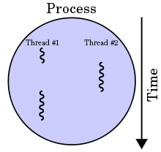
What is Threads?
Thread is a single sequence of execution within a process.
Thread has it own.
program counter that keeps track of which instruction to execute next
system registers which hold its current working variables
stack which contains the execution history.
Processes are generally used to execute large, ‘heavyweight’ jobs such as working in word, while threads are used to carry out smaller or ‘lightweight’ jobs such as auto saving a word document.
A thread shares few information with its peer threads (having same input) like code segment, data segment and open files.
Thread is light weight process created by a process.

Slide 5
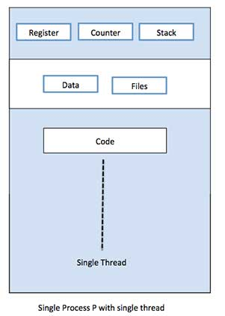
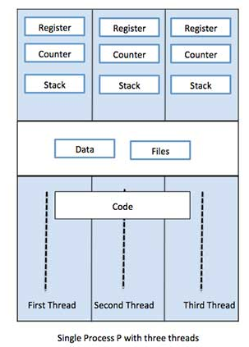
Single Thread VS Multiple Thread

Slide 6
Similarities between Process & Thread
Like processes threads share CPU and only one thread is running at a time.
Like processes threads within a process execute sequentially.
Like processes thread can create children.
Like a traditional process, a thread can be in any one of several states: running, blocked, ready or terminated.
Like process threads have Program Counter, Stack, Registers and State.

Slide 7
Dissimilarities between Process & Thread
Unlike processes threads are not independent of one another.
Threads within the same process share an address space.
Unlike processes all threads can access every address in the task.
Unlike processes threads are design to assist one other. Note that processes might or might not assist one another because processes may be originated from different users.

Slide 8
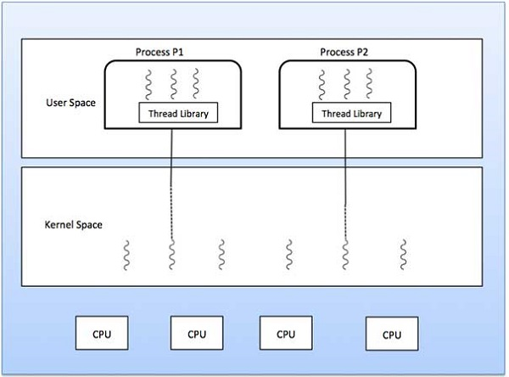
Types of Threads
Kernel Level Thread
User Level Thread
User
Level
Threads
Kernel
Level
Threads

Slide 9
Types of Threads (Cont…)
$$\text{USER} \text{LEVEL} \text{THREAD}$$ | $$\text{KERNEL} \text{LEVEL} \text{THREAD}$$
User thread are implemented by users. | Kernel threads are implemented by OS.
OS doesn’t recognized user level threads. | Kernel threads are recognized by OS.
Implementation of User threads is easy. | Implementation of Kernel thread is complex.
Context switch time is less. | Context switch time is more.
Context switch requires no hardware support. | Context switch requires hardware support.
If one user level thread perform blocking operation then entire process will be blocked. | If one kernel thread perform blocking operation then another thread with in same process can continue execution.
Example : Java thread, POSIX threads. | Example : Window Solaris

Slide 10
Models for Organizing threads
Depending on the application’s needs the threads of a process of the application can be organized in different ways.
Threads can be organized by three different models.
Dispatcher/Worker model
Team model
Pipeline model

Slide 11

Dispatcher/Worker model
In this model, the process consists of a single dispatcher thread and multiple worker threads.
The dispatcher thread:
Accepts requests from clients
Examine the request
Dispatches the request to one of the free worker threads for further processing of the request.
Each worker thread works on a different client request.
Therefore, multiple client requests can be processed in parallel.
Requests
Port
Dispatcher Thread
Worker
Thread
Worker Thread
Worker Thread
Worker Thread

Slide 12
Team model
In this model, all threads behave as equal.
Each thread gets and processes clients' requests on its own.
This model is often used for implementing specialized threads within a process.
Each thread of the process is specialized in servicing a specific type of requests like copy, save, autocorrect.
Requests
Port
Type 1
Type 3
Type 2
Thread
Thread
Thread
Threads

Slide 13
Pipeline model
This model is useful for applications based on the producer-consumer model.
The output data generated by one part of the application is used as input for another part of the application.
The threads of a process are organized as a pipeline.
The output data generated by the first thread is used for processing by the second thread, the output of the second thread is used for third thread, and so on.
The output of the last thread in the pipeline is the final output of the process to which the threads belong.
Requests
Port
Thread
Thread
Thread
Thread

Slide 14
Designing Issues in Thread Package
A system that supports thread facility must provide a set of primitives to its users for threads-related operations.
These primitives of the system are said to form a thread package.
Some of the important issues in designing a thread package are:
Thread Creation
Thread Termination
Thread Synchronization
Thread Scheduling
Signal Handling

Slide 15
Thread Creation
Threads can be created either statically or dynamically.
Static :
The number of threads of a process remains fixed for its entire lifetime.
Memory space is allocate to each thread.
Dynamic:
The number of threads of a process keeps changing dynamically.
Threads are created as and when it is needed during the process life cycle.
It exit when task is completed.
Here the stack size for the threads is specified as parameter to the system call for thread creation.

Slide 16
Thread Termination
Threads may terminate or never terminate until life cycle of process.
Thread termination can be done as follows:
Thread destroys itself on task completion by making an EXIT call.
Thread is killed from outside using KILL command with thread identifier as parameter.
In some process, all its threads are created immediately after the process start and then these threads are never killed until the process terminates.

Slide 17
Thread Synchronization
Since threads belongs to same process share the same address space, thread synchronization is required to ensure that multiple threads don’t access the same data simultaneously.
For example:
If two threads want to increment the same global variable with in the same process.
One thread should exclusive access to shared variable, increment it, and then pass control to the other thread.
It mean that only one thread can execute in critical region at any instance of time.

Slide 18
Thread Scheduling
Another important issue in designing threads package is to decide an appropriate scheduling algorithm.
Thread packages provide calls to give the users the flexibility to specify the scheduling policy to be used for their applications.
Some of the special features for threads scheduling that may be supported by a threads package are as follows:
Priority assignment facility
Flexibility to vary quantum size dynamically
Handoff scheduling
Affinity scheduling

Slide 19
Signal Handling
Signals provide software-generated interrupts and exceptions.
Interrupts are externally generated disruptions of a thread or process.
Exceptions are caused by the occurrence of unusual conditions during a thread's execution.
The two main issues associated with handling signals in a multithreaded environment are as follows:
A signal must be handled properly no matter which thread of the process receives it.
Signals must be prevented from getting lost when another signal of the same type occurs in some other thread before the first one is handled by the thread in which it occurred.
An approach for handling the former issue is to create a separate exception handler thread in each process.
Exception handler thread of a process is responsible for handling all exception conditions occurring in any thread of the process.

Slide 20

Processor Allocation OR Task Assignment
Each process is divided into multiple tasks.
These tasks are scheduled to suitable processor to improve performance.
It requires characteristics of all the processes to be known in advance.
This approach does not take into consideration the dynamically changing state of the system.
In this approach, a process is considered to be composed of multiple tasks and the goal is to find an optimal assignment policy for the tasks of an individual process.

Slide 21
Assumptions For Task Assignment Approach
A process has already been split into pieces called tasks.
The amount of computation required by each task and the speed of each processor are known.
The cost of processing each task on every node of the system is known.
The Inter process Communication (IPC) costs between every pair of tasks is known.
Other constraints, such as resource requirements of the tasks and the available resources at each node, precedence relationships among the tasks, and so on, are also known.

Slide 22
Task Assignment Approach algorithms
Graph Theoretic Deterministic Algorithm
Centralized Heuristic Algorithm
Hierarchical Algorithm

Slide 23
Graph Theoretic Deterministic Algorithm
A system with m CPUs and n processes has any of the following three cases:
m=n: Each process is allocated to one CPU.
M>n: Some CPUs may remain idle (free) or work on earlier allocated processes.
M<n: There is a need to schedule processes on CPUs, and several processes may be assigned to each CPU.
The main objective of performing CPU assignment is to:
Minimize IPC cost.
Obtain quick turnaround time.
Achieve high degree of parallelism for efficient utilization.
Minimize network traffic.

Slide 24
Graph Theoretic Deterministic Algorithm- Example
A
4
B
5
C
3
3
2
3
5
G
H
4
3
2
2
4
D
5
E
4
F
Processes are represented as nodes A, B, C, D, E, F, G and H.
Arcs between sub-graphs represent network traffic and their weights represent IPC costs.
Total network traffic is the sum of the arcs intersected by the dotted cut lines.

Slide 25
Graph Theoretic Deterministic Algorithm- Example
Partition 1
Partition 2
A
4
B
5
C
A
4
B
5
C
3
3
2
3
3
3
2
3
G
H
G
H
5
3
4
5
3
4
2
2
4
2
2
4
D
5
E
4
F
D
5
E
4
F
CPU 1
CPU 2
CPU 1
CPU 2
Partition 1
CPU 1 runs A,D,G
CPU 2 runs B,E,F,H and C
Network traffic= 4+3+2+5=14
Partition 2
CPU 1 runs processes A,D,E,G,B
CPU2 runs processes H,C and F
Network traffic= 5+2+4=11
Thus partition 2 communication generates less network traffic as compared to partition 1.

Slide 26
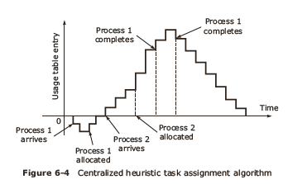
Centralized Heuristic Algorithm
It is also called Top down algorithm.
It doesn’t require advance information.
Coordinator maintains the usage table with one entry for every user (processor) and this is initially zero.

Slide 27
Centralized Heuristic Algorithm
Usage table entries can either be zero, positive, or negative.
Zero value indicates a neutral state.
Positive value implies that the machine is using system resources.
Negative value means that the machine needs resources.

Slide 28
Hierarchical Algorithm
Level 3
Committee of Deans
Deans
Level 2
Dept. Heads
Level 1
Workers
Process hierarchy is modelled like an organization hierarchy.
For each group of workers, one manager machine (department head) is assigned the task of keeping track of who is busy and who is idle.
If the system is large, there will be number of department heads, so some machines will function as “deans”.
Each processor maintains communication with one superior and few subordinates.
When a dean or department head stops functioning (crashes), promote one of the direct subordinates of the faulty manager to fill in for the boss.
The choice of which can be made by the subordinates themselves.

Slide 29
Scheduling in distributed systems
A resource manager schedules the processes in a distributed system to make use of the system resources.
Scheduling is to optimize resource usage, response time, network congestion. It can be broadly classified into three types:
Task assignment approach
In which each process is viewed as a collection of related tasks.
These tasks are scheduled to suitable nodes so as to improve performance.
Load-balancing approach
In which all the processes submitted by the users are distributed among the nodes of the system to equalize the workload among the nodes.
Load-sharing approach
Which simply attempts to conserve the ability of the system to perform work by assuring that no node is idle while processes wait for being processed.

Slide 30
Load Balancing Approach
The distribution of loads to the processing elements is simply called the load balancing.
The goal of the load balancing algorithms is to maintain the load to each processing element such that all the processing elements become neither overloaded nor idle.
Each processing element ideally has equal load at any moment of time during execution to obtain the maximum performance (minimum execution time) of the system.

Slide 31
Classification of Load Balancing
Load Balancing
Static
Dynamic
Deterministic
Heuristic/Probabilistic
Centralized
Distributed

Slide 32
Static Load Balancing
In static algorithm the processes are assigned to the processors at the compile time according to the performance of the nodes.
Once the processes are assigned, no change or reassignment is possible at the run time.
Number of jobs in each node is fixed in static load balancing algorithm.
Static algorithms do not collect any information about the nodes.
The static load balancing algorithms can be divided into two sub classes:
Optimal static load balancing (Deterministic)
Sub optimal static load balancing (Probabilistic)

Slide 33
Static Load Balancing (cntd.)
Optimal Static Load Balancing Algorithm
If all the information and resources related to a system are known optimal static load balancing can be done.
Sub optimal static load balancing Algorithm
Sub-optimal load balancing algorithm will be mandatory for some applications when optimal solution is not found.

Slide 34
Deterministic vs Probabilistic
Deterministic algorithms are suitable when the process behavior is known in advance.
If all the details like list of processes, computing requirements, file requirements and communication requirements are known prior to execution, then it is possible to make a perfect assignment.
In the case load is unpredictable or variable from minute to minute or hour to hour, a Probabilistic/heuristic processor allocation is preferred.

Slide 35
Dynamic Load Balancing
In dynamic load balancing algorithm assignment of jobs is done at the runtime.
In DLB jobs are reassigned at the runtime depending upon the situation.
The load will be transferred from heavily loaded nodes to the lightly loaded nodes.
No decision is taken until the process gets executed.
This strategy collects the information about the system state and about the job information.
As more information is collected, the algorithm can make better decision.

Slide 36
Centralized Vs Distributed
$$\text{CENTRALIZED} \text{LOAD} \text{BALANCING}$$ | $$\text{DISTRIBUTED} \text{LOAD} \text{BALANCING}$$
Scheduling decision is carried out at one single node called the centralized node. | Scheduling decision is carried out at different nodes called the Distributed nodes.
Every information is available at a single node. | Information is distributed at different nodes.
Centralized approach leads to a bottleneck as number of requests increases. | Distributed approach handle the multiple requests by physically distributing among various nodes.
If centralized server fails, all scheduling in the system will fails. | If distributed server fails, all scheduling will be handled by other servers.

Slide 37
Cooperative Vs Non-cooperative
$$\text{COOPERATIVE} \text{LOAD} \text{BALANCING}$$ | $$\text{NON}\text{−}\text{COOPERATIVE} \text{LOAD} \text{BALANCING}$$
In Cooperative Algorithm distributed entities cooperate with each other to make scheduling decisions. | In Non-cooperative algorithm the individual entities make independent scheduling decisions.
Cooperative algorithms are more complex. | Non-cooperative algorithms are easier.
Cooperative algorithms are stable. | Non-cooperative algorithms may not be stable.
It involve large overhead than non-cooperative algorithms. | It involve minor overhead.

Slide 38
Issues in designing load balancing algorithms
Load estimation: determines how to estimate the workload of a node in a distributed system.
Process transfer: decides whether the process can be executed locally or remotely.
Static information exchange: determines how the system load information can be exchanged among the nodes.
Location policy: determines the selection of a destination node during process migration.
Priority assignment: determines the priority of execution of a set of local and remote processes on a particular node.
Migration limiting policy: determines the total number of times a process can migrate from one node to another.

Slide 39
Benefits of Load Balancing
Load balancing improves the performance of each node and hence the overall system performance will improve.
Load balancing reduces the job idle time.
Low cost but high gain.
Small jobs do not suffer from long starvation.
Extensibility and incremental growth.
Maximum utilization of resources.
Higher throughput.
Response time becomes shorter.

Slide 40
Load Sharing Approach
Load sharing algorithms ensure that no node is idle or heavily loaded.
Policies for load sharing approach are the same as load balancing polices.
They include load estimation policy, process transfer policy, location policy and state information exchange.
They differ in location policy.

Slide 41
Location Policies
The location policy decides the sender node or the receiver node of a process that is to be moved within the system for load sharing.
Depending on the type of node that takes the initiative to globally search for a suitable node for the process, the location policies are of the following types:
Sender-initiated policy: In which the sender node of the process decides where to send the process.
Receiver-initiated policy: In which the receiver node of the process decides from where to get the process.

Slide 42
Sender initiated location policy
In the sender-initiated location policy, heavily loaded nodes search for lightly loaded nodes to which work may be transferred.
In this method, when a node's load becomes more than the threshold value, it either broadcasts a message or randomly probes the other nodes one by one to find a lightly loaded node that can accept one or more of its processes.
If a suitable receiver node is not found, the node on which the process originated must execute that process.
Want you please,
Take a process
Please take some work
I'm Overloaded
Help me
Please
Help!
Machine decides that it has too much work

Slide 43
Receiver initiated location policy
In this policy lightly loaded nodes search for heavily loaded nodes from which processes can be accepted for execution.
When the load on a node falls below a threshold value, it broadcasts a probe message to all nodes or probes nodes one by one to search for a heavily loaded node.
Some heavily loaded node may transfer one of its process if such a transfer does not reduce its load below normal threshold.
I have nothing
to do
Need CPU cycles? Just call
I’m free
I’m bored
Need Help??
Machine advertises its availability

Slide 44

Fault Tolerance
The main objective of designing a fault tolerance system is to ensure that the system operates correctly even in presence of faults.
Distributed system made up of independent computers connected over the network, can fail due to fault in any of hardware components or software components.

Slide 45
Component faults
The computer is made up of :
Hardware components: processors, memory, I/O devices etc..
Software components: OS, application programs, database etc..
Component faults can be classified as:
Transient faults
Intermittent faults
Permanent faults

Slide 46
Faults classification: Transient faults
It can occur suddenly, disappear, and may not occur again if the operation is repeated.
For example:
During heavy traffic in network, a telephone call is misroute but if call is retried, it will reach destination correctly.

Slide 47
Faults classification: Intermittent faults
These faults occur often, but may not be periodic in nature.
For example:
The loose connection to network switch may cause intermittent connection problems.
Such faults are difficult to diagnose.
During debugging process, it is possible that the fault may not be detected at all.

Slide 48
Faults classification: Permanent faults
These faults can be easily identified and the components can be replaced.
For example:
Software bug or disk head crash causes permanent faults.
These faults can be identified and corresponding action can be taken.

Slide 49
System failures
Hardware or software faults can be classified as:
Fail silent faults/fail stop faults:
Faulty processor stop responding to any input and doesn’t produce further output.
It intimates to the system that it is no longer functioning.
Byzantine faults:
Faulty processor continues to run but produces wrong output.
These failures are difficult to handle, because detection itself is painstaking task.

Slide 50
Redundancy
Technique to handle fault tolerance is Redundancy.
Types of Redundancy are as follows:
Information redundancy
Extra bits are added to data to handle fault tolerance by detecting errors.
Time redundancy
An action performed once is repeated if needed after a specific time period.
For example, if an atomic transaction aborts, it can be executed without any side effects.
Time redundancy is helpful when the faults are transient or intermittent.
Physical redundancy
Extra equipment's are added to enable the system to tolerate faults due to loss or malfunction of some components.
For example extra stand by processors can be used in the system.

Slide 51
Real time distributed system
External
Devices
D
D
D
D
D
D
Actuator
(Sender)
Sensor
(Receiver)
C
C
C
C
C
C
C
Computer
Network
A Distributed real-time computer system
It is developed by collection of computers in a network.
Some of these are connected to external devices that produce or accept data or expect to be controlled in real time.
Computers may be tiny microcontrollers or stand-alone machines.
In both cases they usually have sensors for receiving signals from the devices and actuators for sending signals to them.
The sensors and actuators may be digital or analog.

Slide 52
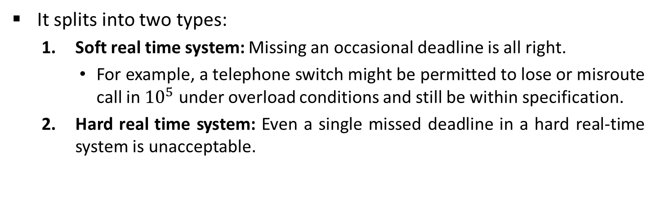
Real time distributed system
External
Devices
D
D
D
D
D
D
Actuator
(Sender)
Sensor
(Receiver)
C
C
C
C
C
C
C
Computer
Network
A Distributed real-time computer system
It splits into two types:
Soft real time system: Missing an occasional deadline is all right.
For example, a telephone switch might be permitted to lose or misroute call in ${10}^{5}$ under overload conditions and still be within specification.
Hard real time system: Even a single missed deadline in a hard real-time system is unacceptable.

Slide 53
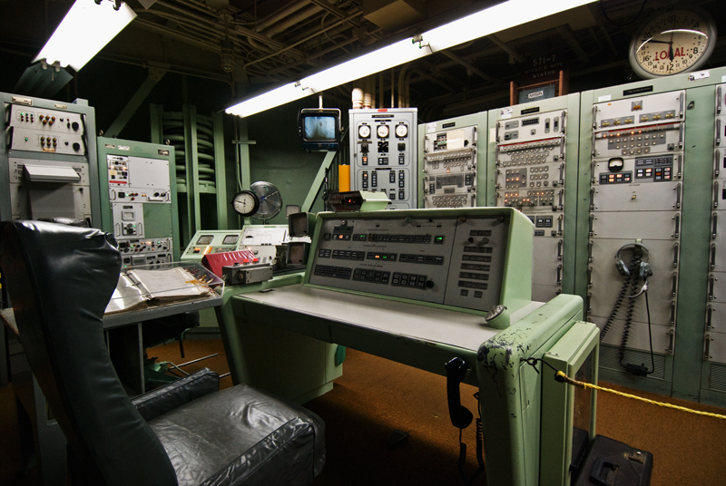

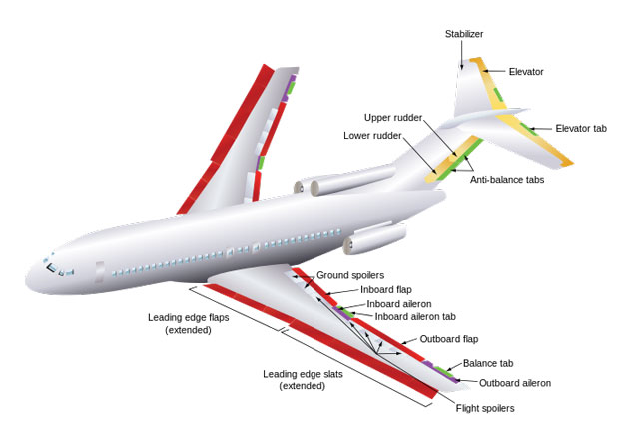
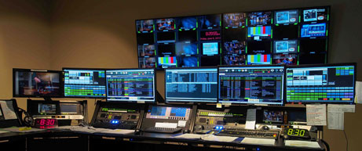

Example of Real time distributed system
Some of the examples of Real time distributed systems are as follows:
Computers embedded in television sets and video recorders.
Computers controlling aircraft ailerons and other parts.
Automobile subsystems controlled by computers.
Military computers controlling guided antitant missiles.
Computerized air traffic control system.

Slide 54
Process Migration
Process migration is a specialized form of process management whereby processes are moved from one computing environment to another.
Process migration is classified into two types:
Non-preemptive: Process is migrated before execution start in source node.
Preemptive: Process is migrated during its execution.

Slide 55
Process Migration mechanism
Source
node
Destination
node
Time
Process P1
in execution
Execution
Suspended
Freezing
Time
Transfer of
control
Execution
resumed
Process P1 in
execution
Process migration involves the following major steps:
Selection of a process that should be migrated.
Selection of the destination node to which the selected process should be migrated.
Actual transfer of the selected process to the destination node.

Slide 56
Desirable features of a good process migration mechanism
Transparency
Object access level transparency: access to objects such as files and devices can be done in a location-independent manner.
System call and inter process communication level transparency: migrated process does not continue to depend upon its originating node.
Minimal Interference
Minimizing the freezing time of the process being migrated.
Minimal Residual Dependencies
Migrated process should not continue to depend on its previous node.

Slide 57
Desirable features of a good process migration mechanism
Efficiency
The main sources of inefficiency are as follows:
The time required for migrating a process.
The cost of locating an object.
The cost of supporting remote execution.
Robustness
The failure of a node other than the one on which a process is currently running should not in any way affect the accessibility or execution of that process.
Communication between coprocesses of a Job
During parallel processing, coprocesses should be able to directly communicate with each other irrespective of their locations.
All these costs should be kept minimum.

Slide 58
Advantages of Process Migration
Reducing average response time of processors.
Speeding up individual jobs by migrating to the different nodes of the system and to execute concurrently.
Gaining higher throughput by using a load-balancing policy.
Utilizing resources effectively.
Reducing network traffic.
Improving system reliability by migrating a critical process to a node whose reliability is higher.
Improving system security by migrating sensitive processes and run on a secure node that is not directly accessible to general users.

Slide 59


