Slide 1


UNIT-1 Introduction to .NET Framework
DOT NET TECHNOLOGY
2160711
Prof. Naimish R. Vadodariya
naimish.vadodariya@darshan.ac.in
+91-8866215253
Computer Engineering Darshan Institute of Engineering & Technology
Notes:
Picture credit :
1)https://www.google.co.in/url?sa=i&rct=j&q=&esrc=s&source=images&cd=&ved=0ahUKEwjGjrGxrs7QAhWBRo8KHeFhBX0QjhwIBQ&url=http%3A%2F%2Fdaniloandrade.me%2F&psig=AFQjCNFNM7SO0YmW_4Ac3oZC34DWst5VUA&ust=1480522521544693&cad=rja

Slide 2
Outline
Introduction to .NET Framework
.NET Framework Components
Managed Code
Unmanaged Code
Assemblies
Garbage Collection
The END to DLL Hell – Managed Execution
.NET Framework Version History

Slide 3
Introduction to .NET Framework
Why do we need a framework?
Let us take an example
If I told you to cut a piece of paper with dimensions 5cm by 5cm then surely you would do that.
But then I ask you to cut 1000 pieces of paper of the same dimensions.
Then you won't do the measuring 1000 times, obviously you would make a frame of 5cm by 5cm and then with the help of it you would be able to cut 1000 papers in less time.
So, what you did is made a framework which would do that type of task and performing the same type of task again and again for the same type of applications.

Slide 4
.NET Framework Cont..
What is .NET framework?
.NET is a programming framework created by Microsoft, for developers can use to create applications more easily.
.NET framework runs on different versions of windows operating system, starting from windows 98 to latest versions of windows 7 and windows 8 & 10.

Slide 5
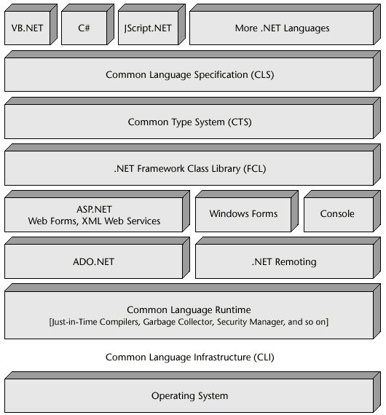
.NET Framework Cont..
.NET Framework Architecture
Notes:
Picture Credit : http://www.codeguru.com/csharp/sample_chapter/article.php/c8245/The-NET-Architecture.htm

Slide 6
.NET Framework Components
Common Language Specification (CLS)
Common Type System (CTS)
.NET Framework Class Library (FCL)
Common Language Runtime (CLR)
Common Language Infrastructure(CLI)

Slide 7
Common Language Specification(CLS)
It defines a set of rules and restrictions that every language must follow which runs under .NET framework.
This is done in such a way, that programs written in any language (.NET compliant) can interoperate with other languages.
This also can take full advantage of inheritance, polymorphism, exceptions, and other features.
The languages which follows these set of rules are said to be CLS Compliant Languages. In simple words, CLS enables Cross-Language Integration.

Slide 8
Common Type System (CTS)
CTS are the mechanism by which code written in one programming language can talk to code written in a different programming language.
It help developers to develop applications in different languages.
It also specifies the rules for type visibility and for access to the members of a type.
It describes how types are declared, used and managed at the runtime.
It describes a set of types that can be used in different .NET languages in common.
It facilitates cross-language integration, type safety, and high performance code execution.

Slide 9
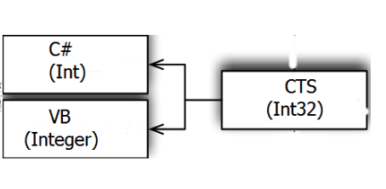
Common Type System (CTS) Cont..
It ensures that objects written in different .NET Languages like C#, VB.NET, F# etc. can interact with each other.

Slide 10
.NET Framework Class Library (FCL)
The .NET Framework Class Library (FCL) includes a huge collection of reusable classes, interfaces, and value types that easy and optimize and integrated with the CLR.
It contains more than 7000+ classes and data types to read and write files, access databases, process XML, display a graphical user interface, draw graphics, use of web services etc.
The .NET Framework Class Library (FCL) contains code supporting all the .NET technologies.
Like Windows Forms, Windows Presentation Foundation, ASP.NET, ADO.NET, Windows Workflow, and Windows Communication Foundation.

Slide 11
Common Language Runtime (CLR)
The CLR is the execution engine for .NET applications and serves as the interface between .NET applications and the operating system.
The CLR is somewhat comparable to the Java Virtual Machine (JVM) that Sun Microsystems furnishes for running programs compiled from the Java language.
The CLR is the platform on which applications are hosted and executed.
Programmers write code in any language, including VB.NET, C# and F# etc.
But when they compile their programs into an intermediate code called MSIL that can be managed by the CLR and then the CLR converts it into machine code to be executed by the processor.

Slide 12
CLR - Example
Source Code
Byte Code
Machine Code
CLR
C# Code
C#
MSIL Code
Native Code
Compiler
Compile Time
Run Time

Slide 13
MSIL = CIL = IL
Microsoft Intermediate Language (MSIL) is a language used as the output of a number of compilers (C#, VB, .NET, and so forth).
We can also call it as Intermediate Language (IL) or Common Intermediate Language (CIL).
During the compile time , the compiler convert the source code into Microsoft Intermediate Language (MSIL).
Microsoft Intermediate Language (MSIL) is a CPU-independent set of instructions that can be efficiently converted to the native code.

Slide 14
Functions of CLR
Convert code into MSIL.
Exception handling
Type safety
Memory management (using the Garbage Collector)
Security
Improved performance
Language independency
Platform independency
Architecture independency
Notes:
Components of the CLR
Class Loader Used to load all classes at run time.
MSIL to Native code The Just In Time (JTI) compiler will convert MSIL code into native code.
Code Manager It manages the code at run time.
Garbage Collector It manages the memory. Collect all unused objects and deallocate them to reduce memory.
Thread Support It supports multithreading of our application.
Exception Handler It handles exceptions at run time.

Slide 15
Common Language Infrastructure(CLI)
The Common Language Infrastructure (CLI) is an open specification (technical standard) developed by Microsoft and standardized by ISO and ECMA (European Computer Manufacturers Association) .
That describes executable code and a runtime environment that allows multiple high-level languages to be used on different platforms without being rewritten for specific architectures.
This implies that it is platform independent.
The .NET Framework, the free and open source Mono and Portable.NET are implementations of the CLI.

Slide 16
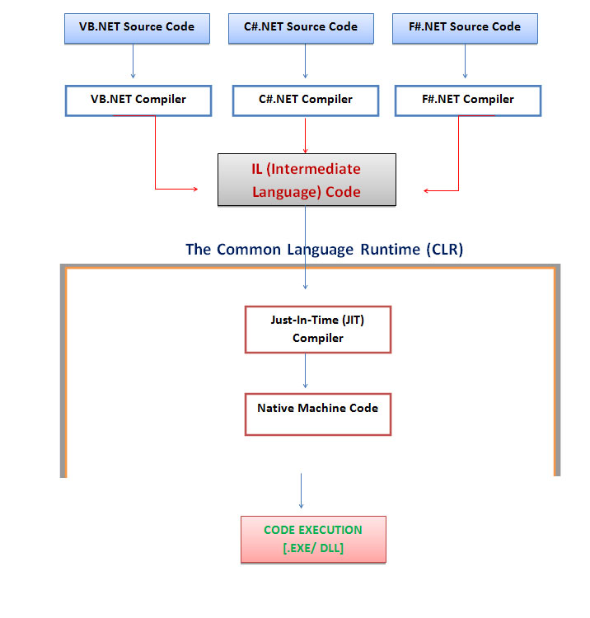
Managed Code

Slide 17
Managed Code Cont..
Managed code is the code that is executed directly by the CLR.
The applications that are created using managed code automatically have CLR services, such as type checking, security and automatic garbage collection.
These CLR services help to provide platform and language independence to managed code applications.
The CLR compiles the applications to Microsoft Intermediate Language (MSIL) and not the machine code.
This MSIL along with the metadata that describes the attributes, classes, and methods of the code reside in assembly.

Slide 18
Managed Code Cont..
The compilation takes place in managed execution environment, which assures the working of the code.
When you compile the code into managed code, the compiler converts the source code into MSIL, which is CPU-independent.
Compilation of source code into MSIL, generates metadata.
The metadata contains definition of types, member signature, the members in the code, and other details that the code uses at the time of execution.

Slide 19
Managed Code Cont..
While executing the application, a JIT compiler translates the MSIL into native code.
After compiling the code is passed through a verification process that examines the MSIL and metadata to check whether the code is safe, such as it should be able to access only those memory, locations which it is authorized to access.

Slide 20
Unmanaged Code
Unmanaged code directly compiles to the machine code and runs on the machine where it has been compiled.
It does not have services, such as security or memory management, which are provided by the runtime.
If code is not security-prone, it can be directly interpreted by any user, which can prove harmful.
Applications that do not run under the control of the CLR are said to be unmanaged.

Slide 21
Unmanaged Code Cont..
Unmanaged code can be unmanaged source code and unmanaged compile code.
Unmanaged code is executed with help of wrapper classes.
Wrapper classes are of two types: CCW (COM Callable Wrapper) and RCW (Runtime Callable Wrapper).

Slide 22
Managed v/s Unmanaged Code
Managed Code | Unmanaged Code
Code Executed by CLR Instead of Operating System | Code which executed by operating system directly
Runtime provide services like GC, Type checking, Exception Handling. | Does not provide the services like GC, Type checking, Exception Handling taken care by the programmer
The code compiled by the language compiler into MSIL code | Code will be compiled into native code.

Slide 23
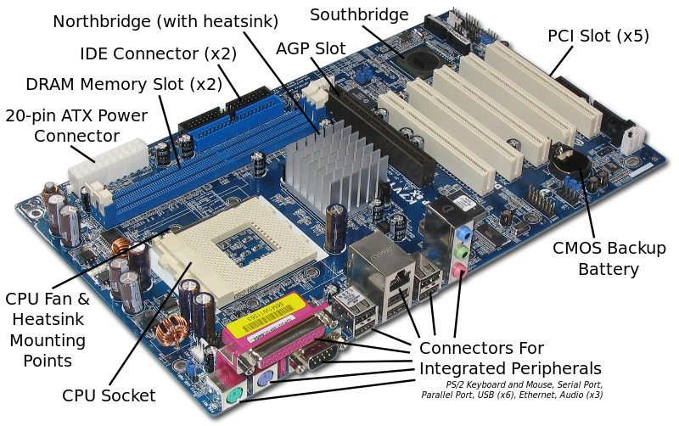
Assembly - Example
Mother Board

Slide 24
What Is .NET Assembly?
An assembly is a collection of types and resources that are built to work together and form a logical unit of functionality.
Assemblies are the building blocks of .NET Framework applications & it is compiled .NET dll or an exe.
Assembly can include any file types like image files, text files etc. along with DLLs or EXEs.
When you compile your source code, the EXE or DLL is generated and it is an assembly.
One assembly may contain one or more files.

Slide 25
.NET Assembly
Assembly contains four major parts.
Manifest:
An assembly manifest is a text file containing metadata about CLI assemblies.
It describes the relationship and dependencies of the components in the assembly, versioning information, scope information and the security permissions required by the assembly.
Metadata:
Metadata is binary information describing your program that is stored either in a common language runtime portable executable (PE) file or in memory.

Slide 26
.NET Assembly Cont..
MSIL code: - Containing business logics and also an Intermediate version of our program.
Set of Resource: - Resources of an assembly like icons, text files, image files etc.

Slide 27
Manifest
Every assembly file contains information about itself. This information is called as Assembly Manifest.
Assembly manifest is a file which stores information about an assembly.
The information includes version information, list of files packed, and definition of types, security permissions, version control and metadata.

Slide 28
Metadata
Metadata is a binary code that contains the self-description of your program.
This binary code is stored in a portable executable (PE) file.
When you compile a .NET program, the metadata is inserted in the one portion of PE file, while the program’s code is converted to the IL code that is inserted into other portion of file.
When the program is executed, the CLR loads the metadata into memory and reference it to discover the information of your code.
Metadata is the information that describes the types used in your code.

Slide 29
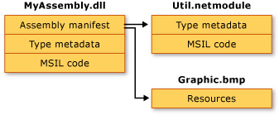
MSIL Code
An assembly is a file that contains MSIL code and corresponding metadata.
Notes:
Picture Credit : http://i.msdn.microsoft.com/dynimg/IC125851.gif

Slide 30
Functions of .NET Assembly
It contains code that the CLR executes.
It forms a security boundary.
An assembly is the unit at which permissions are requested and granted.
It forms a type boundary.
Every type's identity includes the name of the assembly in which it resides.
A type called MyType loaded in the scope of one assembly is not the same as a type called MyType loaded in the scope of another assembly.
It forms a reference scope boundary.
The assembly's manifest contains assembly metadata that is used for resolving types and satisfying resource requests.
It specifies the types and resources that are exposed outside the assembly.

Slide 31
Functions of .NET Assembly Cont..
It forms a version boundary.
The assembly is the smallest versionable unit in the CLR; all types and resources in the same assembly are versioned as a unit.
The assembly's manifest describes the version dependencies you specify for any dependent assemblies.
It forms a deployment unit.
When an application starts, only the assemblies that the application initially calls must be present.
Other assemblies, such as localization resources or assemblies containing utility classes can be retrieved on demand.
This allows applications to be kept simple and thin when first downloaded.
It is the unit at which side-by-side execution is supported.

Slide 32
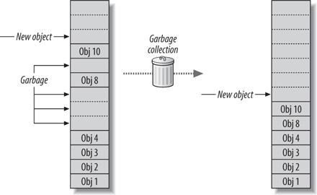
Garbage Collection
Notes:
Picture Credit : http://flylib.com/books/2/714/1/html/2/images/0596102070/figs/pnetcomp2_0402.gif

Slide 33
Garbage Collection Cont..
The .NET Framework provides a new mechanism for releasing unreferenced objects from the memory (that is no longer needed objects in the program), this process is called Garbage Collection (GC).
When a program creates an Object, the Object takes up the memory.
Later when the program has no more references to that Object, the Object's memory becomes unreachable, but it is not immediately freed.
The Garbage Collection checks to see if there are any Objects in the heap that are no longer being used by the application.

Slide 34
Garbage Collection Cont..
If such Objects exist, then the memory used by these Objects can be reclaimed.
So these unreferenced Objects should be removed from memory, then the other new Objects you create can find a place in the Heap.
This releasing of unreferenced Objects is happening automatically in .Net languages by the Garbage Collector (GC).
The programming languages like C++, programmers are responsible for allocating memory for Objects they created in the application and reclaiming the memory when that Object is no longer needed for the program.

Slide 35
Garbage Collection Cont..
In .NET languages there is a facility that we can call Garbage Collector (GC) explicitly in the program by calling System.GC.Collect().
Allow us to develop an application without having worry to free memory.
Allocates memory for objects efficiently on the managed heap.
Reclaims the memory for no longer used objects and keeps the free memory for future allocations.
Provides memory safety by making sure that an object cannot use the content of another object.

Slide 36
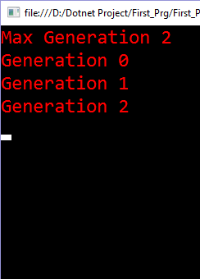
Example - Garbage Collection
using System;
namespace demo
{
class Program
{
public static void Main(string[] args)
{
Program jm = new Program();
Console.WriteLine("Max Generation " + GC.MaxGeneration);
Console.WriteLine("Generation " + GC.GetGeneration(jm));
GC.Collect();
Console.WriteLine("Generation " + GC.GetGeneration(jm));
GC.Collect();
Console.WriteLine("Generation " + GC.GetGeneration(jm));
GC.Collect();
Console.ReadLine();
}
}
}
Output:

Slide 37
End to DLL Hell
Earlier, before the release of .NET, the term DLL Hell, has been common in the world of software.
DLL Hell refers to set of problems, which are caused when multiple applications try to share a common component, for instance a DLL file or a COM class.
Suppose you install an application on your system.
This application automatically updates a new version of the shared component that is not backward compatible with a version already on the machine.
Although your new application that has just been installed works well, but existing application that depended on previous version of the shared component might no longer work.

Slide 38
End to DLL Hell Cont..
This is because the version information of different components of an application is not recorded by the system.
Therefore, changes made by an application on the system affect other applications of the machine.
To end the problems of DLL Hell, Microsoft has introduced .NET along the concept of run once – run forever.
This means that if a .NET application is installed and works then it will work forever, regardless of what other application, including .NET as well as non .NET are installed on the system.

Slide 39
.NET Framework Version History
Version No. | CLR Version | Release Date | Development Tools
1.0 | 1 | 13-02-2002 | Visual Studio .NET
1.1 | 1 | 24-04-2003 | Visual Studio .NET 2003
2.0 | 2 | 07-11-2005 | Visual Studio 2005
3.0 | 2 | 06-11-2006 | Expression Blend
3.5 | 2 | 19-11-2007 | Visual Studio 2008
4.0 | 4 | 12-04-2010 | Visual Studio 2010
4.5 | 4 | 15-08-2012 | Visual Studio 2012
4.5.1 | 4 | 17-10-2013 | Visual Studio 2013
4.5.2 | 4 | 05-05-2014 | N/A
4.6 | 4 | 20-07-2015 | Visual Studio 2015
4.6.1 | 4 | 30-11-2015 | Visual Studio 2015 Update 1
4.6.2 | 4 | 02-08-2016 | N/A
Notes:
Note : Microsoft Releases Visual Studio 2017 RC on 17, Nov 2016. (Preview Release)

Slide 40
Thank you

