Slide 1

UNIT - 11 Creating and Consuming Web Services
DOT NET TECHNOLOGY
2160711
Prof. Naimish R. Vadodariya
naimish.vadodariya@darshan.ac.in
+91-8866215253
Computer Engineering Darshan Institute of Engineering & Technology

Slide 2
Outline
Introduction to Web Service
Create & Consume Web Service
Terms Used For Web Service
Advantages Of Web Service
Examples Of Web Service

Slide 3
Introduction to Web Service
Web services are client and server applications that communicate over the World Wide Web's (WWW) Hypertext Transfer Protocol (HTTP).
A web service is the communication platform between two different or same platform applications that allows to use their web method.
For example weather information, live score of cricket, stock quote etc.
For common purposes you can create a web service and It will useful for not only single website but also for many other websites those are providing same facilities.
Developer just needs to consume the web services and then its required function is calling.

Slide 4
Web Service Cont..
So, it is better to develop a web service common to all instead of writing the same business logic for all websites.
Web service provides common functionalities and results for all websites.
Irrespective from any programming language as web service is based on XML so it can be useful to all language based applications.
Web Service messages are formatted as XML, a standard way for communication between two incompatible system, and this message is sent via HTTP, so that they can reach to any machine on the internet without being blocked by firewall.

Slide 5
Creating a Web Service
Example
Creating a Simple module that will provide basic arithmetic operations to other applications.
The user of this application provides two numbers and it will perform the requested operation like Addition, Multiplication, and Subtraction.

Slide 6
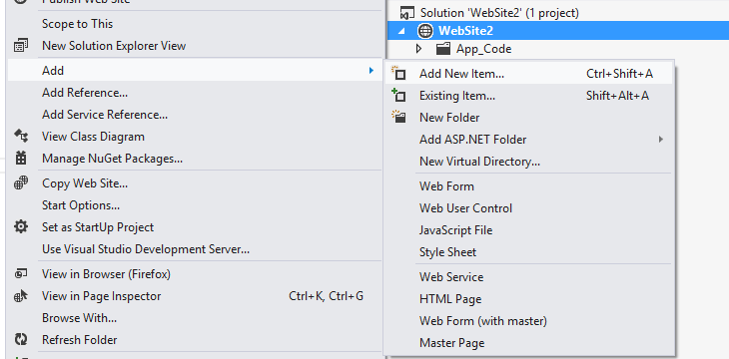
Create Web Service Cont..
Right Click on Website → Add → Add New Item

Slide 7
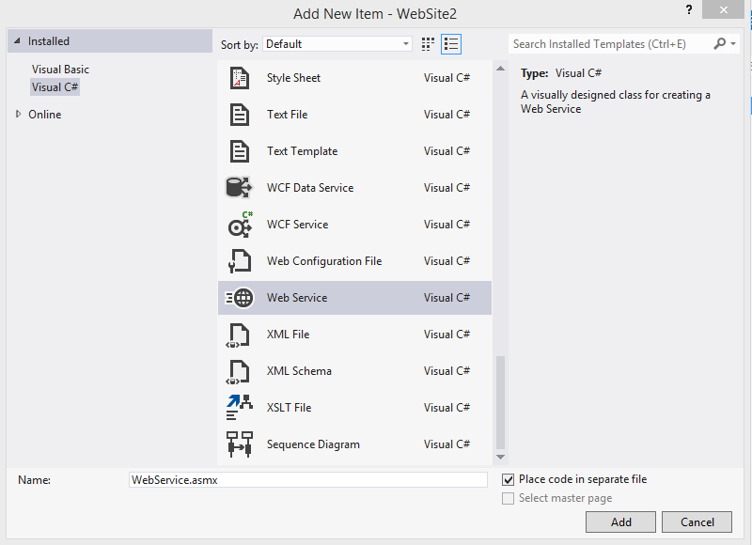
Create Web Service Cont..
Select Language
Select Web Service
Give Web Service Name
Press Add

Slide 8
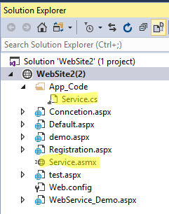
Create Web Service Cont..
You Can See Two Files .asmx & .cs under App_Code

Slide 9
Example – WebService
using System;
using System.Web.Services;
[WebService(Namespace = "http://tempuri.org/")]
[WebServiceBinding(ConformsTo = WsiProfiles.BasicProfile1_1)]
public class Service : System.Web.Services.WebService
{
public Service() {
}
[WebMethod]
public string MyFood(string items)
{
return "I like to eat" + items;
}
[WebMethod]
public string CheckOddandEvenMethods(int a)
{
string results;
if (a % 2 == 0) {
return results = a + "_" + "Is a Even Number"; }
else {
return results = a + "_" + "Is a odd Number"; }
}
}
[WebMethod] Is Compulsory in Web Service.
if you do not write [WebMethod] Above any Function or Method, method or function will not appear in output.

Slide 10
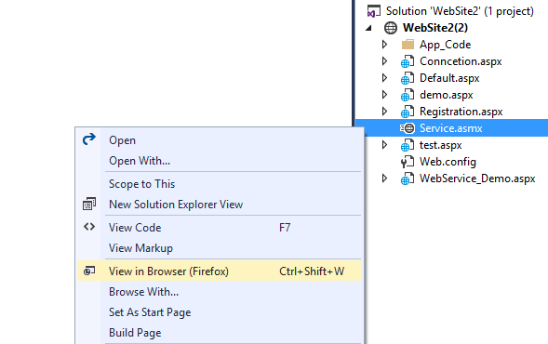
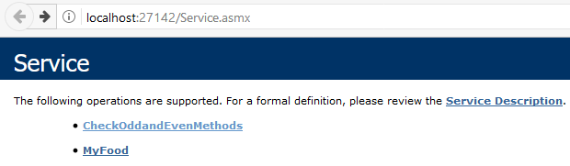
Output – Web Service

Slide 11
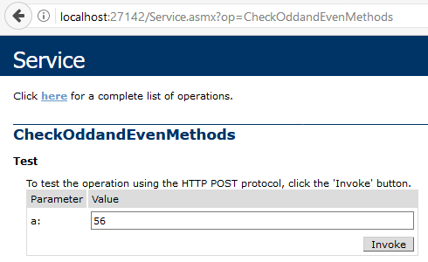

Output – Web Service

Slide 12
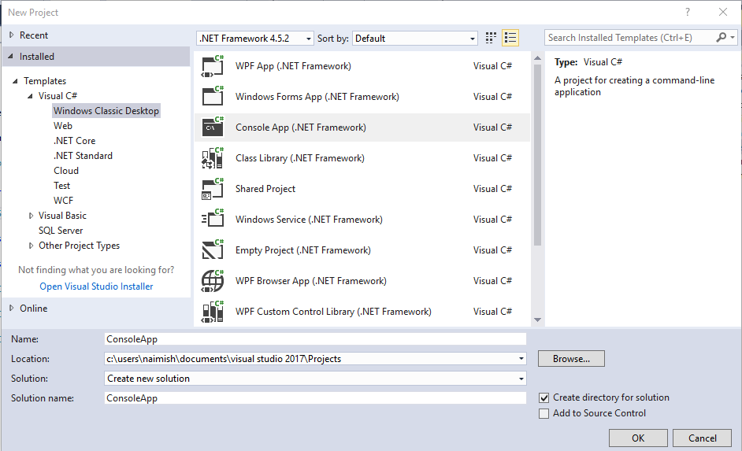
Consuming a Web Service
Create a Client Program

Slide 13
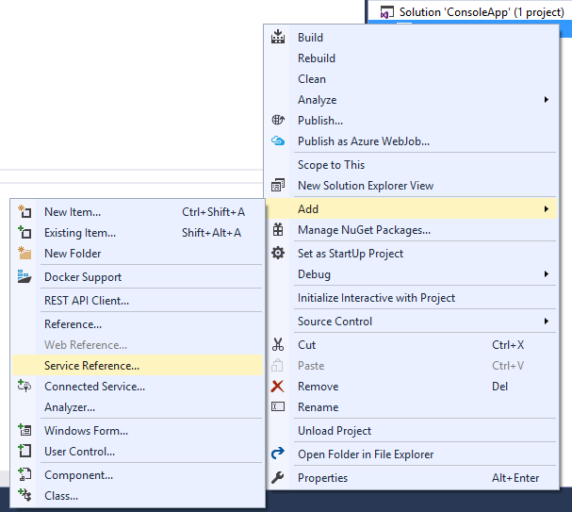
Consuming a Web Service Cont..
Right Click On Project Name And go to Add → Service Reference

Slide 14
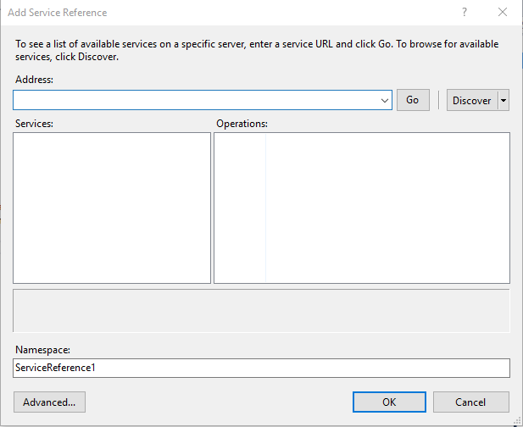
Consuming a Web Service Cont..

Slide 15
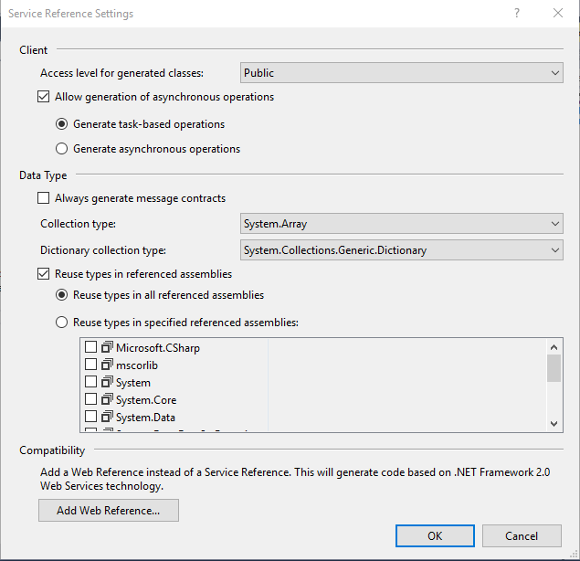
Consuming a Web Service Cont..

Slide 16
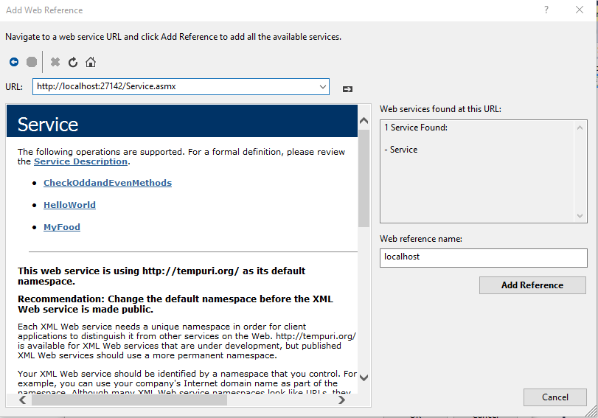
Consuming a Web Service Cont..

Slide 17
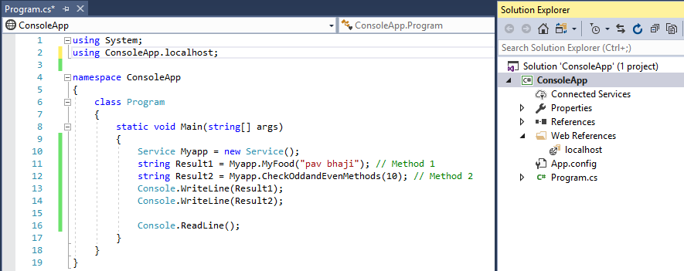
Consuming a Web Service Cont..
You Can call Methods of WebService
Like
MyFood()
CheckOddandEvenMethods()

Slide 18
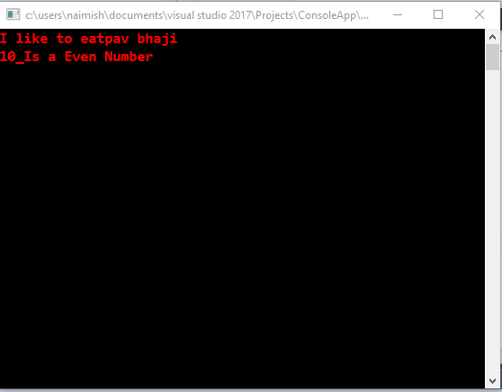
Output - Consuming a Web Service

Slide 19
Terms Used for Web Service
SOAP
SOAP (simple object access protocol) is a remote function calls that invokes method and execute them on Remote machine and translate the object communication into XML format.
In short, SOAP is the way by which method calls are translate into XML format and sent it via HTTP.
WSDL
WSDL stands for Web Service Description Language, a standard by which a web service can tell clients what messages it accepts and which results it will return.
WSDL contains every detail regarding using web service, Method and Properties provided by web service and URLs from which those methods can be accessed and also Data Types used in it.

Slide 20
Terms for Web Service Cont..
UDDI
UDDI stands for Universal Description, Discovery, and Integration.
UDDI is an XML-based standard for describing, publishing, and finding web services.
UDDI allows you to find web services by connecting to a directory.
UDDI is a platform-independent, open framework.
UDDI can communicate via SOAP, Java RMI Protocol.

Slide 21
Advantage Of Web Service
Web Services are supported on a wide range of platforms.
Web services may extend its interface and add new methods without affecting the clients as long as they still provide the old methods and parameters.
A client makes a request to a web service, the web service returns the result, and the connection is closed. There is no permanent connection. This makes it easy to scale up and support many clients at a time.
Web Service messages are formatted as XML, a standard way for communication between two incompatible system.
This message is sent via HTTP, so that they can reach to any machine on the internet without being blocked by firewall.

Slide 22
Examples Of Web Service
Weather Reporting: You can use Weather Reporting web service to display weather information in your personal website.
Stock Quote: You can display latest update of Share market with Stock Quote on your web site.
News Headline: You can display latest news update by using News Headline Web Service in your website.
& Many More..

Slide 23
Thank you

