Slide 1

UNIT - 12 Advanced In .NET
DOT NET TECHNOLOGY
2160711
Prof. Naimish R. Vadodariya
naimish.vadodariya@darshan.ac.in
+91-8866215253
Computer Engineering Darshan Institute of Engineering & Technology

Slide 2
Outline
Introduction to WPF (Windows Presentation Foundation)
Features of WPF
Architecture of WPF
Introduction to WCF (Windows Communication Foundation)
Advantages of WCF
WCF Service Components

Slide 3
Introduction to WPF
Windows Presentation Foundation (WPF) is a next-generation presentation system for building Windows client applications with visually stunning user experiences.
With WPF, we can create a wide range of both standalone and browser-hosted applications.
The core of WPF is a resolution-independent and vector-based rendering engine that is built to take advantage of modern graphics hardware.
WPF extends the core with a comprehensive set of application-development features that includes Extensible Application Markup Language (XAML), controls, data binding, layout, 2-D and 3-D graphics, animation, styles, templates, documents, media, text, and typography.

Slide 4
Features of WPF
Resolution Independence
WPF is resolution independence since all measures in WPF are logical units not pixels. A logical unit is a 1/96 of an inch.
So, with changing the screen resolution setting in WPF each control will look same for each resolution.
Separation of appearance and behaviors
WPF separates the appearance of an UI from its behavior.
The appearance is specified by XAML and behavior is specified by a managed programming language like C# or VB.
Built-In support for graphics and animation
WPF applications run within DirectX environment, hence it has major support of graphics and animation capabilities.
WPF has a separate set of classes that are specifically deal with animation effects and graphics.

Slide 5
Features of WPF Cont..
Supports for Audio and Video
WPF has support for playing any audio or video file supported by Windows Media Player.
It also gives you the tools to integrate video content into your rich UI such as placing a video window on a spinning 3-D cube.
Highly customizable
WPF supports separation of appearance and behaviors; hence we can easily change the look of a control or a set of controls.
This concept of styling controls in WPF is almost like CSS in HTML.
In WPF, you can store styles, controls, animations, and even any object as a resource and you may associate that resource to the controls.
Each resource is declared once when the form loads itself.

Slide 6
Architecture Of WPF
WPF is actually a set of assemblies that build up the entire framework.
These assemblies can be categorized as:
Managed Layer
Unmanaged Layer
Core API

Slide 7
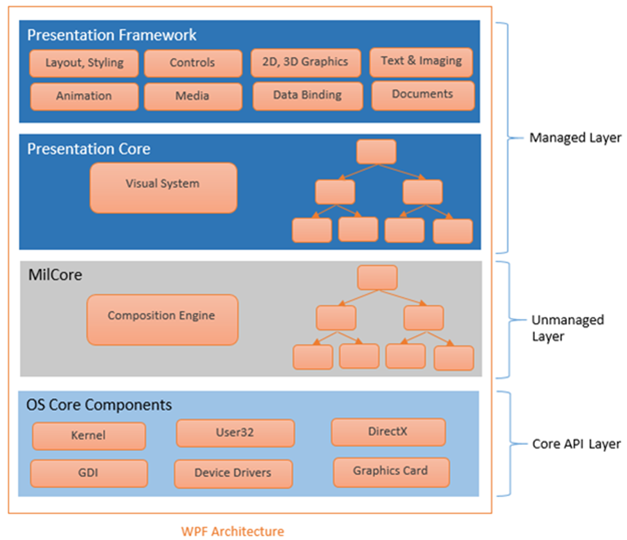
Architecture Of WPF Cont..

Slide 8
1) Managed Layer
Managed layer has two main components – Presentation Framework and Presentation Core.
Presentation Framework provides the required functionalities that we need to build the WPF applications such as controls, data bindings, styling, shapes, media, documents, annotations, animation and more. PresentationFamework.dll is responsible for this purpose.
Presentation Core acts as a managed wrapper around MILCore and provides public interface for MIL (Media Integration Layer). Presentation Core is the home for WPF Visual System and provides classes for creating application visual tree.

Slide 9
2) Unmanaged Layer
This layer is also called MilCore (Media Integration Library Core).
MilCore is written in unmanaged code in order to enable tight integration with DirectX.
DirectX engine is underlying technology used in WPF to display all graphics, allowing for efficient hardware and software rendering.
MIL has composition system that receives rendering instructions from visual system and translates into data, that can be understood by DirectX to render user interface.

Slide 10
3) Core API Layer
This layer has OS core components like Kernel, User32, GDI, Device Drivers, Graphic cards etc.
These components are used by the application to access low level APIs.
User32 manages memory and process separation.

Slide 11
Introduction to WCF
Windows Communication Foundation - WCF is a programming platform and runtime system for building, configuring and deploying network-distributed services.
It is the latest service oriented technology, Interoperability is the fundamental characteristics of WCF.
It is unified programming model provided in .Net Framework.
WCF is a combined feature of Web Service, Remoting, MSMQ(Microsoft Message Queuing) and COM+.
WCF provides a common platform for all .NET communication.

Slide 12
Advantages of WCF
WCF can be hosted under the Windows environment, but it can be utilized by clients of different languages and different platforms.
WCF services provide better reliability and security in compared to ASMX web services.
In WCF, there is no need to make much change in code for implementing the security model and changing the binding. Small changes in the configuration will make your requirements.
WCF has integrated logging mechanism, changing the configuration file settings will provide this functionality. In other technology developer has to write the code for it.

Slide 13
WCF Service Components
Service Class - A WCF service class implements some service as a set of methods.
Host Environment - A Host environment can be a Console application or a Windows Service or a Windows Forms application or IIS as in case of the normal asmx web service in .NET.
Endpoints - All communications with the WCF service will happen via the endpoints. The endpoint is composed of 3 parts (collectively called as ABC's of endpoint) as defines below:
Address
Binding
Contract

Slide 14
WCF Service Components Cont..
Address: The endpoints specify an Address that defines where the endpoint is hosted. It’s basically URL.
Binding: The endpoints also define a binding that specifies how a client will communicate with the service and the address where the endpoint is hosted.
Contract: The endpoints specify a Contract that defines which methods of the Service class will be accessible via the endpoint; each endpoint may expose a different set of methods.

Slide 15
Thank you

