Slide 1

UNIT-2 The Basics and Console Applications in C#
DOT NET TECHNOLOGY
2160711
Prof. Naimish R. Vadodariya
naimish.vadodariya@darshan.ac.in
+91-8866215253
Computer Engineering Darshan Institute of Engineering & Technology

Slide 2
Outline
Constructor
Destructor
Function Overloading
Operator Overloading
Modifiers
Properties
Indexers
Introduction to Console Application
Namespaces

Slide 3
Constructor
What is Constructor?
A constructor is a special member function of a class that is executed whenever we create new objects of that class.
A special method of the class that will be automatically invoked when an instance of the class is created is called as constructor.
A constructor will have exact same name as the class and it does not have any return type.
By default, C# creates default constructor internally.
A default constructor does not have any parameter.
A class can have any number of constructors.
A constructor doesn’t have any return type even void.

Slide 4
Type of Constructor
Constructors can be classified as follows.
Default Constructor
By default, C# creates default constructor internally.
Parameterized Constructor
When an object is declared in a parameterized constructor, the initial values have to be passed as arguments to the constructor function.
Copy Constructor
The copy constructor is a constructor which creates an object by initializing it with an object of the same class, which has been created previously.
The copy constructor is used to: Initialize one object from another of the same type.
Copy an object to pass it as an argument to a function.

Slide 5
Example - Constructor
using System;
namespace Constructor
{
class Square
{
private int Side;
//Default Constructor
public Square()
{
this.Side = 1;
}
//Paramerized Constructor
public Square(int side)
{
//A Constructor is used to initilize private fields of a class
this.Side = side;
}
public int Area()
{
return
this.Side * this.Side;
}
}
class MainClass
{
public static void Main()
{
//Calling Default Constructor
Square squreobject = new Square();
int Area = squreobject.Area();
Console.WriteLine(Area);
//Calling Parametrized Constructor
Square MySquare = new Square(10);
int myarea = MySquare.Area();
Console.WriteLine(myarea);
Console.Read();
}
}
}
Output :
1
100

Slide 6
Destructor
A destructor is a special member function of a class that is executed whenever an object of its class goes out of scope.
A destructor will have exact same name as the class prefixed with a tilde (~) and it can neither return a value nor can it take any parameters.
Destructor can be very useful for releasing resources before coming out of the program like closing files, releasing memories etc.
A class can have only one destructor.
Destructors cannot be inherited or overloaded.
A destructor does not take modifiers.

Slide 7

Destructor - Example
using System;
namespace Destructor
{
class Example
{
public Example()
{
Console.WriteLine("Constructor");
}
~Example()
{
Console.WriteLine("Destructor");
Console.ReadKey();
}
}
class Program
{
static void Main(string[] args)
{
Example x = new Example();
}
}
}
Output :

Slide 8
Constructor v/s Destructor
 | Constructor | Destructor
Purpose | Constructor is used to initialize the instance of a class. | Destructor destroys the objects when they are no longer needed.
When Called | Constructor is Called when new instance of a class is created. | Destructor is called when instance of a class is deleted or released.
Memory Management | Constructor allocates the memory. | Destructor releases the memory.
Arguments | Constructors can have arguments. | Destructor can not have any arguments.
Overloading | Overloading of constructor is possible. | Overloading of Destructor is not possible.
Name | Constructor has the same name as class name. | Destructor also has the same name as class name but with (~) tiled operator.
Syntex | ClassName(Arguments) { //Body of Constructor } | ~ ClassName() { }

Slide 9
Function (Method) Overloading
Function overloading (method overloading) is a programming concept that allows programmers to define two or more functions with the same name.
C# also allows us to define multiple functions with the same name differing in the argument type and order of arguments. This is termed as function overloading.
There is no need to use any keyword while overloading a function or method either in same class or in derived class.
While overloading functions or methods, you have to follow the rules that overloaded methods must differ either in number of arguments or the data type of at least one argument.

Slide 10
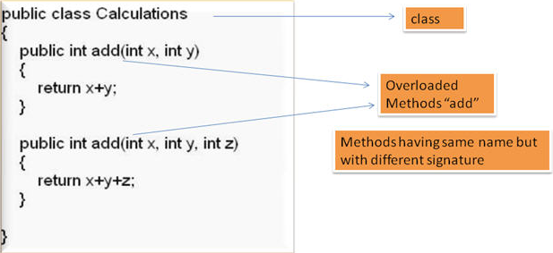
Function Overloading Cont..
In case of function or method overloading, compiler identifies which overloaded method to execute based on number of arguments and their data types during compilation itself.
Hence method overloading is an example for compile time polymorphism.
Notes:
Picture Credit : https://www.google.co.in/search?q=Function+Overloading&biw=1366&bih=653&noj=1&source=lnms&tbm=isch&sa=X&ved=0ahUKEwi2vcKzspTRAhWLPI8KHck6B7QQ_AUICigD#imgrc=KSXxCq42_dmKwM%3A

Slide 11
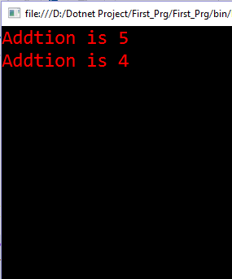
Example - Function Overloading
class add
{
public int ad(int a, int b)
{
return a + b;
}
public int ad(int a)
{
return a + a;
}
}
Output :
class Program
{
public static void Main(string[] args)
{
add sum = new add();
int i = sum.ad(2, 3);
Console.WriteLine("Addtion is {0}",i);
int b = sum.ad(2);
Console.WriteLine("Addtion is {0}",b);
Console.Read();
}
}

Slide 12
Operator Overloading
Each operator has predefined meaning most of them are given additional meaning through the concept of Operator Overloading.
‘+’ is used for addition
‘+’ can not use for concatenation?
String 1 = Ram & String 2 = Rahim
We can not concat two strings using + operator like ‘Ram Rahim’??

Slide 13
Operator Overloading Cont..
Overloaded operators are functions with special names the keyword operator followed by the symbol for the operator being defined.
Syntax
public static return-type operator op(arguments) {
}
When any operator is overloaded, its original meaning is not lost.
Similar to any other function, an overloaded operator has a return type and a parameter list.

Slide 14

Example - Operator Overloading
using System;
namespace Demo
{
class calculation
{
int a, b, c;
public calculation()
{
a = b = c = 0;
}
public calculation(int x, int y, int z)
{
a = x;
b = y;
c = z;
}
public static calculation operator ++(calculation op1)
{
op1.a++;
op1.b++;
op1.c++;
return op1;
}
public void ShowResult()
{
Console.WriteLine(a + "," + b + "," + c);
Console.ReadLine();
}
}
class Program
{
static void Main(string[] args)
{
calculation i = new calculation(10, 20, 30);
i++;
i.ShowResult();
Console.ReadLine();
}
}
}
Output :

Slide 15
Modifiers
Access modifiers are keywords used to specify the declared accessibility of a member or a type.
Why to use access modifiers?
Access modifiers are an integral part of object-oriented programming.
They support the concept of encapsulation, which promotes the idea of hiding functionality.
Access modifiers allow you to define who does or doesn't have access to certain features.

Slide 16
Modifiers
In C# Modifiers can be divided in five categories.
Public
Private
Protected
Internal
Protected internal

Slide 17
Public Modifier
Public members are accessible anywhere in program or application.
Public access is the most permissive access level.
There are no restrictions on accessing public members.
The public keyword is used for it.
Accessibility:
Can be accessed by objects of the class
Can be accessed by derived classes

Slide 18
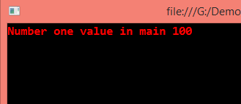
Example - Public Modifier
using System;
namespace Demo
{
class Access
{
public int num1;
}
class Program
{
static void Main(string[] args)
{
Access ob1 = new Access();
//Direct access to public members
ob1.num1 = 100;
Console.WriteLine("Number one value in main {0}", ob1.num1);
Console.ReadLine();
}
}
}
Output :

Slide 19
Private Modifier
Private members are accessible only within the body or scope of the class or the structure in which they are declared.
Private access is the least permissive access level.
The private keyword is used for it.
Accessibility:
Cannot be accessed by object
Cannot be accessed by derived classes

Slide 20
Example - Private Modifier
using System;
namespace Demo
{
class Access
{
public int num1;
private int num2;
}
class Program
{
static void Main(string[] args)
{
Access ob1 = new Access();
//Direct access to public members
ob1.num1 = 100;
//Access to private member is not permitted
ob1.num2 = 10;
Console.WriteLine("Number one value in main {0}", ob1.num1);
Console.ReadLine();
}
}
}

Slide 21
Protected - Modifier
A protected member is accessible from within the class in which it is declared and from within any class derived from the class that declared this member.
A protected member of a base class is accessible in a derived class only if the access takes place through the derived class type.
The protected keyword is used for it.
Accessibility:
Cannot be accessed by object
By derived classes

Slide 22
Example - Protected Modifier
using System;
namespace Demo
{
class Base
{
protected int num1;
}
class Derived : Base
{
public int num2;
}
class Program
{
static void Main(string[] args)
{
Base ob1 = new Base();
Derived ob2 = new Derived();
ob2.num1 = 20;
// Access to protected member as it is inherited by the Derived class
ob2.num2 = 90;
Console.WriteLine("Number2 value {0}", ob2.num2);
Console.WriteLine("Number1 value which is protected {0}", ob2.num1);
Console.ReadLine();
}
}
}

Slide 23
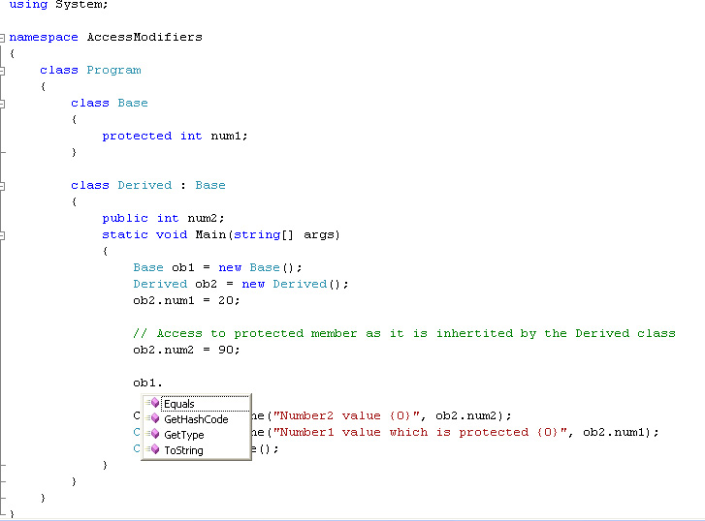
Example - Protected Modifier

Slide 24
Internal Modifier
We can declare a class as internal or its member as internal.
Internal members are accessible only within the same assembly.
In other words, access is limited exclusively to classes defined within the current project assembly.
The internal keyword is used for it.
Accessibility:
The variable or classes that are declared with internal can be access by any member within application.
It is the default access specifiers for a class in C# programming.

Slide 25
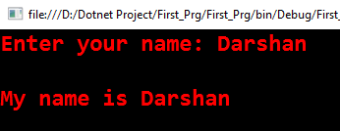
Example - Internal Modifier
using System;
namespace First_Prg
{
class access
{
// String Variable declared as internal
internal string name;
public void print()
{
Console.WriteLine("\nMy name is " + name);
}
}
class Program
{
static void Main(string[] args)
{
access ac = new access();
Console.Write("Enter your name:\t");
// Accepting value in internal variable
ac.name = Console.ReadLine();
ac.print();
Console.ReadLine();
}
}
}
Output :

Slide 26
Protected Internal Modifier
The protected internal accessibility means protected OR internal, not protected AND internal.
In other words, a protected internal member is accessible from any class in the same assembly, including derived classes.
The protected internal access specifier allows its members to be accessed in derived class, containing classes within same application.
Accessibility:
Within the class in which they are declared
Within the derived classes of that class available within the same assembly
Outside the class within the same assembly
Within the derived classes of that class available outside the assembly

Slide 27
Example – Protected Internal Modifier
using System;
namespace First_Prg
{
class access
{
// String Variable declared as protected internal
protected internal string name;
public void print()
{
Console.WriteLine("\nMy name is " + name);
}
}
class Program
{
static void Main(string[] args)
{
access ac = new access();
Console.Write("Enter your name:\t");
// Accepting value in internal variable
ac.name = Console.ReadLine();
ac.print();
Console.ReadLine();
}
}
}
Output :

Slide 28
Default Access
A default access level is used if no access modifier is specified in a member declaration.
The following list defines the default access modifier for certain C# types:
C# Types | Description
enum | The default and only access modifier supported is public.
Class | The default access for a class is private. It may be explicitly defined using any of the access modifiers.
Interface | The default and only access modifier supported is public.
Struct | The default access is private with public and internal supported as well.
Interface and enumeration members are always public and no access modifiers are allowed.

Slide 29
Properties
In C#, properties are nothing but natural extension of data fields.
They are usually known as 'smart fields' in C# community.
We know that data encapsulation and hiding are the two fundamental characteristics of any object oriented programming language.
In C#, data encapsulation is possible through either classes or structures.
Usually inside a class, we declare a data field as private and will provide a set of public SET and GET methods to access the data fields.

Slide 30
Properties Cont..
Properties are special kind of class member, In properties we use predefined Set and Get method.
They use assessors through which we can read, written or change the values of the private fields.
We cannot access these fields from outside the class , but we can accessing these private fields through properties.

Slide 31
Properties Cont..
A property is a combination of variable and a method.
A property is used to provide a flexible way to read, write, or change values of a private field.
The get method is used to return property value to the user.
The set method is used to assign a new value to the property.
Syntax
Public <return type> <PropertyName>
{
get
{
return <var>;
}
set
{
<var> = value;
}
}

Slide 32
Example - Properties
class Example
{
private int number;
public int Number
{
get
{
return number;
}
set
{
number = value;
}
}
}
class Program
{
static void Main(string[] args)
{
Example example = new Example();
// set { }
example.Number = 5;
// get { }
Console.WriteLine(example.Number);
Console.Read();
}
}
Output :
5

Slide 33
Indexers
Indexer is a new concept introduced by C#.
An Indexer is a special type of property that allows a class or structure to be accessed the same way as array for its internal collection.
It is same as property except that it defined with this keyword with square bracket and parameters.
It can be used for overloading a [] operator.

Slide 34
Indexers Cont..
Syntax :
public <return type> this [argument list]
{
get
{
//code for get
}
set
{
//code for get
}
}
The access modifiers used for an indexer is Public.
Return type can be any valid C# data type, such as string or integer.
The this keyword shows that the object is of the current class.
The argument list specifies the parameter of the indexer. C# indexer must have one parameter otherwise compiler gives an error.
The get and set portions of the syntax are known as accessors. The visibility or access level for these accessors is the same as that of the indexer to which they belong.

Slide 35
Example - Indexers
class sample
{
private string[] name = new string[3];
public string this[int index]
{
get
{
if (index < 0 || index >= name.Length)
{
return null;
}
else
{
return name[index];
}
}
set
{
name[index] = value;
}
}
}
class Program
{
static void Main(string[] args)
{
sample s = new sample();
s[0] = "Darshan";
s[1] = "Institute";
s[2] = "Of Engg. & Tech.";
for (int i = 0; i <= 2; i++)
{
Console.WriteLine(s[i]);
}
Console.ReadKey();
}
}
Output :
Darshan
Institute
Of Engg. & Tech.

Slide 36
Properties v/s Indexers
Properties | Indexers
Properties don't require this keyword | Indexers are created with this keyword
Properties are identified by their names | Indexers are identified by signature
Properties are accessed by their names | Indexers are accessed using indexes
Properties are also known as the smart fields | Indexers are also known as smart arrays
A get accessor of a property has no parameters & A set accessor of a property contains the implicit value parameter. | Indexers in C# must have atleast one parameter & it also supports more than one different types of parameters

Slide 37
Properties v/s Indexers Cont..
Properties | Indexers
Syntax of Properties <access_modifier> <return_type> <property_name> { get { // Get codes goes here } set { // Set codes goes here } } | Syntax of Indexers <access_modifier> <return type> this [argument list] { get { // Get codes goes here } set { // Set codes goes here } }

Slide 38
Introduction to Console Application
What is Console Application?
A console application is an application that runs in a console window same as a C, C++ etc.
It doesn’t have any graphical user interface. console applications will have character based interface.
To work with console applications in .NET you have to use a class called Console that is available within the namespace System, which is the root namespace.
But what about Namespace? Let’s see…

Slide 39
Namespace
In C Langugage we write printf it belongs to <stdio.h> header file.
System.Console.WriteLine(“Hello Everyone!!!!");
System is a namespace.
Console is a class in that namespace.
WriteLine() is a method to print on screen or console.
A namespace definition begins with the keyword namespace followed by the namespace name as follows:
Syntax
namespace FirstProgram
{
// Code
}

Slide 40
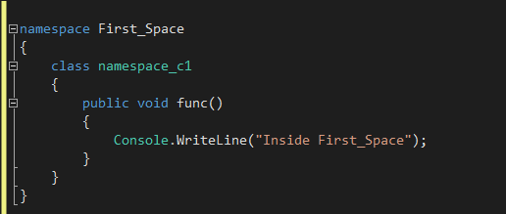
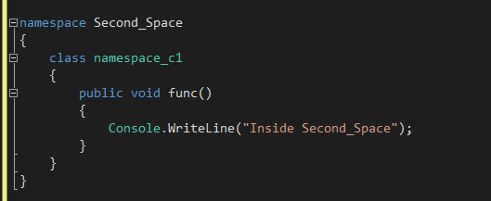
Example - Namespace

Slide 41
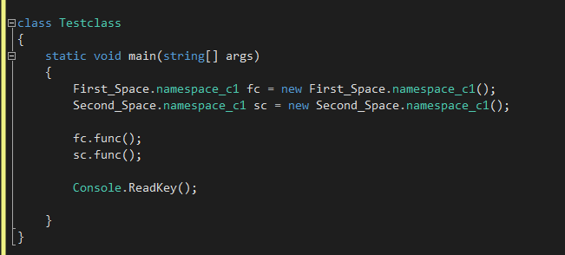
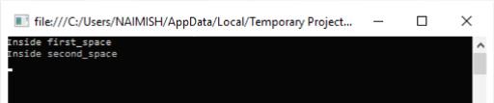
Cont..
Output :

Slide 42
Namespace Cont..
Namespace is a grouping of logically related identifiers, classes, types etc.
Namespace is used to avoid conflicts with the elements of an unrelated code which have the same names.
A namespace acts as a container—like a disk folder—for classes organized into groups usually based on functionality.
All classes and types of .NET FCL are organized in namespaces.
Implementing Namespaces in your own code is a good habit because it is likely to save you from problems later when you want to reuse some of your code.
Namespaces don't correspond to file or directory names.

Slide 43
Namespace Cont..
Namespace | Description
System.Data | Includes classes which lets us handle data from data sources.
System.Drawing | Provides access to drawing methods.
System.IO | Includes classes for data access with Files.
System.NET | Provides interface to protocols used on the internet.
System.Security | Includes classes to support the structure of common language runtime security system.
System.Web | Includes classes and interfaces that support browser-server communication.
System.XML | Includes classes for XML support.

Slide 44
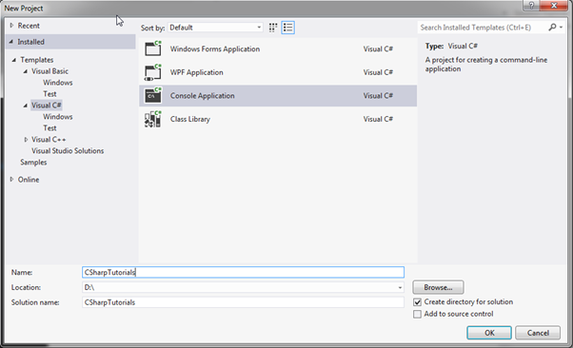

How To Create Console Application?
To Create C# console program,
By clicking Visual Studio -> File -> New Project...
From the popup, select Visual C# under Templates (in the left column) and select Console Application from the middle column.
Notes:
Picture Credit : http://www.tutorialsteacher.com/csharp/csharp-environment-setup

Slide 45
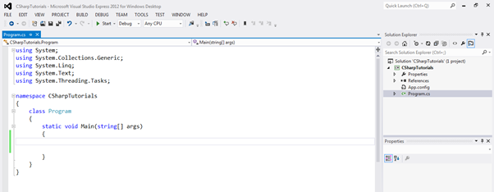
Create Console Application Cont..
In the name section, give any appropriate project name, location where you want to create all the project files and solution name.
Click OK to create the console project Program.cs will be created as default .cs file in Visual Studio where you can write your C# code in Program class as shown below.

Slide 46
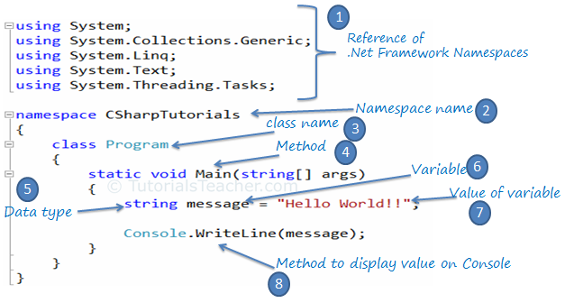
Understanding A Program
Notes:
Picture Credit : http://www.tutorialsteacher.com/Content/images/csharp/csharp-code-structure.png

Slide 47
Compile and Run C# Program
To see the output of the above C# program, we have to compile it and run it by pressing Ctrl + F5, or clicking Run button.
By clicking the "Debug" menu and clicking "Start Without Debugging". You will see following output in the console:

Slide 48
Thank you

