Slide 1


UNIT - 3 C#.NET
DOT NET TECHNOLOGY
2160711
Prof. Naimish R. Vadodariya
naimish.vadodariya@darshan.ac.in
+91-8866215253
Computer Engineering Darshan Institute of Engineering & Technology
Notes:
Picture credit : 1)https://www.google.co.in/url?sa=i&rct=j&q=&esrc=s&source=images&cd=&ved=0ahUKEwjGjrGxrs7QAhWBRo8KHeFhBX0QjhwIBQ&url=http%3A%2F%2Fdaniloandrade.me%2F&psig=AFQjCNFNM7SO0YmW_4Ac3oZC34DWst5VUA&ust=1480522521544693&cad=rja

Slide 2
Outline
Introduction to C#.NET
C#.NET Features
Inheritance
Delegates
Collections
Debugging and Error Handling
String Manipulation
Files & I/O

Slide 3
Introduction to C#.NET
C# (pronounced “see-sharp") is an object-oriented programming language from Microsoft that aims to combine the computing power of C++ with the programming ease of Visual Basic.
C# is based on C++ and contains features similar to Java.
C# is designed to work with Microsoft's .NET platform.
C# is a simple, modern, general-purpose, object-oriented programming language developed by Microsoft within its .NET initiative led by Anders Hejlsberg.

Slide 4
C#.NET Features
It is a modern, general-purpose programming language.
It is object oriented.
It is component oriented.
It is easy to learn.
It is a structured language.
It produces efficient programs.
It can be compiled on a variety of computer platforms.
It is a part of .NET Framework.

Slide 5
Inheritance
Inheritance is where one class (child class) inherits the properties of another class (parent class).
Inheritance is a mechanism of acquiring the features and behaviors of a class by another class.
The class whose members are inherited is called the base class, and the class that inherits those members is called the derived class.
Inheritance implements the IS-A relationship.
Example
“She had inherited the beauty of her mother”

Slide 6
Why Inheritance?
Advantages of Inheritance
Reduce code redundancy
Provides code reusability
Reduces source code size and improves code readability
Code is easy to manage and divided into parent and child classes

Slide 7
Disadvantages - Inheritance
In Inheritance base class and child classes are tightly coupled. Hence If you change the code of parent class, it will get affects to the all the child classes.
In class hierarchy many data members remain unused and the memory allocated to them is not utilized.
Hence affect performance of your program if you have not implemented inheritance correctly.

Slide 8
Different Types of Inheritance
Single Inheritance
Multi-level Inheritance
Multiple Inheritance
Multipath Inheritance
Hierarchical Inheritance
Hybrid Inheritance

Slide 9
Single Inheritance
Single Inheritance
In single inheritance, a derived class is created from a single base class.
Class A (Base)
Class B (Derived)

Slide 10
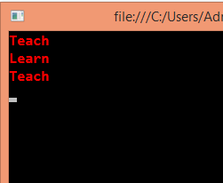
Example - Single Inheritance
//Base Class
class Teacher
{
public void Teach()
{
Console.WriteLine("Teach");
}
}
//Derived Class
class Student : Teacher
{
public void Learn()
{
Console.WriteLine("Learn");
}
}
class Program
{
static void Main(string[] args)
{
Teacher d = new Teacher();
d.Teach();
Student s = new Student();
s.Learn();
s.Teach();
Console.ReadKey();
}
}

Slide 11
Multi-level Inheritance
Multi-level Inheritance
In Multi-level inheritance, a derived class is created from another derived class.
Class A (Base)
Class B
Class C

Slide 12
Example – Multi-Level Inheritance
//Base Class
class Teacher
{
public void Teach()
{
Console.WriteLine("Teach");
}
}
//Base,Derived Class
class Student : Teacher
{
public void Learn()
{
Console.WriteLine("Learn");
}
}
//Derived Class
class SemFour : Student
{
public void FourthSem()
{
Console.WriteLine("Semester Four Students");
}
}
class Program
{
static void Main(string[] args)
{
Teacher d = new Teacher();
d.Teach();
Student s = new Student();
s.Learn();
s.Teach();
SemFour Sem = new SemFour();
Sem.Learn();
Sem.Teach();
Sem.FourthSem();
Console.ReadKey();
}
}

Slide 13
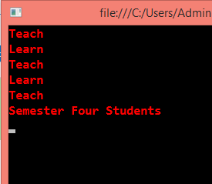
Cont..
Output :

Slide 14
Multiple Inheritance
Class A (Base)
Class B (Base)
Class C
Multiple Inheritance
In Multiple inheritance, a derived class is created from more than one base class.
This inheritance is not supported by .NET Languages like C#, F# etc.

Slide 15
Example – Multiple Inheritance
//Base Class
class Teacher
{
public void Teach()
{
Console.WriteLine("Teach");
}
}
//Base,Derived Class
class Student
{
public void Learn()
{
Console.WriteLine("Learn");
}
}
//Derived Class
class SemFour : Student , Teacher
{
public void FourthSem()
{
Console.WriteLine("Semester Four Students");
}
}

Slide 16
Multipath Inheritance
Class A
Class B
Class C
Class D
Multipath Inheritance
In Multipath inheritance, a derived class is created from another derived classes and the same base class of another derived classes.
This inheritance is not supported by .NET Languages like C#, F# etc.

Slide 17
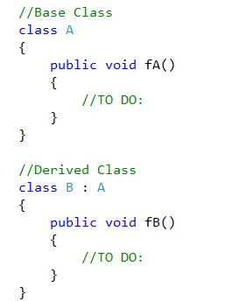
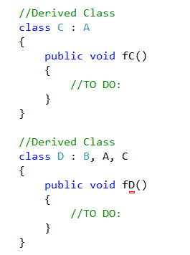
Example – Multipath Inheritance

Slide 18
Hierarchical Inheritance
Class A
Class C
Class B
Class D
Class E
Class F
Class G

Slide 19
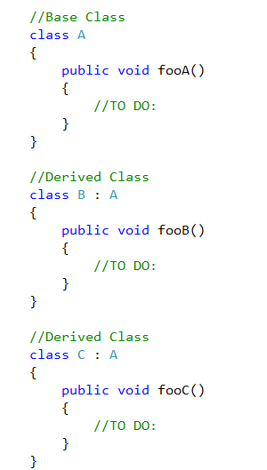
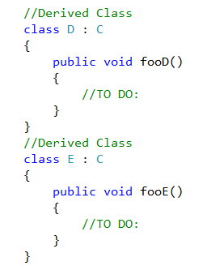
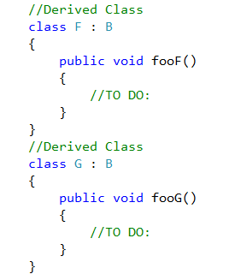
Example – Hierarchical Inheritance

Slide 20
Hybrid Inheritance
Class A
Class F
Class C
Class B
Class D
Class E

Slide 21
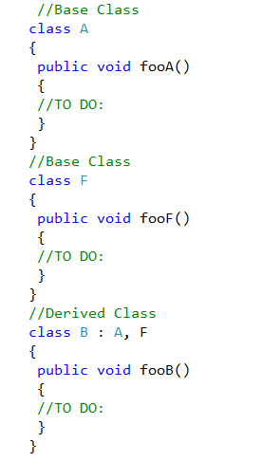
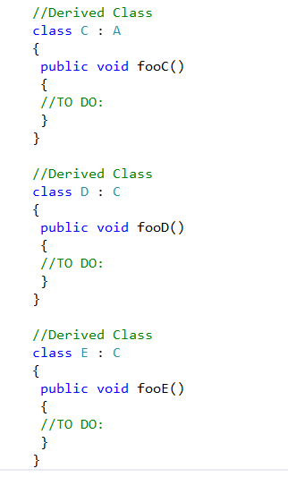
Example – Hybrid Inheritance

Slide 22
Delegates
A function can have one or more parameters of different data types, but what if you want to pass a function itself as a parameter?
How does C# handle the callback functions or event handler?
The answer is - delegate.
A delegate is like a pointer to a function.
It is a reference type data type and it holds the reference of a method.
All the delegates are implicitly derived from System.Delegate class.

Slide 23
Delegates Cont..
A delegate can be declared using delegate keyword followed by a function signature as shown below.
Syntax
<access modifier> delegate <return type> <delegate_name>(<parameters>)
The following example declares a Print delegate.
public delegate void Print(int value);
The Print delegate shown above, can be used to point to any method that has same return type & parameters declared with Print.

Slide 24
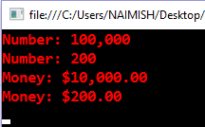
Example - Delegates
using System;
namespace Demo
{
class Program
{
// declare delegate
public delegate void Print(int value);
static void Main(string[] args)
{
// Print delegate points to PrintNumber
Print printDel = PrintNumber;
printDel(100000);
printDel(200);
// Print delegate points to PrintMoney
printDel = PrintMoney;
printDel(10000);
printDel(200);
Console.ReadLine();
}
public static void PrintNumber(int num)
{
Console.WriteLine("Number: {0,-12:N0}", num);
Console.ReadLine();
}
public static void PrintMoney(int money)
{
Console.WriteLine("Money: {0:C}", money);
Console.ReadLine();
}
}
}
Output :

Slide 25
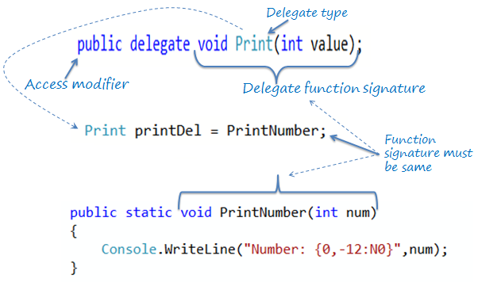
Delegates Cont..

Slide 26
Delegates Cont..
In the above example, we have declared Print delegate that accepts int type parameter and returns void.
In the Main() method, a variable of Print type is declared and assigned a PrintNumber method name.
Now, invoking Print delegate will in-turn invoke PrintNumber method.
In the same way, if the Print delegate variable is assigned to the PrintMoney method, then it will invoke the PrintMoney method.

Slide 27
Invoking Delegate
The delegate can be invoked like a method because it is a reference to a method.
Invoking a delegate will in-turn invoke a method which id refered to.
The delegate can be invoked by two ways: using () operator or using the Invoke() method of delegate as shown below.
Print printDel = PrintNumber;
printDel.Invoke(10000);
//or
printDel(10000);

Slide 28
What is Collections?
We mostly use arrays to store and manage data.
However, arrays can store a particular type of data, such as integer and characters.
To resolve this issue, the .NET framework introduces the concept of collections for data storage and retrieval, where collection means a group of different types of data.
Collections are similar to arrays, it provide a more flexible way of working with a group of objects.
In arrays, you need to define the number of elements at declaration time.
But in a collection, you don't need to define the size of the collection in advance. You can add elements or even remove elements from the collection at any point of time.

Slide 29
Collection Classes
The .NET Framework provides you a variety of collection classes, which are available in the System.Collections namespace.
Most useful collection classes defined are as follows.
ArrayList Class
Stack Class
Queue Class
Hashtable Class
SortedList Class
BitArray Class

Slide 30
ArrayList Class
Using an arrays, the main problem arises is that their size always remain fixed by the number that you specify when declaring an arrays.
In addition, you cannot add items in the middle of array.
Also you can not deal with different data types.
The solution to these problems is the use of ArrayList Class.
Similar to an array, the ArrayList class allows you to store and manage multiple elements.
With the ArrayList class, you can add and remove items from a list of array items from a specified position, and then the array items list automatically resizes itself accordingly.

Slide 31
Properties of ArrayList Class
Property | Description
Capacity | Gets or sets the number of elements that the ArrayList can contain.
Count | Gets the number of elements actually contained in the ArrayList.
IsFixedSize | Gets a value indicating whether the ArrayList has a fixed size.
IsReadOnly | Gets a value indicating whether the ArrayList is read-only.
Item | Gets or sets the element at the specified index.

Slide 32
Methods of ArrayList Class
Sr. | Description
(1) | public virtual int Add(object value); Adds an object to the end of the ArrayList.
(2) | public virtual void Clear(); Removes all elements from the ArrayList.
(3) | public virtual bool Contains(object item); Determines whether an element is in the ArrayList.
(4) | public virtual void Remove(object obj); Removes the first occurrence of a specific object from the ArrayList.
(5) | public virtual void RemoveAt(int index); Removes the element at the specified index of the ArrayList.

Slide 33
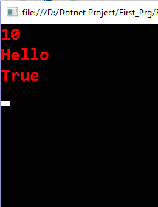
Example – ArrayList Class
using System;
using System.Collections;
namespace First_Prg
{
class MainClass
{
public static void Main(string[] args)
{
ArrayList A1 = new ArrayList();
A1.Add(10);
A1.Add("Hello");
A1.Add(true);
Console.WriteLine(A1[0]);
Console.WriteLine(A1[1]);
Console.WriteLine(A1[2]);
Console.ReadLine();
}
}
}
Output :

Slide 34
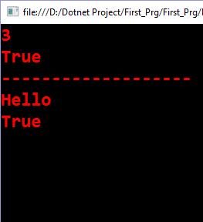
Cont.. – ArrayList Class
using System;
using System.Collections;
namespace First_Prg
{
class MainClass
{
public static void Main(string[] args)
{
ArrayList A1 = new ArrayList();
A1.Add(10);
A1.Add("Hello");
A1.Add(true);
Console.WriteLine(A1.Count);
Console.WriteLine(A1.Contains(10));
Console.WriteLine("-------------------");
Console.WriteLine(A1[1]);
A1.RemoveAt(1);
Console.WriteLine(A1[1]);
Console.ReadLine();
}
}
}
Output :

Slide 35
Stack Class
The stack class represents a last in first out (LIFO) concept.
let's take an example. Imagine a stack of books with each book kept on top of each other.
The concept of last in first out in the case of books means that only the top most book can be removed from the stack of books.
It is not possible to remove a book from between, because then that would disturb the setting of the stack.
Hence in C#, the stack also works in the same way.

Slide 36
Contd..
Elements are added to the stack, one on the top of each other.
The process of adding an element to the stack is called a push operation.
The process of removing an element from the stack is called a pop operation.

Slide 37
Properties & Methods of Stack Class
Properties
Property | Description
Count | Gets the number of elements contained in the Stack.
Methods
Sr. | Description
(1) | public virtual void Push(object obj); Inserts an object at the top of the Stack.
(2) | public virtual object Pop(); Removes and returns the object at the top of the Stack.
(3) | public virtual bool Contains(object obj); Determines whether an element is in the Stack.
(4) | public virtual void Clear(); Removes all elements from the Stack.

Slide 38
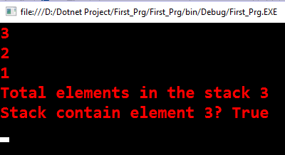
Example – Stack Class (push)
using System;
using System.Collections;
namespace First_Prg
{
class MainClass
{
public static void Main(string[] args)
{
Stack st = new Stack();
st.Push(1);
st.Push(2);
st.Push(3);
foreach (Object obj in st)
{
Console.WriteLine(obj);
}
Console.WriteLine("Total elements in the stack " + st.Count);
Console.WriteLine("Stack contain element 3? " + st.Contains(3));
Console.ReadLine();
}
}
}
Output :

Slide 39
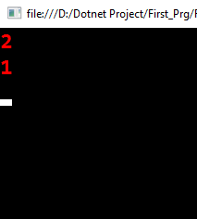
Example – Stack Class (pop)
using System;
using System.Collections;
namespace First_Prg
{
class MainClass
{
public static void Main(string[] args)
{
Stack st = new Stack();
st.Push(1);
st.Push(2);
st.Push(3);
st.Pop();
foreach (Object obj in st)
{
Console.WriteLine(obj);
}
Console.ReadLine();
}
}
}
Output :

Slide 40
Queue Class
The Queue class represents a first in first out (FIFO) concept.
let's take an example. Imagine a queue of people waiting for the bus.
Normally, the first person who enters the queue will be the first person to enter the bus.
Similarly, the last person to enter the queue will be the last person to enter into the bus.
The process of adding an element to the queue is the Enqueue operation.
The process of removing an element from the queue is the Dequeue operation.

Slide 41
Properties & Methods of Queue Class
Properties
Property | Description
Count | Gets the number of elements contained in the Queue.
Methods
Sr. | Description
(1) | public virtual void Enqueue(object obj); Adds an object to the end of the Queue.
(2) | public virtual object Dequeue(); Removes and returns the object at the beginning of the Queue.
(3) | public virtual bool Contains(object obj); Determines whether an element is in the Queue.
(4) | public virtual void Clear(); Removes all elements from the Queue.

Slide 42
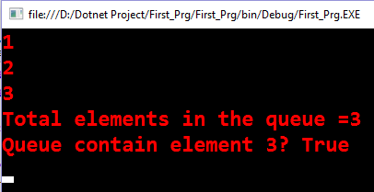
Example – Queue Class (Enqueue)
using System;
using System.Collections;
namespace First_Prg
{
class MainClass
{
public static void Main(string[] args)
{
Queue qt = new Queue();
qt.Enqueue(1);
qt.Enqueue(2);
qt.Enqueue(3);
foreach (Object obj in qt)
{
Console.WriteLine(obj);
}
Console.WriteLine("Total elements in the queue =" + qt.Count);
Console.WriteLine("Queue contain element 3? " + qt.Contains(3));
Console.ReadLine();
}
}
}
Output :

Slide 43
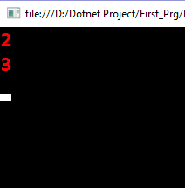
Example – Queue Class (Dequeue)
using System;
using System.Collections;
namespace First_Prg
{
class MainClass
{
public static void Main(string[] args)
{
Queue qt = new Queue();
qt.Enqueue(1);
qt.Enqueue(2);
qt.Enqueue(3);
qt.Dequeue();
foreach (Object obj in qt)
{
Console.WriteLine(obj);
}
Console.ReadLine();
}
}
}
Output :

Slide 44
Hashtable Class
The Hashtable class is similar to the ArrayList class, but it allows you to access the items by a key.
Each item in a Hashtable object has a key/value pair.
So instead of storing just one value like the stack, array list and queue, the Hashtable stores 2 values that is key and value.
The key is used to access the items in a collection and each key must be unique, whereas the value is stored in an array.
The keys are short strings or integers.

Slide 45
Contd..
There is no direct way to display the elements of a Hashtable.
{ "1" , “Darshan" }
{ "2" , “Institute " }
{ "3" , "of Engg. & Technology" }
In order to display the Hashtable , we first need to get the list of keys (1, 2 and 3) from the hash table.
This is done via the ICollection interface.
This is a special data type which can be used to store the keys of a Hashtable collections.

Slide 46
Properties of Hashtable Class
Property | Description
Count | Gets the number of key-and-value pairs contained in the Hashtable.
IsFixedSize | Gets a value indicating whether the Hashtable has a fixed size.
IsReadOnly | Gets a value indicating whether the Hashtable is read-only.
Item | Gets or sets the value associated with the specified key.
Keys | Gets an ICollection containing the keys in the Hashtable.

Slide 47
Methods of Hashtable Class
Sr. | Description
(1) | public virtual void Add(object key, object value); Adds an element with the specified key and value into the Hashtable.
(2) | public virtual void Clear(); Removes all elements from the Hashtable.
(3) | public virtual bool ContainsKey(object key); Determines whether the Hashtable contains a specific key.
(4) | public virtual bool ContainsValue(object value); Determines whether the Hashtable contains a specific value.
(5) | public virtual void Remove(object key); Removes the element with the specified key from the Hashtable.

Slide 48

Example – Hashtable Class
using System;
using System.Collections;
namespace First_Prg
{
class MainClass
{
public static void Main(string[] args)
{
Hashtable ht = new Hashtable();
ht.Add("1","Darshan");
ht.Add("2", "Institute");
ht.Add("3", "of Engg. & Technology");
ICollection keys = ht.Keys;
foreach (String k in keys)
{
Console.WriteLine(ht[k]);
}
Console.ReadLine();
}
}
}
Output :

Slide 49
SortedList Class
The SortedList class is a combination of the array and hashtable classes.
It contains a list of items that can be accessed by using index or a key.
When you access items using indexes, the SortedList objects acts as an ArrayList object, whereas when you access items using keys, it acts as a Hashtable object.
The striking feature about the SortedList class is the collection of items are always sorted by the key value.

Slide 50
BitArray Class
The BitArray class is used to manage an array of the binary representation using the value 1 and 0, where 1 stands for true and 0 stands for false.
A BitArray object is resizable, which is helpful in case if you do not know the number of bits in advance.
You can access items from the BitArray collection class by using an integer index.
A BitArray can be used to perform Logical AND, XOR, OR operations.

Slide 51
Debugging and Error Handling
Exception is a runtime error that arises because of some abnormal conditions, such as division of a number by zero and passing a string to a variable that holds an integer value.
Capturing and handling of runtime error is one of the important and crucial tasks for any programmer.
Compile time errors are those errors that occur during the compilation of a program.
It can happen due to bad coding or incorrect syntax.
We can correct these compile time errors after looking at the error message that the compiler generates.

Slide 52
Debugging and Error Handling Cont..
On the other hand, runtime errors are those errors that occur during the execution of a program, and thus, they cannot be corrected at that time.
So necessary actions need to be taken beforehand to prevent such types of errors.
To do so, you should first identify the following two aspects.
Find out those parts of a program which can cause runtime errors
How to handle those errors when they occur

Slide 53
Exception Classes
Class | Description
SystemException | Represents a base class for other exception classes
DivideByZeroException | Occurs if you try to divide a number by zero
IndexOutOfRangeException | Occurs if the index of an array is out of bound
FormatException | Occurs if there is an incorrect format of argument
OutOfMemoryException | Occurs if an execution stops due to lake of memory
StackOverflowException | Occurs if a stack overflows

Slide 54
Exception Handling
Exceptions can be handled by using the following two statements.
The try…catch…finally statement
The throw statement
try block
Code throws an exception
Yes
catch block
No
All Errors
finally block
Processed
Notes:
Picture Credit :https://www.google.co.in/search?q=try+catch+finally+c%23&espv=2&biw=1366&bih=662&source=lnms&tbm=isch&sa=X&sqi=2&ved=0ahUKEwjxvvCMqdzRAhULQo8KHeJmBqQQ_AUIBygC#imgrc=nPgVZyOKsi8ZOM%3A

Slide 55
Exception Handling Cont..
try:
The try block encloses the statements that might throw an exception.
catch:
The catch block handles the exceptions thrown by the try block.
In a program, a try block can contain one or multiple catch blocks.
finally:
It is an optional block and is always executed.
If no exception occurs inside the try block, the program control is transferred directly to the finally block.

Slide 56
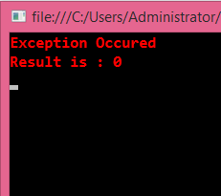
Example – Exception Handling
using System;
namespace Files
{
class Program
{
static void Main(string[] args)
{
int number = 0;
int div = 0;
try
{
div = 100 / number;
}
catch (DivideByZeroException)
{
Console.WriteLine("Exception Occured");
}
Console.WriteLine("Result is : " + div);
Console.ReadLine();
}
}
}
Output :

Slide 57
The throw Statement
The throw statement is used to raise an exception in case an error occurs in a program.
It is also possible to throw an exception programmatically.
try
{
throw new DivideByZeroException();
}
catch (DivideByZeroException e)
{
Console.WriteLine("Exception :" + e);
}
Notes:
Picture Credit :https://www.google.co.in/search?q=try+catch+finally+c%23&espv=2&biw=1366&bih=662&source=lnms&tbm=isch&sa=X&sqi=2&ved=0ahUKEwjxvvCMqdzRAhULQo8KHeJmBqQQ_AUIBygC#imgrc=nPgVZyOKsi8ZOM%3A

Slide 58
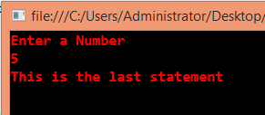
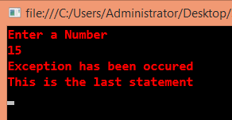
Example – throw
using System;
namespace Exp
{
class Program
{
static void Main(string[] args)
{
int number;
Console.WriteLine("Enter a Number");
number = int.Parse(Console.ReadLine());
try
{
if (number > 10)
{
throw new Exception("Maximum Limit is 10");
}
}
catch (Exception e)
{
Console.WriteLine("Exception has been occured");
}
finally
{
Console.WriteLine("This is the last statement");
Console.ReadLine();
}
}
}
}
Output :

Slide 59
String
In C#, string is another kind of data type that represents Unicode Characters.
It is the alias of System.String however, you can also write System.String instead of string.
Technically there is no difference between them and you can use any of them.
String is a class name whereas string is a reserved keyword. You should always use string instead of String.
It is the sequence of character in which each character is a Unicode character.
Notes:
Picture Credit :https://www.google.co.in/search?q=try+catch+finally+c%23&espv=2&biw=1366&bih=662&source=lnms&tbm=isch&sa=X&sqi=2&ved=0ahUKEwjxvvCMqdzRAhULQo8KHeJmBqQQ_AUIBygC#imgrc=nPgVZyOKsi8ZOM%3A

Slide 60
String Manipulation Functions
Functions | Description
Clone() | // Make String Clone Console.WriteLine(str1.Clone());
CompareTo() | //Compare two string value and returns 0 for true and 1 for false Console.WriteLine(str1.CompareTo(lastname));
Contains() | //Check whether specified value exists or not in string Console.WriteLine(str1.Contains("ven"));
EndsWith() | //Check whether specified value is the last character of string Console.WriteLine(str1.EndsWith("n"));
Equals() | //Compare two string and returns true and false Console.WriteLine(str1.Equals(lastname));
IndexOf() | //Returns the first index position of specified value the first index position of specified value Console.WriteLine(str1.IndexOf("e"));

Slide 61
String Manipulation Functions Cont..
Functions | Description
ToLower() | //Covert string into lower case Console.WriteLine(str1.ToLower());
ToUpper() | //Convert string into Upper case Console.WriteLine(str1.ToUpper());
Insert() | //Insert substring into string Console.WriteLine(str1.Insert(0, "Hello"));
LastIndexOf() | //Returns the last index position of specified value Console.WriteLine(str1.LastIndexOf("e"));
Length | //Returns the Length of String Console.WriteLine(str1.Length);
Remove() | //Deletes all the characters from begining to specified index. Console.WriteLine(str1.Remove(5));
Replace() | // Replace the character Console.WriteLine(str1.Replace('e', 'i'));

Slide 62
String Manipulation Functions Cont..
Functions | Description
StartsWith() | //Check wheater first character of string is same as specified value Console.WriteLine(str1.StartsWith("S"));
Substring() | //Returns substring Console.WriteLine(str1.Substring(2, 5));
Trim() | //It removes starting and ending white spaces from string. Console.WriteLine(str1.Trim());

Slide 63
Files and I/O
A file is a collection of data stored on a disk with specific name, extension and directory path. When you open File using C# for reading and writing purpose it becomes stream.
A stream is a sequence of bytes travelling from a source to a destination over a communication path.
There are two main streams: the input stream and the output stream.
The input stream is used for reading data from file (read operation) and the output stream is used for writing into the file (write operation).
The System.IO namespace has various classes that are used for performing numerous operations with files, such as creating and deleting files, reading from or writing to a file, closing a file etc.
Notes:
Picture Credit :https://www.google.co.in/search?q=try+catch+finally+c%23&espv=2&biw=1366&bih=662&source=lnms&tbm=isch&sa=X&sqi=2&ved=0ahUKEwjxvvCMqdzRAhULQo8KHeJmBqQQ_AUIBygC#imgrc=nPgVZyOKsi8ZOM%3A

Slide 64
I/O Classes
I/O Class | Description
BinaryReader | Reads primitive data from a binary stream.
BinaryWriter | Writes primitive data in binary format.
BufferedStream | A temporary storage for a stream of bytes.
Directory | Helps in manipulating a directory structure.
DirectoryInfo | Used for performing operations on directories.
DriveInfo | Provides information for the drives.
File | Helps in manipulating files.
FileInfo | Used for performing operations on files.
FileStream | Used to read from and write to any location in a file.
MemoryStream | Used for random access to streamed data stored in memory.
Path | Performs operations on path information.

Slide 65
I/O Classes Cont..
I/O Class | Description
StreamReader | Used for reading characters from a byte stream.
StreamWriter | Is used for writing characters to a stream.
StringReader | Is used for reading from a string buffer.
StringWriter | Is used for writing into a string buffer.

Slide 66
File Stream Class
The FileStream class in the System.IO namespace helps in reading from, writing to and closing files.
You need to create a FileStream object to create a new file or open an existing file.
The syntax for creating a FileStream object is as follows.
FileStream <object_name> = new FileStream( <file_name>, <FileMode Enumerator>, <FileAccess Enumerator>, <FileShare Enumerator>);
Example
FileStream Fs = new FileStream("Sample.txt", FileMode.Open, FileAccess.ReadWrite, FileShare.Read);
Notes:
Picture Credit :https://www.google.co.in/search?q=try+catch+finally+c%23&espv=2&biw=1366&bih=662&source=lnms&tbm=isch&sa=X&sqi=2&ved=0ahUKEwjxvvCMqdzRAhULQo8KHeJmBqQQ_AUIBygC#imgrc=nPgVZyOKsi8ZOM%3A

Slide 67
Parameters of File Stream Class
FileMode – It defines various methods for opening files. The members of the FileMode enumerator are..
Append – Open the file if exist or create a new file. If file exists then place cursor at the end of the file.
Create – It specifies operating system to create a new file. If file already exists then previous file will be overwritten.
CreateNew – It create a new file and If file already exists then throw IOException.
Open – Open existing file.
Open or Create – Open existing file and if file not found then create new file.
Truncate – Open an existing file and cut all the stored data. So the file size becomes 0.
Notes:
Picture Credit :https://www.google.co.in/search?q=try+catch+finally+c%23&espv=2&biw=1366&bih=662&source=lnms&tbm=isch&sa=X&sqi=2&ved=0ahUKEwjxvvCMqdzRAhULQo8KHeJmBqQQ_AUIBygC#imgrc=nPgVZyOKsi8ZOM%3A

Slide 68
Parameters of File Stream Class Cont..
FileAccess
FileAccess enumerators have members: Read, ReadWrite and Write
FileShare – It opens file with following share permission.
Inheritable – It passes inheritance to child process.
None – It declines sharing of the current files.
Read– It allows subsequent opening of the file for reading.
ReadWrite – It allows subsequent opening of the file for reading or writing.
Write – Allows subsequent opening of the file for writing.
Notes:
Picture Credit :https://www.google.co.in/search?q=try+catch+finally+c%23&espv=2&biw=1366&bih=662&source=lnms&tbm=isch&sa=X&sqi=2&ved=0ahUKEwjxvvCMqdzRAhULQo8KHeJmBqQQ_AUIBygC#imgrc=nPgVZyOKsi8ZOM%3A

Slide 69
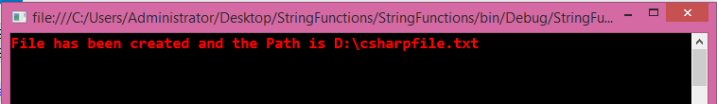
Example - FileStream Class
using System;
using System.IO;
namespace Files
{
class Program
{
static void Main(string[] args)
{
FileStream fs = new FileStream("D:\\csharpfile.txt", FileMode.Create);
fs.Close();
Console.Write("File has been created and the Path is D:\\csharpfile.txt");
Console.ReadKey();
}
}
}

Slide 70
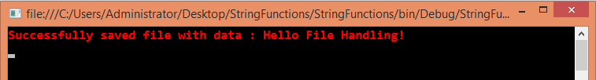
Open & Write Some Text In File
using System;
using System.IO;
using System.Text;
namespace Files
{
class Program
{
static void Main(string[] args)
{
FileStream fs = new FileStream("D:\\csharpfile.txt", FileMode.Append);
byte[] bdata = Encoding.Default.GetBytes("Hello File Handling!");
fs.Write(bdata, 0, bdata.Length);
fs.Close();
Console.WriteLine("Successfully saved file with data : Hello File Handling!");
Console.ReadKey();
}
}
}

Slide 71
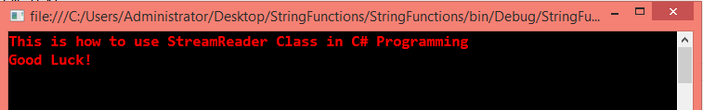
Write & Read from Text File
using System;
using System.IO;
using System.Text;
namespace Files
{
class Program
{
static void Main(string[] args)
{
string file = @"D:\csharpfile.txt";
//Writer data to text file
using (StreamWriter writer = new StreamWriter(file))
{
writer.WriteLine("This is how to use StreamReader Class in C# Programming");
writer.WriteLine("Good Luck!");
}
//Reading text file using StreamReader Class
using (StreamReader reader = new StreamReader(file))
{
Console.WriteLine(reader.ReadToEnd());
}
Console.ReadKey();
}
}
}

Slide 72
Thank you

