Slide 1

UNIT-5 Windows Forms and Controls in details
DOT NET TECHNOLOGY
2160711
Prof. Naimish R. Vadodariya
naimish.vadodariya@darshan.ac.in
+91-8866215253
Computer Engineering Darshan Institute of Engineering & Technology

Slide 2
Outline
Introduction to Windows Forms
How to Create Windows Forms?
Windows Forms Properties & Events
Windows Forms Controls
Menus
Dialogs
Tooltip

Slide 3
Introduction to Windows Forms
Windows Forms provides a graphical user interface (GUI) for building windows client applications.
This GUI represents a part of Microsoft.NET Framework.
You can create Windows Forms Applications in any language that is supported by CLR.
Prior to Windows Forms, Programmers had to perform the difficult and inconvenient task of manually writing thousands of lines of code for designing an application.
Windows Forms provides an easy and ideal way for creating applications.

Slide 4
Windows Forms Cont..
It acts as container that allow you to add different types of controls, such as Button, Label and so many others.
You can also use the Windows Forms for creating message boxes and dialog boxes, displaying messages, and accepting user data.
It allows you to design multiple forms to perform various tasks by using different controls with their properties and methods.
Namespace : System.Windows.Forms.
Examples of a Windows Forms Applications
Notepad
Calculator

Slide 5
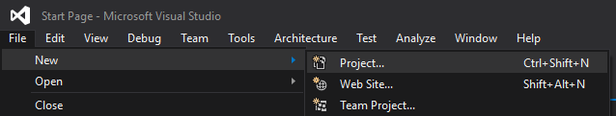
How to Create Windows Forms ?
Step : 1
Open Visual Studio, Go to File menu →New→Project.
After Clicking on Project, new project window will appear.

Slide 6
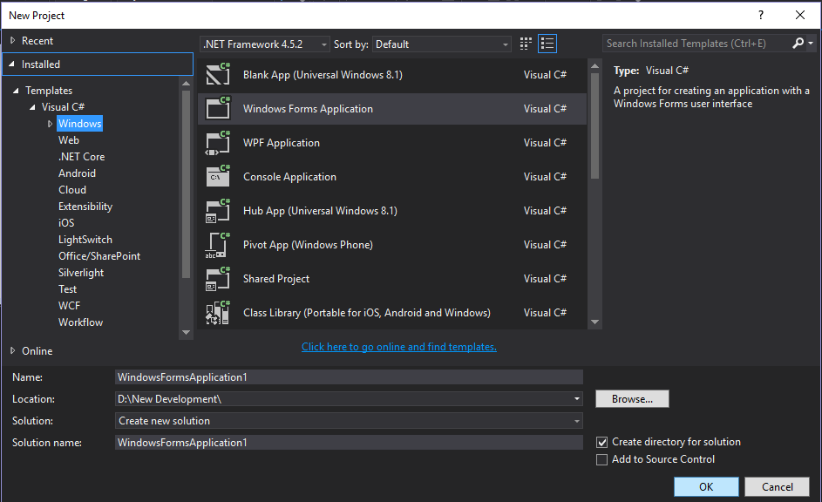
Create Windows Forms Cont..
Select Language, Project Type, Set Location & Give Project Name.
2.2
2.1
2.3
2.4
2.5

Slide 7
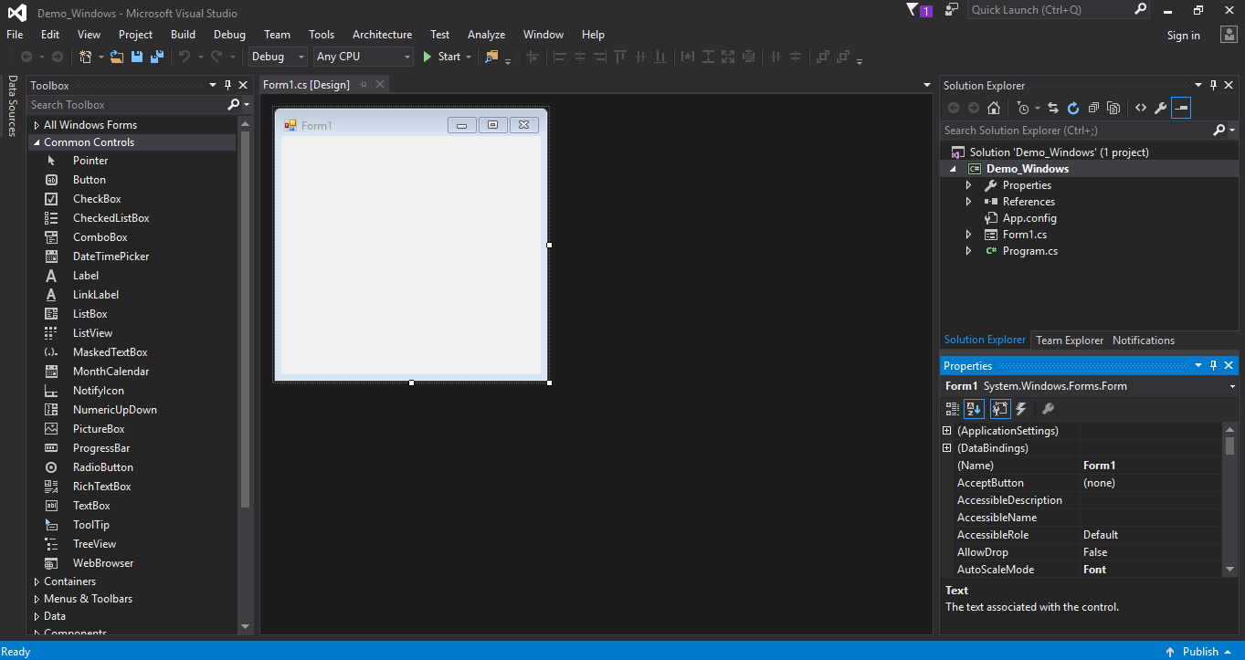
Create Windows Forms Cont..
1
5

Slide 8
Windows Forms Properties
Property | Description
Name | This is the actual name of the form.
Text | The text, which will appear at the title bar of the form.
Width | This is the width of the form in pixel.
Height | This is the height of the form in pixel.
Font | This property specify font type, style, size.
BackColor | Sets the form background color.
AcceptButton | The button that's automatically activated when you press Enter, no matter which control has the focus at the time. Usually the OK button on a form is set as AcceptButton for a form.
CancelButton | The button that's automatically activated when you hit the Esc key.
WindowState | Form remains in default size as you show in design, but you can change its state by minimized, maximized & normal.
StartPosition | This property enables you to set the starting position of the form when it is displayed at run time.

Slide 9
Windows Forms Events
Events | Description
Activated | Occurs when the form is activated in code or by the user.
Click | Occurs when the form is clicked.
Closed | Occurs before the form is closed.
Closing | Occurs when the form is closing.
Load | Occurs before a form is displayed for the first time.
MouseHover | Occurs when the mouse pointer rests on the form.
DoubleClick | Occurs when the form control is double-clicked.
KeyDown | Occurs when a key is pressed while the form has focus.
Shown | Occurs whenever the form is first displayed.

Slide 10
Windows Forms Basic Controls
A Windows forms application runs on the desktop computer.
Normally, GUI is a combination of controls which can used by user.
Some of the controls are :
Basic Controls
Label
TextBox
Button
RadioButton
CheckBox
PictureBox
List Controls
ListBox
ComboBox
CheckedListBox
Data Controls
DataGridView

Slide 11
Common Properties of Controls
Property | Description
Name | The name of the control. This name can be used to reference the control in code.
Text | Gets or sets the text associated with control.
Visible | Specifies whether or not the control is visible at runtime.
Width | The width of the control in pixel.
Height | The Height of the control in pixel.
BackColor | The background color of a control.
ForeColor | The foreground color of the control.
Font | Gets or sets the font of the text displayed by the control.

Slide 12
Common Events of Controls
Event | Description
Click | Occurs when a control is clicked. In some cases, this event will also occur when a user presses Enter.
DoubleClick | Occurs when a control is double-clicked. Handling the Click event on some controls, such as the Button control will mean that the DoubleClick event can never be called.
DragDrop | Occurs when a drag-and-drop operation is completed, in other words, when an object has been dragged over the control, and the user releases the mouse button.
KeyDown | Occurs when a key becomes pressed while the control has focus. This event always occurs before KeyPress and KeyUp.
KeyPress | Occurs when a key becomes pressed, while a control has focus. This event always occurs after KeyDown and before KeyUp.
GotFocus | Occurs when a control receives focus. Do not use this event to perform validation of controls. Use Validating and Validated instead.
LostFocus | Occurs when a control looses focus. Do not use this event to perform validation of controls. Use Validating and Validated instead.

Slide 13
Label Control
Label Control is generally used to display the text that is not supposed to be changed by user.
It is used as instruction to user that which control is used for what purpose.
Namespace : System.Windows.Forms.Label

Slide 14
Properties of Label Control
Property | Description
TextAlign | Gets or sets how text is aligned in a Label control.
Visible | Gets or sets a value indicating whether the control and all its child controls are displayed.
Autosize | Gets or sets a value specifying if the label control should be automatically resized to display all its contents.

Slide 15
Methods of Label Control
Method | Description
Focus() | Sets input focus to the control.
ResetText() | Resets the Text property to its default value.
ResetFont() | Resets the Font property to its default value.
ResetForeColor() | Resets the ForeColor property to its default value.
Show() | Displays the control to the user.

Slide 16
Events of Label Control
Event | Description
TextChanged | Occurs when the Text property value changes.
Click | Occurs when user clicks the label.
Leave | Occurs when the input focus leaves the label.
LostFocus | Occurs when the control loses focus.

Slide 17
TextBox Control
The TextBox control is a windows forms control that lets users enter text on a windows form at runtime.
By default, a TextBox control accepts only a single line of text.
Namespace : System.Windows.Forms.TextBox

Slide 18
Properties of TextBox Control
Property | Description
TextLength | Gets the length of text in the TextBox control.
PasswordChar | Gets or sets the character used to mask characters of a password in a single-line TextBox control.
Multiline | Gets or sets a value indicating whether this is a multiline TextBox control.
ReadOnly | Gets or sets a value indicating whether text in the text box is read-only.
WordWrap | Indicates whether a multiline text box control automatically wraps words to the beginning of the next line when necessary.

Slide 19
Methods of TextBox Control
Method | Description
Clear() | Clears all text from the text box control.
Copy() | Copies the current selection in the text box to the Clipboard.
Cut() | Moves the current selection in the text box to the Clipboard.
DeselectAll() | Specifies that the value of the SelectionLength property is zero so that no characters are selected in the control.
SelectAll() | Selects all text in the text box.
Focus() | Sets input focus to the control.
ResetText() | Resets the Text property to its default value.

Slide 20
Events of TextBox Control
Event | Description
TextChanged | Occurs when the text in the textbox changes.
TextAlignChanged | Occurs when the TextAlign property value changes.

Slide 21
Button Control
A Button Control accepts clicks.
In Windows Forms we use a Button control, that accepts click and performs other actions on the user interface.
Example
When you press a close button, the form will be close.
Namespace : System.Windows.Forms.Button

Slide 22
Properties of Button Control
Property | Description
BackColor | Gets or sets the background color of the button control.
Image | Gets or sets the image that is displayed on a button control.
FlatStyle | Gets or sets the flat style appearance of the button control.

Slide 23
Methods of Button Control
Method | Description
Focus() | Sets input focus to the control.
ResetBackColor() | Resets the BackColor property to its default value.
ResetFont() | Resets the Font property to its default value.
ResetText() | Resets the Text property to its default value.
Select() | Activates the control.
Show() | Displays the control to the user.

Slide 24
Events of Button Control
Event | Description
Click | Occurs when user clicks the Button.
Validated | Occurs when the button control is finished validating.
GotFocus | Occurs when the button control receives focus.
TextChanged | Occurs when the Text property value changes.
FontChange | Occurs when font is changed.

Slide 25
RadioButton Control
RadioButton Control enables the user to select a single option from a group of choices when paired with other RadioButton controls.
When a user clicks on a radio button, it becomes checked, and all other radio buttons with same group become unchecked.
The RadioButton control can display text, an Image, or both.
Namespace : System.Windows.Forms.RadioButton

Slide 26
Properties of RadioButton Control
Property | Description
Checked | Gets or sets a value indicating whether the radio button is checked.
CheckAlign | Gets or sets the location of the check box portion of the radio button control.
Image | Gets or sets the image that is displayed on a radio button control.
Font | Gets or sets the font of the text displayed by radio button control.

Slide 27
Methods of RadioButton Control
Method | Description
Focus() | Sets input focus to the control.
ResetBackColor() | Resets the BackColor property to its default value.
ResetFont() | Resets the Font property to its default value.
ResetText() | Resets the Text property to its default value.
Select() | Activates the control.
Show() | Displays the control to the user.

Slide 28
Events of RadioButton Control
Event | Description
CheckedChanged | Occurs when the value of the checked property of the radio button control is changed.
AppearanceChanged | Occurs when the value of the Appearance property of the radio Button control is changed.

Slide 29

CheckBox Control
A CheckBox control allows users to select a single or multiple options from a list of options.
CheckBox Control accepts either True or False as a value.
Namespace : System.Windows.Forms.CheckBox

Slide 30
Properties of CheckBox Control
Property | Description
CheckAlign | Gets or sets the location of the check box portion of the checkbox.
CheckState | Gets or sets the state of the checkbox.
BackColor | Gets or sets the background color of the checkbox control.
Image | Gets or sets the image that is displayed on a checkbox control.
Font | Gets or sets the font of the text displayed by checkbox control.

Slide 31
Methods of CheckBox Control
Method | Description
Focus() | Sets input focus to the control.
ResetBackColor() | Resets the BackColor property to its default value.
ResetFont() | Resets the Font property to its default value.
ResetText() | Resets the Text property to its default value.
Select() | Activates the control.
Show() | Displays the control to the user.

Slide 32
Events of CheckBox Control
Event | Description
CheckedChanged | Occurs when the value of the Checked property of the CheckBox control is changed.
CheckStateChanged | Occurs when the value of the CheckState property of the CheckBox control is changed.
AppearanceChanged | Occurs when the value of the Appearance property of the CheckBox is changed.

Slide 33

PictureBox Control
The Windows Forms PictureBox Control is used to display images in bitmap, GIF, Icon or JPEG formats.
You can set the Image property to the image you want to display either at design time or at run time.
Namespace : System.Windows.Forms.PictureBox

Slide 34
Properties of PictureBox Control
Property | Description
Image | Gets or sets the image that is displayed by PictureBox.
ImageLocation | Gets or sets the path or URL for the image to display in the PictureBox.
BorderStyle | Indicates the border style for the control.
DefaultSize | Gets the default size of the control.
Padding | Gets or sets padding within the control.

Slide 35
Methods of PictureBox Control
Method | Description
Focus() | Sets input focus to the control.
Load() | Displays the image specified by the ImageLocation property of the PictureBox.
ResetFont() | Resets the Font property to its default value.
ResetText() | Resets the Text property to its default value.
Select() | Activates the control.
Show() | Displays the control to the user.

Slide 36
Events of PictureBox Control
Event | Description
Click | Occurs when the control is clicked.
Resize | Occurs when the control is resized.
SizeChanged | Occurs when the Size property value changes.

Slide 37

ListBox Control
A ListBox control provides a user interface to display a list of items.
Users can select one or more items from the list.
If the items exceed a specified limit, a scroll bar automatically appears to let the user to scroll through the list.
Namespace : System.Windows.Forms.ListBox

Slide 38
Properties of ListBox Control
Property | Description
Items | Gets the items of the ListBox.
SelectedItem | Gets or sets the currently selected item in the ListBox.
SelectedIndex | Gets or sets the zero-based index of the currently selected item in a ListBox.
SelectionMode | Indicates if the list box is to be single-select, multi-select, or non-selectable.

Slide 39
Methods of ListBox Control
Method | Description
ClearSelected() | Unselects all items in the ListBox.
Sort() | Sorts the items in the ListBox.
ResetBackColor() | Resets the BackColor property to its default value.
ResetFont() | Resets the Font property to its default value.
ResetText() | Resets the Text property to its default value.
Select() | Activates the control.
Show() | Displays the control to the user.

Slide 40
Events of ListBox Control
Event | Description
SelectedIndexChanged | Occurs when the SelectedIndex property has changed.
SizeChanged | Occurs when the Size property value changes.

Slide 41
Example - ListBox
private void ListBox_Load(object sender, EventArgs e)
{
// Add Items in ListBox
lstState.Items.Add("Gujarat");
lstState.Items.Add("Maharastra");
lstState.Items.Add("Punjab");
lstState.Items.Add("Delhi");
//Sets currently selected item in the ListBox
lstState.SelectedItem = "Gujarat";
//Sets currently selected Index in the ComboBox
lstState.SelectedIndex = 1;
//Removes Item From List with value "Delhi"
lstState.Items.Remove("Delhi");
//Removes Item From List at Index 2 (Index start from 0)
lstState.Items.RemoveAt(2);
//Accessing All ListBox Items
string value = "";
for (int i = 0; i < lstState.Items.Count; i++)
{
value += lstState.GetItemText(lstState.Items[i]) + "\n";
}
MessageBox.Show(value);
}

Slide 42
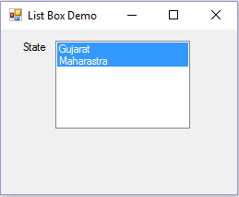
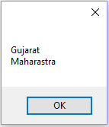
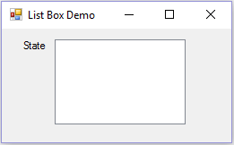
Example – ListBox
lstState.SelectedItem = null;
//Clears All Items From ListBox
lstState.Items.Clear();

Slide 43
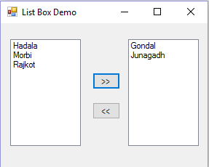
Example – ListBox

Slide 44
Example - ListBox
public partial class ListBox_Demo : Form
{
public ListBox_Demo()
{
InitializeComponent();
lstLeft.Sorted = true;
}
private void btnleft_Click(object sender, EventArgs e)
{
if (lstLeft.SelectedIndex != -1)
{
lstRight.Items.Add(lstLeft.SelectedItem);
lstLeft.Items.Remove(lstLeft.SelectedItem);
}
}
private void btnRight_Click(object sender, EventArgs e)
{
if (lstRight.SelectedIndex != -1)
{
lstLeft.Items.Add(lstRight.SelectedItem);
lstRight.Items.Remove(lstRight.SelectedItem);
}
}
}

Slide 45

ComboBox Control
A ComboBox control is a combination of a TextBox and a ListBox control.
Only one list item is displayed at one time in a ComboBox and other available items are loaded in a ComboBox list.
Namespace : System.Windows.Forms.ComboBox

Slide 46
Properties of ComboBox Control
Property | Description
Items | Gets the items of the ComboBox.
DisplayMember | Gets or sets the property to display for this ListControl.
Enabled | Gets or sets a value indicating whether the control can respond to user interaction.

Slide 47
Methods of ComboBox Control
Method | Description
ClearSelected() | Unselects all items in the ComboBox.
Sort() | Sorts the items in the ComboBox.
ResetBackColor() | Resets the BackColor property to its default value.
ResetFont() | Resets the Font property to its default value.
ResetText() | Resets the Text property to its default value.
Select() | Activates the control.
Show() | Displays the control to the user.

Slide 48
Events of ComboBox Control
Event | Description
SelectedIndexChanged | Occurs when the SelectedIndex property has changed.
SizeChanged | Occurs when the Size property value changes.
GotFocus | Occurs when the control receives focus.

Slide 49
Example - ComboBox
private void Combo_Box_Load(object sender, EventArgs e)
{
// Add Items in ComboBox
cmbState.Items.Add("Gujarat");
cmbState.Items.Add("Maharastra");
cmbState.Items.Add("Punjab");
cmbState.Items.Add("Delhi");
//Sets currently selected Item in the ComboBox
cmbState.SelectedItem = "Gujarat";
//Sets currently selected Index in the ComboBox
cmbState.SelectedIndex = 0;
//Removes Item From List with value "Delhi"
cmbState.Items.Remove("Delhi");
//Removes Item From List at Index 2 (Index start from 0)
cmbState.Items.RemoveAt(2);
//Accessing All ComboBox Items
for (int i = 0; i < cmbState.Items.Count; i++)
{
string value = cmbState.GetItemText(cmbState.Items[i]);
MessageBox.Show(value);
}
}

Slide 50
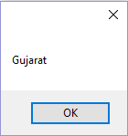
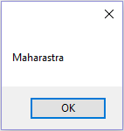
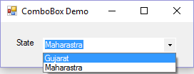

Output - ComboBox
cmbState.SelectedItem = null;
//Clears All Items From ComboBox
cmbState.Items.Clear();

Slide 51
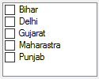
CheckedListBox Control
The Windows Forms CheckedListBox control displays a list of items, like the ListBox control, and also can display a check mark next to items in the list.
Users can select one or more items from the list.
Namespace : System.Windows.Forms.CheckedListBox

Slide 52
Properties of CheckedListBox Control
Property | Description
CheckedItems | Collection of checked items in this CheckedListBox.
CheckedIndices | Collection of checked indexes in CheckedListBox.
CheckOnClick | Gets or sets a value indicating whether the check box should be toggled when an item is selected.
Items | Gets the collection of items in this CheckedListBox.
Sorted | Gets or sets a value indicating whether the items in the CheckedListBox are sorted alphabetically.

Slide 53
Methods of CheckedListBox Control
Method | Description
ClearSelected() | Unselects all items in the CheckedListBox.
Sort() | Sorts the items in the CheckedListBox.
ResetBackColor() | Resets the BackColor property to its default value.
ResetFont() | Resets the Font property to its default value.
ResetText() | Resets the Text property to its default value.
Select() | Activates the control.
Show() | Displays the control to the user.

Slide 54
Events of CheckedListBox Control
Event | Description
Click | Occurs when the user clicks the CheckedListBox control.
ItemCheck | Occurs when the checked state of an item changes.
SelectedIndexChanged | Occurs when the SelectedIndex property or the SelectedIndices collection has changed.
SelectedValueChanged | Occurs when the SelectedValue property changes.

Slide 55
Example - CheckedListBox
private void Form1_Load(object sender, EventArgs e)
{
chklstBox.Items.Add("Gujarat");
chklstBox.Items.Add("Maharastra");
chklstBox.Items.Add("Punjab");
chklstBox.Items.Add("Delhi");
chklstBox.Items.Add("Bihar");
}
private void btnDisplay_Click(object sender, EventArgs e)
{
//With Items
foreach (string s in chklstBox.CheckedItems)
{
lstBox.Items.Add(s);
}
// With Indexes
for (int i = 0; i < chklstBox.CheckedIndices.Count; i++)
{
lstBox.Items.Add(chklstBox.CheckedIndices[i]);
}
}

Slide 56
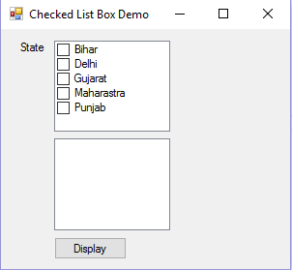
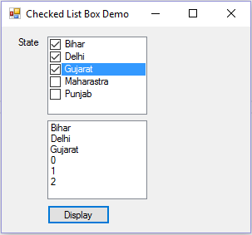
Output - CheckedListBox
Values
Indexes

Slide 57
DataGridView Control
Displaying data in tabular format like rows and columns with the help of DataGridView Control.
The DataGridView Control is designed to displaying tabular data in windows forms.
It makes easy to define the basic appearance of cells and the display formatting of cell values.
All cells derive from the DataGridViewCell base class.

Slide 58
Properties of DataGridView Control
Property | Description
CellBorderStyle | Gets the cell border style for the DataGridView.
ColumnCount | Gets or sets the number of columns displayed in the DataGridView.
Columns | Gets a collection that contains all the columns in the control.
CurrentRow | Gets the row containing the current cell.

Slide 59
Methods of DataGridView Control
Method | Description
AutoResizeRows() | Adjusts the heights of all rows to fit the contents of all their cells, including the header cells.
Refresh() | Forces the control to invalidate its client area and immediately redraw itself and any child controls.
ResetBackColor() | Resets the BackColor property to its default value.
ResetFont() | Resets the Font property to its default value.
ResetText() | Resets the Text property to its default value.
Select() | Activates the control.
Show() | Displays the control to the user.

Slide 60
Events of DataGridView Control
Event | Description
CellClick | Occurs when any part of a cell is clicked.
CellLeave | Occurs when a cell loses input focus and is no longer the current cell.
Click | Occurs when the control is clicked.
DataError | Occurs when an external data-parsing or validation operation throws an exception, or when an attempt to commit data to a data source fails.

Slide 61
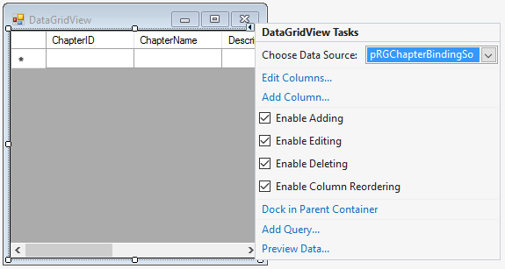
Example - DataGridView Control

Slide 62
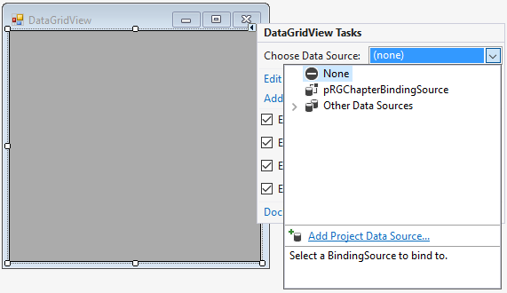
Bind DataGridView Control

Slide 63
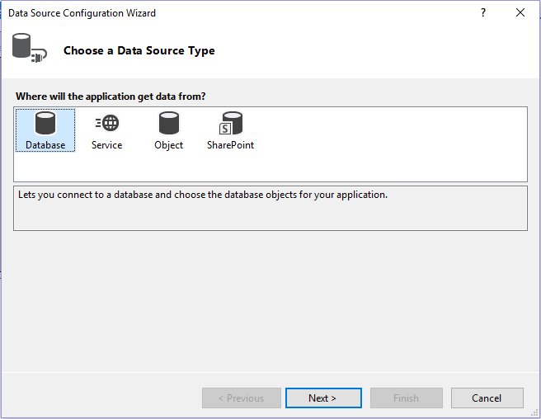
Bind DataGridView Control Cont..

Slide 64
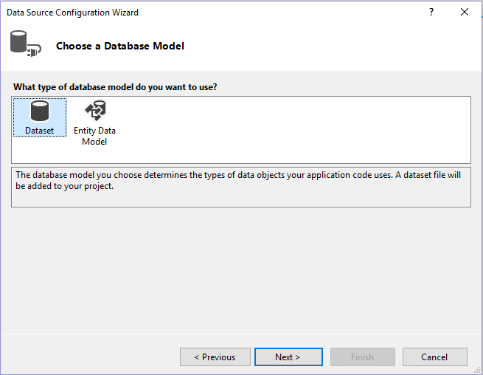
Bind DataGridView Control Cont..

Slide 65
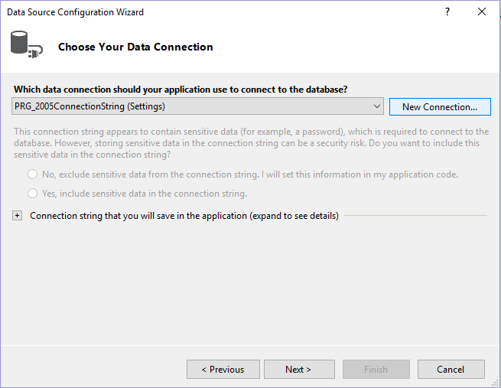
Bind DataGridView Control Cont..

Slide 66
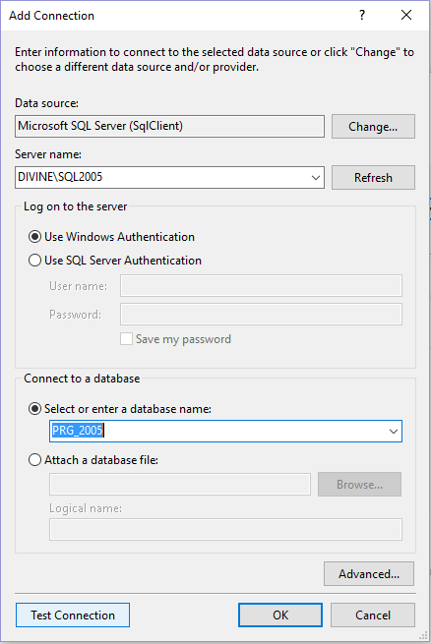
Bind DataGridView Control Cont..

Slide 67
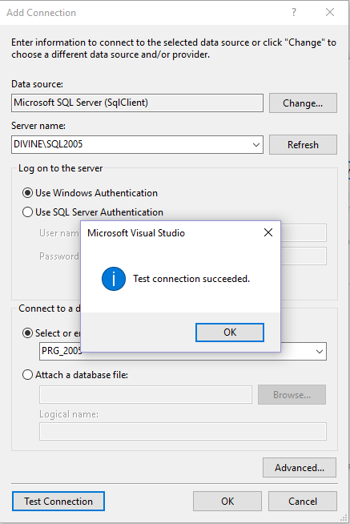
Bind DataGridView Control Cont..

Slide 68
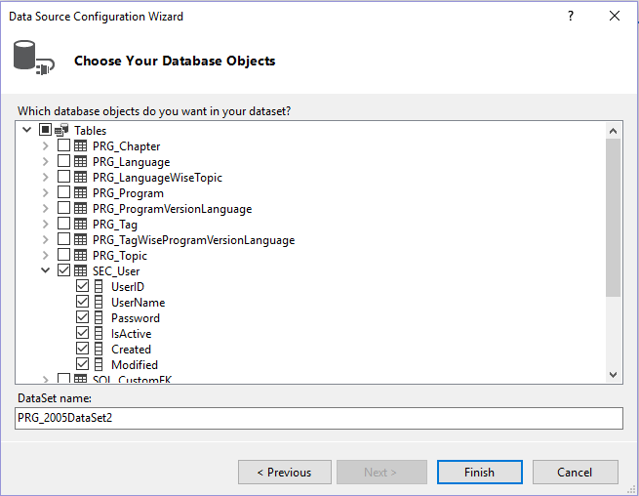
Bind DataGridView Control Cont..

Slide 69
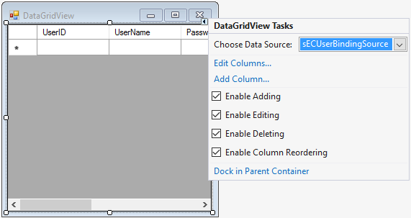
Bind DataGridView Control Cont..

Slide 70
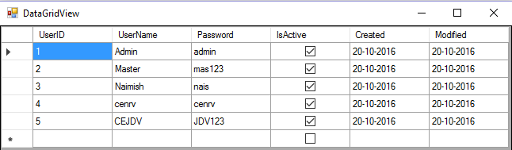
Output

Slide 71
Menus
Menus are controls that allows a user to make selections.
They also hide the selections that are not needed, thereby saving space in windows applications.
Menus act like containers for the ToolStripMenuItem objects and are used to display menu and menu items in a menu bar.
Any item that resides on a menu is known as a menu item and represents an individual part of a menu.
Namespace : System.Windows.Forms.MenuStrip.

Slide 72
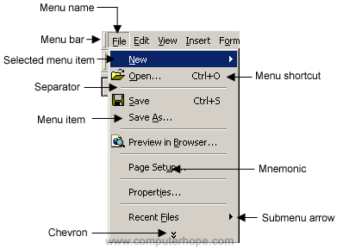
Menus Cont..
There are main two classes in the standard menu handling.
MenuStrip : Acts as a container for the menu structure of a form.
ToolStripMenuItem : Supports the items in a menu system (Including the menus such as File & Edit)

Slide 73
ToolStripMenuItem Class
The ToolStripMenuItem class supports the menus and menu items in a menu system.
These menu items are objects that can handle through Click events in a menu system.
It has the properties that permits you to configure the functionality and appearance of a menu item like add shortcut keys, font, back color etc.
Namespace : System.Windows.Forms.ToolStripMenuItem.

Slide 74
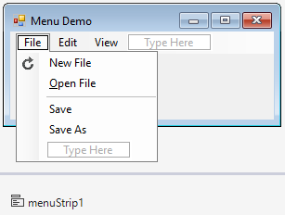
Example – Adding Menu Items
Drag and drop a MenuStrip control, named menuStrip1, from the toolbox to the form.
Click the Type Here text to open a text box and enter ‘File’ text in it. Now you can add some more items to the File menu.
You can make the menu items perform some actions by creating event handlers for handling their Click event in the code editor.

Slide 75
ContextMenuStrip Control
Context menus are shortcut menus that appear when a user right-click on the screen.
Usually, context menus are used to display control-specific options, such as Cut, Copy, Paste in text boxes.
You can use the ContextMenuStrip control to create a context menu and provide users to access frequently used menu commands.
Namespace : System.Windows.Forms.ContextMenuStrip.

Slide 76
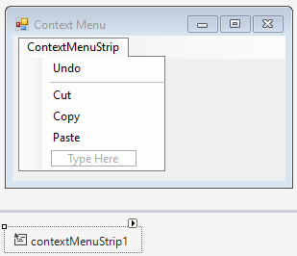
ContextMenuStrip Control Cont..
Similar to main menus, context menu items can be disabled, hidden, or deleted.
You can also show the context menus with the help of the Show() method of ContextMenuStrip control.
Major difference is that the context menus are not divided into separate menus, such as File, Edit and Window.

Slide 77
Introduction to Dialogs
There are several built-in dialog boxes in Windows Forms.
The built-in dialog boxes reduce the time and work required for developing commonly used dialog boxes such as file open, file save and other dialog boxes.
Some of the dialog box controls are OpenFileDialog, SaveFileDialog and FontDialog etc.
The ShowDialog() Method displays the dialog box at runtime.

Slide 78
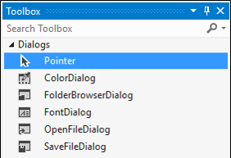
Types of Dialog box Controls
ColorDialog Control
FolderBrowserDialog Contol
FontDialog Control
OpenFileDialog Control
SaveFileDialog Control

Slide 79
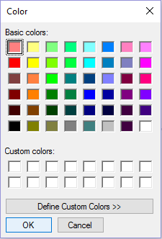
ColorDialog Control
The Color dialog box is use to select or pick a color.
The user can select or create a particular color from the list, which is then reported back to the application when the dialog box exits.
Namespace : System.Windows.Forms.ColorDialog

Slide 80
Properties of ColorDialog
Event | Description
AllowFullOpen | Retrieves or sets a value specifying whether or not the user can use the dialog box to define custom colors.
AnyColor | Retrieves or sets a value specifying whether or not the dialog box displays all available colors in the set of basic colors.
Color | Retrieves or sets the color selected by the user for the text.
CustomColors | Retrieves or sets the set of custom colors shown in the dialog box.
FullOpen | Retrieves or sets a value specifying whether or not the controls used to create custom colors are visible when the dialog box is opened.
ShowHelp | Retrieves or sets a value specifying whether or not a Help button appears in the color dialog box.
SolidColorOnly | Retrieves or sets a value specifying whether or not the dialog box restricts users to selecting solid colors only and not dithered colors.

Slide 81
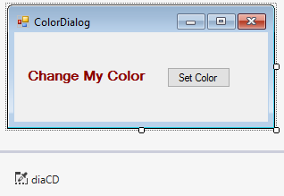
Example – ColorDialog Cont..
Create a from with a label control and a button control.
Drag and drop a ColorDialog control on your form.
When user click on a button, ColorDialog opens and after selecting particular color press OK, You will see the change.

Slide 82
Example – ColorDialog
using System;
using System.ComponentModel;
using System.Windows.Forms;
namespace Demo_Windows
{
public partial class ColorDialog : Form
{
public ColorDialog()
{
InitializeComponent();
}
private void btnSetColor_Click(object sender, EventArgs e)
{
if (diaCD.ShowDialog() == DialogResult.OK)
{
lblChangeMyColor.BackColor = diaCD.Color;
lblChangeMyColor.Text = "Color Changed!!";
}
}
}
}

Slide 83
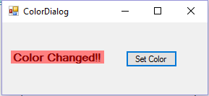
Output – ColorDialog

Slide 84
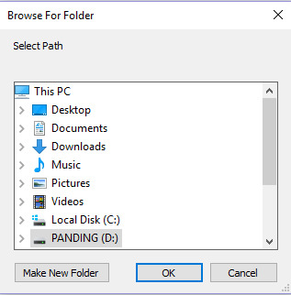
FolderBrowserDialog Control
As name indicates, the FolderBrowserDialog control opens the browse for folder dialog box which lets the user select a folder.
The FolderBrowserDialog control is based on FolderBrowserDialog class.
Namespace : System.Windows.Forms.FolderBrowserDialog

Slide 85
Properties of FolderBrowserDialog
Event | Description
Description | Retrieves or sets the description text displayed above the TreeView control in the dialog box.
RootFolder | Retrieves or sets the root folder where the browsing starts.
SelectedPath | Retrieves or sets the path selected by the user.
ShowNewFolderButton | Retrieves or sets a value indicating whether or not the New Folder button appears in the folder dialog box.

Slide 86
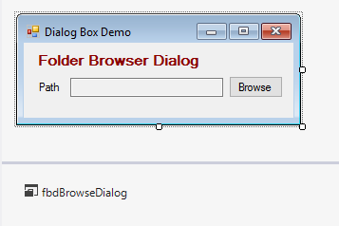
Example – FolderBrowserDialog
Create a from with a label control, textbox control and a button control.
Drag and drop a FolderBrowserDialog control on your form.
When user click on a button, FolderBrowserDialog opens and after selecting particular folder path comes in a textbox.

Slide 87
Example – FolderBrowserDialog
using System;
using System.ComponentModel;
using System.Windows.Forms;
namespace Demo_Windows
{
public partial class DialogBoxDemo : Form
{
public DialogBoxDemo()
{
InitializeComponent();
}
// Browse Button Click Event
private void btnBrowse_Click(object sender, EventArgs e)
{
FolderBrowserDialog fbd = new FolderBrowserDialog();
fbd.RootFolder = Environment.SpecialFolder.MyComputer;
fbd.SelectedPath = "D:\\";
fbd.Description = "Select Path";
if (fbd.ShowDialog() == DialogResult.OK)
{
txtPath.Text = fbd.SelectedPath;
}
}
}
}

Slide 88
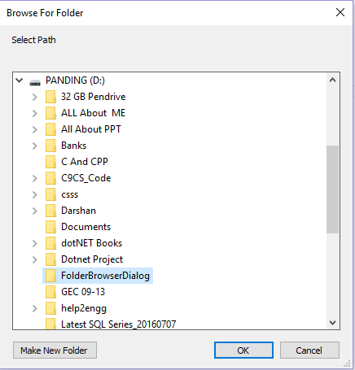
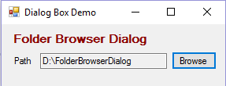
Output – FolderBrowserDialog

Slide 89
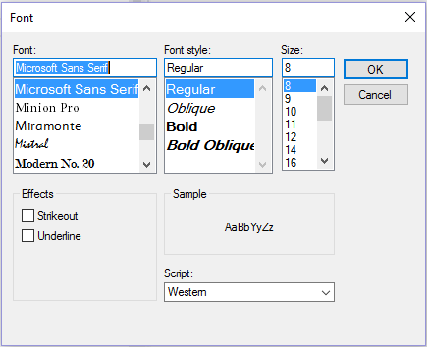
FontDialog Control
The font dialog box is use to select the font, font style and font size.
Namespace : System.Windows.Forms.FontDialog

Slide 90
Properties of FontDialog
Event | Description
Font | Retrieves or sets the selected font.
FontMustExist | Retrieves or sets a value specifying whether or not the dialog box specifies an error condition if the user attempts to select a font or style that does not exist.
MaxSize | Retrieves or sets the maximum font size a user can select. The default value for the font size is 0.
MinSize | Retrieves or sets the minimum font size a user can select.
ShowApply | Retrieves or sets a value specifying whether or not the dialog box contains an Apply button.
ShowColor | Retrieves or sets a value specifying whether or not the dialog box displays the color choice.
ShowHelp | Retrieves or sets a value specifying whether or not the dialog box displays a Help button.

Slide 91
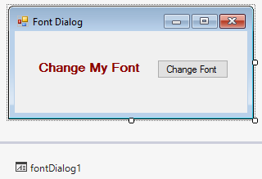
Example - FontDialog
Create a from with a label control and a button control.
Drag and drop a FontDialog control on your form.
When user click on a button, FontDialog opens and after choosing particular font, font size, and color press OK for see the change.

Slide 92
Example – FontDialog Cont..
using System;
using System.ComponentModel;
using System.Windows.Forms;
namespace Demo_Windows
{
public partial class FontDialog : Form
{
public FontDialog()
{
InitializeComponent();
}
private void btnChangeFont_Click(object sender, EventArgs e)
{
if (fontDialog1.ShowDialog() == DialogResult.OK)
{
lblChangeMyFont.Font = fontDialog1.Font;
lblChangeMyFont.ForeColor = fontDialog1.Color;
lblChangeMyFont.Text = "Font Changed.";
}
}
}
}

Slide 93
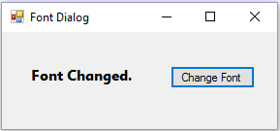
Output – FontDialog

Slide 94
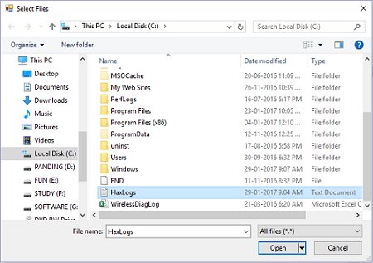
OpenFileDialog Control
This control allows user to select a file and open from the OpenFileDialog box.
It enables user to check if file exists or not and then opens it.
Namespace : System.Windows.Forms.OpenFileDialog

Slide 95
Properties of OpenFileDialog
Event | Description
CheckFileExists | Retrieves or sets a value indicating whether the dialog box diaplays a warning if the user specifies a non-existent file.
MultiSelect | Retrieves or sets a value specifying whether or not the dialog box allows multiple file selections.
ReadOnlyChecked | Retrieves or sets a value specifying whether or not the read only checkbox is selected on the dialog box.
SafeFileName | Retrieves the file name and extension for the selected file in the dialog box. The file name does not include the path.
ShowReadOnly | Retrieves or sets a value specifying whether or not the dialog box displays a read only checkbox.

Slide 96
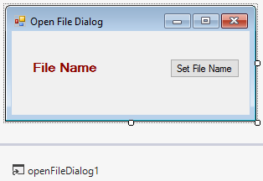
Example - OpenFileDialog
Create a from with a label control and a button control.
Drag and drop a OpenFileDialog control on your form.
When user click on a button, OpenFileDialog opens and after choosing a file, path will be set to the label control.

Slide 97
Example – OpenFileDialog Cont..
using System;
using System.ComponentModel;
using System.Windows.Forms;
namespace Demo_Windows
{
public partial class OpenFileDialog : Form
{
public OpenFileDialog()
{
InitializeComponent();
}
private void btnSetFileName_Click(object sender, EventArgs e)
{
openFileDialog1.InitialDirectory = @"C:\";
openFileDialog1.Title = "Select Files";
openFileDialog1.CheckFileExists = true;
openFileDialog1.CheckPathExists = true;
openFileDialog1.DefaultExt = "jpg";
openFileDialog1.Filter = "Image files (*.jpg)|*.jpg|All files (*.*)|*.*";
if (openFileDialog1.ShowDialog() == DialogResult.OK)
{
lblFileName.Text = openFileDialog1.FileName;
}
}
}
}

Slide 98
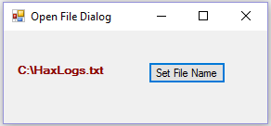
Output – OpenFileDialog

Slide 99
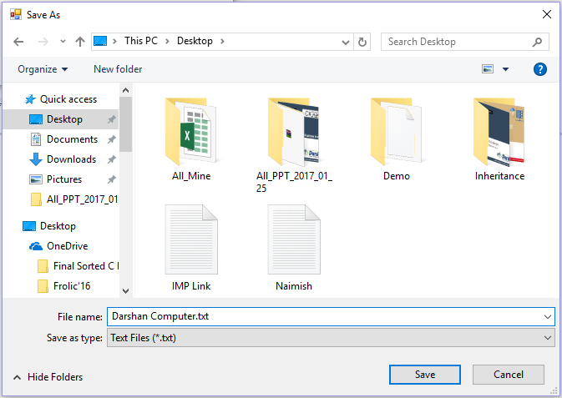
SaveFileDialog Control
The SaveFileDialog control supports the Save As dialog box that allows the user to specify the name of a file to save data.
Namespace : System.Windows.Forms.SaveFileDialog

Slide 100
Properties of SaveFileDialog
Event | Description
CreatePrompt | Retrieves or sets a value specifying whether or not the dialog box asks the user that it should create a file if the user specifies a non existent file.
OverwritePrompt | Retrieves or sets a value specifying whether or not the dialog box displays a warning if the user specifies a name that already exists.

Slide 101
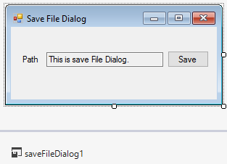
Example - SaveFileDialog
Create a from with a label control, a button control and a text box control.
Drag and drop a SaveFileDialog control on your form.
When user click on a button, SaveFileDialog opens and after saving a file with name, whatever remains in a text box will write in the file.

Slide 102
Example – SaveFileDialog Cont..
using System;
using System.ComponentModel;
using System.Windows.Forms;
using System.IO;
namespace Demo_Windows
{
public partial class SaveFileDialog : Form
{
public SaveFileDialog()
{
InitializeComponent();
}
private void btnSave_Click(object sender, EventArgs e)
{
saveFileDialog1.Filter = "Text Files (*.txt)|*.txt*";
if (saveFileDialog1.ShowDialog() == DialogResult.OK)
{
File.WriteAllText(saveFileDialog1.FileName, txtPath.Text);
}
}
}
}

Slide 103
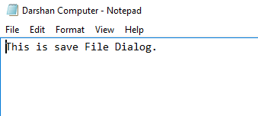
Output – SaveFileDialog

Slide 104
ToolTip
The Tooltip control is used to display a small window with explanatory text for an element on the interface.
It is for a control or window appears when you move the mouse over the control or window.
Namespace : System.Windows.Forms.ToolTip
Properties for a ToolTip control are as follows.
Properties | Description
Active | Specifies whether or not the tooltip control is active
AutomaticDelay | Obtains or sets the time (in milliseconds) before the tool tip appears

Slide 105
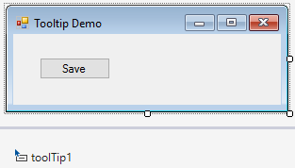
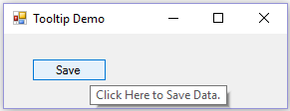
Example - ToolTip
Create a from with a button control.
Drag and drop a ToolTip control on your form.
When user hover on a button, ToolTip with the text displays.

Slide 106
Cont..
using System;
using System.Windows.Forms;
namespace Demo_Windows
{
public partial class Tooltip_Demo : Form
{
public Tooltip_Demo()
{
InitializeComponent();
}
private void Tooltip_Demo_Load(object sender, EventArgs e)
{
ToolTip toolTip = new ToolTip();
toolTip.ShowAlways = true;
toolTip.SetToolTip(btnSave, "Click Here to Save Data.");
}
}
}

Slide 107
Thank you

