Slide 1

UNIT-6 Visual Inheritance in C#.NET
DOT NET TECHNOLOGY
2160711
Prof. Naimish R. Vadodariya
naimish.vadodariya@darshan.ac.in
+91-8866215253
Computer Engineering Darshan Institute of Engineering & Technology

Slide 2
Outline
Applying Inheritance techniques to Forms
Creating Base Forms
Programming Derived Forms

Slide 3
Applying Inheritance to Forms
Inheritance is a technique for providing reusability.
It is generally applied to classes and interfaces for inheriting and reusing the properties and features of the base or parent class or interface.
Inheritance is also possible in case of GUI windows forms.
You can use the concept of inheritance for reusing GUI part.
You need to make a form which will serve as the "parent form".
This form should have the common properties and controls (and functionality) which are used in those forms who will inherit from parent form.

Slide 4
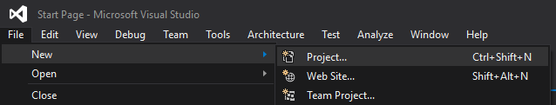
Creating Base Forms
Open Visual Studio, Go to File menu → New → Project.
After Clicking on Project, new project window will appear.

Slide 5
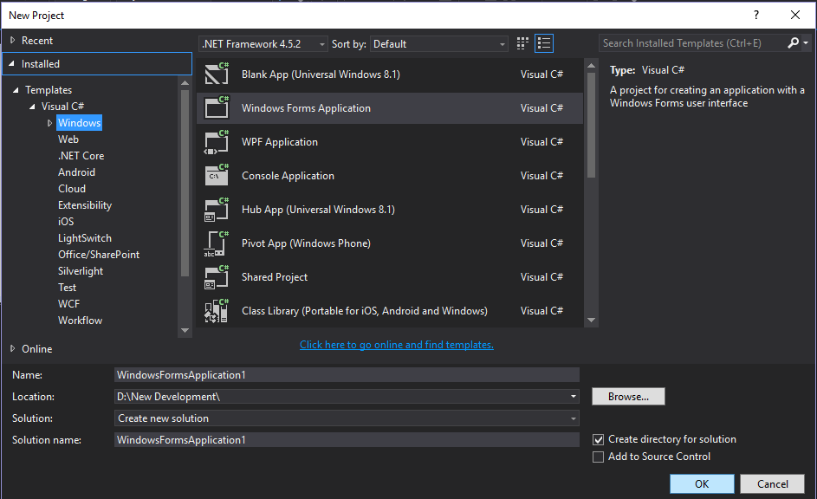
Creating Base Forms Cont..
Select Language, Project Type, Set Location & Give Project Name.
2.2
2.1
2.3
2.4
2.5

Slide 6
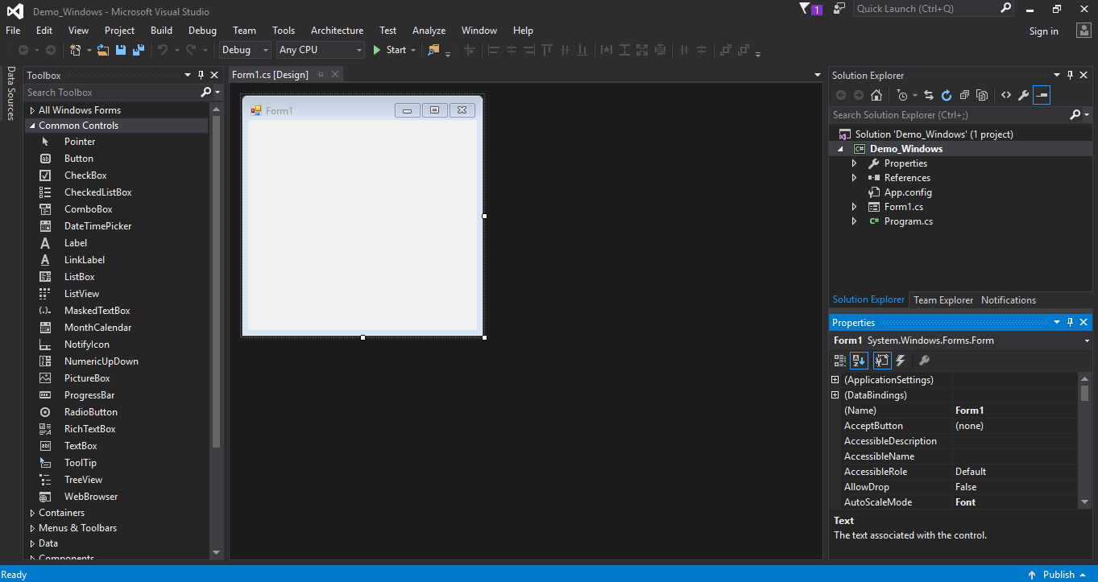
Creating Base Forms Cont..
1
5

Slide 7
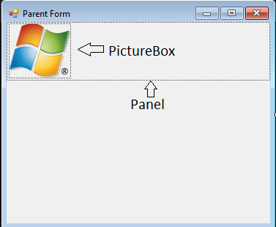
Creating Base Forms Cont..
We create a form with panel & picture box (For Company Logo) control and set logo in picture box.
Give form name as Parent Form.

Slide 8
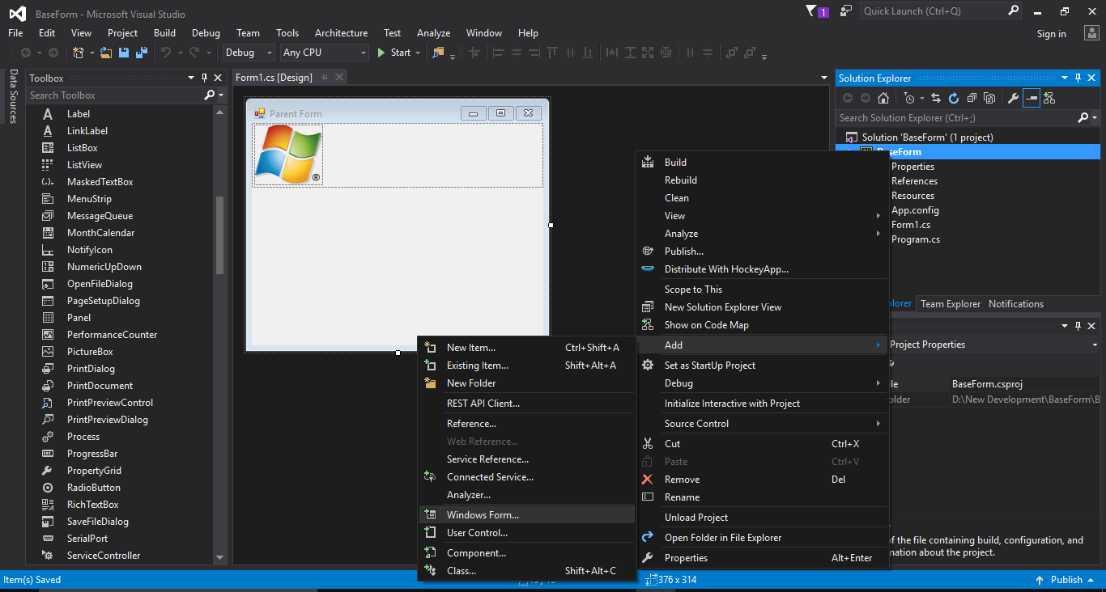
Creating Base Forms Cont..
Go to solution explorer and right click on solution name, then Add → Windows Form.

Slide 9
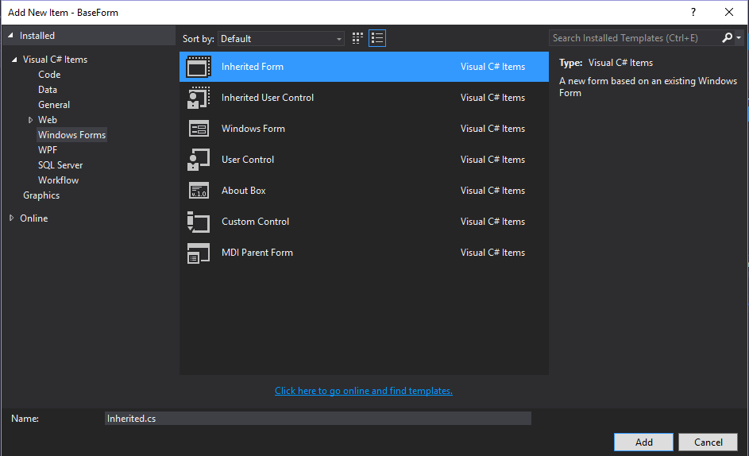
Creating Base Forms Cont..
After Clicking Windows Form, Do below steps.

Slide 10
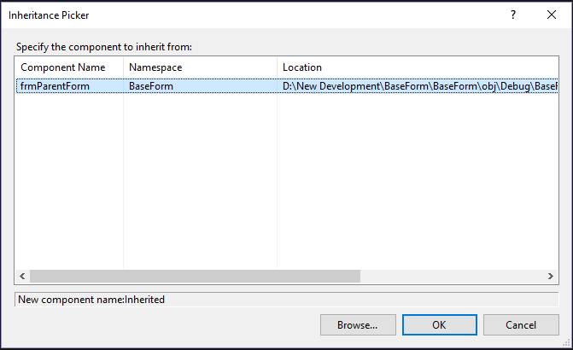
Creating Base Forms Cont..
Now Inheritance picker window will appear.

Slide 11
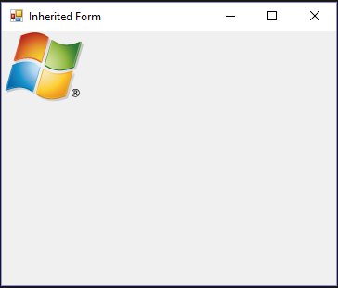
Creating Base Forms Cont..
Now build an application and run inherited form.
You will see whatever you put in Parent form comes in Inherited form.

Slide 12
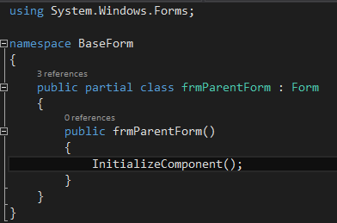
Programming Derived Forms
By default any windows form is always derived from Form.
This Form is a parent form.

Slide 13
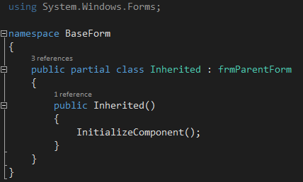
Programming Derived Forms Cont..
Instead of Form, we have to give base form name.

Slide 14
Thank you

