Slide 1

UNIT-7 Mastering Windows Forms
DOT NET TECHNOLOGY
2160711
Prof. Naimish R. Vadodariya
naimish.vadodariya@darshan.ac.in
+91-8866215253
Computer Engineering Darshan Institute of Engineering & Technology

Slide 2
Outline
Printing
Handling Multiple Events
GDI+
Creating Windows Forms Controls

Slide 3
Printing
In C#.NET, the PrintDocument class allows you to print documents.
You can add an object of this class to a project and than handle events, such as PrintPage.
The event PrintPage is called every time a new page is to be printed.
When PrintDocument is added to a form, the PrintDocument component appears in the component tray at the bottom of the windows forms designer.

Slide 4
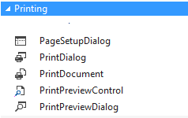
Printing Controls
PageSetupDialog
PrintDialog
PrintDocument
PrintPreviewControl
PrintPreviewDialog

Slide 5
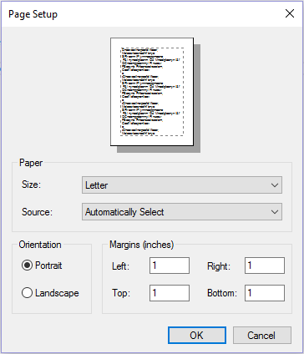
PageSetupDialog
The PageSetupDialog box allows you to specify page orientation, paper size and margin size.
PageSetupDialog control sets the page-related settings.
Namespace :
System.Windows.Forms.PageSetupDialog

Slide 6
PrintDialog
The PrintDialog box lets the user print documents and this dialog box is supported by the PrintDialog class.
Namespace :
System.Windows.Forms.PrintDialog

Slide 7
PrintDocument
The PrintDocument control supports the actual events and opertations of printing in C#.
Also sets the properties that describes how to print.
The Document property of the PrintDialog class needs to be set before calling the Print dialog box.
This property accepts an object of the PrintDocument class, which obtains the printer settings and sends the output to the printer.
Namespace :
System.Drawing.Printing.PrintDocument

Slide 8
PrintPreviewControl
PrintPreviewControl displays a document to be printed- e.g., it displays a Review of the document to be printed. This control has no buttons or any other user interface elements.
The PrintPreviewControl is typically used only when there is a need to write custom print preview user interfaces.
You can use PrintPreviewControl objects to create your own custom print previews.
Namespace :
System.Windows.Forms.PrintPreviewControl

Slide 9
PrintPreviewDialog
You can use the PrintPreviewDialog that displays a preview of the document that is to be printed.
The PrintPreviewDialog class supports the PrintPreviewDialog control.
This class contains the buttons for printing, zooming in, displaying one or multiple pages, and closing the dialog box.
Namespace :
System.Windows.Forms.PrintPreviewDialog

Slide 10
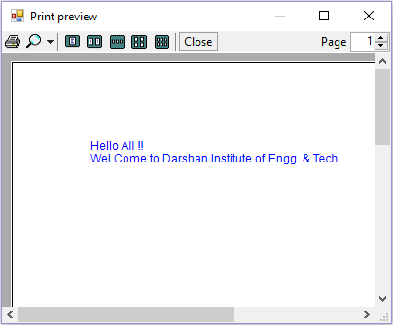
PrintPreviewDialog Cont..

Slide 11
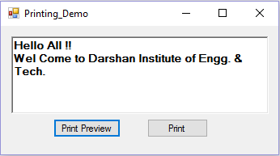
Example - Printing
Take a windows form with RichTextBox and two Button control and also take printing controls from toolbox, as shown in Figure:

Slide 12
Example – Printing - Cont..
PrintPreview Button
private void btnPrintPreview_Click(object sender, EventArgs e)
{
printPreviewDialog1.Document = printDocument1;
printPreviewDialog1.ShowDialog();
}
PrintDocument1 (PrintPage Event)
e.Graphics.DrawString(richTextBox1.Text, new Font("Arial", Convert.ToInt64(12)), Brushes.Blue, e.MarginBounds.Left + 10, e.MarginBounds.Top + 10);

Slide 13
Example – Printing - Cont..
Print Button
pageSetupDialog1.PrinterSettings = printDocument1.PrinterSettings;
pageSetupDialog1.PageSettings = printDocument1.DefaultPageSettings;
if (pageSetupDialog1.ShowDialog() == DialogResult.OK)
{
printDocument1.PrinterSettings = pageSetupDialog1.PrinterSettings;
printDocument1.DefaultPageSettings = pageSetupDialog1.PageSettings;
}
printPreviewDialog1.Document = printDocument1;
printPreviewDialog1.Show();

Slide 14
Example – Printing - Cont..
private void btnPrintPreview_Click(object sender, EventArgs e)
{
printPreviewDialog1.Document = printDocument1;
printPreviewDialog1.ShowDialog();
}
private void btnPrint_Click(object sender, EventArgs e)
{
pageSetupDialog1.PrinterSettings = printDocument1.PrinterSettings;
pageSetupDialog1.PageSettings = printDocument1.DefaultPageSettings;
if (pageSetupDialog1.ShowDialog() == DialogResult.OK)
{
printDocument1.PrinterSettings = pageSetupDialog1.PrinterSettings;
printDocument1.DefaultPageSettings = pageSetupDialog1.PageSettings;
}
printPreviewDialog1.Document = printDocument1;
printPreviewDialog1.Show();
}
private void printDocument1_PrintPage(object sender, PrintPageEventArgs e)
{
e.Graphics.DrawString(richTextBox1.Text, new Font("Arial", Convert.ToInt64(12)), Brushes.Blue, e.MarginBounds.Left + 10, e.MarginBounds.Top + 10);
}

Slide 15
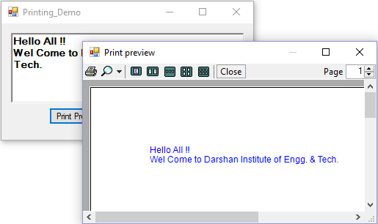
Output

Slide 16
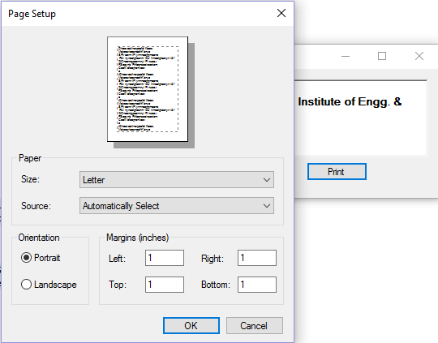
Cont..

Slide 17
Handling Multiple Events
C#.NET is an event-driven language, which means the objects of C#.NET reacts when an event is triggered, for example, clicking a button or entering some text into a text box & many more.
An event is nothing but an action that calls a function or may cause another event, which do something as specified in the code.
There are mainly two types of events:
Mouse events (events generated by supplying the input through a mouse)
Keyboard events (events generated by supplying the input through the keyboard)

Slide 18
Mouse Events
You can handle mouse events-such as mouse movements in forms and controls.
Events | Description
MouseDown | Occurs when the mouse pointer is over the control and a mouse button is pressed
MouseEnter | Occurs when the mouse pointer enters the control
MouseHover | Occurs when the mouse pointer moves to and fro over the control
MouseLeave | Occurs when the mouse pointer leaves the control
MouseMove | Occurs when the mouse pointer moves over the control
Mouseup | Occurs when the mouse pointer is over the control and a mouse button is released
MouseWheel | Occurs when the mouse wheel moves, while the control has focus

Slide 19
Keyboard Events
In C#.NET, the following events are available to handle the keyboard events:
Events | Description
KeyDown | Occurs when a key is pressed down while the control has focus
KeyPress | Occurs when a key is pressed while the control has focus
KeyUp | Occurs when a key is released while the control has focus

Slide 20
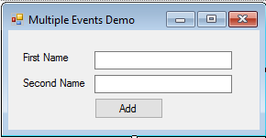
Example - Handling Multiple Events
Create a form with two labels, two textbox and a button control.

Slide 21
Handling Multiple Events Cont..
using System;
using System.Drawing;
using System.Windows.Forms;
namespace Demo_Windows
{
public partial class frmMultipleEvents : Form
{
public frmMultipleEvents()
{
InitializeComponent();
}
private void textBox1_MouseEnter(object sender, EventArgs e)
{
textBox1.BackColor = Color.Red;
textBox1.ForeColor = Color.White;
}
private void textBox1_MouseLeave(object sender, EventArgs e)
{
textBox1.BackColor = Color.White;
textBox1.ForeColor = Color.Black;
}

Slide 22
Handling Multiple Events Cont..
private void textBox2_MouseEnter(object sender, EventArgs e)
{
textBox2.BackColor = Color.Red;
textBox2.ForeColor = Color.White;
}
private void textBox2_MouseLeave(object sender, EventArgs e)
{
textBox2.BackColor = Color.White;
textBox2.ForeColor = Color.Black;
}
private void btnAdd_Click(object sender, EventArgs e)
{
MessageBox.Show("Your name is " + textBox1.Text + " " + textBox2.Text);
}
}
}

Slide 23
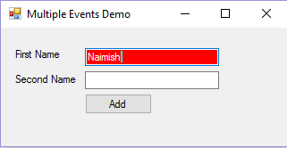
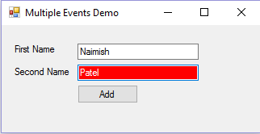
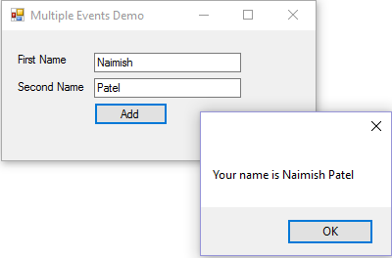
Output

Slide 24
GDI+
GDI+ stands for Graphics Device Interface.
In Windows Forms Applications, GDI+ is used to create graphics, draw text, and manipulate graphical images.
The basic use of GDI+ is to render graphical images on a form.
The core of the GDI+ functionality is the Graphics class.
GDI+ consists of a set of base classes that are available to control the custom drawing on the screen.
This set of classes is collectively called the GDI+ managed class interface.

Slide 25
Namespaces of GDI+
System.Drawing
System.Drawing.Drawing2D
System.Drawing.Imaging
System.Drawing.Printing
System.Drawing.Design
System.Drawing.Text

Slide 26
Namespaces of GDI+ Cont..
Namespace | Description
System.Drawing | Contains most of the classes, structs, enums and delegates concerned with the basic functionality of drawing
System.Drawing.Drawing2D | Provides support for advance 2-D vector, drawing and graphics path
System.Drawing.Imaging | Contains classes that provide advanced imaging functionality
System.Drawing.Printing | Contains classes that assist in printing
System.Drawing.Design | Contains classes that extend design-time UI logic and drawing
System.Drawing.Text | Contains classes to provide advanced GDI+ typography functionality

Slide 27
Graphics Class
Graphics class provides a method, such as CreateGraphics(), for drawing objects.
In addition, you can draw many different shapes and lines by using different methods of the Graphics object, such as DrawLine, DrawArc, DrawClosedCurve, DrawPolygon, and DrawRectangle.
You can also draw images by using the Drawlmage() and Drawlcon() methods of the Graphics class.

Slide 28
Graphics Objects
Name | Description
Brush | Used to fill enclosed surfaces with patterns, colors, or bitmaps.
Pen | Used to draw lines and polygons, including rectangles, arcs, and pies.
Font | Used to describe the font to be used to render text.
Color | Used to describe the color used to render a particular object. In GDI+ color can be alpha blended.

Slide 29
Pen Class
A pen draws a line of specified width and style.
You always use Pen constructor to create a pen.
The constructor initializes a new instance of the Pen class. You can initialize it with a color or brush.
Example
public Pen(Color);
Pen pn = new Pen(Color.Blue);
public Pen(Brush);

Slide 30
Properties of Pen Class
Property | Description
Alignment | Gets or sets the alignment for objects drawn with this Pen.
Brush | Gets or sets the Brush that determines attributes of this Pen.
Color | Gets or sets the color of this Pen.
Width | Gets or sets the width of this Pen.

Slide 31
Brush Class
The Brush class is used to fill the interiors of graphical shapes, such as rectangles, ellipse, polygons, and paths.
You can draw the outline of the shape using the Pen class and fill the shape using the Brush class.
The different types of brushes available in Windows Forms are SolidBrush, HatchBrush, TextureBrush, LinearGradientBrush, and PathGradientBrush.
Example
Brush brsh = new SolidBrush(Color.Red), 40, 40, 140, 140);

Slide 32
Different Types of Brush
Type | Description
SolidBrush | Fills the shape with one solid color.
HatchBrush | Fills the shape with a hatch style.
TextureBrush | Fills the shape with a pattern stored in a bitmap.
LinearGradientBrush | Fills the shape with color that changes gradually as you move across the shape.
PathGradientBrush | Fills the shape with color which changes as you move from the center of a shape towards the edge.

Slide 33
Font Class
The Font class defines a particular format for text such as font type, size, and style attributes.
You use font constructor to create a font.
Example
public Font(Font, FontStyle);
Font font = new Font("Times New Roman", 26);

Slide 34
Properties of Font Class
Property | Description
Bold | Gets a value indicating whether this Font is bold.
Italic | Gets a value indicating whether this Font is Italic.
Underline | Gets a value indicating whether this Font is underlined.
Name | Gets the face name of this Font.
Size | Gets the size of this Font.
Strikeout | Gets a value indicating whether this Font is strikeout (has a line through it).

Slide 35
Color Structure
A Color structure represents an ARGB color.
Here are ARGB properties of it:
Property | Description
A | Gets the alpha component value for this Color.
B | Gets the blue component value for this Color.
G | Gets the green component value for this Color.
R | Gets the red component value for this Color.
You can call the Color members. Each color name (say Blue) is a member of the Color structure.
Example
Color.Blue
Color.Red

Slide 36
Example – GDI+
using System.Drawing;
using System.Windows.Forms;
namespace BaseForm
{
public partial class frmParentForm : Form
{
public frmParentForm()
{
InitializeComponent();
}
private void frmParentForm_Paint(object sender, PaintEventArgs e)
{
Graphics g = e.Graphics;
g.DrawLine(Pens.Blue, 10, 10, 200, 100);
g.DrawEllipse(Pens.Red, 20, 10, 150, 80);
g.FillEllipse(Brushes.Black, 20, 10, 150, 80);
g.DrawRectangle(Pens.Green, 30, 100, 120, 60);
g.FillRectangle(Brushes.Magenta, 30, 100, 120, 60);
}
}
}

Slide 37
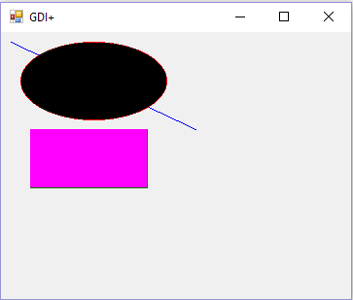
Output – GDI+

Slide 38
Creating Windows Forms Controls
A user control is nothing, but user defined control.
That means you can create our own control, and you can use it in any form, wherever required.
The user control may contain some user interface with controls like buttons, textboxes etc.
So finally, you need to design the user interface only once in the "User Control", and you can use it manytimes, in any form.
Advantage : Avoids repetition of design and code.

Slide 39
Cont..
Create User Control
Open Visual studio, go to File→ New → Project.
Click on "Project" menu "Add User Control".
Enter the name of the new user control.
Click on "Add".
Design and Develop the User Control
Design the UI in the user control, by dragging the controls from the toolbox.
Write the code in "Code window". (User control also supports event handlers similar to forms).

Slide 40
Cont..
Invoke the User Control
Open the required form and build the project.
Then the user control name will be displayed in the toolbox automatically.
To invoke the user control on a form, just drag it from the toolbox into the form designer.

Slide 41
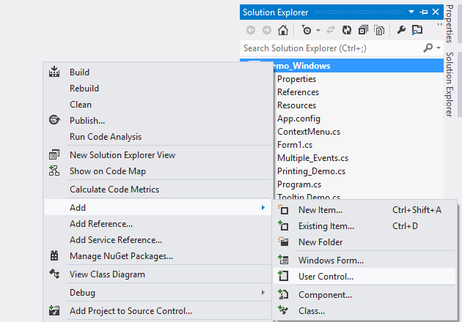
Example - User Control
Open Visual Studio → File → New → Project
After Selecting Windows Forms Application, Add User Control.

Slide 42
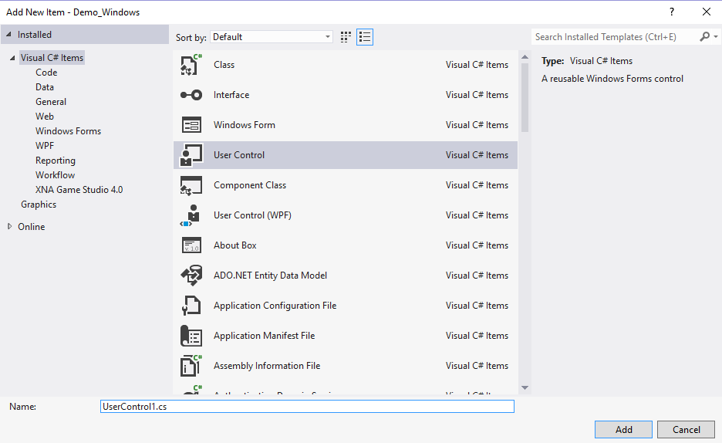
User Control Cont..
Give User Control Name and Press Add.

Slide 43
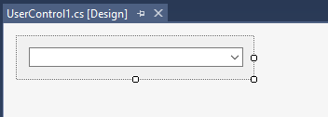
User Control Cont..
Now below screen appears & you can put any control from toolbox in user control area.
After writing code for user control, build Application.
Now you can use this control in any windows form.

Slide 44
User Control Cont..
Constructor
User Control Load Event
public UserControl1()
{
InitializeComponent();
this.Load += new EventHandler(UserControl1_Load);
this.cmbCity.SelectedIndexChanged += new EventHandler(cmbCity_SelectedIndexChanged);
}
void UserControl1_Load(object sender, EventArgs e)
{
BindComboBox();
}

Slide 45
User Control Cont..
Properties
public string SelectedText
{
get
{
return cmbCity.Text;
}
}
public string Selectedvalue
{
get
{
return cmbCity.SelectedValue.ToString();
}
}

Slide 46
User Control Cont..
Function : BindComboBox()
private void BindComboBox()
{
DataTable dtCity = new System.Data.DataTable();
dtCity.Columns.Add("txtPart");
dtCity.Columns.Add("valuePart");
dtCity.Rows.Add("Rajkot", "1");
dtCity.Rows.Add("Ahmedabad", "2");
dtCity.Rows.Add("Patna", "3");
dtCity.Rows.Add("Siddhpur", "4");
cmbCity.DataSource = dtCity;
cmbCity.DisplayMember = "txtPart";
cmbCity.ValueMember = "ValuePart";
}

Slide 47
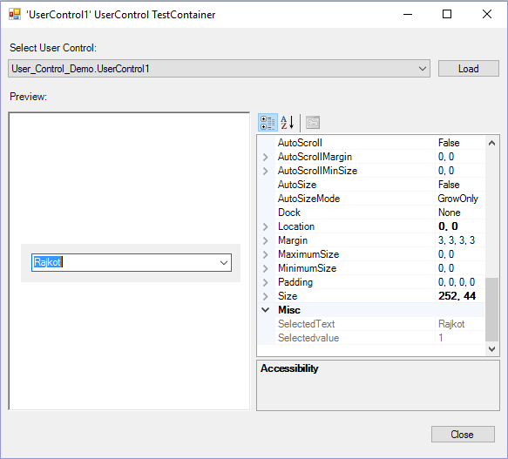
Output – User Control

Slide 48
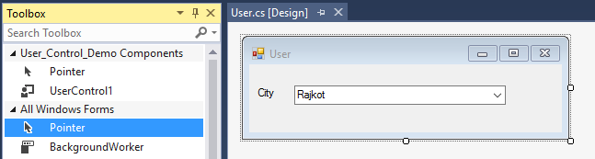
User Control Cont..
Now add new windows form to your application & check in toolbox, user control is there.
You can simply drag and drop it to your windows form.

Slide 49
Thank you

