Slide 1


UNIT-8 ASP.NET (Active Server Pages.NET)
DOT NET TECHNOLOGY
2160711
Prof. Naimish R. Vadodariya
naimish.vadodariya@darshan.ac.in
+91-8866215253
Computer Engineering Darshan Institute of Engineering & Technology

Slide 2
Outline
Introduction to ASP.NET
Basic Web Server Controls
Validation Controls
Login controls
Configuration Overview

Slide 3
Introduction to Web
Processing Request
Browser
Http Request
Web Server
Http Response

Slide 4
Introduction to Web Cont..
What is a Website ?
A website is a collection of related web pages, including multimedia content, typically identified with a common domain name, and published on at least one web server.
Example
www.darshan.ac.in
www.7th-pay.com
www.facebook.com
www.flipkart.com
www.redbus.in

Slide 5
Introduction to Web Cont..
What is webpage?
A webpage is a document commonly written in Hypertext Markup Language (HTML) that is accessible through the Internet or other network using an Internet browser.
Example
Home Page
About Us Page
Contact Us Page
Products Page

Slide 6
Introduction to ASP.NET
ASP Refers to Active Server Pages.
ASP.NET is a server-side web application framework designed for web development to produce dynamic web pages.
It is developed by Microsoft to allow programmers to build dynamic web sites, web applications and web services.
ASP.NET pages have the extension .aspx and are normally written in C# (C sharp) and VB.NET.

Slide 7
ASP.NET Page Life Cycle
The life cycle of the ASP.NET page specifies how the page is instantiated and processed to generate the specific output.
There are different phases through which the page is processed before rendering the output on web.
Page Request
Start
Initialization
Load
Rendering
Unload

Slide 8
ASP.NET Page Life Cycle Cont..
Page request
Start
Initialization
Load
Rendering
Unload

Slide 9
ASP.NET Page Life Cycle Cont..
Page Request:
The page request occurs before the life cycle of the page executed.
It checks whether the page needs to be parsed or cached version to be sent to the user.
Start:
The page properties Request and Response values are set in the Start phase of the page.
IsPostBack and UICulture property are set in the Start method.
Initialization:
In the Initialization phase, controls are available on the page.

Slide 10
ASP.NET Page Life Cycle Cont..
Load:
During the load phase, the request is post back and control properties are loaded with information.
Rendering:
The view state of the controls on the page is saved before rendering on the server.
The page calls the Render method for every control.
Unload:
The event is raised after the control is completely rendered.
The Request and Response properties are unloaded and cleanup is performed.

Slide 11
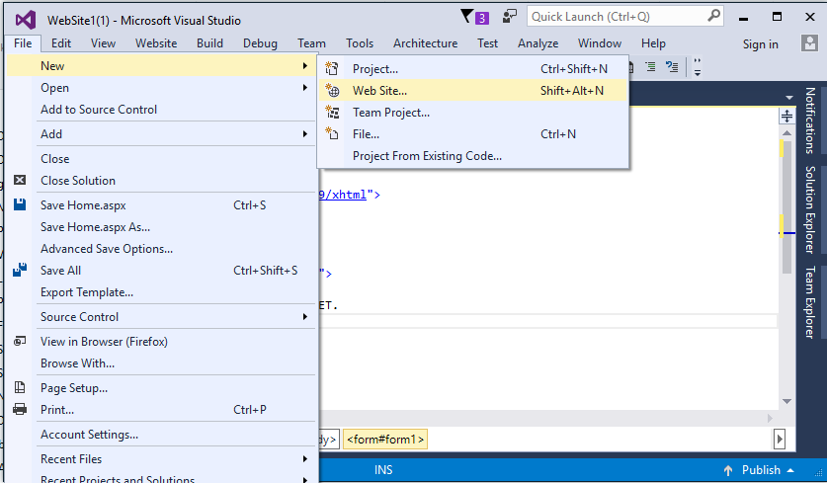
How to Create Website?
Start Visual Studio and click File menu→ New → Web Site.

Slide 12
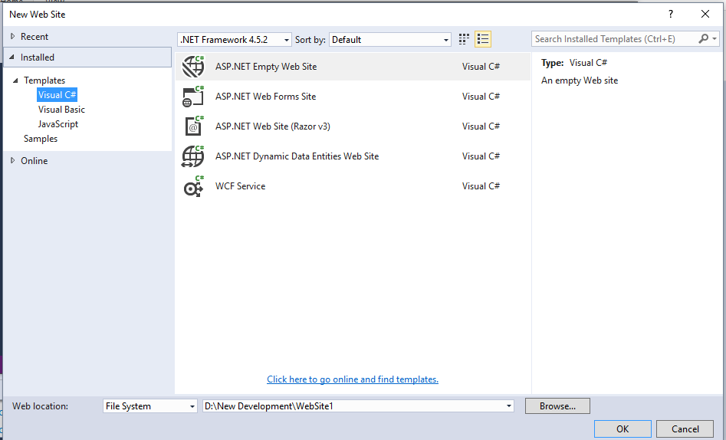
Create Website Cont..
Select Language
Select Empty Website
Select path
Press
OK

Slide 13
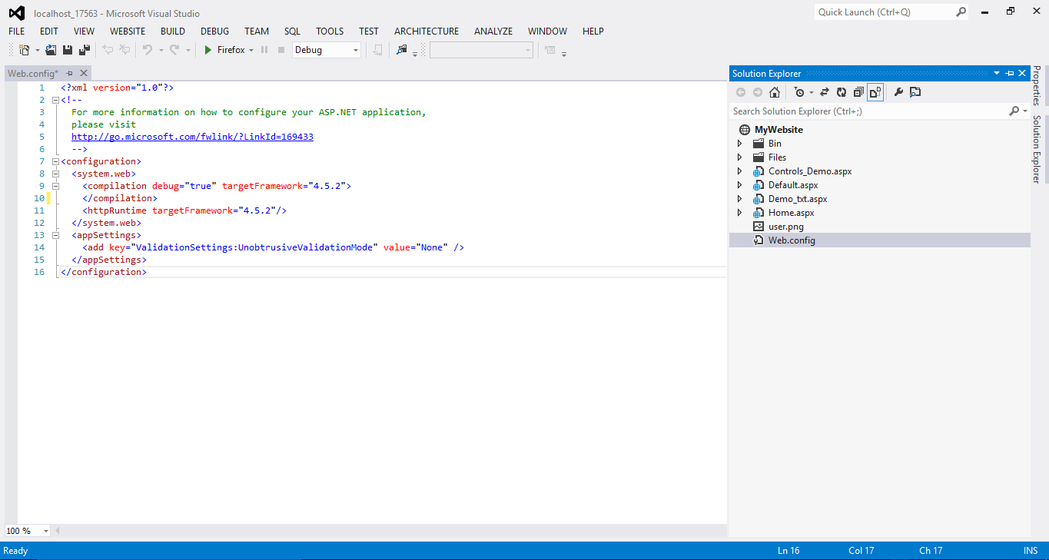
Create Website Cont..
Configuration File

Slide 14
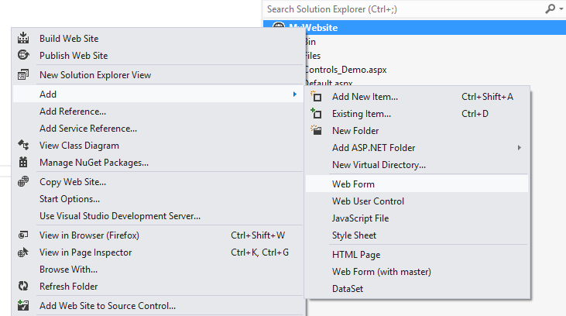
Adding a New Web Form to Website
Right Click On Website Name And Press
Add → Web Form

Slide 15
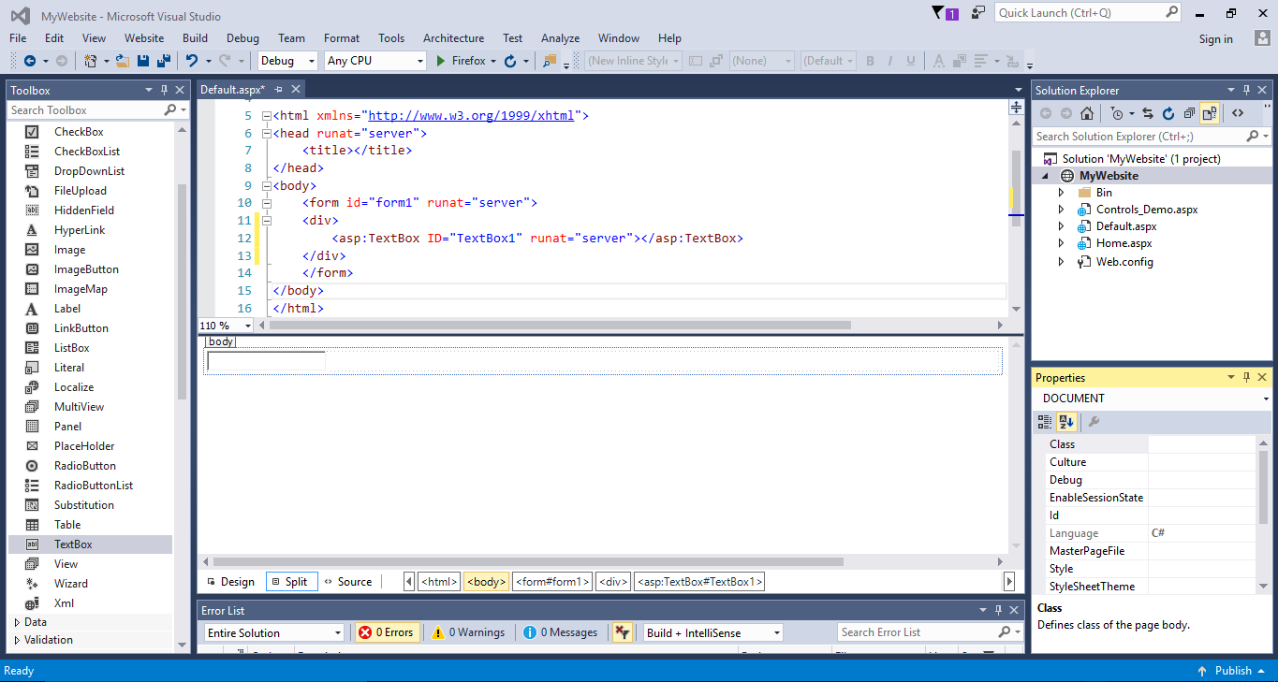
Design Page of Website (.aspx)
Design Code
Solution Explorer
ToolBox
Design
Property Window

Slide 16
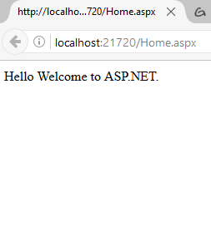
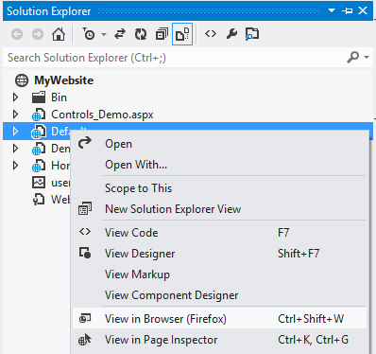
Viewing an Output
Right click on Web Form & click View in Browser

Slide 17
Controls in ASP.NET
The ASP.NET controls are designed similar to standard Windows forms controls.
This controls are used to design the interface of a web application.
Example
When you visit the website of Google, you type your search query in a text box, which is a control.
ASP.NET provides a standard set of controls that can be used to develop web applications.

Slide 18
Controls in ASP.NET Cont..
You can access all these controls from the Toolbox present in Visual Studio.
These controls can be easily used by dragging and dropping them at any desired location on a web form.
Based on tasks performed by them, these controls are grouped under various categories known as tabs.
For example controls for validating the data are placed under the validation tab and controls used for logging on to websites are placed under the Login tab.
The System.Web.UI.Control class is the base class for all web server controls.

Slide 19
Controls in ASP.NET Cont..
The standard web form controls are inherited from a common base class namely System.Web.UI.WebControls class.
Standard Controls
Label Control
TextBox Control
Button Control
CheckBox Control
RadioButton Control
HyperLink Control
Image Control
FileUpload Control
LinkButton Control
ImageButton Control
HiddenField Control
Validation Controls
RequiredFieldValidator
RangeValidator
CompareValidator
RegularExpressionValidator
CustomValidator
ValidationSummary
Login Controls
Login
LoginName
LoginStatus
LoginView
PasswordRecovery
ChangePassword
CreateUserWizard
List Controls
DropDownList
CheckBoxList
RadioButtonList
ListBox

Slide 20
Label Control
Label Control is used to display the static or dynamic text on web page that cannot be changed by user.
Example
<asp:Label ID="lblUserName" runat="server"
Text="Enter Your Name">
</asp:Label>

Slide 21
TextBox Control
The TextBox control is an input control which can be used to accept user input.
Example
<asp:TextBox ID="txtUserName" runat="server" ReadOnly="true" MaxLength="10" TextMode="SingleLine" Text="Darshan Institute of Engineering & Technology">
</asp:TextBox>
<asp:TextBox ID="txtClgName" runat="server" TextMode="MultiLine" Rows="3" Text="Darshan Institute of Engineering & Technology is a leading institute offering undergraduate, graduate and postgraduate programs in engineering.">
</asp:TextBox>

Slide 22
Button Control
A Button Control accepts clicks and performs other actions on the user interface of web page.
Example
<asp:Button ID="btnSave" runat="server" Text="Save">
</asp:Button>

Slide 23
Example – Button Control
Drag and drop two textbox, label and button on your web form.
<div>
<table>
<tr>
<td><asp:TextBox ID="txtNum1" runat="server"></asp:TextBox></td>
<td>+</td>
<td><asp:TextBox ID="txtNum2" runat="server"></asp:TextBox></td>
</tr>
<tr>
<td><asp:Button ID="btnAddition" runat="server" Text="Addition" OnClick="btnAddition_Click" /></td>
<td></td>
<td><asp:Label Text="" ID="lblAnswer" runat="server">
</asp:Label></td>
</tr>
</table>
</div>

Slide 24

Example – Button Control Cont..
Output
protected void btnAddition_Click(object sender, EventArgs e)
{
Double Num1 = Convert.ToDouble(txtNum1.Text);
Double Num2 = Convert.ToDouble(txtNum2.Text);
Double Ans = Num1 + Num2;
lblAnswer.Text = "Addition Is " + Ans.ToString();
}

Slide 25

CheckBox Control
CheckBox control is used to give option to the user.
It Represent a choice that can be only Yes(checked) or No(Unchecked) value.
Example
<asp:CheckBox ID="chkMusic" runat="Server" Text="Music" />
<asp:CheckBox ID="chkCricket" runat="Server" Text="Cricket" />
<asp:CheckBox ID="chkReading" runat="Server" Text="Reading" />

Slide 26
Example - CheckBox Control
<table>
<tr>
<td>
<asp:CheckBox ID="chkMusic" runat="Server" Text="Music" />
<asp:CheckBox ID="chkCricket" runat="Server" Text="Cricket"/>
<asp:CheckBox ID="chkReading" runat="Server" Text="Reading"/>
</td>
<td><asp:Button ID="btnHobbies" runat="server" Text="Show Hobbies" OnClick="btnHobbies_Click" /></td>
<td><asp:Label Text="" ID="lblHobbies“ runat="server” /></td>
</tr>
</table>

Slide 27
Example - CheckBox Control Cont..
protected void btnHobbies_Click(object sender, EventArgs e)
{
if (chkCricket.Checked == true)
lblHobbies.Text = chkCricket.Text;
else if (chkMusic.Checked == true)
lblHobbies.Text = chkMusic.Text;
else
lblHobbies.Text = chkReading.Text;
}
Output

Slide 28

RadioButton Control
RadioButton Control is similar to checkbox control.
In which user has to select one option.
Radio Buttons are grouped together using group name property.
Example
<asp:RadioButton ID="rbMale" runat="Server"
Text="Male" GroupName="Gender" />
<asp:RadioButton ID="rbFemale" runat="Server" Text="Female" GroupName="Gender" />

Slide 29
Example – RadioButton Control
<table>
<tr><td>
<asp:RadioButton ID="rbMale" runat="Server" Text="Male" GroupName="Gender" />
<asp:RadioButton ID="rbFemale" runat="Server" Text="Female" GroupName="Gender" />
</td>
<td><asp:Button ID="btnGender" runat="server" Text="Show Gender" OnClick="btnGender_Click" /></td>
<td><asp:Label Text="" ID="lblGender" runat="server"></asp:Label> </td>
</tr>
</table>

Slide 30
Example – RadioButton Control
Output
protected void btnGender_Click(object sender, EventArgs e)
{
if (rbMale.Checked == true)
lblGender.Text = rbMale.Text.ToString();
else
lblGender.Text = rbFemale.Text.ToString();
}

Slide 31

HyperLink Control
Hyperlink control is used to jump to another location.
It is useful when you want to display a link to a site.
Example
<asp:HyperLink ID="hlGoogle" runat="server" Target="_blank" NavigateUrl="http://www.google.com" Text="Go to Google.com"/>

Slide 32

Image Control
Image control is used to place an image on the web page.
It is used when displaying products, user profile photo etc.
Example
<asp:Image ID="imgUser" runat="server" ImageUrl="~/user.png" AlternateText="This is Profile Picture" />

Slide 33

FileUpload Control
FileUpload control allows users to upload file to the webserver.
Once the server receives the posted file data, the application can save it, check it, or ignore it.
Required Namespace for uploading file is using System.IO.
Example
<asp:FileUpload ID="fuFile" runat="server" />

Slide 34
Example – FileUpload Control
<div>
<asp:FileUpload ID="fuFile" runat="server" />
<hr />
<asp:Button ID="btnUpload" Text="Upload" runat="server" OnClick="UploadFile" />
<br />
<asp:Label ID="lblMessage" ForeColor="Green" runat="server" />
</div>

Slide 35
Example – FileUpload Control
protected void UploadFile(object sender, EventArgs e)
{
string folderPath = Server.MapPath("~/Files/");
//Check whether Directory (Folder) exists.
if (!Directory.Exists(folderPath))
{
//If Directory (Folder) does not exists. Create it.
Directory.CreateDirectory(folderPath);
}
//Save the File to the Directory (Folder).
fuFile.SaveAs(folderPath + Path.GetFileName(fuFile.FileName));
//Display the success message.
lblMessage.Text = Path.GetFileName(fuFile.FileName) + " has been uploaded.";
}

Slide 36
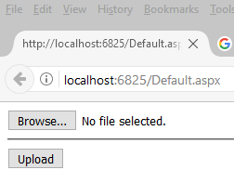
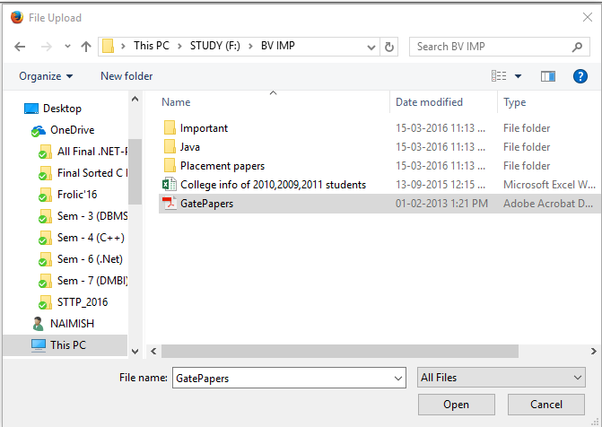
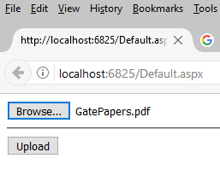
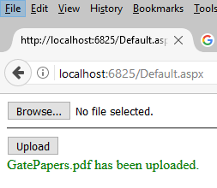
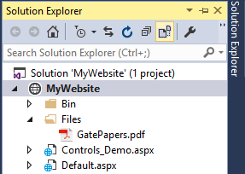
Output – FileUpload Control

Slide 37

LinkButton Control
LinkButton control is used to create a hyperlink button.
This control looks like a HyperLink control but has the same functionality as the Button control.
Example
<asp:LinkButton ID="lnkbtnLogout" runat="server" Text="Logout" />

Slide 38

ImageButton Control
ImageButton control is used to display a clickable image.
The properties of the Image control can also be used on the ImageButton control.
Example
<asp:ImageButton ID="imgbtnUser" runat="server" ImageUrl="~/user.png"/>

Slide 39

HiddenField Control
HiddenField, as name implies, is hidden that means non visual control in ASP.NET where you can save the value.
Anyone can see HiddenField details by simply viewing the source of document.
HiddenFields are not encrypted or protected and can be changed by any one, from a security point of view, this is not suggested. ASP.NET uses HiddenField control for managing the ViewState.
So, don’t store any important or confidential data like password and credit card details with this control.
Example
<asp:HiddenField ID="hfDate" runat="server" />

Slide 40
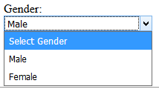
DropdownList Control
DropDownList control is used to give a single select option to the user from multiple listed items.
You can add its option items by directly writing into .aspx page directly or dynamically add at run time or bind through database.
Example
<asp:DropDownList ID="ddlGender" runat="server" Width="200px">
<asp:ListItem Text="Select Gender" Value="0"></asp:ListItem>
<asp:ListItem Text="Male" Value="1"></asp:ListItem>
<asp:ListItem Text="Female" Value="2"></asp:ListItem>
</asp:DropDownList>

Slide 41
Properties of DropdownList Control
Property | Description
SelectedValue | Get the value of the Selected item from the dropdown box.
SelectedIndex | Gets or Sets the index of the selected item in the dropdown box.
SelectedItem | Gets the selected item from the list.
Items | Gets the collection of items from the dropdown box.
DataTextField | Name of the data source field to supply the text of the items. (No need to set when you are adding items directly into .aspx page.)
DataValueField | Name of the data source field to supply the value of the items. (No need to set when you are adding items directly into .aspx page.)

Slide 42
Example – DropdownList Control
<h3>How to use Dropdown list</h3>
<div>
<label>Gender:</label><br />
<asp:DropDownList ID="ddlGender" runat="server" Width="200px">
<asp:ListItem Text="Select Gender" Value="0"></asp:ListItem>
<asp:ListItem Text="Male" Value="1"></asp:ListItem>
<asp:ListItem Text="Female" Value="2"></asp:ListItem>
</asp:DropDownList>
</div>
<div>
<asp:Button ID="btnSubmit" runat="server" Text="Click to Retrieve Value" OnClick="btnSubmit_Click" />
</div>
<div>
Selected Item Text:
<asp:Label ID="lblSelectedText" runat="server"></asp:Label>
</div>
<div>
Selected Item Value:
<asp:Label ID="lblSelectedValue" runat="server"></asp:Label>
</div>

Slide 43
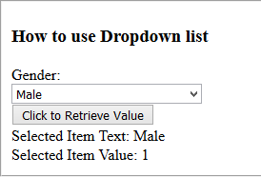
Example – DropdownList Control
protected void btnSubmit_Click(object sender, EventArgs e)
{
//Retrieve Selected Text from Dropdown
lblSelectedText.Text = ddlGender.SelectedItem.Text;
//Retrieve Selected Value from Dropdown
lblSelectedValue.Text = ddlGender.SelectedValue;
}
Output

Slide 44
CheckBoxList Control
CheckBoxList control is a control that groups a collection of checkable list items.
Example
<asp:CheckBoxList ID="chklstStates" runat="server">
<asp:ListItem Text="Gujarat“ Value ="Gujarat"></asp:ListItem>
<asp:ListItem Text="Maharastra" Value="Maharastra"> </asp:ListItem>
<asp:ListItem Text="Bihar" Value="Bihar"></asp:ListItem>
<asp:ListItem Text="Assam" Value="Assam"></asp:ListItem>
<asp:ListItem Text="Goa" Value="Goa"></asp:ListItem>
</asp:CheckBoxList>

Slide 45
Example – CheckBoxList Control
<div>
<fieldset>
<h3>How to use Checkbox list control</h3>
<div>
<asp:CheckBoxList ID="chklstStates" runat="server">
<asp:ListItem Text="Gujarat" Value="Gujarat"></asp:ListItem>
<asp:ListItem Text="Maharastra" Value="Maharastra"></asp:ListItem>
<asp:ListItem Text="Bihar" Value="Bihar"></asp:ListItem>
<asp:ListItem Text="Assam" Value="Assam"></asp:ListItem>
<asp:ListItem Text="Goa" Value="Goa"></asp:ListItem>
</asp:CheckBoxList>
</div>
<asp:Button ID="btnShow" runat="server" Text="Submit" OnClick="btnShow_Click" />
</fieldset>
</div>
<div>
<fieldset>
<h3>Selected States:</h3>
<div>
<asp:Label ID="lblStates" runat="server"></asp:Label>
</div>
</fieldset>
</div>

Slide 46
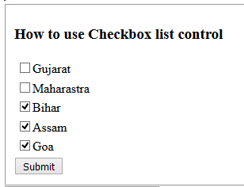
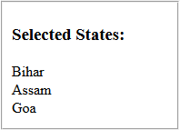
Example – CheckBoxList Control
protected void btnShow_Click(object sender, EventArgs e)
{
foreach (ListItem item in chklstStates.Items)
{
if (item.Selected)
lblStates.Text += item.Text + "<br/>";
}
}
Output

Slide 47
RadioButtonList Control
RadioButtonList control enable user to select an item from list that groups a collection of radiobuttons.
Example
<asp:RadioButtonList ID="rbtLstRating" runat="server" RepeatDirection="Horizontal" RepeatLayout="Table">
<asp:ListItem Text="Excellent" Value="Excellent"></asp:ListItem>
<asp:ListItem Text="Very Good" Value="Very Good"></asp:ListItem>
<asp:ListItem Text="Good" Value="Good"></asp:ListItem>
<asp:ListItem Text="Bad" Value="Bad"></asp:ListItem>
</asp:RadioButtonList>

Slide 48
Example – RadioButtonList Control
<div>
<fieldset>
<h3>How to use Radiobutton list control</h3>
<div>
<asp:RadioButtonList ID="rbtLstRating" runat="server" RepeatDirection="Horizontal" RepeatLayout="Table">
<asp:ListItem Text="Excellent" Value="Excellent"></asp:ListItem>
<asp:ListItem Text="Very Good" Value="Very Good"></asp:ListItem>
<asp:ListItem Text="Good" Value="Good"></asp:ListItem>
<asp:ListItem Text="Bad" Value="Bad"></asp:ListItem>
</asp:RadioButtonList>
</div>
<asp:Button ID="btnChoice" runat="server" Text="Submit" OnClick="btnChoice_Click" />
<h3>Selected Rating:</h3>
<div>
<asp:Label ID="lblSelectedRating" runat="server"></asp:Label>
</div>
</fieldset>
</div>

Slide 49
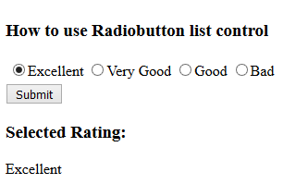
Example – RadioButtonList Control
protected void btnChoice_Click(object sender, EventArgs e)
{
if (rbtLstRating.SelectedItem != null)
{
lblSelectedRating.Text = rbtLstRating.SelectedItem.Text;
}
}
Output

Slide 50

ListBox Control
ListBox control is used to give a single or multiple select options to the user from multiple listed items.
Example
<asp:ListBox ID="lstColor" runat="server">
<asp:ListItem Text="Red" Value="red"></asp:ListItem>
<asp:ListItem Text="Blue" Value="blue"></asp:ListItem>
<asp:ListItem Text="Green" Value="green"></asp:ListItem>
<asp:ListItem Text="Pink" Value="pink"></asp:ListItem>
</asp:ListBox>

Slide 51
Properties of ListBox Control
Property | Description
Rows | No. of rows (items) can be set to display in the List.
SelectionMode | Single or Multiple. If multiple, it allows user to select multiple items from the list by holding Ctrl or Shift key.
SelectedValue | Get the value of the Selected item from the List box.
SelectedIndex | Gets or Sets the index of the selected item in the List box.
SelectedItem | Gets the selected item from the list.
Items | Gets the collection of items from the List box.
DataTextField | Name of the data source field to supply the text of the items. (No need to set when you are adding items directly into .aspx page.)
DataValueField | Name of the data source field to supply the value of the items. (No need to set when you are adding items directly into .aspx page.)

Slide 52
ASP.NET Validation Controls
Validation is important part of any web application. User's input must always be validated before sending across different layers of the application.
Validation controls are used to:
To validate user input data.
Data format, data type and data range is used for validation.
Validation is of two types:
Client Side
Server Side

Slide 53
ASP.NET Validation Controls Cont..
Client side validation is good but we have to be dependent on browser and scripting language support.
Client side validation is considered convenient for users as they get instant feedback.
The main advantage is that it prevents a page from being postback to the server until the client validation is executed successfully.
For developers point of view server side is preferable because it will not fail, it is not dependent on browser and scripting language.

Slide 54
ASP.NET Validation Controls Cont..
There are different validation controls for specific types of validation in ASP.NET, such as range checking, pattern matching etc.
With client-side validation, any errors are detected on the client end when the form is submitted to the server.
If any of the validators are found to be in error, the submission of the form to the server is cancelled and the validator's ErrorMessage property is displayed.
This permits the user to correct the input before submitting the form to the server.

Slide 55
ASP.NET Validation Controls Cont..
Control | Description
RequiredFieldValidator | Ensures that the user does not skip an entry.
CompareValidator | Compares a user's entry with a constant value or a property value of another control using a comparison operator (less than, equal to, greater than, and so on).
RangeValidator | Checks that a user's entry is between specified lower and upper boundaries. You can check ranges within pairs of numbers, alphabetic characters, or dates. Boundaries can be expressed as constants.
RegularExpressionValidator | Checks that the entry matches a pattern defined by a regular expression. E.g. social security numbers, e-mail addresses, telephone numbers, postal codes, and so on.
CustomValidator | Checks the user's entry using validation logic that you code yourself. This type of validation allows you to check for values derived at run time.
ValidationSummary | Displays the validation errors in summary form for all of the validators on a page.

Slide 56
Common Properties : Validation Controls
Property | Description
ErrorMessage | The ErrorMessage property is commonly used to provide different messages for the validation control and the ValidationSummary control.
ControlToValidate | The programmatic ID of the input control that the validation control will evaluate. If this is not a legitimate ID, an exception is thrown.
ValidationGroup | Specifies the name of the validation group to which this validation control belongs.
IsValid | Indicates whether the input control specified by the ControlToValidate property is determined to be valid.
ForeColor | Specifies the color in which to display the inline message when validation fails.
SetFocusOnError | Indicates whether focus is set to the control specified by the ControlToValidate property when validation fails.
Display | The display behavior for the specified validation control. This property can be one of the following values:

Slide 57
Common Properties : Validation Controls
Property | Description
Display | None The validation control is never displayed inline. Use this option when you want to show the error message only in a ValidationSummary control. Static The validation control displays an error message if validation fails. Space is allocated on the Web page for the error message even if the input control passes validation. The layout of the page does not change when the validation control displays its error message. Because the page layout is static, multiple validation controls for the same input control must occupy different physical locations on the page. Dynamic Space for the error message is allocated dynamically on the page when validation fails. This allows multiple validation controls to share the same physical location on the page.

Slide 58
RequiredFieldValidation Control
The RequiredFieldValidator control is simple validation control, which checks to see if the data is entered for the input control or not.
You can have a RequiredFieldValidator control for each form element on which you wish to enforce mandatory Field rule.
Example
<asp:RequiredFieldValidator ID="rfvPassword" runat="server" ErrorMessage="Password Required" ControlToValidate="txtPassword">
</asp:RequiredFieldValidator>

Slide 59

CompareValidator Control
The CompareValidator control allows you to make comparison to compare data entered in an input control with a constant value or a value in a different control.
It can most commonly be used when you need to confirm password entered by the user at the registration time. The data is always case sensitive.
Example
<asp:CompareValidator ID="cmpComfirmPassword" runat="server" ErrorMessage="Password Mismatch" ForeColor="Red" ControlToValidate="txtConfirmPassword" ControlToCompare="txtPassword"></asp:CompareValidator>

Slide 60
CompareValidator Control Cont..
Important Properties
Property | Description
Type | Specifies the data type of the values being compared.
Operator | The Operator property allows you to specify the type of comparison to perform, such as greater than, equal to, and so on.
ValueToCompare | Instead of comparing the values of two input controls, you can compare the value of an input control to a constant value. Specify the constant value to compare with by setting the ValueToCompare property.
ControlToCompare | If you want to compare a specific input control with another input control, set the ControlToCompare property with the name of the control to compare.

Slide 61
RangeValidator Control
The RangeValidator Server Control is another validator control, which checks to see if a control value is within a valid range.
The attributes that are necessary to this control are: MaximumValue, MinimumValue, and Type.
Example
<asp:RangeValidator ID="rngCPI" runat="server" ErrorMessage="CPI Must Be In 0 to 10" ForeColor="Red" ControlToValidate="txtCPI" MaximumValue="10" MinimumValue="0"></asp:RangeValidator>

Slide 62
RegularExpressionValidator Control
A regular expression is a powerful pattern matching language that can be used to identify simple and complex characters sequence that would otherwise require writing code to perform.
Using RegularExpressionValidator server control, you can check a user's input based on a pattern that you define using a regular expression.
If you don't find your desired regular expression, you can create your custom one.

Slide 63
RegularExpressionValidator Cont..
Example
<asp:RegularExpressionValidator ID="rgeEmail" runat="server" ErrorMessage="Enter Proper Email" ForeColor="Red" ControlToValidate="txtEmail"
ValidationExpression="\w+([-+.']\w+)*@\w+([-.]\w+)*\.\w+([-.]\w+)*">
</asp:RegularExpressionValidator>

Slide 64
CustomValidator Control
You can solve your purpose with ASP.NET validation controls. But if you still don't find solution you can create your own custom validator control.
The CustomValidator Control can be used on client side and server side. JavaScript is used to do client validation and you can use any .NET language to do server side validation.
Example
<asp:CustomValidator ID="cvTerms" runat="server" ErrorMessage="Sorry ! You must accept our terms & condition" ClientValidationFunction="ValidateCheckBox" ForeColor="Red" />

Slide 65
Example - CustomValidator Control
<html xmlns="http://www.w3.org/1999/xhtml">
<head runat="server">
<title>Custom Validation</title>
<script type = "text/javascript">
function ValidateCheckBox(sender, args)
{
if (document.getElementById("<%=ChkTerms.ClientID %>").checked == true)
{
args.IsValid = true;
}
else
{
args.IsValid = false;
}
}
</script>
</head>
<body>
<form id="form1" runat="server">
<div>
<asp:TextBox ID="txtTerms" runat="server" Text="All prices are f.o.b. point of manufacture. Seller reserves the right to place a service charge on past due accounts at the highest rate permitted by law." ReadOnly="true" TextMode="MultiLine"></asp:TextBox><br />
<asp:CheckBox ID="ChkTerms" runat="server" Text="Accept Terms & Condition"/>
<asp:CustomValidator ID="cvTerms" runat="server" ErrorMessage="Sorry ! You must accept our terms & condition" ClientValidationFunction="ValidateCheckBox" ForeColor="Red" /><br />
<asp:Button ID="btnAgree" runat="server" Text="Agree" />
</div>
</form>
</body>
</html>

Slide 66
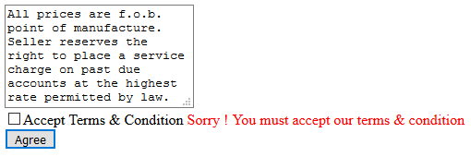
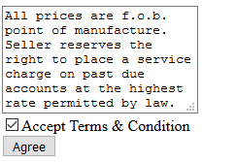
Output - CustomValidator Control

Slide 67

ValidationSummary Control
The ValidationSummary control is reporting control, which is used by the other validation controls on a page.
You can use this validation control to consolidate errors reporting for all the validation errors that occur on a page instead of leaving this up to each and every individual validation control.
The validation summary control will collect all the error messages of all the non-valid controls and put them in a list.
Example
<asp:ValidationSummary ID="valSummary" runat="server" ValidationGroup="Save" ForeColor="Red"/>

Slide 68
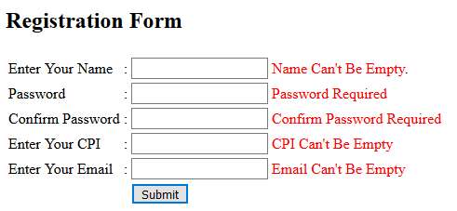
Example – Validation Control

Slide 69
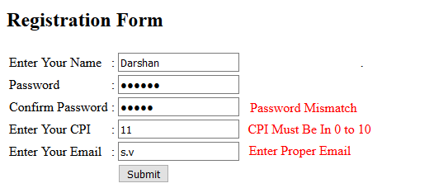
Example – Validation Control

Slide 70
Login Controls
Internet is now emerging as the most widely used medium for performing various tasks, such as online shopping, data exchanging and bank transactions etc.
All this Information and data need to be secured against unauthorized access from malicious and illegal sources.
We know that, we need to write large piece of code to create forms and user interfaces for authenticating the user.
It is very time consuming so that Microsoft developed a new series of server controls, called login controls.

Slide 71
Login Controls Cont..
There are following Login controls which are used in ASP.NET Website as given below:-
Login
LoginName
LoginStatus
LoginView
PasswordRecovery
ChangePassword
CreateUserWizard

Slide 72
Login Control Cont..
The ASP.NET login controls provide a login solution for ASP.NET Web applications without requiring programming.
It provides you with a ready-to-use user interface that queries the user name and password from the user and offers a Log In button for login.
Login control displays a user interface for user authentication.
It also allows users to indicate whether they want to store their identity and automatically authenticated the next time they visit the site.

Slide 73
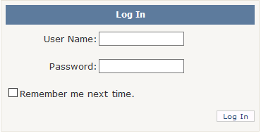
Login Control Cont..
It authenticate the username and password and grant the access to the desired services on the basis of the credentials.

Slide 74

LoginName Control
The LoginName Control is responsible for display the names of all the authenticated users. If users are not logged in, then this control is not displayed on the page.
This control uses the Page.User.Identity.Name namespace to return the value for the user's name.

Slide 75
LoginStatus Control
The LoginStatus control specifies whether a particular user has logged on to the website or not.
When the user is not logged in, this control display the Login text as a hyperlink. When the user is logged in, this control display the logout text as a hyperlink.
To do this, LoginStatus control uses the authentication section of the web.config file.

Slide 76
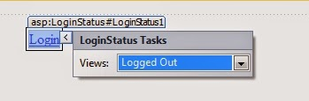
LoginStatus Control Cont..
LoginStatus control provides the following two views:-
LoggedIn :- It will be displayed, when the user is not Logged In.
Logout :- It will be displayed when the user is Logged In.

Slide 77
LoginView Control
The LoginView Control is a web server control, which is used to display two different views of a web page of any website.
Depending on whether the any user has logged on to a web page as anonymous user or registered user.
If the user is authenticated, the control displays the appropriate to the person with the help of the following views template.
Anonymous Template
This template (default of all) will be displayed when any user just open the web page but not logged in.

Slide 78
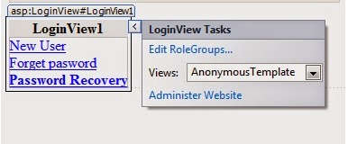
LoginView Control Cont..
LoggedInTemplate
This Template (page)will be displayed when the user in logged in.
RoleGroups
This template will be displayed when user logged in, that is the member of the specific role (defined role group).

Slide 79
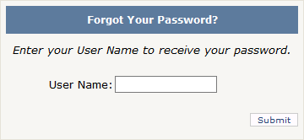
PasswordRecovery Control
The PasswordRecovery control is used to recover or reset the forgotten password of a user.
This control does not display the password on the browser, but it sends the password to the respective email address whatever you have specified at the time of registration.

Slide 80
PasswordRecovery Control Cont..
This control has included three views as given below:-
UserName :- It refers to the view that accepts the username of a user.
Question :- It accepts the security questions asked from the users.
Success :- It display a message to the user that retrieved password has been set to the user.

Slide 81
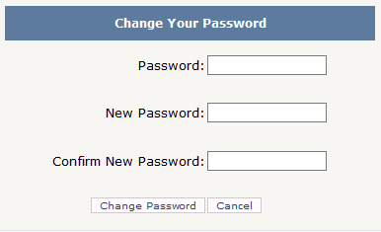
ChangePassword Control
Using this control, user can easily change their existing password (old password) on the ASP.NET Website.
This control prompts the user to provide the current password first and then set the new password.

Slide 82
ChangePassword Control
If the old password is not correct then new password can't be set.
This is also helps to send the email to the respective users about the new password.
This control is used ChangePassword class.

Slide 83
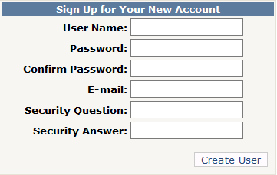
CreateUserWizard Control
The CreateUserWizard control is provides by the CreateUserWizard class and it can be customized by using template and style properties.
Using this control any user can easily create an account and login to the web page.

Slide 84
Thank you

