Slide 1
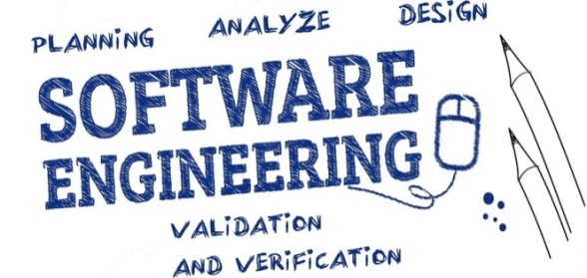

Unit-1 Introduction to Software & Software Engineering
SOFTWARE ENGINEERING
2160701
Prof. Jignasu Mahidhareeya
jignasu.mahidhareeya@darshan.ac.in
+ 91 9890261198
Computer Engineering Darshan Institute of Engineering & Technology

Slide 2
Unit-1 Outlines
1.1 The Evolving Role of Software
1.2 Software Engineering: A Layered Technology
1.3 Software: A Crisis on the Horizon and Software Myths
1.4 Software Process Models
1.5 The Linear Sequential Model
1.6 The Prototyping Model
1.7 The RAD Model
1.8 Evolutionary Process Models
1.9 Agile Process Model
1.10 Component-Based Development
1.11 Product and Process

Slide 3
What is Software ?
Software is a set of computer programs that provides functionality and performs desired tasks.
Technical Definition
Software is:
Instructions: A computer programs which provides desired functions and performance while executed.
Data Structures: Enables program to adequately (effectively) manipulate (handle) information.
Documents: that describes the operation and use of program.

Slide 4
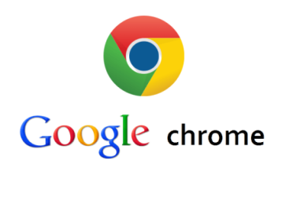




Software Examples
Examples
Operating Systems, Internet browser, Movie Player, Antivirus, Games etc…
Applications

Slide 5
What is Software Engineering ?
Software engineering
is the science and art of building (designing and writing programs) a software systems that are:
1) on time
2) on budget
3) with acceptable performance
4) with correct operation

Slide 6
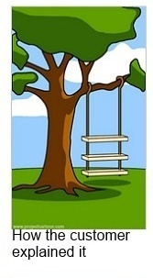






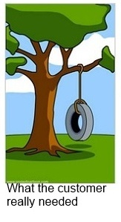

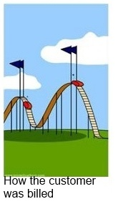
Product Development from an IT failures perspective
© http://www.projectcartoon.com/

Slide 7
1.1 The Evolving Role of Software
Dual Role of Software
A product
as an information transformer —
producing, managing, acquiring, modifying, displaying and/or transmitting information
The vehicle for delivering a product
as
the control of the computer (Ex. operating systems),
the communication of information (Ex. Networking software) and
the creation of other programs (Ex. software tools)

Slide 8
Software Applications
Software categorization based on their application areas
System Software
Business Software
Engineering and Scientific Software
Personal Computer Software
Web-based Software
Artificial Intelligence Software
Real-time System
Embedded System

Slide 9




1) System Software
Interacts with hardware and provides interface to other applications.
Examples
Operating System, Device Driver, Compiler, File Management Utilities etc…
Applications

Slide 10


2) Business Software
Software applications that are used by business users to perform various business functions.
Examples
Accounting System, Enterprise resource planning (ERP) etc…
Applications

Slide 11
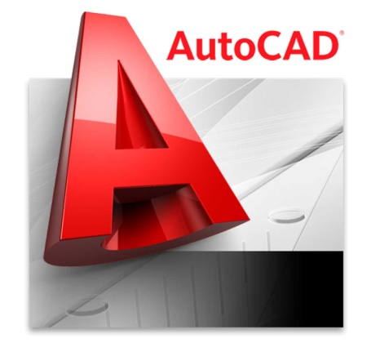

3) Engineering and Scientific Software
Number crunching algorithms used to solve scientific problems
Examples
Matlab, Autocad etc…

Slide 12



4) Personal Computer Software
Prolific (productive) application domain
Examples
Word processing software, Spreadsheets, Multimedia Software etc…
Applications

Slide 13



5) Web-based Software
The web pages retrieved by a web browser
Examples
Websites, Webpages
Applications

Slide 14


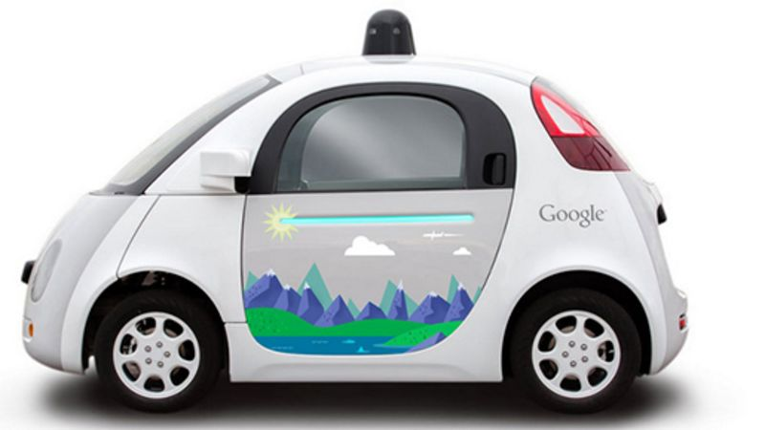
6) Artificial Intelligence Software
Computer systems able to perform tasks normally requiring human intelligence
Examples
Speech Recognition, Visual Perception, Decision-making and Translation between Languages etc..
Applications

Slide 15
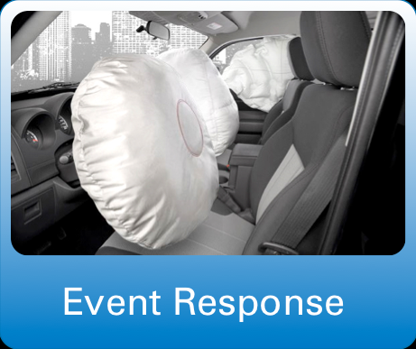
7) Real-time System
Monitor, Analyse and Control the real time events.
Examples
Vehicle Event Controller, Radar, Air traffic control system etc…
Applications

Slide 16
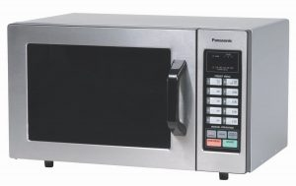
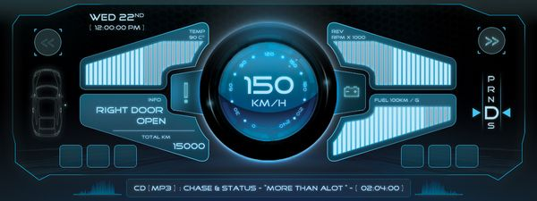
8) Embedded System
Resides in read-only memory (ROM) of a device and is used to control its functions
Examples
Keypad Control for a Microwave Oven, Digital Functions in an Automobile such as Fuel Indicator, Dashboard Displays and Braking Systems
Applications

Slide 17
Software Characteristics
Software is a logical rather than a physical system (Physical Product).
Therefore, software product has characteristics that are considerably different than hardware (physical products)
Software is developed or engineered, it is not manufactured in the classical sense.
Software doesn't "wear out.“
Although the industry is moving toward component-based assembly, most software continues to be custom built.

Slide 18
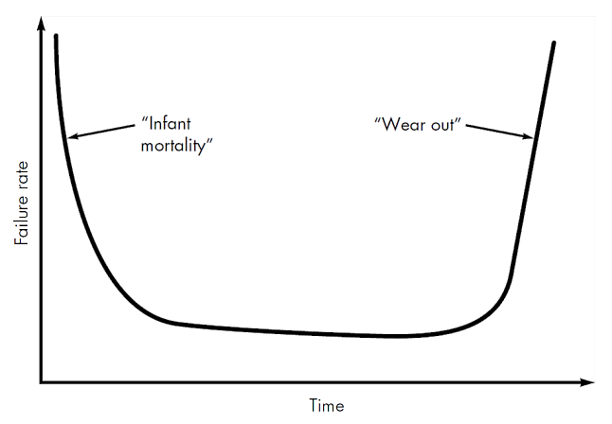
Hardware Failure curve

Slide 19
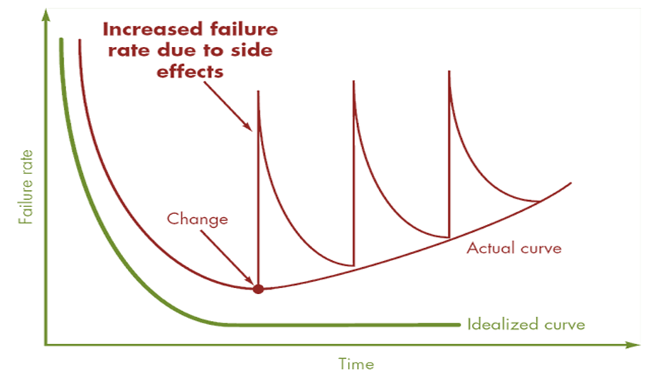
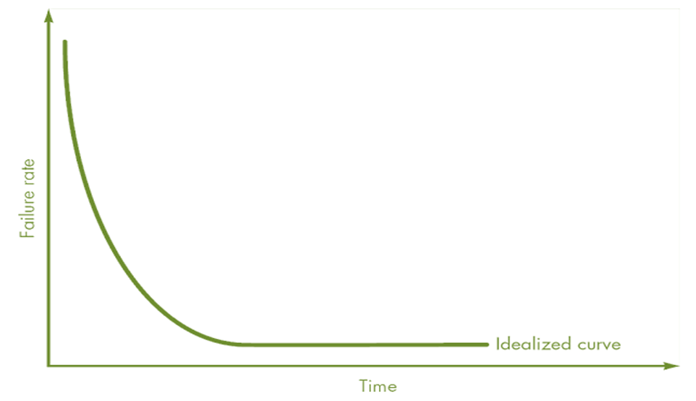
Software Failure curve

Slide 20
1.2 Software Engineering: A Layered Technology
Software engineering in practice is built of 3 main layers
Process
Methods
Tools
3. Tools
2. Methods
1. Process
“Quality” focus

Slide 21
1.2 Software Engineering: A Layered Technology
Software Engineering Tools allows automation of activities which helps to perform systematic activities.
A system for the support of software development, called computer-aided software engineering (CASE).
Examples: Testing Tools, Bug/Issue Tracking Tools etc…
3. Tools
2. Methods
Practices with proven techniques to perform certain activities
Examples: Encompass a broad array of tasks that include communication, requirements analysis, design, construction, testing and support
1. Process
“Quality” focus
Foundation layer for software engineering.
Framework with order of activities.
Examples: Sequence of Requirement Gathering, Design, Development, Testing activities
Defines continuous process improvement principles

Slide 22
1.3 Software Myths
Beliefs about software and the process used to build it.
“Misleading Attitudes that cause serious problem” are myths.
Management Myths
Customer Myths
Practitioner's (Developer) Myths

Slide 23
1) Management Myths
Myth 1:
We have standards and procedures to build a system, which is enough.
Reality:
Are software practitioners aware of standard’s existence?
Does it reflect modern software engineering practice?
Is it complete?
Is it streamlined to improve time to delivery while still maintaining a focus on quality?
In many cases, the answer to all of these questions is "no.“

Slide 24
1) Management Myths (Cont…)
Myth 2:
We have the newest computers and development tools.
Reality:
It takes much more than the latest model computers to do high-quality software development.
Computer-aided software engineering (CASE) tools are more important than hardware.

Slide 25
1) Management Myths (Cont…)
Myth 3:
We can add more programmers and can catch up the schedule.
Reality:
Software development is not a mechanistic process like manufacturing.
In the words of Fred Brooks : "adding people to a late software project makes it later."
People who were working must spend time educating the newcomers.
People can be added but only in a planned and well-coordinated manner.

Slide 26
1) Management Myths (Cont…)
Myth 4:
I outsourced the development activity, now I can relax and can wait for the final working product.
Reality:
If an organization does not understand how to manage and control software projects internally, it will invariably struggle when it outsources software projects.

Slide 27
2) Customer Myths
Myth 1:
A general statement of objectives (requirements) is sufficient to start a development.
Reality:
Comprehensive (detailed) statements of requirements is not always possible, an ambiguous (unclear) “statement of objectives” can lead to disaster.
Unambiguous (clear) requirements can be gathered only through effective and continuous communication between customer and developer.

Slide 28
2) Customer Myths (Cont…)
Myth 2:
Requirement Changes can be easily accommodated because software is very flexible.
Reality:
It is true that software requirements change, but the impact of change varies with the time at which it is introduced.
When requirements changes are requested early the cost impact is relatively small.

Slide 29
3) Practitioner's (Developer) Myths
Myth 1:
Once we write the program, our job is done.
Reality:
Experts say "the sooner you begin 'writing code', the longer it will take you to get done."
Industry data indicates that 60 to 80 % effort expended on software will be after it is delivered to the customer for the first time.

Slide 30
3) Practitioner's (Developer) Myths (Cont…)
Myth 2:
I can’t access quality until it is running.
Reality:
One of the most effective software quality assurance mechanisms can be applied from the inception (beginning) of a project—the technical review.
Software reviews are more effective “quality filter” than testing for finding software defects.

Slide 31
3) Practitioner's (Developer) Myths (Cont…)
Myth 3:
Working program is the only deliverable work product.
Reality:
A working program is only one part of a software configuration.
A variety of work products (e.g., models, documents, plans) provide a foundation for successful engineering and, more important, guidance for software support.

Slide 32
3) Practitioner's (Developer) Myths (Cont…)
Myth 4:
Software engineering is about unnecessary documentation.
Reality:
Software engineering is not about creating documents. It is about creating a quality product.
Better quality leads to reduced rework. And reduced rework results in faster delivery times.

Slide 33
Software Process
A process is a collection of activities, actions and tasks that are performed when some work product is to be created.
Activity
to achieve a broad objective
is applied regardless of the application domain, size of the project, complexity of the effort
E.g. Communication with Stakeholders
Action
a set of tasks that produce a major work product
E.g. Architectural Design

Slide 34
Software Process (Cont…)
Task
Focuses on a small, but well-defined objective
E.g. Conducting a Unit Test

Slide 35
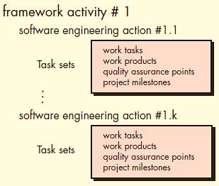
Generic Process Model
Software process
Process framework
Umbrella activities
.
.
.

Slide 36
Generic Process Framework Activities
It encompasses (covers) five activities
Communication
Communication with customers, stakeholders etc…
Requirements gathering and related activities
Planning
Defining workflow that is to follow
Describe technical task, risks, resources requirements and a work schedule

Slide 37
Generic Process Framework Activities (Cont..)
Modeling
Analysis of requirements
Design of software
Construction
Code generation
Testing
Deployment
Delivery to the customer
Customer feedback
Support

Slide 38
Umbrella Activities
Umbrella activities are applied throughout a software project and help a software team to manage and control; progress, quality, change and risk.
Software project tracking and control
allows the software team to assess progress against the project plan and take any necessary action to maintain the schedule.
Risk management
assesses (evaluates) risks that may affect the outcome of the project or the quality of the product.
Software quality assurance
defines and conducts the activities required to ensure software quality.

Slide 39
Umbrella Activities (Cont..)
Technical reviews
assesses software engineering work products in an effort to uncover and remove errors before they are propagated to the next activity.
Measurement
defines and collects process, project and product measures that assist the team in delivering software that meets stakeholders’ needs.

Slide 40
Umbrella Activities (Cont..)
Software configuration management
manages the effects of change throughout the software process.
Reusability management
defines criteria for work product reuse (including software components) and establishes mechanisms to achieve reusable components.
Work product preparation and production
encompasses (includes) the activities required to create work products such as models, documents, logs, forms and lists.

Slide 41
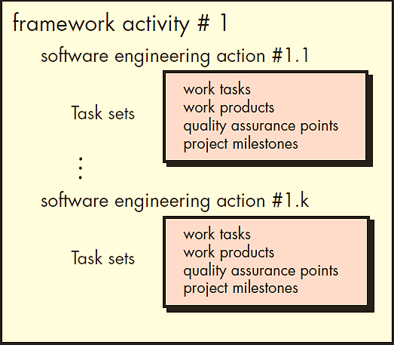
Identifying a Task Set
A task set defines the actual work to be done to accomplish (achieve) the objectives of a software engineering action.
A list of the task to be accomplished
A list of the work products to be produced
A list of the quality assurance filters to be applied
A list of the milestones (special events) to determine project status

Slide 42
1.4 Software Process Models
The process model is the abstract representation of process.
Also known as Software development life cycle (SDLC) or Application development life cycle Models
Process models prescribe a distinct set of activities, actions, tasks and milestones (deliverables) required to engineer high quality software.
Process models are not perfect, but provide roadmap for software engineering work.
Software models provide stability, control and organization to a process that if not managed can easily get out of control.
Software process models are adapted (adjusted) to meet the needs of software engineers and managers for a specific project.

Slide 43
SDLC Phases
Project Initiation
Requirements Gathering
Delivery
Support
Feedback
Communication
Estimation
Scheduling
Tracking
Deployment
Planning
SDLC
Analysis
Design
Coding
Testing
Construction
Modelling

Slide 44
1.5 The Linear Sequential Model (Waterfall model)
This Model also called as the Classic life cycle or the Waterfall model.
The Linear sequential model suggests a systematic sequential approach to software development.
Once a phase is complete, you cannot go back and repeat the process of previous phase.
Communication
Planning
Modelling
Construction
Deployment

Slide 45
1.5 The Linear Sequential Model (Cont…)
When to use ?
Requirements are very well known, clear and fixed
Product definition is stable
Technology is understood
There are no ambiguous (unclear) requirements
Ample (sufficient) resources with required expertise are available freely
The project is short

Slide 46
1.5 The Linear Sequential Model (Cont…)
Advantages
Simple to implement and manage
Drawbacks
Unable to accommodate changes at later stages, that is required in most of the cases.
Working version is not available during development. Which can lead the development with major mistakes.
Deadlock can occur due to delay in any step.
Not suitable for large projects.

Slide 47
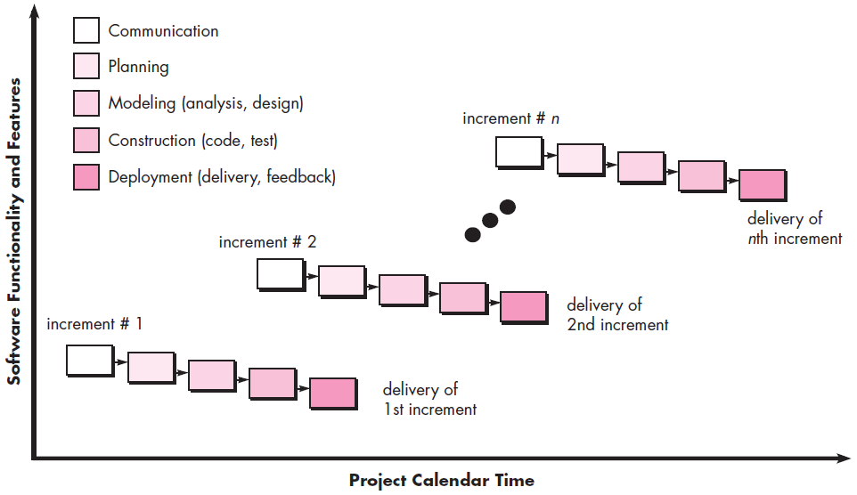
Incremental Model

Slide 48
Incremental Model (Cont…)
Waterfall model in iterative manner.
Initially core working product is delivered.
For example
word-processing software developed using the incremental model
might deliver basic file management, editing and document production functions in the first increment;
more sophisticated editing in the second increment;
spelling and grammar checking in the third increment; and
advanced page layout capability in the fourth increment.

Slide 49
Incremental Model (Cont…)
When to Use ?
The requirements of the complete system are clearly defined and understood.
Resources with needed skill set are not available at the beginning.
Advantages
Generates working software quickly and early during the software life cycle.
It is easier to test and debug during a smaller iteration.
Customer can respond to each built.
Lowers initial delivery cost.
Easier to manage risk because risky pieces are identified and handled during iteration.

Slide 50
Incremental Model (Cont…)
Disadvantages
Needs good planning and design.
Needs a clear and complete definition of the whole system before it can be broken down and built incrementally.
Total cost is higher than Waterfall.

Slide 51
1.7 RAD (Rapid Application Development) Model
Team-1
Modeling
Integration
Delivery
Feedback
Construction
Communication
Team-2
Planning
Modeling
Deployment
Construction
Team-3
Modeling
Component Reuse
Automatic Code Generation
Testing
Business Modeling
Data Modeling
Process Modeling
Construction

Slide 52
1.7 RAD Model (Cont…)
It is a type of incremental model in which; components or functions are developed in parallel.
Rapid development is achieved by component based construction
This can quickly give the customer something to see and use and to provide feedback.
Communication
to understand business problem.
Planning
multiple software teams work in parallel on different systems/modules.

Slide 53
1.7 RAD Model (Cont…)
Modeling
Business Modeling: Information flow among the business.
Ex. What kind of information drives (moves)?
Who is going to generate information?
From where information comes and goes?
Data Modeling: Information refine into set of data objects that are needed to support business.
Process Modeling: Data object transforms to information flow necessary to implement business.

Slide 54
1.7 RAD Model (Cont…)
Construction
It highlighting the use of pre-existing software component.
Deployment
Deliver to customer basis for subsequent iteration.
When to Use ?
There is a need to create a system that can be modularized in 2-3 months of time.
High availability of designers and budget for modeling along with the cost of automated code generating tools.
Resources with high business knowledge are available.

Slide 55
1.7 RAD Model (Cont…)
Advantages
Reduced development time.
Increases reusability of components.
Quick initial reviews occur.
Encourages customer feedback.
Integration from very beginning solves a lot of integration issues.

Slide 56
1.7 RAD Model (Cont…)
Drawback
For large but scalable projects, RAD requires sufficient human resources.
Projects fail if developers and customers are not committed in a much shortened time-frame.
Problematic if system can not be modularized.
Not appropriate when technical risks are high (heavy use of new technology).

Slide 57
1.8 Evolutionary Process Models
Produce an increasingly more complete version of the software with each iteration.
Evolutionary Models are iterative.
Evolutionary models
Prototyping Model
Spiral Model
Concurrent Development Model

Slide 58
1) The Prototyping Model
Serves as a mechanism for identifying software requirements.
Prototype can be serve as “the first system”.
Quick planning and modeling.
Feedback from customer/end user will refine requirement.
Both customers and developers like this paradigm.
Customer/End user gets a feel for the actual system.
Developer gets to build something immediately.
Quick Plan
Communication
Modeling:
Quick Design
Deployment:
Delivery
and Feedback
Prototype Construction

Slide 59
1) The Prototyping Model (Cont…)
When to Use ?
Customers are not sure about the detail input, output and requirements.
Developers are not sure about the technical feasibilities.
Problem Areas:
Customer demand that “a few fixes” be applied to make the prototype a working product, due to that software quality suffers as a result.
Developer often makes implementation in order to get a prototype working quickly; without considering other factors in mind like OS, Programming language, etc.

Slide 60
1) The Prototyping Model (Cont…)
Advantages
Users are actively involved in the development
Since in this methodology a working model of the system is provided, the users get a better understanding of the system being developed.
Errors can be detected much earlier.
Disadvantages
Leads to implementing and then repairing way of building systems.
Incomplete or inadequate (insufficient) problem analysis.

Slide 61
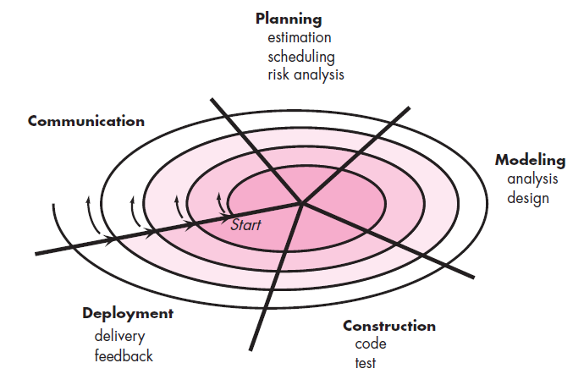
2) Spiral Model

Slide 62
2) Spiral Model (Cont…)
Couples iterative nature of prototyping with the controlled and systematic aspects.
Using spiral, software developed in a series of evolutionary release.
Early iteration, release might be on paper or prototype.
Later iteration, more complete version of software.
Divided into framework activities (C,P,M,C,D). Each activity represent one segment.

Slide 63
2) Spiral Model (Cont…)
When to use Spiral Model?
When costs and risk evaluation is important.
For medium to high-risk projects.
Users are unsure of their needs.
Requirements are complex.
New product line.
Significant (considerable) changes are expected.

Slide 64
2) Spiral Model (Cont…)
Advantages
High amount of risk analysis hence, avoidance of Risk is enhanced.
Good for large projects.
Strong approval and documentation control.
Additional Functionality can be added at a later date.
Software is produced early in the Software Life Cycle.
Disadvantages
Can be a costly model to use.
Risk analysis requires highly specific expertise.
Project’s success is highly dependent on the risk analysis phase.
Doesn’t work well for smaller projects.

Slide 65
3) Concurrent Development Model
Inactive
Allow a software team to represent iterative and concurrent elements of any of the process models.
The Figure shows modeling may be in any one of the states at any given time.
Each activity, action or task on the network exists simultaneously (all together) with other activities, actions or tasks.
Modeling Activity
Under Development
Awaiting Changes
Under Review
Under Revision
Baselined
Done

Slide 66
3) Concurrent Development Model (Cont…)
For example,
Communication activity has completed its first iteration and is in the awaiting changes state.
The modeling activity was in inactive state, now makes a transition into the under development state.

Slide 67
1.9 Agile Process Model
Agile SDLC model is a combination of iterative and incremental process models with focus on process adaptability and customer satisfaction by rapid delivery of working software product.
Agile Methods break the product into small incremental builds.
Every iteration involves functional teams working simultaneously on various areas like planning, requirements analysis, design, coding, unit testing, and acceptance testing.

Slide 68
1.9 Agile Process Model
Planning
Req. Analysis
Designing
Building
Testing
Iteration 1
2-3 Months
Planning
Req. Analysis
Designing
Building
Testing
Iteration 2
2-3 Months
Planning
Req. Analysis
Designing
Building
Testing
Iteration 3

Slide 69
1.9 Agile Process Model (Cont…)
Advantages
Customer satisfaction by rapid, continuous delivery of useful software.
Customers, developers and testers constantly interact with each other.
Daily cooperation between business people and developers.
Continuous attention to technical excellence (quality) and good design.
Regular adaptation to changing circumstances.

Slide 70
1.9 Agile Process Model (Cont…)
Disadvantages
In case of some software, it is difficult to estimate the effort required at the beginning of the software development life cycle.
The project can easily get “off track” if the customer representative is not clear about final outcome, that they want.
Only senior programmers are capable of taking the kind of decisions required during the development process.

Slide 71
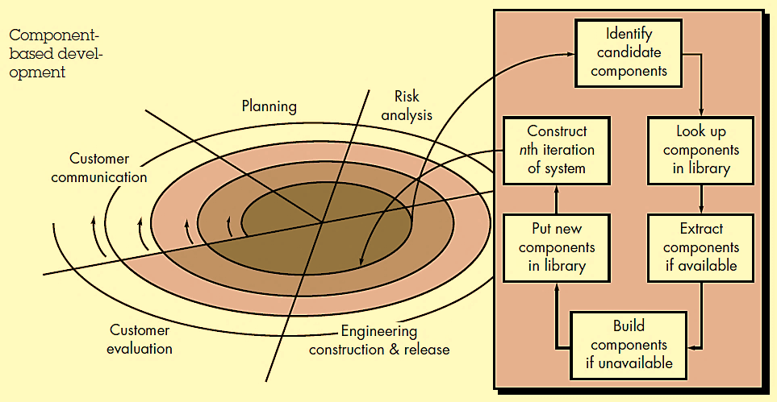
1.10 Component-Based Development

Slide 72
1.10 Component-Based Development (Cont…)
Consists of the following process steps
Available component-based products are researched and evaluated for the application domain.
Component integration issues are considered.
A software architecture is designed to accommodate the components.
Comprehensive (complete) testing is conducted to ensure proper functionality.
Relies on a robust (healthy) component library.
Capitalizes (take advantage) on software reuse, which leads to savings in project cost and time.

Slide 73
1.11 Product and Process
If the process is weak, the end product will suffer. But an overreliance (more confidence) on process is also dangerous.
People derive (gain) as much (or more) satisfaction from the creative process as they do from the end product.
Like an artist enjoys the brush strokes as much as the framed result.
A writer enjoys the search for the proper metaphor (comparison) as much as the finished book.
As creative software professional, you should also derive as much satisfaction from the process as the end product.
The duality (contrast) of product and process is one important element in keeping creative people engaged as software engineering continues to evolve.

Slide 74
Unit-1 Summary
What is Software and Software Engineering?
Product Development from an IT failures perspective
The Evolving Role of Software
Software Applications
Software Characteristics
Software Engineering: A Layered Technology
Software Myths
Software Process
Generic Process Model
Software Process Models (SDLC)
Linear Sequential Model (Waterfall Model)
Incremental Model
RAD Model
Evolutionary Process Models
Prototyping Model
Spiral Model
Concurrent Development Model
Agile Process Model
Component-Based Development
Product and Process

