Slide 1


Unit-10 Advanced Topics in Software Engineering
SOFTWARE ENGINEERING
2160701
Prof. Jignasu Mahidhareeya
jignasu.mahidhareeya@darshan.ac.in
+ 91 9890261198
Computer Engineering Darshan Institute of Engineering & Technology

Slide 2
Outlines
Component-Based Software Engineering
Client/Server Software Engineering
Web Engineering
Computer-Aided Software Engineering

Slide 3
Component-Based Software Engineering
Component-based software engineering (CBSE) is a process that makes the design and construction of computer-based systems using reusable software “components”.
CBSE seems quite similar to conventional or object-oriented software engineering.
The process begins when a software team establishes requirements for the system to be built.

Slide 4
Activities
Component Qualification
Component qualification ensures that a component will
perform the function required
will properly “fit” into the architectural style specified for the system
will have the quality characteristics (e.g., performance, reliability, usability) that are required for the application.
Component Adaptation
Domain engineering creates a library of components that can be easily integrated into an application architecture.
The implication of “easy integration” is that
(1) consistent methods of resource management have been implemented for all components in the library

Slide 5
Activities (Cont…)
(2) common activities such as data management exist for all components
(3) interfaces within the architecture and with the external environment have been implemented in a consistent manner.
Component Composition
Architectural style again plays a key role in the way in which software components are integrated to form a working system.
Component Update
When systems are implemented with a third party components, update is complicated.
i.e., the organization that developed the reusable component may be outside the control of the software engineering organization.

Slide 6
Client/Server Software Engineering
Two approaches are most commonly used
An evolutionary paradigm that makes use of event-based and/or object-oriented software engineering.
Component based software engineering that draws on a library of COTS (commercial off-the-shelf) and in-house software components.
Client/server systems are developed using the classic software engineering activities - analysis, design, construction and testing.

Slide 7
Software Components for Client/Server Systems
Instead of viewing software as a monolithic application to be implemented on one machine,
the software has several distinct subsystems that can be allocated to the client, the server or distributed between both machines.
User interaction/presentation subsystem
This subsystem implements all functions that are typically associated with a graphical user interface.
Application subsystem.
This subsystem implements the requirements defined by the application.

Slide 8
Software Components for Client/Server Systems
Database management subsystem.
This subsystem performs the data manipulation and management required by an application.
Data manipulation and management may be as simple as the transfer of a record or as complex as the processing of SQL transactions.

Slide 9
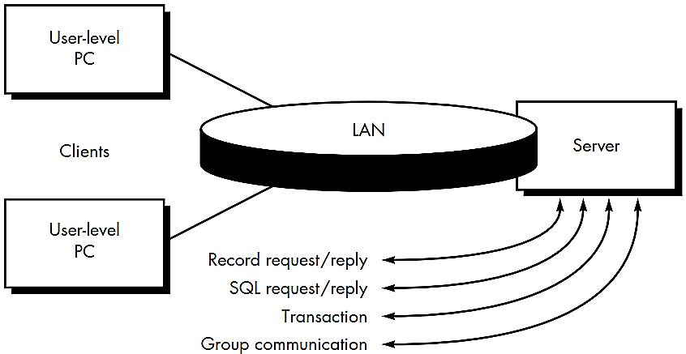
Structure of Client/Server System

Slide 10
Structure of Client/Server System (Cont…)
File servers
The client requests specific records from a file, the server transmits these records to the client across the network.
Database servers
The client sends structured query language (SQL) requests to the server.
These are transmitted as messages across the network.
The server processes the SQL request and finds the requested information, passing back the results only to the client.
Transaction servers
The client sends a request that invokes remote procedures at the server site.
The remote procedures are a set of SQL statements.

Slide 11
Structure of Client/Server System (Cont…)
A transaction occurs when a request results in the execution of the remote procedure with the result transmitted back to the client.
Groupware servers
When the server provides a set of applications that enable communication among clients (and the people using them) using text, images, bulletin boards, video, and other representations, a groupware architecture exists.

Slide 12
Web Engineering
Web engineering is the process used to create high-quality Web Apps.
Web engineering is not a perfect clone of software engineering, but it borrows many of software engineering’s fundamental concepts and principles, emphasizing the same technical and management activities.
Web Engineering (WebE) is concerned with the establishment and use of sound scientific, engineering and management principles.
It is a systematic approach to the successful development, deployment and maintenance of high quality Web-based systems and applications.

Slide 13
Web Engineering Process
The characteristics of Web-based applications have a impact on the WebE process.
Immediacy and continuous evolution require an iterative, incremental process model that produces WebApp releases in rapid sequence.
The network-intensive nature of applications in this domain suggests a population of users that is diverse and an application architecture that can be highly specialized.
Because WebApps are often content driven with an emphasis on aesthetics
It is likely that parallel development activities will be scheduled within the WebE process and involve a team of both technical and non-technical people.

Slide 14
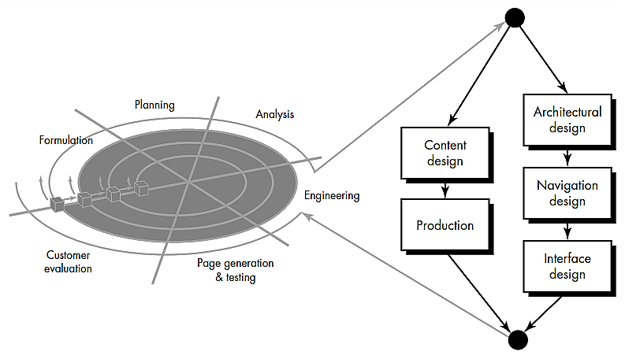
Frame work for Web Engineering

Slide 15
Frame work for Web Engineering (Cont…)
As WebApps evolve from static (content-directed information) to dynamic (user-directed application environments) the need to apply solid management and engineering principles grows.
To accomplish this, it is necessary to develop a WebE framework that encompasses an effective process model.
The WebE process begins with a formulation
An activity that identifies the goals
Objectives of the WebApp and establishes the scope for the first increment.
Planning estimates
overall project cost
evaluates risks associated with the development effort

Slide 16
Frame work for Web Engineering (Cont…)
defines a finely granulated development schedule for the initial WebApp increment
and a more granulated schedule for subsequent increments.
Analysis establishes technical requirements for the WebApp and identifies the content items that will be incorporated.
Requirements for graphic design (aesthetics) are also defined.
The engineering activity incorporates two parallel tasks illustrated on the right side of Figure.
Content design and Content production are tasks performed by nontechnical members of the WebE team.
The intent of these tasks is to design, produce and/or acquire all text, graphics, audio, and video content that are to be integrated into the WebApp.

Slide 17
Frame work for Web Engineering (Cont…)
Page generation is a construction activity that makes heavy use of automated tools for WebApp creation.
Testing exercises
WebApp navigation;
attempts to uncover errors in scripts and forms;
ensure that the WebApp will operate correctly in different environments (e.g., with different browsers).
Each increment produced as part of the WebE process is reviewed during customer evaluation.
This is the point at which changes are requested (scope extensions occur).

Slide 18
Computer-Aided Software Engineering (CASE)
A CASE (Computer Aided Software Engineering) tool is a generic term used to denote any form of automated support for software engineering.
A CASE tool means any tool used to automate some activity associated with software development.
The primary reasons for using a CASE tool are:
To increase productivity
To help produce better quality software at lower cost

Slide 19
Components of CASE
Design
Generator
Analysis
tool
Drawing
Tool
Code
Generator
CASE
Repository
Document
Generator
Database
Generator
Error-checking
tool
Prototyping
Tool
Security and
Version Control
Screen and
Report Generator

Slide 20
Components of CASE (Cont…)
CASE repository
Central component of any CASE tool
Also known as the information repository or data dictionary
Centralized database
Allows easy sharing of information between tools and SDLC activities
Used to store graphical diagrams and prototype forms and reports during analysis and design workflows
Provides wealth of information to project manager and allows control over project
Facilitates reusability
Notes:
CASE repository
Stores the diagrams and other project information
Keeps track of how the diagrams fit together

Slide 21
Components of CASE (Cont…)
Diagramming tools
Allow you to represent a system and its components visually
Allows higher level processes to be easily decomposed
Can examine processes or data models at high or low level
Screen and report generators
Used to
Create, modify and test prototypes of computer displays and reports
Identify which data items to display or collect for each screen or report
Some tools have templates
Notes:
Diagramming tools
Allow you to draw DFDs, ERDs, use case diagrams, case diagrams
Allows you to use stepwise refinement in building models (work from high level to low level)

Slide 22
Components of CASE (Cont…)
Analysis tools
Generate reports that help identify possible inconsistencies, redundancies and omissions (deficiency)
Generally focus on
diagram completeness and consistency
data structures and usage
CASE documentation generator tools
Create standard reports based on contents of repository
Need textual descriptions of requirements, solutions, diagrams of data and processes, prototype forms and reports, program specifications and user documentation
High-quality documentation leads to 80% reduction in system maintenance effort in comparison to average quality documentation
Notes:
Analysis tools
Types of analyses depend on methodology used and features of CASE environment

Slide 23
CASE Tool Taxonomy (Classification)
Business process engineering tools
represent business data objects, their relationships and flow of the data objects between company business areas
Process modeling and management tools
represent key elements of processes and provide links to other tools that provide support to defined process activities
Project planning tools
used for cost and effort estimation and project scheduling
Risk analysis tools
help project managers build risk tables by providing detailed guidance in the identification and analysis of risks

Slide 24
CASE Tool Taxonomy (Cont…)
Requirements tracing tools
provide systematic database-like approach to tracking requirement status beginning with specification
Metrics and management tools
management oriented tools capture project specific metrics that provide an overall indication of productivity or quality
Documentation tools
provide opportunities for improved productivity by reducing the amount of time needed to produce work products

Slide 25
CASE Tool Taxonomy (Cont…)
System software tools
network system software, object management services, distributed component support and communications software
Quality assurance tools
metrics tools that audit source code to determine compliance with language standards or tools that extract metrics to project the quality of software
Database management tools
RDBMS and OODMS (object-oriented database management system) serve as the foundation for the establishment of the CASE repository
Software configuration management tools
uses the CASE repository to assist with all SCM tasks (identification, version control, change control, auditing, status accounting)

Slide 26
CASE Tool Taxonomy (Cont…)
Analysis and design tools
enable the software engineer to create analysis and design models of the system to be built, perform consistency checking between models
Simulation tools
simulation tools provide software engineers with ability to predict the behavior of real-time systems before they are built and the creation of interface mockups for customer review
Interface design and development tools
toolkits of interface components, often part environment with a GUI to allow rapid prototyping of user interface designs

Slide 27
CASE Tool Taxonomy (Cont…)
Prototyping tools
enable rapid definition of screen layouts, data design, and report generation
Programming tools
compilers, editors, debuggers, OO programming environments, graphical programming environments, applications generators, and database query generators
Web development tools
assist with the generation of web page text, graphics, forms, scripts, applets, etc.

Slide 28
CASE Tool Taxonomy (Cont…)
Integration and testing tools
data acquisition
get data for testing
static measurement
analyze source code without using test cases
dynamic measurement
analyze source code during execution
test management

Slide 29
CASE Tool Taxonomy (Cont…)
Static analysis tools
code-based testing tools, specialized testing languages, requirements-based testing tools
Dynamic analysis tools
intrusive tools modify source code by inserting probes (enquiry) to check path coverage, assertions or execution flow
Test management tools
coordinate regression testing, compare actual and expected output, conduct batch testing and serve as generic test drivers

Slide 30
CASE Tool Taxonomy (Cont…)
Client/server testing tools
exercise the GUI and network communications requirements for the client and server
Reengineering tools
reverse engineering to specification tools
generate analysis and design models from source code
code restructuring and analysis tools
analyze program syntax, generate control flow graph and automatically generates a structured program
on-line system reengineering tools
used to modify on-line DBMS

Slide 31
Summary
Component-Based Software Engineering
Client/Server Software Engineering
Web Engineering
Frame work for Web Engineering
Computer-Aided Software Engineering
Components of CASE
CASE Tool Taxonomy

