Slide 1
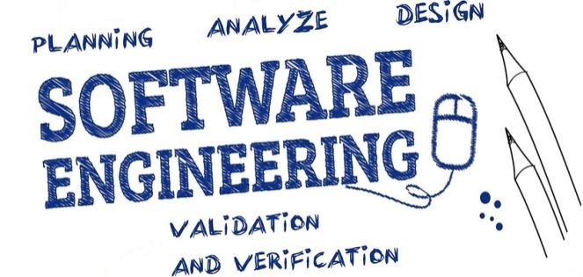

Unit-2 Agile Development
SOFTWARE ENGINEERING
2160701
Prof. Jignasu Mahidhareeya
jignasu.mahidhareeya@darshan.ac.in
+ 91 9890261198
Computer Engineering Darshan Institute of Engineering & Technology

Slide 2
Outlines
Agility and Agile Process Model
Extreme Programming
Other Process Model of Agile Development and Tools

Slide 3

What is Agility?
Effective response to change
Change
Request
Current Functionality
Change
Request
Current Functionality
© randomactsofleadership.com

Slide 4

What is Agility? (Cont…)
Effective communication among all stakeholders
© www.clipartkid.com

Slide 5

What is Agility? (Cont…)
Drawing the customer onto the team
Eliminate the “us and them” attitude
Software Development Team
Customer
© marketculture.files.wordpress.com

Slide 6
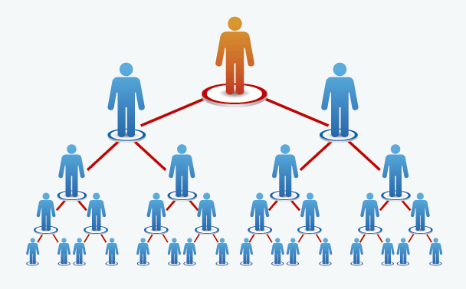
What is Agility? (Cont…)
Organizing a team so that it is in control to perform the work
Top Management
Project Manager
Team Lead
Senior Developer
Developer
© www.eudigital.co

Slide 7
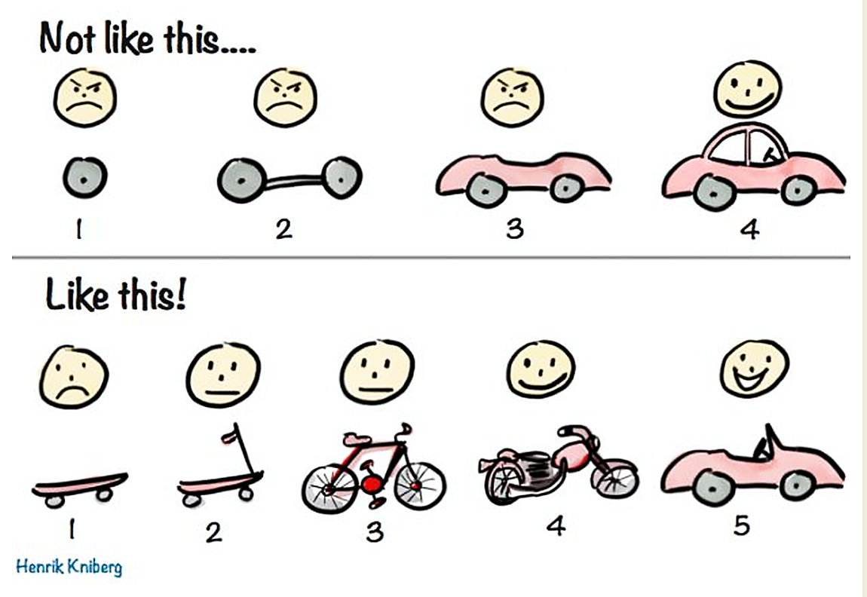
What is Agility? (Cont…)
Rapid and Incremental delivery of software
© herdingcats.typepad.com

Slide 8
Principles to achieve agility
Highest priority -> satisfy the customer
Welcome change requirements
Deliver working software frequently
Business people and developers must work together
Build projects around motivated individuals
Emphasize face-to-face conversation
Continuous attention to technical excellence and good design
Simplicity – the art of maximizing the amount of work
The best designs emerge from self-organizing teams
The team tunes and adjusts its behavior to become more effective

Slide 9
Agile Software Process – Key Assumptions
Difficulty in predicting changes of requirements and customer priorities.
For many types of software; design and construction are interleaved (mixed).
Analysis, design, construction and testing are not as predictable as we might like.

Slide 10
Agile Software Process
An agile process must be adaptable
It must adapt incrementally
Requires customer feedback
An effective catalyst (main source) for customer feedback is an operational prototype

Slide 11
Agile Process Models
Extreme Programming (XP)
Adaptive Software Development (ASD)
Dynamic Systems Development Method (DSDM)
Scrum
Feature Driven Development (FDD)
Crystal
Agile Modelling (AM)

Slide 12
Extreme Programming (XP)
The most widely used agile process, originally proposed by Kent Beck.
XP uses an object-oriented approach as its preferred development paradigm (ideal pattern).
Defines four framework activities
Planning
Design
Coding
Testing

Slide 13
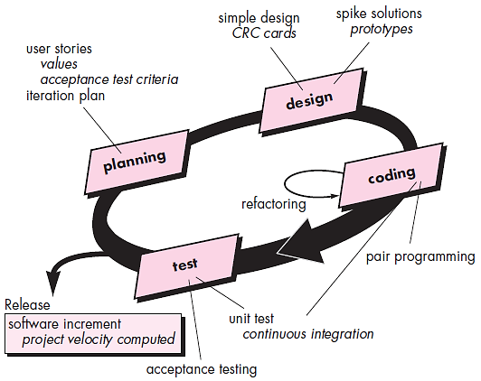
Extreme Programming (XP) (Cont…)
CRC: class-responsibility collaborator
© Roger S. Pressman

Slide 14
1. XP - Planning
User story-cards
Instead of creating large requirement documents user stories are written by the customer. In which what they need is mentioned.
Release planning
Release plan for overall project is prepared
From which the iteration plan can be prepared for individual module.
Small releases
Plan for releasing the small functionalities
Iterative process
Keep the iteration of nearly equal length
Stand up meetings
The stand up meetings must be conducted for the current outcomes

Slide 15
2. XP - Design
Simple design
It is always good to keep the things simple to meet the current requirements
Spike solution
For answering the tough technical problem
Refactoring
Reduction in the redundancy, elimination of unused functionalities

Slide 16
3. XP - Coding
Customer availability
In XP customer should be the part of the project development
Paired programming
All code must be coded by groups of two people working at the same computer
Collective code ownership
By having collective code ownership approach,
Everyone contributes new ideas
Anyone can change any line of code to fix a bug

Slide 17
4. XP - Testing
Unit testing
All the code must be tested by unit testing using test cases before its release
Continuous integration
As soon as one task is finished integrate it into the whole system
No overtime
Conduct the release plan meeting to change the scope or to reschedule the project delivery

Slide 18
Adaptive Software Development (ASD)
Adaptive Software Development (ASD) was proposed by Jim Highsmith.
This is a technique for building complex software systems using iterative approach.
ASD focus on working in collaboration and team self-organization.
ASD incorporates three phases
Speculation
Collaboration
Learning

Slide 19
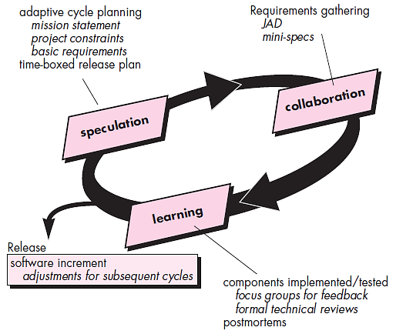
Adaptive Software Development (ASD)
JAD : Joint Application Development

Slide 20
Speculation
The adaptive cycle planning is conducted.
In this cycle planning mainly three types of information is used
Customer’s mission statement
Project constraints
Delivery date, budgets etc…
Basic requirements of the project

Slide 21
Collaboration
In this, collaboration among the members of development team is a key factor.
For successful collaboration and coordination it is necessary to have following qualities in every individual
Assist each other without resentment (offense)
Work hard
Posses the required skill set
Communicate problems and help each other
Criticize without any hate

Slide 22
Learning
Emphasize is on learning new skills and techniques.
There are three ways by which the team members learn
Focus groups
The feedback from the end-users is obtained.
Formal technical review
This review is conducted for better quality.
Postmortems
Team analyses its own performance and makes appropriate improvements.

Slide 23
Dynamic Systems Development Methods (DSDM)
It defines agile process model called DSDM life cycle.
Various phases of this life cycle model
Feasibility study
By analysing the business requirements and constraints the viability of the application is determined
Business study
The functional and informational requirements are identified and then the business value of the application is determined
Functional model iteration
The incremental approach is adopted for development
Design and build iteration
If possible design and build activities can be carried out in parallel

Slide 24
Dynamic Systems Development Methods (DSDM)
Implementation
The software increment is placed in the working environment
The DSDM can be combined with XP method or ASD concepts to create combinational model.

Slide 25
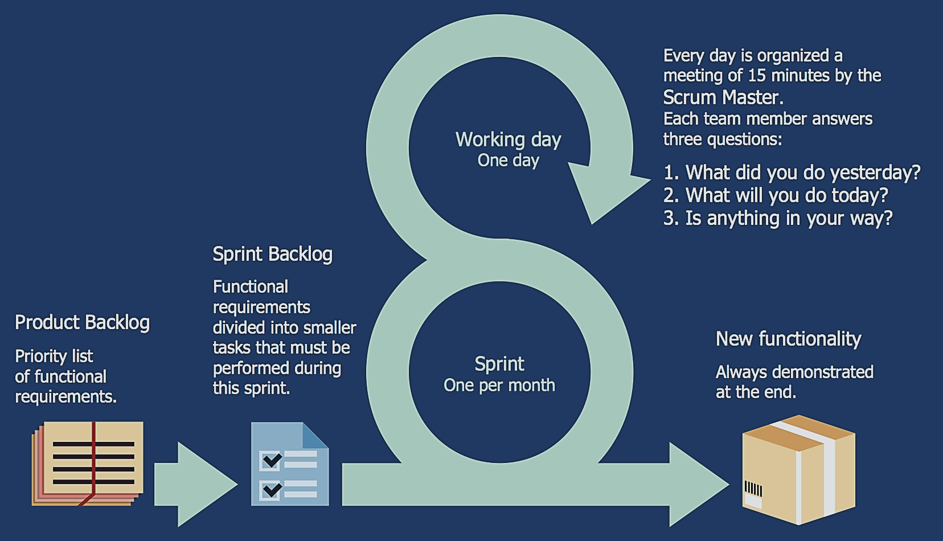
Scrum
© http://www.conceptdraw.com/examples/scrum-guide

Slide 26
Scrum
This model is developed by Jeff Sutherland and Ken Schwaber in 1995.
Scrum is an agile process model which is used for developing the complex software systems.
It is a lightweight process framework.
Lightweight means the overhead of the process is kept as small as possible in order to maximize the productivity.

Slide 27
Scrum Principles
There are small working teams on the projects due to which there is maximum communication and minimum overhead.
The task of people must be partitioned into small and clean packets.
The process must accommodate the technical or business changes if they occur.
The process should produce software increments.
During product building the constant testing and documentation must be conducted.
The SCRUM process must produce the working model of the product whenever required.

Slide 28
Scrum Development Activities
Backlog
It is a list of project requirements or features that must be provided to the customer.
The items can be included in the backlog at any time.
The product manager analyses this list and updates the priorities as per the requirements.
Sprint
These are the work units that are needed to achieve the requirements mentioned in the backlogs.
Typically the sprints have fixed duration or time box (of 2 to 4 weeks).
Thus sprints allow the team members to work in stable and short-term environment.

Slide 29
Scrum Development Activities
Meetings
There are 15 minutes daily meetings to report the completed activities, obstacles and plan for next activities.
Following are three questions that are mainly discussed during the meetings.
What are the tasks done since last meeting ?
What are the issues that team is facing ?
What are the next activities that are planned ?
Demo
During this phase implemented functionalities are demonstrated to the customer.

Slide 30
Roles (Scrum)
Scrum master
The scrum master leads the meeting and analyses the response of each team member.
The potential problems are discussed and solved in meeting with the help of scrum master.
Team members
These are the persons working in a team to develop the software solutions.

Slide 31
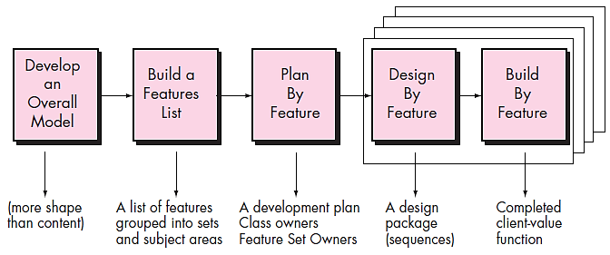
Feature Driven Development (FDD)
© Roger S. Pressman

Slide 32
Feature Driven Development (FDD)
Originally Peter Coad suggested this approach for object oriented software engineering.
Stephen Palmer and John Flesing has extended and enhanced Coad’s work.
In FDD, the feature means client valued function.
Various phases in the FDD life cycle
Develop overall model
The high-level walkthrough of scope and detailed domain walkthrough are conducted to create overall models.
Build feature list
List of features is created and expressed in the following form
<action> the <result> <by for of to> a(n) <object>
For Ex. “Display product-specifications of the product”

Slide 33
Feature Driven Development (FDD)
Plan by feature
After completing the feature list the development plan is created
Design by feature
For each feature the sequence diagram is created
Build by feature
Finally the class owner develop the actual code for their classes

Slide 34
Crystal
Alistair and Highsmith suggested the crystal family of agile methods.
In this method, a set of methodologies are defined which contains the core elements that are common to all.
This method also contains roles, process patterns, work products and practice that are unique to each.
Thus the crystal family is actually a set of agile processes that are useful for different types of projects.
The agile team has to select the members of the crystal family that is most appropriate for their ongoing project and environment.

Slide 35
Agile Modeling (AM)
Agile Modeling can be used for large and complex projects.
The problem can be partitioned effectively among the group of people.
And the quality of working model can be assessed at every step of development.
Scott Ambler described the Agile Modeling as
Agile modeling is a collection of values, principles and practices for modeling the software.
AM is a practice-based methodology for effective modeling and documentation.

Slide 36
Agile Modeling (AM)
Various features suggested for AM
Specify the purpose for the model
Goal and objective of the model must be known to developers
Make use of multiple models
Set of models can be useful for building desired software product
Follow a definite path
Use only those models that give long term value
Give importance to contents and not the presentation
Correct information is more important than the representation
Understand the models and supporting tools
Understand the strengths and weakness of the model and tools
Adapt locally
Needs of modeling must be satisfied by adopting appropriate model

Slide 37
Summary
What is Agility?
Principles to achieve agility
Agile Software Process – Key Assumptions
Agile Software Process
Agile Process Models
Extreme Programming (XP)
Adaptive Software Development (ASD)
Dynamic Systems Development Method (DSDM)
Scrum
Feature Driven Development (FDD)
Crystal
Agile Modelling (AM)

