Slide 1
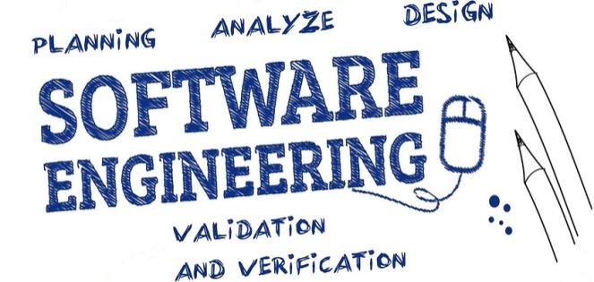

Unit-4 Requirement Analysis and Specification
SOFTWARE ENGINEERING
2160701
Prof. Jignasu Mahidhareeya
jignasu.mahidhareeya@darshan.ac.in
+ 91 9890261198
Computer Engineering Darshan Institute of Engineering & Technology

Slide 2
Outlines
Understanding the Requirement
Requirement Modeling
Software Requirement Specification (SRS)
Requirement Analysis and Requirement Elicitation
Requirement Engineering

Slide 3
Requirements Engineering
Requirement
A function, constraint or other property that the system must provide to fill the needs of the system’s intended user(s).
Engineering
Implies that systematic and repeatable techniques should be used.
Requirement Engineering
It is a systematic approach to define, manage and test requirements for a software.

Slide 4
Requirements Engineering Tasks
Requirements Engineering encompasses seven distinct tasks:
Inception (initiation)
Establish a basic understanding of the problem and the nature of the solution.
Elicitation (to gather)
Draw out the requirements from stakeholders.
Elaboration
Create an analysis model that represents information, functional, and behavioral aspects of the requirements.
Negotiation
Agree on a deliverable system that is realistic for developers and customers.

Slide 5
Requirements Engineering Tasks (Cont…)
Specification
Describe the requirements formally or informally.
Validation
Review the requirement specification for errors, ambiguities, omissions (absence) and conflicts.
Requirements Management
Manage changing requirements.

Slide 6
Eliciting Requirements
Requirements Elicitation (also called requirements gathering) combines elements of problem solving, elaboration, negotiation, and specification.
Requirements Elicitation encourages:
collaborative and team-oriented approach to requirements gathering
stakeholders work together to identify the problem
propose elements of the solution
negotiate different approaches
specify a preliminary set of solution requirements

Slide 7
Collaborative Requirements Gathering
The goal is to identify the problem, propose elements of the solution, negotiate different approaches and specify a preliminary set of solution requirements.
Facility Application Specification Technique (FAST) is an approach in which joint team of customers and developers work together to identify the requirements.
Guideline for FAST approach:
Meetings are conducted and attended by both software engineers and other stakeholders.
Rules for preparation and participation are established.
An agenda is suggested that is formal enough to cover all important points but informal enough to encourage the free flow of ideas.

Slide 8
Collaborative Requirements Gathering
A “facilitator” (can be a customer, a developer, or an outsider) controls the meeting.
A “definition mechanism” (can be work sheets, flip charts, or wall stickers or an electronic bulletin board, chat room, or virtual forum) is used.

Slide 9
Quality Function Deployment (QFD)
This is a technique that translates the needs of the customer into technical requirements for software.
It emphasizes an understanding of what is valuable to the customer and then deploys these values throughout the engineering process through functions, information, and tasks.
It identifies three types of requirements
Normal requirements
These requirements are the objectives and goals stated for a product or system during meetings with the customer.
Expected requirements
These requirements are implicit to the product or system and may be so fundamental that the customer does not explicitly state them.

Slide 10
Quality Function Deployment (Cont…)
Exciting requirements
These requirements are for features that go beyond the customer's expectations and prove to be very satisfying when present.

Slide 11
Usage Scenarios
As requirements are gathered, an overall vision of system functions and features begins to materialize (put into practice).
Users can create a set of scenarios that identify a thread of usage for the system to be constructed.
The scenarios, often called use cases.

Slide 12
Elicitation Work Products
The work products will vary depending on the system, but should include one or more of the following items.
A statement of need and feasibility.
A bounded statement of scope for the system or product.
A list of customers, users, and other stakeholders who participated in requirements elicitation.
A description of the system's technical environment.
A list of requirements (organized by function) and the domain constraints.
A set of preliminary usage scenarios (in the form of use cases) that provide insight into the use of the system under different operating conditions.
Any prototypes developed to better define requirements.

Slide 13
Building the Requirements Analysis Model
The intent of this model is to provide a description of the required informational, functional, and behavioral domains for a system.
The analysis model is a snapshot of requirements at any given time.
Elements of the Requirements Model:
Scenario-based elements
Describe the system from the user's point of view using scenarios that are depicted (stated) in use cases and activity diagrams.
Class-based elements
Identify the domain classes for the objects manipulated by the actors, the attributes of these classes, and how they interact with one another; which utilize class diagrams to do this.

Slide 14
Building the Requirements Analysis Model (Cont…)
Behavioral elements
Use state diagrams to represent the state of the system, the events that cause the system to change state, and the actions that are taken as a result of a particular event.
This can also be applied to each class in the system.
Flow-oriented elements
Use data flow diagrams to show the input data that comes into a system, what functions are applied to that data to do transformations, and what resulting output data are produced.

Slide 15
Use-Cases
A collection of user scenarios that describe the thread of usage of a system.
Each scenario is described from the point-of-view of an “actor”.
Actor: a person or device that interacts with the software.
Each scenario answers the following questions:
Who is the primary actor, the secondary actor (s)?
What are the actor’s goals?
What preconditions should exist before the story begins?
What main tasks or functions are performed by the actor?
What extensions might be considered as the story is described?
What variations in the actor’s interaction are possible?
What system information will the actor acquire, produce, or change?

Slide 16
Use-Cases (Cont…)
Will the actor have to inform the system about changes in the external environment?
What information does the actor desire from the system?
Does the actor wish to be informed about unexpected changes?

Slide 17
Use-Case Diagram
It is referred as the diagram used to describe a set of actions (use cases) that some system should perform in collaboration with system users.
Ex., Use Case diagram for SafeHome home security function
Arms/disarms System
Accesses System via Internet
Homeowner
Responds to
Alarm Event
Sensors
Encounters
an Error
Condition
Reconfigures Sensors and related System Features
System Administrator

Slide 18
Class Diagram
It describes the structure of a system by showing the system's classes, their attributes, operations (or methods), and the relationships among objects.
Ex., Class Diagram for sensor
Sensor
Name
Type
Location
Area
Characteristics
Identify()
Enable()
Disable()
Reconfigure()

Slide 19
State Diagram
It is used to describe the behavior of systems.
It requires that the system described is composed of a finite number of states.
Ex., State Diagram Notation
Reading
Commands
State Name
System status = “ready”
Display msg = “enter cmd”
Display status = steady
State Variables
Entry/subsystems ready
Do: poll user input panel
Do: read user input
Do: interpret user input
State Activities

Slide 20
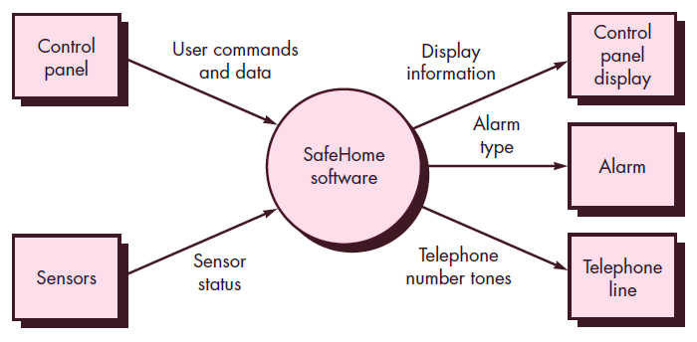
Data Flow Diagram (DFD)
It is a graphical representation of the "flow" of data through an information system, modelling its process aspects.
It is often used as a preliminary step to create an overview of the system, which can later be elaborated.
Ex., Context-level DFD for the SafeHome security function
@ Roger S. Pressman

Slide 21
Negotiating Requirements
Agree on a deliverable system that is realistic for developers and customers.
Activities in negotiation are:
Identify the key stakeholders
These are the people who will be involved in the negotiation.
Determine each of the stakeholders “win conditions”
Win conditions are not always obvious.
Negotiate
Work toward a set of requirements that lead to “win-win”.

Slide 22
Functional and non-functional requirements
Functional Requirements
Statements of services the system should provide.
How the system should react to particular inputs and should behave in particular situations.
Non-functional Requirements
Constraints on the services or functions offered by the system,
such as timing constraints, constraints on the development process, standards, etc.
Domain Requirements
Requirements that come from the application domain of the system and that reflect characteristics of that domain.

Slide 23
Software Requirements Specification

Slide 24
Software Requirements Specification
Software Requirement Specification (SRS) is a document that completely describes what the proposed software should do without describing how software will do it.
It contains:
a complete information description
a detailed functional description
a representation of system behaviour
an indication of performance requirements and design constraints
appropriate validation criteria
other information suitable to requirements
SRS is also helping the clients to understand their own needs.

Slide 25
Characteristics of a Good SRS
SRS should be accurate, complete, efficient, and of high quality
so that it does not affect the entire project plan.
An SRS is said to be of high quality when the developer and user easily understand the prepared document.
Characteristics of a Good SRS:
Correct
SRS is correct when all user requirements are stated in the requirements document.
Note that there is no specified tool or procedure to assure the correctness of SRS.
Unambiguous
SRS is unambiguous when every stated requirement has only one interpretation.

Slide 26
Characteristics of a Good SRS (Cont…)
Complete
SRS is complete when the requirements clearly define what the software is required to do.
Ranked for Importance/Stability
All requirements are not equally important, hence each requirement is identified to make differences among other requirements.
Stability implies the probability of changes in the requirement in future.
Modifiable
The requirements of the user can change, hence requirements document should be created in such a manner that those changes can be modified easily.
Traceable
SRS is traceable when the source of each requirement is clear and facilitates the reference of each requirement in future.

Slide 27
Characteristics of a Good SRS (Cont…)
Verifiable
SRS is verifiable when the specified requirements can be verified with a cost-effective process to check whether the final software meets those requirements.
Consistent
SRS is consistent when the subsets of individual requirements defined do not conflict with each other.

Slide 28
Standard Template for writing SRS
Front Page
Software Requirements Specification
for
<Project>
Version <no.>
Prepared by <author>
<organization>
<date created>
Table of Contents
Revision History

Slide 29
Standard Template for writing SRS (Cont…)
1. Introduction
1.1 Purpose
1.2 Document Conventions
1.3 Intended Audience and Reading Suggestions
1.4 Project Scope
1.5 References
2. Overall Description
2.1 Product Perspective
2.2 Product Features
2.3 User Classes and Characteristics
2.4 Operating Environment
2.5 Design and Implementation Constraints

Slide 30
Standard Template for writing SRS (Cont…)
2.6 User Documentation
2.7 Assumptions and Dependencies
3. System Features
3.1 System Feature 1
3.2 System Feature 2 (and so on)
4. External Interface Requirements
4.1 User Interfaces
4.2 Hardware Interfaces
4.3 Software Interfaces
4.4 Communications Interfaces

Slide 31
Standard Template for writing SRS (Cont…)
5. Other Nonfunctional Requirements
5.1 Performance Requirements
5.2 Safety Requirements
5.3 Security Requirements
5.4 Software Quality Attributes
6. Other Requirements
Appendix A: Glossary
Appendix B: Analysis Models
Appendix C: Issues List

Slide 32
Problems Without SRS
Without developing the SRS document, the system would not be properly implemented according to customer needs.
Software developers would not know whether what they are developing is what exactly is required by the customer.
Without SRS, it will be very difficult for the maintenance engineers to understand the functionality of the system.
It will be very difficult for user document writers to write the users’ manuals properly without understanding the SRS.

Slide 33
Summary
Requirements Engineering
Requirements Engineering Tasks
Eliciting Requirements
Collaborative Requirements Gathering
Quality Function Deployment
Usage Scenarios
Elicitation Work Products
Requirements Analysis Model
Use-Case Diagram
Class Diagram
State Diagram
Data Flow Diagram
Negotiating Requirements
Functional and non-functional requirements
SRS

