Slide 1


Unit-5 Software Design
SOFTWARE ENGINEERING
2160701
Prof. Jignasu Mahidhareeya
jignasu.mahidhareeya@darshan.ac.in
+ 91 9890261198
Computer Engineering Darshan Institute of Engineering & Technology

Slide 2
Outlines
Design Concepts and Design Principal
Architectural Design
Component Level Design (MS Visio Tool)
Function Oriented Design
Object Oriented Design
User Interface Design
Web Application Design

Slide 3
Design Concepts and Principles

Slide 4
Design Concepts
Software design concepts can be applied regardless of the software process model that is used.
Design task produces:
Architectural design
Data design
Component design
Interface design

Slide 5
Design Concepts (Cont…)
Architectural Design
It defines the relationship between major structural elements of the software.
Data Design
It transforms the information domain model into the data structures.
Data objects and relationships are defined using the entity relationship diagram.
Component-level Design
It transforms structural elements of the software architecture into a procedural description of software components.

Slide 6
Design Concepts (Cont…)
Interface Design
It describes how the software communicates within itself, with systems that interoperate with it, and with humans who use it.
An interface implies a flow of information and a specific type of behavior.

Slide 7
Design principles
Design process should not suffer from “tunnel vision”.
Design should be traceable to the analysis model.
Design should not reinvent the wheel.
Design should “minimize the intellectual distance” between the software and the real world problem.
Design should exhibit (present) uniformity and integration.
Design should be structured to accommodate change.
Design should be structured to degrade gently, even when abnormal data, events, or operating conditions are encountered.
Design is not coding, coding is not design.
Design should be assessed for quality as it is being created, not after the fact.
Design should be reviewed to minimize conceptual (semantic) errors.

Slide 8
Architectural Design

Slide 9
Software Architecture and Design
Architectural design represents the structure of data and program components.
It considers,
Architectural style that the system will take,
Structure and properties of the components that constitute the system, and
Interrelationships that occur among all architectural components of a system.
Representations of software architecture are an enabler for communication between all parties (stakeholders).
Architecture “constitutes a relatively small, intellectually graspable model of how the system is structured and how its components work together”

Slide 10
Architectural Styles
Data-centered architecture style
Data-flow architectures
Call and return architecture
Object-oriented architecture
Layered architecture

Slide 11
Architectural Styles (Cont…)
Each style describes a system category that encompasses,
A set of components (Ex., a database, computational modules) that perform a function required by a system.
A set of connectors that enable “communication, coordination and cooperation” among components.
Constraints that define how components can be integrated to form the system.
Semantic models that enable a designer to understand the overall properties of a system.

Slide 12
Architectural Styles (Cont…)
Data-centered architecture style
Data-flow architectures
Call and return architecture
Object-oriented architecture
Layered architecture

Slide 13
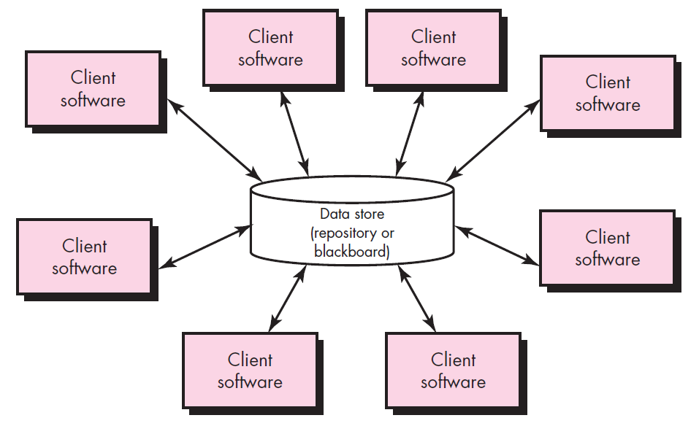
1. Data-centered architecture style

Slide 14
1. Data-centered architecture style
A data store (Ex., a file or database) resides at the center of this architecture and is accessed frequently by other components.
Client software accesses a central repository.
In some cases the data repository is passive.
That is, client software accesses the data independent of any changes to the data or the actions of other client software.

Slide 15
Architectural Styles (Cont…)
Data-centered architecture style
Data-flow architectures
Call and return architecture
Object-oriented architecture
Layered architecture

Slide 16
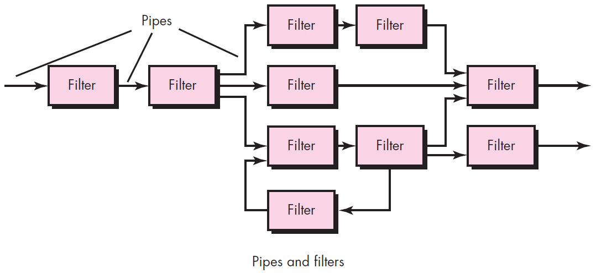
2. Data-flow architectures

Slide 17
2. Data-flow architectures
This architecture is applied when input data are to be transformed.
A set of components (called filters) connected by pipes that transmit data from one component to the next.
Each filter works independently of those components upstream and downstream, is designed to
expect data input of a certain form, and
produces data output (to the next filter) of a specified form.

Slide 18
Architectural Styles (Cont…)
Data-centered architecture style
Data-flow architectures
Call and return architecture
Object-oriented architecture
Layered architecture

Slide 19
3. Call and return architecture
This architectural style enables a software designer (system architect) to achieve a program structure that is relatively easy to modify and scale.
A number of sub styles exist within this category as below.
Main program/subprogram architectures
This classic program structure decomposes function into a control hierarchy where a “main” program invokes a number of program components, which in turn may invoke still other components.
Remote procedure call architectures
The components of a main program/subprogram architecture are distributed across multiple computers on a network.

Slide 20
Architectural Styles (Cont…)
Data-centered architecture style
Data-flow architectures
Call and return architecture
Object-oriented architecture
Layered architecture

Slide 21
4. Object-oriented architecture
The components of a system encapsulate data and the operations that must be applied to manipulate the data.
Communication and coordination between components is accomplished via message passing.

Slide 22
Architectural Styles (Cont…)
Data-centered architecture style
Data-flow architectures
Call and return architecture
Object-oriented architecture
Layered architecture

Slide 23
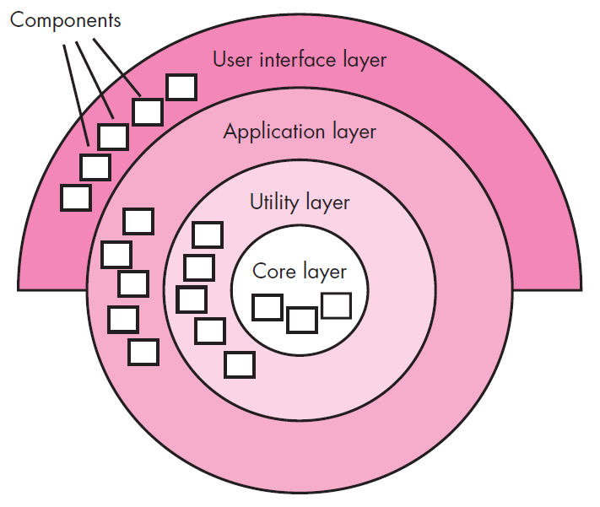
5. Layered architecture

Slide 24
5. Layered architecture
A number of different layers are defined, each accomplishing operations that progressively become closer to the machine instruction set.
At the outer layer, components service user interface operations.
At the inner layer, components perform operating system interfacing.
Intermediate layers provide utility services and application software functions.

Slide 25
Data Design

Slide 26
Data Design
This section describes data design at both the architectural and component levels.
At the architecture level, data design is the process of creating a model of the information represented at a high level of abstraction (using the customer's view of data).

Slide 27
Data Design at the Architectural Level
The challenge is extract useful information from the data environment.
To solve this challenge, the business IT community has developed data mining techniques, (KDD - knowledge discovery in databases)
that navigate through existing databases in an attempt to extract appropriate business-level information.
The existence of multiple databases, their different structures, and the degree of detail make data mining difficult within an existing database environment.
An alternative solution, called a data warehouse, adds on additional layer to the data architecture.
A data warehouse is a separate data environment that is not directly integrated with day-to-day applications.

Slide 28
Data Design at the Component Level
At the component level, data design focuses on specific data structures which are required to be manipulated by a component.
Refine data objects and develop a set of data abstractions
Implement data object attributes as one or more data structures
Review data structures to ensure that appropriate relationships have been established
Set of principles for data specification:
The systematic analysis principles applied to function and behavior should also be applied to data.
All data structures and the operations to be performed should be identified.
A data dictionary should be established and used to define both data and program design.

Slide 29
Data Design at the Component Level
Low level data design decisions should be deferred until late in the design process.
The representation of data structure should be known only to those modules that must make direct use of the data.
A library of useful data structures and the operations that may be applied to them should be developed.
A software design and programming language should support the specification and realization of abstract data types.

Slide 30
Component-Level Design

Slide 31
Component-Level Design or Procedural Design
Component is a modular, deployable and replaceable part of a system that encapsulates implementation and exposes a set of interfaces.
Component-level design occurs after data, architectural and interface designs have been established.
It defines the data structures, algorithms, interface characteristics, and communication mechanisms allocated to each component.
The intent is to translate the design model into operational software.
But the abstraction level of the existing design model is relatively high and the abstraction level of the operational program is low.

Slide 32
1. Function Oriented Approach
The following are the features of a typical function-oriented design approach:
A system is viewed as something that performs a set of functions.
Starting at this high level view of the system, each function is successively refined into more detailed functions.
For example, consider a function create-new-library member
which essentially creates the record for a new member, assigns a unique membership number to him, and prints a bill towards his membership charge.
This function may consist of the following sub-functions:
assign-membership-number, create-member-record and print-bill
Each of these sub-functions may be split into more detailed sub-functions and so on.

Slide 33
1. Function Oriented Approach (Cont…)
The system state is centralized and shared among different functions.
For Ex., data such as member-records is available for reference and updating to several functions such as:
create-new-member
delete-member
update-member-record

Slide 34
2. Object Oriented Approach
In the object-oriented design approach, the system is viewed as collection of objects (i.e., entities).
The state is decentralized among the objects and each object manages its own state information.
For example, in a Library Automation Software,
each library member may be a separate object with its own data and functions to operate on these data.
In fact, the functions defined for one object cannot refer or change data of other objects.
Objects have their own internal data which define their state.

Slide 35
Cohesion and Coupling
Cohesion
Cohesion is an indication of the relative functional strength of a module.
A cohesive module performs a single task, requiring little interaction with other components.
Stated simply, a cohesive module should (ideally) do just one thing.
Coupling
Coupling is an indication of the relative interdependence among modules.
If two modules interchange large amounts of data, then they are highly interdependent.

Slide 36
Cohesion and Coupling (Cont…)
A module having high cohesion and low coupling is said to be functionally independent of other modules.
By the term functional independence, we mean that a cohesive module performs a single task or function.

Slide 37

Classification of Cohesion

Slide 38
Classification of Cohesion (Cont…)
Coincidental cohesion
A module is said to have coincidental cohesion, if it performs a set of tasks that relate to each other very loosely.
For Ex., in a transaction processing system (TPS), the get-input, print-error, and summarize-members functions are grouped into one module.
Logical cohesion
A module is said to be logically cohesive, if all elements of the module perform similar operations.
For Ex., error handling, data input, data output, etc.

Slide 39
Classification of Cohesion (Cont…)
Temporal cohesion
When a module contains functions that are related by the fact that all the functions must be executed in the same time span.
For Ex., the set of functions responsible for initialization, start-up, shutdown of some process, etc.
Procedural cohesion
If the set of functions of the module are all part of a procedure (algorithm) in which certain sequence of steps have to be carried out for achieving an objective
For Ex., the algorithm for decoding a message.
Communicational cohesion
If all functions of the module refer to the same data structure
For Ex., the set of functions defined on an array or a stack.

Slide 40
Classification of Cohesion (Cont…)
Sequential cohesion
If the elements of a module form the parts of sequence, where the output from one element of the sequence is input to the next.
For Ex., In a TPS, the get-input, validate-input, sort-input functions are grouped into one module.
Functional cohesion
If different elements of a module cooperate to achieve a single function.
For Ex., A module containing all the functions required to manage employees’ pay-roll exhibits functional cohesion.

Slide 41

Classification of Coupling

Slide 42
Classification of Coupling (Cont…)
Data coupling
Two modules are data coupled, if they communicate through a parameter.
An example is an elementary (primal) data item passed as a parameter between two modules, e.g. an integer, a float, a character, etc.
Stamp coupling
If they communicate using a composite data item such as a structure in C.
Control coupling
If data from one module is used to direct the order of instructions execution in another.
An example of control coupling is a flag set in one module and tested in another module.

Slide 43
Classification of Coupling (Cont…)
Common coupling
Two modules are common coupled, if they share data through some global data items.
Content coupling
Content coupling exists between two modules, if they share code.

Slide 44
User Interface Design

Slide 45
User Interface Design
User interface design creates an effective communication medium between a human and a computer.
By following a set of interface design principles,
designer identifies interface objects and actions and then creates a screen layout that forms the basis for a user interface prototype.

Slide 46
Design Rules for User Interface

Slide 47
1. Place the User in Control
During a requirements-gathering session for a major new information system, a key user was asked about.
Following are the design principles that allow the user to maintain control:
Define interaction modes in a way that does not force a user into unnecessary or undesired actions.
Provide for flexible interaction.
Allow user interaction to be interruptible and undoable.
Streamline interaction as skill levels advance and allow the interaction to be customized.
Hide technical internals from the casual user.
Design for direct interaction with objects that appear on the screen.

Slide 48
2. Reduce the User’s Memory Load
The more a user has to remember, the more error-prone the interaction with the system will be.
Following are the design principles that enable an interface to reduce the user’s memory load:
Reduce demand on short-term memory.
Establish meaningful defaults.
Define shortcuts that are intuitive.
The visual layout of the interface should be based on a real-world metaphor.
Disclose information in a progressive fashion.

Slide 49
3. Make the Interface Consistent
The interface should present and acquire information in a consistent fashion.
Following are the design principles that help make the interface consistent:
Maintain consistency across a family of applications.
If past interactive models have created user expectations, do not make changes unless there is a compelling (convincing) reason to do so.

Slide 50
User Interface Analysis and Design Models
User profile model – Established by a software engineer
Establishes the profile of the end-users of the system
based on age, gender, physical abilities, education, cultural background, motivation, goals, and personality.
Design model – Created by a software engineer
Derived from the analysis model of the requirements.
Incorporates data, architectural, interface, and procedural representations of the software.
Implementation model – Created by the software implementers
Consists of the look and feel of the interface combined with all supporting information (books, videos, help files) that describe system syntax and semantics.

Slide 51
User Interface Analysis and Design Models
User's mental model – Developed by the user when interacting with the application
Often called the user's system perception.
Consists of the image of the system; that users carry in their heads.
The role of the interface designer is to merge these differences and derive a consistent representation of the interface.

Slide 52
Web Application Design

Slide 53
Web Application Design
Design for WebApp encompasses technical and nontechnical activities that include:
establishing the look and feel of the WebApp
defining the overall architectural structure
developing the content and functionality that reside within the architecture
planning the navigation that occurs within the WebApp

Slide 54
WebApp Design Quality Requirement

Slide 55
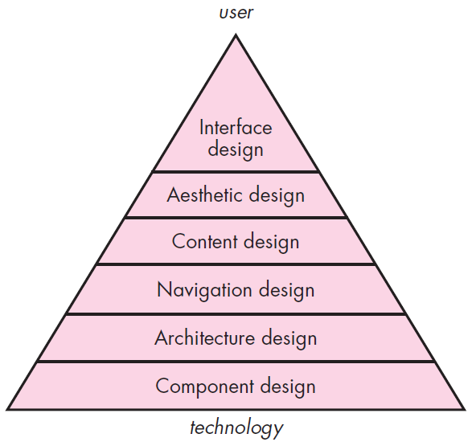
Web App Interface Design
The objectives of a WebApp interface are to:
Establish a consistent window into the content and functionality provided by the interface.
Guide the user through a series of interactions with the WebApp.
Organize the navigation options and content available to the user.
Design pyramid for WebApps

Slide 56
Design pyramid for WebApps
Interface Design
One of the challenges of interface design for WebApps is the nature of the user’s entry point.
Aesthetic Design
Also called graphic design, is an artistic endeavor (offer) that complements the technical aspects of WebApp design.
Content Design
Generate content and design the representation for content to be used within aWebApp.
Architecture Design
It is tied to the goals established for a WebApp,
the content to be presented, the users who will visit, and the navigation that has been established.

Slide 57
Design pyramid for WebApps (Cont…)
Navigation Design
Define navigation pathways that enable users to access WebApp content and functions.
Component-Level Design
Modern WebApps deliver increasingly sophisticated processing functions that,
Perform localized processing to generate content and navigation capability in a dynamic fashion,
Provide computation or data processing capability that are appropriate for the WebApp’s business domain.
Provide sophisticated database query and access.
Establish data interfaces with external corporate systems.

Slide 58
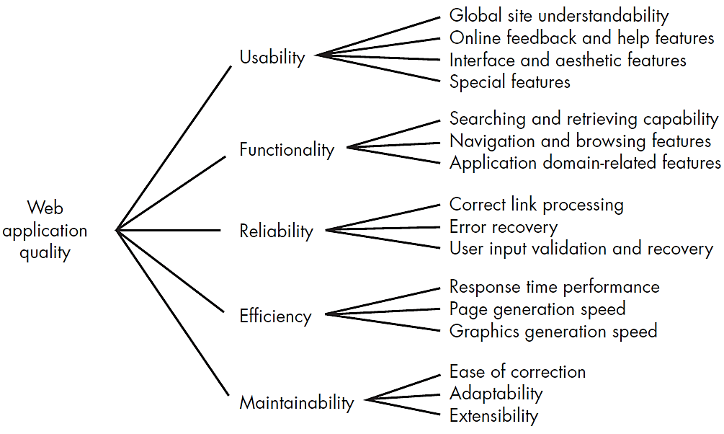
WebApp Design Quality Requirement
Design is the engineering activity that leads to a high-quality product.

Slide 59
Summary
Design Concepts
Design principles
Architectural Design
Architectural Styles
Data-centered architecture style
Data-flow architectures
Call and return architecture
Object-oriented architecture
Layered architecture
Component-Level Design
Function Oriented Approach
Object Oriented Approach
Cohesion and Coupling
User Interface Design
Design Rules for User Interface
Web Application Design

