Slide 1


Unit-6 Software Coding & Testing
SOFTWARE ENGINEERING
2160701
Prof. Jignasu Mahidhareeya
jignasu.mahidhareeya@darshan.ac.in
+ 91 9890261198
Computer Engineering Darshan Institute of Engineering & Technology

Slide 2
Outlines
Coding Standard and Coding Guidelines
Code Review
Software Documentation
Testing Strategies
Testing Techniques and Test Case
Test Suites Design
Testing Conventional Applications
Testing Object Oriented Applications
Testing Web and Mobile Applications

Slide 3
Coding Standard and Guidelines

Slide 4
Coding
Software development organizations require their programmers to adhere (follow) well-defined and standard style of coding.
Most software development organizations formulate their own coding standards that suit them most.
Purpose of following a standard style of coding is:
A coding standard gives a uniform appearance to the codes.
It enhances code understanding.
It encourages good programming practices.
A coding standard lists several rules to be followed such as,
the way variables are to be named
the way the code is to be laid out
error return conventions, etc.

Slide 5
Coding standards and guidelines
The following are some representative coding standards
Rules for limiting the use of global.
Contents of the headers preceding codes for different modules.
Naming conventions for global variables, local variables, and constant identifiers.
Error return conventions and exception handling mechanisms.
Do not use a coding style that is too clever or too difficult to understand.
Avoid obscure (unclear) side effects.
Do not use an identifier for multiple purposes.
The code should be well-documented.
The length of any function should not exceed 10 source lines.
Do not use goto statements.

Slide 6
Code Review Code Walk Through Code Inspection

Slide 7
Code Review
Code Review is carried out after the module is successfully compiled and all the syntax errors have been eliminated.
Code Reviews are extremely cost-effective strategies for reduction in coding errors and to produce high quality code.
Two types of reviews are carried out on the code of a module.
Code Inspection
Code Walk Through

Slide 8
Code Walk Through
Code Walk Through is an informal code analysis technique.
This technique is applied after a module has been coded, successfully compiled and all syntax errors eliminated.
A few members of the team are given the code before the walk through meeting to read and understand code.
Each member selects some test cases and simulates execution of the code.
Objectives of the walk through are to discover the algorithmic and logical errors.
Even though a code walk through is an informal analysis technique,
several guidelines have evolved to make this technique more effective.

Slide 9
Code Inspection
The aim of Code Inspection is to discover some common types of errors caused due to improper programming.
In other words, during Code Inspection the code is examined for the presence of certain kinds of errors.
For instance, consider the classical error of writing a procedure that modifies a parameter while the calling routine calls that procedure with a constant actual parameter.
It is more likely that such an error will be discovered by looking for these kinds of mistakes in the code.
In addition to this, adherence to coding standards is also checked.
Software Development Companies collect statistics regarding different types of errors commonly committed.

Slide 10
Software Documentation
Various kinds of documents such as users’ manual, software requirements specification (SRS) documents, design documents, test documents, installation manual, etc. are also developed as part of any software engineering process.
Different types of software documents can broadly be classified into the following:
Internal Documentation
External Documentation

Slide 11
Internal Documentation
It is the code comprehension (perception) features provided as part of the source code.
It is provided through appropriate module headers and comments embedded in the source code.
It is also provided through the useful variable names, module and function headers, code indentation, code structuring, use of enumerated types and constant identifiers, use of user-defined data types, etc.
Even when code is carefully commented, meaningful variable names are still more helpful in understanding a piece of code.
Good organizations ensure good internal documentation by appropriately formulating their coding standards and guidelines.

Slide 12
External Documentation
It is provided through various types of supporting documents
such as users’ manual, software requirements specification document, design document, test documents, etc.
A systematic software development style ensures that all these documents are produced in an orderly fashion.

Slide 13
Testing Strategies
It is a critical element of software quality assurance and represents the ultimate (absolute) review of specification, design, and code generation.
Usually a software development organization pays 30 to 40 percent of total project effort on testing.
The engineer creates a series of test cases to "defeat“ (to fail) the software that has been built.
In fact, testing is the one step in the software process that could be viewed (psychologically, at least) as destructive rather than constructive.

Slide 14
Type of Testing Approach
Verification and Validation approach.
Verification
refers to the set of activities that ensure that software correctly implements a specific function.
"Are we building the product right?"
Validation
refers to a different set of activities that ensure that the software that has been built is traceable to customer requirements.
"Are we building the right product?

Slide 15
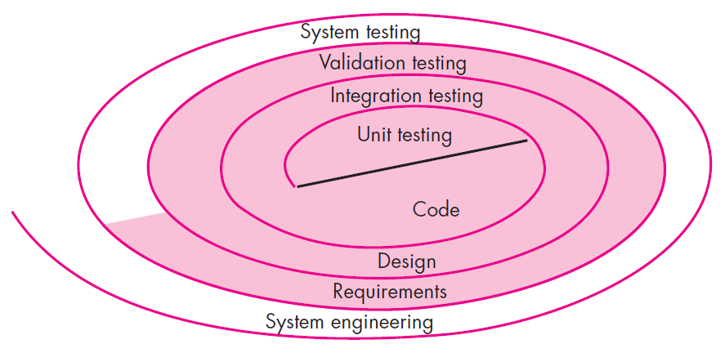
Testing Strategies

Slide 16
Testing Strategies
Initially, system engineering defines the role of software and leads to software requirements analysis.
Like, where the information domain, function, behavior, performance, constraints, and validation criteria for software are established.
Moving inward along the spiral, you come to design and finally to coding.
To develop computer software, you spiral inward (counterclockwise) that decrease the level of abstraction on each turn.

Slide 17
Test Strategies for Conventional Software

Slide 18
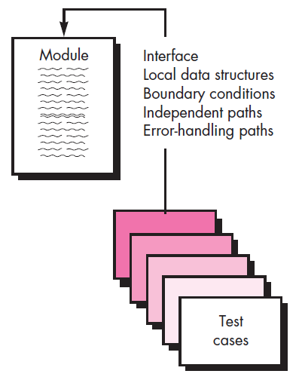
Unit Testing

Slide 19
Unit Testing
Unit is the smallest part of a software system which is testable.
it may include code files, classes and methods which can be tested individually for correctness.
Unit Testing validates small building block of a complex system before testing an integrated large module or whole system.
Driver and/or Stub software must be developed for each unit test.
A driver is nothing more than a "main program" that accepts test case data, passes such data to the component, and prints relevant results.
Stubs serve to replace modules that are subordinate (called by) the component to be tested.
A stub or "dummy subprogram" uses the subordinate module's interface.

Slide 20
Integration Testing
Integration is defined as a set of interflow among components.
Testing the interactions between the modules and interactions with other system externally is called Integration Testing.
Testing of integrated modules to verify combined functionality after integration.
Modules are typically; code modules, individual applications, client and server applications on a network, etc.
Types of integration testing are:
Top-down Integration Testing
Bottom-up Integration Testing
Regression Testing
Smoke Testing

Slide 21
Validation Testing
The process of evaluating software to determine whether it satisfies specified business requirements (client’s need).
It provides final assurance that software meets all informational, functional, behavioral, and performance requirements.
If software is developed as a product to be used by many customers, it is impractical to perform formal acceptance tests with each one.
Most software product builders use a process called alpha and beta testing to uncover errors that only the end user seems able to find.

Slide 22
Alpha and Beta Test
Alpha Test
The alpha test is conducted at the developer’s site by a representative group of end users.
The software is used in a natural setting with the developer “looking over the shoulder” of the users and recording errors and usage problems.
Alpha tests are conducted in a controlled environment.
Beta Test
The beta test is conducted at one or more end-user sites.
Unlike alpha testing, the developer generally is not present.
Therefore, the beta test is a “live” application of the software in an environment that cannot be controlled by the developer.

Slide 23
System Testing
In system testing the software and other system elements are tested.
To test computer software, you spiral out in a clockwise direction along streamlines that increase the scope of testing with each turn.
System testing verifies that all elements mesh properly and overall system function/performance is achieved.
System testing is actually a series of different tests whose primary purpose is to fully exercise the computer-based system.

Slide 24
Types of System Testing
Recovery testing
Security testing
Stress testing
Performance testing
Deployment testing

Slide 25
Types of System Testing (Cont…)
Recovery testing
It is a system test that forces the software to fail in a variety of ways and verifies that recovery is properly performed.
If recovery is automatic (performed by the system itself)
Re-initialization, check pointing mechanisms, data recovery, and restart are evaluated for correctness.
If recovery requires human intervention
The mean-time-to-repair (MTTR) is evaluated to determine whether it is within acceptable limits.
Security testing
It attempts to verify software’s protection mechanisms, which protect it from improper penetration (access).
During this test, the tester plays the role of the individual who desires to penetrate the system.

Slide 26
Types of System Testing (Cont…)
Stress testing
It executes a system in a manner that demands resources in abnormal quantity, frequency or volume.
A variation of stress testing is a technique called sensitivity testing.
Performance testing
It is designed to test the run-time performance of software.
It occurs throughout all steps in the testing process.
Even at the unit testing level, the performance of an individual module may be tested.

Slide 27
Types of System Testing (Cont…)
Deployment testing (Configuration Testing)
It exercises the software in each environment in which it is to operate.
In addition, it examines
all installation procedures
specialized installation software that will be used by customers
all documentation that will be used to introduce the software to end users

Slide 28
Acceptance Testing
It is a level of the software testing where a system is tested for acceptability.
The purpose of this test is to evaluate the system’s compliance with the business requirements.
It is a formal testing conducted to determine whether or not a system satisfies the acceptance criteria
with respect to user needs, requirements, and business processes
It enables the customer to determine, whether or not to accept the system.
It is performed after System Testing and before making the system available for actual use.

Slide 29
White Box Testing and Black Box Testing

Slide 30
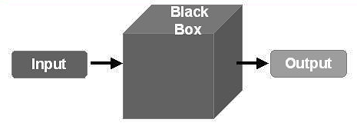
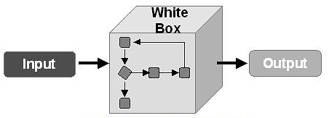
Black Box and White Box Testing

Slide 31
Black Box Testing (Behavioral Testing)
Black Box Testing is a software testing method in which the internal structure/design/implementation of the module being tested is not known to the tester.
This techniques enable to derive sets of input conditions that will fully exercise all functional requirements for a program.
It attempts to find errors in the following categories:
Incorrect or missing functions
Interface errors
Errors in data structures or external database access
Behavior or performance errors
Initialization and termination errors

Slide 32
Black Box Testing (Cont…)
It is applicable to the following levels of software testing:
Integration Testing
System Testing
Acceptance Testing
Advantages
Tests are done from a user’s point of view and will help in exposing discrepancies in the specifications.
Tester need not know programming languages.
Tests can be conducted by a body independent from the developers, allowing to avoid developer-biased testing.
Test cases can be designed as soon as the specifications are complete.

Slide 33
Black Box Testing (Cont…)
Disadvantages
Only a small number of possible inputs can be tested and many program paths will be left untested.
Test cases will be difficult to design without having clear specifications, which is the situation in many projects.
Tests can be redundant if the software designer/developer has already run a test case.

Slide 34
White box testing (Glass-box Testing)
White Box Testing is a software testing method in which the internal structure/design/implementation of the module being tested is known to the tester.
Using white-box testing methods, you can derive test cases that
Guarantee that all independent paths within a module have been exercised at least once.
Exercise all logical decisions on their true and false sides.
Execute all loops at their boundaries.
Exercise internal data structures to ensure their validity.

Slide 35
White box testing (Cont…)
It is applicable to the following levels of software testing
Unit Testing: For testing paths within a unit.
Integration Testing: For testing paths between units.
System Testing: For testing paths between subsystems.
Advantages
Testing can be commenced at an earlier stage as one need not wait for the GUI to be available.
Testing is more thorough, with the possibility of covering most paths.

Slide 36
White box testing (Cont…)
Disadvantages
Since tests can be very complex, highly skilled resources are required, with thorough knowledge of programming and implementation.
Test script maintenance can be a burden, if the implementation changes too frequently.
Since this method of testing is closely tied with the application being testing, tools to cater to every kind of implementation/platform may not be readily available.

Slide 37
Testing Object Oriented Applications

Slide 38
Unit Testing in the OO Context
The concept of the unit testing changes in object-oriented software.
Encapsulation drives the definition of classes and objects.
Means, each class and each instance of a class (object) packages attributes (data) and the operations (methods or services) that manipulate these data.
Rather than testing an individual module, the smallest testable unit is the encapsulated class.
Unlike unit testing of conventional software,
which focuses on the algorithmic detail of a module and the data that flows across the module interface,
class testing for OO software is driven by the operations encapsulated by the class and the state behavior of the class.

Slide 39
Integration Testing in the OO Context
Object-oriented software does not have a hierarchical control structure,
conventional top-down and bottom-up integration strategies have little meaning.
There are two different strategies for integration testing of OO systems.
Thread-based testing
integrates the set of classes required to respond to one input or event for the system.
Each thread is integrated and tested individually.
Regression testing is applied to ensure that no side effects occur.

Slide 40
Integration Testing in the OO Context
Use-based testing
begins the construction of the system by testing those classes (called independent classes) that use very few (if any) of server classes.
After the independent classes are tested, the next layer of classes, called dependent classes, that use the independent classes are tested.
Cluster testing is one step in the integration testing of OO software.
Here, a cluster of collaborating classes is exercised by designing test cases that attempt to uncover.

Slide 41
Validation Testing in an OO Context
At the validation or system level, the details of class connections disappear.
Like conventional validation, the validation of OO software focuses on user-visible actions and user-recognizable outputs from the system.
To assist in the derivation of validation tests, the tester should draw upon use cases that are part of the requirements model.
Conventional black-box testing methods can be used to drive validation tests.

Slide 42
Testing Web Applications

Slide 43
Testing Web Applications
WebApp testing is a collection of related activities with a single goal to uncover errors in WebApp content, function, usability, navigability, performance, capacity, and security.
To accomplish this, a testing strategy that encompasses both reviews and executable testing is applied.

Slide 44
Dimensions of Quality
Content is evaluated at both a syntactic and semantic level.
At the syntactic level, spelling, punctuation, and grammar are assessed for text-based documents.
At a semantic level, correctness of information presented.
Consistency across the entire content object and related objects, and lack of ambiguity are all assessed.
Function is tested to uncover errors that indicate lack of conformance to customer requirements.
Structure is assessed to ensure that it properly delivers WebApp content.
Usability is tested to ensure that each category of user is supported by the interface and can learn and apply all required navigation.

Slide 45
Dimensions of Quality
Navigability is tested to ensure that all navigation syntax and semantics are exercised to uncover any navigation errors
Ex., dead links, improper links, and erroneous links
Performance is tested under a variety of operating conditions, configurations, and loading
to ensure that the system is responsive to user interaction and handles extreme loading.
Compatibility is tested by executing the WebApp in a variety of different host configurations on both the client and server sides.
Interoperability is tested to ensure that the WebApp properly interfaces with other applications and/or databases.
Security is tested by assessing potential vulnerabilities.

Slide 46
Content Testing
Errors in WebApp content can be
as trivial as minor typographical errors or
as significant as incorrect information, improper organization, or violation of intellectual property laws.
Content testing attempts to uncover these and many other problems before the user encounters them.
Content testing combines both reviews and the generation of executable test cases.
Reviews are applied to uncover semantic errors in content.
Executable testing is used to uncover content errors
that can be traced to dynamically derived content that is driven by data acquired from one or more databases.

Slide 47
User Interface Testing
Verification and validation of a WebApp user interface occurs at three distinct points.
During requirements analysis
the interface model is reviewed to ensure that it conforms to stakeholder requirements.
During design
the interface design model is reviewed to ensure that generic quality criteria established for all user interfaces have been achieved.
During testing
the focus shifts to the execution of application-specific aspects of user interaction as they are manifested by interface syntax and semantics.
In addition, testing provides a final assessment of usability.

Slide 48
Component-Level Testing
Component-level testing (function testing), focuses on a set of tests that attempt to uncover errors in WebApp functions.
Each WebApp function is a software component (implemented in one of a variety of programming languages)
WebApp function can be tested using black-box (and in some cases, white-box) techniques.
Component-level test cases are often driven by forms-level input.
Once forms data are defined, the user selects a button or other control mechanism to initiate execution.

Slide 49
Navigation Testing
The job of navigation testing is to ensure that
the mechanisms that allow the WebApp user to travel through the WebApp are all functional and,
to validate that each Navigation Semantic Unit (NSU) can be achieved by the appropriate user category.
Navigation mechanisms should be tested are
Navigation links,
Redirects,
Bookmarks,
Frames and framesets,
Site maps,
Internal search engines.

Slide 50
Configuration Testing
Configuration variability and instability are important factors that make WebApp testing a challenge.
Hardware, operating system(s), browsers, storage capacity, network communication speeds, and a variety of other client-side factors are difficult to predict for each user.
One user’s impression of the WebApp and the manner in which he/she interacts with it can differ significantly.
Configuration testing is to test a set of probable client-side and server-side configurations
to ensure that the user experience will be the same on all of them and,
to isolate errors that may be specific to a particular configuration

Slide 51
Security Testing
Security tests are designed to probe
vulnerabilities of the client-side environment,
the network communications that occur as data are passed from client to server and back again, and
the server-side environment.
Each of these domains can be attacked, and it is the job of the security tester to uncover weaknesses
that can be exploited by those with the intent to do so.

Slide 52
Performance Testing
Performance testing is used to uncover
performance problems that can result from lack of server-side resources,
inappropriate network bandwidth,
inadequate database capabilities,
faulty or weak operating system capabilities,
poorly designed WebApp functionality, and
other hardware or software issues that can lead to degraded client-server performance.

Slide 53
Verification and Validation
Verification | Validation
Static practice of verifying documents, design, code and program. | Dynamic mechanism of validating and testing the actual product.
Does not involve executing the code. | Always involves executing the code.
Human based checking of documents and files. | Computer based execution of program.
Uses methods like inspections, reviews, walkthroughs etc. | Uses methods like black box (functional) testing, white box (structural) testing etc.
To check whether the software conforms to specifications. | To check whether software meets the customer expectations and requirements.
Target is requirements specification, application and software architecture, high level, complete design, and database design etc. | Target is actual product-a unit, a module, a bent of integrated modules, and effective final product.
Done by QA team to ensure that the software is as per the specifications in the SRS document. | Carried out with the involvement of testing team.
Generally comes first-done before validation. | Generally follows after verification.

Slide 54
Summary
Coding Standard and Guidelines
Code Review, Walk Through and Inspection
Software Documentation
Test Strategies for Conventional Software
Unit Testing
Integration Testing
Validation Testing
Alpha and Beta Test
System Testing
Acceptance Testing
White Box and Black Box Testing
Testing Object Oriented Applications
Testing Web Applications
Dimensions of Quality
Content Testing
User Interface Testing
Component-Level Testing
Navigation Testing
Configuration Testing
Security Testing
Performance Testing
Verification and Validation

