Slide 1


Unit-7
Quality Assurance and Management
SOFTWARE ENGINEERING
2160701
Prof. Jignasu Mahidhareeya
jignasu.mahidhareeya@darshan.ac.in
+ 91 9890261198
Computer Engineering Darshan Institute of Engineering & Technology

Slide 2
Outlines
Quality Concepts and Software Quality Assurance
Software Reviews (Formal Technical Reviews)
Software Reliability
The Quality Standards
  ISO 9000
  CMM
  Six Sigma for SE
SQA Plan

Slide 3
Software Quality Assurance (SQA)
Software quality assurance (also called quality management) is an umbrella activity that is applied throughout the software process.
It is planned and systematic pattern of activities necessary to provide high degree of confidence in the quality.
Software quality assurance (SQA) encompasses
  An SQA process.
  Specific quality assurance and quality control tasks.
  Effective software engineering practice.
  Control of all software work products.
  A procedure to ensure compliance with software development standards.
  Measurement and reporting mechanisms.

Slide 4
Importance of SQA
Quality control and assurance are essential activities for any business that produces products to be used by others.
Software quality assurance starts from the beginning of a project, right from the analysis phase.
The major reason of involving quality assurance in software product development is
  to make sure that the final product built is as per the requirement specification and comply with the standards.

Slide 5
SQA Activities
Prepare an SQA plan for a project
Participate in the development of the project’s software process description
Review software engineering activities to verify compliance with the defined software process.
Audit designated software work products to verify compliance with those defined as part of the software process.
Ensure that deviations in software work and work products are documented and handled according to a documented procedure.
Records any noncompliance and reporting to senior management.

Slide 6
SQA Techniques
Statistical quality assurance implies the following steps:
  Information about software defects is collected and categorized.
  An attempt is made to trace each defect to its underlying cause
    Ex., non-conformance to specifications, design error, violation of standards, poor communication with the customer
  Using the Pareto principle (80 percent of the defects can be traced to 20 percent of all possible causes), isolate the 20 percent (the "vital few").
  Once the vital few causes have been identified, move to correct the problems that have caused the defects.
Some of the defects are uncovered as software is being developed.
Other are encountered after the software has been released.

Slide 7
SQA Techniques (Cont…)
Uncovered errors can be tracked to (one or more) of the following causes:
  incomplete or erroneous specifications (IES)
  misinterpretation of customer communication (MCC)
  intentional deviation from specifications (IDS)
  violation of programming standards (VPS)
  error in data representation (EDR)
  inconsistent component interface (ICI)
  error in design logic (EDL)
  incomplete or erroneous testing (IET)
  inaccurate or incomplete documentation (IID)
  error in programming language translation of design (PLT)
  ambiguous or inconsistent human/computer interface (HCI)
  miscellaneous (MIS)

Slide 8
Software Reviews (Formal Technical Reviews)
A formal technical review (FTR) is a software quality control activity performed by software engineers (and others).
The objectives of an FTR are:
  To uncover errors in function, logic, or implementation; for any representation of the software.
  To verify that the software under review meets its requirements.
  To ensure that the software has been represented according to predefined standards.
  To achieve software that is developed in a uniform manner.
  To make projects more manageable.

Slide 9
Review Reporting and Record Keeping
During the FTR,
  a reviewer (the recorder) actively records all issues that have been raised.
These are summarized at the end of the review meeting, and a reviewed issues list is produced.
In addition, a formal technical review summary report is completed.

Slide 10
Review Guidelines
Guidelines for conducting formal technical reviews must be
  established in advance,
  distributed to all reviewers,
  agreed upon, and then followed.
Review the product, not the producer.
Set an agenda and maintain it.
Limit debate and denial:
  Speak problem areas, but don't attempt to solve every problem noted.
Take written notes.
Limit the number of participants and insist upon advance preparation.

Slide 11
Review Guidelines (Cont…)
Develop a checklist for each product that is likely to be reviewed.
Allocate resources and schedule time for FTRs
Conduct meaningful training for all reviewers.
Review your early reviews.

Slide 12
Sample-Driven Reviews
Ideally, every software engineering work product would undergo a formal technical review.
In the real word of software projects, resources are limited and time is short.
As a consequence, reviews are often skipped, even though their value as a quality control mechanism is recognized.
Thelin and his colleagues suggest a sample-driven review
  in which samples of all software engineering work products are inspected to determine which work products are most error prone.
Full FTR resources are then focused only on those work products that are likely (based on data collected during sampling) to be error prone.

Slide 13
Software Reliability
Software reliability is defined in statistical terms as
  “the probability of failure-free operation of a computer program in a specified environment for a specified time”.

Slide 14
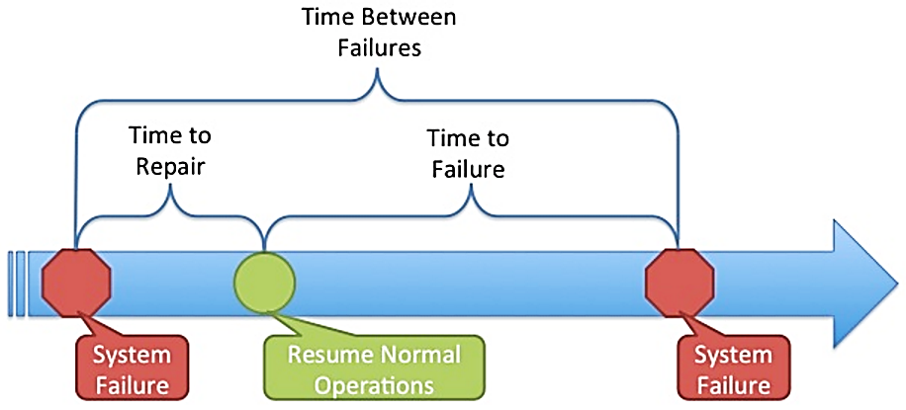
Measures of Reliability
A simple measure of reliability is meantime-between-failure (MTBF):
  MTBF = MTTF + MTTR
  MTTF = mean-time-to-failure, MTTR = mean-time-to-repair

Slide 15
Measures of Reliability (Cont…)
Many researchers argue that MTBF is a far more useful measure than other quality-related software metrics.
An end user is concerned with failures, not with the total defect count.
Because each defect contained within a program does not have the same failure rate, the total defect count provides little indication of the reliability of a system.
An alternative measure of reliability is failures-in-time (FIT)
  a statistical measure of how many failures a component will have over one billion hours of operation.

Slide 16
Software Safety
Software safety is a software quality assurance activity
  that focuses on the identification and assessment of potential hazards that may affect software negatively and cause an entire system to fail.
If hazards can be identified early in the software process,
  software design features can be specified that will either eliminate or control potential hazards.
A modelling and analysis process is conducted as part of software safety.
Initially, hazards are identified and categorized by criticality and risk.

Slide 17
Software Safety (Cont…)
Although software reliability and software safety are closely related to one another, it is important to understand the subtle difference between them.
  Software reliability uses statistical analysis to determine the likelihood that a software failure will occur.
  However, the occurrence of a failure does not necessarily result in a hazard or accident.
  Software safety examines the ways in which failures can lead to an accident.

Slide 18
The quality standards
ISO 9000 and 9001, Six Sigma, CMM

Slide 19
ISO 9001
In order to bring quality in product and service,
  many organizations are adopting Quality Assurance System.
ISO standards are issued by the International Organization for Standardization (ISO) in Switzerland.
Proper documentation is an important part of an ISO 9001 Quality Management System.
ISO 9001 is the quality assurance standard that applies to software engineering.
It includes, requirements that must be present for an effective quality assurance system.
ISO 9001 standard is applicable to all engineering discipline.

Slide 20
ISO 9001 (Cont…)
The requirements delineated (described) by ISO 9001:2000 address topics such as
  Management Responsibility
  Quality System
  Contract Review
  Design Control
  Document
  Data Control
  Product Identification
  Traceability
  Process Control
  Inspection
  Testing
  Preventive Action
  Control of Quality Records
  Internal Quality
  Audits
  Training
  Servicing

Slide 21
ISO 9001 (Cont…)
In order for a software organization to become registered to ISO 9001:2000,
  it must establish policies and procedures to address each of the requirements just noted
  and then be able to demonstrate that these policies and procedures are being followed.

Slide 22
Six Sigma
Six sigma is “A generic quantitative approach to improvement that applies to any process”
“Six Sigma is a disciplined, data-driven approach and methodology for eliminating defects in any process - from manufacturing to transactional and from product to service”
To achieve six sigma, a process must not produce more than 3.4 defects per million opportunities.
4 Sigma -> 6210 defects per million opportunities.
5 Sigma -> 230 defects per million opportunities.
Six sigma have two methodologies.
  DMAIC (Define, Measure, Analyze, Improve, Control)
  DMADV (Define, Measure, Analyze, Design, Verify)

Slide 23
1) DMAIC (Define, Measure, Analyze, Improve, Control)
Define
  Define the problem or process to improve upon related to the customer and goals.
Measure
  How can you measure this process in a systematic way?
Analyze
  Analyze the process or problem and identify the way in which it can be improved.
  What are the root causes of problems within the process?
Improve
  Once you know the causes of the problems, present solutions for them and implement them.

Slide 24
1) DMAIC (Define, Measure, Analyze, Improve, Control) (Cont…)
Control
  Utilize Statistical Process Control to continuously measure your results and ensure you are improving.
Several Software Packages available to assist in measuring
  yield, defects per million opportunities, etc.

Slide 25
2) DMADV: (Define, Measure, Analyze, Design, Verify)
Define, Measure and analyze are similar to above method.
Design
  Avoid root causes of defects and meet the customer requirements.
Verify
  To verify the process, compare the process with the standard plan and find differences.

Slide 26
CMM (Capability Maturity Model)
To determine an organization’s current state of process maturity, the SEI (Software Engineering Institute) uses an assessment that results in a five point grading scheme.
The grading scheme determines compliance with a capability maturity model (CMM) that defines key activities required at different levels of process maturity.
The SEI approach establishes five process maturity levels that are defined in the following manner:
Level 1: Initial
  The software process is characterized as ad hoc and occasionally.
  Few processes are defined and success depends on individual effort.

Slide 27
CMM (Capability Maturity Model)
Level 2: Repeatable
  Basic project management processes are established to track cost, schedule, and functionality.
  The necessary process discipline is in place to repeat earlier successes on projects.
Level 3: Defined
  The software process for both management and engineering activities is documented, standardized and integrated.
  This level includes all characteristics defined for level 2.
Level 4: Managed
  Detailed measures of the software process and product quality are collected.
  This level includes all characteristics defined for level 3.

Slide 28
CMM (Capability Maturity Model)
Level 5: Optimizing
  Continuous process improvement is enabled by quantitative feedback from the process and from testing innovative ideas and technologies.
  This level includes all characteristics defined for level 4.

Slide 29
SQA Plan
The SQA Plan provides a road map for instituting (establishing) software quality assurance.
The plan serves as a template for SQA activities that are instituted for each software project.
The standard recommends a structure that identifies:
  The purpose and scope of the plan.
  A description of all software engineering work products (e.g., models, documents, source code).
  All applicable standards that are applied during the software process.
  SQA actions and their placement throughout the software process.
  The tools and methods that support SQA actions and tasks.

Slide 30
SQA Plan
  Software configuration management procedures.
  Methods for assembling, safeguarding and maintaining all SQA-related records.
  Organizational roles and responsibilities relative to product quality.

Slide 31
Summary
SQA
Importance of SQA
SQA Activities
SQA Techniques
Software Reviews (Formal Technical Reviews)
Software Reliability
Software Safety
The Quality Standards
  ISO 9000
  CMM
  Six Sigma for SE
SQA Plan

