Slide 1
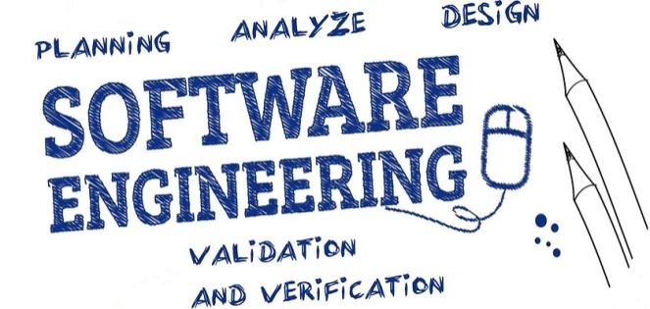

Unit-8 Software Maintenance and Configuration Management
SOFTWARE ENGINEERING
2160701
Prof. Jignasu Mahidhareeya
jignasu.mahidhareeya@darshan.ac.in
+ 91 9890261198
Computer Engineering Darshan Institute of Engineering & Technology

Slide 2
Outlines
Types of Software Maintenance
Re-Engineering
Reverse Engineering
Forward Engineering
The SCM Process
Identification of Objects in the Software Configuration
Version Control and Change Control

Slide 3
Types of Software Maintenance
In a software lifetime, type of maintenance may vary based on its nature.
It may be just a routine maintenance tasks as some bug discovered by some user or it may be a large event in itself based on maintenance size or nature.
Following are some types of maintenance based on their characteristics:
Corrective Maintenance
Adaptive Maintenance
Perfective Maintenance
Preventive Maintenance

Slide 4
Types of Software Maintenance (Cont…)
Corrective Maintenance:
This includes modifications done in order to fix problems.
Corrective maintenance deals with the repair of defects found in day-to-day system functions.
Adaptive Maintenance:
This includes modifications applied to keep the software product up-to-date.
Adaptive maintenance is the implementation of changes in a part of the system, which has been affected by a change that occurred in some other part of the system.

Slide 5
Types of Software Maintenance (Cont…)
Perfective Maintenance:
This includes modifications done in order to keep the software usable over long period of time.
It includes new features, new user requirements for refining the software and improve its reliability and performance.
This includes changing the functionalities of the system as per the user’s changing needs.

Slide 6
Types of Software Maintenance (Cont…)
Preventive Maintenance:
This includes modifications to prevent future problems of the software.
It aims to attend problems, which are not significant at this moment but may cause serious issues in future.
It comprises documentation updating, code optimization and code restructuring.
Documentation updating involves modifying the documents affected by the changes.

Slide 7
Re-Engineering
When we need to update the software to keep it to the current market, without impacting its functionality, it is called software re-engineering.
It is a process where the design of software is changed and programs are re-written.
Legacy software cannot keep tuning with the latest technology available in the market.
For example, initially UNIX was developed in assembly language. When language C came into existence, UNIX was re-engineered in C, because working in assembly language was difficult.
Other than this, sometimes programmers notice that few parts of software need more maintenance than others and they also need re-engineering.

Slide 8
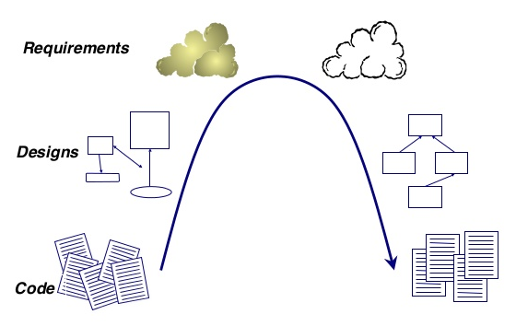
Re-Engineering
Forward Engineering
Reverse Engineering
© https://pt.slideshare.net/onierstrasz/i-object

Slide 9
Re-Engineering Process
Program Restructuring
Obtain specifications of existing software
Change program and/or data structure
Get re-engineered software developed
Reverse Engineering
Forward Engineering

Slide 10
Re-Engineering Process
Decide what to re-engineer. Is it whole software or a part of it?
Perform Reverse Engineering, in order to obtain specifications of existing software.
Restructure Program if required.
For example, changing function-oriented programs into object-oriented programs and re-structure data as required.
Apply Forward engineering concepts in order to get re-engineered software.

Slide 11
Reverse Engineering
Reverse engineering can extract design information from source code.
The abstraction level of a reverse engineering process refers to the sophistication of the design information that can be extracted from source code.
Ideally, the abstraction level should be as high as possible.
The reverse engineering process should be capable of;
deriving procedural design representations (a low-level abstraction)
program and data structure information (a somewhat higher level of abstraction)
object models, data flow models (a relatively high level of abstraction)
entity relationship models (a high level of abstraction).

Slide 12
Reverse Engineering
As the abstraction level increases, information will allow easier understanding of the program.
Interactivity refers to the degree to which the human is “integrated” with automated tools to create an effective reverse engineering process.
In most cases, as the abstraction level increases, interactivity must increase.
The directionality of the reverse engineering process is one-way, all information extracted from the source code is provided to the software engineer.

Slide 13
Forward Engineering
Forward engineering is a process of obtaining desired software from the specifications, which were brought by reverse engineering.
Forward engineering is same as software engineering process with only one difference it is carried out always after reverse engineering.
In most cases, forward engineering does not simply create a modern equivalent of an older program.
Rather, new user and technology requirements are integrated into the reengineering effort.
The redeveloped program extends the capabilities of the older application.

Slide 14
The SCM (Software Configuration Management)
The SCM is a set of activities that have been developed to manage change throughout the software life cycle.
Purpose
Systematically control changes to the configuration and maintain the integrity and traceability of the configuration throughout the system’s life cycle.

Slide 15
The SCM (Software Configuration Management) Process
The software configuration management process defines a series of tasks that have four primary objectives:
To identify all items that collectively define the software configuration.
To manage changes to one or more of these items.
To facilitate the construction of different versions of an application.
To ensure that software quality is maintained as the configuration evolves over time.

Slide 16
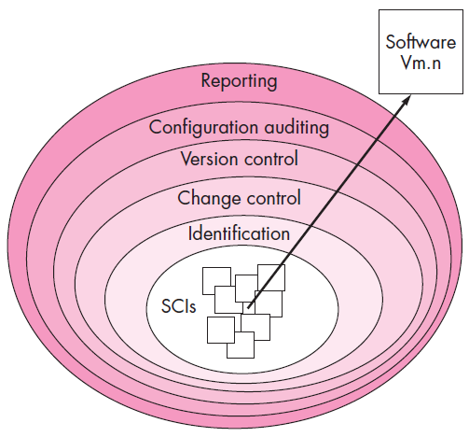
Layers of SCM Process

Slide 17
The SCM (Software Configuration Management) Process
Referring to the figure, SCM tasks can viewed as concentric layers.
SCIs (Software Configuration Item) flow outward through these layers throughout their useful life.
As an SCI moves through a layer, the actions implied by each SCM task may or may not be applicable.
For example, when a new SCI is created, it must be identified.
However, if no changes are requested for the SCI, the change control layer does not apply.
The SCI is assigned to a specific version of the software (version control mechanisms come into play).
A record of the SCI (its name, creation date, version, etc.) is maintained for configuration auditing purposes.

Slide 18
Identification Task
Identification separately names each SCI and then organizes it in the SCM repository using an object-oriented approach.
Objects start out as basic objects and are then grouped into aggregate objects.
Each object has a set of distinct features that identify it.
A name that is unambiguous to all other objects
A description that contains the SCI type, a project identifier, and change and/or version information
List of resources needed by the object
The object realization (i.e., the document, the file, the model, etc.)

Slide 19
Change Control
Change control is a procedural activity that ensures quality and consistency as changes are made to a configuration object.
A change request is submitted to a configuration control authority, which is usually a change control board (CCB).
The request is evaluated for technical merit, potential side effects, overall impact on other configuration objects and system functions, and projected cost in terms of money, time and resources.
An engineering change order (ECO) is issued for each approved change request.
Describes the change to be made, the constraints to follow and the criteria for review and audit.

Slide 20
Change Control (Cont…)
The Baselined SCI is obtained from the SCM repository.
Access control governs which software engineers have the authority to access and modify a particular configuration object.
Synchronization control helps to ensure that parallel changes performed by two different people don't overwrite one another.

Slide 21
Version Control
Version control is a set of procedures and tools for managing the creation and use of multiple occurrences of objects in the SCM repository.
Version Control Capabilities
An SCM repository that stores all relevant configuration objects.
A version management capability that stores all versions of a configuration object.
A make facility that enables the software engineer to collect all relevant configuration objects and construct a specific version of the software.
Issues tracking (bug tracking) capability that enables the team to record and track the status of all outstanding issues associated with each configuration object.

Slide 22
Version Control (Cont…)
The SCM repository maintains a change set.
Serves as a collection of all changes made to a baseline configuration.
Used to create a specific version of the software.
Captures all changes to all files in the configuration along with the reason for changes and details of who made the changes and when.

Slide 23
Configuration Audit
Configuration auditing is an SQA activity that helps to ensure that quality is maintained as changes are made.
It complements the formal technical review and is conducted by the SQA group.
It addresses the following questions
Has a formal technical review been conducted to assess technical correctness?
Has the software process been followed and have software engineering standards been properly applied?
Has the change been "highlighted" and "documented" in the SCI? Have the change data and change author been specified? Do the attributes of the configuration object reflect the change?

Slide 24
Configuration Audit (Cont…)
Have SCM procedures for noting the change, recording it and reporting it been followed?
Have all related SCIs been properly updated?
A configuration audit ensures that
The correct SCIs (by version) have been incorporated into a specific build.
That all documentation is up-to-date and consistent with the version that has been built.

Slide 25
Status Reporting
Configuration status reporting (CSR) is also called status accounting.
Provides information about each change to those personnel in an organization with a need to know.
Answers what happened, who did it, when did it happen and what else will be affected?
Sources of entries for configuration status reporting
Each time a SCI is assigned new or updated information
Each time a configuration audit is conducted

Slide 26
Status Reporting (Cont…)
The configuration status report
Placed in an on-line database or on a website for software developers and maintainers to read.
Given to management and practitioners to keep them appraised of important changes to the project SCIs.

Slide 27
Summary
Types of Software Maintenance
Re-Engineering
Reverse Engineering
Forward Engineering
The SCM Process
Identification Task
Change Control
Version Control
Configuration Audit
Status Reporting
Version Control and Change Control

