Slide 1
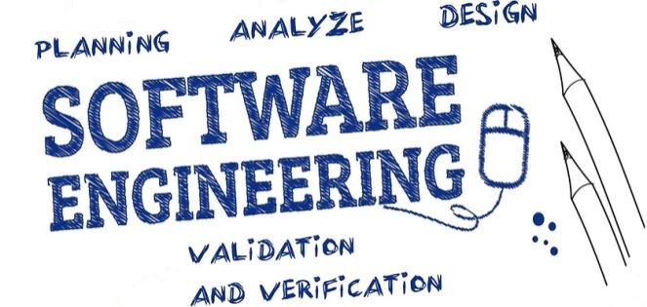

Unit-9 Software Engineering and Software as a Service
SOFTWARE ENGINEERING
2160701
Prof. Jignasu Mahidhareeya
jignasu.mahidhareeya@darshan.ac.in
+ 91 9890261198
Computer Engineering Darshan Institute of Engineering & Technology

Slide 2
Outlines
Software as a Service
SaaS Architecture
Product Lifetime
Independent Product Vs. Continues Improvement

Slide 3
Software as a Service
SaaS (Software as a Service) describes any cloud service where consumers are able to access software applications over the internet.
Google, Twitter and Facebook are all examples of SaaS, with users able to access the services via any internet enabled device.
Enterprise users are able to use applications for a range of needs, including accounting and invoicing, tracking sales, planning, performance monitoring and communications.
SaaS is often referred to as software-on-demand and utilizing it as renting software rather than buying it.
With traditional software applications you would purchase the software upfront as a package and then install it onto your computer.

Slide 4
Software as a Service (Cont…)
The software’s license may also limit the number of users and/or devices where the software can be deployed.
Software as a Service users, however, subscribe to the software rather than purchase it, usually on a monthly basis.
Applications are purchased and used online with files (data files) saved in the cloud rather than on individual computers.

Slide 5
Software as a Service (Cont…)
Benefits of SaaS to organizations and personal users:
No additional hardware costs
No initial setup costs
Pay for what you use
Usage is scalable
Updates are automated
Cross device compatibility
Accessible from any location
Applications can be customized

Slide 6
Software as a Service (Cont…)
Office software is the best example of businesses utilizing SaaS
Tasks related to accounting, invoicing, sales and planning can all be performed through Software as a Service.
The required software can be subscribed via the internet and then accessed online via any computer in the office using a username and password.
If needs change they can easily switch to software that better meets their requirements.
Everyone who needs access to a particular piece of software can be set up as a user
whether it is one or two people or every employee in a corporation.

Slide 7
Software as a Service (Summary)
There are no setup costs with SaaS, as there often are with other applications.
SaaS is scalable with upgrades available on demand.
Access to Software as a Service is compatible across all internet enabled devices.
As long as there is an internet connection, applications are accessible from any location.

Slide 8
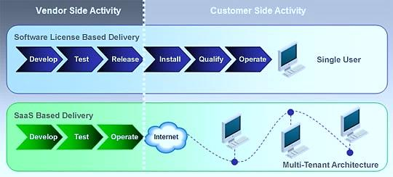
SaaS Architecture
Traditional Software Delivery Model
SaaS Model

Slide 9
SaaS Architecture (Cont…)
The diagram illustrates the key differences between the traditional software delivery model and a SaaS-based delivery model.
In essence, all users of SaaS-based applications run exactly the same code with customizations and configurations stored as metadata parameters.
The key difference between SaaS and traditional software delivery is that SaaS-based applications are fully hosted within some form of Data Centre environment.
All updates to the SaaS application are carried out within the Data Centre and therefore the user can always be assured that they are using the most recent version of the application.
These applications are designed to work and take advantage of operating within a web browser-based environment.

Slide 10
SaaS Architecture (Cont…)
Since nearly every computer comes with a browser as part of the operating environment, there is hardly any implementation work required by a company’s IT department.
This allows the IT department to focus on other activities reducing support costs.
SaaS is traditionally sold on a subscription basis that includes upgrades, maintenance and some level of basic support.
These subscriptions operate on a monthly, quarterly or yearly basis.
SaaS is ideal for companies who would be using the application periodically.

Slide 11
Product Lifetime
In order to understand the engineering process for the software, it is essential to contrast software and hardware engineering with respect to product lifetime.
The concept product life time concerns the life of product in the market with respect to business or commercial cost and sales measures.
The time period of product life and the length of each stage varies from product to product.
Lifetime of one product can be over in few months and of another product may last for many years.

Slide 12
Product Lifetime (Cont…)
There are three assumptions made for product lifetime.
Products have a limited life and thus every product has a life cycle.
Product sales pass through distinct stages, each posing different challenges, opportunities and problems to the seller.
Products require different marketing, financing, manufacturing, purchasing and human resource strategies throughout its lifetime.
Product lifetime is an important factor for the difference between hardware and software.
There are two important approaches for product lifetime
Independent Product
Continuous Improvement

Slide 13
Independent Product Vs. Continues Improvement
Hardware design must be created and implemented completely before they get deployed at the working environment.
On the other hand, software is expected to grow and evolve over time.
The cost for upgrade of hardware is very expensive while software upgrade is normally affordable.
Hence software is getting improved at each new release or version while hardware decay (waste) into obsolescence (unused).
As hardware product is not getting better over the time, customer expects it to be completely bug free and independent product when it is launched.

Slide 14
Independent Product Vs. Continues Improvement (Cont…)
If it is not working properly,
then customer thinks it faulty and returns the product immediately and the manufacturing company has to bear the loss.
On the other hand, even if there are some problems in the software during installation,
customer install the latest versions or updates thinking that one day or other the problem will get resolved.
The main reason behind it is the continuous improvement in software development.
There is a tendency of using improved versions of the software over its lifetime.
In fact long product life of software means maintenance and enhancement of the software continuously.

Slide 15
Independent Product Vs. Continues Improvement (Cont…)
Thus the successful software can live decades and is expected to evolve and improve continuously.
While the computer hardware is finalized at the time of manufacturing and can be considered obsolete within just few years.

Slide 16
Continuous Improvement Tasks
The continuous improvement tasks are:
Review product, processes and practices periodically.
Conduct frequent retrospectives (looking back in the past) and experiments to continually improve team.
Gather feedback from stakeholders.
Develop a team of specialists by providing learning opportunities.
Perform analysis on existing processes to remove wastes and improve efficiency.
Disseminate (expand) knowledge gained during project works to the whole organization for organizational improvement.

Slide 17
Summary
Software as a Service
SaaS Architecture
Product Lifetime
Independent Product Vs. Continues Improvement
Continuous Improvement Tasks

