Slide 1

Unit – 1 Review of Mathematical Theory
Hardik Doshi
 9978911553
→ hardik.doshi@darshan.ac.in
Theory of Computation (2160704) Darshan Institute of Engineering & Technology

Slide 2
Topics to be covered
Sets
Logic
Functions
Relations
Languages
Proofs
Principle of Mathematical Induction
Strong Principle of Mathematical Induction
Recursive Definitions

Slide 3
Sets
Unit – 1: Review of Mathematical Theory Darshan Institute of Engineering & Technology

Slide 4

Sets
A set is a collection of objects.
The objects in a set are called elements of the set.
Examples
A = {11, 12, 21, 22}
B = {x | x is odd integer greater than 1}
C = {x | x is a two digit integer, each of whose digits is 1 or 2}
D = {3i + 7j | i, j Є N}
E = {x | x Є B and x ≤ 11}
Roster Notation
Set-builder Notation

Slide 5
Operations on Sets
Complement
The complement of a set A is the set A’ of everything that is not an element of A from Universal Set U.
Example
U = {1,2,3,4,5}
A = {1,2}
A’ = {3,4,5}
A’ = {x ∈ U | x ∉ A}
U
U
A

Slide 6
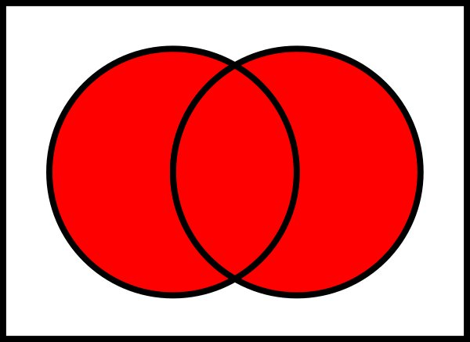
Operations on Sets
Union
The union (A U B) of a collection of sets is the set of all distinct elements in the collection.
Example
A = {1, 3, 5, 7, 9}
B = {1, 2, 3, 4, 5}
A U B = {1, 2, 3, 4, 5, 7, 9}
A U B = {x | x ∈ A or x ∈ B}

Slide 7
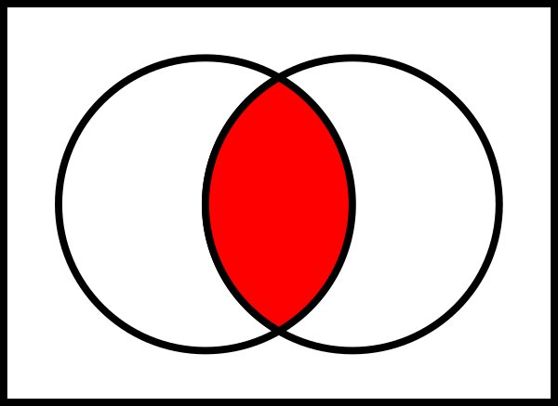
Operations on Sets
Intersection
The intersection A ∩ B of two sets A and B is the set that contains all elements of A that also belong to B (or equivalently, all elements of B that also belong to A), but no other elements.
Example
A = {1, 3, 5, 7, 9}
B = {1, 2, 3, 4, 5}
A ∩ B = {1, 3, 5}
A ∩ B = {x | x ∈ A and x ∈ B}

Slide 8
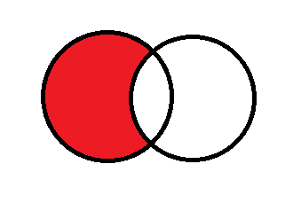
Operations on Sets
Set Difference
The set difference A - B of two sets A and B is the set of everything in A but not in B.
Example
A = {1, 3, 5, 7, 9}
B = {1, 2, 3, 4, 5}
A - B = {7, 9}
A – B = {x | x ∈ A and x ∉ B}
= {x | x ∈ A} ∩ {x | x ∉ B}
= A ∩ B’

Slide 9
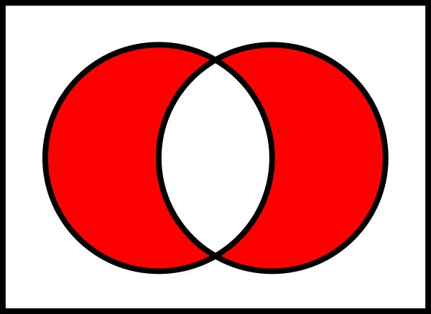
Operations on Sets
Symmetric Difference
The symmetric difference A ⊖ B of two sets A and B is the set of everything in A but not in B or the set of everything in B but not in A.
Example
A = {1, 3, 5, 7, 9}
B = {1, 2, 3, 4, 5}
A ⊖ B = {7, 9, 2, 4}
A ⊖ B = (A – B) U (B – A)

Slide 10
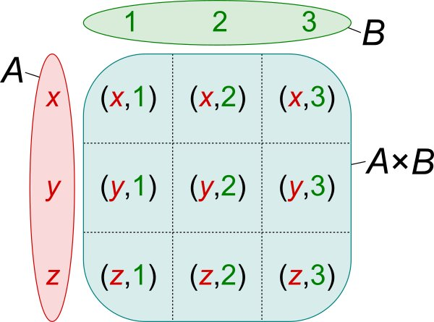
Operations on Sets
Cartesian Product
The Cartesian product A x B of two sets A and B is the set of all ordered pairs (a,b) where a ∈ A and b ∈ B.
Ordered means that the pair (a, b) is different from the pair (b, a)
Example
A = {1, 3, 5}
B = {2, 4}
A x B = {(1,2), (1,4), (3,2), (3,4), (5,2), (5,4)}
A x B = {(a,b) | a ∈ A and b ∈ B}

Slide 11
Set of Identities
Commutative laws
Associative laws
Distributive laws
A ∩ B = B ∩ A
A U B = B U A
A ∩ (B ∩C) =(A ∩ B) ∩ C
A U (B U C) =(A U B) U C
A U (B ∩ C) = (A U B) ∩ (A U C)
A ∩ (B U C) = (A ∩ B) U (A ∩ C)

Slide 12
Set of Identities
Idempotent laws
Absorptive laws
De Morgan laws
A U A = A
A ∩ A = A
A U (A ∩ B) = A
A ∩ (A U B) = A
(A U B)’ = A’ ∩ B’
(A ∩ B)’ = A’ U B’

Slide 13
Set of Identities
Other complements laws
Other empty set laws
(A’)’ = A
A ∩ A’ = Φ
A U A’ = U
A U Φ = A
A ∩ Φ = Φ
Other universal set laws
A U U = U
A ∩ U = A

Slide 14
Logic
Unit – 1: Review of Mathematical Theory Darshan Institute of Engineering & Technology

Slide 15
Propositions
Declarative statement that is sufficiently objective, meaningful and precise to have a truth value (true or false) is known as proposition.
Example
p : Fourteen is an even integer.
q : Mumbai is the capital city of India.
r : 0 = 0

Slide 16
Logical Connectives
Conjunction (^)
The logical connective Conjunction (And) is true only when both of the propositions are true.
Example
p : It is raining
q : It is warm
r : It is raining AND it is warm
Truth table
p | q | r = p ^ q
False | False | False
True | False | False
False | True | False
True | True | True

Slide 17
Logical Connectives
2) Disjunction (v)
The logical disjunction, or logical Or, is true if one or both of the propositions are true.
Examples
p : 2 + 2 = 5
q : 1 < 2
r : 2 + 2 = 5 OR 1 < 2
Truth table
p | q | r = p ^ q
False | False | False
True | False | True
False | True | True
True | True | True

Slide 18
Logical Connectives
3) Negation (¬)
¬p, the negation of a proposition p, is also a proposition
Examples:
p : John studies.
¬p : John does NOT study.
Truth table
P | ¬P
True | False
False | True

Slide 19
Logical Quantifiers
1) Universal Quantifier
Represented by an upside-down A: ∀
It means “for all”
Let P(x) = x+1 > x
We can state the following:
∀x P(x)
English translation: “for all values of x, P(x) is true”
English translation: “for all values of x, x+1>x is true”
Let P(x) = x/2 < x
Not true for the negative numbers!
Thus, ∀x P(x) is false
When the domain is all the real numbers
In order to prove that a universal quantification is true, it must be shown for ALL cases
In order to prove that a universal quantification is false, it must be shown to be false for only ONE case

Slide 20
Logical Quantifiers
2) Existential Quantifier
Let P(x) = x+1 > x
There is a numerical value for which x+1>x
In fact, it’s true for all of the values of x!
Thus, ∃x P(x) is true
In order to show an existential quantification is true, you only have to find ONE value
In order to show an existential quantification is false, you have to show it’s false for ALL values

Slide 21
Functions
Computer Engineering Darshan Institute of Engineering & Technology

Slide 22
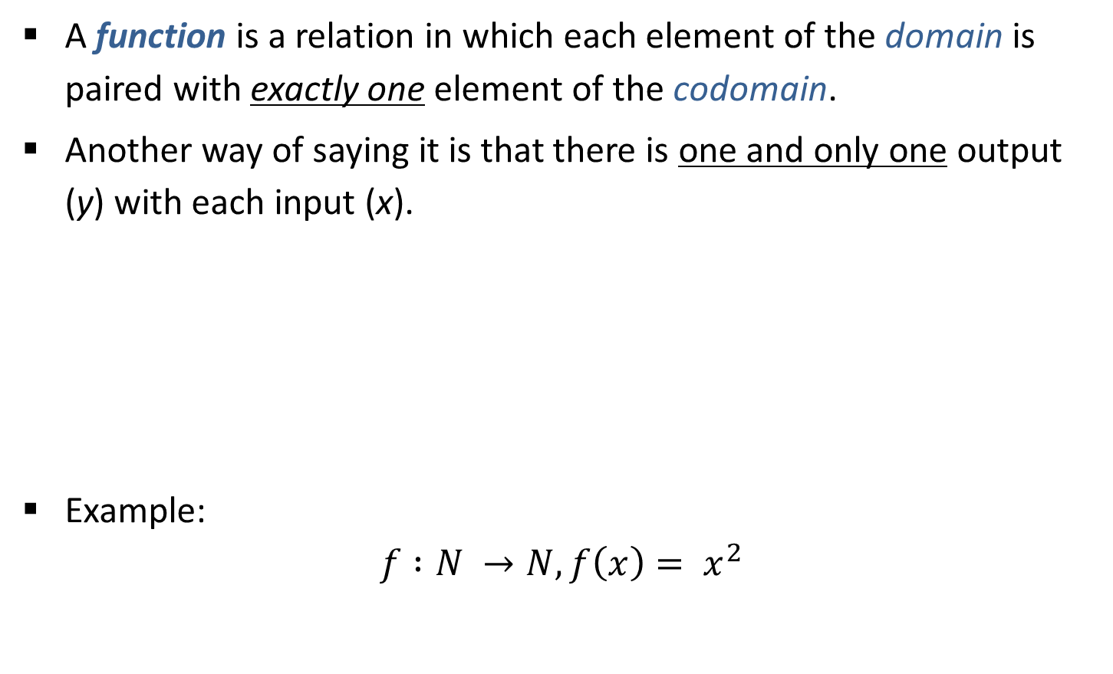
Functions
A function is a relation in which each element of the domain is paired with exactly one element of the codomain.
Another way of saying it is that there is one and only one output (y) with each input (x).
Example:
$$f :N →N, f\left(x\right)= x^{2}$$
f(x)
y
x

Slide 23
Function Notation
$$f:domain →codomain$$
Input
Name of Function
Output

Slide 24
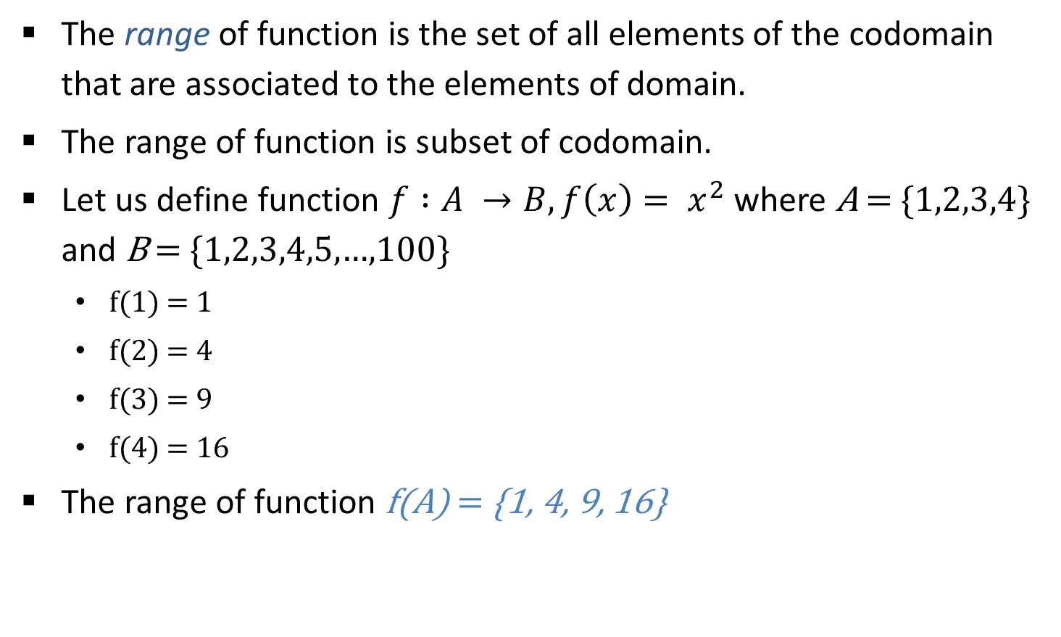
Range of Function
The range of function is the set of all elements of the codomain that are associated to the elements of domain.
The range of function is subset of codomain.
Let us define function $f :A →B, f\left(x\right)= x^{2}$ where A = {1,2,3,4} and B = {1,2,3,4,5,…,100}
f(1) = 1
f(2) = 4
f(3) = 9
f(4) = 16
The range of function f(A) = {1, 4, 9, 16}

Slide 25
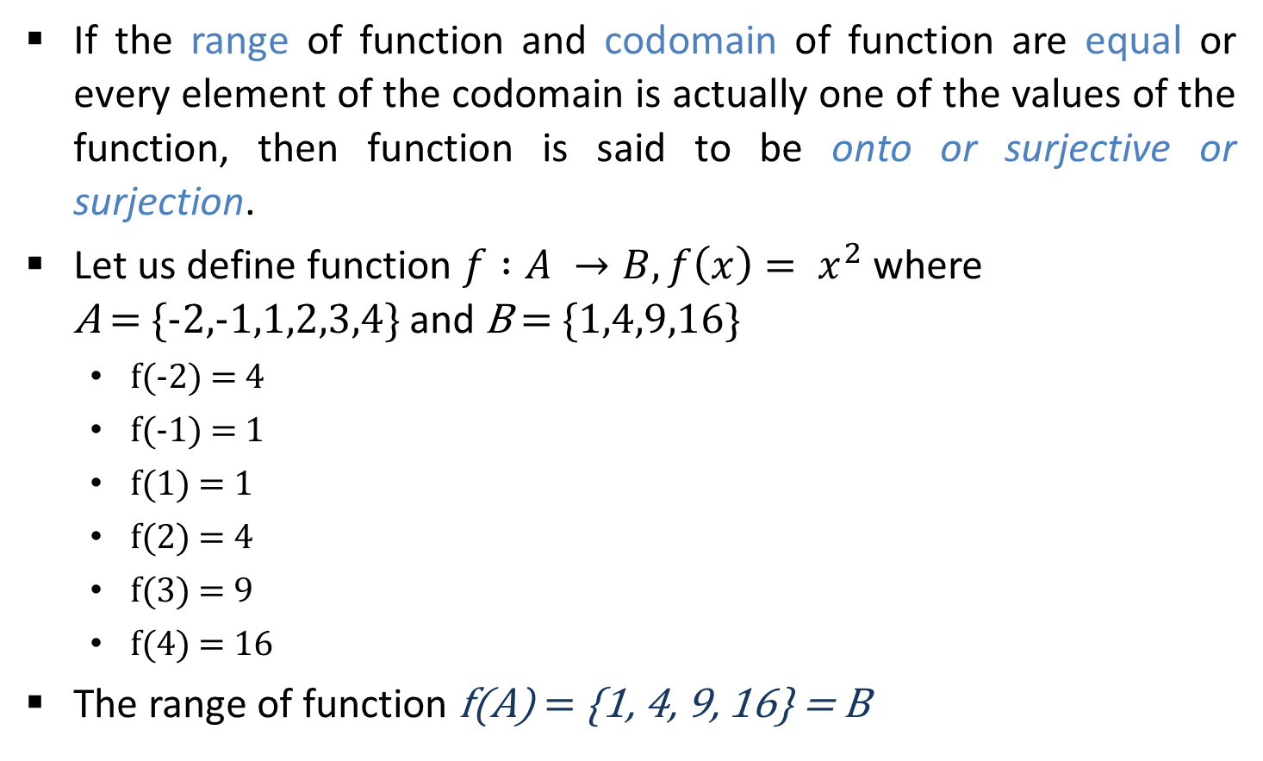
Onto Function
If the range of function and codomain of function are equal or every element of the codomain is actually one of the values of the function, then function is said to be onto or surjective or surjection.
Let us define function $f :A →B, f\left(x\right)= x^{2}$ where A = {-2,-1,1,2,3,4} and B = {1,4,9,16}
f(-2) = 4
f(-1) = 1
f(1) = 1
f(2) = 4
f(3) = 9
f(4) = 16
The range of function f(A) = {1, 4, 9, 16} = B
A
-2
B
-1
1
1
4
2
9
3
4
16

Slide 26
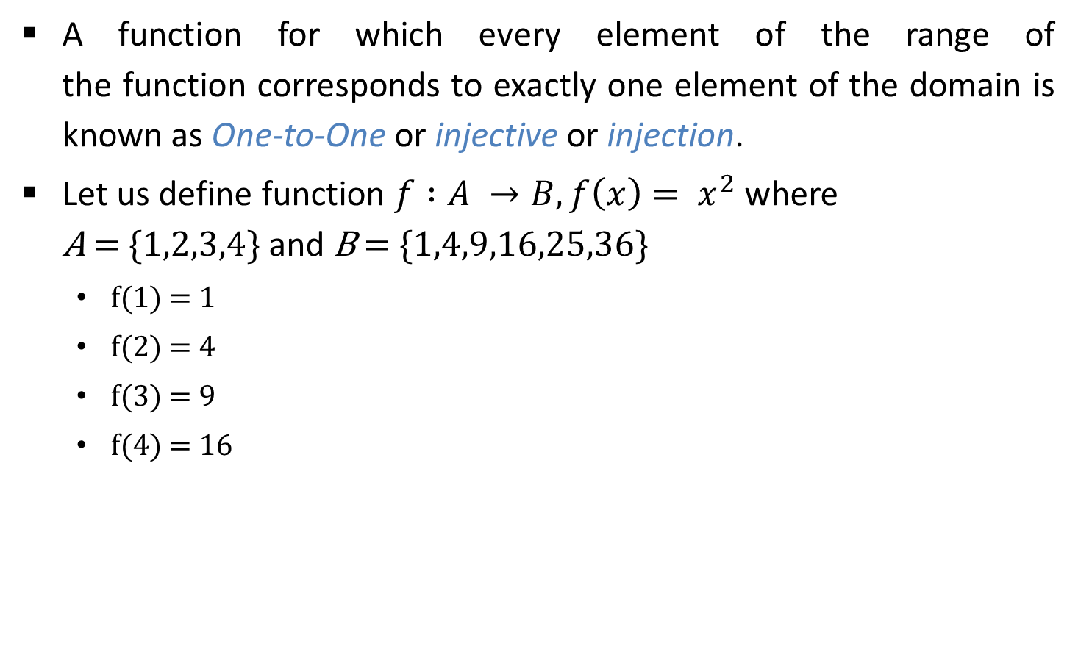
One-to-One Function
A function for which every element of the range of the function corresponds to exactly one element of the domain is known as One-to-One or injective or injection.
Let us define function $f :A →B, f\left(x\right)= x^{2}$ where A = {1,2,3,4} and B = {1,4,9,16,25,36}
f(1) = 1
f(2) = 4
f(3) = 9
f(4) = 16
A
B
1
1
2
4
3
9
16
4
25
36

Slide 27
Examples (One-to-One & Onto)
General Function
Onto(Surjective) Function
One-to-One(Injective) Function
Bijection(Injective & Surjective) Function

Slide 28

More Examples (One-to-One & Onto)
Prove that $f :R →R, f\left(x\right)= x^{2}$ is neither one-to-one nor onto.
Prove that $f :R →R+, f\left(x\right)= x^{2}$ is onto but not one-to-one.
Prove that $f :R+→R, f\left(x\right)= x^{2}$ is one-to-one but no onto.
Prove that $f :R+→R+, f\left(x\right)= x^{2}$ is one-to-one and onto (bijection).

Slide 29
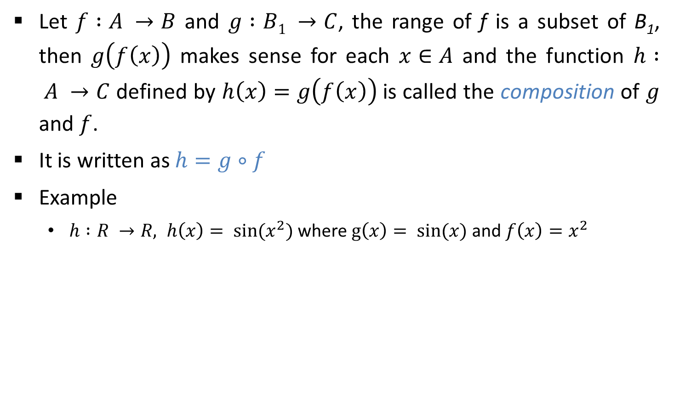
Compositions of Function
Let $f :A →B$ and $g :B1 →C$, the range of f is a subset of B₁, then $g\left(f\left(x\right)\right)$ makes sense for each $x∈A$ and the function $h : A →C$ defined by $h\left(x\right)=g\left(f\left(x\right)\right)$ is called the composition of $g$ and $f$.
It is written as $h=g∘f$
Example
$h :R →R, h\left(x\right)= \sin{(x^{2})}$ where $g\left(x\right)= \sin{(x)}$ and $f\left(x\right)=x^{2}$

Slide 30
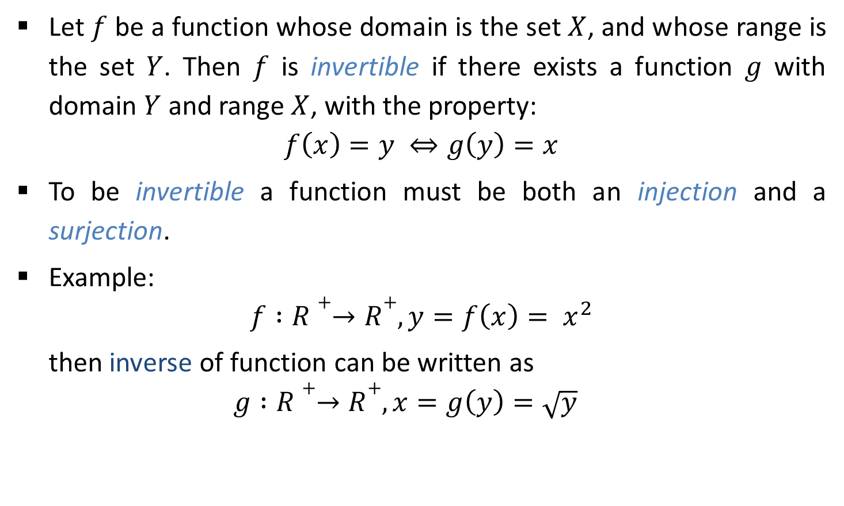
Inverse of Function
Let $f$ be a function whose domain is the set $X$, and whose range is the set $Y$. Then $f$ is invertible if there exists a function $g$ with domain $Y$ and range $X$, with the property:
$$f\left(x\right)=y ⇔g\left(y\right)=x$$
To be invertible a function must be both an injection and a surjection.
Example:
$$f :R+→R+, y=f\left(x\right)= x^{2}$$
then inverse of function can be written as
$$g :R+→R+, x=g\left(y\right)=\sqrt{y}$$

Slide 31
Relations
Computer Engineering Darshan Institute of Engineering & Technology

Slide 32
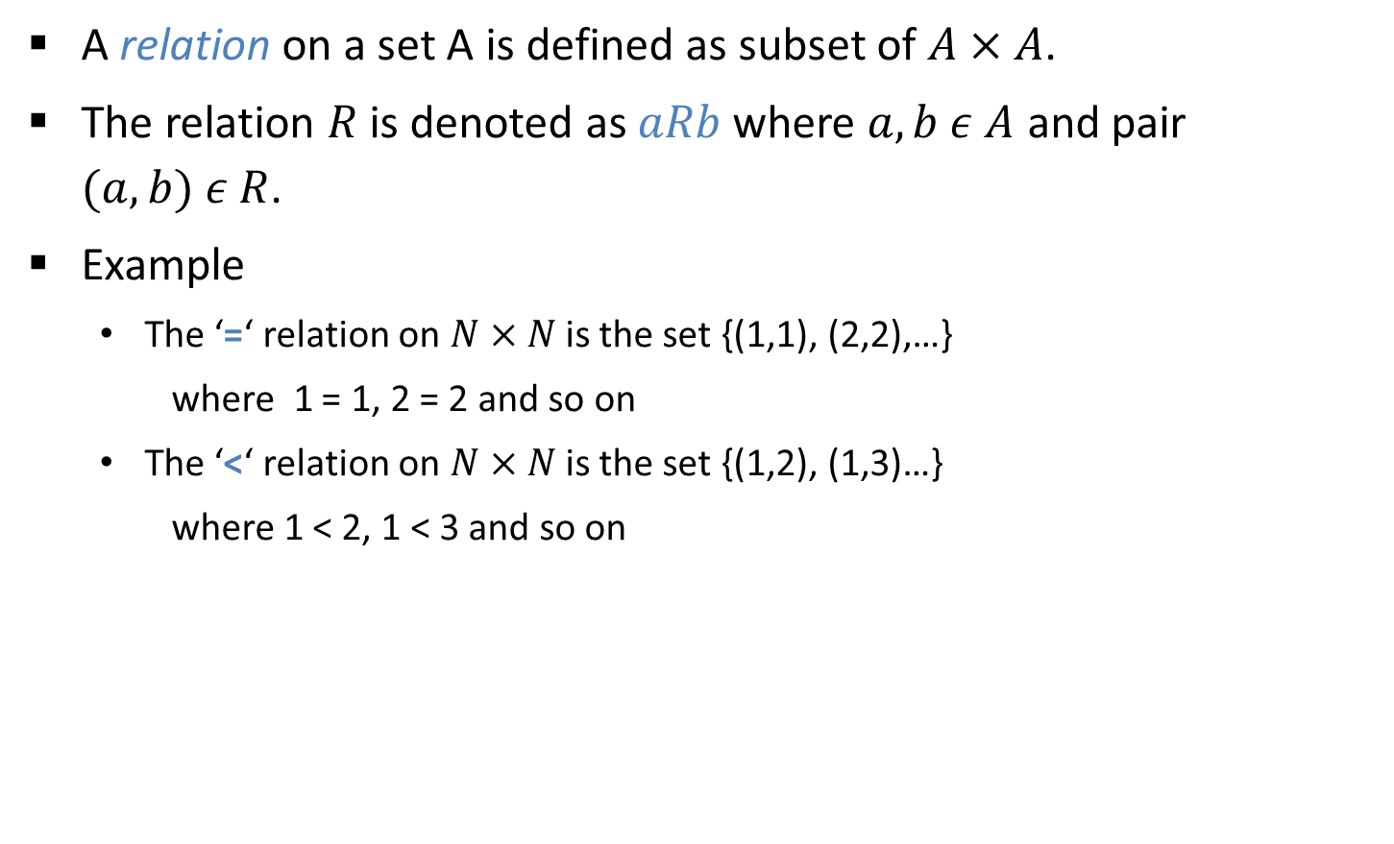
Relations
A relation on a set A is defined as subset of $A×A$.
The relation $R$ is denoted as $aRb$ where $a,b ε A$ and pair $(a,b) ε R$.
Example
The ‘=‘ relation on $N×N$ is the set {(1,1), (2,2),…}
where 1 = 1, 2 = 2 and so on
The ‘<‘ relation on $N×N$ is the set {(1,2), (1,3)…}
where 1 < 2, 1 < 3 and so on

Slide 33
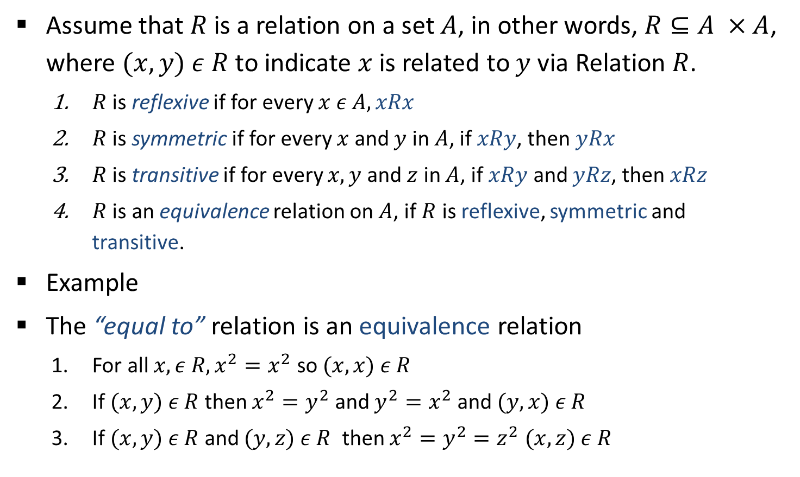
Properties of Equivalence Relations
Assume that $R$ is a relation on a set $A$, in other words, $R⊆A ×A$, where $(x,y) ε R$ to indicate $x$ is related to $y$ via Relation $R$.
$R$ is reflexive if for every $x ε A, xRx$
$R$ is symmetric if for every $x$ and $y$ in $A$, if $xRy$, then $yRx$
$R$ is transitive if for every $x,y$ and $z$ in $A$, if $xRy$ and $yRz$, then $xRz$
$R$ is an equivalence relation on $A$, if $R$ is reflexive, symmetric and transitive.
Example
The “equal to” relation is an equivalence relation
For all $x,ε R, x^{2}=x^{2}$ so $(x,x) ε R$
If $(x,y) ε R$ then $x^{2}=y^{2}$ and $y^{2}=x^{2}$ and $(y, x) ε R$
If $(x,y) ε R$ and $(y,z) ε R$ then $x^{2}=y^{2}=z^{2}$ $(x, z) ε R$

Slide 34
Languages
Computer Engineering Darshan Institute of Engineering & Technology

Slide 35
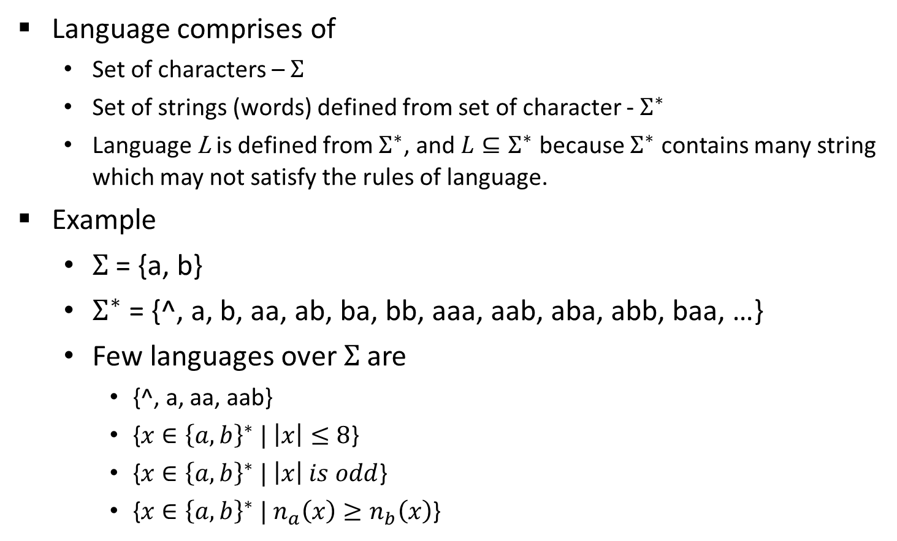
Language
Language comprises of
Set of characters – $Σ$
Set of strings (words) defined from set of character - $Σ^{∗}$
Language L is defined from $Σ^{∗}$, and $L⊆Σ^{∗}$ because $Σ^{∗}$ contains many string which may not satisfy the rules of language.
Example
$Σ$ = {a, b}
$Σ^{∗}$ = {^, a, b, aa, ab, ba, bb, aaa, aab, aba, abb, baa, …}
Few languages over $Σ$ are
{^, a, aa, aab}
{$x∈{\left\{a, b\right\}}^{∗} | \left|x\right|≤8$}
{$x∈{\left\{a, b\right\}}^{∗} | \left|x\right| is odd$}
{$x∈{\left\{a, b\right\}}^{∗} | n_{a}\left(x\right)≥n_{b}\left(x\right)$}
(| | indicates length of string)
(indicates number of a in string x)

Slide 36
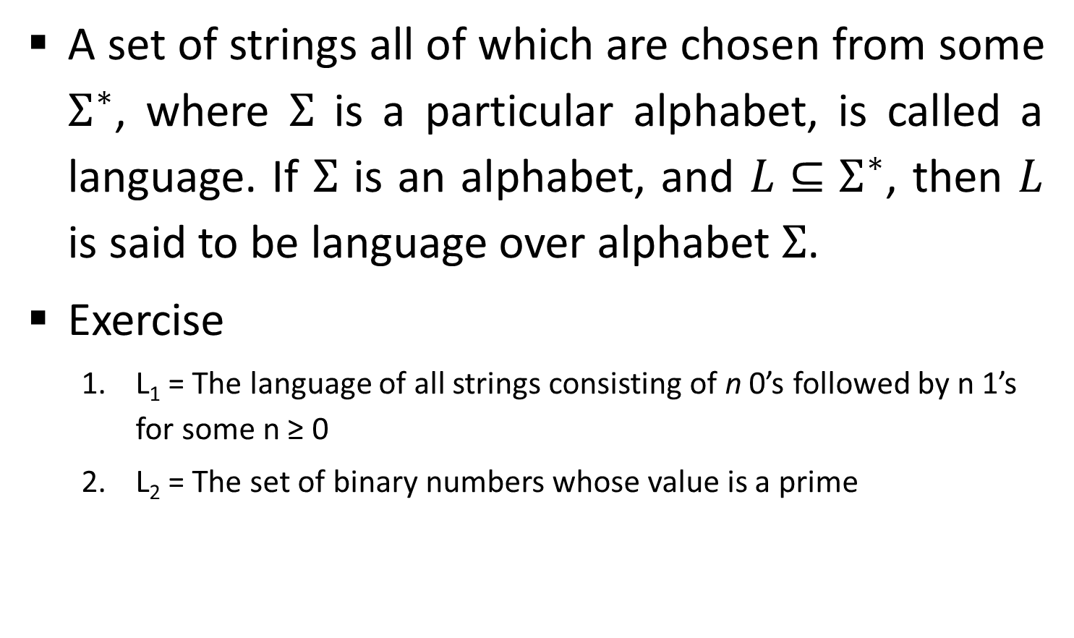
Language
A set of strings all of which are chosen from some $Σ^{∗}$, where $Σ$ is a particular alphabet, is called a language. If $Σ$ is an alphabet, and $L⊆Σ^{∗}$, then $L$ is said to be language over alphabet $Σ$.
Exercise
L₁ = The language of all strings consisting of n 0’s followed by n 1’s for some n ≥ 0
L₂ = The set of binary numbers whose value is a prime

Slide 37


Operations over Language
Concatenation
If $L_{1}, L_{2}⊆ Σ^{∗}$ then concatenation is defined as
$$L1L2=\left\{xy \right| x ε L1 and y ε L2\}$$
Example
$L1$ = {hope, fear} and $L2$ = {less, fully}
hope
less
hopeless
$L1L2$ = {hopeless, hopefully, fearless, fearfully}

Slide 38


Operations over Language
Union
If $L_{1}, L_{2}⊆ Σ^{∗}$ then union is defined as
$$L1 | L2=\left\{x \right| x ε L1 or x ε L2\}$$
Example
$L1$ = {hope, fear} and $L2$ = {less, fully}
$L1 | L2$ = {hope, fear, less, fully}

Slide 39
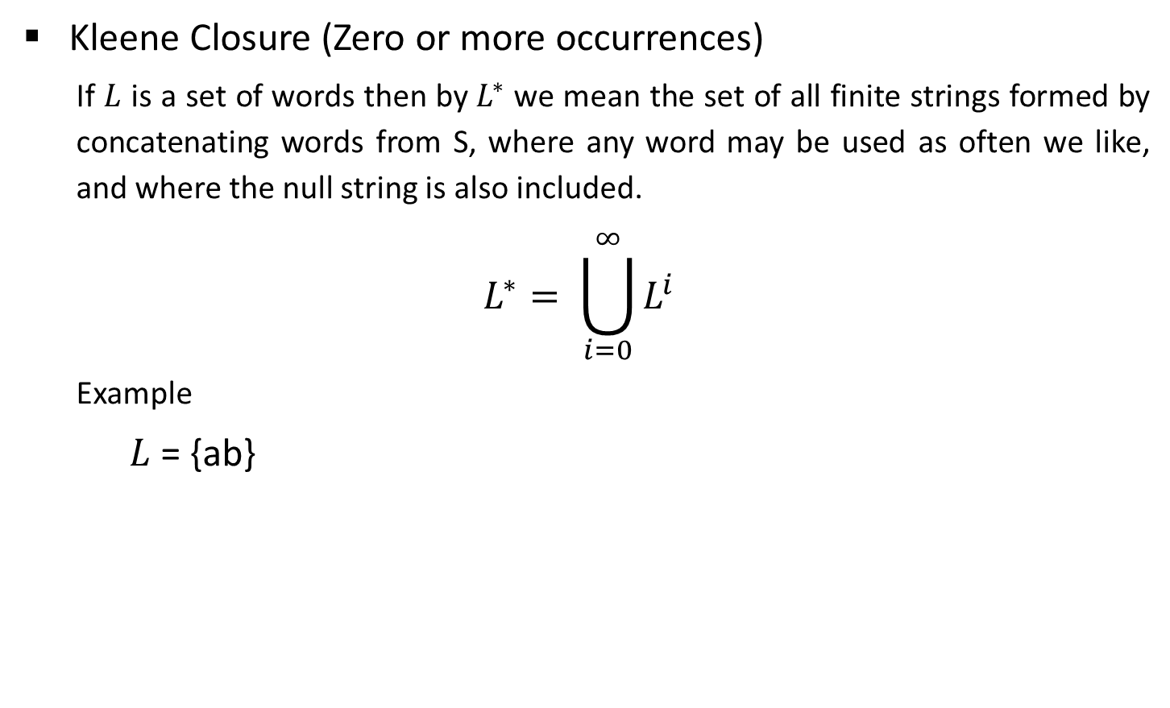
Operations over Language
Kleene Closure (Zero or more occurrences)
If $L$ is a set of words then by $L^{∗}$ we mean the set of all finite strings formed by concatenating words from S, where any word may be used as often we like, and where the null string is also included.
$$L^{∗}= \bigcup_{i=0}^{∞}{L^{i}}$$
Example
$L$ = {ab}
^
ab
ab
ab
ab
ab
ab
ab
ab
ab
ab
……
$L$* = {^, ab, abab, ababab, abababab, ….}

Slide 40

Operations over Language
$L^{+}$
If $L$ is a set of words then by $L^{+}$ we mean the set of all finite strings formed by concatenating words from L, where any word may be used as often we like, and where the null string is not included.
$$L^{+}= \bigcup_{i=1}^{∞}{L^{i}}$$
Example
$L$ = {ab}
ab
ab
ab
ab
ab
ab
ab
ab
ab
ab
……
$L^{+}$ = {ab, abab, ababab, abababab, ….}

Slide 41
Proof
Computer Engineering Darshan Institute of Engineering & Technology

Slide 42
Proof
A proof of a statement is essentially just a convincing argument that the statement is true.
A typical step in proof is to derive some statement from
assumptions or hypotheses
statements that have already been derived
Other generally accepted facts

Slide 43
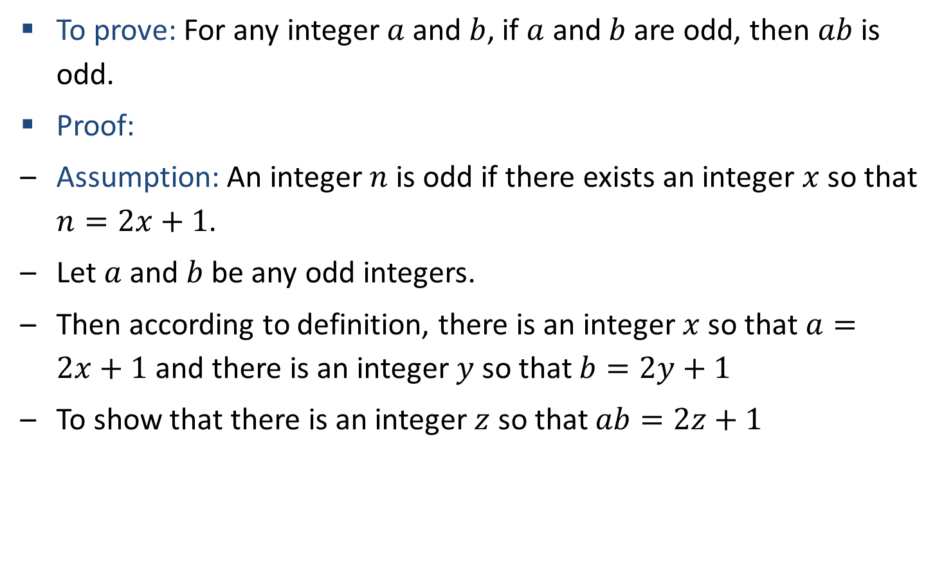
Prove: Product of Two Odd Integers is Odd
To prove: For any integer $a$ and $b$, if $a$ and $b$ are odd, then $ab$ is odd.
Proof:
Assumption: An integer $n$ is odd if there exists an integer $x$ so that $n=2x+1$.
Let $a$ and $b$ be any odd integers.
Then according to definition, there is an integer $x$ so that $a=2x+1$ and there is an integer $y$ so that $b=2y+1$
To show that there is an integer $z$ so that $ab=2z+1$

Slide 44




Prove: Product of Two Odd Integers is Odd
Therefore
Since we have shown that there is a $z=2xy+x+y$ so that $ab=2z+1$.
Hence we proved that “The product of two odd integers is odd”.
$$ab$$ | $$=$$ | $$(2x+1)(2y+1)$$
 | $$=$$ | $$4xy+ 2x+2y+1$$
 | $$=$$ | $$2(2xy+ x+y)+1$$

Slide 45
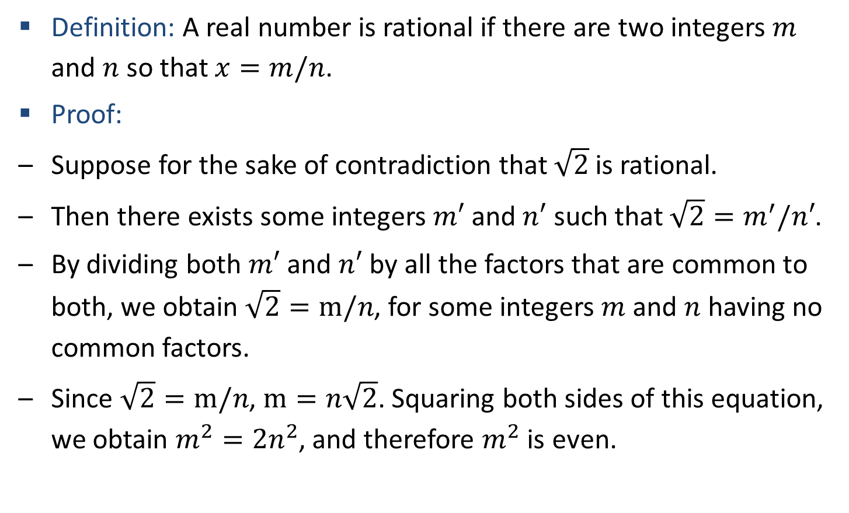

Prove: $\sqrt{2}$ is Irrational
Definition: A real number is rational if there are two integers $m$ and $n$ so that $x=m/n$.
Proof:
Suppose for the sake of contradiction that $\sqrt{2}$ is rational.
Then there exists some integers $m′$ and $n′$ such that ${\sqrt{2}=m}^{′}/n′$.
By dividing both $m′$ and $n′$ by all the factors that are common to both, we obtain $\sqrt{2}=m/n$, for some integers $m$ and $n$ having no common factors.
Since $\sqrt{2}=m/n$, $m=n\sqrt{2}$. Squaring both sides of this equation, we obtain $m^{2}=2n^{2}$, and therefore $m^{2}$ is even.

Slide 46
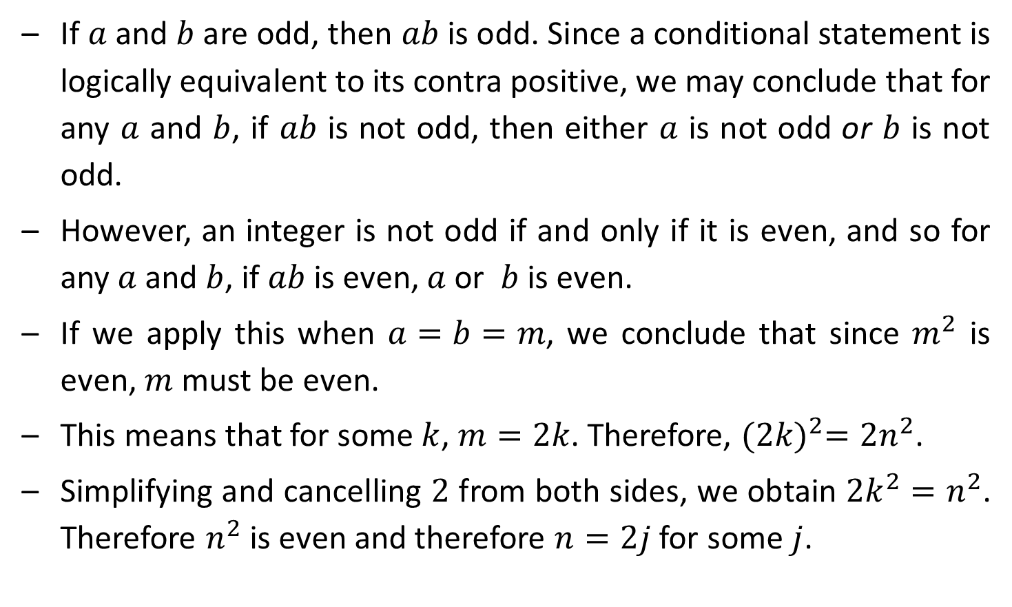
Prove: $\sqrt{2}$ is Irrational
If $a$ and $b$ are odd, then $ab$ is odd. Since a conditional statement is logically equivalent to its contra positive, we may conclude that for any $a$ and $b$, if $ab$ is not odd, then either $a$ is not odd or $b$ is not odd.
However, an integer is not odd if and only if it is even, and so for any $a$ and $b$, if $ab$ is even, $a$ or $b$ is even.
If we apply this when $a=b=m$, we conclude that since $m^{2}$ is even, $m$ must be even.
This means that for some $k$, $m=2k$. Therefore, ${(2k)}^{2}=2n^{2}$.
Simplifying and cancelling $2$ from both sides, we obtain $2k^{2}=n^{2}$. Therefore $n^{2}$ is even and therefore $n=2j$ for some $j$.

Slide 47

Prove: $\sqrt{2}$ is Irrational
We have shown that $m$ and $n$ are both divisible by 2. This contradicts the previous statement that $m$ and $n$ have no common factor.
The assumption that $\sqrt{2}$ is rational therefore leads to a contradiction, and the conclusion is that $\sqrt{2}$ is irrational.

Slide 48
Principle of Mathematical Induction
Computer Engineering Darshan Institute of Engineering & Technology

Slide 49

Principle of Mathematical Induction
Suppose $P(n)$ is a statement involving an integer $n$. Then to prove that $P(n)$ is true for every $n≥n_{0}$, it is sufficient to show these two things:
$P(n_{0})$ is true.
For any $k≥n_{0}$, if $P(k)$ is true, then $P(k+1)$ is true.

Slide 50
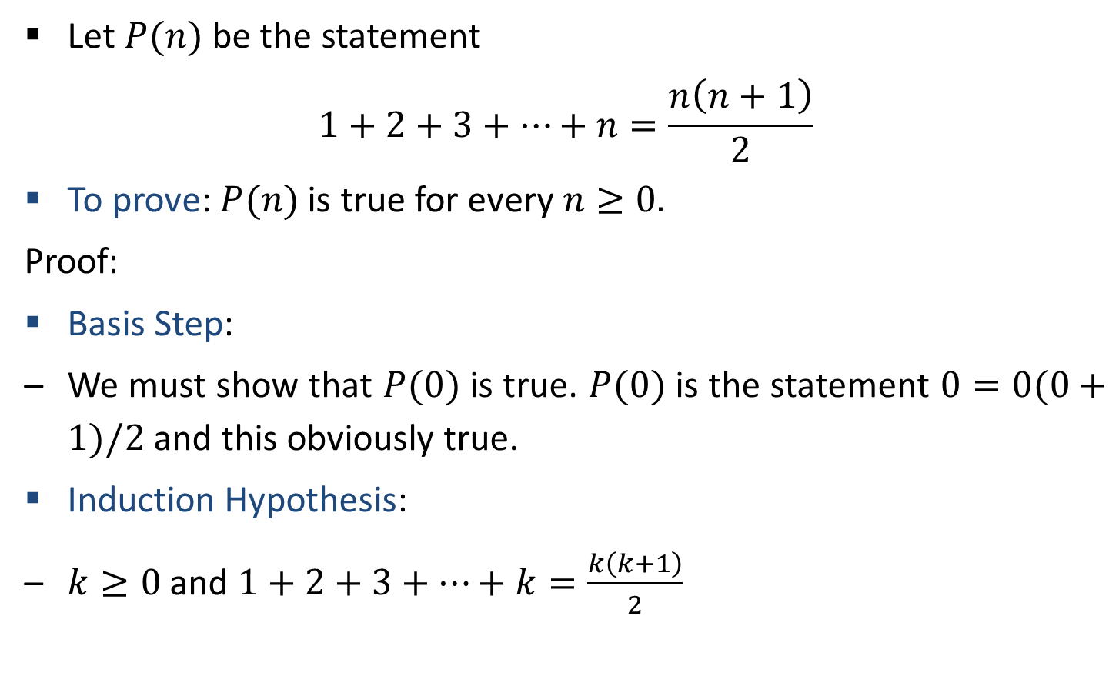

Prove $\sum_{i=1}^{n}{i}=n(n+1)/2$ using PMI
Let $P(n)$ be the statement
$$1+2+3+…+n=\frac{n\left(n+1\right)}{2}$$
To prove: $P(n)$ is true for every $n≥0.$
Proof:
Basis Step:
We must show that $P(0)$ is true. $P(0)$ is the statement $0=0(0+1)/2$ and this obviously true.
Induction Hypothesis:
$k≥0$ and $1+2+3+…+k=\frac{k\left(k+1\right)}{2}$

Slide 51
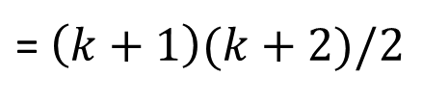

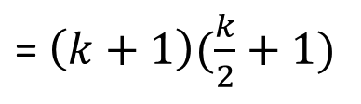
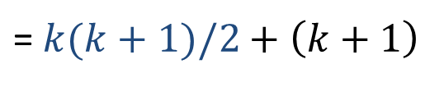
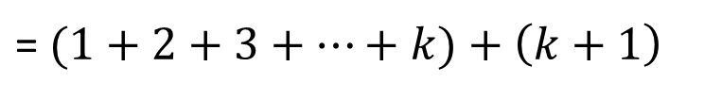
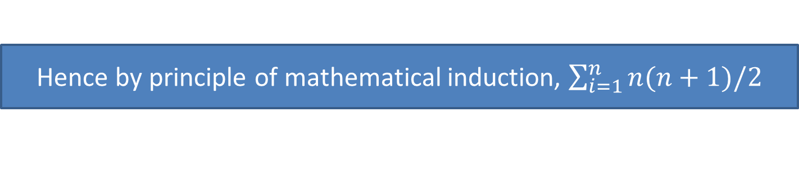
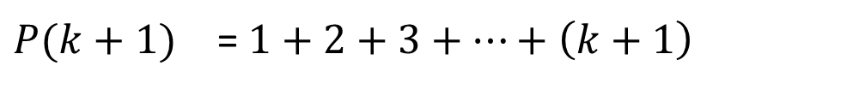
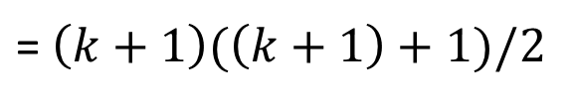
Prove $\sum_{i=1}^{n}{i}=n(n+1)/2$ using PMI
To prove: $P(k+1)$ is true
$$P\left(k+1\right)=1+2+3+…+\left(k+1\right)=(k+1)(\left(k+1\right)+1)/2$$
Proof of Induction
$$P(k+1)$$ | = $1+2+3+…+\left(k+1\right)$
= $(1+2+3+…+k)+\left(k+1\right)$
= $k(k+1)/2+\left(k+1\right)$
(by induction hypothesis)
= $\left(k+1\right)(\frac{k}{2}+1)$
= $\left(k+1\right)(k+2)/2$
= $\left(k+1\right)(\left(k+1\right)+1)/2$
(Hence Proved)
Hence by principle of mathematical induction, $\sum_{i=1}^{n}{n(n+1)/2}$

Slide 52
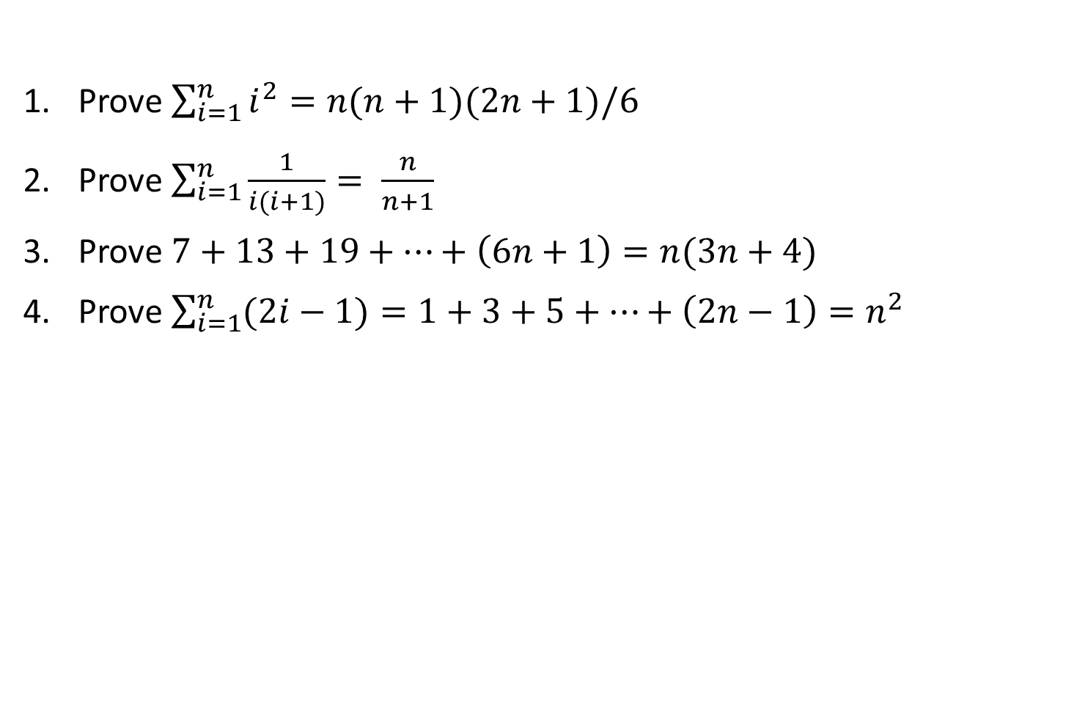
Exercise (PMI)
Prove $\sum_{i=1}^{n}{i^{2}}=n(n+1)(2n+1)/6$
Prove $\sum_{i=1}^{n}{\frac{1}{i(i+1)}}= \frac{n}{n+1}$
Prove $7+13+19+…+\left(6n+1\right)=n(3n+4)$
Prove $\sum_{i=1}^{n}{(2i−1)}=1+3+5+…+\left(2n−1\right)=n^{2}$

Slide 53

Strong Principle of Mathematical Induction
Suppose $P(n)$ is a statement involving an integer $n$. Then to prove that $P(n)$ is true for every $n≥n_{0}$, it is sufficient to show these two things:
$P(n_{0})$ is true.
For any $k≥n_{0}$, if $P(n)$ is true for every $n$ satisfying $n_{0}≤n≤k$, then $P(k+1)$ is true.

Slide 54
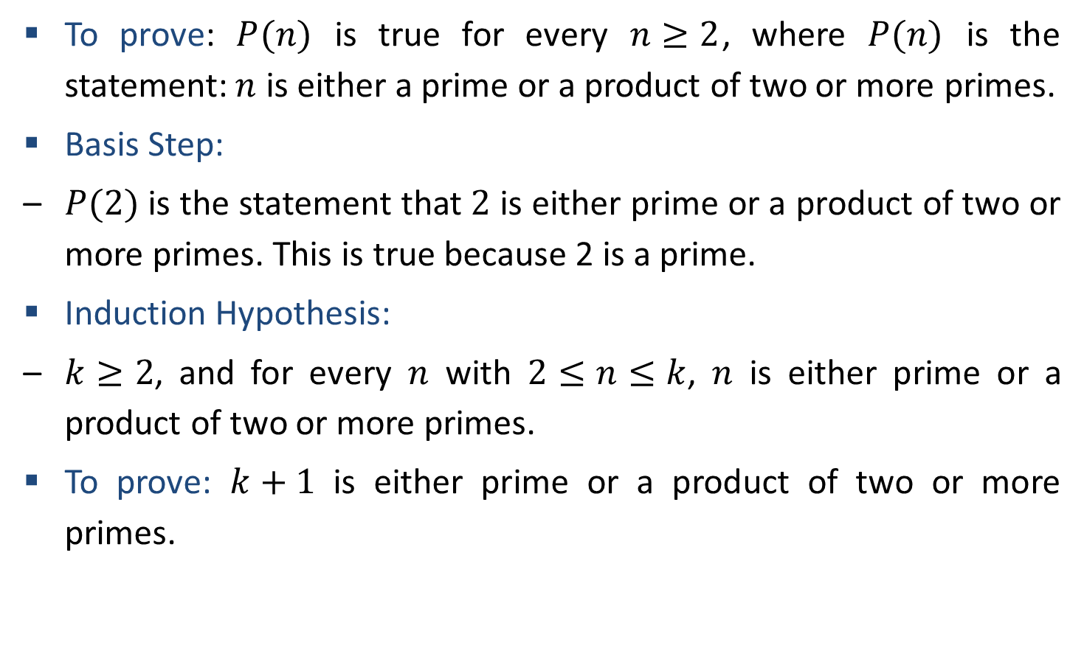
Prove that Integer Bigger than 2 have prime factorization using strong PMI
To prove: $P(n)$ is true for every $n≥2$, where $P(n)$ is the statement: $n$ is either a prime or a product of two or more primes.
Basis Step:
$P(2)$ is the statement that $2$ is either prime or a product of two or more primes. This is true because 2 is a prime.
Induction Hypothesis:
$k≥2$, and for every $n$ with $2≤n≤k$, $n$ is either prime or a product of two or more primes.
To prove: $k+1$ is either prime or a product of two or more primes.

Slide 55
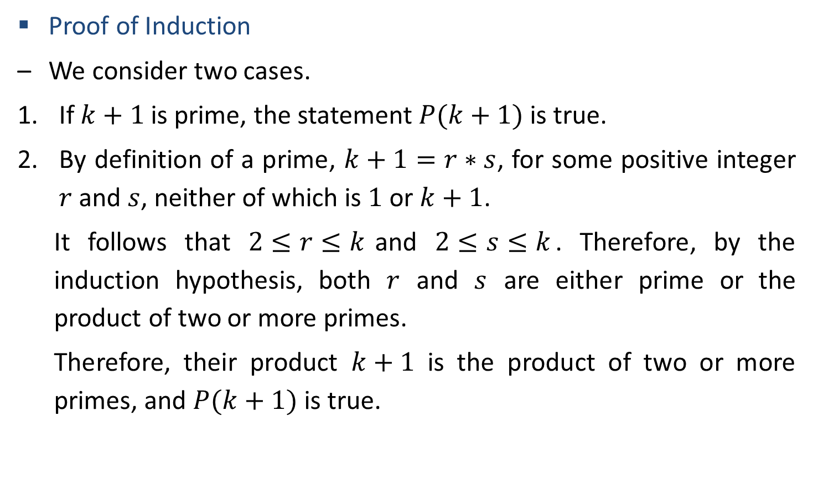
Prove that Integer Bigger than 2 have prime factorization using strong PMI
Proof of Induction
We consider two cases.
If $k+1$ is prime, the statement $P(k+1)$ is true.
By definition of a prime, $k+1=r∗s$, for some positive integer $r$ and $s$, neither of which is $1$ or $k+1$.
It follows that $2≤r≤k$and $2≤s≤k$. Therefore, by the induction hypothesis, both $r$ and $s$ are either prime or the product of two or more primes.
Therefore, their product $k+1$ is the product of two or more primes, and $P(k+1)$ is true.
Hence by strong principle of mathematical induction, Integer bigger than 2 have prime factorization

