Slide 1

Unit – 3
Context Free Grammar (CFG)
Hardik Doshi
 9978911553
→ hardik.doshi@darshan.ac.in
Theory of Computation (2160704) Darshan Institute of Engineering & Technology

Slide 2
Topics to be covered
Context Free Grammar
Derivation & languages
Relationship between derivation and derivation trees
Ambiguity & Unambiguous CFG
Bacus Naur Form
Chomsky Normal Form

Slide 3
Context Free Grammar

Slide 4


What is Grammar?
Boy ate apple
Subject
Verb
Object
<sentence> → <subject phrase> <verb phrase> <object> |
<subject phrase> <verb phrase>
Example
Ram drinks coffee
Ate apple boy
Darshan is engineering college
Apple ate boy

Slide 5
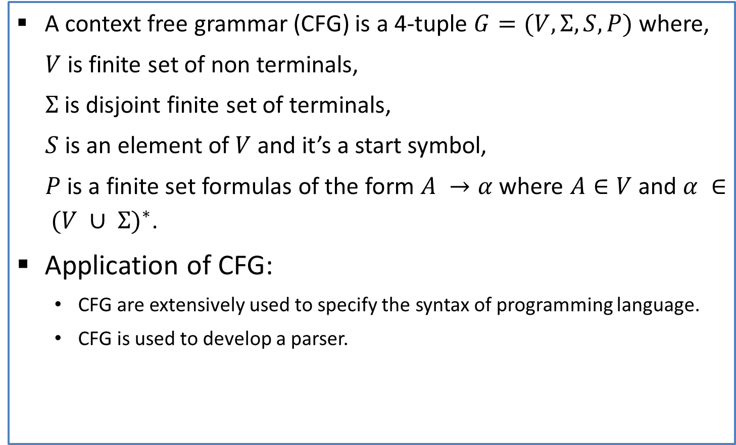
Context Free Grammar
A context free grammar (CFG) is a 4-tuple $G=(V,Σ,S,P)$where,
$V$ is finite set of non terminals,
$Σ$ is disjoint finite set of terminals,
$S$ is an element of $V$ and it’s a start symbol,
$P$ is a finite set formulas of the form $A →α$ where $A∈V$ and $α ∈ {(V ∪ Σ)}^{∗}$.
Application of CFG:
  CFG are extensively used to specify the syntax of programming language.
  CFG is used to develop a parser.

Slide 6

Context Free Language
Let $G=(V,Σ,S,P)$ be a CFG. The language generated by $G$ is
$$L\left(G\right) :\left\{x ∈ Σ^{∗}\right| S⇒_{G}^{∗}x\}$$
A language $L$ is a context free Language (CFL) if there is a CFG $G$ so that $L=L\left(G\right)$.

Slide 7
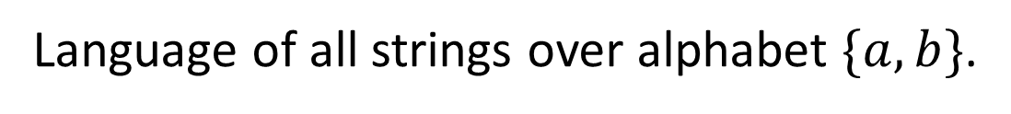









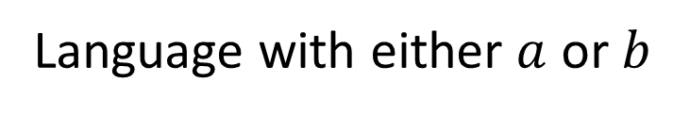




















CFG Examples
Language with either $a$ or $b$
$$S$$
$$→$$
$$a$$
$$|$$
$$b$$
Language of all strings over alphabet $\{a,b\}$.
$$Λ$$
$$|$$
$$S$$
$$|$$
$$S$$
$$S$$
$$→$$
$$a$$
$$b$$
Language for palindromes
$$Λ$$
$$|$$
$$|$$
$$a$$
$$S$$
$$|$$
$$b$$
$$S$$
$$S$$
$$→$$
$$a$$
$$|$$
$$b$$
$$a$$
$$b$$

Slide 8





CFG Examples
Language of Algebraic expressions
$S→S+S \left| S−S \right| S /$ $S \left| \left(S\right)\right| a$
$$a+a$$
$$a−a$$
$$a/a$$
$$(a+a)$$

Slide 9






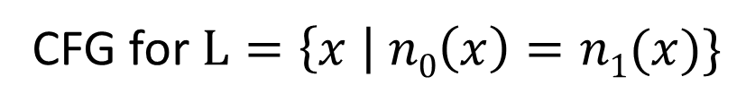


CFG Examples
CFG for syntax of programming language
<statement> $→$ … | <if-statement> | <for-statement> | …
<if-statement> $→$ if ( <expression> ) <statement>
<for-statement> $→$ for ( <expression>; <expression>; <expression> ) <statement>
CFG for $L=\left\{x \right| n0\left(x\right)=n1(x)\}$
$$S→Λ \left| 0S1 \right| 1S0 | SS$$
$$Λ$$
$$01$$
$$10$$
$$0101$$
$$0110$$
$$…$$

Slide 10







Regular Expression to CFG
Concatenation
$$01$$
$$A→01$$
Union
$$011+1$$
$$A→011 | 1$$
Kleene *
$${(01)}^{∗}$$
$$B→AB | Λ$$
$$A→01$$

Slide 11















Regular Expression to CFG
$${(011+1)}^{∗}{(01)}^{∗}$$
$${(011+1)}^{∗}{(01)}^{∗}$$
$$S→BC$$
$$A→011 | 1$$
$$D→01$$
$$B→AB | Λ$$
$${(011+1)}^{∗}$$
$$A→011 | 1$$
$$B→AB | Λ$$
$$C→DC | Λ$$
$$A→011 | 1$$
$$D→01$$
$${(01)}^{∗}$$
$$C→DC | Λ$$
$$D→01$$

Slide 12
Exercise
(a+b)*abb
(a+b)*aa(a+b)*

Slide 13

Regular Grammar
A grammar $G=(V,Σ,S,P)$is regular if every production takes one of the two forms,
  $$B→aC$$
  $$B→a$$
  where $B$ and $C$ are Nonterminal and $a$ is terminal.

Slide 14










FA to Regular Grammar
0
1
$$A→0A$$
0
$$A→1B$$
$$A$$
1
$$B$$
$$C$$
$$B→0C$$
$$B→1B$$
1
0
$$C→0A$$
$$C→1B$$
$$B→0$$
At last, all the incoming transitions to the accepting states are designated by the production
Source State → input symbol

Slide 15




Exercise
b
0
a
B
a
1
b
$$C$$
0
A
b
C
$$A$$
0
$$B$$
1
b
b
1
a
a
$$D$$
0
E
a
D
1

Slide 16
Derivation trees & Ambiguity

Slide 17
Derivation & Derivation Tree
Let us consider a Grammar
S→S+S | S-S | S*S | S/S | (S) | a
String: a*a-a
S
S-S
S*S-S
a*S-S
a*a-S
a*a-a
Derivation Tree
S
S
-
S
S
*
S
a
a
a
Derivation

Slide 18
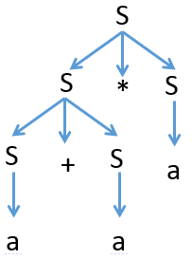
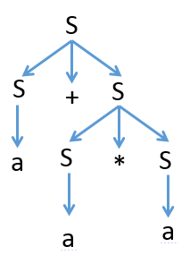
Ambiguous Grammar
A context free grammar G is ambiguous if there is at least one string in L(G) having two or more distinct derivation tree.
Ex: S→S+S | S-S | S*S | S/S | (S) | a
String: a+a*a
S S
S*S S+S
S+S*S a+S
a+S*S a+S*S
a+a*S a+a*S
a+a*a a+a*a
Here, we have two left most derivation for string a+a*a hence, above grammar is ambiguous.

Slide 19
Unambiguous Grammar
S→ S+S | S*S | (S) | a
String: a+a*a
S
S+T
T+T
F+T
a+T
a+T*F
a+F*F
a+a*F
a+a*a
S→ S+T | T
T→ T*F | F
F→ (S) | a
Equivalent Unambiguous grammar
Here, we do not have two left most derivation for string a+a*a hence, grammar is Unambiguous.

Slide 20
Simplified forms & Normal forms

Slide 21

Nullable Variable
A Nullable variable in a CFG, $G=(V,Σ,S,P)$ is defined as follows:
Any variable A for which P contains $A→^$ is nullable.
If P contains the production $A→B1 B2….Bn$ are nullable variable, then A is nullable.
No other variables in V are nullable.

Slide 22
Elimination of ^ productions
Given a CFG $G=(V,Σ ,S,P)$ , construct a CFG $G1=(V,Σ ,S,P1)$ with no ^- production as follows.
Initialize P1 to be P.
Find all nullable variable in V.
For every production $A→α$ in P, add to P1 every production that can be obtained from this one by deleting from $α$ one or more of the occurrences of nullable variables in $α$.
Delete all the empty productions from P1. also delete any duplicates, as well as production of the form $A→A$

Slide 23
Eliminate ˄ production
S→a X |Yb
X→S |˄
Y→bY|b
Nullable variable={X}
S→aX|Yb|a^
X→S|^
Y→bY|b
Replacing X by ^ in all productions containing X on RHS and rewriting the production again
S→aX|Yb|a
X→S
Y→bY|b
Removing ^ productions and production of the form A→A

Slide 24
A-derivable
A variable is called A-derivable ,
If $A→B$ is a production, B is A-derivable.
If C is A-derivable, $C→B$ is a production, and $B≠A$ , then B is A-derivable.
No other variables are A-derivable.
S→A
S→B
S-derivable={A,B}
S→A
A→B
S-derivable={A,B}

Slide 25
Unit Production & Elimination of Unit productions
A productions in form of A→B are unit productions. Where A & B are nonterminals.
Algorithm
Given a CFG $G=(V,Σ ,S,P)$ with no ^ productions, construct a CFG $G1=(V,Σ,S,P1)$ having no unit production as follows.
Initialize P1 to be P.
For each A ∈ V ,finding the set of A derivable variable.
For every pair (A, B) such that B is A- derivable and every non unit production B→α, add the production A→α to P1 if it is not already present in P1.
Delete all unit productions from P1.

Slide 26
Elimination of unit production
S→ABA|BA|AA|AB|A|B
A→aA|a
B→bB|b
Unit Productions are S→A and S→B
A→aA|a
B→bB|b
S→ABA|BA|AA|AB
|aA|A
|bB|b
Removing unit productions

Slide 27
Chomsky Normal Form (CNF)
A context free grammar is in Chomsky normal form (CNF) is every production is one of these two forms:
A → BC
A → a
Where A, B, and C are nonterminals and a is terminal.

Slide 28
Converting CFG to CNF
Steps to convert CFG to CNF
Eliminate ˄-Productions
Eliminate Unit Productions
Restricting the right side of productions to single terminal or string of two or more nonterminals
Final step of CNF (shorten the string of NT to length 2)

Slide 29
Example (CFG to CNF)
S→AAC
A→aAb|˄
C→aC|a
Step 1: Elimination of ^ production
Eliminate A→^
S→AAC|
AC |
C
A→aAb|
ab
C→aC|a

Slide 30
CFG to CNF
Step-2: Eliminate Unit Production
Step-3: Replace all mixed string with solid NT
Unit Production is S→C
S→AAC|AC|
aC|a
C
A→aAb|ab
C→aC|a
aC
|a
S→AAC|AC|
PC
PAQ|PQ
aAb|ab
A→
PC|a
C→
aC|a
P→a
Q→b

Slide 31
CFG to CNF
Step-4 : Shorten the string of NT to length 2
S→AX₁
X₁→AC
S→AC|PC|a
A→PY₁
Y₁→AQ
A→PQ
C→PC|a
P→a
Q→b
S→AAC|AC|PC|a
A→PAQ|PQ
C→PC|a
P→a
Q→B
Chomsky Normal Form

