Slide 1

Unit – 4 Pushdown Automata
Hardik Doshi
 9978911553
→ hardik.doshi@darshan.ac.in
Theory of Computation (2160704) Darshan Institute of Engineering & Technology

Slide 2

Why Pushdown Automata?
Exercise
Draw Finite automata for language $L=\left\{anbn\right\}$
FA have limited capability.
This is due to the "finite memory” and "no external memory" involved with them.
Not Possible??

Slide 3
Pushdown Automata
Pushdown automata is a computational model equivalent to context free grammar.
A pushdown Automata is essentially a finite Automata with a stack data structure.
A PDA can write an unbounded no. of stack symbols on the stack and read these symbols later.
Writing a symbol on to the stack is called “PUSH” operation.
Removing a symbol off the stack is called “POP” operation.
Input
Finite Stack Control
Accept | Reject
Stack

Slide 4
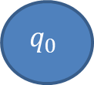
Design PDA for palindrome with middle symbol c.
Move No | State | Input | Stack Symbol | Move(s)
$$1_{}$$ | $$q_{0}$$ | $$a_{}$$ | $$z_{0}$$ | $$(q0,az0)$$
$$2_{}$$ | $$q_{0}$$ | $$b_{}$$ | $$z_{0}$$ | $$(q0,bz0)$$
$$3_{}$$ | $$q_{0}$$ | $$a_{}$$ | $$a$$ | $$(q0,aa)$$
$$4_{}$$ | $$q_{0}$$ | $$b_{}$$ | $$a$$ | $$(q0,ba)$$
$$5_{}$$ | $$q_{0}$$ | $$a_{}$$ | $${ b}_{}$$ | $$(q0,ab)$$
$$6_{}$$ | $$q_{0}$$ | $$b_{}$$ | $${ b}_{}$$ | $$(q0,bb)$$
b, z₀|bz₀
a, z₀|az₀
a, a | aa
$$q_{0}$$
b, b | bb
b, a | ba
a, b | ab

Slide 5
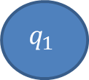

Design PDA for palindrome with middle symbol c.
Move No | State | Input | Stack Symbol | Move(s)
$$7_{}$$ | $$q_{0}$$ | $$c_{}$$ | $$z_{0}$$ | $$(q1,z0)$$
$$8_{}$$ | $$q_{0}$$ | $$c_{}$$ | $$a_{}$$ | $$(q1,a)$$
$$9_{}$$ | $$q_{0}$$ | $$c_{}$$ | $$b_{}$$ | $$(q1,b)$$
b, z₀|bz₀
a, z₀|az₀
a, a | aa
c,a | a
$$q_{0}$$
c,b | b
$$q_{1}$$
c,z₀ | z₀
b, b | bb
b, a | ba
a, b | ab

Slide 6

Design PDA for palindrome with middle symbol c.
Move No | State | Input | Stack Symbol | Move(s)
$${10}_{}$$ | $$q_{1}$$ | $$a$$ | $${ a}_{}$$ | $$(q1,^)$$
$${11}_{}$$ | $$q_{1}$$ | $$b_{}$$ | $${ b}_{}$$ | $$(q1,^)$$
$${12}_{}$$ | $$q_{1}$$ | $${^}_{}$$ | $${ z}_{0}$$ | $$(q2,{ z}_{0})$$
$$(all other combinations)$$ | $$none$$
b, z₀|bz₀
b, b | ^
a, z₀|az₀
a, a | aa
c,a | a
$$q_{0}$$
c,b | b
$$q_{1}$$
^,z₀ | z₀
$$q_{2}$$
c,z₀ | z₀
b, b | bb
b, a | ba
a, b | ab
a, a | ^

Slide 7





String Tracing
b, z₀|bz₀
b, b | ^
a, z₀|az₀
a, a | aa
c,a | a
$$q_{0}$$
c,b | b
$$q_{1}$$
^,z₀ | z₀
$$q_{2}$$
c,z₀ | z₀
b, a | ba
a, a | ^
b, b | bb
a, b | ab
Move No | Resulting State | Unread Input | Stack
$$Initially$$ | $$q_{0}$$ | $${abcba}_{}$$ | $$z_{0}$$
$$1$$ | $$q_{0}$$ | $${bcba}_{}$$ | $${az}_{0}$$
$$4$$ | $$q_{0}$$ | $$cba$$ | $${baz}_{0}$$
$$9$$ | $$q_{1}$$ | $${ba}_{}$$ | $${baz}_{0}$$
$$11$$ | $$q_{1}$$ | $$a_{}$$ | $${az}_{0}$$
$$10$$ | $$q_{1}$$ | $$−$$ | $$z_{0}$$
$$12$$ |  | $$−$$ | $$z_{0}$$
$$q_{2}$$
$$q_{2}$$

Slide 8
Exercise
Trace the following string:
bcb
ab
acaa

Slide 9
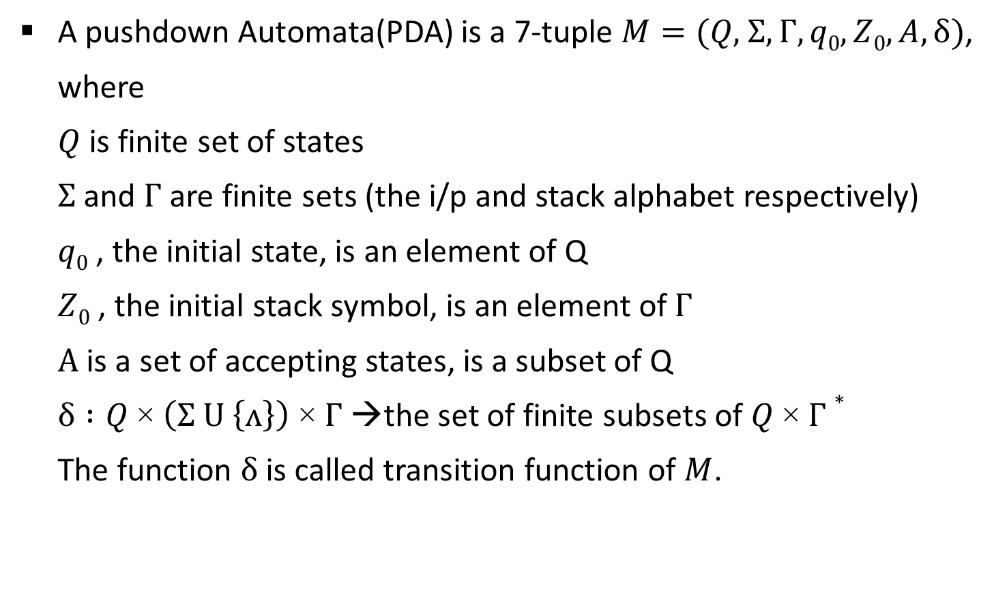
Definition of PDA
A pushdown Automata(PDA) is a 7-tuple $M=(Q\text{, }Σ,Γ, q0,Z0,A,δ)$,
where
$Q$ is finite set of states
$Σ$ and $Γ$ are finite sets (the i/p and stack alphabet respectively)
$q0$ , the initial state, is an element of Q
$Z0$ , the initial stack symbol, is an element of$Γ$
$A$ is a set of accepting states, is a subset of Q
$δ :Q \text{×} \left(Σ U \left\{ʌ\right\}\right) \text{×} Γ$ →the set of finite subsets of $Q \text{×} Γ∗$
The function $δ$ is called transition function of $M$.

Slide 10

Acceptance by PDA
If $M=(Q\text{, }Σ,Γ, q0,Z0,A,δ)$is a PDA and $x ε Σ∗$, $x$ is accepted by $M$ if
$$\left(q_{0},x,Z_{0}\right) ├_{M}^{∗} (q, ^, α)$$
for some $α ϵ Γ∗$ and some $q ε A$. A language $L⊆Σ∗$is said to be accepted by $M$ if L is precisely the set of strings accepted by $M$, in this case, we write $L=L(M)$.

Slide 11
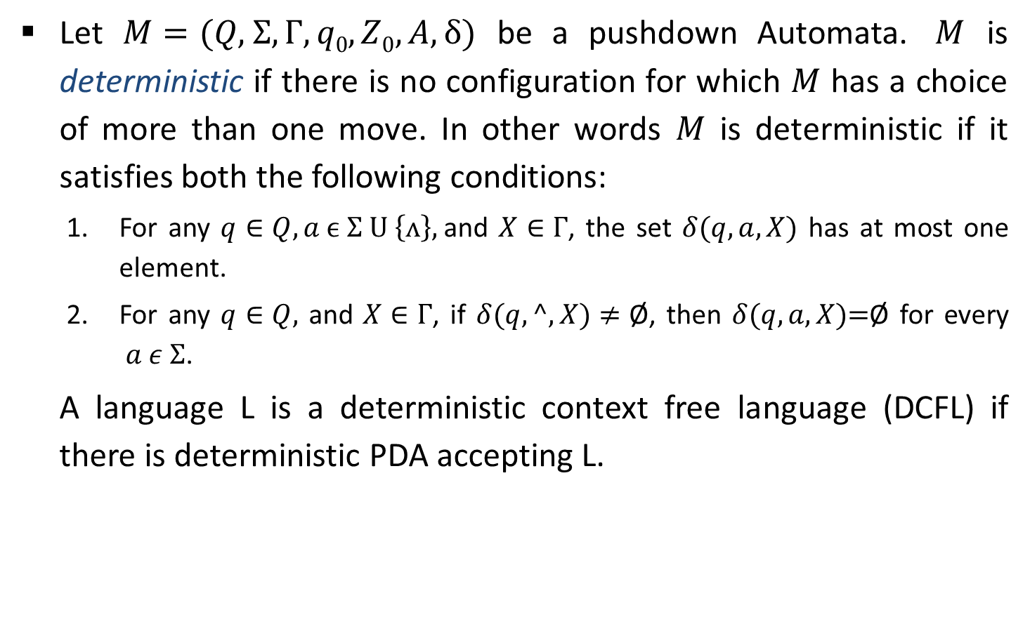
Deterministic PDA
Let $M=(Q\text{, }Σ,Γ, q0,Z0,A,δ)$ be a pushdown Automata. $M$ is deterministic if there is no configuration for which $M$ has a choice of more than one move. In other words $M$ is deterministic if it satisfies both the following conditions:
For any $q∈Q, a ϵ Σ U \left\{ʌ\right\},$and $X∈Γ$, the set $δ(q, a, X)$ has at most one element.
For any $q∈Q,$ and $X∈Γ$, if $δ(q, ^, X)≠\text{Ø}$, then $δ(q, a, X)\text{=}\text{Ø}$ for every $a ε Σ$.
A language L is a deterministic context free language (DCFL) if there is deterministic PDA accepting L.

Slide 12

Design PDA for even odd length palindrome (Nondeterministic)
Move No | State | Input | Stack Symbol | Move(s)
$$1_{}$$ | $$q_{0}$$ | $$a_{}$$ | $$z_{0}$$ | $$(q0,az0)(q1,z0)$$
$$2_{}$$ | $$q_{0}$$ | $$b_{}$$ | $$z_{0}$$ | $$(q0,bz0)(q1,z0)$$
$$3_{}$$ | $$q_{0}$$ | $$a_{}$$ | $$a$$ | $$(q0,aa)(q1,a)$$
$$4_{}$$ | $$q_{0}$$ | $$b_{}$$ | $$a$$ | $$(q0,ba)(q1,a)$$
$$5_{}$$ | $$q_{0}$$ | $$a_{}$$ | $${ b}_{}$$ | $$(q0,ab)(q1,a)$$
$$6_{}$$ | $$q_{0}$$ | $$b_{}$$ | $${ b}_{}$$ | $$(q0,bb)(q1,b)$$
b, z₀|bz₀
a, z₀|az₀
a, a | aa
b, z₀| z₀ z₀
$$q_{0}$$
a, z₀| z₀
$$q_{1}$$
q₁ | a
q₁ | a
b, b | bb
b, a | ba
a, b | ab
q₁ | b
q₁ | b

Slide 13
Design PDA for even odd length palindrome
Move No | State | Input | Stack Symbol | Move(s)
$$7_{}$$ | $$q_{0}$$ | $$^$$ | $$z_{0}$$ | $$(q1,z0)$$
$$8_{}$$ | $$q_{0}$$ | $$^$$ | $$a$$ | $$(q1,a)$$
$$9_{}$$ | $$q_{0}$$ | $${^}_{}$$ | $$b_{}$$ | $$(q1,b)$$
^,b | b
b, z₀|bz₀
^,a | a
^,z₀ | z₀
a, z₀|az₀
a, a | aa
q₁ | z₀
$$q_{0}$$
q₁ | z₀
$$q_{1}$$
q₁ | a
b, a | ba
q₁ | a
b, b | bb
a, b | ab
q₁ | b
q₁ | b

Slide 14
Design PDA for even odd length palindrome
Move No | State | Input | Stack Symbol | Move(s)
$${10}_{}$$ | $$q_{1}$$ | $$a$$ | $${ a}_{}$$ | $$(q1,^)$$
$${11}_{}$$ | $$q_{1}$$ | $$b$$ | $$b$$ | $$(q1,^)$$
$${12}_{}$$ | $$q_{1}$$ | $${^}_{}$$ | $${ z}_{0}$$ | $$(q2,{ z}_{0})$$
$$(all other combinations)$$ | $$none$$
^,b | b
b, z₀|bz₀
^,a | a
^,z₀ | z₀
b, b | ^
a, z₀|az₀
a, a | aa
a,z₀|z₀
$$q_{0}$$
b,z₀|z₀
$$q_{1}$$
^,z₀ | z₀
$$q_{2}$$
a,a | a
b, a | ba
b,b | b
b, b | bb
a, b | ab
a,b | b
a, a | ^
b,a | a

Slide 15
Design DPDA for L={a^{n}b^{n}|a,b ∈ Ʃ, n≥0}
Move No | State | Input | Stack Symbol | Move(s)
$$1_{}$$ | $$q_{0}$$ | $${^}_{}$$ | $$z_{0}$$ | $$(q2,z0)$$
$$2_{}$$ | $$q_{0}$$ | $$a_{}$$ | $$z_{0}$$ | $$(q0,az0)$$
$$3_{}$$ | $$q_{0}$$ | $$a_{}$$ | $$a$$ | $$(q0,aa)$$
$$4_{}$$ | $$q_{0}$$ | $$b_{}$$ | $$a$$ | $$(q1,^)$$
$$5_{}$$ | $$q_{1}$$ | $$b_{}$$ | $${ a}_{}$$ | $$(q1,^)$$
$$6_{}$$ | $$q_{1}$$ | $${^}_{}$$ | $${ z}_{0}$$ | $$(q2,z0)$$
$$(all other combinations)$$ | $$none$$
a, z₀|az₀
b, a | ^
$$q_{0}$$
b, a | ^
$$q_{1}$$
^,z₀ | z₀
$$q_{2}$$
a, a | aa
^,z₀ | z₀

Slide 16


Design PDA to accept string with more a’s than b’s.
Move No | State | Input | Stack Symbol | Move(s)
$$1_{}$$ | $$q_{0}$$ | $$a_{}$$ | $$z_{0}$$ | $$(q1,az0)$$
$$2_{}$$ | $$q_{0}$$ | $$b_{}$$ | $$z_{0}$$ | $$(q0,bz0)$$
$$3_{}$$ | $$q_{0}$$ | $$a_{}$$ | $$b$$ | $$(q0,^)$$
$$4_{}$$ | $$q_{0}$$ | $$b_{}$$ | $$b$$ | $$(q0,bb)$$
$$5_{}$$ | $$q_{1}$$ | $$a_{}$$ | $${ a}_{}$$ | $$(q1,aa)$$
$$6_{}$$ | $$q_{1}$$ | $$b_{}$$ | $$a$$ | $$(q0,^)$$
$$7_{}$$ | $$q_{0}$$ | $${^}_{}$$ | $${ a}_{}$$ | $$(q1,a)$$
$$(all other combinations)$$ | $$none$$
b, z₀| bz₀
a, a | aa
a, b | ^
^, a | a
$$q_{0}$$
a, z₀|az₀
$$q_{1}$$
b, a | ^
b, b | bb

Slide 17


Design DPDA for grammar S→SS|[S]|{S}|˄
Move No | State | Input | Stack Symbol | Move(s)
$$1_{}$$ | $$q_{0}$$ | $$[_{}$$ | $$z_{0}$$ | $$(q1,[z0)$$
$$2_{}$$ | $$q_{0}$$ | $$\{_{}$$ | $$z_{0}$$ | $$(q1,\{z0)$$
$$3_{}$$ | $$q_{1}$$ | $$[_{}$$ | $$[_{}$$ | $$(q1,[[)$$
$$4_{}$$ | $$q_{1}$$ | $$\{_{}$$ | $$[_{}$$ | $$(q1,\{[)$$
$$5_{}$$ | $$q_{1}$$ | $$[_{}$$ | $$\{_{}$$ | $$(q1,[\{)$$
$$6_{}$$ | $$q_{1}$$ | $$\{_{}$$ | $$\{_{}$$ | $$(q1,\{\{)$$
{, [ | {[
{, z₀|{z₀
[, [|[[
[, { | [{
$$q_{0}$$
[, z₀|[z₀
$$q_{1}$$
{, { | {{

Slide 18
Design DPDA for grammar S→SS|[S]|{S}|˄
Move No | State | Input | Stack Symbol | Move(s)
$$7_{}$$ | $$q_{1}$$ | $$]_{}$$ | $$[_{}$$ | $$(q1,^)$$
$$8_{}$$ | $$q_{1}$$ | $$\}_{}$$ | $$\{_{}$$ | $$(q1,^)$$
$$9_{}$$ | $$q_{1}$$ | $${^}_{}$$ | $$z0$$ | $$(q0,z0)$$
$$(all other combinations)$$ | $$none$$
{, [ | {[
{, z₀|{z₀
[, [|[[
[, { | [{
$$q_{0}$$
[, z₀|[z₀
$$q_{1}$$
}, { | ^
^,z₀ | z₀
{, { | {{
], [ | ^

Slide 19
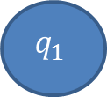
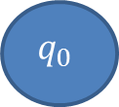
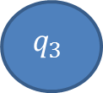
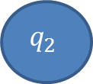
Design PDA for {a^{n}b^{n+m} c^{m} | n,m>=1}
Move No | State | Input | Stack Symbol | Move(s)
$$1_{}$$ | $$q_{0}$$ | $$a_{}$$ | $$z_{0}$$ | $$(q1,az0)$$
$$2_{}$$ | $$q_{1}$$ | $$a_{}$$ | $$a$$ | $$(q1,aa)$$
$$3_{}$$ | $$q_{1}$$ | $$b_{}$$ | $$a$$ | $$(q2,^)$$
$$4_{}$$ | $$q_{2}$$ | $$b_{}$$ | $$a$$ | $$(q2,^)$$
$$5_{}$$ | $$q_{2}$$ | $$b_{}$$ | $$z_{0}$$ | $$(q3,bz0)$$
$$6_{}$$ | $$q_{3}$$ | $$b_{}$$ | $$b_{}$$ | $$(q3,bb)$$
a, a| aa
b, a| ^
b, b| bb
a, z₀| az₀
b, a| ^
$$q_{2}$$
b, z₀| bz₀
$$q_{3}$$
$$q_{0}$$
$$q_{1}$$

Slide 20


Design PDA for {a^{n}b^{n+m} c^{m} | n,m>=1}
Move No | State | Input | Stack Symbol | Move(s)
$$7_{}$$ | $$q_{3}$$ | $$c_{}$$ | $$b_{}$$ | $$(q4,^)$$
$$8_{}$$ | $$q_{4}$$ | $$c_{}$$ | $$b_{}$$ | $$(q4,^)$$
$$9_{}$$ | $$q_{4}$$ | $${^}_{}$$ | $$z_{0}$$ | $$(q5,z0)$$
$${(All other combination)}_{}$$ | $$none$$
a, a| aa
b, a| ^
b, b| bb
c, b| ^
a, z₀| az₀
b, a| ^
b, z₀| bz₀
$$q_{3}$$
c, b| ^
$$q_{4}$$
$$q_{0}$$
$$q_{1}$$
$$q_{2}$$
^, z₀| z₀
$$q_{5}$$

Slide 21
Design PDA for {a^{i}b^{j}c^{k} | i,j,k>=1 & j=i or j=k}
Move No | State | Input | Stack Symbol | Move(s)
$$1_{}$$ | $$q_{0}$$ | $$a_{}$$ | $$z_{0}$$ | $$(q1,az0)$$
$$2_{}$$ | $$q_{1}$$ | $$a_{}$$ | $$a$$ | $$(q1,aa)$$
$$3_{}$$ | $$q_{1}$$ | $$b_{}$$ | $$a$$ | $$(q2,^)$$
$$4_{}$$ | $$q_{2}$$ | $$b_{}$$ | $$a$$ | $$(q2,^)$$
$$5_{}$$ | $$q_{2}$$ | $$c_{}$$ | $$z_{0}$$ | $$(q3,z0)$$
$$6_{}$$ | $$q_{3}$$ | $$c_{}$$ | $$z_{0}$$ | $$(q3,z0)$$
a, a| aa
b, a| ^
c, z₀| z₀
a, z₀| az₀
b, a| ^
$$q_{2}$$
c, z₀| z₀
$$q_{3}$$
$$q_{0}$$
$$q_{1}$$

Slide 22


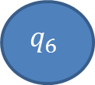




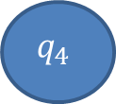
Design PDA for {a^{i}b^{j}c^{k} | i,j,k>=1 & j=i or j=k}
Move No | State | Input | Stack Symbol | Move(s)
$$7_{}$$ | $$q_{3}$$ | $${^}_{}$$ | $$z_{0}$$ | $$(q7,z0)$$
$$8_{}$$ | $$q_{0}$$ | $$a_{}$$ | $$z0$$ | $$(q4,z0)$$
$$9_{}$$ | $$q_{4}$$ | $$a_{}$$ | $$z0$$ | $$(q4,z0)$$
$${10}_{}$$ | $$q_{4}$$ | $$b_{}$$ | $$z_{0}$$ | $$(q5,bz0)$$
$${11}_{}$$ | $$q_{5}$$ | $$b_{}$$ | $b_{}$ | $$(q5,bb)$$
$${12}_{}$$ | $$q_{5}$$ | $$c_{}$$ | $$b_{}$$ | $$(q6,^)$$
$${13}_{}$$ | $$q_{6}$$ | $$c_{}$$ | $$b_{}$$ | $$(q6,^)$$
a, a| aa
b, a| ^
c, z₀| z₀
a, z₀| az₀
b, a| ^
c, z₀| z₀
$$q_{3}$$
^, z₀| z₀
$$q_{7}$$
$$q_{0}$$
$$q_{1}$$
$$q_{2}$$
a, z₀| z₀
b, b| bb
c, b| ^
a, z₀| z₀
$$q_{4}$$
b,z₀| bz₀
$$q_{5}$$
c, b| ^
$$q_{6}$$

Slide 23





Design PDA for {a^{i}b^{j}c^{k} | i,j,k>=1 & j=i or j=k}
Move No | State | Input | Stack Symbol | Move(s)
$${13}_{}$$ | $$q_{6}$$ | $${^}_{}$$ | $$z_{0}$$ | $$(q7,z0)$$
$${(All other combination)}_{}$$ | $$none$$
J=
j=i
a, a| aa
b, a| ^
c, z₀| z₀
a, z₀| az₀
b, a| ^
$$q_{2}$$
c, z₀| z₀
$$q_{3}$$
^, z₀| z₀
$$q_{7}$$
$$q_{0}$$
$$q_{1}$$
J=
j=k
a, z₀| z₀
a, z₀| z₀
b, b| bb
c, b| ^
^, z₀| z₀
$$q_{4}$$
b,z₀| bz₀
$$q_{5}$$
c, b| ^
$$q_{6}$$

