Slide 1

Unit – 5 Turing Machine
Hardik Doshi
 9978911553
→ hardik.doshi@darshan.ac.in
Theory of Computation (2160704) Darshan Institute of Engineering & Technology

Slide 2
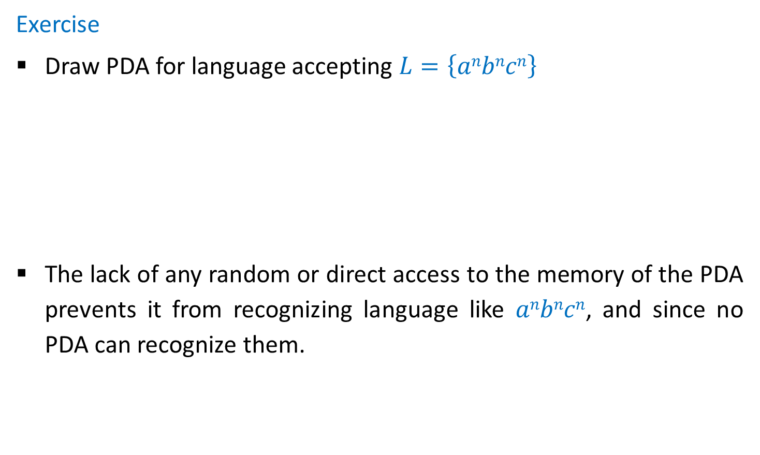
Why Turing machine?
Exercise
Draw PDA for language accepting $L=\left\{anbncn\right\}$
The lack of any random or direct access to the memory of the PDA prevents it from recognizing language like $anbncn$, and since no PDA can recognize them.
Not Possible??

Slide 3
Turing machine
A Turing machine (TM) is the most powerful kind of automaton.
TM consist of states and transitions, and use an infinite tape for storage.
The tape is divided into square, each square holds a single symbol.
The head is capable of performing 3 operations:
Reading a symbol being scanned.
Modifying a symbol being scanned.
Shifting either to previous square or next square.
a
b
a
a
b
a
a
Finite Control

Slide 4



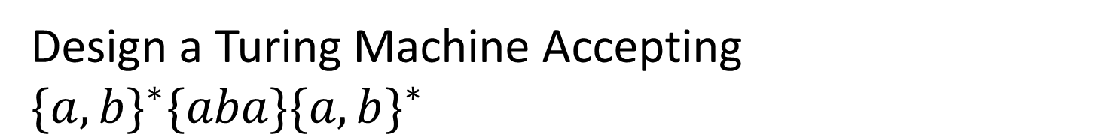



Design a Turing Machine Accepting ${\{a,b\}}^{∗}\{aba\}{\{a,b\}}^{∗}$
$${ h}_{r}$$
Δ|Δ,R
Δ|Δ,R
Δ|Δ,R
b|b,R
a|a,R
$${ q}_{0}$$
Δ|Δ,R
$${ q}_{1}$$
a|a,R
$${ q}_{2}$$
b|b,R
$${ q}_{3}$$
a|a,R
$${ h}_{a}$$
b|b,R

Slide 5
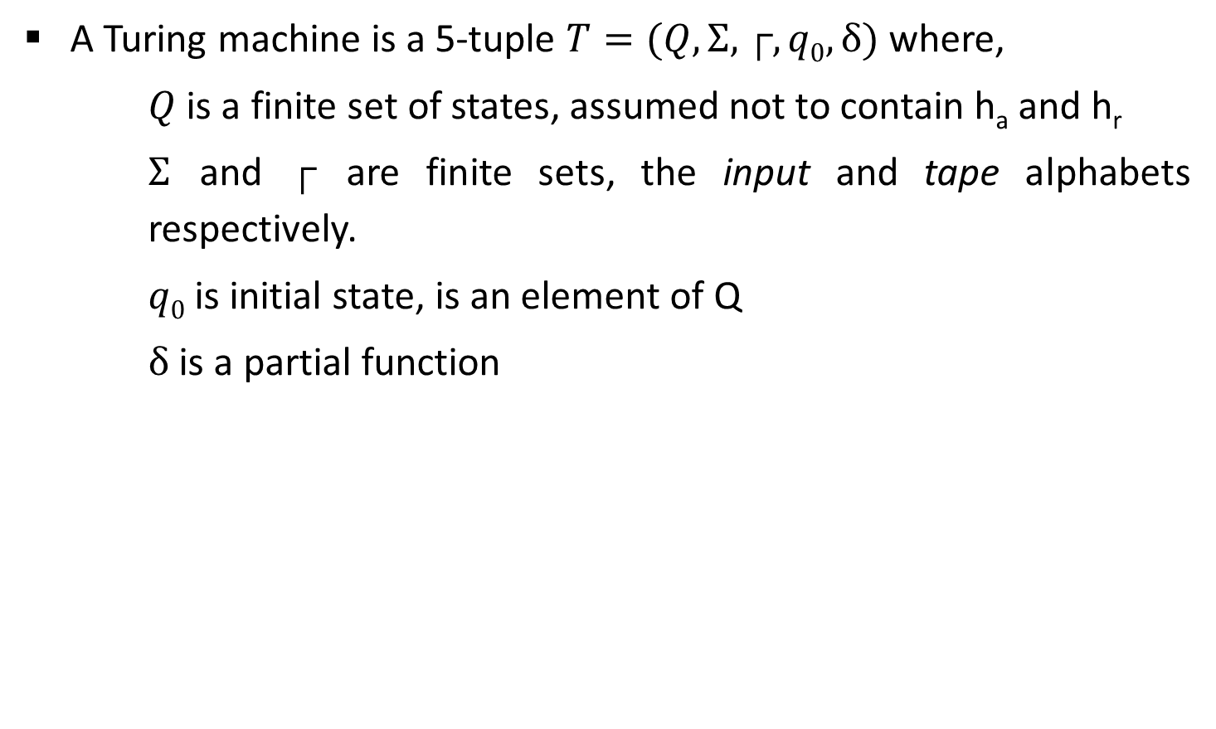
Definition: Turing Machine
A Turing machine is a 5-tuple $T=(Q,Σ,┌,q0,δ)$ where,
$Q$ is a finite set of states, assumed not to contain h_{a} and h_{r}
$Σ$ and $┌$ are finite sets, the input and tape alphabets respectively.
$q0$ is initial state, is an element of Q
$δ$ is a partial function

Slide 6

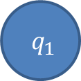


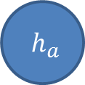
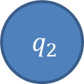


Design a TM for accepting Palindromes for odd and even length.
a/a,R
b/b,R
Δ/Δ,R
(odd pal)
$${ q}_{2}$$
Δ/Δ,L
$${ q}_{3}$$
a/a,L
b/b,L
a/Δ,R
a/Δ,L
$${ q}_{0}$$
Δ/Δ,R
$${ q}_{1}$$
Δ/Δ,R
$${ q}_{4}$$
$${ h}_{a}$$
b/Δ,R
b/Δ,L
Δ/Δ,R
$${ q}_{5}$$
Δ/Δ,L
$${ q}_{6}$$
(odd pal)
a/a,R
b/b,R
Δ/Δ,R
(even pal)

Slide 7
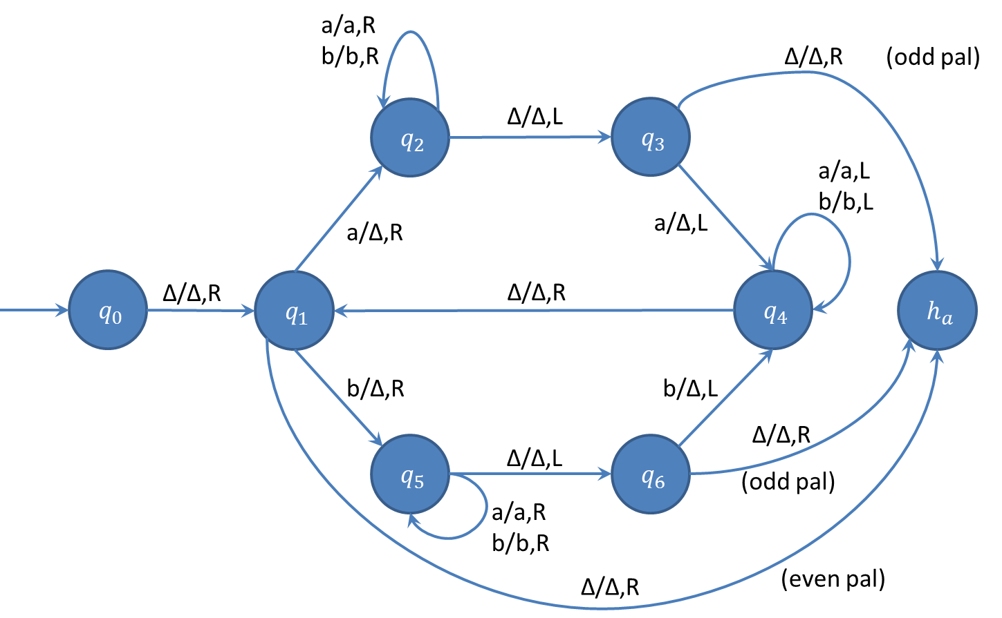
String Tracing
├ (q₀,△ a a)
├ (q₁,△ a a)
├ (q₂,△ △ a )
├ (q₂,△ △ a △ )
├ (q₃,△ △ a )
├ (q₄,△ △ )
├ (q₁,△ △ △)
├ (h_{a}, △ △ △ △)
Accept
Exercise
aba
abab

Slide 8






Design a Turing machine for accepting ${\{a}^{n}b^{n}c^{n} | n≥0 \}$
a/a,R
b,b/R
C,C/L
a/a,L
B,B/R
C/C,R
$${ q}_{2}$$
b,B/R
$${ q}_{3}$$
c,C/L
$${ q}_{4}$$
b/b,L
B/B,L
a/A,R
A/A,R
$${ q}_{0}$$
Δ/Δ,R
$${ q}_{1}$$
Δ/Δ,S
$${ h}_{a}$$
B/B,R
$${ q}_{5}$$
C/C,R
Δ/Δ,S
$${ q}_{6}$$
B/B,R
C/C,R

Slide 9



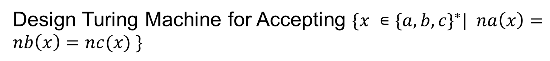





Design Turing Machine for Accepting ${\{x ∊\{a,b,c\}}^{∗}| na\left(x\right)=nb\left(x\right)=nc(x) \}$
x/x,R
b/b,R
c/c,R
x/x,L
b/b,L
c/c,L
x/x,R
a/a,R
c/c,R
x/x,L
a/a,L
c/c,L
x/x,R
b/b,R
a/a,R
x/x,L
b/b,L
a/a,L
$${ q}_{0}$$
Δ/Δ,R
$${ q}_{1}$$
a/x,L
$${ q}_{2}$$
Δ/Δ,R
$${ q}_{3}$$
b/x,L
$${ q}_{4}$$
Δ/Δ,R
$${ q}_{5}$$
c/x,L
$${ q}_{6}$$
Δ/Δ,L
Δ/Δ,R
$${ q}_{7}$$
Δ/Δ,S
$${ h}_{a}$$
x/x,L

Slide 10





Design a Turing machine to copy a string.
a/a,R
b/b,R
a/a,R
b/b,R
$${ q}_{2}$$
Δ/Δ,R
$${ q}_{3}$$
a/a,L
b/b,L
a/a,L
b/b,L
Δ/a,L
a/A,R
$${ q}_{0}$$
Δ/Δ,R
$${ q}_{1}$$
$${ q}_{4}$$
Δ/Δ,L
$${ q}_{5}$$
Δ/Δ,L
b/B,R
Δ/b,L
$${ h}_{a}$$
Δ/Δ,S
$${ q}_{8}$$
$${ q}_{6}$$
Δ/Δ,R
$${ q}_{7}$$
a/a,R
b/b,R
a/a,R
b/b,R
A/a,L
B/b,L
A/A,R
B/B,R

Slide 11
Design a TM for Accepting {SS | S ∈ {a,b}*}
ss.pptx

Slide 12





Design a Turing machine to delete a symbol
a/a,L
$${ q}_{3}$$
a/a,R
b/b,R
a/Δ,L
Δ/a,S
a/Δ,R
b/Δ,R
Δ/Δ,R
$${ q}_{0}$$
$${ q}_{1}$$
Δ/Δ,L
$${ q}_{2}$$
b/a,L
a/b,L
$${ h}_{a}$$
b/Δ,L
Δ/b,S
$${ q}_{4}$$
Δ/Δ,S
b/b,L

Slide 13
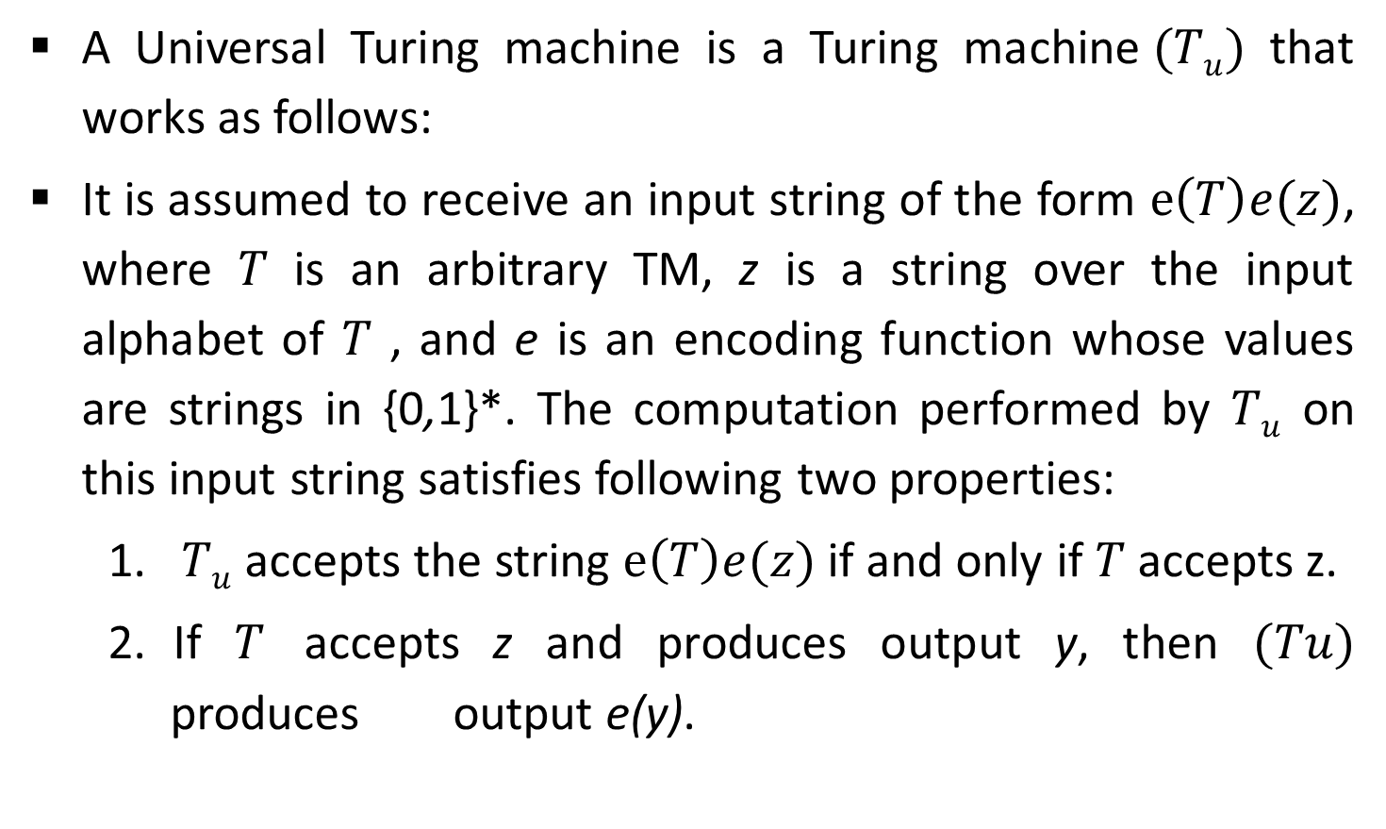
Universal Turing machine
A Universal Turing machine is a Turing machine$(Tu)$ that works as follows:
It is assumed to receive an input string of the form $e\left(T\right)e(z)$, where $T$ is an arbitrary TM, z is a string over the input alphabet of $T$ , and e is an encoding function whose values are strings in {0,1}*. The computation performed by $Tu$ on this input string satisfies following two properties:
$Tu$ accepts the string $e\left(T\right)e(z)$ if and only if $T$ accepts z.
If $T$ accepts z and produces output y, then $(Tu)$ produces output e(y).

Slide 14
Church Turing Thesis
Any algorithmic procedure that can be carried out at all, by a human computer or a team of humans or an electronic computer, can be carried out by a TM. This statement usually referred to as Church’s thesis, or the Church-Turing thesis.
It is not a mathematically precise statement that can be proved, because we do not have a precise definition of the term algorithmic procedure.
Here is an informal summary of some of the evidence.
Humans normally work with a two-dimensional sheet of paper. A TM tape could be organized so as to simulate two dimensions; one likely consequence would be that the TM would require more moves to do what a human could do in one.

Slide 15
Church Turing Thesis
Various enhancements of the TM model have been suggested to make the operation more like that of a human computer, or more convenient & efficient. The multitape TM is an example.
Other theoretical models includes abstract machines with two stacks or with a queue.
Since the introduction of the Turing machine, no one has suggested any type of computation that ought to be included in the category of “algorithmic procedure” and cannot be implemented on a TM.

