Slide 1

Unit – 6 Computable Functions
Hardik Doshi
 9978911553
→ hardik.doshi@darshan.ac.in
Theory of Computation (2160704) Darshan Institute of Engineering & Technology

Slide 2
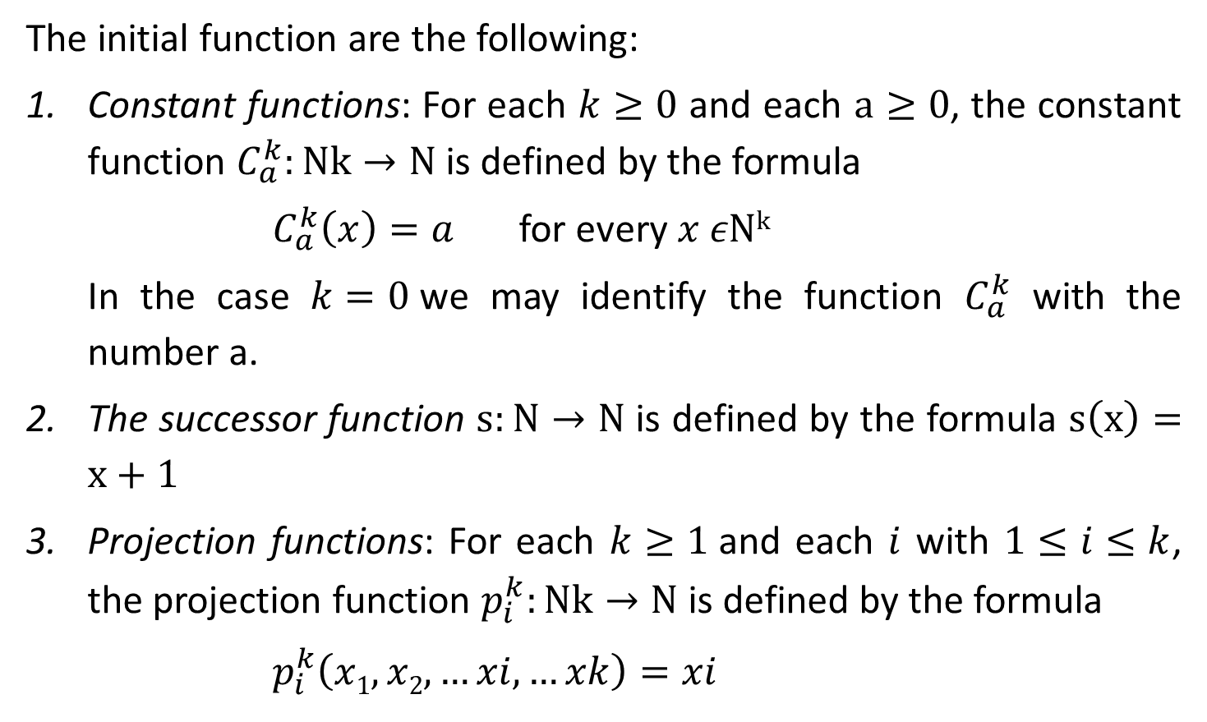
Initial functions
The initial function are the following:
Constant functions: For each $k≥0$ and each $a≥0$, the constant function $C_{a}^{k}:Nk→N$ is defined by the formula
$C_{a}^{k}\left(x\right)=a$ for every $x εNk$
In the case $k=0$we may identify the function $C_{a}^{k}$ with the number a.
The successor function $s:N→N$ is defined by the formula $s\left(x\right)=x+1$
Projection functions: For each $k≥1$and each $i$ with $1≤i≤k$, the projection function $p_{i}^{k}:Nk→N$ is defined by the formula
$p_{i}^{k}\left(x1,x2,…xi,…xk\right)=xi$

Slide 3

Composition
Suppose f is a partial function from $Nk to N$, and for each $i$ with $1 ≤ i ≤ k, gi$ is a partial function from $Nm to N$. The partial function obtained from $f$ and $g1, g2, … , gk$ by composition is the partial function $h$ from $Nm to N$defined by the formula
$h(X) = f(g1(X), g2(X), .. , gk(X)) (X ε Nm)$

Slide 4
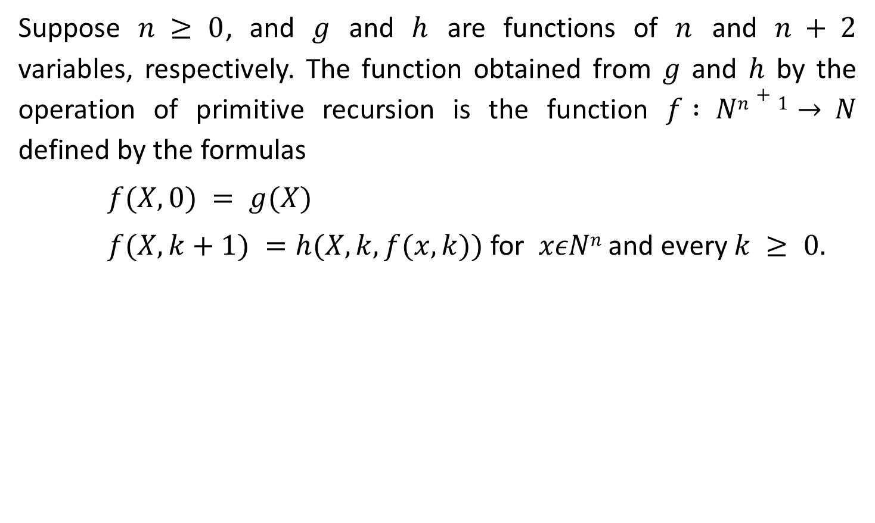
Primitive Recursion Operation
Suppose $n ≥ 0$, and $g$ and $h$ are functions of $n$ and $n + 2$ variables, respectively. The function obtained from $g$ and $h$ by the operation of primitive recursion is the function $f : Nn+1→ N$ defined by the formulas
$f(X,0) = g(X)$
$f(X,k+1) =h(X,k,f(x,k))$ for $xεNn$ and every $k ≥ 0.$

Slide 5
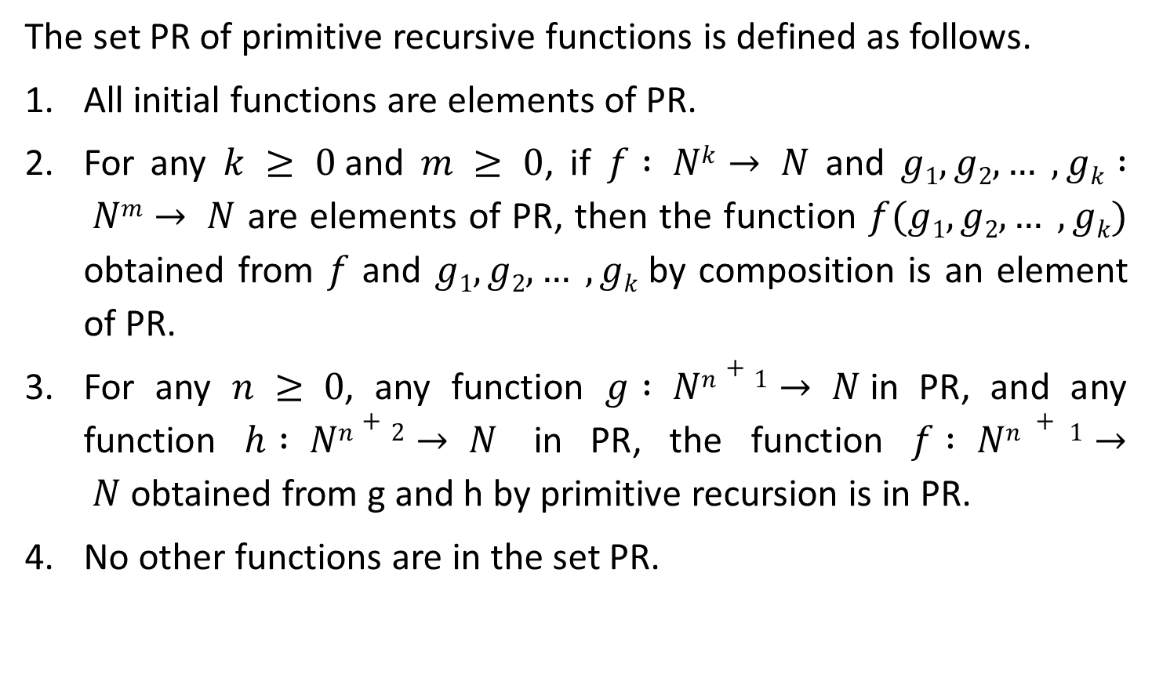
Primitive Recursive Functions
The set PR of primitive recursive functions is defined as follows.
All initial functions are elements of PR.
For any $k ≥ 0$and $m ≥ 0$, if $f : Nk→ N$ and $g1, g2, … , gk : Nm→ N$ are elements of PR, then the function $f(g1, g2, … , gk)$ obtained from $f$ and $g1, g2, … , gk$by composition is an element of PR.
For any $n ≥ 0$, any function $g : Nn+1→ N$in PR, and any function $h : Nn+2→ N$ in PR, the function $f : Nn + 1→ N$obtained from g and h by primitive recursion is in PR.
No other functions are in the set PR.

Slide 6
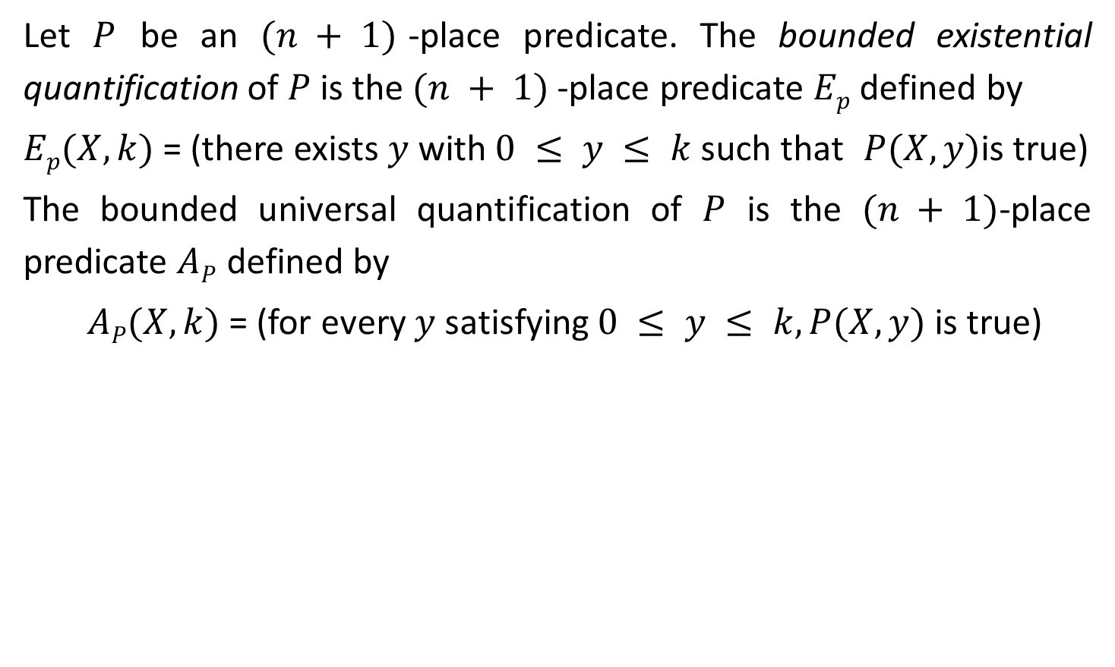
Bounded Quantifications
Let $P$ be an $(n + 1)$-place predicate. The bounded existential quantification of $P$ is the $(n + 1)$-place predicate $Ep$ defined by
$Ep(X, k)$= (there exists $y$ with $0 ≤ y ≤ k$such that $P(X, y)$is true)
The bounded universal quantification of $P$ is the $(n + 1)$-place predicate $AP$ defined by
$AP(X, k)$= (for every $y$ satisfying $0 ≤ y ≤ k, P(X, y)$is true)

Slide 7
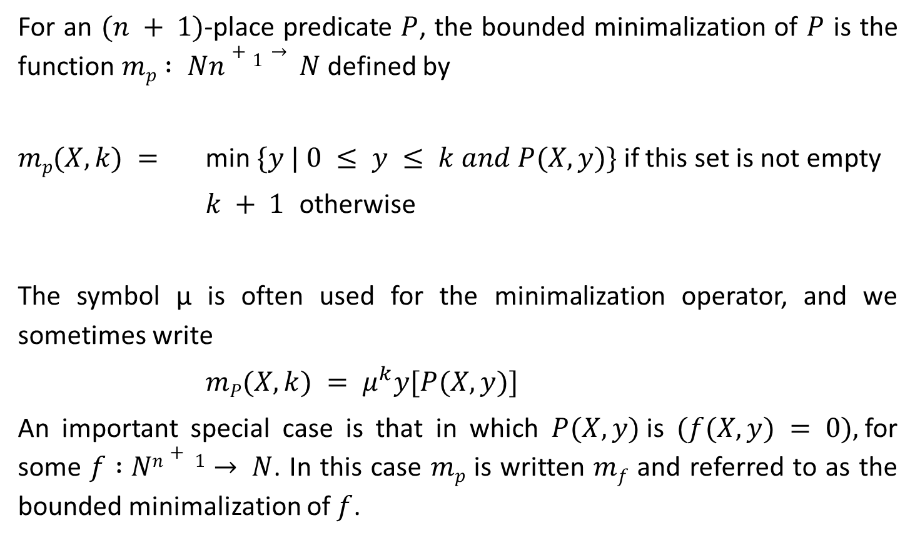
Bounded Minimalization
For an $(n + 1)$-place predicate $P$, the bounded minimalization of $P$ is the function $mp : Nn+1→ N$defined by
$mp(X, k) =$ min $\{y | 0 ≤ y ≤ k and P(X, y)\}$if this set is not empty
$k + 1$ otherwise
The symbol μ is often used for the minimalization operator, and we sometimes write
$mP(X, k) = μ^{k}y[P(X, y)]$
An important special case is that in which $P(X, y)$is $(f(X, y) = 0),$for some $f :Nn+ 1→ N$. In this case $mp$ is written $mf$ and referred to as the bounded minimalization of $f$.

Slide 8
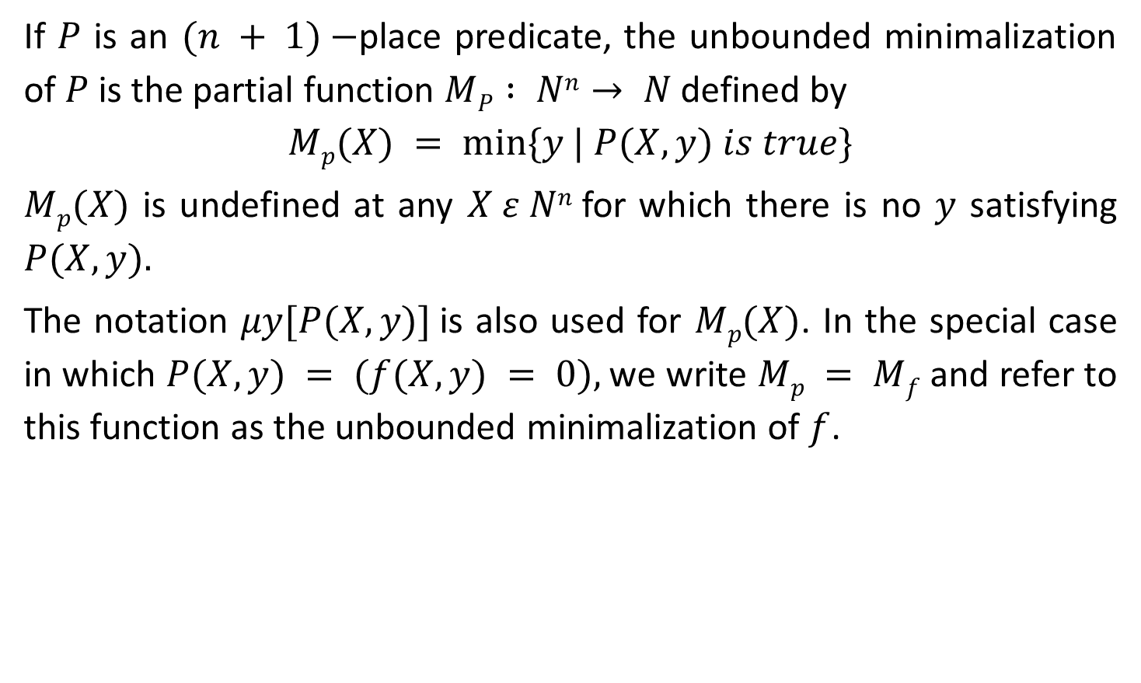
Unbounded Minimalization
If $P$ is an $(n + 1)−$place predicate, the unbounded minimalization of $P$ is the partial function $MP : Nn→ N$defined by
$$Mp(X) = min⁡\{y | P(X, y) is true\}$$
$Mp(X)$ is undefined at any $X ε Nn$for which there is no $y$ satisfying $P(X, y).$
The notation $μy[P(X, y)]$is also used for $Mp(X)$. In the special case in which $P(X, y) = (f(X, y) = 0),$we write $Mp = Mf$and refer to this function as the unbounded minimalization of $f$.

Slide 9
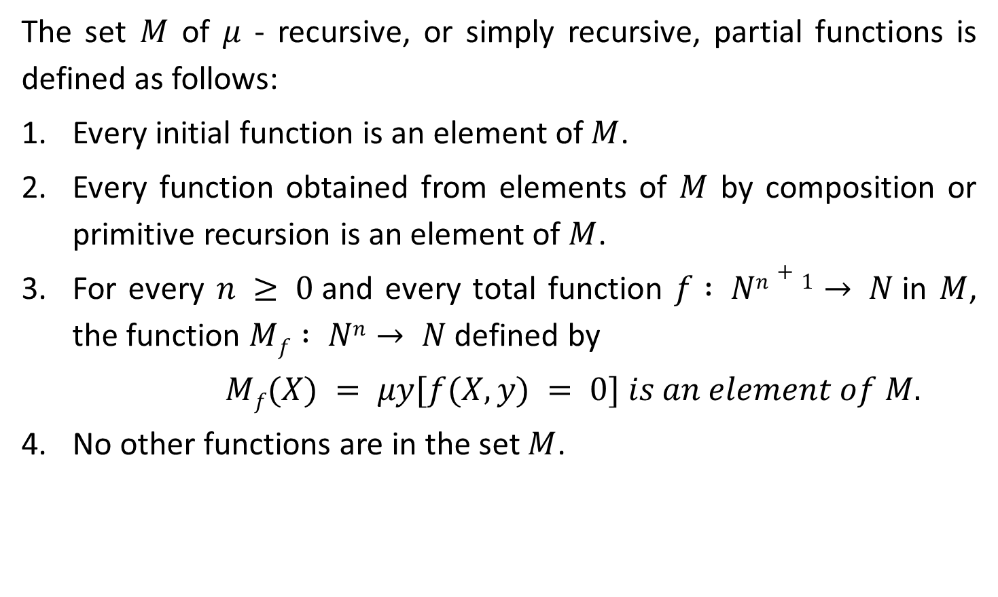
μ – Recursive Functions
The set $M$ of $μ$ - recursive, or simply recursive, partial functions is defined as follows:
Every initial function is an element of $M$.
Every function obtained from elements of $M$ by composition or primitive recursion is an element of $M$.
For every $n ≥ 0$and every total function $f : Nn+1→ N$in $M$, the function $Mf : Nn→ N$defined by
$Mf(X) = μy[f(X, y) = 0] is an element of M.$
No other functions are in the set $M$.

Slide 10

Gödel Number of a sequence of Natural Numbers
For any finite sequence $x0, x1, … , xn$of natural numbers, the Gödel Number of the sequence is the number
$gn(x0, x1, … , xn) = 2x03x15x2 … (PrNo(n))xn$
Where $PrNo(n)$is the $nth$ prime.

Slide 11
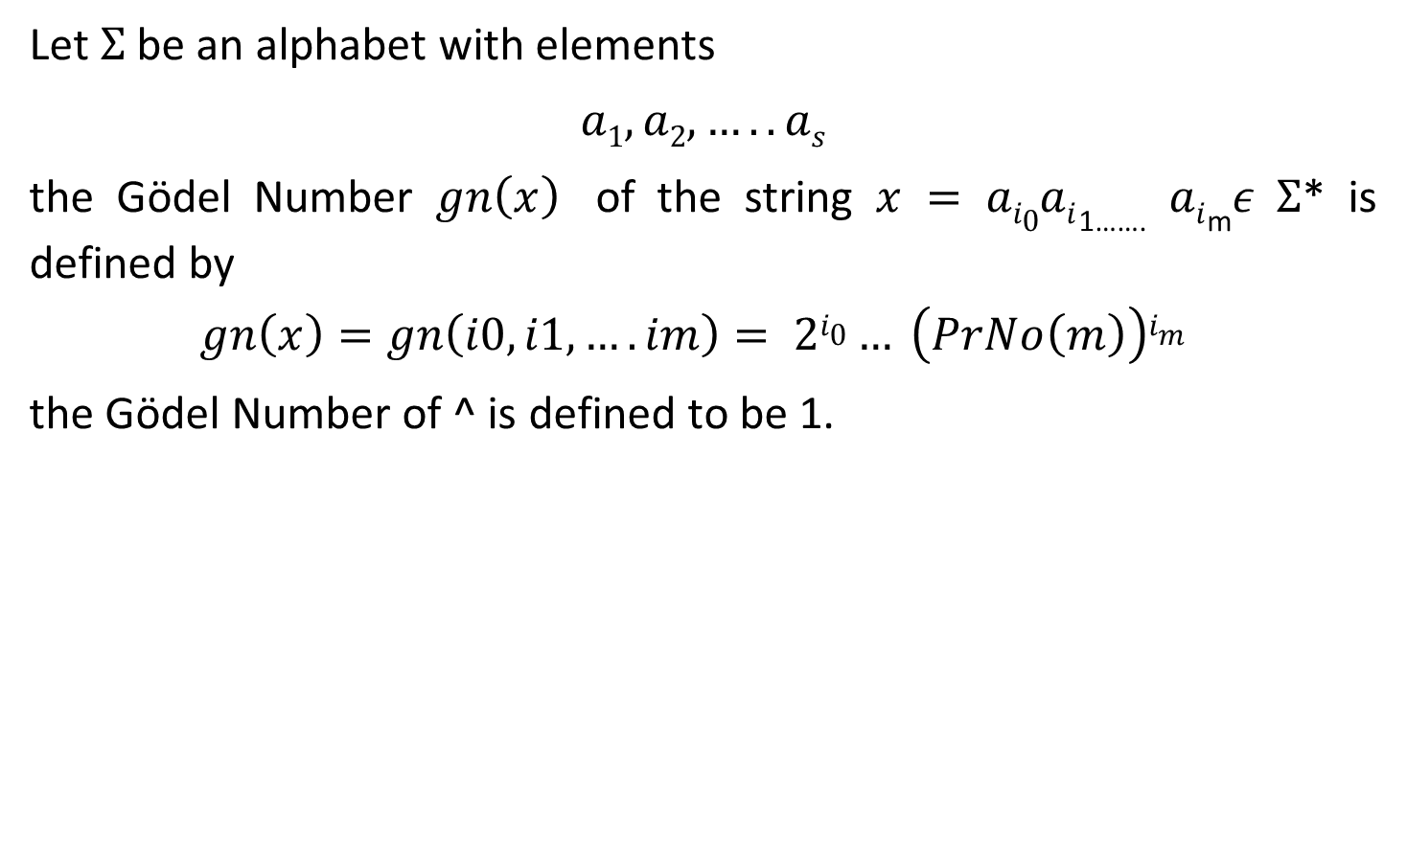
Gödel Numbering of strings
Let $Σ$ be an alphabet with elements
$a1,a2,…..as$
the Gödel Number $gn\left(x\right)$ of the string $x = ai0ai$_{1…….} $ai$_{m}𝜖 $Σ$* is defined by
$$gn\left(x\right)=gn\left(i0,i1,….im\right)= 2i0… \left(PrNo\left(m\right)\right)im$$
the Gödel Number of ^ is defined to be 1.

