Slide 1

Unit – 4 Pushdown Automata
Unit – 2
Lexical Analysis
Prof. Dixita Kagathara
dixita.kagathara@darshan.ac.in
Compiler Design (2170701) Darshan Institute of Engineering & Technology

Slide 2
Interaction of Scanner & Parser
Token
Source Program
Lexical Analyzer
Parser
Get next token
Symbol Table
Upon receiving a “get next token” command from parser, the lexical analyzer reads the input character until it can identify the next token.
Lexical Analyzer also stripping out comments and white space in the form of blanks, tabs, and newline characters from the source program.

Slide 3
Why to separate lexical analysis & parsing?
Simplicity of Design
Improving compiler efficiency
Enhancing compiler portability

Slide 4
Token, Pattern & Lexemes
Token
Sequence of character having a collective meaning is known as token.
Categories of Tokens:
Identifier
Keywords
Operators
Special symbol
Constants
Pattern
The set of rules called pattern associated with a token.
Example: “non-empty sequence of digits”, “letter followed by letters and digits”
Lexemes
The sequence of character in a source program matched with a pattern for a token is called lexeme.
Example: 123, abc

Slide 5
Token, Pattern & Lexemes (Example)
Example: total = sum + 12.5
Tokens
total
=
sum
+
12.5
Lexemes
Lexemes of identifier: total, sum
Lexemes of operator: =, +
Lexemes of constant: 12.5
Identifier1
Operator1
Tokens
Identifier2
Operator2
Constant1

Slide 6
Input Buffering

Slide 7
Input Buffering
There are mainly two techniques for input buffering:
Buffer pair
Sentinels
Buffer Pairs
The lexical analysis scans the input string from left to right one character at a time.
Buffer divided into two N-character halves, where N is the number of character on one disk block.
: : : E : : = : : Mi : * : :
: C: * : * : 2 : eof : : :

Slide 8
Buffer Pair
Pointer Lexeme Begin, marks the beginning of the current lexeme.
Pointer Forward, scans ahead until a pattern match is found.
Once the next lexeme is determined, forward is set to character at its right end.
Lexeme Begin is set to the character immediately after the lexeme just found.
If forward pointer is at the end of first buffer half then second is filled with N input character.
If forward pointer is at the end of second buffer half then first is filled with N input character.
: : : E : : = : : Mi : * : :
: C: * : * : 2 : eof : : :
forward
forward
lexeme_beginnig

Slide 9
Buffer Pair
Code to advance forward pointer
if forward at end of first half then begin
reload second half;
forward := forward + 1;
end
else if forward at end of second half then begin
reload first half;
move forward to beginning of first half;
end
else forward := forward + 1;
: : : E : : = : : M : * : :
: C: * : * : 2 : eof : : :
forward
forward
forward
lexeme_beginnig

Slide 10
Sentinels
In buffer pairs we must check, each time we move the forward pointer that we have not moved off one of the buffers.
Thus, for each character read, we make two tests.
We can combine the buffer-end test with the test for the current character.
We can reduce the two tests to one if we extend each buffer to hold a sentinel character at the end.
The sentinel is a special character that cannot be part of the source program, and a natural choice is the character EOF.
: : E : : = : : M : * : eof
: C: * : * : 2 : eof : : eof
forward
lexeme_beginnig

Slide 11
Sentinels
: : E : : = : : M : * : eof
: C: * : * : 2 : eof : : eof
eof
forward
forward
forward
lexeme_beginnig
forward := forward + 1;
if forward = eof then begin
if forward at end of first half then begin
reload second half;
forward := forward + 1;
end
else if forward at the second half then begin
reload first half;
move forward to beginning of first half;
end
else terminate lexical analysis;
end

Slide 12
Specification of Tokens

Slide 13
Strings and Languages
Term | Definition
Prefix of s | A string obtained by removing zero or more trailing symbol of string S. e.g., ban is prefix of banana.
Suffix of S | A string obtained by removing zero or more leading symbol of string S. e.g., nana is suffix of banana.
Sub string of S | A string obtained by removing prefix and suffix from S. e.g., nan is substring of banana
Proper prefix, suffix and substring of S | Any nonempty string x that is respectively proper prefix, suffix or substring of S, such that s≠x.
Subsequence of S | A string obtained by removing zero or more not necessarily contiguous symbol from S. e.g., baaa is subsequence of banana.

Slide 14
Operations on Languages
Operation | Definition
Union of L and M Written L U M | L U M = {s | s is in L or s is in M }
Concatenation of L and M Written LM | LM = {st | s is in L and t is in M }
Kleene closure of L Written L* | L* denotes “zero or more concatenation of” L.
Positive closure of L Written L⁺ | L⁺ denotes “one or more concatenation of” L.

Slide 15
Regular Expression & Regular Definition

Slide 16
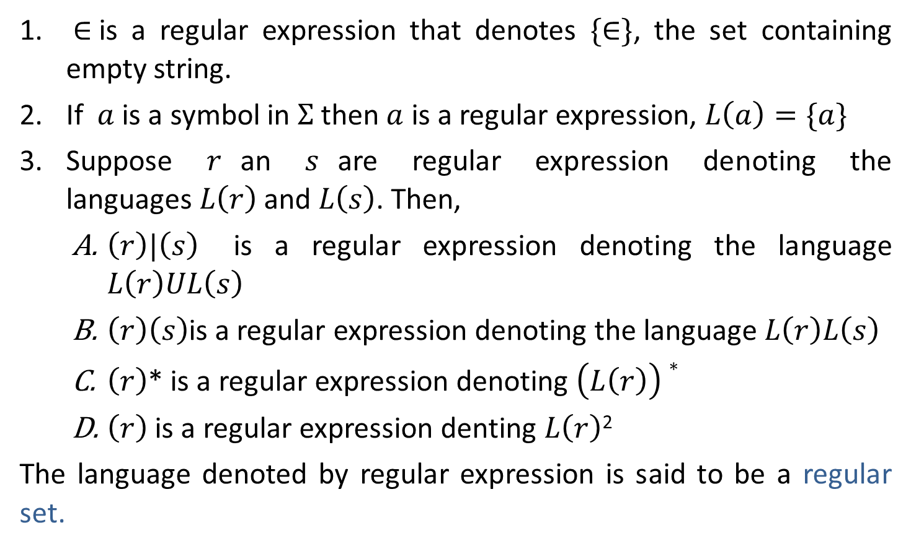
Rules to define Regular Expression
$∈$is a regular expression that denotes $\{∈\}$, the set containing empty string.
If $a$ is a symbol in $Σ$then $a$ is a regular expression, $L\left(a\right)=\{a\}$
Suppose $r$an $s$are regular expression denoting the languages$L\left(r\right)$ and $L\left(s\right)$. Then,
$\left(r\right)|\left(s\right)$ is a regular expression denoting the language $L\left(r\right)UL\left(s\right)$
$\left(r\right)\left(s\right)$is a regular expression denoting the language $L\left(r\right)L\left(s\right)$
$\left(r\right)$* is a regular expression denoting $\left(L\left(r\right)\right)∗$
$\left(r\right)$ is a regular expression denting $L\left(r\right)$²
The language denoted by regular expression is said to be a regular set.

Slide 17
Notational shorthand's & Precedence
Notational shorthand's
One or more instances: +
Zero or more instances: *
Zero or one instances: ?
Character classes: [abc]
Precedence & Associativity
Operator | Precedence | Associative
* | highest | left
concatenation | Second | left
| | lowest | left

Slide 18
Algebraic properties of RE
AXIOMS | DESCRIPTION
$$r|s=s|r$$ | | is commutative
$$r|(s|t)=(r|s)|t$$ | | is associative
$$(rs)t=r(st)$$ | concatenation is associative
$$r(s|t)=rs|rt$$ $$\left(s | t\right)r=sr|tr$$ | concatenation is distributive over |
$$∈r=r$$ $$r∈=r$$ | $∈$ is identity element for concatenation
$$r∗=\left(r | ∈\right)∗$$ | Relation between * and $∈$
$$r∗∗=r∗$$ | * Is idempotent

Slide 19
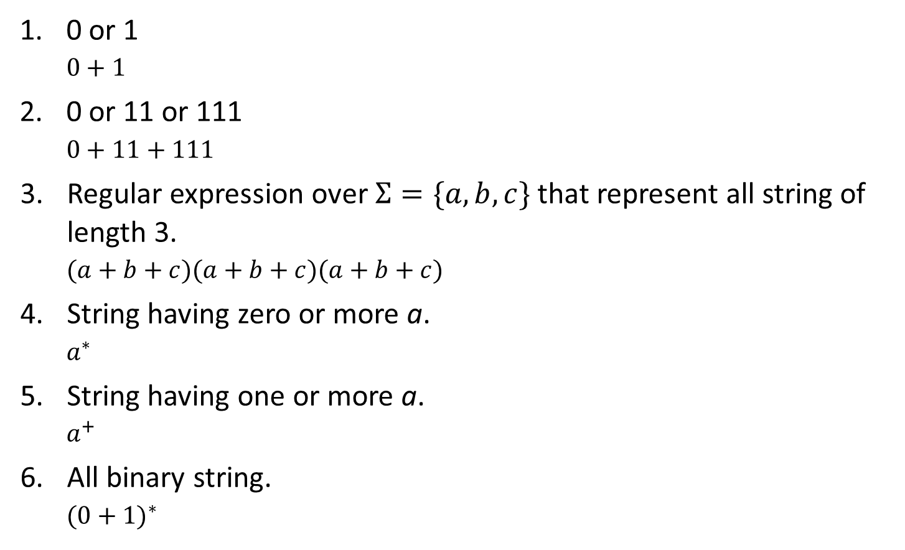
Regular Expressio Examples
0 or 1
$$0+1$$
0 or 11 or 111
$$0+11+111$$
Regular expression over $Σ=\{a,b,c\}$ that represent all string of length 3.
$$(a+b+c)(a+b+c)(a+b+c)$$
String having zero or more a.
$$a^{∗}$$
String having one or more a.
$$a^{+}$$
All binary string.
$${(0+1)}^{∗}$$

Slide 20
Regular Expression Examples
0 or more occurrence of either a or b or both
$${(a+b)}^{∗}$$
1 or more occurrence of either a or b or both
$${(a+b)}^{+}$$
Binary no. ends with 0
$${(0+1)}^{∗}0$$
Binary no. ends with 1
$${(0+1)}^{∗}1$$
Binary no. starts and ends with 1
$${1(0+1)}^{∗}1$$
String starts and ends with same character
${0(0+1)}^{∗}0$ or ${a(a+b)}^{∗}a$
${1(0+1)}^{∗}1$ ${b(a+b)}^{∗}b$

Slide 21
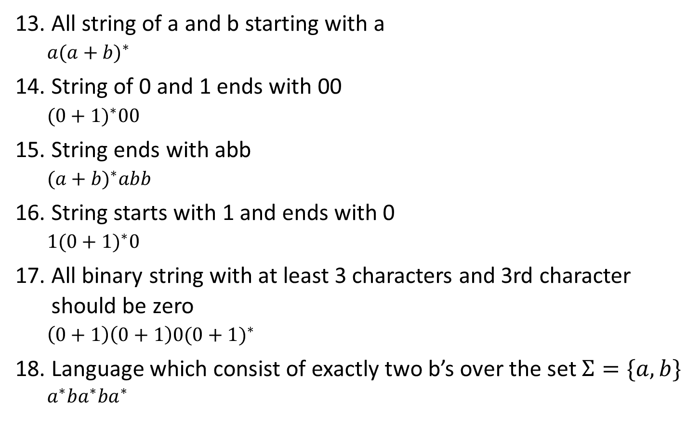
Regular Expression Examples
All string of a and b starting with a
$${a(a+b)}^{∗}$$
String of 0 and 1 ends with 00
$${(0+1)}^{∗}00$$
String ends with abb
$${(a+b)}^{∗}abb$$
String starts with 1 and ends with 0
$$1{(0+1)}^{∗}0$$
All binary string with at least 3 characters and 3rd character should be zero
$${\left(0+1\right)\left(0+1\right)0(0+1)}^{∗}$$
Language which consist of exactly two b’s over the set $Σ=\{a,b\}$
$$a^{∗}ba^{∗}ba^{∗}$$

Slide 22
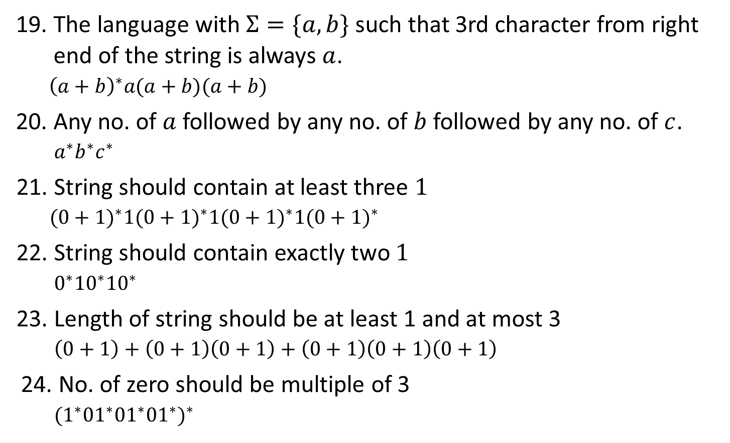
Regular Expression Examples
The language with $Σ=\{a,b\}$ such that 3rd character from right end of the string is always $a$.
$${\left(a+b\right)}^{∗}a(a+b)(a+b)$$
Any no. of $a$ followed by any no. of $b$ followed by any no. of $c$.
$$a^{∗}b^{∗}c^{∗}$$
String should contain at least three $1$
$${(0+1)}^{∗}1{(0+1)}^{∗}1{(0+1)}^{∗}1{(0+1)}^{∗}$$
String should contain exactly two $1$
$$0^{∗}10^{∗}10^{∗}$$
Length of string should be at least 1 and at most 3
$$\left(0+1\right)+\left(0+1\right)\left(0+1\right)+\left(0+1\right)\left(0+1\right)\left(0+1\right)$$
No. of zero should be multiple of 3
$${(1^{∗}01^{∗}01^{∗}01^{∗})}^{∗}$$

Slide 23
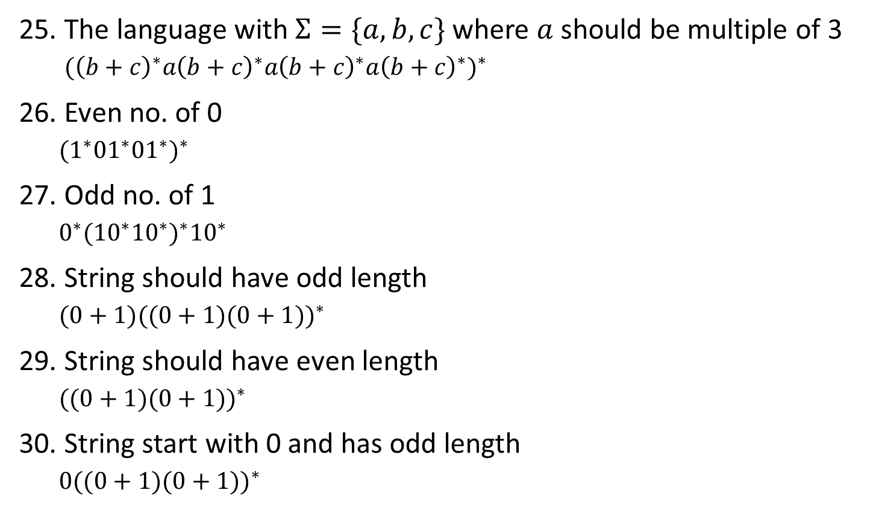
Regular Expression Examples
The language with $Σ=\{a,b,c\}$ where $a$ should be multiple of 3 ${({\left(b+c\right)}^{∗}a{\left(b+c\right)}^{∗}a{\left(b+c\right)}^{∗}a{\left(b+c\right)}^{∗})}^{∗}$
Even no. of 0
$${(1^{∗}01^{∗}01^{∗})}^{∗}$$
Odd no. of 1
$${0^{∗}(10^{∗}10^{∗})}^{∗}{10}^{∗}$$
String should have odd length
$${(0+1)((0+1)(0+1))}^{∗}$$
String should have even length
$${((0+1)(0+1))}^{∗}$$
String start with 0 and has odd length
$$0{((0+1)(0+1))}^{∗}$$

Slide 24
Regular Expression Examples
String start with 1 and has even length
$$1\left(0+1\right){\left(\left(0+1\right)\left(0+1\right)\right)}^{∗}$$
Even no of 1
$${(0^{∗}10^{∗}10^{∗})}^{∗}$$
String of length 6 or less
$${(0+1+^)}^{6}$$
String ending with 1 and not contain 00
$${(1+01)}^{+}$$
All string begins or ends with 00 or 11
$${(00+11)(0+1)}^{∗}+{\left(0+1\right)}^{∗}(00+11)$$
Language of all string containing both 11 and 00 as substring
$${((0+1)}^{∗}00{(0+1)}^{∗}11{(0+1)}^{∗})+{((0+1)}^{∗}11{(0+1)}^{∗}00{(0+1)}^{∗})$$
Language of C identifier
$${(_+L)(_ + L +D)}^{∗}$$

Slide 25
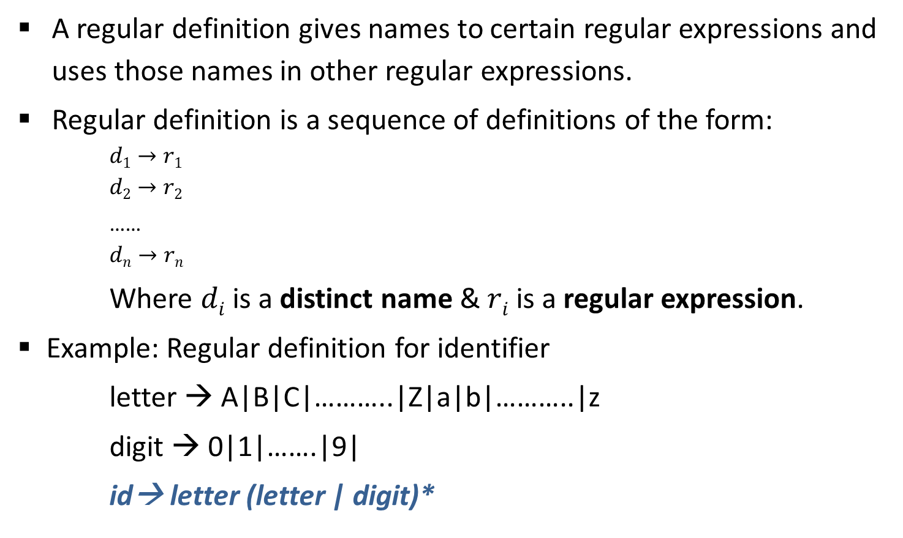
Regular Definition
A regular definition gives names to certain regular expressions and uses those names in other regular expressions.
Regular definition is a sequence of definitions of the form:
$$d1→r1$$
$$d2→r2$$
……
$$dn→rn$$
Where $di$ is a distinct name & $ri$is a regular expression.
Example: Regular definition for identifier
letter → A|B|C|………..|Z|a|b|………..|z
digit → 0|1|…….|9|
id→ letter (letter | digit)*

Slide 26
Regular Definition Example
Example: Unsigned Pascal numbers
5280
39.37
6.336E4
1.894E-4
2.56E+7
Regular Definition
digit → 0|1|…..|9
digits → digit digit*
optional_fraction → .digits | 𝜖
optional_exponent → (E(+|-|𝜖)digits)|𝜖
num → digits optional_fraction optional_exponent

Slide 27
Transition Diagram

Slide 28
Transition Diagram
A stylized flowchart is called transition diagram.
is a state
is a transition
is a the start state
is a final state

Slide 29



Transition Diagram Example
Transition Diagram example for relational operator
$$0$$
<
$$1$$
=
2
return (relop,LE)
>
3
return (relop,NE)
=
5
other
4
return (relop,LT)
return (relop,EQ)
>
$$6$$
=
7
return (relop,GE)
other
8
return (relop,GT)

Slide 30
Finite Automata

Slide 31
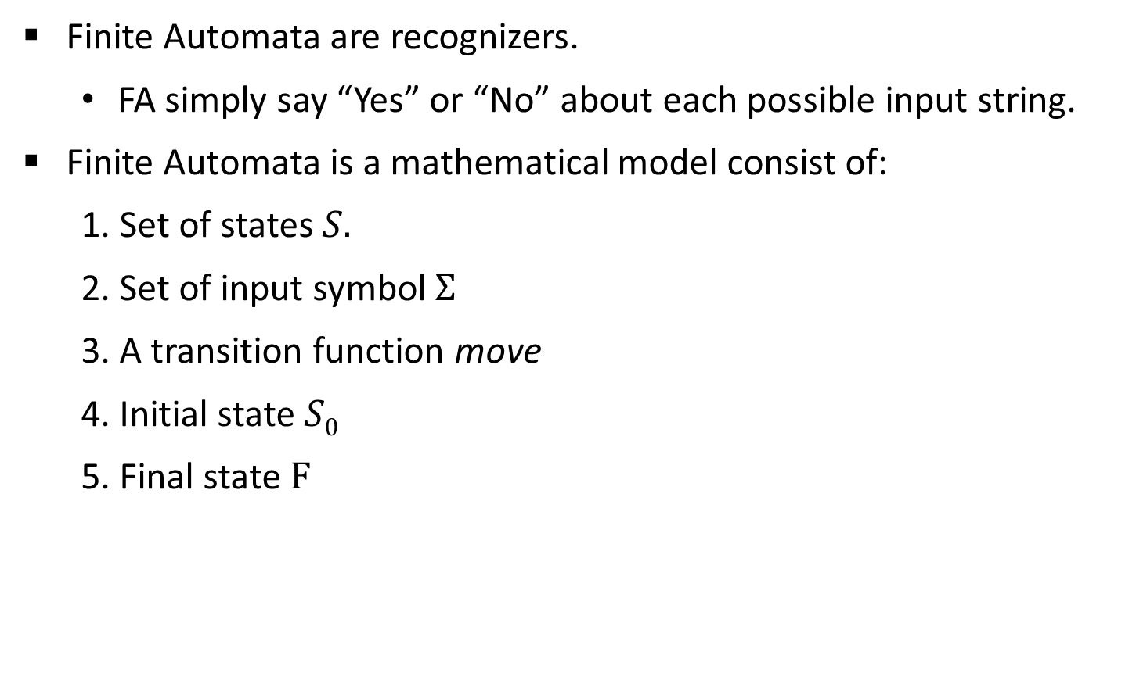
Finite Automata
Finite Automata are recognizers.
FA simply say “Yes” or “No” about each possible input string.
Finite Automata is a mathematical model consist of:
Set of states $S.$
Set of input symbol $Σ$
A transition function move
Initial state $S0$
Final state $F$

Slide 32

Types of Finite Automata
There are two types of finite automata:
Nondeterministic finite automata (NFA): There are no restrictions on the edges leaving a state. There can be several with the same symbol as label and some edges can be labeled with $ε$.
Deterministic finite automata (DFA): have for each state exactly one edge leaving out for each symbol.
b
a
1
a
2
b
3
b
4
1
a
2
b
3
b
4
a
a
b
b
a
NFA
DFA

Slide 33
RE to NFA using Thompson’s rule

Slide 34





RE to NFA (Thompson’s construction)
For $∈$ , construct the NFA
For $a$ in $Σ$, construct the NFA
start
$$i$$
𝜖
$$f$$
start
$$i$$
a
$$f$$

Slide 35



RE to NFA (Thompson’s construction)
For regular expression $s|t$
Ex: (a|b)
N(s)
𝜖
𝜖
start
$$i$$
$$f$$
𝜖
N(t)
𝜖
a
2
3
𝜖
𝜖
start
1
6
𝜖
4
5
𝜖
b

Slide 36



RE to NFA (Thompson’s construction)
For regular expression $st$
Ex: ab
start
N(s)
N(t)
$$i$$
$$f$$
start
a
2
b
1
3

Slide 37



RE to NFA (Thompson’s construction)
For regular expression $s$*
Ex: (a|b)*
𝜖
start
$$i$$
𝜖
N(s)
𝜖
$$f$$
𝜖
𝜖
a
2
3
𝜖
𝜖
start
𝜖
𝜖
0
1
6
7
𝜖
4
5
𝜖
b
𝜖

Slide 38







RE to NFA Examples
a*
a*ab
𝜖
1
𝜖
2
$$a$$
3
𝜖
$$4$$
𝜖
𝜖
1
𝜖
2
$$a$$
3
𝜖
$$4$$
$$a$$
$$b$$
5
$$6$$
𝜖

Slide 39
RE to NFA Examples
Exercise
a⁺ab
aa*+bb*
(a+b)*abb
10(0+1)*1
(a+b)*a(a+b)
(0+1)*010(0+1)*
(010+00)*(10)*
(ab+ba+aa+bb)*

Slide 40
Conversion from NFA to DFA using Subset construction method

Slide 41
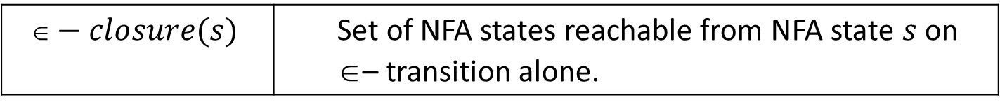

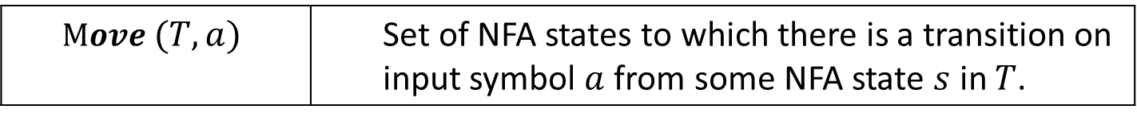
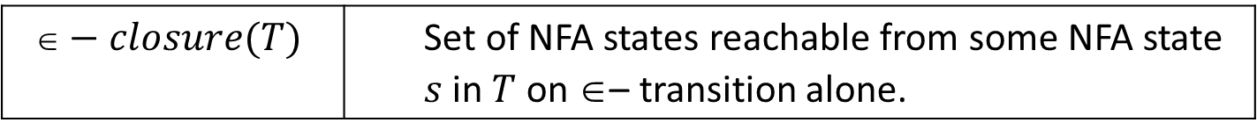
Subset construction algorithm
Input: An NFA $N$.
Output: A DFA D accepting the same language.
Method: Algorithm construct a transition table $Dtran$ for D. We use the following operation:
OPERATION | DESCRIPTION
$$−closure(s)$$ | Set of NFA states reachable from NFA state $s$ on $$– transition alone.
$$−closure(T)$$ | Set of NFA states reachable from some NFA state $s$ in $T$ on $$– transition alone.
$$Move (T,a)$$ | Set of NFA states to which there is a transition on input symbol $a$ from some NFA state $s$ in $T$.

Slide 42
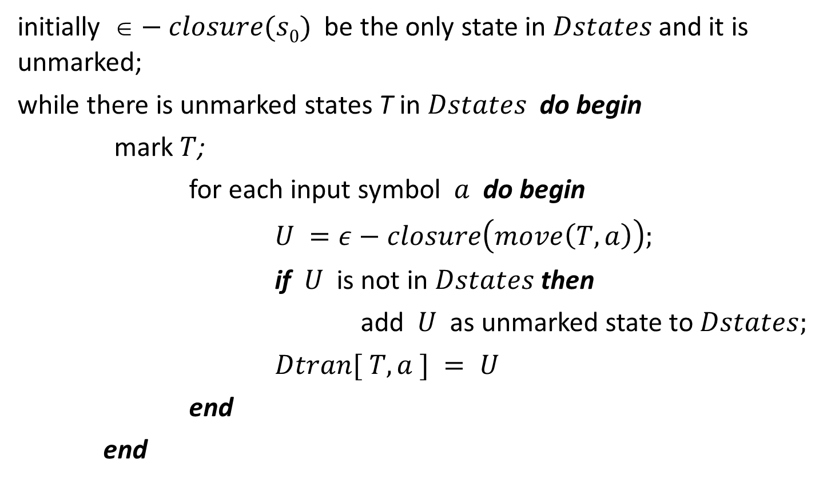
Subset construction algorithm
initially $−closure(s0)$be the only state in $Dstates$and it is unmarked;
while there is unmarked states T in $Dstates$ do begin
mark $T$;
for each input symbol $a$ do begin
$U =ε−closure\left(move\left(T, a\right)\right);$
if $U$ is not in $Dstates$ then
add $U$ as unmarked state to $Dstates;$
$Dtran[ T, a ] = U$
end
end

Slide 43
Conversion from NFA to DFA
(a|b)
abb
*
𝜖
a
2
3
𝜖
𝜖
𝜖
𝜖
7
a
8
b
9
b
10
0
1
6
𝜖
4
5
𝜖
b
𝜖
𝜖- Closure(0)
= {0,1,2,4,7}
---- A
ε – closure (0)

Slide 44
Conversion from NFA to DFA
𝜖
a
2
3
𝜖
𝜖
𝜖
𝜖
7
a
8
b
9
b
10
0
1
6
𝜖
4
5
𝜖
b
States | a | b
𝜖
A = {0,1,2,4,7} | B
A= {0,1,2,4,7}
Move(A,a)
= {3,8}
𝜖- Closure(Move(A,a))
= {3,6,7,1,2,4,8}
= {1,2,3,4,6,7,8}
---- B

Slide 45
Conversion from NFA to DFA
𝜖
a
2
3
𝜖
𝜖
𝜖
𝜖
7
a
8
b
9
b
10
0
1
6
𝜖
4
5
𝜖
b
States | a | b
𝜖
A = {0,1,2,4,7} | B | C
A= {0,1,2,4,7}
Move(A,b)
= {5}
𝜖- Closure(Move(A,b))
= {5,6,7,1,2,4}
= {1,2,4,5,6,7}
---- C

Slide 46
Conversion from NFA to DFA
𝜖
a
2
3
𝜖
𝜖
𝜖
𝜖
7
a
8
b
9
b
10
0
1
6
𝜖
4
5
𝜖
b
States | a | b
𝜖
A = {0,1,2,4,7} | B | C
B= {1,2,3,4,6,7,8}
B = {1,2,3,4,6,7,8} | B
Move(B,a)
= {3,8}
𝜖- Closure(Move(B,a))
= {3,6,7,1,2,4,8}
= {1,2,3,4,6,7,8}
---- B

Slide 47
Conversion from NFA to DFA
𝜖
a
2
3
𝜖
𝜖
𝜖
𝜖
7
a
8
b
9
b
10
0
1
6
𝜖
4
5
𝜖
b
States | a | b
𝜖
A = {0,1,2,4,7} | B | C
B= {1,2,3,4,6,7,8}
B = {1,2,3,4,6,7,8} | B | D
Move(B,b)
= {5,9}
𝜖- Closure(Move(B,b))
= {5,6,7,1,2,4,9}
= {1,2,4,5,6,7,9}
---- D

Slide 48
Conversion from NFA to DFA
𝜖
a
2
3
𝜖
𝜖
𝜖
𝜖
7
a
8
b
9
b
10
0
1
6
𝜖
4
5
𝜖
b
States | a | b
𝜖
A = {0,1,2,4,7} | B | C
C= {1,2,4,5,6,7}
B = {1,2,3,4,6,7,8} | B | D
Move(C,a)
= {3,8}
C = {1,2,4,5,6,7} | B
𝜖- Closure(Move(C,a))
= {3,6,7,1,2,4,8}
= {1,2,3,4,6,7,8}
---- B

Slide 49
Conversion from NFA to DFA
𝜖
a
2
3
𝜖
𝜖
𝜖
𝜖
7
a
8
b
9
b
10
0
1
6
𝜖
4
5
𝜖
b
States | a | b
𝜖
A = {0,1,2,4,7} | B | C
C= {1,2,4,5,6,7}
B = {1,2,3,4,6,7,8} | B | D
Move(C,b)
= {5}
C = {1,2,4,5,6,7} | B | C
𝜖- Closure(Move(C,b))
= {5,6,7,1,2,4}
= {1,2,4,5,6,7}
---- C

Slide 50
Conversion from NFA to DFA
𝜖
a
2
3
𝜖
𝜖
𝜖
𝜖
7
a
8
b
9
b
10
0
1
6
𝜖
4
5
𝜖
b
States | a | b
𝜖
A = {0,1,2,4,7} | B | C
D= {1,2,4,5,6,7,9}
B = {1,2,3,4,6,7,8} | B | D
Move(D,a)
= {3,8}
C = {1,2,4,5,6,7} | B | C
𝜖- Closure(Move(D,a))
= {3,6,7,1,2,4,8}
D = {1,2,4,5,6,7,9} | B
= {1,2,3,4,6,7,8}
---- B

Slide 51
Conversion from NFA to DFA
𝜖
a
2
3
𝜖
𝜖
𝜖
𝜖
7
a
8
b
9
b
10
0
1
6
𝜖
4
5
𝜖
b
States | a | b
𝜖
A = {0,1,2,4,7} | B | C
D= {1,2,4,5,6,7,9}
B = {1,2,3,4,6,7,8} | B | D
Move(D,b)
= {5,10}
C = {1,2,4,5,6,7} | B | C
𝜖- Closure(Move(D,b))
= {5,6,7,1,2,4,10}
D = {1,2,4,5,6,7,9} | B | E
= {1,2,4,5,6,7,10}
---- E

Slide 52
Conversion from NFA to DFA
𝜖
a
2
3
𝜖
𝜖
𝜖
𝜖
7
a
8
b
9
b
10
0
1
6
𝜖
4
5
𝜖
b
States | a | b
𝜖
A = {0,1,2,4,7} | B | C
E= {1,2,4,5,6,7,10}
B = {1,2,3,4,6,7,8} | B | D
Move(E,a)
= {3,8}
C = {1,2,4,5,6,7} | B | C
𝜖- Closure(Move(E,a))
= {3,6,7,1,2,4,8}
D = {1,2,4,5,6,7,9} | B | E
---- B
E = {1,2,4,5,6,7,10} | B
= {1,2,3,4,6,7,8}

Slide 53
Conversion from NFA to DFA
𝜖
a
2
3
𝜖
𝜖
𝜖
𝜖
7
a
8
b
9
b
10
0
1
6
𝜖
4
5
𝜖
b
States | a | b
𝜖
A = {0,1,2,4,7} | B | C
E= {1,2,4,5,6,7,10}
B = {1,2,3,4,6,7,8} | B | D
Move(E,b)
= {5}
C = {1,2,4,5,6,7} | B | C
𝜖- Closure(Move(E,b))
= {5,6,7,1,2,4}
D = {1,2,4,5,6,7,9} | B | E
---- C
E = {1,2,4,5,6,7,10} | B | C
= {1,2,4,5,6,7}

Slide 54



DFA
a
States | a | b
b
$$B$$
$$D$$
A | B | C
a
B | B | D
a
C | B | C
$$A$$
a
a
b
D | B | E
E | B | C
b
$$C$$
$$E$$
b
Transition Table
b
DFA

Slide 55
Convert NFA to DFA
Exercise:
(a+b)*a(a+b)
(a+b)*ab*a

Slide 56
DFA Optimization

Slide 57
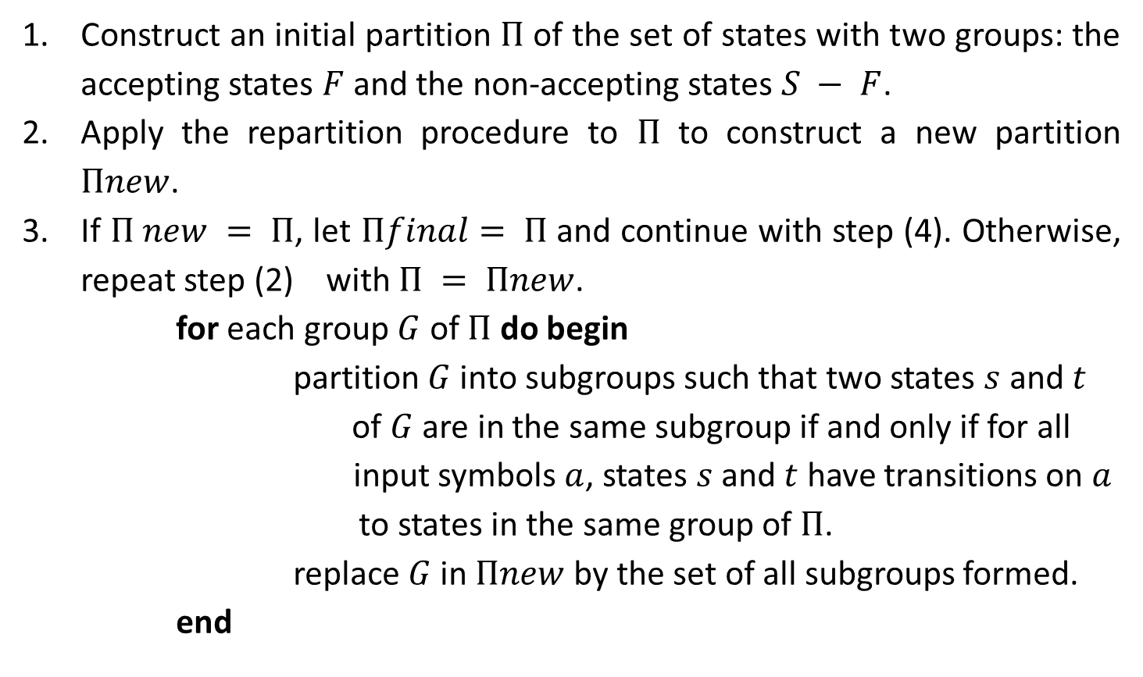
DFA Optimization Algorithm
Construct an initial partition $Π$ of the set of states with two groups: the accepting states $F$ and the non-accepting states $S − F$.
Apply the repartition procedure to $Π$ to construct a new partition $Πnew$.
If $Π new = Π$, let $Πfinal= Π$and continue with step (4). Otherwise, repeat step (2) with $Π = Πnew$.
for each group $G$ of $Π$ do begin
partition $G$ into subgroups such that two states $s$ and $t$
of $G$ are in the same subgroup if and only if for all
input symbols $a$, states $s$ and $t$ have transitions on $a$
to states in the same group of $Π$.
replace $G$ in $Πnew$ by the set of all subgroups formed.
end

Slide 58
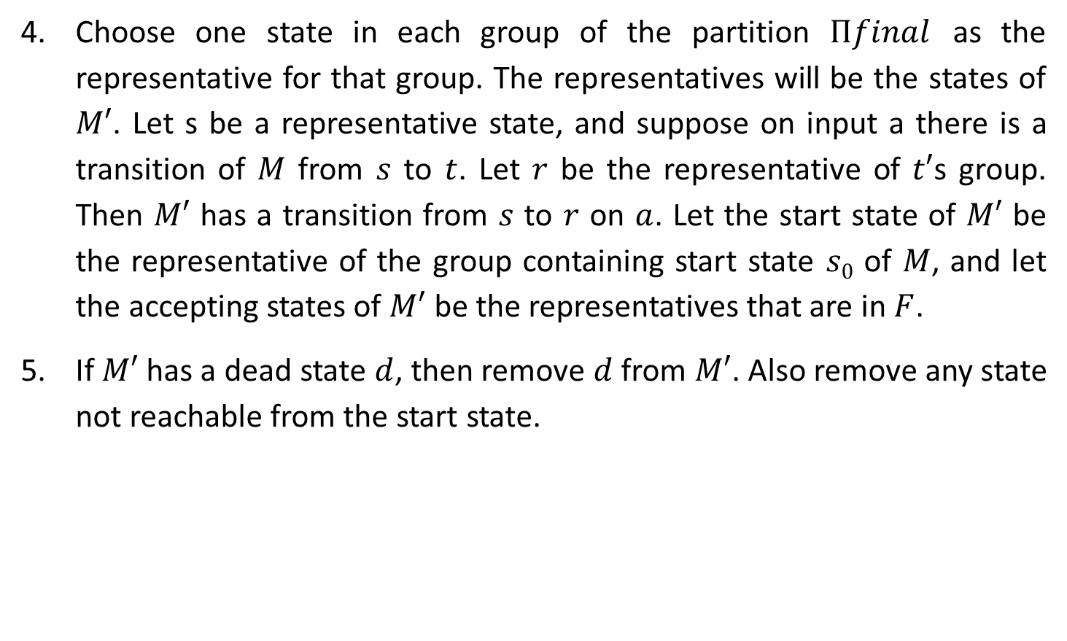
DFA Optimization Algorithm
Choose one state in each group of the partition $Πfinal$ as the representative for that group. The representatives will be the states of $M′$. Let s be a representative state, and suppose on input a there is a transition of $M$ from $s$ to $t$. Let $r$ be the representative of $t′$s group. Then $M′$ has a transition from $s$ to $r$ on $a$. Let the start state of $M′$ be the representative of the group containing start state $s0$ of $M$, and let the accepting states of $M′$ be the representatives that are in $F$.
If $M′$ has a dead state $d$, then remove $d$ from $M′$. Also remove any state not reachable from the start state.

Slide 59

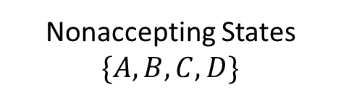


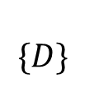
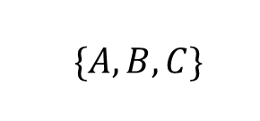

DFA Optimization
$$\{A,B,C,D,E\}$$
States | a | b
A | B | C
Nonaccepting States $\{A,B,C,D\}$
Accepting States
$$\{E\}$$
B | B | D
C | B | C
D | B | E
$\{A,B,C\}$
$$\{D\}$$
E | B | C
$\{AC\}$
$\{B\}$
States | a | b
A | B | C
B | B | D
Now no more splitting is possible.
D | B | E
If we chose A as the representative for group (AC), then we obtain reduced transition table
E | B | C
Optimized Transition Table

Slide 60
RE to DFA without constructing NFA

Slide 61
Construct RE to direct DFA
Construct a syntax tree for (r)#
Traverse the tree to construct functions nullable, firstpos, lastpos, and followpos.
Construct DFA.

Slide 62
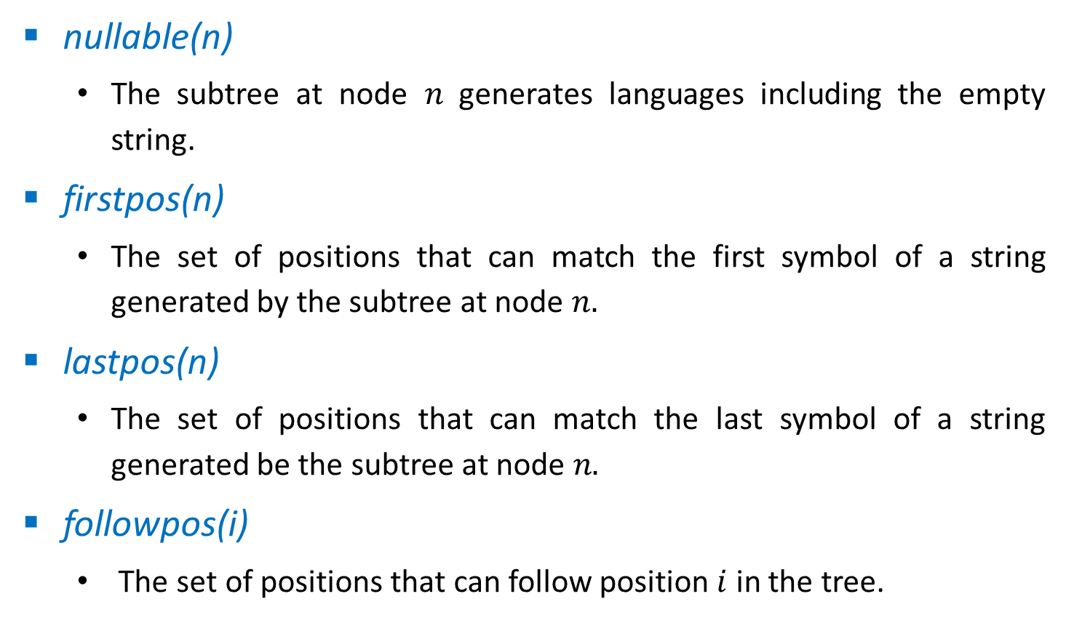
Function Computed From the Syntax Tree
nullable(n)
The subtree at node $n$ generates languages including the empty string.
firstpos(n)
The set of positions that can match the first symbol of a string generated by the subtree at node $n.$
lastpos(n)
The set of positions that can match the last symbol of a string generated be the subtree at node $n.$
followpos(i)
The set of positions that can follow position $i$ in the tree.

Slide 63



Rules to Compute Nullable, Firstpos, Lastpos
Node n | nullable(n) | firstpos(n) | lastpos(n)
A leaf labeled by $$ | true | $$∅$$ | $$∅$$
A leaf with position $i$ | false | $$\{i\}$$ | $$\{i\}$$
 | nullable(c₁) or nullable(c₂) | firstpos(c₁) ∪ firstpos(c₂) | lastpos(c₁) ∪ lastpos(c₂)
n
$$|$$
c₁
c₂
 | nullable(c₁) and nullable(c₂) | if (nullable(c₁)) firstpos(c₁) ∪ firstpos(c₂) else firstpos(c₁) | if (nullable(c₂)) lastpos(c₁) ∪ lastpos(c₂) else lastpos(c₂)
n
$$.$$
c₁
c₂
 | true | firstpos(c₁) | lastpos(c₁)
n
$$∗$$
c₁

Slide 64
Rules to compute followpos
If n is concatenation node with left child c1 and right child c2 and i is a position in lastpos(c1), then all position in firstpos(c2) are in followpos(i)
If n is * node and i is position in lastpos(n), then all position in firstpos(n) are in followpos(i)

Slide 65














Conversion from RE to DFA
(a|b)
abb
*
#
Step2: Nullable node
Here, * is only nullable node
.
.
$$\#$$
.
$$6$$
$$b$$
.
$$5$$
$$b$$
$$4$$
$$∗$$
$$a$$
$$3$$
$$|$$
$$a$$
$$b$$
$$1$$
$$2$$

Slide 66






























Conversion from RE to DFA
Step3: Calculate firstpos & lastpos
$$\{1,2,3\}$$
.
$$\{6\}$$
Firstpos
Lastpos
$$\{1,2,3\}$$
.
$$\{5\}$$
$$\{6\}$$
$$\{6\}$$
$$\#$$
$$\{1,2,3\}$$
.
$$6$$
$$\{4\}$$
$$\{5\}$$
$$\{5\}$$
$$b$$
$$\{1,2,3\}$$
.
$$\{3\}$$
$$5$$
$$\{4\}$$
$$b$$
$$\{4\}$$
$$4$$
$$\{1,2\}$$
$$∗$$
$$\{1,2\}$$
$$\{3\}$$
$$a$$
$$\{3\}$$
$$3$$
$$\{1,2\}$$
$$|$$
$$\{1,2\}$$
$$a$$
$$b$$
$$\{1\}$$
$$\{1\}$$
$$\{2\}$$
$$\{2\}$$
$$1$$
$$2$$

Slide 67





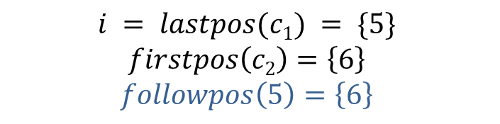

Conversion from RE to DFA
Step4: Calculate followpos
Position | followpos
Firstpos
Lastpos
5 | 6
$$\{1,2,3\}$$
.
$$\{6\}$$
$$\{1,2,3\}$$
.
$$\{5\}$$
$$\{6\}$$
$$\{6\}$$
$$\#$$
$$\{1,2,3\}$$
.
$$6$$
$$\{4\}$$
$$\{5\}$$
$$\{5\}$$
$$b$$
$$\{1,2,3\}$$
.
$$\{3\}$$
$$5$$
.
$$\{4\}$$
$$b$$
$$\{4\}$$
$$4$$
$$\{1,2\}$$
$$∗$$
$$\{1,2\}$$
$$\{3\}$$
$$a$$
$$\{3\}$$
$$\{1,2,3\}$$
$$c1$$
$$\{5\}$$
$$\{6\}$$
$$c2$$
$$\{6\}$$
$$3$$
$$\{1,2\}$$
$$|$$
$$\{1,2\}$$
$$i = lastpos(c1) = \{5\}$$
$$firstpos\left(c2\right)=\left\{6\right\}$$
$$followpos\left(5\right)=\left\{6\right\}$$
$$a$$
$$b$$
$$\{1\}$$
$$\{1\}$$
$$\{2\}$$
$$\{2\}$$
$$1$$
$$2$$

Slide 68


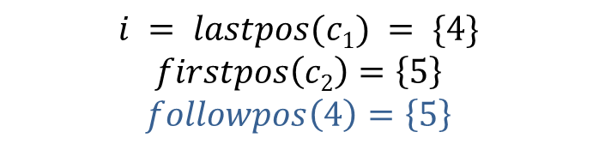

Conversion from RE to DFA
Step4: Calculate followpos
Position | followpos
Firstpos
Lastpos
5 | 6
$$\{1,2,3\}$$
.
$$\{6\}$$
4 | 5
$$\{1,2,3\}$$
.
$$\{5\}$$
$$\{6\}$$
$$\{6\}$$
$$\#$$
$$\{1,2,3\}$$
.
$$6$$
$$\{4\}$$
$$\{5\}$$
$$\{5\}$$
$$b$$
$$\{1,2,3\}$$
.
$$\{3\}$$
$$5$$
.
$$\{4\}$$
$$b$$
$$\{4\}$$
$$4$$
$$\{1,2\}$$
$$∗$$
$$\{1,2\}$$
$$\{3\}$$
$$a$$
$$\{3\}$$
$$\{1,2,3\}$$
$$c1$$
$$\{4\}$$
$$\{5\}$$
$$c2$$
$$\{5\}$$
$$3$$
$$\{1,2\}$$
$$|$$
$$\{1,2\}$$
$$i = lastpos(c1) = \{4\}$$
$$firstpos\left(c2\right)=\left\{5\right\}$$
$$followpos\left(4\right)=\left\{5\right\}$$
$$a$$
$$b$$
$$\{1\}$$
$$\{1\}$$
$$\{2\}$$
$$\{2\}$$
$$1$$
$$2$$

Slide 69




Conversion from RE to DFA
Step4: Calculate followpos
Position | followpos
Firstpos
Lastpos
5 | 6
$$\{1,2,3\}$$
.
$$\{6\}$$
4 | 5
$$\{1,2,3\}$$
.
$$\{5\}$$
3 | 4
$$\{6\}$$
$$\{6\}$$
$$\#$$
$$\{1,2,3\}$$
.
$$6$$
$$\{4\}$$
$$\{5\}$$
$$\{5\}$$
$$b$$
$$\{1,2,3\}$$
.
$$\{3\}$$
$$5$$
.
$$\{4\}$$
$$b$$
$$\{4\}$$
$$4$$
$$\{1,2\}$$
$$∗$$
$$\{1,2\}$$
$$\{3\}$$
$$a$$
$$\{3\}$$
$$\{1,2,3\}$$
$$c1$$
$$\{3\}$$
$$\{4\}$$
$$c2$$
$$\{4\}$$
$$3$$
$$\{1,2\}$$
$$|$$
$$\{1,2\}$$
$$i = lastpos(c1) = \{3\}$$
$$firstpos\left(c2\right)=\left\{4\right\}$$
$$followpos\left(3\right)=\left\{4\right\}$$
$$a$$
$$b$$
$$\{1\}$$
$$\{1\}$$
$$\{2\}$$
$$\{2\}$$
$$1$$
$$2$$

Slide 70





Conversion from RE to DFA
Step4: Calculate followpos
Position | followpos
Firstpos
Lastpos
5 | 6
$$\{1,2,3\}$$
.
$$\{6\}$$
4 | 5
$$\{1,2,3\}$$
.
$$\{5\}$$
3 | 4
$$\{6\}$$
$$\{6\}$$
$$\#$$
.
$$6$$
2 | 3
$$\{1,2,3\}$$
$$\{4\}$$
$$\{5\}$$
$$\{5\}$$
$$b$$
1 | 3
$$\{1,2,3\}$$
.
$$\{3\}$$
$$5$$
.
$$\{4\}$$
$$b$$
$$\{4\}$$
$$4$$
$$\{1,2\}$$
$$∗$$
$$\{1,2\}$$
$$\{3\}$$
$$a$$
$$\{3\}$$
$$\{1,2\}$$
$$c1$$
$$\{1,2\}$$
$$\{3\}$$
$$c2$$
$$\{3\}$$
$$3$$
$$\{1,2\}$$
$$|$$
$$\{1,2\}$$
$$i = lastpos(c1) = \{1,2\}$$
$$firstpos\left(c2\right)=\left\{3\right\}$$
$$followpos\left(1\right)=\left\{3\right\}$$
$$followpos\left(2\right)=\left\{3\right\}$$
$$a$$
$$b$$
$$\{1\}$$
$$\{1\}$$
$$\{2\}$$
$$\{2\}$$
$$1$$
$$2$$

Slide 71




Conversion from RE to DFA
Step4: Calculate followpos
Position | followpos
Firstpos
Lastpos
5 | 6
$$\{1,2,3\}$$
.
$$\{6\}$$
4 | 5
$$\{1,2,3\}$$
.
$$\{5\}$$
3 | 4
$$\{6\}$$
$$\{6\}$$
$$\#$$
2 | 3
.
$$6$$
1,2,
$$\{1,2,3\}$$
$$\{4\}$$
$$\{5\}$$
$$\{5\}$$
$$b$$
1 | 3
1,2,
$$\{1,2,3\}$$
.
$$\{3\}$$
$$5$$
$$\{4\}$$
$$b$$
$$\{4\}$$
$$4$$
$$\{1,2\}$$
*
$$\{1,2\}$$
$$\{1,2\}$$
$$∗$$
$$\{1,2\}$$
$$\{3\}$$
$$a$$
$$\{3\}$$
$$n$$
$$3$$
$$\{1,2\}$$
$$|$$
$$\{1,2\}$$
$$i = lastpos(n) = \{1,2\}$$
$$firstpos\left(n\right)=\left\{1,2\right\}$$
$$followpos\left(1\right)=\left\{1,2\right\}$$
$$followpos\left(2\right)=\left\{1,2\right\}$$
$$a$$
$$b$$
$$\{1\}$$
$$\{1\}$$
$$\{2\}$$
$$\{2\}$$
$$1$$
$$2$$

Slide 72

Construct DFA
Initial state = $firstpos$ of root = {1,2,3} ----- A
State A
δ( (1,2,3),a) = followpos(1) U followpos(3)
=(1,2,3) U (4) = {1,2,3,4} ----- B
δ( (1,2,3),b) = followpos(2)
=(1,2,3) ----- A
Position | followpos
5 | 6
4 | 5
3 | 4
2 | 1,2,3
1 | 1,2,3
States | a | b
A={1,2,3} | B | A
B={1,2,3,4}

Slide 73
Construct DFA
State B
δ( (1,2,3,4),a) = followpos(1) U followpos(3)
=(1,2,3) U (4) = {1,2,3,4} ----- B
δ( (1,2,3,4),b) = followpos(2) U followpos(4)
=(1,2,3) U (5) = {1,2,3,5} ----- C
State C
δ( (1,2,3,5),a) = followpos(1) U followpos(3)
=(1,2,3) U (4) = {1,2,3,4} ----- B
δ( (1,2,3,5),b) = followpos(2) U followpos(5)
=(1,2,3) U (6) = {1,2,3,6} ----- D
Position | followpos
5 | 6
4 | 5
3 | 4
2 | 1,2,3
1 | 1,2,3
States | a | b
A={1,2,3} | B | A
B={1,2,3,4} | B | C
C={1,2,3,5} | B | D
D={1,2,3,6}

Slide 74
Construct DFA
State D
δ( (1,2,3,6),a) = followpos(1) U followpos(3)
=(1,2,3) U (4) = {1,2,3,4} ----- B
δ( (1,2,3,6),b) = followpos(2)
=(1,2,3) ----- A
Position | followpos
5 | 6
4 | 5
3 | 4
2 | 1,2,3
1 | 1,2,3
b
States | a | b
a
A={1,2,3} | B | A
A
a
B
b
C
b
D
B={1,2,3,4} | B | C
C={1,2,3,5} | B | D
a
a
D={1,2,3,6} | B | A
b
DFA

Slide 75
Exercise
(c | d)*c#

Slide 76
End of Unit-2

