Slide 1

Unit – 4 Pushdown Automata
Unit – 3
Parsing Theory (I)
Prof. Dixita Kagathara
dixita.kagathara@darshan.ac.in
Compiler Design (2170701) Darshan Institute of Engineering & Technology

Slide 2
Role of Parser
Parser obtains a string of token from the lexical analyzer and reports syntax error if any otherwise generates syntax tree.
There are two types of parser:
Top-down parser.
Bottom-up parser.
Token
Source Program
Lexical Analyzer
Parse tree
Parse
tree
Rest of front end
IR
Parser
Get next token
Symbol Table

Slide 3
Derivation & Ambiguity

Slide 4
Derivation
Derivation is used to find whether the string belongs to a given grammar or not.
Types of derivations are:
Leftmost derivation
Rightmost derivation

Slide 5
Leftmost Derivation
A derivation of a string W in a grammar G is a left most derivation if at every step the left most non terminal is replaced.
Let us consider a Grammar
S→S+S | S-S | S*S | S/S | (S) | a
String: a*a-a
S
S-S
S*S-S
a*S-S
a*a-S
a*a-a
S
S
-
S
S
*
S
a
a
a
Leftmost Derivation Tree
Leftmost Derivation

Slide 6
Rightmost Derivation
A derivation of a string W in a grammar G is a right most derivation if at every step the right most non terminal is replaced.
Let us consider a Grammar
S→S+S | S-S | S*S | S/S | (S) | a
String: a*a-a
S
S*S
S*S-S
S*S-a
S*a-a
a*a-a
S
S
*
S
a
S
-
S
a
a
Rightmost Derivation Tree
Rightmost Derivation

Slide 7
Exercise
S→A1B
A→0A | 𝜖
B→0B | 1B | 𝜖 (String: 1001) Perform leftmost derivation.
E→E+E | E*E | id | (E) | -E
String : id + id * id. Perform rightmost derivation

Slide 8
Ambiguous Grammar

Slide 9
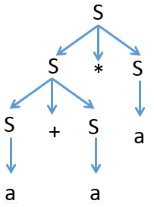
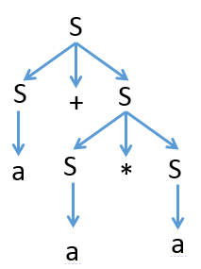
Ambiguous Grammar
A context free grammar G is ambiguous if there is at least one string in L(G) having two or more distinct derivation tree.
Example: S→S+S | S-S | S*S | S/S | (S) | a
String: a+a*a
S S
S*S S+S
S+S*S a+S
a+S*S a+S*S
a+a*S a+a*S
a+a*a a+a*a
Here, we have two left most derivation for string a+a*a hence, above grammar is ambiguous.

Slide 10
Exercise
Check whether following grammars are ambiguous or not:
S→ aS | Sa | 𝜖 (string: aaaa)
S→ aSbS | bSaS | 𝜖 (string: abab)
S→SS+ | SS* | a (string: aa+a*)

Slide 11
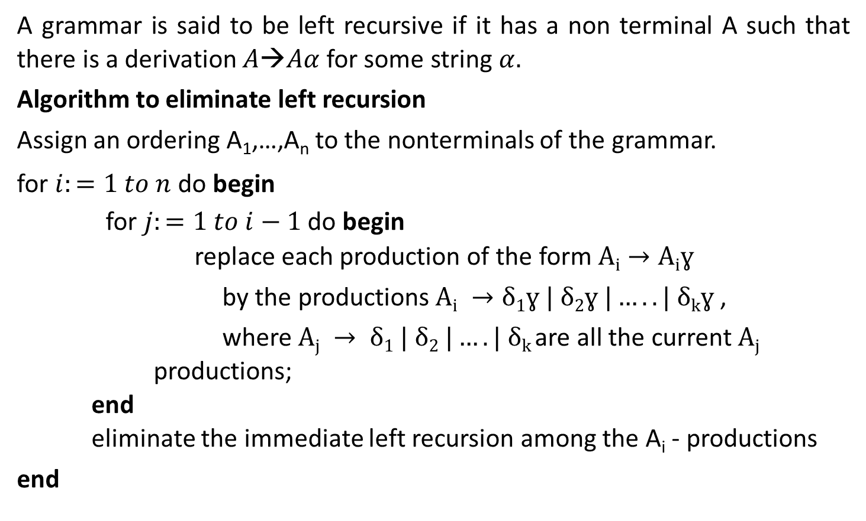
Left Recursion
A grammar is said to be left recursive if it has a non terminal A such that there is a derivation $A→Aα$for some string $α.$
Algorithm to eliminate left recursion
Assign an ordering A₁,…,A_{n} to the nonterminals of the grammar.
for $i:=1 to n$ do begin for $j:=1 to i−1$ do begin replace each production of the form $Ai→Aiɣ$
by the productions $Ai →δ1ɣ | δ2ɣ |…..| δkɣ$,
where $Aj → δ1 | δ2 |….| δk$are all the current $Aj$ productions; end eliminate the immediate left recursion among the A_{i} - productions
end

Slide 12


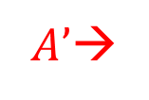






Left Recursion Removal
Removal of Left recursion from production
$$A→Aα |$$
$A→$
$$β$$
$$A’$$
$$α$$
$$β$$
$|$𝜖
$A’$→
$$A’$$

Slide 13
Example: Left Recursion Removal
E→E+T | T
E→TE’
E’→+TE’ | ε
T→T*F | F
T→FT’
T’→*FT’ | ε
X→X%Y | Z
X→ZX’
X’→%YX’ | ε

Slide 14
Example: Left recursion removal
S→ Aa | b
A→ Ac | Sd | ε
Here, Non terminal S is left recursive because:
S→Aa→Sda
S→ Aa | b
A→ Ac
A→ Aad
A→ bd
A→ ε
Now, remove left recursion
S→ Aa | b
A→ bdA’ | A’
A’→ cA’ | adA’ | ε
A→Ac | Aad | bd | ε

Slide 15
Exercise
A→Abd | Aa | a
B→Be | b
A→AB | AC | a | b
S→A | B
A→ABC | Acd | a | aa
B→Bee | b
Exp→Exp+term | Exp-term | term

Slide 16
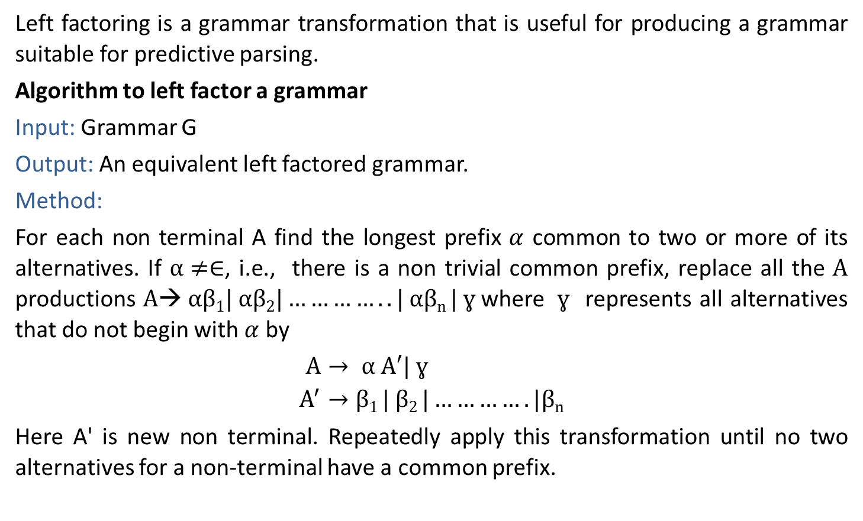
Left factoring
Left factoring is a grammar transformation that is useful for producing a grammar suitable for predictive parsing.
Algorithm to left factor a grammar
Input: Grammar G
Output: An equivalent left factored grammar.
Method:
For each non terminal A find the longest prefix $α$ common to two or more of its alternatives. If $α≠∈$, i.e., there is a non trivial common prefix, replace all the $A$ productions $A→ αβ1| αβ2|…………..| αβn | ɣ$where $ɣ$ represents all alternatives that do not begin with $α$ by
$A→ α A′| ɣ$
$$A^{′}→β1 | β2 |………….|βn$$
Here A' is new non terminal. Repeatedly apply this transformation until no two alternatives for a non-terminal have a common prefix.

Slide 17










Left factoring Removal
Removal of Left factoring
$A→$
$A→$
$A^{′}$
$$α$$
$$α$$
$$α$$
$$β$$
$$α$$
$$β$$
|
δ
δ
$A^{′}→ |$

Slide 18
Example: Left factoring removal
S→aAB | aCD
S→aS’
S’→AB | CD
A→ xByA | xByAzA | a
A→ xByAA’ | a
A’→ Є | zA
A→ aAB | aA |a
A→aA’
A’→AB | A | 𝜖
A’→AA’’ | 𝜖
A’’→B | 𝜖

Slide 19
Exercise
S→iEtS | iEtSeS | a
A→ ad | a | ab | abc | x

Slide 20
Parsing

Slide 21
Parsing
Parsing is a technique that takes input string and produces output either a parse tree if string is valid sentence of grammar, or an error message indicating that string is not a valid sentence of given grammar.
Types of parsing are:
Top down parsing: In top down parsing parser build parse tree from top to bottom.
Bottom up parsing: Bottom up parser starts from leaves and work up to the root.

Slide 22
Classification of Parsing Methods
Parsing
Top down Parsing
Bottom up Parsing
Back
tracking
Parsing without Backtracking (Predictive Parsing)
Operator precedence parsing
LR Parsing
SLR
CLR
LALR
Recursive Descent
LL(1)

Slide 23
Top Down Parsing

Slide 24
Backtracking

Slide 25
Backtracking
In Backtracking expansion of non-terminal symbol we choose one alternative and if any mismatch occurs then we try another alternative.
Example:
S→ cAd
A→ ab | a
Input string: cad
S
S
S
c
A
d
c
A
d
c
A
d
a
b
a

Slide 26
Exercise
E→ 5+T | 3-T
T→ V | V*V | V+V
V→ a | b
(String: 3-a+b)

Slide 27
Recursive Descent Parsing

Slide 28
Recursive Descent Parsing
A top down parsing that executes a set of recursive procedure to process the input without backtracking is called recursive descent parser.
There is a procedure for each non terminal in the grammar.
Consider RHS of any production rule as definition of the procedure.
As it reads expected input symbol, it advances input pointer to next position.

Slide 29
Recursive Descent Parsing
Procedure E
{
If lookahead=num
{
Match(num);
T();
}
Else
Error();
If lookahead=$
{
Declare success;
}
Else
Error();
}
Procedure T
{
If lookahead=’*’
{
Match(‘*’);
If lookahead=num
{
Match(num);
T();
}
Else
Error();
}
Else
NULL
}
Proceduce Match(token t)
{
If lookahead=t
Lookahead=next_token;
Else
Error();
}
Procedure Error
{
Print(“Error”);
}
Example:
E→ numT
T→ *numT | 𝜖
3 | * | 4 | $

Slide 30
Exercise
X→ charY
Y→ +charY | 𝜖

Slide 31
LL(1) Parsing

Slide 32
LL(1) Parser
LL(1) is non recursive top down parser.
LL (1) – the first L indicates input is scanned from left to right. The second L means it uses leftmost derivation for input string and 1 means it uses only input symbol to predict the parsing process.
a | + | b | $
INPUT
X
Y
Z
$
Predictive parsing program
Stack
OUTPUT
Parsing table M

Slide 33
LL(1) Parsing
Steps to construct LL(1) parser
Remove left recursion / Perform left factoring (if any).
Compute FIRST and FOLLOW of Nonterminals.
Construct predictive parsing table.
Parse the input string using parsing table.

Slide 34
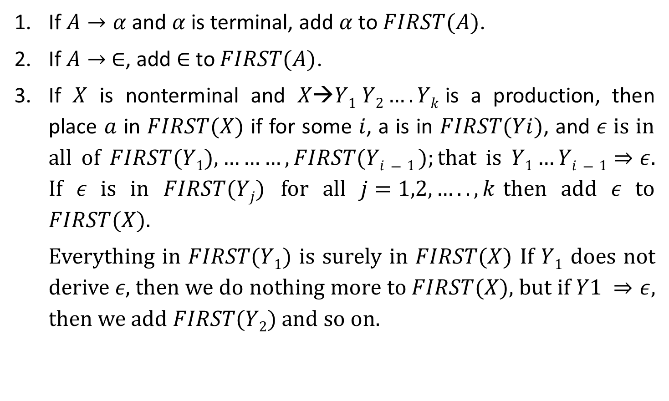
Rules to compute First of NT
If $A→α$and $α$ is terminal, add $α$ to $FIRST(A)$.
If $A→ ∈$, add $∈$to $FIRST(A)$.
If $X$ is nonterminal and $X→Y1 Y2….Yk$is a production, then place $a$ in $FIRST(X)$ if for some $i$, a is in $FIRST(Yi)$, and 𝜖 is in all of $FIRST(Y1),………,FIRST(Yi−1 );$that is $Y1…Yi−1⇒ε$. If 𝜖 is in $FIRST(Yj)$ for all $j=1,2,…..,k$then add 𝜖 to $FIRST(X)$.
Everything in $FIRST(Y1)$ is surely in $FIRST(X)$ If $Y1$ does not derive 𝜖, then we do nothing more to $FIRST(X)$, but if $Y1 ⇒ε$, then we add $FIRST(Y2)$ and so on.
*
*

Slide 35
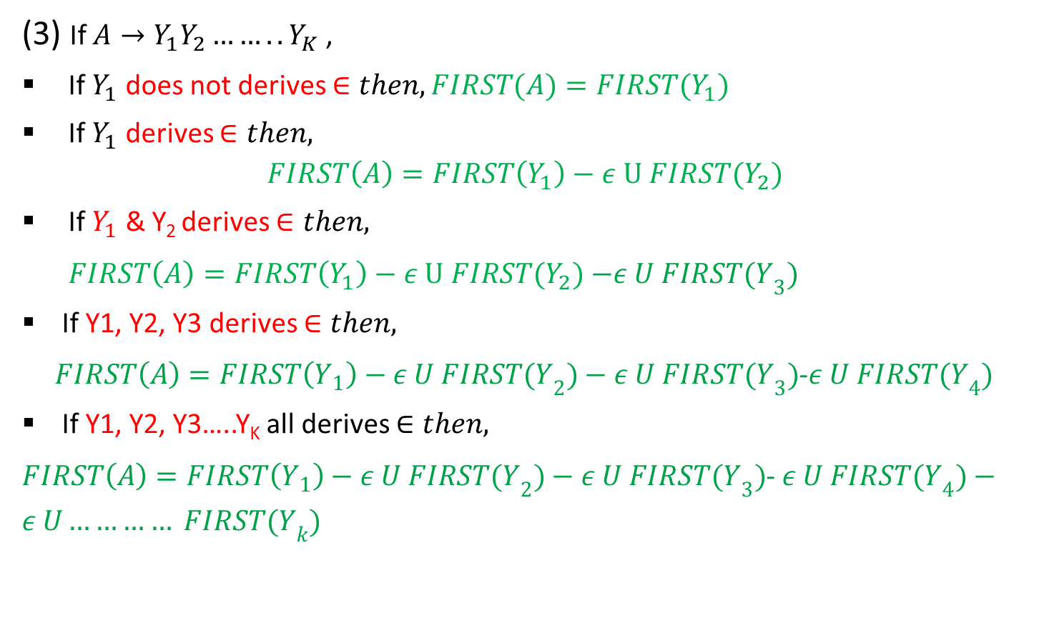
Rules to compute First of NT
(3) If $A→Y_{1}Y_{2}……..Y_{K}$ ,
If $Y_{1}$ does not derives $∈then, FIRST(A)=FIRST{(Y}_{1})$
If $Y_{1}$ derives $∈then,$
$$FIRST\left(A\right)=FIRST\left(Y_{1}\right)−ε U FIRST{(Y}_{2})$$
If $Y_{1}$ & Y₂ derives $∈then,$
$FIRST\left(A\right)=FIRST\left(Y_{1}\right)−ε U FIRST{(Y}_{2})$ $−ε U FIRST{(Y}_{3})$
If Y1, Y2, Y3 derives $∈then,$
$FIRST\left(A\right)=FIRST\left(Y_{1}\right)−ε U FIRST{(Y}_{2})−ε U FIRST{(Y}_{3})$-$ε U FIRST{(Y}_{4})$
If Y1, Y2, Y3…..Y_{K} all derives $∈then,$
$FIRST\left(A\right)=FIRST\left(Y_{1}\right)−ε U FIRST{(Y}_{2})−ε U FIRST{(Y}_{3})$-$ε U FIRST{(Y}_{4})−ε U………… FIRST{(Y}_{k})$

Slide 36

Rules to compute FOLLOW of NT
Place $\$ in follow\left(S\right). ($S =start symbol)
If $A→αBβ ,$then everything in $FIRST(β)$ except for 𝜖 is placed in $FOLLOW(B)$
If there is a production$A→αB$ or a production $A→αBβ$ where $FIRST(β)$ contains $ε$ then everything in $FOLLOW\left(A\right)=FOLLOW\left(B\right)$

Slide 37








Rules to compute FOLLOW of NT
Place $\$ in follow\left(S\right). ($S =start symbol)
$$A→αBβ$$
$β is$Absent
$$β is present$$
Rule 3
$$β is terminal$$
$β is$ Nonterminal
Rule 2
$β does not derives$ 𝜖
$β derives$ 𝜖
Rule 2
Rule 2+Rule 3

Slide 38
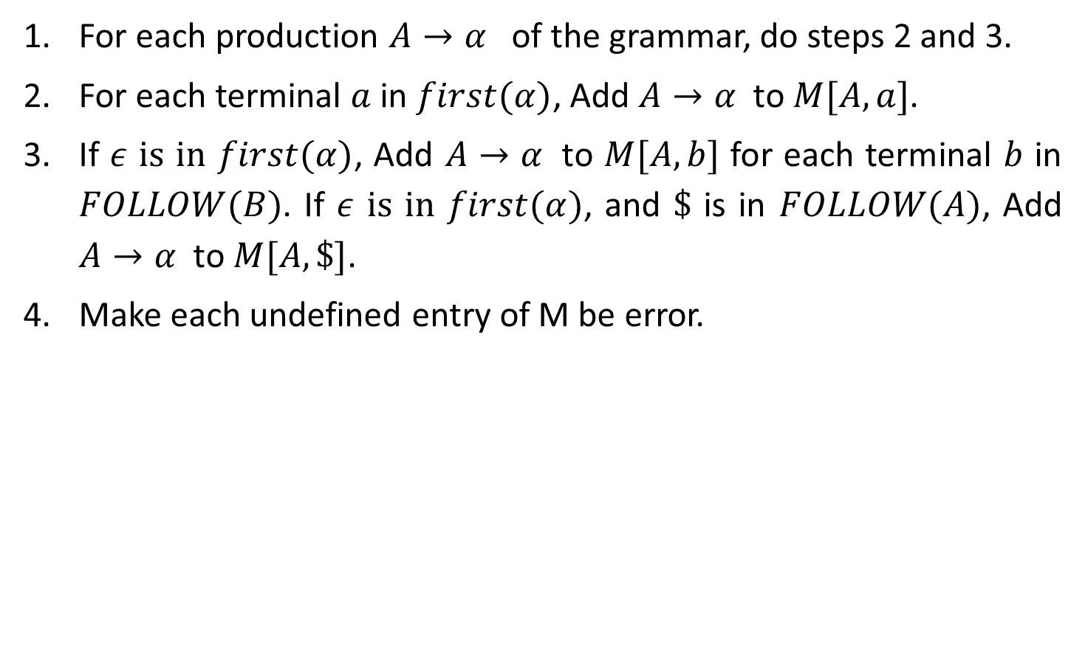
Rules to construct Predictive Parsing Table
For each production $A→α$ of the grammar, do steps 2 and 3.
For each terminal $a$ in $first(α)$, Add $A→α$ to $M[A,a]$.
If $ε$ is in $first(α)$, Add $A→α$ to $M[A,b]$ for each terminal $b$ in $FOLLOW(B)$. If $ε$ is in $first(α)$, and $\$$ is in $FOLLOW(A)$, Add $A→α$ to $M[A,\$]$.
Make each undefined entry of M be error.

Slide 39
Example: LL(1) Parsing
E→E+T | T
T→T*F | F
F→(E) | id
Step1: Remove left recursion
E→TE’
E’→+TE’ | ϵ
T→FT’
T’→*FT’ | ϵ
F→(E) | id

Slide 40


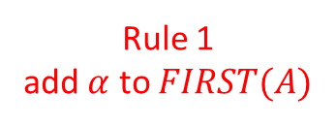
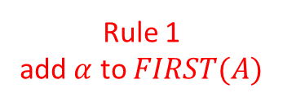
Example: LL(1) Parsing
Step2: Compute FIRST
First(E)
E→TE’
First(T)
T→FT’
First(F)
F→(E)
F→id
E→TE’
E’→+TE’ | ϵ
T→FT’
T’→*FT’ | ϵ
F→(E) | id
E | → | T | E’
Rule 3
First(A)=First(Y1)
A | → | Y₁ | Y₂
FIRST(E)=FIRST(T)
NT | First
E | { (,id }
E’
T | → | F | T’
Rule 3
First(A)=First(Y1)
T | { (,id }
A | → | Y₁ | Y₂
T’
FIRST(T)=FIRST(F)
F | { (,id }
F | → | ( | E | )
Rule 1
add $α$ to $FIRST(A)$
F | → | id
Rule 1
add $α$ to $FIRST(A)$
A | → | $$α$$
A | → | $$α$$
FIRST(F)={ (
, id }

Slide 41


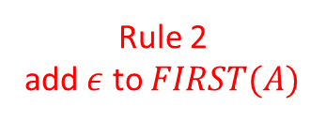
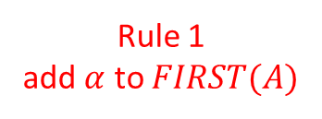

Example: LL(1) Parsing
Step2: Compute FIRST
First(E’)
E’→+TE’
E’→𝜖
E→TE’
E’→+TE’ | ϵ
T→FT’
T’→*FT’ | ϵ
F→(E) | id
E’ | → | + | T | E’
Rule 1
add $α$ to $FIRST(A)$
NT | First
A | → | $$α$$
E | { (,id }
E’ | { +, 𝜖 }
T | { (,id }
T’
E’ | → | $$ε$$
Rule 2
add $ε$ to $FIRST(A)$
F | { (,id }
A | → | $$ε$$
FIRST(E’)={ +
, 𝜖 }

Slide 42

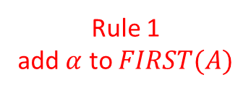
Example: LL(1) Parsing
Step2: Compute FIRST
First(T’)
T’→*FT’
T’→𝜖
E→TE’
E’→+TE’ | ϵ
T→FT’
T’→*FT’ | ϵ
F→(E) | id
T’ | → | * | F | T’
Rule 1
add $α$ to $FIRST(A)$
NT | First
A | → | $$α$$
E | { (,id }
E’ | { +, 𝜖 }
T | { (,id }
T’ | { *, 𝜖 }
T’ | → | $$ε$$
Rule 2
add $ε$ to $FIRST(A)$
F | { (,id }
A | → | $$ε$$
FIRST(T’)={ *
, 𝜖 }

Slide 43

Example: LL(1) Parsing
Step2: Compute FOLLOW
FOLLOW(E)
F→(E)
E→TE’
E’→+TE’ | ϵ
T→FT’
T’→*FT’ | ϵ
F→(E) | id
Rule 1: Place $ in FOLLOW(E)
NT | First | Follow
E | { (,id } | { $,) }
E’ | { +, 𝜖 }
F | → | ( | E | )
Rule 2
T | { (,id }
A | → | $$α$$ | B | $$β$$
T’ | { *, 𝜖 }
F | { (,id }
FOLLOW(E)={ $,
) }

Slide 44


Example: LL(1) Parsing
Step2: Compute FOLLOW
FOLLOW(E’)
E→TE’
E’→+TE’
E→TE’
E’→+TE’ | ϵ
T→FT’
T’→*FT’ | ϵ
F→(E) | id
NT | First | Follow
E | → | T | E’
Rule 3
E | { (,id } | { $,) }
A | → | $$α$$ | B
E’ | { +, 𝜖 } | { $,) }
T | { (,id }
T’ | { *, 𝜖 }
F | { (,id }
E’ | → | +T | E’
Rule 3
A | → | $$α$$ | B
}
FOLLOW(E’)={ $,)

Slide 45


Example: LL(1) Parsing
Step2: Compute FOLLOW
FOLLOW(T)
E→TE’
E→TE’
E’→+TE’ | ϵ
T→FT’
T’→*FT’ | ϵ
F→(E) | id
NT | First | Follow
E | → |  | T | E’
Rule 2
E | { (,id } | { $,) }
A | → | $$α$$ | B | $$β$$
E’ | { +, 𝜖 } | { $,) }
T | { (,id }
T’ | { *, 𝜖 }
F | { (,id }
E | → |  | T | E’
Rule 3
A | → | $$α$$ | B | $$β$$
FOLLOW(T)={ +,
$, )

Slide 46


Example: LL(1) Parsing
Step2: Compute FOLLOW
FOLLOW(T)
E’→+TE’
E→TE’
E’→+TE’ | ϵ
T→FT’
T’→*FT’ | ϵ
F→(E) | id
NT | First | Follow
E’ | → | + | T | E’
Rule 2
E | { (,id } | { $,) }
A | → | $$α$$ | B | $$β$$
E’ | { +, 𝜖 } | { $,) }
T | { (,id } | { +,$,) }
T’ | { *, 𝜖 }
F | { (,id }
E’ | → | + | T | E’
Rule 3
A | → | $$α$$ | B | $$β$$
}
FOLLOW(T)={ +,
$, )

Slide 47
Example: LL(1) Parsing
Step2: Compute FOLLOW
FOLLOW(T’)
T→FT’
T’→*FT’
E→TE’
E’→+TE’ | ϵ
T→FT’
T’→*FT’ | ϵ
F→(E) | id
NT | First | Follow
T | → | F | T’
Rule 3
E | { (,id } | { $,) }
A | → | $$α$$ | B
E’ | { +, 𝜖 } | { $,) }
T | { (,id } | { +,$,) }
T’ | { *, 𝜖 } | { +,$,) }
F | { (,id }
T’ | → | *F | T’
Rule 3
A | → | $$α$$ | B
}
FOLLOW(T’)={+ $,)

Slide 48


Example: LL(1) Parsing
Step2: Compute FOLLOW
FOLLOW(F)
T→FT’
E→TE’
E’→+TE’ | ϵ
T→FT’
T’→*FT’ | ϵ
F→(E) | id
NT | First | Follow
T | → |  | F | T’
Rule 2
E | { (,id } | { $,) }
A | → | $$α$$ | B | $$β$$
E’ | { +, 𝜖 } | { $,) }
T | { (,id } | { +,$,) }
T’ | { *, 𝜖 } | { +,$,) }
F | { (,id }
T | → |  | F | T’
Rule 3
A | → | $$α$$ | B | $$β$$
FOLLOW(F)={ *,
+ ,$ , )

Slide 49
Example: LL(1) Parsing
Step2: Compute FOLLOW
FOLLOW(F)
T’→*FT’
E→TE’
E’→+TE’ | ϵ
T→FT’
T’→*FT’ | ϵ
F→(E) | id
NT | First | Follow
T’ | → | * | F | T’
Rule 2
E | { (,id } | { $,) }
A | → | $$α$$ | B | $$β$$
E’ | { +, 𝜖 } | { $,) }
T | { (,id } | { +,$,) }
T’ | { *, 𝜖 } | { +,$,) }
F | { (,id } | {*,+,$,)}
T’ | → | * | F | T’
Rule 3
A | → | $$α$$ | B | $$β$$
}
FOLLOW(F)={ *,+,
$, )

Slide 50

Example: LL(1) Parsing
NT | First | Follow
Step3: Construct predictive parsing table
E→TE’
a=FIRST(TE’)={ (,id }
M[E,(]=E→TE’
M[E,id]=E→TE’
E | { (,id } | { $,) }
NT | Input Symbol
 | id | + | * | ( | ) | $
E | E→TE’ |  |  | E→TE’
E’
T
T’
F
E’ | { +, 𝜖 } | { $,) }
T | { (,id } | { +,$,) }
T’ | { *, 𝜖 } | { +,$,) }
F | { (,id } | {*,+,$,)}
Rule: 2
A→ $α$
a = first($α$)
M[A,a] = A→ $α$
E→TE’
E’→+TE’ | ϵ
T→FT’
T’→*FT’ | ϵ
F→(E) | id

Slide 51
Example: LL(1) Parsing
NT | First | Follow
Step3: Construct predictive parsing table
E’→+TE’
a=FIRST(+TE’)={ + }
M[E’,+]=E’→+TE’
E | { (,id } | { $,) }
NT | Input Symbol
 | id | + | * | ( | ) | $
E | E→TE’ |  |  | E→TE’
E’ |  | E’→+TE’
T
T’
F
E’ | { +, 𝜖 } | { $,) }
T | { (,id } | { +,$,) }
T’ | { *, 𝜖 } | { +,$,) }
F | { (,id } | {*,+,$,)}
Rule: 2
A→ $α$
a = first($α$)
M[A,a] = A→ $α$
E→TE’
E’→+TE’ | ϵ
T→FT’
T’→*FT’ | ϵ
F→(E) | id

Slide 52

Example: LL(1) Parsing
NT | First | Follow
Step3: Construct predictive parsing table
E’→𝜖
b=FOLLOW(E’)={ $,) }
M[E’,$]=E’→𝜖
M[E’,)]=E’→𝜖
E | { (,id } | { $,) }
NT | Input Symbol
 | id | + | * | ( | ) | $
E | E→TE’ |  |  | E→TE’
E’ |  | E’→+TE’ |  |  | E’→𝜖 | E’→𝜖
T
T’
F
E’ | { +, 𝜖 } | { $,) }
T | { (,id } | { +,$,) }
T’ | { *, 𝜖 } | { +,$,) }
F | { (,id } | {*,+,$,)}
Rule: 3
A→ $α$
b = follow(A)
M[A,b] = A→ $α$
E→TE’
E’→+TE’ | ϵ
T→FT’
T’→*FT’ | ϵ
F→(E) | id

Slide 53
Example: LL(1) Parsing
NT | First | Follow
Step3: Construct predictive parsing table
T→FT’
a=FIRST(FT’)={ (,id }
M[T,(]=T→FT’
M[T,id]=T→FT’
E | { (,id } | { $,) }
NT | Input Symbol
 | id | + | * | ( | ) | $
E | E→TE’ |  |  | E→TE’
E’ |  | E’→+TE’ |  |  | E’→𝜖 | E’→𝜖
T | T→FT’ |  |  | T→FT’
T’
F
E’ | { +, 𝜖 } | { $,) }
T | { (,id } | { +,$,) }
T’ | { *, 𝜖 } | { +,$,) }
F | { (,id } | {*,+,$,)}
Rule: 2
A→ $α$
a = first($α$)
M[A,a] = A→ $α$
E→TE’
E’→+TE’ | ϵ
T→FT’
T’→*FT’ | ϵ
F→(E) | id

Slide 54
Example: LL(1) Parsing
NT | First | Follow
Step3: Construct predictive parsing table
T’→*FT’
a=FIRST(*FT’)={ * }
M[T’,*]=T’→*FT’
E | { (,id } | { $,) }
NT | Input Symbol
 | id | + | * | ( | ) | $
E | E→TE’ |  |  | E→TE’
E’ |  | E’→+TE’ |  |  | E’→𝜖 | E’→𝜖
T | T→FT’ |  |  | T→FT’
T’ |  |  | T’→*FT’
F
E’ | { +, 𝜖 } | { $,) }
T | { (,id } | { +,$,) }
T’ | { *, 𝜖 } | { +,$,) }
F | { (,id } | {*,+,$,)}
Rule: 2
A→ $α$
a = first($α$)
M[A,a] = A→ $α$
E→TE’
E’→+TE’ | ϵ
T→FT’
T’→*FT’ | ϵ
F→(E) | id

Slide 55
Example: LL(1) Parsing
NT | First | Follow
Step3: Construct predictive parsing table
T’→𝜖
b=FOLLOW(T’)={ +,$,) }
M[T’,+]=T’→𝜖
M[T’,$]=T’→𝜖
M[T’,)]=T’→𝜖
E | { (,id } | { $,) }
NT | Input Symbol
 | id | + | * | ( | ) | $
E | E→TE’ |  |  | E→TE’
E’ |  | E’→+TE’ |  |  | E’→𝜖 | E’→𝜖
T | T→FT’ |  |  | T→FT’
T’ |  | T’→𝜖 | T→*FT’ |  | T’→𝜖 | T’→𝜖
F
E’ | { +, 𝜖 } | { $,) }
T | { (,id } | { +,$,) }
T’ | { *, 𝜖 } | { +,$,) }
F | { (,id } | {*,+,$,)}
Rule: 3
A→ $α$
b = follow(A)
M[A,b] = A→ $α$
E→TE’
E’→+TE’ | ϵ
T→FT’
T’→*FT’ | ϵ
F→(E) | id

Slide 56
Example: LL(1) Parsing
NT | First | Follow
Step3: Construct predictive parsing table
F→(E)
a=FIRST((E))={ ( }
M[F,(]=F→(E)
E | { (,id } | { $,) }
NT | Input Symbol
 | id | + | * | ( | ) | $
E | E→TE’ |  |  | E→TE’
E’ |  | E’→+TE’ |  |  | E’→𝜖 | E’→𝜖
T | T→FT’ |  |  | T→FT’
T’ |  | T’→𝜖 | T→*FT’ |  | T’→𝜖 | T’→𝜖
F |  |  |  | F→(E)
E’ | { +, 𝜖 } | { $,) }
T | { (,id } | { +,$,) }
T’ | { *, 𝜖 } | { +,$,) }
F | { (,id } | {*,+,$,)}
Rule: 2
A→ $α$
a = first($α$)
M[A,a] = A→ $α$
E→TE’
E’→+TE’ | ϵ
T→FT’
T’→*FT’ | ϵ
F→(E) | id

Slide 57
Example: LL(1) Parsing
NT | First | Follow
Step3: Construct predictive parsing table
F→id
a=FIRST(id)={ id }
M[F,id]=F→id
E | { (,id } | { $,) }
NT | Input Symbol
 | id | + | * | ( | ) | $
E | E→TE’ |  |  | E→TE’
E’ |  | E’→+TE’ |  |  | E’→𝜖 | E’→𝜖
T | T→FT’ |  |  | T→FT’
T’ |  | T’→𝜖 | T→*FT’ |  | T’→𝜖 | T’→𝜖
F | F→id |  |  | F→(E)
E’ | { +, 𝜖 } | { $,) }
T | { (,id } | { +,$,) }
T’ | { *, 𝜖 } | { +,$,) }
F | { (,id } | {*,+,$,)}
Rule: 2
A→ $α$
a = first($α$)
M[A,a] = A→ $α$
E→TE’
E’→+TE’ | ϵ
T→FT’
T’→*FT’ | ϵ
F→(E) | id

Slide 58
Example: LL(1) Parsing
NT | First | Follow
Step3: Construct predictive parsing table
E | { (,id } | { $,) }
NT | Input Symbol
 | id | + | * | ( | ) | $
E | E→TE’ | Error | Error | E→TE’ | Error | Error
E’ | Error | E’→+TE’ | Error | Error | E’→𝜖 | E’→𝜖
T | T→FT’ | Error | Error | T→FT’ | Error | Error
T’ | Error | T’→𝜖 | T→*FT’ | Error | T’→𝜖 | T’→𝜖
F | F→id | Error | Error | F→(E) | Error | Error
E’ | { +, 𝜖 } | { $,) }
T | { (,id } | { +,$,) }
T’ | { *, 𝜖 } | { +,$,) }
F | { (,id } | {*,+,$,)}
Rule: 4 Make each undefined entry of M table be ERROR
E→TE’
E’→+TE’ | ϵ
T→FT’
T’→*FT’ | ϵ
F→(E) | id

Slide 59
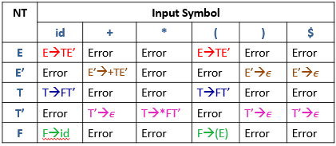
Example: LL(1) Parsing
Step4: Parse the string : id + id * id $
STACK | INPUT | OUTPUT
$E | id+id*id$
$E’T | id+id*id$ | E→TE’
$E’T’F | id+id*id$ | T→FT’
$E’T’id | id+id*id$ | F→id
$E’T’ | +id*id$
$E’ | +id*id$ | T’→𝜖
$E’T+ | +id*id$ | E’→+TE’
$E’T | id*id$
$E’T’F | id$
$E’T’F | id*id$ | T→FT’
$E’T’id | id$ | F→id
$E’T’id | id*id$ | F→id
$E’T’ | $
$E’T’ | *id$
$E’ | $ | T’→𝜖
$E’T’F* | *id$ | T→*FT’
$ | $ | E’→𝜖

Slide 60
Exercise
S → AaAb | BbBa A→𝜖 B→𝜖 | S→ aAB | bA | 𝜖 A→ aAb | 𝜖 B→ bB | 𝜖 | S→iCtSA | a A→ eS | 𝜖 C→ b
S→ (L) | a L→ L,S | S | E→ TA A→ +TA | 𝜖 T→ VB B→ *VB |𝜖 V→ id | (E) | S→ a | ^ | (R) T→ S, T | S R→ T

Slide 61
Bottom Up Parsing

Slide 62
Handle & Handle pruning
Handle: A “handle” of a string is a substring of the string that matches the right side of a production, and whose reduction to the non terminal of the production is one step along the reverse of rightmost derivation.
Handle pruning: The process of discovering a handle and reducing it to appropriate Left hand side non terminal is known as handle pruning.
E→E+E
E→E*E
E→id
String: id1+id2*id3
Right sentential form | Handle | Production
Rightmost Derivation
E
E+E
E+E*E
E+E*id3
E+id2*id3
id1+id2*id3
id1+id2*id3 | id1 | E→id
E+id2*id3 | id2 | E→id
E+E*id3 | id3 | E→id
E+E*E | E*E | E→E*E
E+E | E+E | E→E+E
E

Slide 63
Shift Reduce Parser
The shift reduce parser performs following basic operations:
Shift: Moving of the symbols from input buffer onto the stack, this action is called shift.
Reduce: If handle appears on the top of the stack then reduction of it by appropriate rule is done. This action is called reduce action.
Accept: If stack contains start symbol only and input buffer is empty at the same time then that action is called accept.
Error: A situation in which parser cannot either shift or reduce the symbols, it cannot even perform accept action then it is called error action.

Slide 64
Example: Shift Reduce Parser
Grammar:
E→E+T | T
T→T*F | F
F→id
String:id+id*id
Stack | Input Buffer | Action
$ | id+id*id$ | Shift
$id | +id*id$ | Reduce F→id
$F | +id*id$ | Reduce T→F
$T | +id*id$ | Reduce E→T
$E | +id*id$ | Shift
$E+ | id*id$ | Shift
$E+id | *id$ | Reduce F→id
$E+F | *id$ | Reduce T→F
$E+T | *id$ | Shift
$E+T* | id$ | Shift
$E+T*id | $ | Reduce F→id
$E+T*F | $ | Reduce T→T*F
$E+T | $ | Reduce E→E+T
$E | $ | Accept

Slide 65
Operator Precedence Parser

Slide 66
Operator Precedence Parsing
Operator Grammar: A Grammar in which there is no Є in RHS of any production or no adjacent non terminals is called operator grammar.
Relation | Meaning
a<.b | a “yields precedence to” b
a=.b | a “has the same precedence as” b
a.>b | a “takes precedence over” b

Slide 67
Steps of Operator Precedence Parsing
Find Leading and trailing of NT
Establish relation
Creation of table
Parse the string

Slide 68
Leading & Trailing
Leading:- Leading of a nonterminal is the first terminal or operator in production of that nonterminal.
Trailing:- Trailing of a nonterminal is the last terminal or operator in production of that nonterminal.
Example: E→E+T | T
T→T*F | F
F→id
Nonterminal | Leading | Trailing
E | {+,*,id} | {+,*,id}
T | {*,id} | {*,id}
F | {id} | {id}

Slide 69

Rules to Establish a Relation
.
For a = b, aAb, where A is 𝜖 or a single NT
a <.b$⇒Op .NT then Op <. Leading\left(NT\right)$
a .>b$⇒NT . Op then \left(Trailing(NT\right)) .>Op$
$ <. leading(start symbol)
Trailing(start symbol) .> $

Slide 70

Example: Operator precedence parsing
a <.b
$Op .NT Op <. Leading\left(NT\right)$
$+T + <. \left\{∗,id\right\}$
$∗F ∗ <. \{id\}$
Step1: Find Leading & Trailing of NT
E→ E
+T
| T
Nonterminal | Leading | Trailing
T→ T
| F
*F
E | {+,*,id} | {+,*,id}
F→ id
T | {*,id} | {*,id}
F | {id} | {id}
Step2: Establish Relation
Step3: Creation of Table
 | + | * | id | $
+ | .> | <. | <. | .>
* | .> | .> | <. | .>
id | .> | .> |  | .>
$ | <. | <. | <.

Slide 71

Example: Operator precedence parsing
a .>b
$NT . Op \left(Trailing(NT\right)).>Op$
$E+ \left\{+,∗,id\right\}.> +$
$T∗ \{∗,id\}.>∗$
Step1: Find Leading & Tailing of NT
E→
E+
T| T
Nonterminal | Leading | Trailing
T→
F| F
T*
E | {+,*,id} | {+,*,id}
F→ id
T | {*,id} | {*,id}
F | {id} | {id}
Step2: Establish Relation
Step3: Creation of Table
 | + | * | id | $
+ | .> | <. | <. | .>
* | .> | .> | <. | .>
id | .> | .> |  | .>
$ | <. | <. | <.

Slide 72

Example: Operator precedence parsing
$<. leading(start symbol)
$ <. $\left\{+,∗,id\right\}$
Trailing(start symbol) .> $
$\left\{+,∗,id\right\} \text{.}\text{>} \text{\$}$
Step1: Find Leading & Tailing of NT
E→
E+
T| T
Nonterminal | Leading | Trailing
T→
F| F
T*
E | {+,*,id} | {+,*,id}
F→ id
T | {*,id} | {*,id}
F | {id} | {id}
Step2: Establish Relation
Step3: Creation of Table
 | + | * | id | $
+ | .> | <. | <. | .>
* | .> | .> | <. | .>
id | .> | .> |  | .>
$ | <. | <. | <.

Slide 73
Example: Operator precedence parsing
Scan the input string until first .> is encountered.
Scan backward until <. is encountered.
The handle is string between <. and .>
String: id+id*id
$ id+id*id $
$ <. id+id*id$
$ <. id .> +id*id$
$ <. id .> + <. id*id$
$ <. id .> + <. id .> *id$
$ <. id .> + <. id .> *<. id$
$ <. id .> + <. id .> *<. id .> $
Step4: Parse the string using Precedence Table
 | + | * | id | $
+ | .> | <. | <. | .>
* | .> | .> | <. | .>
id | .> | .> |  | .>
$ | <. | <. | <.

Slide 74
Example: Operator precedence parsing
$ <. Id .> + <. Id .> * <. Id .> $ | Handle id is obtained between <. .> Reduce this by F→id
$ F + <. Id .> * <. Id .> $ | Handle id is obtained between <. .> Reduce this by F→id
$ F + F * <. Id .> $ | Handle id is obtained between <. .> Reduce this by F→id
$ F + F * F $ | Perform appropriate reductions of all nonterminals.
$ E + T * F $ | Remove all non terminals.
$ + * $ | Place relation between operators
$ <. + <. * >$ | The * operator is surrounded by <. .>. This indicates * becomes handle we have to reduce T*F.
$ <. + >$ | + becomes handle. Hence reduce E+T.
$ $ | Parsing Done

Slide 75
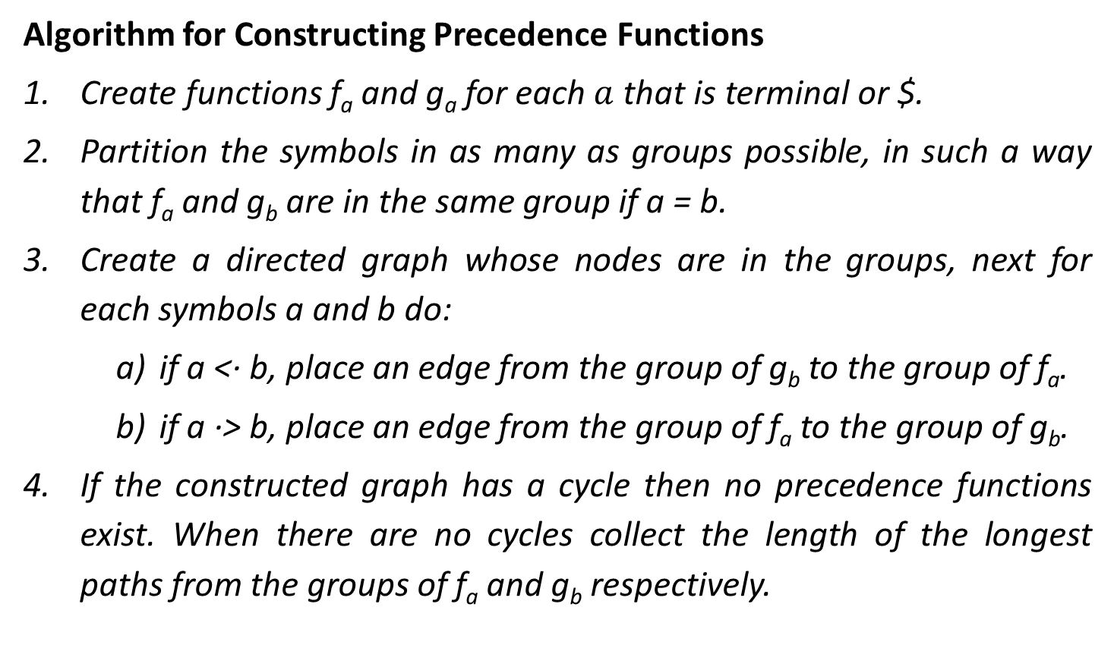
Operator precedence function
Algorithm for Constructing Precedence Functions
Create functions f_{a} and g_{a} for each $a$ that is terminal or $.
Partition the symbols in as many as groups possible, in such a way that f_{a} and g_{b} are in the same group if a = b.
Create a directed graph whose nodes are in the groups, next for each symbols a and b do:
if a <· b, place an edge from the group of g_{b} to the group of f_{a}.
if a ·> b, place an edge from the group of f_{a} to the group of g_{b}.
If the constructed graph has a cycle then no precedence functions exist. When there are no cycles collect the length of the longest paths from the groups of f_{a} and g_{b} respectively.
.

Slide 76

Operator precedence function
Create functions f_{a} and g_{a} for each a that is terminal or $.
$a= \{+,∗,id\} or \$$
E→ E+T | T
T→ T*F | F F→ id
f₊
f*
f_{id}
f$
g₊
g*
g_{id}
g$

Slide 77
Operator precedence function
Partition the symbols in as many as groups possible, in such a way that f_{a} and g_{b} are in the same group if a =· b.
 | + | * | id | $
g_{id}
f_{id}
+ | .> | <. | <. | .>
* | .> | .> | <. | .>
id | .> | .> |  | .>
$ | <. | <. | <.
f*
g*
g₊
f₊
f$
g$

Slide 78
Operator precedence function
if a <· b, place an edge from the group of g_{b} to the group of f_{a}
if a ·> b, place an edge from the group of f_{a} to the group of g_{b}
g
f
 | + | * | id | $
g_{id}
f_{id}
+ | .> | <. | <. | .>
* | .> | .> | <. | .>
id | .> | .> |  | .>
$ | <. | <. | <.
f*
g*
g₊
f₊
f₊ .> g₊
f₊ → g₊
f* .> g₊
f* → g₊
f_{id} .> g₊
f_{id} → g₊
f$
g$
f$ <. g₊
f$ ← g₊

Slide 79
Operator precedence function
if a <· b, place an edge from the group of g_{b} to the group of f_{a}
if a ·> b, place an edge from the group of f_{a} to the group of g_{b}
g
f
 | + | * | id | $
g_{id}
f_{id}
+ | .> | <. | <. | .>
* | .> | .> | <. | .>
id | .> | .> |  | .>
$ | <. | <. | <.
f*
g*
g₊
f₊
f₊ <. g*
f₊ ← g*
f* .> g*
f* → g*
f_{id} .> g*
f_{id} → g*
f$
g$
f$ <. g*
f$ ← g*

Slide 80
Operator precedence function
if a <· b, place an edge from the group of g_{b} to the group of f_{a}
if a ·> b, place an edge from the group of f_{a} to the group of g_{b}
g
f
 | + | * | id | $
g_{id}
f_{id}
+ | .> | <. | <. | .>
* | .> | .> | <. | .>
id | .> | .> |  | .>
$ | <. | <. | <.
f*
g*
g₊
f₊
f₊ <. g_{id}
f₊ ← g_{id}
f* <. g_{id}
f* ← g_{id}
f$ <. g_{id}
f$ ← g_{id}
f$
g$

Slide 81
Operator precedence function
if a <· b, place an edge from the group of g_{b} to the group of f_{a}
if a ·> b, place an edge from the group of f_{a} to the group of g_{b}
g
f
 | + | * | id | $
g_{id}
f_{id}
+ | .> | <. | <. | .>
* | .> | .> | <. | .>
id | .> | .> |  | .>
$ | <. | <. | <.
f*
g*
g₊
f₊
f₊ <. g$
f₊ → g$
f* <. g$
f* → g$
f_{id} <. g$
f_{id} → g$
f$
g$

Slide 82
Operator precedence function
 | + | * | id | $
g_{id}
f_{id}
f | 2
g
f*
g*
If the constructed graph has a cycle then no precedence functions exist. When there are no cycles collect the length of the longest paths from the groups of f_{a} and g_{b} respectively.
g₊
f₊
f$
g$

Slide 83
Operator precedence function
 | + | * | id | $
g_{id}
f_{id}
f | 2
g | 1
f*
g*
g₊
f₊
f$
g$

Slide 84
Operator precedence function
 | + | * | id | $
g_{id}
f_{id}
f | 2 | 4
g | 1
f*
g*
g₊
f₊
f$
g$

Slide 85
Operator precedence function
 | + | * | id | $
g_{id}
f_{id}
f | 2 | 4
g | 1 | 3
f*
g*
g₊
f₊
f$
g$

Slide 86
Operator precedence function
 | + | * | id | $
g_{id}
f_{id}
f | 2 | 4 | 4
g | 1 | 3
f*
g*
g₊
f₊
f$
g$

Slide 87
Operator precedence function
 | + | * | id | $
g_{id}
f_{id}
f | 2 | 4 | 4
g | 1 | 3 | 5
f*
g*
g₊
f₊
f$
g$

Slide 88
Operator precedence function
 | + | * | id | $
g_{id}
f_{id}
f | 2 | 4 | 4 | 0
g | 1 | 3 | 5 | 0
f*
g*
g₊
f₊
f$
g$

Slide 89
LR Parser

Slide 90
LR Parser
LR parsing is most efficient method of bottom up parsing which can be used to parse large class of context free grammar.
The technique is called LR(k) parsing: The “L” is for left to right scanning of input symbol, the “R” for constructing right most derivation in reverse, and the k for the number of input symbols of lookahead that are used in making parsing decision.
a | + | b | $
INPUT
X
Y
Z
$
LR parsing program
Stack
OUTPUT
Parsing Table
Action
Goto

Slide 91
Types of LR Parser
LR Parser
SLR Parser
CLR Parser
Or
LR Parser
LALR Parser

Slide 92
SLR Parser

Slide 93
Steps to construct SLR Parser
Construct Canonical set of items
Construct SLR parsing table
Parse the input string

Slide 94
Computation of Closure & goto function
X→ Xb
Closure(I):
X→.Xb
Goto(I,X)
X→X.b

Slide 95
Computation of Closure & goto function
X→ Xb
Closure(I):
X→ X b
Goto(I,X)
X→ X b
.
.

Slide 96
Computation of Closure & goto function
S→AS | b
A→SA | a
Closure(I):
S→.AS
S→.b
A→.SA
A→.a
Goto(I,A)
S→A.S
S→.AS
S→.b
A→.SA
A→.a
Goto(I,b)
S→b.
Goto(I,a)
A→a.
Goto(I,S)
A→S.A
A→.SA
A→.a
S→.AS
S→.b

Slide 97
Computation of Closure & goto function
S→Aa | bAc | Bc | bBc
A→d
B→d
Closure(I):
S→.Aa
S→.bAc
S→.Bc
S→.bBc
A→.d
B→.d
Goto(I,A)
S→A.a
Goto(I,B)
S→B.c
Goto(I,b)
S→b.Ac
S→b.Bc
A→.d
B→.d
Goto(I,d)
A→d.
B→d.

Slide 98
Example: SLR(1)- Simple LR
I₆
E→ E+T | T
T→ T*F | F
F→ (E) | id
Goto (I₁,+)
E→E+.T
I₁
E’→E.
T→.T*F
E→E.+T
T→.F
Goto (I₀,E)
F→.(E)
I₂
F→.id
E→T.
I₀
Goto (I₀,T)
T→T.*F
Goto (I₂,*)
E’→.E
Augmented Grammar
I₇
E→.E+T
Goto (I₀,F)
I₃
T→T*.F
E→.T
T→F.
F→.(E)
T→.T*F
F→.id
T→.F
Goto (I₀,()
F→.(E)
I₄
Goto (I₄,E)
F→(.E)
I₈
F→(E.)
F→.id
E→.E+T
E→E.+T
Goto (I₀,id)
E→.T
Goto (I₄,T)
I₂
T→.T*F
E→T.
T→T.*F
T→.F
F→.(E)
I₅
F→.id
F→id.

Slide 99
Example: SLR(1)- Simple LR
I₆
Goto (I₁,+)
E→E+.T
I₁
E’→E.
T→.T*F
E→E.+T
T→.F
Goto (I₀,E)
F→.(E)
I₂
F→.id
E→T.
I₀
Goto (I₀,T)
T→T.*F
Goto (I₂,*)
E’→.E
I₇
E→.E+T
Goto (I₀,F)
I₃
T→T*.F
E→.T
T→F.
F→.(E)
T→.T*F
F→.id
T→.F
Goto (I₀,()
Goto (I₄,E)
F→.(E)
I₄
I₈
F→(.E)
F→(E.)
F→.id
E→.E+T
E→E.+T
I₄
Goto (I₀,id)
F→(.E)
E→.T
Goto (I₄,T)
I₂
E→.E+T
I₂
T→.T*F
E→T.
T→T.*F
E→.T
T→.F
Goto (I₄,F)
T→.T*F
F→.(E)
I₃
I₅
I₃
T→.F
F→id.
F→.id
T→F.
Goto (I₄,()
F→.(E)
F→.id

Slide 100
Example: SLR(1)- Simple LR
I₆
E→E+.T
Goto (I₆,T)
I₉
I₁
Goto (I₁,+)
E→E+T.
E’→E.
T→.T*F
T→T.*F
E→E.+T
T→.F
Goto (I₆,F)
Goto (I₀,E)
I₃
F→.(E)
I₃
T→F.
I₂
F→.id
Goto (I₆,()
E→T.
I₀
Goto (I₀,T)
T→T.*F
Goto (I₂,*)
I₄
I₇
I₄
E’→.E
F→(.E)
E→.E+T
Goto (I₀,F)
I₃
T→T*.F
E→.E+T
E→.T
T→F.
F→.(E)
E→.T
T→.T*F
F→.id
T→.T*F
T→.F
Goto (I₀,()
Goto (I₄,E)
T→.F
F→.(E)
I₄
I₈
F→.(E)
F→(.E)
F→(E.)
F→.id
E→.E+T
E→E.+T
F→.id
Goto (I₀,id)
E→.T
Goto (I₄,T)
I₂
T→.T*F
T→.F
Goto (I₄,F)
I₄
F→.(E)
I₃
I₅
F→.id
F→id.
Goto (I₄,()
Goto (I₄,id)

Slide 101
Example: SLR(1)- Simple LR
I₆
E→E+.T
Goto (I₆,T)
I₉
I₁
Goto (I₁,+)
E→E+T.
E’→E.
T→.T*F
T→T.*F
E→E.+T
T→.F
Goto (I₆,F)
Goto (I₀,E)
F→.(E)
I₃
I₂
F→.id
E→T.
Goto (I₆,()
Goto (I₀,T)
T→T.*F
Goto (I₂,*)
I₄
I₀
I₇
E’→.E
Goto (I₆,id)
E→.E+T
I₅
T→T*.F
I₅
Goto (I₀,F)
I₃
F→id.
E→.T
T→F.
F→.(E)
T→.T*F
F→.id
T→.F
Goto (I₀,()
Goto (I₄,E)
F→.(E)
I₄
I₈
F→(.E)
F→(E.)
F→.id
E→.E+T
E→E.+T
Goto (I₀,id)
E→.T
Goto (I₄,T)
I₂
T→.T*F
T→.F
Goto (I₄,F)
I₄
F→.(E)
I₃
I₅
F→.id
F→id.
Goto (I₄,()
Goto (I₄,id)

Slide 102
Example: SLR(1)- Simple LR
I₆
Goto (I₆,T)
I₉
E→E+.T
E→E+T.
I₁
Goto (I₁,+)
E’→E.
T→.T*F
T→T.*F
E→E.+T
Goto (I₆,F)
Goto (I₀,E)
T→.F
I₃
F→.(E)
I₂
F→.id
Goto (I₆,()
E→T.
I₄
I₀
Goto (I₀,T)
T→T.*F
Goto (I₂,*)
Goto (I₆,id)
E’→.E
I₇
E→.E+T
I₅
Goto (I₀,F)
I₃
T→T*.F
E→.T
T→F.
Goto (I₇,F)
F→.(E)
T→.T*F
F→.id
I₁₀
Goto (I₇,()
T→T*F.
T→.F
Goto (I₀,()
Goto (I₄,E)
F→.(E)
I₄
I₈
Goto (I₇,id)
I₄
F→(.E)
F→(E.)
F→.id
E→.E+T
E→E.+T
Goto (I₀,id)
I₅
E→.T
Goto (I₄,T)
I₂
T→.T*F
T→.F
Goto (I₄,F)
I₄
F→.(E)
I₃
I₅
F→.id
F→id.
Goto (I₄,()
Goto (I₄,id)

Slide 103
Example: SLR(1)- Simple LR
I₇
Goto (I₉,*)
I₆
Goto (I₆,T)
I₉
Goto (I₁,+)
E→E+.T
E→E+T.
I₁
E’→E.
T→.T*F
T→T.*F
E→E.+T
Goto (I₆,F)
Goto (I₀,E)
T→.F
I₃
F→.(E)
I₂
F→.id
Goto (I₆,()
E→T.
I₄
I₀
Goto (I₀,T)
T→T.*F
Goto (I₂,*)
Goto (I₆,id)
E’→.E
I₇
E→.E+T
I₅
Goto (I₀,F)
I₃
T→T*.F
E→.T
T→F.
Goto (I₇,F)
F→.(E)
T→.T*F
F→.id
I₁₀
Goto (I₇,()
T→T*F.
T→.F
Goto (I₀,()
Goto (I₄,E)
F→.(E)
I₄
I₈
Goto (I₇,id)
I₄
F→(.E)
F→(E.)
F→.id
E→.E+T
E→E.+T
Goto (I₀,id)
I₅
E→.T
Goto (I₄,T)
I₂
Goto (I₈,))
T→.T*F
T→.F
I₄
I₁₁
F→.(E)
Goto (I₄,F)
I₃
F→(E).
I₅
F→.id
F→id.
Goto (I₈,+)
Goto (I₄,()
I₆
Goto (I₄,id)

Slide 104
Example: SLR(1)- Simple LR
I₀→ ( → I₄
I₀→ id → I₅
I₆→ ( → I₄
I₆→ id → I₅
Action |  |  |  |  |  |  | Goto
 | id | + | * | ( | ) | $ | E | T | F
0 | S5 |  |  | S4
1 |  | S6 |  |  |  | Accept
2 |  |  | S7
3
4 | S5 |  |  | S4
5
6 | S5 |  |  | S4
7 | S5 |  |  | S4
8 |  | S6 |  |  | S11
9 |  |  | S7
10
11
I₇→ ( → I₄
I₇→ id → I₅
I₄→ ( → I₄
I₄→ id → I₅
I₁→ + → I₆
I₈→ ) → I₁₁
I₂→ * → I₇
I₈→ + → I₆
I₉→ * → I₇

Slide 105
Example: SLR(1)- Simple LR
Action |  |  |  |  |  |  | Goto
 | id | + | * | ( | ) | $ | E | T | F
0 | S5 |  |  | S4
1 |  | S6 |  |  |  | Accept
2 |  | R2 | S7 |  | R2 | R2
3 |  | R4 | R4 |  | R4 | R4
4 | S5 |  |  | S4
5 |  | R6 | R6 |  | R6 | R6
6 | S5 |  |  | S4
7 | S5 |  |  | S4
8 |  | S6 |  |  | S11
9 |  | R1 | S7 |  | R1 | R1
10 |  | R3 | R3 |  | R3 | R3
11 |  | R5 | R5 |  | R5 | R5
E→ E+T
E→ T
T→ T*F
T→ F
F→ (E)
F→ id
NT | FOLLOW
E | {+,),$}
T | {+,*,),$}
F | {+,*,),$}
I₅
F→id.
_{R6 in Follow(F)}
I₁₁
F→(E).
_{R3 in Follow(T)}
I₁₀
T→T*F.
_{R3 in Follow(T)}
I₂
E→T.
_{R2 in Follow(E)}
I₃
T→F.
_{R4 in Follow(T)}
I₉
E→E+T.
_{R1 in Follow(E)}

Slide 106
Example: SLR(1)- Simple LR
Action |  |  |  |  |  |  | Goto
 | id | + | * | ( | ) | $ | E | T | F
0 | S5 |  |  | S4 |  |  | 1 | 2 | 3
1 |  | S6 |  |  |  | Accept
2 |  | R2 | S7 |  | R2 | R2
3 |  | R4 | R4 |  | R4 | R4
4 | S5 |  |  | S4 |  |  | 8 | 2 | 3
5 |  | R6 | R6 |  | R6 | R6
6 | S5 |  |  | S4 |  |  |  | 9 | 3
7 | S5 |  |  | S4 |  |  |  |  | 10
8 |  | S6 |  |  | S11
9 |  | R1 | S7 |  | R1 | R1
10 |  | R3 | R3 |  | R3 | R3
11 |  | R5 | R5 |  | R5 | R5
I₀→ E → I₁
I₀→ F → I₃
I₆→ F → I₃
I₀→ T → I₂
I₄→ T → I₂
I₄→ F → I₃
I₆→ T → I₉
I₇→ F → I₁₀
I₄→ E → I₈

Slide 107
Exercise
E→ E+T | T
T→ TF | F
F→ F* | a | b

Slide 108
CLR Parser

Slide 109

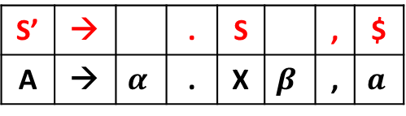

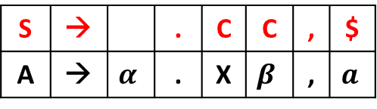
Example: CLR(1)- Canonical LR
S→CC
C→ cC | d
Closure(I)
S’→.S,$
S→.CC,
C→.cC,
C→.d,
S’ | → |  | . | S |  | , | $
A | → | $$α$$ | . | X | $$β$$ | , | $$a$$
$$Lookahead=First\left(βa\right)$$
$$First\left(\$\right)$$
$$=\$$$
$
c|d
c|d
S | → |  | . | C | C | , | $
A | → | $$α$$ | . | X | $$β$$ | , | $$a$$
$$Lookahead=First\left(βa\right)$$
$$First\left(C\$\right)$$
$$=c,d$$

Slide 110
Example: CLR(1)- Canonical LR
I₅
S→CC. , $
S→CC
C→ cC | d
I₁
S’→S. ,$
I₉
C→cC. , $
Goto (I₂,C)
Goto (I₆,C)
I₆
C→c.C , $
C→.cC , $
C→.d , $
I₆
C→c.C , $
C→.cC , $
C→.d , $
Goto (I₀,S)
Goto (I₂,c)
Goto (I₆,c)
I₂
S→C.C , $
C→.cC , $
C→.d , $
I₀
S’→.S ,$
S→.CC , $
C→.cC , c|d
C→.d , c|d
Goto (I₀,C)
Goto (I₂,d)
Augmented Grammar
Goto (I₆,d)
I₇
C→d. , $
I₇
C→d. , $
Goto (I₀,c)
Goto (I₃,C)
I₃
C→c.C , c|d
C→.cC , c|d
C→.d , c|d
I₈
C→cC. , c|d
Goto (I₀,d)
Goto (I₃,c)
I₃
C→c.C , c|d
C→.cC , c|d
C→.d , c|d
Goto (I₃,d)
I₄
C→d. , c|d
I₄
C→d. , c|d

Slide 111
Example: CLR(1)- Canonical LR
Canonical Parsing Table
States | Action |  |  | Goto
 | c | d | $ | S | C
0 | S3 | S4
1 |  |  | Accept
2 | S6 | S7
3 | S3 | S4
4
5
6 | S6 | S7
7
8
9
I₃→ c → I₃
I₆→ c → I₆
I₂→ c → I₆
I₂→ d → I₇
I₀→ c → I₃
I₀→ d → I₄
I₃→ d → I₄
I₆→ d → I₇

Slide 112
Example: CLR(1)- Canonical LR
Canonical Parsing Table
States | Action |  |  | Goto
 | c | d | $ | S | C
0 | S3 | S4
1 |  |  | Accept
2 | S6 | S7
3 | S3 | S4
4 | R3 | R3
5 |  |  | R1
6 | S6 | S7
7 |  |  | R3
8 | R2 | R2
9 |  |  | R2
S→CC
C→ cC
C→d
I₉
C→cC. , $
_{R2 in Lookahead}
I₈
C→cC. , c|d
_{R2 in Lookahead}
I₇
C→d. , $
_{R3 in Lookahead}
I₅
S→CC. , $
_{R1 in Lookahead}
I₄
C→d. , c|d
_{R3 in Lookahead}

Slide 113
Example: CLR(1)- Canonical LR
Canonical Parsing Table
States | Action |  |  | Goto
 | c | d | $ | S | C
0 | S3 | S4 |  | 1 | 2
1 |  |  | Accept
2 | S6 | S7 |  |  | 5
3 | S3 | S4 |  |  | 8
4 | R3 | R3
5 |  |  | R1
6 | S6 | S7 |  |  | 9
7 |  |  | R3
8 | R2 | R2
9 |  |  | R2
I₂→ C → I₅
I₀→ C → I₂
I₃→ C → I₈
I₀→ S → I₁
I₆→ C → I₉

Slide 114
LALR

Slide 115
Example: LALR(1)- Lookahead LR
I₅
S→CC. , $
S→CC
C→ cC | d
I₁
S’→S. ,$
I₉
C→cC. , $
Goto (I₂,C)
Goto (I₆,C)
I₆
C→c.C , $
C→.cC , $
C→.d , $
Goto (I₀,S)
Goto (I₂,c)
Goto (I₆,c)
I₆
I₂
S→C.C , $
C→.cC , $
C→.d , $
I₀
S’→.S ,$
S→.CC , $
C→.cC , c|d
C→.d , c|d
Goto (I₆,d)
Goto (I₀,C)
Goto (I₂,d)
I₇
I₇
C→d. , $
Goto (I₀,c)
Goto (I₃,C)
I₃
C→c.C , c|d
C→.cC , c|d
C→.d , c|d
I₈
C→cC. , c|d
Goto (I₀,d)
CLR
Goto (I₃,c)
I₃
Goto (I₃,d)
I₄
C→d. , c|d
I₄

Slide 116
Example: LALR(1)- Lookahead LR
I₅
S→CC. , $
S→CC
C→ cC | d
I₁
S’→S. ,$
I₉
C→cC. , $
Goto (I₂,C)
Goto (I₆,C)
I₆
C→c.C , $
C→.cC , $
C→.d , $
Goto (I₀,S)
Goto (I₂,c)
Goto (I₆,c)
I₆
I₂
S→C.C , $
C→.cC , $
C→.d , $
I₀
S’→.S ,$
S→.CC , $
C→.cC , c|d
C→.d , c|d
Goto (I₆,d)
Goto (I₀,C)
Goto (I₂,d)
I₇
I₇
C→d. , $
I₃₆
C→c.C , c|d|$
C→.cC , c|d |$
C→.d , c|d |$
Goto (I₀,c)
Goto (I₃,C)
I₃
C→c.C , c|d
C→.cC , c|d
C→.d , c|d
I₈
C→cC. , c|d
Goto (I₀,d)
Goto (I₃,c)
I₃
I₄₇
C→d. , c|d |$
Goto (I₃,d)
I₄
C→d. , c|d
I₄
I₈₉
C→.cC , c|d |$

Slide 117
Example: LALR(1)- Lookahead LR
Parsing Table
States | Action |  |  | Goto
 | c | d | $ | S | C
0 | S3 | S4 |  | 1 | 2
1 |  |  | Accept
2 | S6 | S7 |  |  | 5
3 | S3 | S4 |  |  | 8
4 | R3 | R3
5 |  |  | R1
6 | S6 | S7 |  |  | 9
7 |  |  | R3
8 | R2 | R2
9 |  |  | R2

Slide 118
Example: LALR(1)- Lookahead LR
Parsing Table
S3,S6 = S36
S4,S7 = S47
States | Action |  |  | Goto
 | c | d | $ | S | C
0 | S36 | S47 |  | 1 | 2
1 |  |  | Accept
2 | S36 | S47 |  |  | 5
36 | S36 | S47 |  |  | 8
47 | R3 | R3
5 |  |  | R1
6 | S6 | S7
7
89 | R2 | R2
9
9
R3
R2

Slide 119
Example: LALR(1)- Lookahead LR
Parsing Table
S3,S6 = S36
S4,S7 = S47
States | Action |  |  | Goto
 | c | d | $ | S | C
0 | S36 | S47 |  | 1 | 2
1 |  |  | Accept
2 | S36 | S47 |  |  | 5
36 | S36 | S47 |  |  | 89
47 | R3 | R3 | R3
5 |  |  | R1
89 | R2 | R2 | R2

