Slide 1

Unit – 4 Pushdown Automata
Unit – 3
Parsing Theory (II)
Prof. Dixita Kagathara
dixita.kagathara@darshan.ac.in
Compiler Design (2170701) Darshan Institute of Engineering & Technology

Slide 2
Syntax Directed Definitions
Syntax directed definition is a generalization of context free grammar in which each grammar symbol has an associated set of attributes.
Types of attributes are:
Synthesized attribute
Inherited attribute

Slide 3
Attribute
E.
value
Memory location
type
Return Type

Slide 4
Synthesized Attributes
Value of synthesized attribute at a node can be computed from the value of attributes at the children of that node in the parse tree.
Syntax directed definition that uses synthesized attribute exclusively is said to be S-attribute definition.
An Annotated parse tree is a parse tree showing the value of the attributes at each node.
The process of computing the attribute values at the node is called Annotating or Decorating the parse tree.

Slide 5
Synthesized Attributes
Example: Simple Desk Calculator
Production | Semantic Rules
L → E_{n} | Print (E.val)
E → E1+T | E.Val = E1.val + T.val
E → T | E.Val = T.val
T → T1*F | T.Val = T1.val * F.val
T → F | T.Val = F.val
F → (E) | F.Val = E.val
F → digit | F.Val = digit . lexval

Slide 6
Example: Synthesized Attributes
String: 3*5+4n;
L
Production | Semantic Rules
L → E_{n} | Print (E.val)
E → E₁+T | E.Val = E1.val + T.val
E → T | E.Val = T.val
T → T₁*F | T.Val = T1.val * F.val
T → F | T.Val = F.val
F → (E) | F.Val = E.val
F → digit | F.Val = digit . lexval
n
E.val=19
+
T.val=4
E.val=15
T.val=15
F.val=4
*
digit.lexval=4
T.val=3
F.val=5
F.val=3
digit.lexval=5
digit.lexval=3
Annotated parse tree for 3*5+4n

Slide 7
Exercise
Draw Annotated Parse tree for (3+4)*(5+6)n

Slide 8
Syntax-Directed Definition to translates arithmetic expressions from infix to prefix notation
Production | Semantic Rules
L→E | Print(E.val)
E→E+T | E.val=’+’ E.val T.val
E→E-T | E.val=’-‘ E.val T.val
E→T | E.val= T.val
T→T*F | T.val=’*’ T.val F.val
T→T/F | T.val=’/’ T.val F.val
T→F | T.val= F.val
F→F^P | F.val=’^’ F.val P.val
F→P | F.val= P.val
P→(E) | P.val= E.val
P→digit | P.val=digit.lexval

Slide 9
Inherited Attribute
An inherited value at a node in a parse tree is computed from the value of attributes at the parent and/or siblings of the node.
Symbol T is associated with a synthesized attribute type.
Symbol L is associated with an inherited attribute in.
Production | Semantic Rules
D → T L | L.in = T.type
T → int | T.type = integer
T → real | T.type = real
L → L₁ , id | L₁.in = L.in, addtype(id.entry,L.in)
L → id | addtype(id.entry,L.in)

Slide 10
Example: Inherited Attribute
real id1,id2,id3
D
L
T
L.in=real
T.type=real
real
,
id
L₁
id3
L.in=real
Production | Semantic Rules
D → T L | L.in = T.type
T → int | T.type = integer
T → real | T.type = real
L → L₁ , id | L₁.in = L.in, addtype(id.entry,L.in)
L → id | addtype(id.entry,L.in)
,
id2
L.in=real
id
L₁
id
id1
L → L₁ , id
L → id
D→TL

Slide 11
Exercise: Inherited Attribute
Char id1,id2,id3,id4

Slide 12
Dependency graph

Slide 13
Dependency graph
The directed graph that represents the interdependencies between synthesized and inherited attribute at nodes in the parse tree is called dependency graph.
For the rule X→YZ the semantic action is given by X.x=f(Y.y, Z.z) then synthesized attribute X.x depends on attributes Y.y and Z.z.

Slide 14
Dependency graph
Algorithm
for each node n in the parse tree do
for each attribute a of the grammar symbol at n do
Construct a node in the dependency graph for a;
for each node n in the parse tree do
for each semantic rule b=f(c1,c2,…..,ck)
associated with the production used at n do
for i=1 to k do
construct an edge from the node for Ci to the node for b;

Slide 15
Dependency Graph
Example:
E→E1+E2
Production | Semantic Rules
E→E1+E2 | E.val=E1.val+E2.val
val
E
E₁
E₂
val
+
val
$E.Val$ is synthesized from $E1.val$ and $E2.val$

Slide 16
Construction of Syntax Tree

Slide 17
Construction of Syntax Tree
Following functions to be used create the nodes of the syntax tree.
Mknode(op,left,right): creates an operator node with label op and two fields containing pointers to left and right.
Mkleaf(id, entry): creates an identifier node with label id and a field containing entry, a pointer to the symbol table entry for the identifier.
Mkleaf(num, val): creates a number node with label num and a field containing val, the value of the number.

Slide 18
Construction of syntax tree for expressions
Example: construct syntax tree for a-4+c
P1:mkleaf(id, entry for a);
P2:mkleaf(num, 4);
P3:mknode(‘-‘,p1,p2);
P4:mkleaf(id, entry for c);
P5:mknode(‘+’,p3,p4);
P5
+
P3
-
P4
id
Entry for c
P1
id
P2
Num | 4
Entry for a

Slide 19
Exercise
Create syntax tree for X*Y+Z-A

Slide 20
L-Attributed Definitions

Slide 21
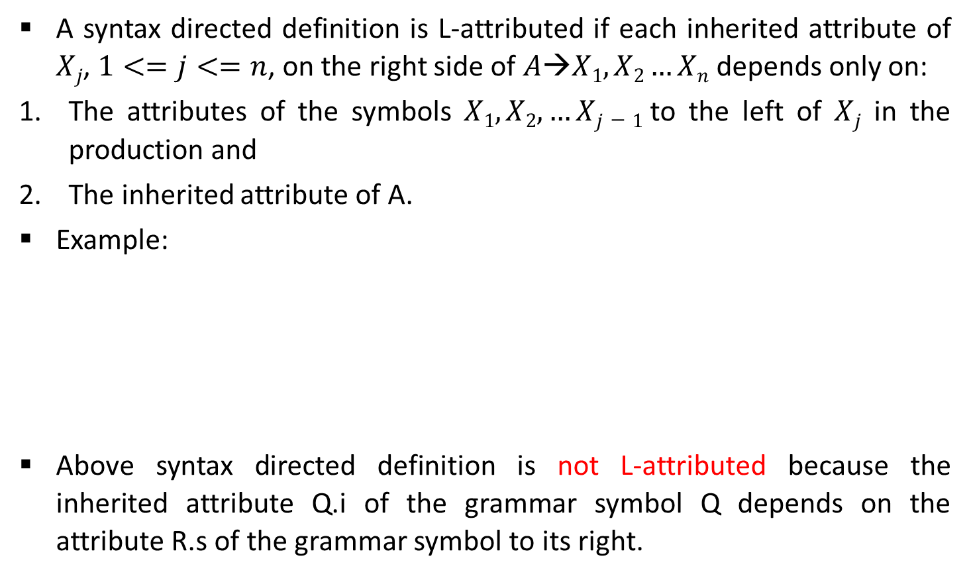
L-Attributed Definitions
A syntax directed definition is L-attributed if each inherited attribute of $Xj$, $1<=j<=n$, on the right side of $A→X1,X2…Xn$depends only on:
The attributes of the symbols $X1,X2,…Xj−1$to the left of $Xj$ in the production and
The inherited attribute of A.
Example:
Above syntax directed definition is not L-attributed because the inherited attribute Q.i of the grammar symbol Q depends on the attribute R.s of the grammar symbol to its right.
Production | Semantic Rules
A→ LM | L.i:=l(A.i) M.i=m(L.s) A.s=f(M.s)
A→ QR | R.i=r(A.i) Q.i=q(R.s) A.s=f(Q.s)

Slide 22
L-Attributed
A→XYZ
L- Attributed
Not L- Attributed

Slide 23
Translation Scheme

Slide 24
Translation schemes
Translation scheme is a context free grammar in which attributes are associated with the grammar symbols and semantic actions enclosed between braces {} are inserted within the right sides of productions.
Attributes are used to evaluate the expression along the process of parsing.
During the process of parsing the evaluation of attribute takes place by consulting the semantic action enclosed in { }.
A translation scheme generates the output by executing the semantic actions in an ordered manner.
This process uses the depth first traversal.

Slide 25

Example: Translation scheme
Example: Infix to Postfix notation
E→TR
R→ addop $T \left\{ Print\left(addop.lexeme\right)\right\}$R1 | 𝜖
T→ num $\left\{ Print\left(num.val\right)\right\}$

Slide 26
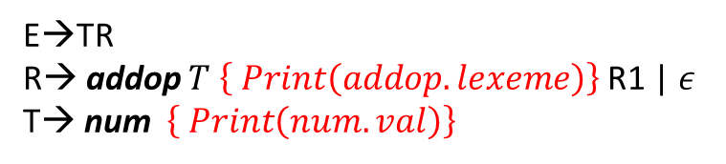
Example: Translation scheme
9-5+2
E→TR
R→ addop $T \left\{ Print\left(addop.lexeme\right)\right\}$R1 | 𝜖
T→ num $\left\{ Print\left(num.val\right)\right\}$
E
T
R
-
T
R
9
{Print(9)}
{Print(-)}
5
{Print(5)}
+
R
T
{Print(+)}
2
{Print(2)}
𝜖
Postfix=95-2+

Slide 27
End of Unit-3

