Slide 1

UNIT - 1 Overview and concepts Data Warehousing and Business Intelligence
2170715 - Data Mining & Business Intelligence
Prof. Naimish R. Vadodariya
naimish.vadodariya@darshan.ac.in
+91-8866215253
Computer Engineering Darshan Institute of Engineering & Technology

Slide 2
Outline
Why Reporting & Analyzing Data?
Introduction to Business Intelligence
Introduction to Data Warehousing
Features of Data Warehousing
Introduction to Data marts
Types of Data Marts
Meta Data

Slide 3
Why Reporting & Analyzing Data?
The amount of data stored in databases of industry is growing exponentially & databases are now measured in gigabytes and terabytes.
However row data does not provide much useful information. In today’s highly competitive business environment, companies need to turn these terabytes of raw data into some useful information.
The general methods of analysis/reporting can be broadly classified into two categories: non-parametric analysis & parametric analysis
Example
Managers will generally be more interested in actual data and non-parametric analysis results, while engineers will be more concerned with parametric analysis.

Slide 4
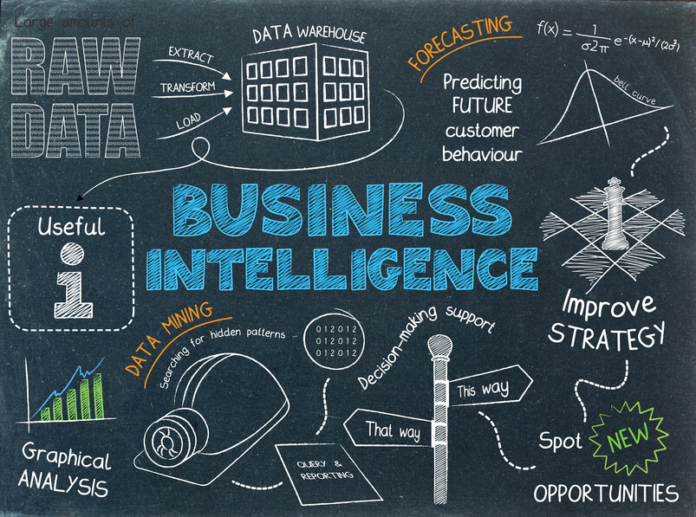

Slide 5
Business Intelligence
Business Intelligence (BI) - technology infrastructure for gaining maximum information from available data for the purpose of improving business processes.
BI tools access and analyze data sets and present analytical findings in reports, summaries, dashboards, graphs, charts and maps to provide users with detailed intelligence about the state of the business.
Typical BI infrastructure components are as follows: software solution for gathering, cleansing, integrating, analyzing and sharing data.
Business Intelligence produces analysis and provides believable information to help making effective and high quality business decisions.

Slide 6
Business Intelligence (Cont..)
The most common kinds of Business Intelligence systems are:
EIS - Executive Information Systems
DSS - Decision Support Systems
MIS - Management Information Systems
GIS - Geographic Information Systems
OLAP - Online Analytical Processing and multidimensional analysis
CRM - Customer Relationship Management

Slide 7
Introduction to Data Warehouse
Collections of databases that work together are called data warehouses.
This makes it possible to integrate data from multiple databases & it is used to help individuals and organizations make better decisions.
A database consists of one or more files that need to be stored on a computer. In large organizations, databases are typically not stored on the individual computers of employees but in a central system (server).
A server is a computer system that provides a service over a network. The server is often located in a room with controlled access, so only authorized personnel can get physical access for it.

Slide 8
Data Warehouse (Cont..)
In a typical setting, the database files reside on the server, but it can be accessed from many different computers in the organization. As the number and complexity of databases grows, we start referring to them together as a data warehouse.
The ultimate goal of a database is not just to store data, but to help businesses make decisions based on that data.
A data warehouse supports this goal by providing an architecture and tools to systematically organize and understand data from multiple databases.

Slide 9
Data Warehouse (Cont..)
According to William H. Inmon, a leading architect in the construction of data warehouse systems, “A data warehouse is a subject-oriented, integrated, time-variant, and nonvolatile collection of data in support of management’s decision making process”.
Features of Data Warehousing
Subject-oriented
Integrated
Time-variant
Nonvolatile

Slide 10
Data Warehouse – Example
We can say that data warehousing is basically a process in which data from multiple sources/databases is combined into one comprehensive and easily accessible database. Then this data is readily available to any business professionals, managers, etc. who need to use the data to create forecasts – and who basically use the data for data mining.
Facebook

Slide 11
Features of Data Warehousing
Subject-oriented:
A data warehouse is organized around major subjects, such as customer, supplier, product, and sales.
Rather than concentrating on the day-to-day operations and transaction processing of an organization, a data warehouse focuses on the modeling and analysis of data for decision makers.
Data warehouses typically provide a simple and concise view around particular subject issues by excluding data that are not useful in the decision support process.

Slide 12
Features of Data Warehousing
Integrated:
A data warehouse is usually constructed by integrating multiple heterogeneous sources, such as relational databases, flat files, and on-line transaction records.
Data cleaning and data integration techniques are applied to ensure consistency in naming conventions, encoding structures, attribute measures, and so on.

Slide 13
Features of Data Warehousing
Time-variant:
Data are stored to provide information from a historical perspective (e.g., the past 5–10 years).
Every key structure in the data warehouse contains, either implicitly or explicitly, an element of time.
Nonvolatile:
A data warehouse is always a physically separate store of data transformed from the application data found in the operational environment.
Due to this separation, a data warehouse does not require transaction processing, recovery, and concurrency control mechanisms.
It usually requires only two operations in data accessing: initial loading of data and access of data.

Slide 14
Data Warehouse Design Process
A data warehouse can be built using a top-down approach, a bottom-up approach, or a combination of both.
Top Down Approach
The top-down approach starts with the overall design and planning.
It is useful in cases where the technology is mature and well known, and where the business problems that must be solved are clear and well understood.
Bottom up Approach
The bottom-up approach starts with experiments and prototypes.
This is useful in the early stage of business modeling and technology development.
It allows an organization to move forward at considerably less expense and to evaluate the benefits of the technology before making significant commitments.
Combined Approach
In the combined approach, an organization can exploit the planned and strategic nature of the top-down approach while retaining the rapid implementation and opportunistic application of the bottom-up approach.

Slide 15
Introduction to Data Marts
A data mart is a simple form of a data warehouse that is focused on a single subject (or functional area), such as Sales or Finance or Marketing.
Data marts are often built and controlled by a single department within an organization.
Given their single-subject focus, data marts usually draw data from only a few sources.
The sources could be internal operational systems, a central data warehouse, or external data.

Slide 16
Data Marts (Cont..)
A data mart is a repository of data that is designed to serve a particular community of knowledge workers.
The difference between a data warehouse and a data mart can be confusing because the two terms are sometimes used incorrectly as synonyms.
A data warehouse is a central repository for all an organization's data.
The goal of a data mart, however, is to meet the particular demands of a specific group of users within the organization, such as human resource management (HRM).
Generally, an organization's data marts are subsets of the organization's data warehouse.

Slide 17
Data Warehouse v/s Data Mart
Data warehouse:
Holds multiple subject areas
Holds very detailed information
Works to integrate all data sources
Size (typical) 100 GB-TB+
Implementation Time : Months to Years
Data mart:
Often holds only one subject area- for example, Finance, or Sales
May hold more summarized data
Concentrates on integrating information from a given subject area or set of source systems
It is built focused on a dimensional model using a star schema
Size (typical) < 100GB
Implementation Time : Months

Slide 18
Reasons for creating a data mart
Easy access to frequently needed data
Creates collective view by a group of users
Improves end-user response time
Ease of creation
Lower cost than implementing a full data warehouse
Potential users are more clearly defined than in a full data warehouse
Contains only business essential data and is less cluttered

Slide 19
Types of Data Marts
There are three kinds of Data-Marts (DMs), which are as follows:
Dependent DM: Created from a data warehouse to a separate physical data-store. (build over data warehouse physically)
Independent DM: Created from operational systems and have separate physical data-store.
Logical or Hybrid DM: Exists as a subset of data warehouse. (build over data warehouse logically)

Slide 20
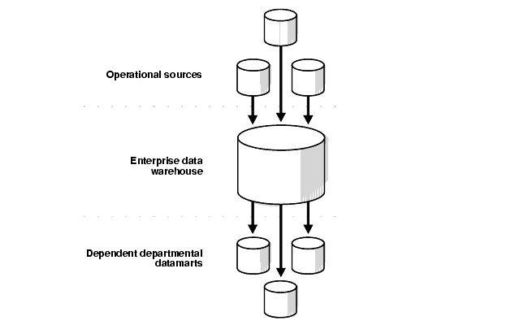
Dependent Data Marts
A dependent data mart allows you to unite your organization's data in one data warehouse.
This gives you the usual advantages of centralization.

Slide 21
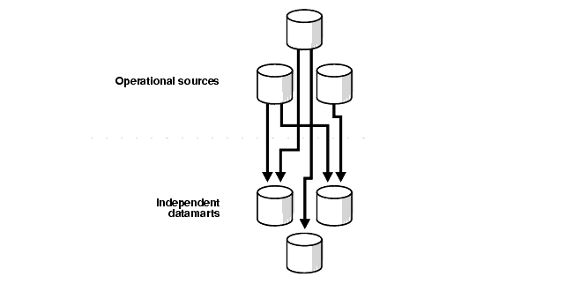
Independent Data Marts
An independent data mart is created without the use of a central data warehouse.
This could be desirable for smaller groups within an organization.

Slide 22
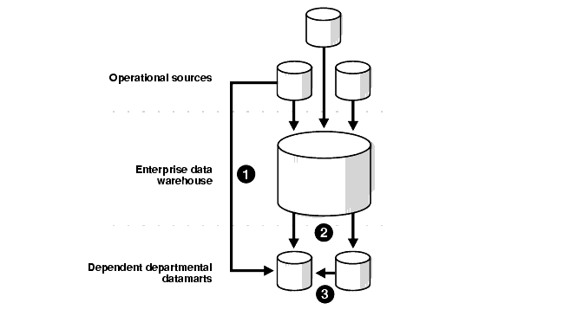
Hybrid Data Mart
A hybrid data mart allows you to combine input from sources other than a data warehouse.
This could be useful for many situations, especially when you need ad hoc integration, such as after a new group or product is added to the organization.

Slide 23
Meta Data
Metadata are data about data.
When it used in a data warehouse, metadata are the data that define warehouse objects.
Metadata are created for the data names and definitions of the given warehouse.
Additional metadata are created and captured for time stamping any extracted data, the source of the extracted data, and missing fields that have been added by data cleaning or integration processes.

Slide 24
Metadata – Example
To Describe Meta Data of a Book Store:
Name of Book
Summary of the Book
The Date of publication
High level description of what it contains
How you can find the book
Author of the book
Whether the book is available OR not
The information helps you to:
Search for the book
Access the book
Understand the book before you access OR buy it.

Slide 25


