Slide 1

UNIT - 2 The Architecture of BI and DW
2170715 - Data Mining & Business Intelligence
Prof. Naimish R. Vadodariya
naimish.vadodariya@darshan.ac.in
+91-8866215253
Computer Engineering Darshan Institute of Engineering & Technology

Slide 2
Outline
Data Warehouse Architecture
OLTP v/s OLAP
Data Warehouse Schema Architecture
OLAP Operations
OLAP Servers

Slide 3
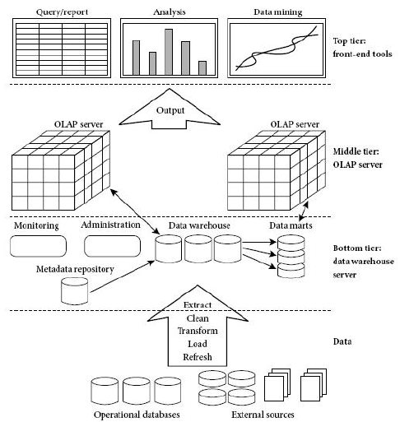
Data Warehouse Architecture

Slide 4
Data Warehouse Architecture
Bottom tier:
The bottom tier is a warehouse database server that is almost always a relational database system.
Back-end tools and utilities are used to feed data into the bottom tier from operational databases or other external sources.
These tools and utilities perform data extraction, cleaning, and transformation, as well as load and refresh functions to update the data warehouse.
The data are extracted using application program interfaces known as gateways.
A gateway is supported by the underlying DBMS and allows client programs to generate SQL code to be executed at a server.
Examples of gateways include ODBC (Open Database Connection) and OLEDB (Open Linking and Embedding for Databases) by Microsoft and JDBC (Java Database Connection).
This tier also contains a metadata repository, which stores information about the data warehouse and its contents.

Slide 5
Data Warehouse Architecture
Middle tier:
The middle tier is an OLAP server that is typically implemented using either
A relational OLAP (ROLAP) model, that is, an extended relational DBMS that maps operations on multidimensional data to standard relational operations or,
A multidimensional OLAP (MOLAP) model, that is, a special-purpose server that directly implements multidimensional data and operations.
Top tier:
The top tier is a front-end client layer, which contains query and reporting tools, analysis tools, and/or data mining tools.

Slide 6
Data Warehouse Models
Enterprise warehouse:
An enterprise warehouse collects all of the information about subjects spanning the entire organization.
It provides corporate-wide data integration, usually from one or more operational systems or external information providers, and is cross-functional in scope.
It typically contains detailed data as well as summarized data,
It can range in size from a few gigabytes to hundreds of gigabytes, terabytes, or beyond.

Slide 7
Data Warehouse Models
Data mart:
A data mart contains a subset of corporate-wide data that is of value to a specific group of users.
Virtual warehouse:
A virtual warehouse is a set of views over operational databases.
For efficient query processing, only some of the possible summary views may be materialized.

Slide 8
OLTP v/s OLAP
 | OLTP | OLAP
Characteristic | Operational processing informational processing | Transaction Analysis
Orientation | Transaction | Analysis
User | Clerk, DBA, database professional | Knowledge worker (e.g., manager, executive, analyst)
Function | day-to-day operations | long-term informational requirements, decision support
DB design | ER based, application-oriented | Star/snowflake, subject-oriented
Data | Current; guaranteed up-to-date | Historical; accuracy maintained over time
Summarization | Primitive, highly detailed | Summarized, consolidated
View | Detailed, flat relational | Summarized, multidimensional
Unit of work | Short, simple transaction | Complex query
Access | Read/write | Mostly read

Slide 9
Data Warehouse Schema Architecture
Data Warehouse environment usually transforms the relational data model into some special architectures.
There are many schema models designed for data warehousing but the most commonly used are:
Star Schema
Snowflake Schema
Fact constellation Schema
The determination of which schema model should be used for a data warehouse should be based upon the analysis of project requirements, accessible tools and project team preferences.

Slide 10
Star Schema
The star schema architecture is the simplest data warehouse schema.
It is called a star schema because the diagram resembles a star, with points radiating from a center.
The center of the star consists of fact table and the points of the star are the dimension tables.
Usually the fact tables in a star schema are in third normal form (3NF) whereas dimensional tables are de-normalized.
Despite the fact that the star schema is the simplest architecture, it is most commonly used nowadays and is recommended by Oracle.

Slide 11
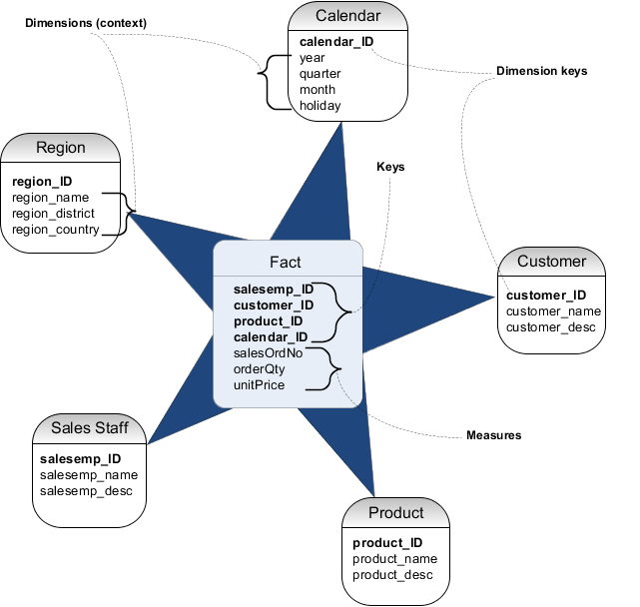
Star Schema - Example

Slide 12
Snowflake Schema
The snowflake schema architecture is a more complex variation of the star schema used in a data warehouse, because the tables which describe the dimensions are normalized.
This table is easy to maintain and saves storage space.
However, this saving of space is negligible in comparison to the typical magnitude of the fact table.
Furthermore, the snowflake structure can reduce the effectiveness of browsing, since more joins will be needed to execute a query.
Hence, although the snowflake schema reduces redundancy, it is not as popular as the star schema in data warehouse design.

Slide 13
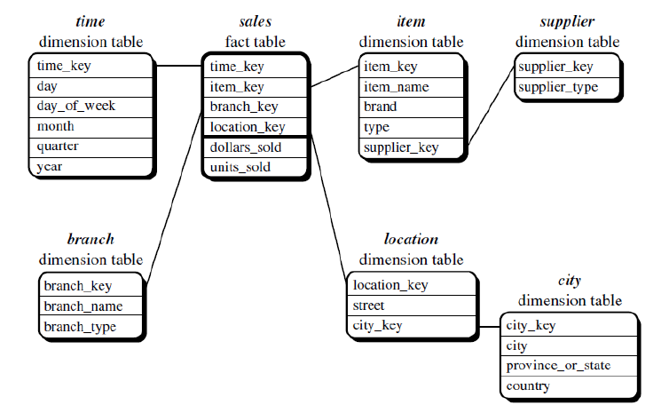
Snowflake Schema - Example

Slide 14
Snowflake Schema - Example
DMQL(Data Mining Query Language) code for star schema can be written as follows:
Define cube sales snowflake [time, item, branch, location]:
Dollars sold = sum(sales in dollars), units sold = count(*)
Define dimension time as (time key, day, day of week, month, quarter, year)
Define dimension item as (item key, item name, brand, type, supplier (supplier key, supplier type))
Define dimension branch as (branch key, branch name, branch type)
Define dimension location as (location key, street, city (city key, city, province or state, country))

Slide 15
Fact Constellation Schema
Sophisticated applications may require multiple fact tables to share dimension tables.
This kind of schema can be viewed as a collection of stars, and hence is called a galaxy schema or a fact constellation.
A fact constellation schema allows dimension tables to be shared between fact tables.
For example, the dimensions tables for time, item, and location are shared between both the sales and shipping fact tables.
The main shortcoming of the fact constellation schema is a more complicated design because many variants for particular kinds of aggregation must be considered and selected. Moreover, dimension tables are still large.

Slide 16
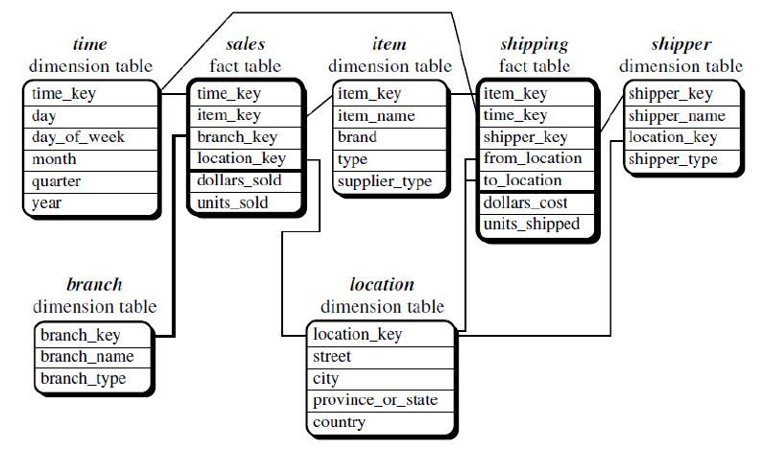
Fact Constellation Schema

Slide 17
Fact Constellation Schema
DMQL code for star schema can be written as follows:
Define cube sales [time, item, branch, location]:
Dollars sold = sum(sales in dollars), units sold = count(*)
Define dimension time as (time key, day, day of week, month, quarter, year)
Define dimension item as (item key, item name, brand, type, supplier type)
Define dimension branch as (branch key, branch name, branch type)
Define dimension location as (location key, street, city, province or state, country)
Define cube shipping [time, item, shipper, from location, to location]:
Dollars cost = sum(cost in dollars), units shipped = count(*)
Define dimension time as time in cube sales
Define dimension item as item in cube sales
Define dimension shipper as (shipper key, shipper name, location as location in cube sales, shipper type)
Define dimension from location as location in cube sales
Define dimension to location as location in cube sales

Slide 18
OLAP Operations
Roll up
Drill Down
Slice
Dice
Pivot (Rotate)

Slide 19
Roll up – OLAP Operation
The roll-up operation (also called drill-up or aggregation operation) performs aggregation on a data cube by following ways:
By climbing up a concept hierarchy for a dimension
By dimension reduction
Roll-up is performed by climbing up a concept hierarchy for the dimension location.
Initially the concept hierarchy was "street < city < province < country".
On rolling up, the data is aggregated by ascending the location hierarchy from the level of city to the level of country.
The data is grouped into cities rather than countries.
When roll-up is performed, one or more dimensions from the data cube are removed.

Slide 20
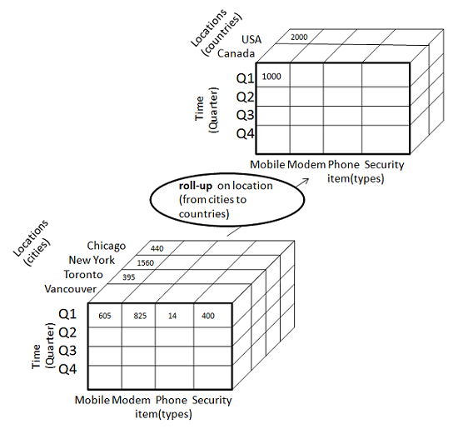
Roll up – OLAP Operation

Slide 21
Drill Down – OLAP Operation
Drill-down is the reverse operation of roll-up. It is performed by either of the following ways:
By stepping down a concept hierarchy for a dimension
By introducing a new dimension
Drill-down is performed by stepping down a concept hierarchy for the dimension time.
Initially the concept hierarchy was "day < month < quarter < year."
On drilling down, the time dimension is descended from the level of quarter to the level of month.
When drill-down is performed, one or more dimensions from the data cube are added.
It navigates the data from less detailed data to highly detailed data.

Slide 22
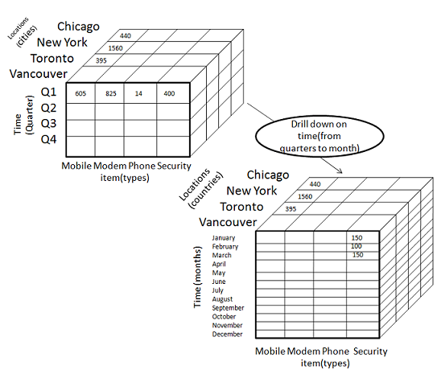
Drill Down – OLAP Operation

Slide 23
Slice – OLAP Operation
The slice operation selects one particular dimension from a given cube and provides a new sub cube.
Here Slice is performed for the dimension "time" using the criterion time = "Q1".
It will form a new sub-cube by selecting one or more dimensions.

Slide 24
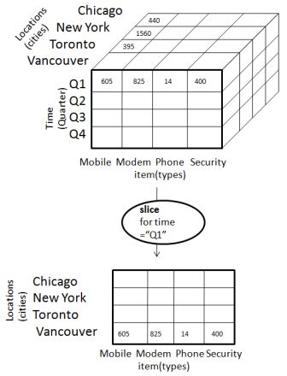
Slice – OLAP Operation

Slide 25
Dice – OLAP Operation
Dice selects two or more dimensions from a given cube and provides a new sub cube.
The dice operation on the cube based on the following selection criteria involves three dimensions.
(location = "Toronto" or "Vancouver")
(time = "Q1" or "Q2")
(item =" Mobile" or "Modem")

Slide 26
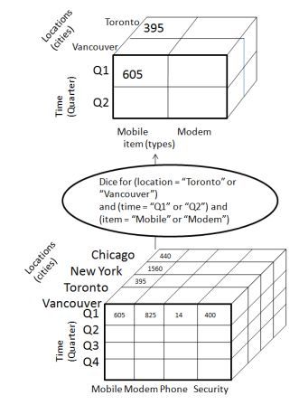
Dice – OLAP Operation

Slide 27
Pivot – OLAP Operation
The pivot operation is also known as rotation.
It rotates the data axes in view in order to provide an alternative presentation of data.
Consider the following diagram that shows the pivot operation.
In this the item and location axes in 2-D slice are rotated.

Slide 28
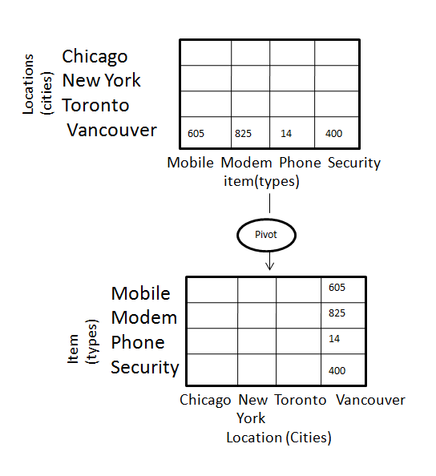
Pivot – OLAP Operation

Slide 29
OLAP Servers
Relational OLAP (ROLAP)
Multidimensional OLAP (MOLAP)
Hybrid OLAP (HOLAP)
Specialized SQL Servers

Slide 30
Relational OLAP (ROLAP)
ROLAP servers are placed between relational back-end server and client front-end tools.
To store and manage warehouse data, ROLAP uses relational or extended-relational DBMS.
ROLAP includes the following:
Implementation of aggregation navigation logic.
Optimization for each DBMS back end.
Additional tools and services.

Slide 31
Multidimensional OLAP (MOLAP)
MOLAP uses array-based multidimensional storage engines for multidimensional views of data.
With multidimensional data stores, the storage utilization may be low if the data set is sparse.
Many MOLAP server use two levels of data storage representation to handle dense and sparse data sets.

Slide 32
Hybrid OLAP (HOLAP)
Hybrid OLAP is a combination of both ROLAP and MOLAP.
It offers higher scalability of ROLAP and faster computation of MOLAP.
HOLAP servers allows to store the large data volumes of detailed information.
The aggregations are stored separately in MOLAP store.

Slide 33
Specialized SQL Servers
Specialized SQL servers provide advanced query language and query processing support for SQL queries over star and snowflake schemas in a read-only environment.

Slide 34


