Slide 1

Unit – 6 Classification & Prediction
2170715 - Data Mining & Business Intelligence
Prof. Naimish R. Vadodariya
naimish.vadodariya@darshan.ac.in
+91-8866215253
Computer Engineering Darshan Institute of Engineering & Technology

Slide 2
Outline
Introduction : Classification
Classification Problem
Issues Regarding Classification & Prediction
Classification Methods
Prediction Methods

Slide 3
Classification ?
Classification is a supervised learning and the aim is to conclude a function to represent the given behavior.
It is similar to human learning from past experiences to get some new knowledge in order to improve the ability to perform real world tasks.
In supervised learning, the learner(computer program) is provided with two sets of data, a training set and a test set.
The idea is for the learner to “learn” from a set of labeled examples in the training set so that it can identify unlabeled examples in the test set with the highest possible accuracy.

Slide 4
Classification Problem
Suppose a Database D is given as D = {t₁,t₂,..t_{n}} and a set of desired classes are C={C₁,…,C_{m}}, the classification problem is to define the mapping m in such a way that which tuple of database D belongs to which class of C.
Actually we divides D into equivalence classes.
Prediction is similar, but may be viewed as having infinite number of classes.
Prediction models continuous-valued functions, i.e. predicts unknown or missing values.

Slide 5
Classification Example
Teachers classify students grades as A,B,C,D or E.
Predict when a river will flood.
Identify individuals with credit risks.
Cricket (batsman, bowler, all-rounder etc.)
Websites (Category wise)
Pattern recognition

Slide 6
Classification Example (Cont..)
How teachers gives grades to students based on their marks obtained :
If x >= 90 then A grade.
If 80 <= x < 90 then B grade.
If 70 <= x < 80 then C grade.
If 60 <= x < 70 then D grade.
If x < 60 then E grade.
x
<90
>=90
x
A
<80
>=80
x
B
<70
>=70
x
C
<60
>=60
E
D

Slide 7
Classification : Two Step Process
1) Model Construction
Classification
Algorithms
Training
Data
Name | Rank | Years | Tenured
Mike | Asst. Prof. | 3 | No
Mary | Asst. Prof. | 7 | Yes
Bill | Prof. | 2 | Yes
Jim | Asso. Prof. | 7 | Yes
Dave | Asst. Prof. | 6 | No
Anne | Asso. Prof. | 3 | No
Classifier
(Model)
If Rank = ‘professor’
OR year > 6
THEN tenured = ‘yes’

Slide 8
Classification : Two Step Process
2) Model Usage
Classifier
Testing
Data
Unseen Data
Name | Rank | Years | Tenured
Tom | Asst. Prof. | 2 | No
Merlisa | Asso. Prof. | 7 | No
George | Prof. | 5 | Yes
Joseph | Asst. Prof. | 7 | Yes
(Jeff, Professor, 4)
Tenured?
Yes

Slide 9
Classification : Two Step Process
Model Construction
Describing a set of predetermined classes :
Each tuple/sample is assumed to belong to a predefined class, as determined by the class label attribute.
The set of tuples used for model construction is called as training set.
The model is represented as classification rules, decision trees, or mathematical formulae.
Model Usage
For classifying future or unknown objects
Estimate accuracy of the model
The known label of test sample is compared with the classified result from the model.
Accuracy rate is the percentage of test set samples that are correctly classified by the model.

Slide 10
Issues Regarding Classification & Prediction
Data Preparation
Data Cleaning
Pre-process data in order to reduce noise and handle missing values.
Relevance Analysis (Feature Selection)
Remove the irrelevant or redundant attributes.
Data Transformation
Generalize the data to higher level concepts using concept hierarchies and/or normalize data which involves scaling the values.

Slide 11
Issues Regarding Classification & Prediction
Evaluating Classification Methods :
Predictive Accuracy :
This refers the ability of the model to correctly predict the class label of new or previously unseen data.
Speed and scalability
Time to construct model
Time to use the model
Robustness
Handling noise and missing values
Interpretability
Understanding and insight provided by model
Goodness of rules
Decision tree size
Strongest rule or not

Slide 12
Classification & Prediction Methods
Classification
Decision Tree
Bayesian Classification
Prediction
Linear Regression
Non Linear Regressions
Rule Based Classification
Neural Network
Logistic Regression

Slide 13
Decision Tree
One of the most common tasks is to build models for the prediction of the class of an object on the basis of its attributes.
Here the object can be seen as a customer, patient, transaction, e-mail message or even a single character.
Attributes of such objects can be,
For example, for the patient object, heart rate, blood pressure, weight and gender, whereas the class of the patient object would most commonly be positive/negative for a certain disease.

Slide 14
Decision Tree (Cont..)
In decision tree are represented by a fixed set of attributes (e.g. gender) and their values (e.g. male, female) described as attribute-value pairs.
If the attribute has small number of disjoint possible values (e.g. high, medium, low) or there are only two possible classes (e.g. true, false) then decision tree learning is easy.
Extension to decision tree algorithm also handles real value attributes (e.g. salary).
It gives a class label to each instance of dataset.
Decision tree methods can be used even when some training examples have unknown values (e.g. humidity)

Slide 15
Decision Tree (Cont..)
Decision tree is a classifier in the form of a tree structure
Decision node: specifies a test on a single attribute
Leaf node: indicates the value of the target attribute
Arc/edge: split of one attribute
Path: a disjunction of test to make the final decision

Slide 16
Decision Tree Representation- Example
Root Node
Branches
Leaf Node
Leaf Node
Set of Possible Answers
Set of Possible Answers

Slide 17
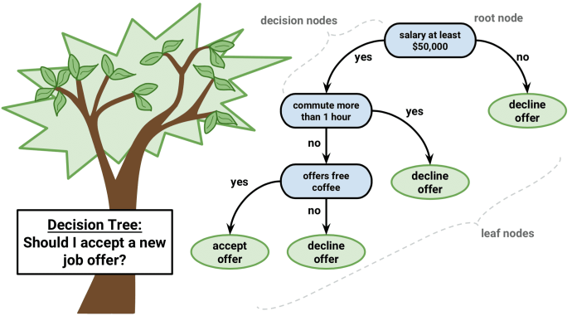
Decision Tree Representation- Example

Slide 18
Key Requirements
Sufficient data:
Enough training cases should be provided to learn the model.
Attribute-value description:
Object or case must be expressible in terms of a fixed collection of properties or attributes (e.g., hot, mild, cold).
Predefined classes (target values):
The target function has discrete output values (Boolean or multiclass)

Slide 19
Important Terms For Decision Tree
Entropy
Information Gain
Gini Index

Slide 20
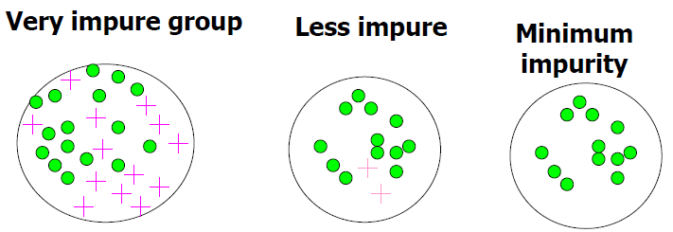
Entropy (E)
Information theory defines the certainty of a decision
1 if completely certain,
0 if completely uncertain,
Normally in between (0 to 1) as entropy, a probability-based measure used to calculate the amount of uncertainty.

Slide 21
Entropy (E) (Cont..)
It measures that of how much information we don't know (how uncertain we are about the data).
It can be also used to measure how much information we gain from an attribute when the target attribute is revealed to us.
Which Attribute is Best?
The attribute with the largest expected reduction in entropy is the 'best' attribute to use next.
Because if we have a large expected reduction it means taking away that attribute has a big effect, meaning it must be very certain.

Slide 22
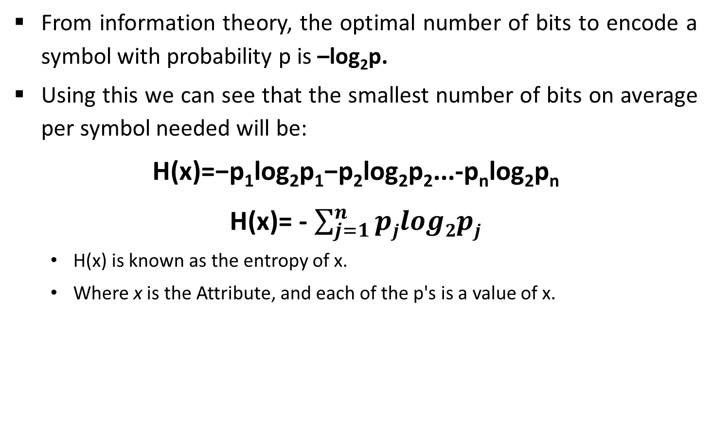
Entropy (E) (Cont..)
From information theory, the optimal number of bits to encode a symbol with probability p is –log₂p.
Using this we can see that the smallest number of bits on average per symbol needed will be:
H(x)=−p₁log₂p₁−p₂log₂p₂...-p_{n}log₂p_{n}
H(x)= - $\sum_{j=1}^{n}{pjlog2pj}$
H(x) is known as the entropy of x.
Where x is the Attribute, and each of the p's is a value of x.

Slide 23
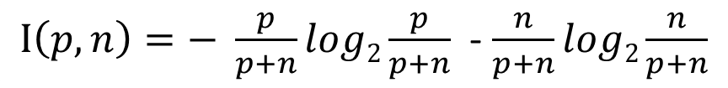
Information Gain
Information gain can be used for continues-valued (numeric) attributes.
The attribute which has the highest information gain is selected for split.
Assume that there are two classes P & N.
Suppose we have S samples, out of these p samples belongs to class P and n samples belongs to class N.
The amount of information, needed to decide split in S belongs to P or N & that is defined as
$I\left(p,n\right)=− \frac{p}{p+n}log2\frac{p}{p+n}$ - $\frac{n}{p+n}log2\frac{n}{p+n}$

Slide 24
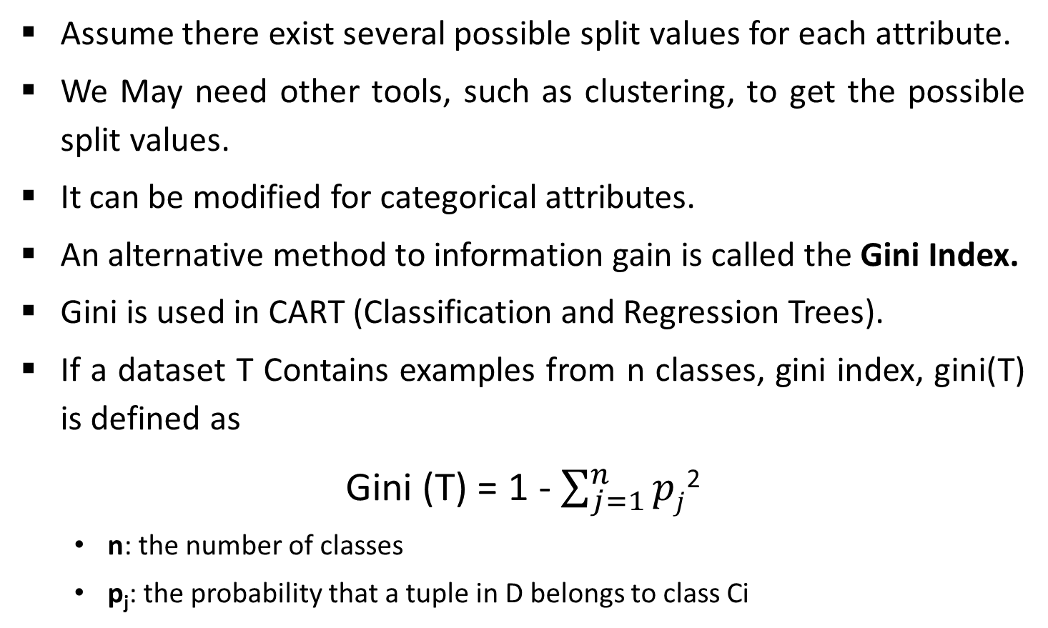
Gini Index
Assume there exist several possible split values for each attribute.
We May need other tools, such as clustering, to get the possible split values.
It can be modified for categorical attributes.
An alternative method to information gain is called the Gini Index.
Gini is used in CART (Classification and Regression Trees).
If a dataset T Contains examples from n classes, gini index, gini(T) is defined as
Gini (T) = 1 - $\sum_{j=1}^{n}{pj}$²
n: the number of classes
p_{j}: the probability that a tuple in D belongs to class Ci

Slide 25

Gini Index (Cont..)
After splitting T into two subsets T1 and T2 with sizes N1 and N2, the gini index of the split data is defined as
Gini_{split} (T) = $\frac{N1}{N}$ gini (T₁) + $\frac{N2}{N}$ gini (T₂)

Slide 26
Example Using Entropy
Entropy
A decision tree is built top-down from a root node and involves partitioning the data into subsets that contain instances with similar values (homogenous). ID3 algorithm uses entropy to calculate the homogeneity of a sample. If the sample is completely homogeneous the entropy is zero and if the sample is an equally divided it has entropy of one.

Slide 27
Example – ID3
Age | Income | Student | Credit_Rating | Class : buys_computer
<=30 | High | No | Fair | No
<=30 | High | No | Excellent | No
31..40 | High | No | Fair | Yes
>40 | Medium | No | Fair | Yes
>40 | Low | Yes | Fair | Yes
>40 | Low | Yes | Excellent | No
31..40 | Low | Yes | Excellent | Yes
<=30 | Medium | No | Fair | No
<=30 | Low | Yes | Fair | Yes
>40 | Medium | Yes | Fair | Yes
<=30 | Medium | Yes | Excellent | Yes
31..40 | Medium | No | Excellent | Yes
31..40 | High | Yes | Fair | Yes
>40 | Medium | No | Excellent | No

Slide 28
Solution – ID3
Class P : buys_computer = “Yes”
Class N : buys_computer = “No”
Total number of Records 14.
Count the number of records with “yes” class and “No” class.
So,
Records with “Yes” class = 9
Records with “No” class = 5

Slide 29
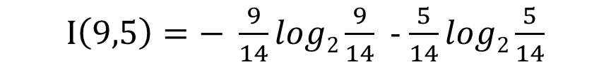
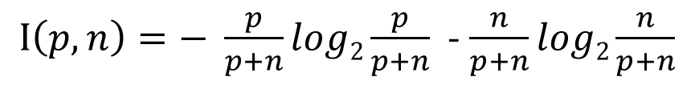
Solution – ID3
Now, Information Gain = I (p,n)
$I\left(p,n\right)=− \frac{p}{p+n}log2\frac{p}{p+n}$ - $\frac{n}{p+n}log2\frac{n}{p+n}$
$I\left(9,5\right)=− \frac{9}{14}log2\frac{9}{14}$ - $\frac{5}{14}log2\frac{5}{14}$
I(9,5) = 0.940

Slide 30
Solution – ID3 (Age <=30,31..40,>40)
Age | Income | Student | Credit_Rating | Buys_Computer
<=30 | High | No | Fair | No
<=30 | High | No | Excellent | No
<=30 | Medium | No | Fair | No
<=30 | Low | Yes | Fair | Yes
<=30 | Medium | Yes | Excellent | Yes
Age | Income | Stu. | Cr_Rating | Buys
31..40 | High | No | Fair | Yes
31..40 | Low | Yes | Excellent | Yes
31..40 | Medium | No | Excellent | Yes
31..40 | High | Yes | Fair | Yes
Age | Income | Stu. | Cr_Rating | Buys
>40 | Medium | No | Fair | Yes
>40 | Low | Yes | Fair | Yes
>40 | Low | No | Excellent | No
>40 | Medium | Yes | Fair | Yes
>40 | Medium | No | Excellent | No

Slide 31

Solution – ID3 (Age <=30)
Compute the information gain & Entropy For Age <=30,
P_{i} = Yes class = 2
N_{i} = No class = 3
So, Information Gain = I (p,n)
$I\left(p,n\right)=− \frac{p}{p+n}log2\frac{p}{p+n}$ - $\frac{n}{p+n}log2\frac{n}{p+n}$
$I\left(2,3\right)=− \frac{2}{5}log2\frac{2}{5}$ - $\frac{3}{5}log2\frac{3}{5}$
I(2,3) = 0.971

Slide 32
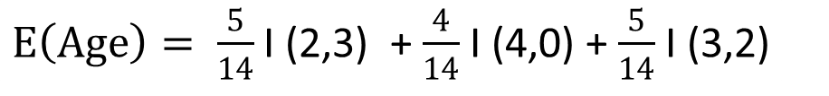
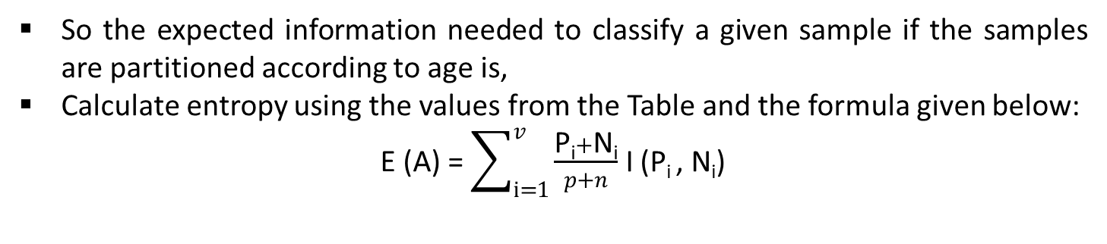
Solution – ID3
Age | P_{i} | N_{i} | I (P_{i} , N_{i})
<=30 | 2 | 3 | 0.971
31..40 | 4 | 0 | 0
>40 | 3 | 2 | 0.971
So the expected information needed to classify a given sample if the samples are partitioned according to age is,
Calculate entropy using the values from the Table and the formula given below:
E (A) = $\sum_{i=1}^{v}{\frac{\text{P}\text{i}+\text{N}\text{i}}{p+n}}$ I (P_{i} , N_{i})
$E\left(Age\right)= \frac{5}{14}$ I (2,3) + $\frac{4}{14}$ I (4,0) + $\frac{5}{14}$ I (3,2)
E(Age) = 0.694

Slide 33
Solution – ID3
Gain (Age) = I (p, n) – E (Age)
= 0.940 – 0.694
= 0.246
Similarly,
Gain | value
Gain (age) | 0.246
Gain (income) | 0.029
Gain (student) | 0.151
Gain (credit_rating) | 0.048
So, Here we start decision tree with root node Age.

Slide 34
Solution – ID3
Now the age has highest information gain among all the attributes, so select age as test attribute and create the node as age and show all possible values of age for further splitting.
Age
<=30
31..40
>40

Slide 35
Solution – ID3 (Age <= 30)
Age | Income | Student | Credit_Rating | Buys_Computer
<=30 | High | No | Fair | No
<=30 | High | No | Excellent | No
<=30 | Medium | No | Fair | No
<=30 | Low | Yes | Fair | Yes
<=30 | Medium | Yes | Excellent | Yes

Slide 36

Solution – ID3 (Age <=30)
Compute Information gain & Entropy for Age with sample S_{<=30.}
For age <=30,
Pi = Yes = 2
Ni = No = 3
$I\left(p,n\right)=− \frac{p}{p+n}log2\frac{p}{p+n}$ - $\frac{n}{p+n}log2\frac{n}{p+n}$
$I\left(2,3\right)=− \frac{2}{5}log2\frac{2}{5}$ - $\frac{3}{5}log2\frac{3}{5}$
I(3,2) = 0.971

Slide 37
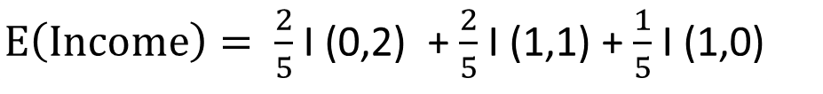
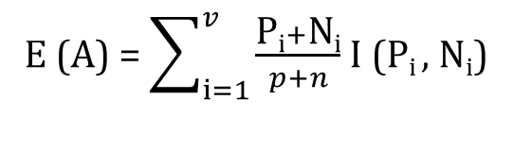
Solution – ID3 (Age <= 30, Income)
Income | P_{i} | N_{i} | I (P_{i} , N_{i})
High | 0 | 2 | 0
Medium | 1 | 1 | 1
Low | 1 | 0 | 0
In above table high (0,2) homogeneous so I(0,2) = 0, Medium equal portion so I(1,1) = 1 & Low I(1,0) = 0.
E (A) = $\sum_{i=1}^{v}{\frac{\text{P}\text{i}+\text{N}\text{i}}{p+n}}$ I (P_{i} , N_{i})
Gain (S_{<=30},Income)
= I (p, n) – E (Income)
= 0.971 – 0.4
= 0.571
$E\left(Income\right)= \frac{2}{5}$ I (0,2) + $\frac{2}{5}$ I (1,1) + $\frac{1}{5}$ I (1,0)
E(Income) = 0.4

Slide 38
Solution – ID3 (Age <= 30, Student)
student | P_{i} | N_{i} | I (P_{i} , N_{i})
No | 0 | 3 | 0
Yes | 2 | 0 | 0
In above table I (0,3) = 0 & I (2,0) = 0 So E(Student) is 0.
E(Student) = 0
Gain (S_{<=30},Student) = I (p,n) – E(Student)
= 0.971 – 0
= 0.971

Slide 39

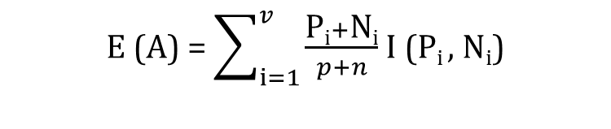
Solution – ID3 (Age <= 30, credit_rating)
credit_rating | P_{i} | N_{i} | I (P_{i} , N_{i})
Fair | 1 | 2 | 0.918
Excellent | 1 | 1 | 1
E (A) = $\sum_{i=1}^{v}{\frac{\text{P}\text{i}+\text{N}\text{i}}{p+n}}$ I (P_{i} , N_{i})
$E\left(credit_rating\right)= \frac{3}{5}$ I (1,2) + $\frac{2}{5}$ I (1,1)
E(credit_rating) = 0.951
Gain (S_{<=30},credit_rating) = I (p, n) – E (credit_rating)
= 0.971 – 0.951
= 0.020

Slide 40
Solution – ID3 (Age <=30)
Gain (Age <= 30) | value
Income | 0.571
Student | 0.971
Credit_rating | 0.020
As shown in table we get maximum gain for student so, select student as leaf node for age <=30
Age
<=30
31..40
>40
Student
No
Yes

Slide 41
Solution – ID3 (Age 31..40)
Age | Income | Student | Credit_Rating | Buys_Computer
31..40 | High | No | Fair | Yes
31..40 | Low | Yes | Excellent | Yes
31..40 | Medium | No | Excellent | Yes
31..40 | High | Yes | Fair | Yes
Age
<=30
31..40
>40
Student
Yes
No
Yes

Slide 42
Solution – ID3 (Age > 40)
Age | Income | Student | Credit_Rating | Buys_Computer
>40 | Medium | No | Fair | Yes
>40 | Low | Yes | Fair | Yes
>40 | Low | No | Excellent | No
>40 | Medium | Yes | Fair | Yes
>40 | Medium | No | Excellent | No

Slide 43

Solution – ID3 (Age > 40)
Compute Information gain for Age with sample S_{>40.}
For age > 40,
Pi = Yes = 3
Ni = No = 2
$I\left(p,n\right)=− \frac{p}{p+n}log2\frac{p}{p+n}$ - $\frac{n}{p+n}log2\frac{n}{p+n}$
$I\left(3,2\right)=− \frac{3}{5}log2\frac{3}{5}$ - $\frac{2}{5}log2\frac{2}{5}$
I(3,2) = 0.971

Slide 44
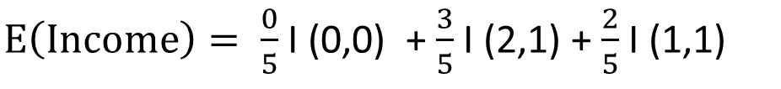
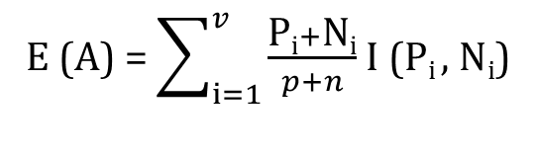
Solution – ID3 (Age > 40, Income)
Income | P_{i} | N_{i} | I (P_{i} , N_{i})
High | 0 | 0 | 0
Medium | 2 | 1 | 0.918
Low | 1 | 1 | 1
E (A) = $\sum_{i=1}^{v}{\frac{\text{P}\text{i}+\text{N}\text{i}}{p+n}}$ I (P_{i} , N_{i})
Gain (S_{>40},Income)
= I (p, n) – E (Income)
= 0.971 – 0.951
= 0.020
$E\left(Income\right)= \frac{0}{5}$ I (0,0) + $\frac{3}{5}$ I (2,1) + $\frac{2}{5}$ I (1,1)
E(Income) = 0.951

Slide 45

Solution – ID3 (Age > 40, credit_rating)
Credit_rating | P_{i} | N_{i} | I (P_{i} , N_{i})
Fair | 3 | 0 | 0
Excellent | 0 | 2 | 0
E (A) = $\sum_{i=1}^{v}{\frac{\text{P}\text{i}+\text{N}\text{i}}{p+n}}$ I (P_{i} , N_{i})
$E\left(credit_rating\right)= \frac{3}{5}$ I (3,0) + $\frac{2}{5}$ I (0,2)
E(credit_rating) = 0
Gain (S_{>40},credit_rating) = I (p, n) – E (credit_rating)
= 0.971 – 0
= 0.971

Slide 46
Solution – ID3 (Age > 40)
Gain (Age > 40) | value
Income | 0.020
Credit_rating | 0.971
As shown in table we get maximum gain for credit_rating so, select credit_rating as leaf node for age > 40
Age
<=30
31..40
>40
Student
Credit_rating
Yes
No
yes

Slide 47
Decision Tree – ID3
Age
<=30
31..40
>40
Student
Credit_rating
Yes
No
yes
Excellent
Fair
No
Yes

Slide 48
Classification Rules From Decision Tree
IF age = “<=30” AND student = “no” THEN buys_computer = “no”
IF age = “<=30” AND student = “yes” THEN buys_computer = “yes”
IF age = “31..40” THEN buys_computer = “yes”
IF age = “>40” AND credit_rating = “excellent” THEN buys_computer = “no”
IF age = “>40” AND credit_rating = “fair” THEN buys_computer = “yes”

Slide 49
Bayesian Classification
Thomas Bayes, who proposed the Bayes Theorem so, it named Bayesian theorem.
Statistical method & Supervised Learning Method for classification.
It can solve problems involving both categorical and continuous valued attributes.
Bayesian classification is used to find conditional probabilities.

Slide 50
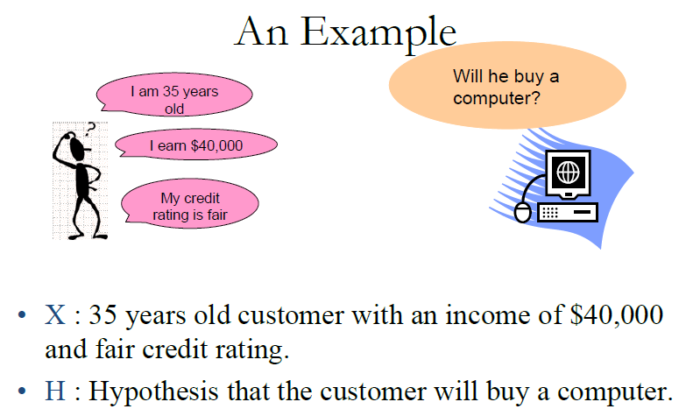
Bayesian Classification

Slide 51
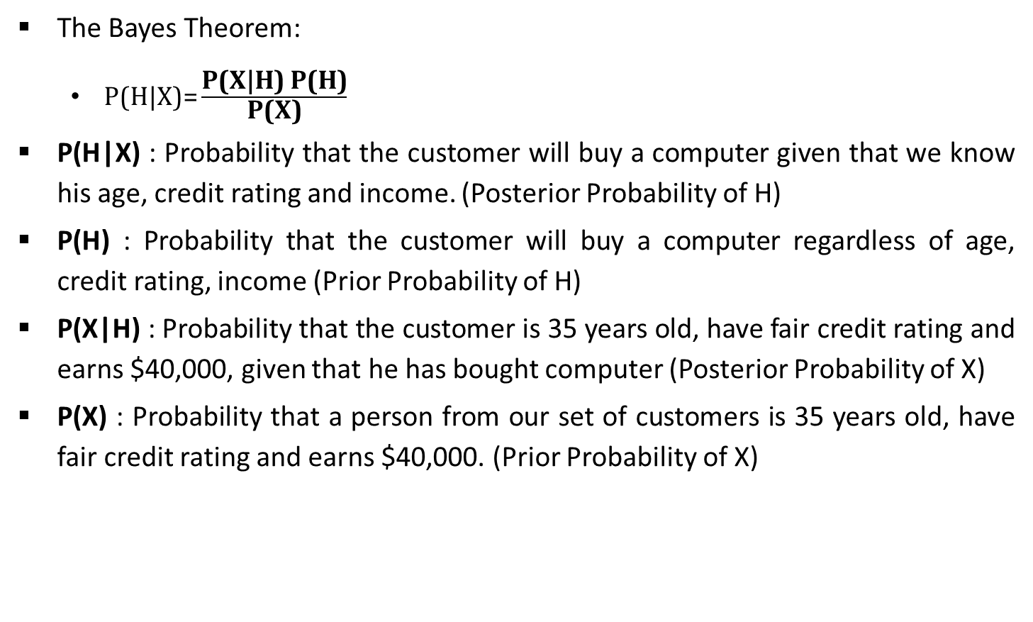
The Bayes Theorem
The Bayes Theorem:
P(H|X)= $\frac{\text{P}\text{(}\text{X}\text{|}\text{H}\text{) }\text{P}\text{(}\text{H}\text{)}}{\text{P}\text{(}\text{X}\text{)}}$
P(H|X) : Probability that the customer will buy a computer given that we know his age, credit rating and income. (Posterior Probability of H)
P(H) : Probability that the customer will buy a computer regardless of age, credit rating, income (Prior Probability of H)
P(X|H) : Probability that the customer is 35 years old, have fair credit rating and earns $40,000, given that he has bought computer (Posterior Probability of X)
P(X) : Probability that a person from our set of customers is 35 years old, have fair credit rating and earns $40,000. (Prior Probability of X)

Slide 52
Naïve Bayes classifier - Example
Age | Income | Student | Credit_Rating | Class : buys_computer
<=30 | High | No | Fair | No
<=30 | High | No | Excellent | No
31..40 | High | No | Fair | Yes
>40 | Medium | No | Fair | Yes
>40 | Low | Yes | Fair | Yes
>40 | Low | Yes | Excellent | No
31..40 | Low | Yes | Excellent | Yes
<=30 | Medium | No | Fair | No
<=30 | Low | Yes | Fair | Yes
>40 | Medium | Yes | Fair | Yes
<=30 | Medium | Yes | Excellent | Yes
31..40 | Medium | No | Excellent | Yes
31..40 | High | Yes | Fair | Yes
>40 | Medium | No | Excellent | No

Slide 53
Naïve Bayes classifier - Example
Age
P (<=30 | Yes) = 2/9 | P (<=30 | No) = 3/5 | P (Yes) = 9/14 P (No) = 5/14
P (31..40 | Yes) = 4/9 | P (31..40 | No) = 0/5
P (> 40 | Yes) = 3/9 | P (> 40 | No) = 2/5
Income
P (High | Yes) = 2/9 | P (High | No) = 2/5
P (Medium | Yes) = 4/9 | P (Medium | No) = 2/5
P (Low | Yes) = 3/9 | P (Low | No) = 1/5
Student
P (No | Yes) = 3/9 | P (No | No) = 4/5
P (Yes | Yes) = 6/9 | P (Yes | No) = 1/5
Credit_rating
P (Fair | Yes) = 6/9 | P (Fair | No) = 2/5
P (Excellent | Yes) = 3/9 | P (Excellent | No) = 3/5

Slide 54
Naïve Bayes classifier - Example
An unseen sample Y = (<=30, Low, Yes, Excellent)
P(Y|Yes).P(Yes) = P(<=30|Yes). P(Low|Yes). P(Yes|Yes). P(Excellent|Yes) . P(Yes)
= 2/9 * 3/9 * 6/9 * 3/9 * 9/14
= 0.010582
P(Y|No).P(No) = P(<=30|No). P(Low|No). P(Yes|No). P(Excellent|No) . P(No)
= 3/5 * 1/5 * 1/5 * 3/5 * 5/14
= 0.005142
Choose the class so that it maximizes this probability, this means that new instance will be classified as Yes (Buys_computer)

Slide 55
Try yourself!
Age | Competition | Type | Profit
Old | Yes | Swr | Down
Old | No | Swr | Down
Old | No | Hwr | Down
Mid | Yes | Swr | Down
Mid | Yes | Hwr | Down
Mid | No | Hwr | Up
Mid | No | Swr | Up
New | Yes | Swr | Up
New | No | Hwr | Up
New | No | Swr | Up

Slide 56
Rule Based Classification
It is featured by building rules based on object attributes.
Rule-based classifier makes use of a set of IF-THEN rules for classification.
We can express a rule in the following from
IF condition THEN conclusion
Let us consider a rule R1,
R1: IF age=youth AND student=yes THEN buy_computer=yes
The IF part of the rule is called rule antecedent or precondition.
The THEN part of the rule is called rule consequent (conclusion).
The antecedent (IF) part the condition consist of one or more attribute tests and these tests are logically ANDed.
The consequent (THEN) part consists of class prediction.

Slide 57
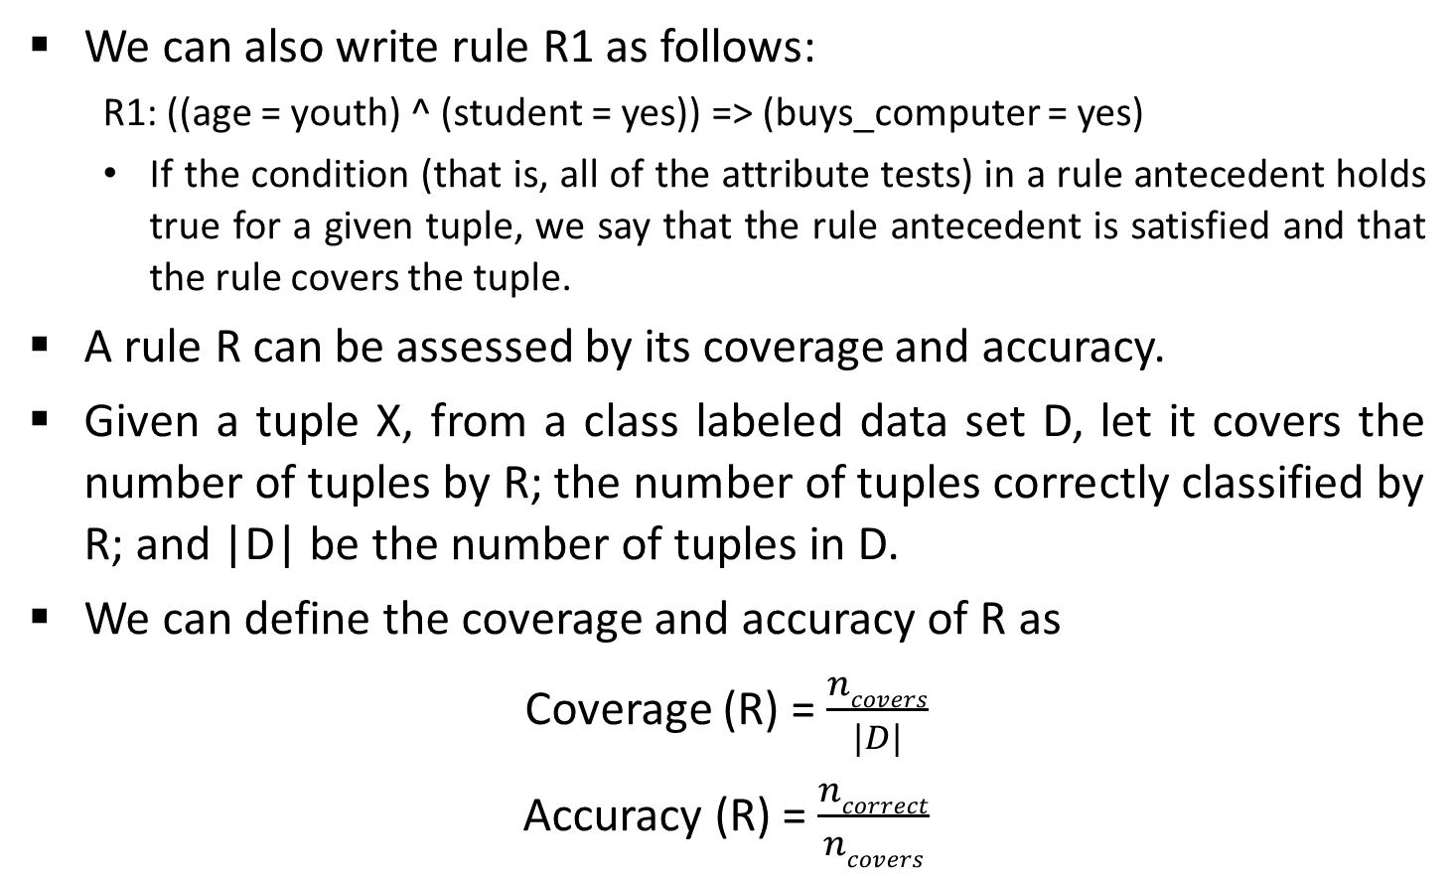
Rule Based Classification (Cont..)
We can also write rule R1 as follows:
R1: ((age = youth) ^ (student = yes)) => (buys_computer = yes)
If the condition (that is, all of the attribute tests) in a rule antecedent holds true for a given tuple, we say that the rule antecedent is satisfied and that the rule covers the tuple.
A rule R can be assessed by its coverage and accuracy.
Given a tuple X, from a class labeled data set D, let it covers the number of tuples by R; the number of tuples correctly classified by R; and |D| be the number of tuples in D.
We can define the coverage and accuracy of R as
Coverage (R) = $\frac{ncovers}{|D|}$
Accuracy (R) = $\frac{ncorrect}{ncovers}$

Slide 58
Neural Network
Neural Network is a set of connected INPUT/OUTPUT UNITS, where each connection has a WEIGHT associated with it.
Neural Network learning is also called CONNECTIONIST learning due to the connections between units.
Neural Network learns by adjusting the weights so It is able to correctly classify the training data and after testing phase, to classify unknown data.

Slide 59
Neural Network (Cont..)
Strengths of Neural Network:
It can handle against complex data. (i.e., problems with many parameters)
It can handle noise in the training data.
The Prediction accuracy is generally high.
Neural Networks are robust, work well even when training examples contain errors.
Neural Networks can handle missing data well.

Slide 60
Neural Network (Cont..)
Weakness of Neural Network:
Neural Network implementations are slow in the training phase.
A major disadvantage of neural network lies in their knowledge representation.
Acquired knowledge in the form of a network units connected by weighted links is difficult for humans to interpret.

Slide 61
Regression
Regression is a data mining function that predicts a number.
Age, weight, distance, temperature, income, or sales could all be predicted using regression techniques.
For example, a regression model could be used to predict children's height, given their age, weight, and other factors.
A regression task begins with a data set in which the target values are known.
For example, a regression model that predicts children's height could be developed based on observed data for many children over a period of time.
The data might track age, height, weight, developmental milestones, family history, etc.

Slide 62
Regression (Cont..)
Height would be the target, the other attributes would be the predictors, and the data for each child would constitute a case.
Regression models are tested by computing various statistics that measure the difference between the predicted values and the expected values.
It is required to understand the mathematics used in regression analysis to develop quality regression models for data mining.
The goal of regression analysis is to determine the values of parameters for a function that cause the function to fit best in a set of data observations that we provide.

Slide 63
Linear Regression
The simplest form of regression to visualize is linear regression with a single predictor.
A linear regression technique can be used if the relationship between x and y can be approximated with a straight line.
Linear regression with a single predictor can be expressed with the following equation with one dependent and one independent variable is defined by the formula
Where y = Dependent variable which we are trying to predict, b₁ = The Slope, and X = independent variable, b₀ = The Intercept, u = Random Error/Residual
Y = b₁X + b₀ + u

Slide 64
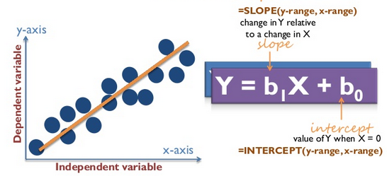
Linear Regression (Cont..)

Slide 65
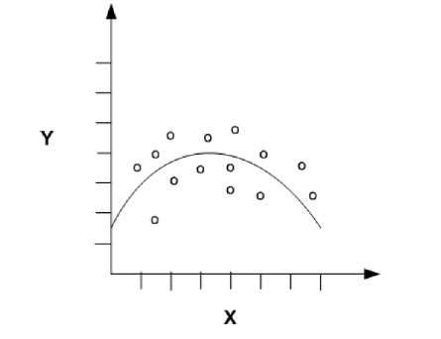
Nonlinear Regression
Often the relationship between x and y cannot be approximated with a straight line.
In this case, a nonlinear regression technique may be used. Alternatively, the data could be preprocessed to make the relationship linear.

Slide 66
Multiple Linear Regression
Multiple Linear regression is an extension of simple linear regression analysis.
It uses two or more independent variables to predict the outcome and a single continuous dependent variable, Like..
Where Y = dependent variable or response variable
X₁,X₂,….X_{n} are the independent variables or predictors
u = Random Error
b₀,b₁,b₂,….b_{n} are the regression coefficients
Y = b₀ + b₁X₁+ b₂X₂+ b₃X₃ +….+ b_{n}X_{n} + u

Slide 67
Logistic Regression
A linear regression is not appropriate for predicting the value of a binary variable for two reasons:
A linear regression will predict values outside the acceptable range (e.g. predicting probabilities outside the range 0 to 1).
Since the experiments can only have one of two possible values for each experiment, the residuals(random errors) will not be normally distributed about the predicted line.
A logistic regression produces a logistic curve, which is limited to values between 0 and 1.
Logistic regression is similar to a linear regression, but the curve is constructed using the natural logarithm “odds” of the target variable, rather than the probability.

Slide 68
Logistic Regression (Cont..)

Slide 69
Try yourself (Bayesian Classification)
Car No | Color | Type | Origin | Stolen?
1 | Red | Sports | Domestic | Yes
2 | Red | Sports | Domestic | No
3 | Red | Sports | Domestic | Yes
4 | Yellow | Sports | Domestic | No
5 | Yellow | Sports | Imported | Yes
6 | Yellow | SUV | Imported | No
7 | Yellow | SUV | Imported | Yes
8 | Yellow | SUV | Domestic | No
9 | Red | SUV | Imported | No
10 | Red | Sports | Imported | Yes

Slide 70
Bayesian Classification - Classification
Unseen Data Y = <Red, Domestic, SUV>
Actual Data Y = <Red, Sports, Domestic>
0.024,0.072 (Unseen)
0.192, 0.096 (Actual)

