Slide 1

UNIT - 8 Advance Topics
2170715 - Data Mining & Business Intelligence
Prof. Naimish R. Vadodariya
naimish.vadodariya@darshan.ac.in
+91-8866215253
Computer Engineering Darshan Institute of Engineering & Technology

Slide 2
Outline
Clustering
Spatial Mining
Web Mining
Text Mining
Introduction to Big Data
Hadoop Architecture & Storage
Common Hadoop Shell Commands

Slide 3
Clustering
Cluster is a group of objects that belongs to the same class.
In other words, similar objects are grouped in one cluster and dissimilar objects are grouped in another cluster.
It is an unsupervised learning problem.
Clustering is a data mining technique used to place elements into related groups without advance knowledge of the group definitions.
It is a process of partitioning data objects into sub classes, which are called as clusters.

Slide 4
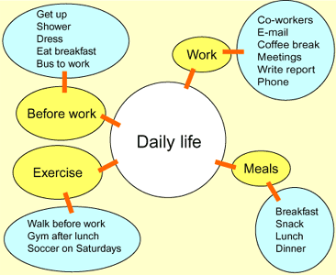
Example - Cluster

Slide 5
Cluster Applications
Marketing
Clustering can be used for targeted marketing
E.g. Given a customer database, containing properties and past buying records.
Similar groups of customers can be identified and grouped into one cluster.
Libraries
Based on different details about books clustering can be used for book ordering.
E.g. Book of similar contents
Insurance
With the help of clustering different groups of policy holders can be identified.
E.g. Policy holders with high average claim cost or identify some frauds.

Slide 6
Clustering Applications (Cont..)
City Planning
Using details like house type, geographical locations, group of houses can be identified using clustering.
Earthquake Studies
Clustering can also be used to identify dangerous zones based on earthquake epicenters.
WWW
Clustering can be used to find groups of similar access patterns using weblog data.
It can also be used for classification of documents.

Slide 7
Requirements of Clustering
Scalability − We need highly scalable clustering algorithms to deal with large databases.
Ability to deal with different kinds of attributes − Algorithms should be capable to be applied on any kind of data such as interval-based (numerical) data, categorical, and binary data.
Ability to deal with noisy data − Databases contain noisy, missing or erroneous data. Some algorithms are sensitive to such data and may lead to poor quality clusters.
Interpretability − The clustering results should be interpretable, comprehensible, and usable.

Slide 8
Spatial Mining
Spatial data mining is the application of data mining to spatial models.
In spatial data mining, analysts use geographical or spatial information to produce business intelligence or other results.
This requires specific techniques and resources to get the geographical data into relevant and useful formats.
Task is to search for spatial patterns.

Slide 9
Spatial Mining
Non-trivial search – as “automated” as possible.
Large search space of plausible hypothesis
Ex. Asiatic cholera: causes water, food, air and insects.
Interesting, useful, and unexpected spatial patterns.
Useful in certain application domain
Ex. Shutting off identified water pump => saved human lives.

Slide 10
Spatial Data Mining Tasks
Geo-Spatial Warehousing and OLAP
Spatial data classification/predictive modeling
Spatial clustering/segmentation
Spatial association and correlation analysis
Spatial regression analysis
Time-related spatial pattern analysis: trends, sequential patterns, partial periodicity analysis

Slide 11
Web Mining
Web mining is the use of data mining techniques to automatically discover and extract information from Web documents and services.
There are three general classes of information that can be discovered by web mining: Web activity, from server logs and Web browser activity tracking.
Web mining can be broadly divided into three distinct categories, according to the kinds of data to be mined.
Web Content Mining
Web Structure Mining
Web Usage Mining

Slide 12
Web Mining (Cont..)
Web content – text, image, records, etc.
Web structure – hyperlinks, tags, etc.
Web usage – http logs, app server logs, etc.

Slide 13
Web Mining (Cont..)
Web Mining
Web Content Mining
Web Structure Mining
Web Usage Mining
Identify information within given web pages
Uses inter-connections between web pages to give weight to the pages
Understand access patterns and the trends to improve structure

Slide 14
Uses of Web Content Mining
To gather, categorize, organize data provides best possible information available on the WWW to the user requesting the information.
To determine the relevance of the content to the search query.
Improve the navigation of information on the web provides productive marketing.
Produce a higher quality of information to the user.
Understand customer or user behavior, evaluate effectiveness of a particular web site, and help quantify the success of a marketing campaign.

Slide 15
Text Mining
Text mining, also referred to as text data mining, roughly equivalent to text analytics, is the process of deriving high-quality information from text.
With the advancement of technology, more and more data is available in digital form. Among which, most of the data (approx. 85%) is in unstructured textual form.
Text, so it has become essential to develop better techniques and algorithms to extract useful and interesting information from this large amount of textual data.

Slide 16
Text Mining (Cont..)
Text mining is a emerging new field that tries to extract meaningful information from natural language text.
It may be characterized as the process of analyzing text to extract information that is useful for a specific purpose.
Compared with the kind of data stored in databases, text is unstructured, ambiguous, and difficult to process.
Nevertheless, in modern culture, text is the most communal way for the formal exchange of information.
Text mining usually deals with texts whose function is the communication of actual information or opinions.

Slide 17
Areas of Text Mining
Information Retrieval (IR)
Information retrieval is regarded as an extension to document retrieval where the documents that are returned are processed to extract the particular information sought by the user.
Data Mining (DM)
Data mining can be loosely described as looking for patterns in data.
It can be more fully characterized as the extraction of hidden, previously unknown, and useful information from data.
Data mining tools can predict behaviors and future trends, allowing businesses to make positive, knowledge based decisions.
Data mining tools can answer business questions that have traditionally been too time consuming to resolve.

Slide 18
Areas of Text Mining (Cont..)
Natural Language Processing (NLP)
NLP is one of the oldest and most challenging problems in the field of artificial intelligence. It is the study of human language so that computers can understand natural languages as humans do.
NLP research pursues the question of how we understand the meaning of a sentence or a document.
While words - nouns, verbs, adverbs and adjectives - are the building blocks of meaning, it is their correlation to each other within the structure of a sentence in a document, and within the context of what we already know about the world, that provides the true meaning of a text.

Slide 19
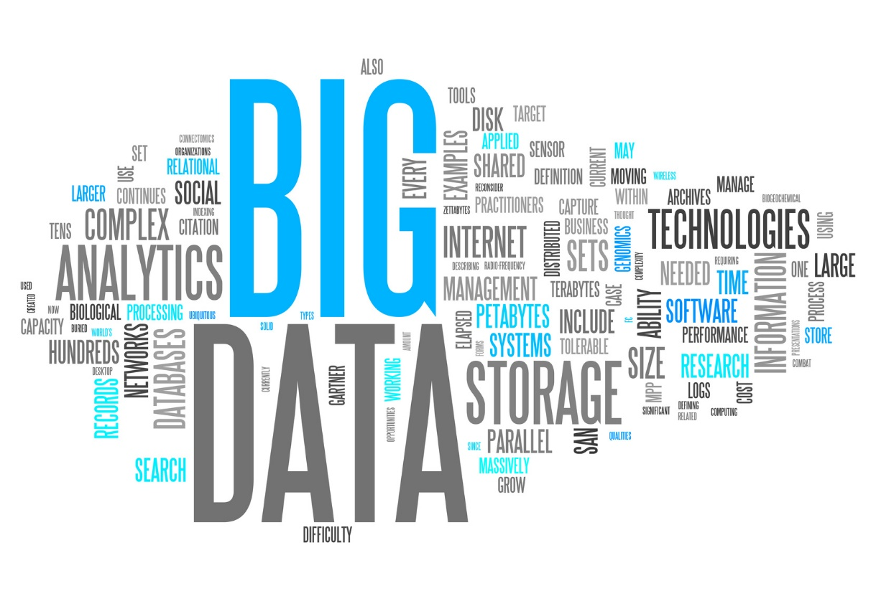
Big Data

Slide 20
Big Data
Big data is a term for data sets that are so large or complex that traditional data processing application software is inadequate to deal with them.
Big data challenges include capturing data, data storage, data analysis, search, sharing, transfer, visualization of data, querying, updating and information privacy.
Big data is an evolving term that describes any voluminous amount of structured, semistructured and unstructured data that has the potential to be mined for information.

Slide 21
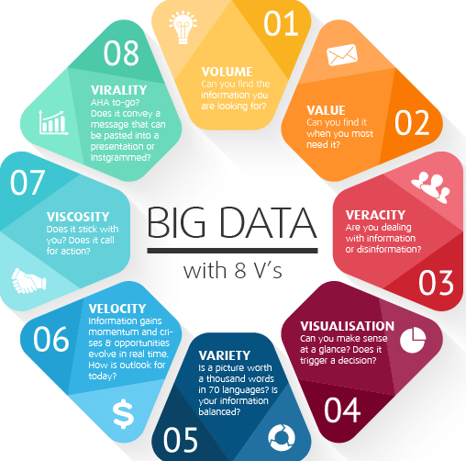
Big Data
Notes:
Source : https://www.sas.com/en_us/insights/big-data/hadoop.html

Slide 22
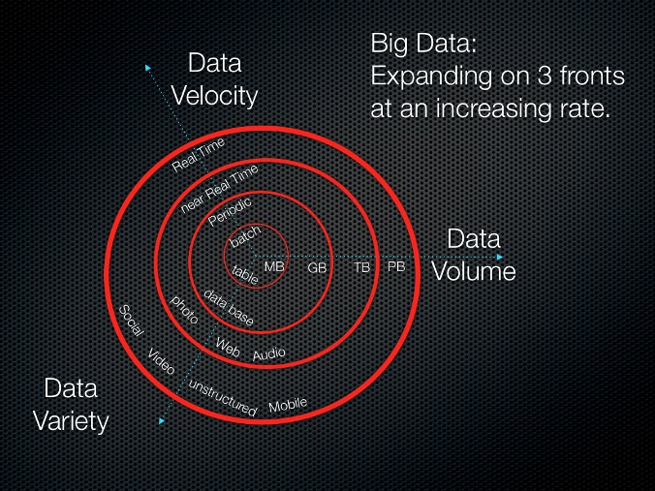
Big Data : 3V’s

Slide 23
Big Data : 3V’s
Volume
A typical PC might have had 10 gigabytes of storage in 2000.
Today, Facebook ingests 500 terabytes of new data every day.
Boeing 737 will generate 240 terabytes of flight data during a single flight across the US.
The smart phones, the data they create and consume; sensors embedded into everyday objects will soon result in billions of new data, constantly-updated data feeds containing environmental, location, and other information, including video.

Slide 24
Big Data : 3V’s
Velocity
Clickstreams and ad impressions capture user behavior at millions of events per second
High-frequency stock trading algorithms reflect market changes within microseconds
Machine to machine processes exchange data between billions of devices
Infrastructure and sensors generate massive log data in real-time
On-line gaming systems support millions of concurrent users, each producing multiple inputs per second.

Slide 25
Big Data : 3V’s
Variety
Big Data isn't just numbers, dates, and strings. It is also geospatial data, 3D data, audio and video, and unstructured text, including log files and social media.
Traditional database systems were designed to address smaller volumes of structured data, fewer updates or a predictable, consistent data structure.
Big Data analysis includes different types of data

Slide 26

Hadoop
Hadoop is an open-source software framework for storing data and running applications on clusters of commodity hardware.
It provides massive storage for any kind of data, enormous processing power and the ability to handle virtually limitless concurrent tasks or jobs.
As the World Wide Web grew in the late 1900s and early 2000s, search engines and indexes were created to help locate relevant information in the text-based content.
In the early years, search results were returned by humans. But as the web grew from dozens to millions of pages, automation was needed.
Web crawlers were created, many as university-led research projects, and search engine start-ups took off (Yahoo, AltaVista, etc.).

Slide 27
Hadoop
One such project was an open-source web search engine called Nutch – the brainchild of Doug Cutting and Mike Cafarella.
They wanted to return web search results faster by distributing data and calculations across different computers so multiple tasks could be accomplished simultaneously.
During this time, another search engine project called Google was in progress. It was based on the same concept – storing and processing data in a distributed, automated way so that relevant web search results could be returned faster.

Slide 28
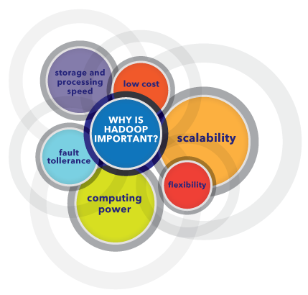
Why is Hadoop important?

Slide 29
Why is Hadoop important?
Ability to store and process huge amounts of any kind of data, quickly
With data volumes and varieties constantly increasing, especially from social media and the Internet of Things (IoT), that's a key consideration.
Computing power
Hadoop's distributed computing model processes big data fast. The more computing nodes you use, the more processing power you have.
Fault tolerance
Data and application processing are protected against hardware failure.
If a node goes down, jobs are automatically redirected to other nodes to make sure the distributed computing does not fail.
Multiple copies of all data are stored automatically.

Slide 30
Why is Hadoop important?
Flexibility
Unlike traditional relational databases, you don’t have to preprocess data before storing it.
You can store as much data as you want and decide how to use it later. That includes unstructured data like text, images and videos.
Low cost
The open-source framework is free and uses commodity hardware to store large quantities of data.
Scalability
You can easily grow your system to handle more data simply by adding nodes.
Little administration is required.

Slide 31
How Hadoop Works ?
Hadoop Commands
The libraries and utilities used by other Hadoop modules.
Hadoop Distributed File System (HDFS)
The Java-based scalable system that stores data across multiple machines without prior organization.
YARN (Yet Another Resource Negotiator)
It provides resource management for the processes running on Hadoop.
MapReduce
A parallel processing software framework.
It is comprised of two steps.
Map step is a master node that takes inputs and partitions them into smaller sub problems and then distributes them to worker nodes.
After the map step has taken place, the master node takes the answers to all of the sub problems and combines them to produce output.

Slide 32
What are the challenges of using Hadoop?
MapReduce programming is not a good match for all problems
It’s good for simple information requests and problems that can be divided into independent units, but it's not efficient for iterative and interactive analytic tasks.
MapReduce is file-intensive. Because the nodes don’t intercommunicate except through sorts and shuffles, iterative algorithms require multiple map-shuffle/sort-reduce phases to complete.
This creates multiple files between MapReduce phases and is inefficient for advanced analytic computing.

Slide 33
What are the challenges of using Hadoop?
There is a widely acknowledged talent gap
It can be difficult to find entry-level programmers who have sufficient Java skills to be productive with MapReduce.
That's one reason distribution providers are racing to put relational (SQL) technology on top of Hadoop. It is much easier to find programmers with SQL skills than MapReduce skills.
Data Security
Another challenge centers around the fragmented data security issues, though new tools and technologies are surfacing.
The Kerberos authentication protocol is a great step toward making Hadoop environments secure.
Full-fledged data management and governance
Hadoop does not have easy-to-use, full-feature tools for data management, data cleansing, governance and metadata.
Especially lacking are tools for data quality and standardization.

Slide 34


