Slide 1


UNIT-1 Symmetric Cipher Model
Prof. R. K. Karangiya
rekha.karangiya@darshan.ac.in
Information & Network Security (2170709) Darshan Institute of Engineering & Technology

Slide 2
Outline
Introduction
Security Objectives
OSI Security Architecture
Security Attacks
Security Services
Security Mechanism
Symmetric Cipher Model
Cryptography
Cryptanalysis and Attacks
Substitution and Transposition Techniques
Notes:
X.800 and RFC 2828
International Telecommunication Union (ITU)

Slide 3
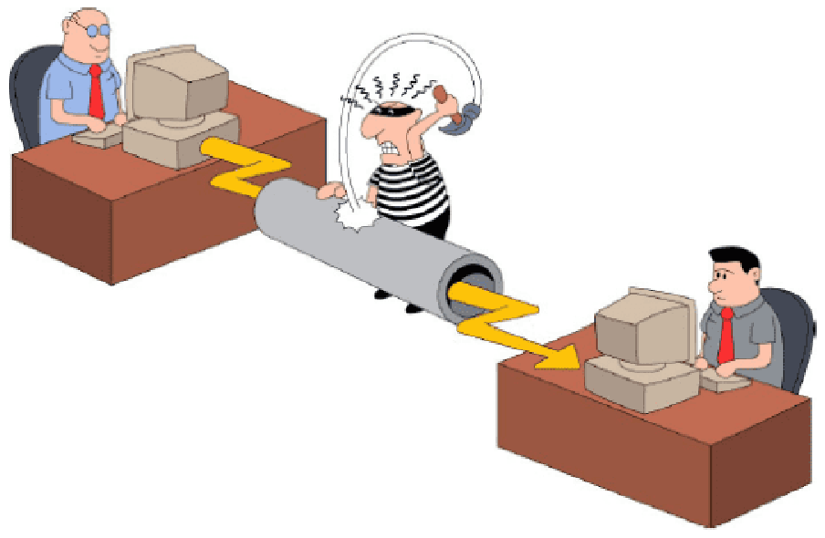
Introduction to Information & N/W Security

Slide 4
Information & Network Security
What is Information ?
The processed form of data or meaningful data is called information. Basically, information is the message that is being conveyed.
What is Security ?
Computer Security : Generic name for the collection of tools designed to protect data.
Network and Internet Security : Measures to protect data during their transmission over a collection of interconnected networks.
Data
Process
Information

Slide 5
Key Security Objectives
Goal/Objectives of Security :
Confidentiality
Integrity
Availability
Authenticity
Accountability

Slide 6




Confidentiality
Confidentiality:
Data confidentiality: Assure confidential information not made available to unauthorized individuals.
Example : Individual files are locked and secured
Bob
Alice
Packet sniffing, illegal copying
Attacker

Slide 7
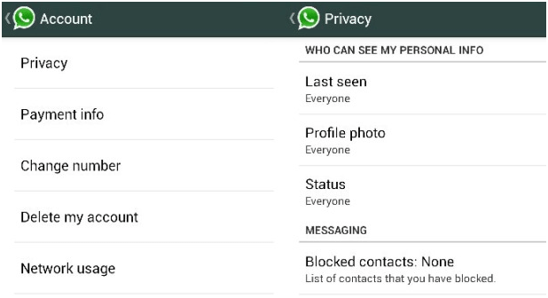
Confidentiality
Privacy: Assure individuals can control what information related to them is collected, stored, distributed.
Privacy is the right of an individual to protect personal or sensitive information.

Slide 8
Integrity
Integrity :
Data integrity: Assure information and programs are changed only in a authorized manner.
Message
Bob
Alice
Modifies the message, or Inserts a new one.
Message
How can Bob be sure that message really comes from Alice?
Attacker

Slide 9
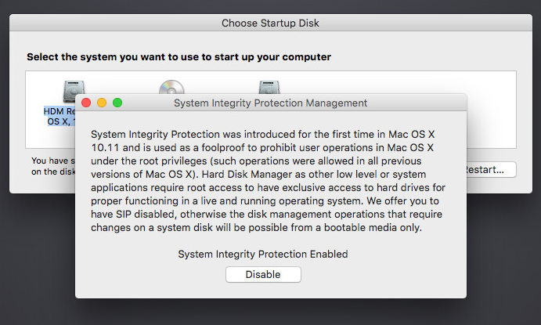
Integrity
System integrity: Assure system performs intended function.

Slide 10




Availability
Availability :
Assure that systems work promptly and service is not denied to authorized users.
www.amazon.com
User
Browser working
Server down

Slide 11



Authenticity
Authenticity:
The property of being genuine and being able to be verified and trusted; confidence in the validity of a transmission, a message, or message originator.
This means verifying that each input arriving at the system came from a trusted source.
Password
+
Verification
=
Access

Slide 12


Authenticity
Transfer Rs. 1,00,000
From A to C.
I am User A
User A
Bank
User C

Slide 13
Accountability
Accountability:
The security goal that generates the requirement for actions of an entity to be traced uniquely to that entity.
This supports nonrepudiation(assurance that someone cannot deny something).
Transfer Rs. 1,00,000
to Bank
User A
Bank

Slide 14
Impact of Security Breaches
Effectiveness of primary operations are reduced
Example: Hackers compromised exam question paper.
Financial loss
Example: The cost of repairing a company database once it’s been compromised.
Damage to assets
Example: Hackers compromised Amazon Web Services account and demanded a ransom. When the company declined, the hacker started destroying their resources.
Harm to individuals
Example: Hackers compromised patience database and change it.

Slide 15
OSI Security Architecture
Systematic approach to define requirements for security and approaches to satisfying those requirements
The OSI (Open Systems Interconnection) security architecture focuses on Security Attacks, Mechanisms, and Services.
Security Attack: Any action that compromises the security of information owned by an organization.
Security Mechanism: A process that is designed to detect, prevent, or recover from a security attack.
Security Service: A communication service that enhances the security of the data processing systems and the information transfers of an organization.

Slide 16
Security Attacks

Slide 17
Security Attacks
A passive attack attempts to learn or make use of information from the system but does not affect system resources.
Release of message contents
Traffic analysis
Relatively hard to detect, but easier to prevent
An active attack attempts to alter system resources or affect their operation.
Masquerade
Replay
Modification of messages
Denial of service.
Relatively hard to prevent, but easier to detect

Slide 18
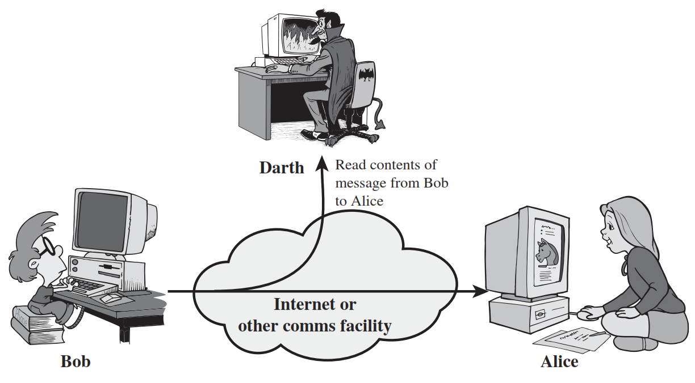
Release of message contents (Passive Attack)
A telephone conversation, an electronic mail message, and a transferred file may contain sensitive or confidential information.
We would like to prevent an opponent from learning the contents of these transmissions.
Attack on Confidentiality.

Slide 19
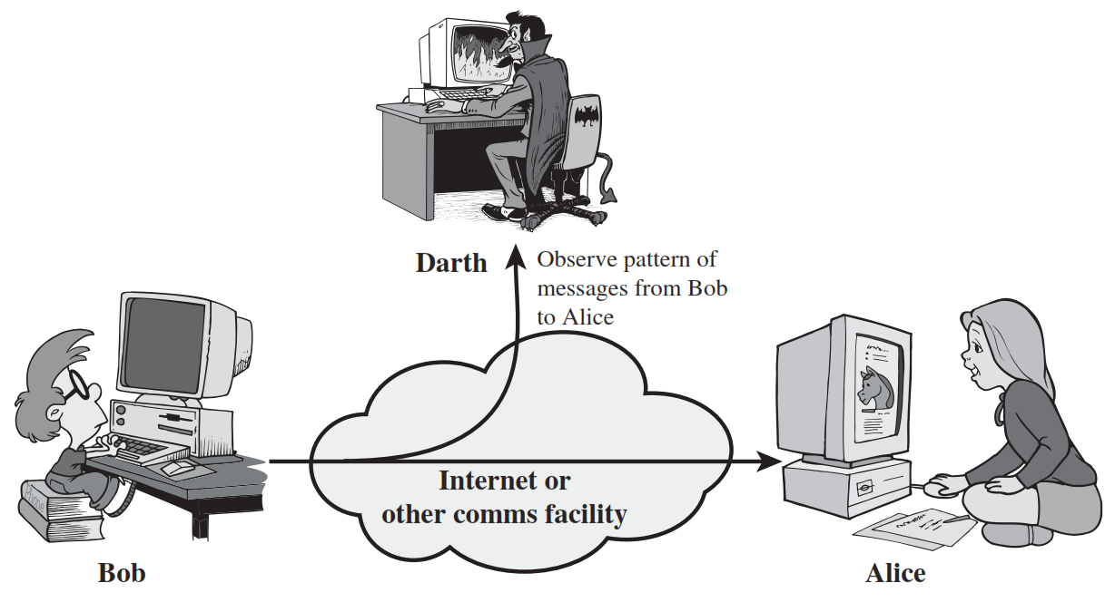
Traffic Analysis (Passive Attack)
In such attacks, an attacker analyses the traffic and observes the frequency and length of exchanged messages. He uses all this information to predict the nature of communication.
Studying the flow of "traffic" to find patterns of behaviour.

Slide 20
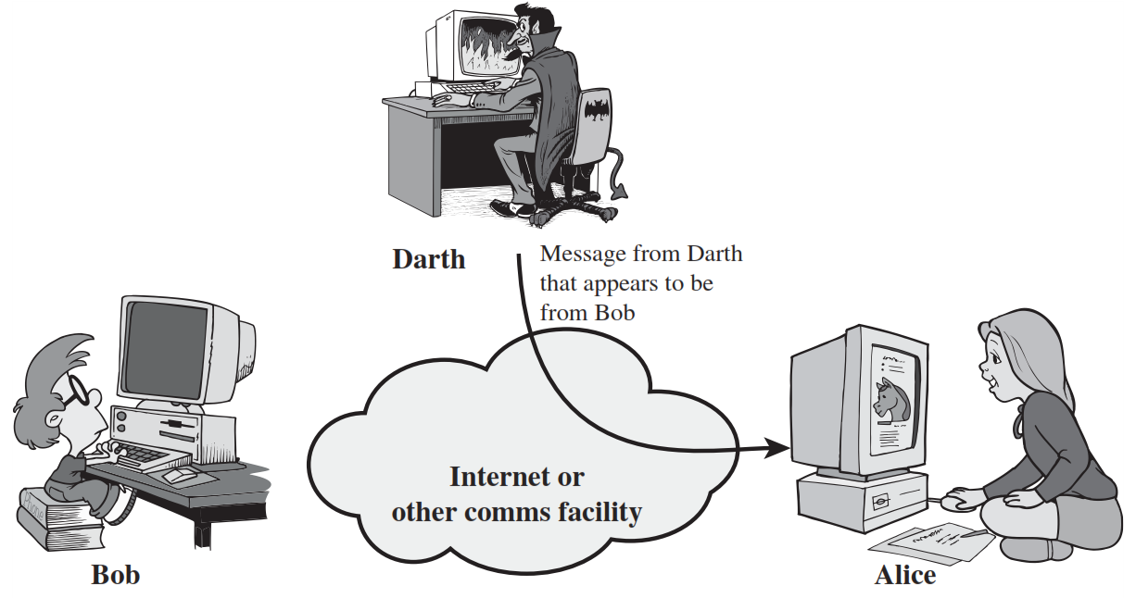
Masquerade Attack (Active Attack)
A masquerade takes place when one entity pretends to be a different entity.
A masquerade attack is an attack that uses a fake identity to gain unauthorized access to personal information.
Attack on Authentication.

Slide 21

Replay Attack (Active Attack)
Replay attack involves the passive capture of a data unit and its subsequent retransmission to produce an unauthorized effect.
Replay attack is to replay the message sent to a network by an attacker, which was earlier sent by an authorized user.

Slide 22
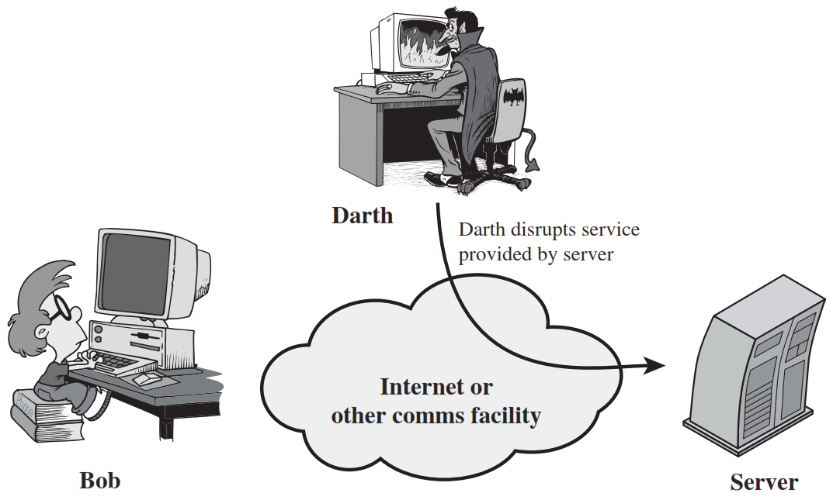
Modification of messages Attack (Active Attack)
Modification of messages simply means that some portion of a legitimate message is altered, or that messages are delayed or reordered, to produce an unauthorized effect.
Attack on Integrity.

Slide 23
Denial of Service Attack (Active Attack)
The denial of service attack prevents the normal use or management of communications facilities.
Sending large number of packets to block the server.
Attack on Availability.

Slide 24
Security Services

Slide 25
Security Services (X.800)
X.800 standard defines a security service as a service that is provided by a protocol layer of communicating open systems and that ensures security of the systems or of data transfers.
Notes:
a processing or communication service that is provided by

Slide 26
Security Services
Authentication
Access Control
Data Confidentiality
Data Integrity
Non Repudiation
Peer Entity Authentication
Connection Confidentiality
Connection Integrity with recovery
Non Repudiation Origin
Data Origin Authentication
Connection less Confidentiality
Connection Integrity with out recovery
Non Repudiation Destination
Selective Repeat Confidentiality
Selective Field Connection Integrity
Traffic Flow Confidentiality
Connection less Integrity
Selective Field Connection less Integrity

Slide 27
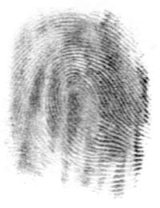
Authentication
Authentication is the assurance that the communicating entity is the one that it claims to be.
Peer Entity Authentication: Used in association with a logical connection (TCP) to provide confidence in the identity of the entities connected.
Data-Origin Authentication: In a connectionless (UDP) transfer, provides assurance that the source of received data is as claimed.
Who you are ? (biometrics)
Physical authentication
where you are ?
What you know ?
Password
One-time Password(OTP)
Notes:
Peer Entity Authentication: Used in association with a logical connection to provide confidence in the identity of the entities connected.
Data-Origin Authentication: In a connectionless transfer, provides assurance that the source of received data is as claimed.

Slide 28
Security Services
Authentication
Access Control
Data Confidentiality
Data Integrity
Non Repudiation
Peer Entity Authentication
Connection Confidentiality
Connection Integrity with recovery
Non Repudiation Origin
Data Origin Authentication
Connection less Confidentiality
Connection Integrity with out recovery
Non Repudiation Destination
Selective Repeat Confidentiality
Selective Field Connection Integrity
Traffic Flow Confidentiality
Connection less Integrity
Selective Field Connection less Integrity

Slide 29

Access Control
Access control is the prevention of unauthorized use of a resource
This service controls who can have access to a resource, under what conditions access can occur, and what those accessing the resource are allowed to do.
User A
User B
Human resources
network
Development
network

Slide 30
Security Services
Authentication
Access Control
Data Confidentiality
Data Integrity
Non Repudiation
Peer Entity Authentication
Connection Confidentiality
Connection Integrity with recovery
Non Repudiation Origin
Data Origin Authentication
Connection less Confidentiality
Connection Integrity with out recovery
Non Repudiation Destination
Selective Repeat Confidentiality
Selective Field Connection Integrity
Traffic Flow Confidentiality
Connection less Integrity
Selective Field Connection less Integrity

Slide 31
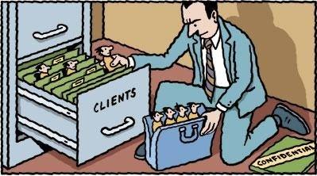
Data Confidentiality
Data confidentiality is the protection of data from unauthorized disclosure.
Connection Confidentiality: The protection of all user data on a connection.
Connectionless Confidentiality: The protection of all user data in a single data block.
Selective-Field Confidentiality: The confidentiality of selected fields within the user data on a connection or in a single data block.
Traffic-Flow Confidentiality: The protection of the information that might be derived from observation of traffic flows.

Slide 32
Security Services
Authentication
Access Control
Data Confidentiality
Data Integrity
Non Repudiation
Peer Entity Authentication
Connection Confidentiality
Connection Integrity with recovery
Non Repudiation Origin
Data Origin Authentication
Connection less Confidentiality
Connection Integrity with out recovery
Non Repudiation Destination
Selective Repeat Confidentiality
Selective Field Connection Integrity
Traffic Flow Confidentiality
Connection less Integrity
Selective Field Connection less Integrity

Slide 33

Data Integrity
Data integrity is the assurance that data received are exactly as sent by an authorized entity (i.e., contain no modification, insertion, deletion, or replay).
Channel
Alice
Bob
Both are same

Slide 34
Data Integrity (Cont…)
Connection Integrity with Recovery: Provides integrity of all user data on a connection and detects any modification, insertion, deletion, or replay of any data with recovery attempted.
Connection Integrity without Recovery: As above, but provides only detection without recovery.
Selective-Field Connection Integrity: Provides integrity of selected fields within the user data and takes the form of determination of whether the selected fields have been modified, inserted, deleted, or replayed.

Slide 35
Data Integrity (Cont…)
Connectionless Integrity: Provides integrity of a single connectionless data block and may take the form of detection of data modification. Additionally, a limited form of replay detection may be provided.
Selective-Field Connectionless Integrity: Provides integrity of selected fields within a single connectionless data block; takes the form of determination of whether the selected fields have been modified.

Slide 36
Security Services
Authentication
Access Control
Data Confidentiality
Data Integrity
Non Repudiation
Peer Entity Authentication
Connection Confidentiality
Connection Integrity with recovery
Non Repudiation Origin
Data Origin Authentication
Connection less Confidentiality
Connection Integrity with out recovery
Non Repudiation Destination
Selective Repeat Confidentiality
Selective Field Connection Integrity
Traffic Flow Confidentiality
Connection less Integrity
Selective Field Connection less Integrity

Slide 37
Non Repudiation
Nonrepudiation is the assurance that someone cannot deny something.
Typically, nonrepudiation refers to the ability to ensure that a communication cannot deny the authenticity of their signature on a document or the sending of a message that they originated.
Transfer Rs. 1,00,000
to Bank
After few days
User A
I have never requested to transfer Rs. 1,00,000
to Bank
Bank
Notes:
Hash functions, Digital signatures

Slide 38
Non Repudiation (Cont…)
Nonrepudiation-Origin: Proof that the message was sent by the specified party.
Nonrepudiation-Destination: Proof that the message was received by the specified party.

Slide 39
Security Mechanisms

Slide 40
Security Mechanisms (X.800)
Techniques designed to prevent, detect or recover from attacks
No single mechanism can provide all services
Common in most mechanisms: cryptographic techniques
Specific security mechanisms: Integrated into the appropriate protocol layer in order to provide some of the OSI security services.
Pervasive security mechanisms: Not integrated to any particular OSI security service or protocol layer

Slide 41
Security Mechanism (Specific security)
Encipherment: Hiding or covering data using mathematical algorithms.
Digital Signature: The sender can electronically sign the data and the receiver can electronically verify the signature.
Access Control: A variety of mechanisms that enforce access rights to resources.
Data Integrity: A variety of mechanisms used to assure the integrity of a data unit or stream of data units.

Slide 42
Security Mechanism (Specific security)
Authentication Exchange: Two entities exchange some messages to prove their identity to each other.
Traffic Padding: The insertion of bits into gaps in a data stream to frustrate traffic analysis attempts.
Routing Control: Selecting and continuously changing routes between sender and receiver to prevent opponent(attacker) from eavesdropping.
Notarization: The use of a trusted third party to assure and control the communication.

Slide 43
Model for Network Security
Trusted third party
(e.g., arbiter, distributer
of secret information)
Sender
Recipient
Security -related Transformation
Info.
Channel
Security -related Transformation
Message
Secure
Message
Secure
Message
Message
Secret
Information
Secret
Information
Opponent
(Attacker)

Slide 44
Encryption and Decryption
Sender
Hello
Encryption
f7#er
Decryption
Hello
Receiver

Slide 45



Symmetric Cipher Model (Conventional Encryption)
Secret key shared by sender and recipient
Secret key shared by sender and recipient
K
K
Transmitted
cipher text
Y = E(K, X)
X
X
Plaintext
input
Encryption Algorithm
(e.g. AES)
Decryption Algorithm
(reverse of encryption algorithm)
Plaintext
output
Plaintext is the original intelligible message or data that is fed into the algorithm as input.
Encryption algorithm performs various substitutions and transformations on the plaintext.
The secret key is also input to the encryption algorithm.
The key is a value independent of the plaintext and of the algorithm.
The algorithm will produce a different output depending on the specific key being used at the time.
Decryption algorithm is essentially the encryption algorithm run in reverse.
It takes the ciphertext and the secret key and produces the original plaintext.
Ciphertext is the scrambled message produced as output.
It depends on the plaintext and the secret key.
The ciphertext is an apparently random stream of data and, as it stands, is unintelligible.
An original message is known as the plaintext, while the coded message is called the ciphertext.
The process of converting from plaintext to ciphertext is known as enciphering or encryption; restoring the plaintext from the ciphertext is deciphering or decryption.

Slide 46
Terminology
Plaintext: original message
Ciphertext: encrypted or coded message
Encryption: convert from plaintext to ciphertext (enciphering)
Decryption: restore the plaintext from ciphertext (deciphering)
Key: information used in cipher known only to sender/receiver
Cipher: a particular algorithm (cryptographic system)
Cryptography: study of algorithms used for encryption
Cryptanalysis: study of techniques used for decryption without knowledge of plaintext
Cryptology: areas of cryptography and cryptanalysis

Slide 47
Cryptography and Cryptanalysis
Cryptography(Secret Writing) is the process of protecting information by transforming it into a secure (unreadable) format.
Cryptanalysis is the decryption and analysis of encrypted text. Cryptanalysis uses mathematical formulas to search algorithm vulnerabilities and break into cryptography.
Hello
Cryptography
$!dzx
$!dzx
Cryptanalysis
Hello
Notes:
either "writing" or a "field of study"
Calligraphy
Geography
cinematography
autobiography

Slide 48
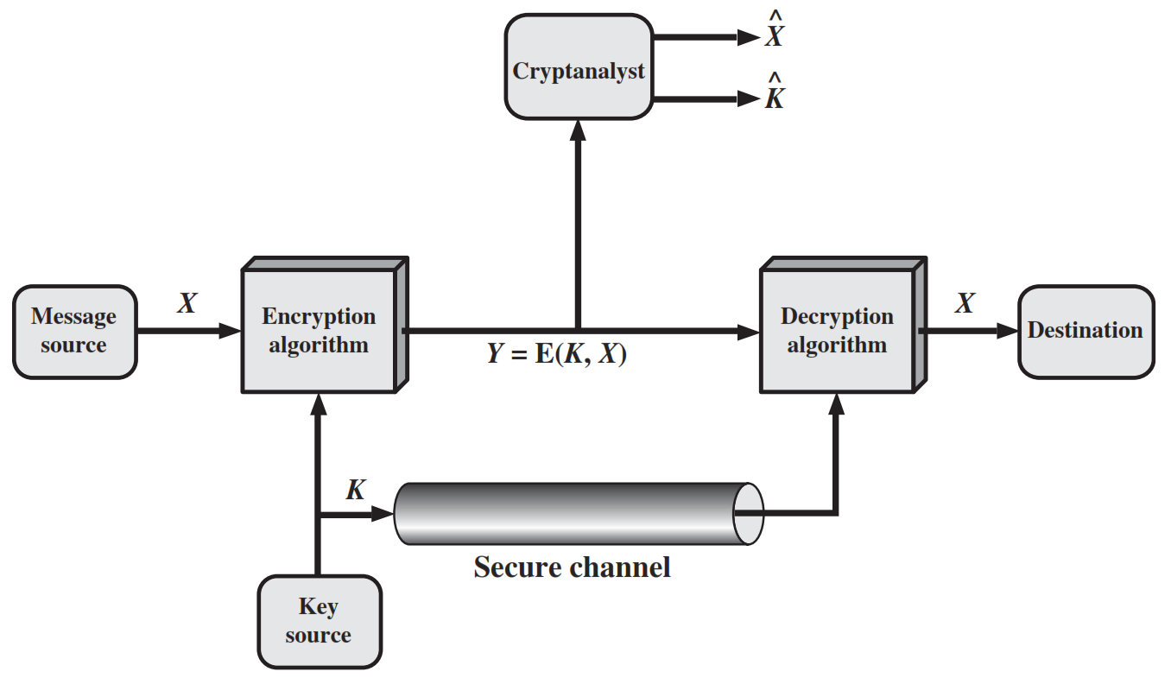
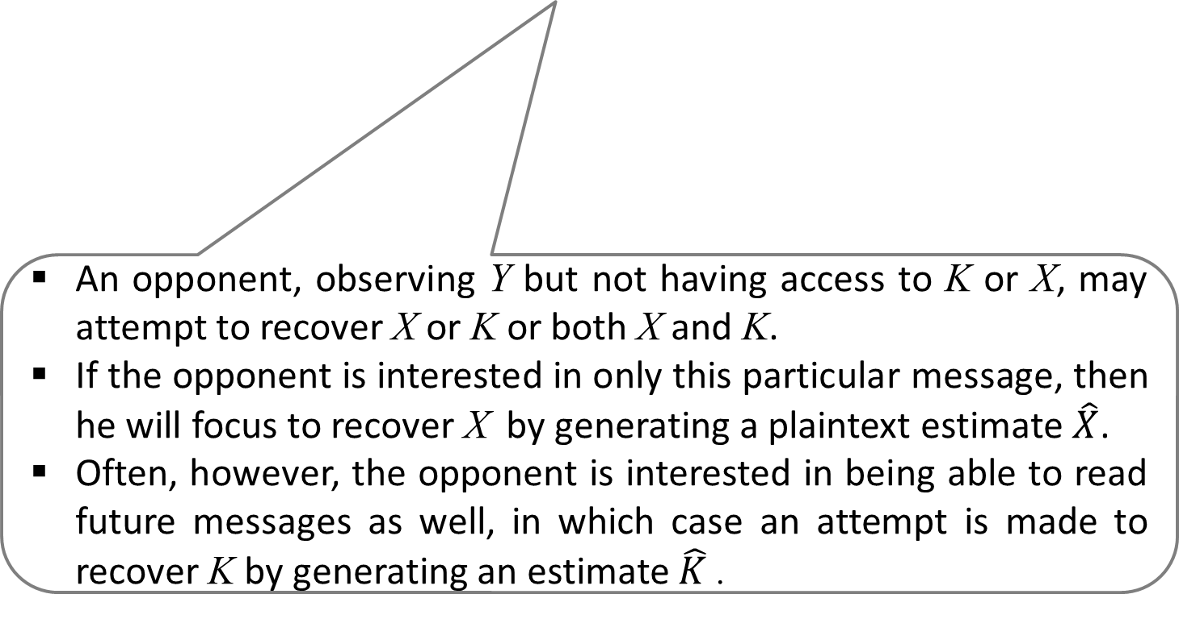
An opponent, observing Y but not having access to K or X, may attempt to recover X or K or both X and K.
If the opponent is interested in only this particular message, then he will focus to recover X by generating a plaintext estimate $\hat{X}$.
Often, however, the opponent is interested in being able to read future messages as well, in which case an attempt is made to recover K by generating an estimate $\hat{K}$.

Slide 49
Requirements and Assumptions
Requirements for secure use of symmetric encryption:
Strong encryption algorithm: Given the algorithm and cipher text, an attacker cannot obtain key or plaintext.
Shared secret keys: sender and receiver both have shared a secret key; no-one else knows the key(keep it secret).
Assumptions:
Cipher is known
Secure channel to distribute keys

Slide 50
Cryptanalysis and Brute-Force Attack
Objective of attacker: recover key (not just message)
Approaches of attacker:
Cryptanalysis: This type of attack exploits the characteristics of the algorithm to attempt to derive a specific plaintext or to derive the key being used.
Brute-force attack: The attacker tries every possible key on a piece of ciphertext until an intelligible translation into plaintext is obtained.
On average, half of all possible keys must be tried to achieve success.

Slide 51
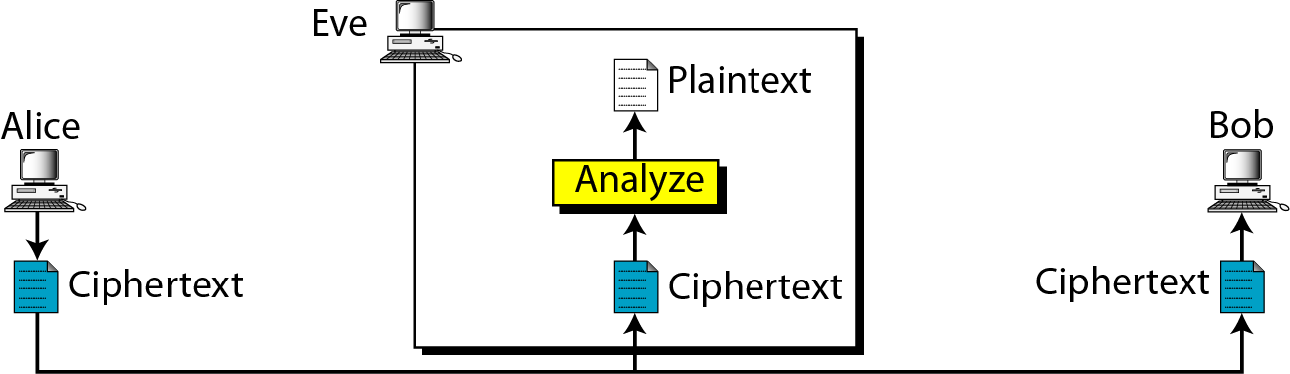
Attacks on Encrypted Messages
Type of Attack | Known to cryptanalyst
Ciphertext Only | Encryption algorithm, Ciphertext

Slide 52
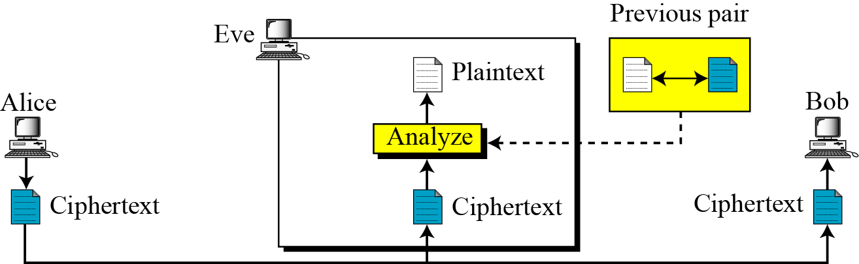
Attacks on Encrypted Messages
Type of Attack | Known to cryptanalyst
Known Plaintext | Encryption algorithm, Ciphertext, One or more plaintext-cipher text pairs formed with the secret key

Slide 53
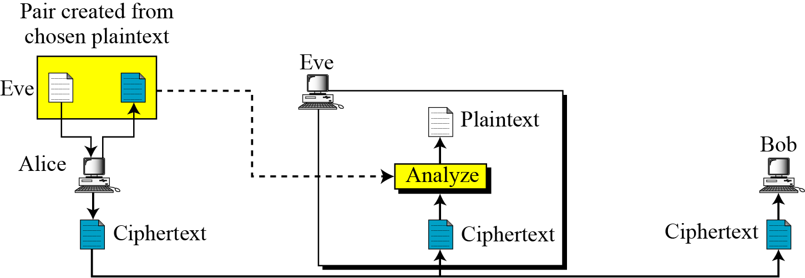
Attacks on Encrypted Messages
Type of Attack | Known to cryptanalyst
Chosen Plaintext | Encryption algorithm, Ciphertext, Plaintext message chosen by cryptanalyst

Slide 54
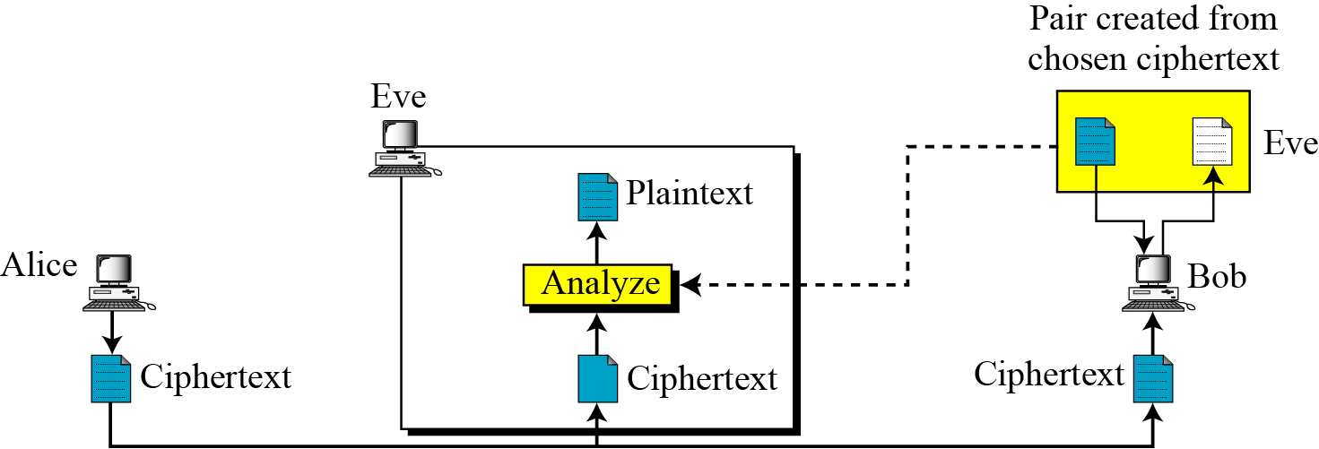
Attacks on Encrypted Messages
Type of Attack | Known to cryptanalyst
Chosen Ciphertext | Encryption algorithm, Ciphertext, Ciphertext chosen by cryptanalyst, with its corresponding decrypted plaintext generated with the secret key

Slide 55
Attacks on Encrypted Messages
Type of Attack | Known to cryptanalyst
Chosen text | Encryption algorithm, Ciphertext, Plaintext chosen by cryptanalyst, with its corresponding ciphertext generated with the secret key , Ciphertext chosen by cryptanalyst, with its corresponding decrypted plaintext generated with the secret key

Slide 56
Substitution Techniques
A substitution technique is one in which the letters of plaintext are replaced by other letters or by numbers or symbols.
If plaintext viewed as sequence of bits, replace plaintext bit patterns with ciphertext bit patterns.
Caesar Cipher
Monoalphabetic Cipher
Playfair Cipher
Hill Cipher
Polyalphabetic Ciphers
One-Time Pad

Slide 57
Caesar Cipher
The Caesar Cipher involves replacing each letter of the alphabet with the letter standing three places further down the alphabet.
For encryption algorithm is:
For decryption algorithm is:
C = E(3, P) = (P + 3) mod 26
P = D(3, C) = (C - 3) mod 26

Slide 58
Caesar Cipher (Cont…)
Let us assign a numerical equivalent to each letter
a | b | c | d | e | f | g | h | i | j | k | l | m
0 | 1 | 2 | 3 | 4 | 5 | 6 | 7 | 8 | 9 | 10 | 11 | 12
n | o | p | q | r | s | t | u | v | w | x | y | z
13 | 14 | 15 | 16 | 17 | 18 | 19 | 20 | 21 | 22 | 23 | 24 | 25
C = E(3, P) = (P + 3) mod 26
Plain: a b c d e f g h i j k l m n o p q r s t u v w x y z
Cipher: d e f g h i j k l m n o p q r s t u v w x y z a b c
Example:
Plaintext: THE QUICK BROWN FOX
Ciphertext: WKH TXLFN EURZQ IRA

Slide 59
Caesar Cipher (Cont…)
Generalised Caesar Cipher
Allow shift by k positions.
Encryption :
Decryption :
Modulo for negative number is = N- (B%N)
Example :
-11 mod 26 = 15
26-(11%26) = 15
C = E(K, P) = (P + K) mod 26
P = D(K, C) = (C - K) mod 26

Slide 60

Caesar Cipher Examples
Plaintext: networksecurity
Key: 7
Cipher:
Cipher: exxegoexsrgi
Key: 4
Plaintext :
Cipher: kyzj dvjjrxv zj vetipgkvu
Key: 17
Plain:
Plain: information security
Key: l
Cipher:
uladvyrzljbypaf
attackatonce
this message is encrypted
tyqzcxletzy dpnfctej

Slide 61
Brute force attack on Caesar Cipher
The encryption and decryption algorithms are known.
There are only 25 keys to try, e.g. k=1, k=2, …
The language of the plaintext is known and easily recognizable.

Slide 62
Brute force attack on Caesar Cipher
Ciphertext: ZNK WAOIQ HXUCT LUD
Key | Transformed text
1 | YMJ VZNHP GWTBS KTC
2 | XLI UYMGO FVSAR JSB
3 | WKH TXLFN EURZQ IRA
4 | VJG SWKEM DTQYP HQZ
5 | UIF RVJDL CSPXOGPY
6 | THE QUICK BROWN FOX
7 | SGD PTHBJ AQNVM ENW
8 | RFC OSGAI ZPMUL DMV
9 | QEB NRFZH YOLTK CLU
10 | PDA MQEYG XNKSJ BKT
11 | OCZ LPDXF WMJRI AJS
12 | NBY KOCWE VLIQH ZIR
13 | MAX JNBVD UKHPG YHQ
Key | Transformed text
14 | LZW IMAUC TJGOF XGP
15 | KYV HLZTB SIFNE WFO
16 | JXU GKYSA RHEMD VEN
17 | IWT FJXRZ QGDLC UDM
18 | HVS EIWQY PFCKB TCL
19 | GUR DHVPX OEBJA SBK
20 | FTQ CGUOW NDAIZ RAJ
21 | ESP BFTNV MCZHY QZI
22 | DRO AESMU LBYGX PYH
23 | CQN ZDRLT KAXFW OXG
24 | BPM YCQKS JZWEV NWF
25 | AOL XBPJR IYVDU MVE

Slide 63
Substitution Techniques
Caesar Cipher
Monoalphabetic Cipher
Playfair Cipher
Hill Cipher
Polyalphabetic Ciphers
One-Time Pad

Slide 64
2. Monoalphabetic Cipher (Simple substitution)
It is an improvement to the Caesar Cipher.
Instead of shifting the alphabets by some number, this scheme uses some permutation of the letters in alphabet.
Use a single alphabet for both plaintext and cipher text.
Example:
Cipher: kxlvzofemrj
Plaintext:
Try Brute force attack :
With 26 letters in alphabet, the possible permutations are 26! Keys (>4x10²⁶)
Plain: a b c d e f g h i j k l m n o p q r s t u v w x y z
Cipher: y n l k x b s h m i w d p j r o q v f e a u g t z c
decrypstion

Slide 65
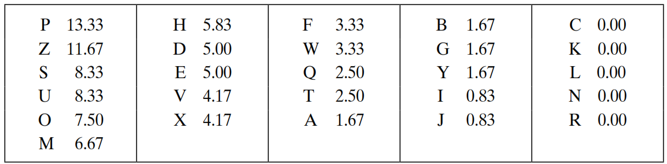
Attack on Monoalphabetic Cipher
The relative frequencies of the letters in the ciphertext (in %) are
Ciphertext:
uzqsovuohxmopvgpozpevsgzwszopfpesxudbmetsxaizvuephzhmdzshzowsfpappdtsvpquzwymxuzuhsxepyepopdzszufpombzwpfupzhmdjudtmohmq
In our ciphertext, the most common digram is ZW, which appears three times. So equate Z with t, W with h and P with e.
Now notice that the sequence ZWP appears in the ciphertext, and we can translate that sequence as “the.”

Slide 66
Attack on Monoalphabetic Cipher (Cont…)
If the cryptanalyst knows the nature of the plaintext, then the analyst can exploit the regularities of the language.
The relative frequency of the letters can be determined and compared to a standard frequency distribution for English.
If the message were long enough, this technique alone might be sufficient, but because this is a relatively short message, we cannot expect an exact match.

Slide 67
Substitution Techniques
Caesar Cipher
Monoalphabetic Cipher
Playfair Cipher
Hill Cipher
Polyalphabetic Ciphers
One-Time Pad

Slide 68
Playfair Cipher
The Playfair algorithm is based on a 5 × 5 matrix (key) of letters.
The matrix is constructed by filling in the letters of the keyword (minus duplicates) from left to right and from top to bottom, and then filling in the remainder of the matrix with the remaining letters in alphabetic order. The letters I and J count as one letter.
O | C | U | R | E
N | A | B | D | F
G | H | I/J | K | L
M | P | Q | S | T
V | W | X | Y | Z
Example:
Keyword= OCCURRENCE
Plaintext= TALL TREES

Slide 69
Playfair Cipher - Encrypt Plaintext
Operate on pair of letters (digram) at a time.
Special: if digram with same letters appears, separate by special letter (e.g. x)
If there is an odd number of letters, then add uncommon letter to complete digram, a X/Z may be added to the last letter.
Plaintext= NETWORK
Plaintext= NE TW OR KX
Plaintext= TALL TREES
Plaintext= TA LX LT RE ES

Slide 70
Playfair Cipher - Encrypt Plaintext
Map each pair in key matrix
O | C | U | R | E
N | A | B | D | F
G | H | I/J | K | L
M | P | Q | S | T
V | W | X | Y | Z
Plaintext: TA LX LT RE ES
Ciphertext: PF IZ TZ EO RT
If the letters are on different rows and columns, replace them with the letters on other corner of the same row.
The order is important - the first letter of the pair should be replaced first.
For example, using the table above, the letter pair TA would be encoded as PF.
If the letters appear on the same row, replace them with the letters to their immediate right respectively, wrapping around to the left side of the row if necessary.
For example, using the table above, the letter pair RE would be encoded as EO.
If the letters appear on the same column, replace them with the letters immediately below, wrapping around to the top if necessary.
For example, using the table above, the letter pair LT would be encoded as TZ.

Slide 71
Playfair Cipher - Is it Breakable?
Better than monoalphabetic: relative frequency of digrams much less than of individual letters.
But relatively easy (digrams, trigrams, expected words)

Slide 72
Playfair Cipher Examples
Key= “engineering ” Plaintext= “test this process ”
Key= “keyword ” Plaintext= “come to the window”
Key= “moonmission ” Plaintext= “greet ”
E N G I R A B C D F H K L M O P Q S T U V W X Y Z | Encrypted Message: pi tu pm gt ue lf gp xg
K E Y W O R D A B C F G H I L M N P Q S T U V X Z | Encrypted Message: Lc nk zk vf yo gq ce bw
M O N I S A B C D E F G H K L P Q R T U V W X Y Z | Encrypted Message: hq cz du

Slide 73
Playfair Cipher Examples
Key: EXAMPLE
Ciphertext: UA ARBED EXAPO PR QNX AXANR
Pair: UA AR BE DE XA PO PR QN XA XA NR
Plaintext: we wi lx lm ex et at th ex ex it
Plaintext: we wilxl mexet at thex exit
Plaintext: we will meet at the exit
E | X | A | M | P
L | B | C | D | F
G | H | I/J | K | N
O | Q | R | S | T
U | V | W | Y | Z

Slide 74
Substitution Techniques
Caesar Cipher
Monoalphabetic Cipher
Playfair Cipher
Hill Cipher
Polyalphabetic Ciphers
One-Time Pad

Slide 75
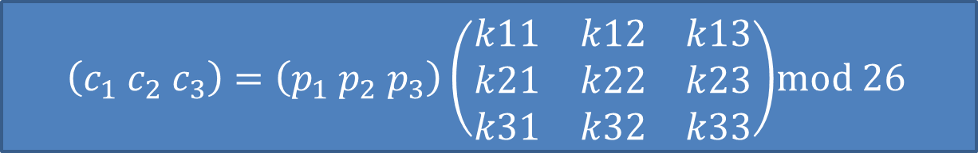
Hill Cipher
Hill cipher is based on linear algebra
Each letter is represented by numbers from 0 to 25 and calculations are done using modulo 26.
Encryption and decryption can be given by the following formula:
Encryption:
Decryption:
C=PK mod 26
P=CK⁻¹ mod 26
$\left(c_{1} c_{2} c_{3}\right)=\left(p_{1} p_{2} p_{3}\right)\left(\begin{matrix}k11 & k12 & k13 \\ k21 & k22 & k23 \\ k31 & k32 & k33\end{matrix}\right)$mod 26

Slide 76
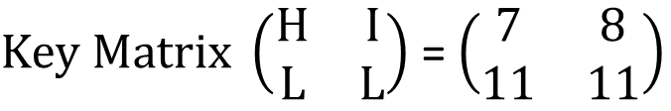
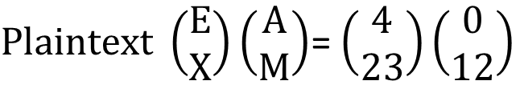
Hill Cipher Encryption
To encrypt a message using the Hill Cipher we must first turn our keyword and plaintext into a matrix (a 2 x 2 matrix or a 3 x 3 matrix, etc).
Example: Key = “HILL”, Plaintext = “EXAM”
a | b | c | d | e | f | g | h | i | j | k | l | m
0 | 1 | 2 | 3 | 4 | 5 | 6 | 7 | 8 | 9 | 10 | 11 | 12
n | o | p | q | r | s | t | u | v | w | x | y | z
13 | 14 | 15 | 16 | 17 | 18 | 19 | 20 | 21 | 22 | 23 | 24 | 25
$Key Matrix \left(\begin{matrix}H & I \\ L & L\end{matrix}\right)$ = $\left(\begin{matrix}7 & 8 \\ 11 & 11\end{matrix}\right)$
$Plaintext \left(\begin{matrix}E \\ X\end{matrix}\right)\left(\begin{matrix}A \\ M\end{matrix}\right)$= $\left(\begin{matrix}4 \\ 23\end{matrix}\right)\left(\begin{matrix}0 \\ 12\end{matrix}\right)$
Notes:
Exam

Slide 77

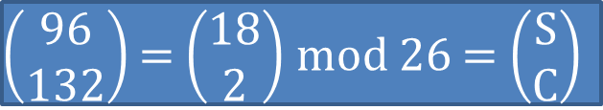
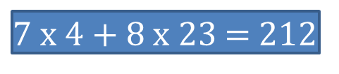
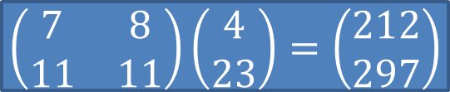
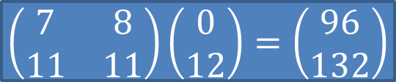
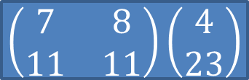
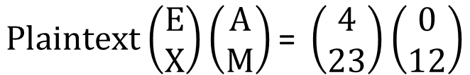
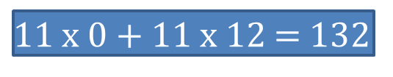
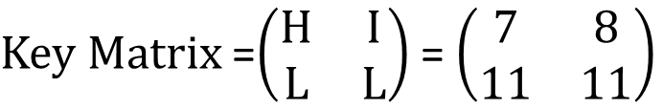
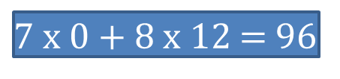
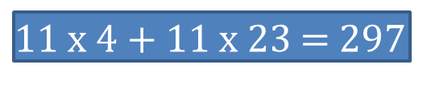
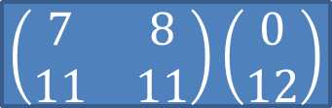
Hill Cipher Encryption (Cont…)
$Key Matrix$=$\left(\begin{matrix}H & I \\ L & L\end{matrix}\right)$ = $\left(\begin{matrix}7 & 8 \\ 11 & 11\end{matrix}\right)$
$$Plaintext\left(\begin{matrix}E \\ X\end{matrix}\right)\left(\begin{matrix}A \\ M\end{matrix}\right)\text{= }\left(\begin{matrix}4 \\ 23\end{matrix}\right)\left(\begin{matrix}0 \\ 12\end{matrix}\right)$$
C=PK mod 26
$$\left(\begin{matrix}7 & 8 \\ 11 & 11\end{matrix}\right)\left(\begin{matrix}4 \\ 23\end{matrix}\right)$$
$$\left(\begin{matrix}7 & 8 \\ 11 & 11\end{matrix}\right)\left(\begin{matrix}0 \\ 12\end{matrix}\right)$$
$7$ x 4 + 8 x 23 = 212
$7$ x 0 + 8 x 12 = 96
$11$ x 4 + 11 x 23 = 297
$11$ x 0 + 11 x 12 = 132
$$\left(\begin{matrix}7 & 8 \\ 11 & 11\end{matrix}\right)\left(\begin{matrix}4 \\ 23\end{matrix}\right)=\left(\begin{matrix}212 \\ 297\end{matrix}\right)$$
$$\left(\begin{matrix}7 & 8 \\ 11 & 11\end{matrix}\right)\left(\begin{matrix}0 \\ 12\end{matrix}\right)=\left(\begin{matrix}96 \\ 132\end{matrix}\right)$$
$\left(\begin{matrix}212 \\ 297\end{matrix}\right)$= $\left(\begin{matrix}4 \\ 11\end{matrix}\right)$ mod 26 = $\left(\begin{matrix}E \\ L\end{matrix}\right)$
$\left(\begin{matrix}96 \\ 132\end{matrix}\right)$= $\left(\begin{matrix}18 \\ 2\end{matrix}\right)$ mod 26 = $\left(\begin{matrix}S \\ C\end{matrix}\right)$
Ciphertext = “ELSC”

Slide 78
Hill Cipher Decryption
Step 1: Find Inverse of key matrix
Step 2: Multiply the Multiplicative Inverse of the Determinant by the Adjoin Matrix
Step 3: Multiply inverse key matrix with ciphertext matrix to obtain plaintext matrix
P=CK⁻¹ mod 26

Slide 79
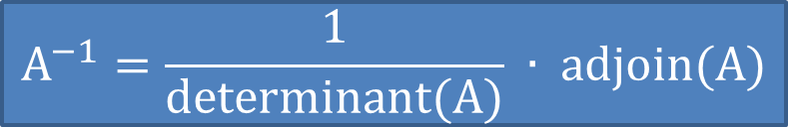
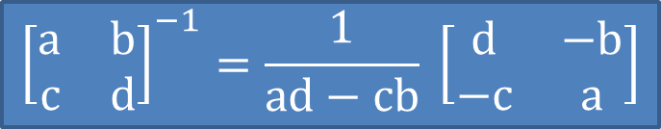
Step 1: Inverse of key matrix
2 X 2 inverse of matrix
$${\left[\begin{matrix}a & b \\ c & d\end{matrix}\right]}^{−1}=\frac{1}{ad−cb} \left[\begin{matrix}d & −b \\ −c & a\end{matrix}\right]$$
3 X 3 inverse of matrix
$$A^{−1}=\frac{1}{determinant(A)} ∙ adjoin(A)$$

Slide 80
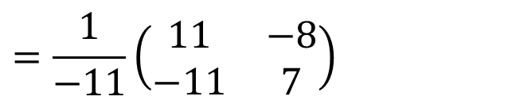
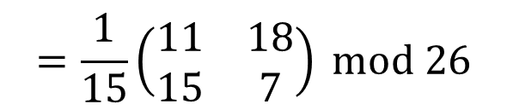
Step 1: Inverse of key matrix
$$Inverse Key Matrix={\left(\begin{matrix}7 & 8 \\ 11 & 11\end{matrix}\right)}^{−1}=\frac{1}{77−88} \left(\begin{matrix}11 & −8 \\ −11 & 7\end{matrix}\right)$$
$$=\frac{1}{−11}\left(\begin{matrix}11 & −8 \\ −11 & 7\end{matrix}\right)$$
-11 mod 26 = 15
Because, modulo for negative number is = N- (B%N)
= 26 – (11%26)
$$=\frac{1}{15}\left(\begin{matrix}11 & 18 \\ 15 & 7\end{matrix}\right) mod 26$$

Slide 81
Step 2: Modular (Multiplicative) inverse
The inverse of a number A is 1/A since A * 1/A = 1
e.g. the inverse of 5 is 1/5
In modular arithmetic we do not have a division operation.
The modular inverse of A (mod C) is A⁻¹
(A * A⁻¹) ≡ 1 (mod C)
Example:
The modular inverse of A mod C is the B value that makes
A * A⁻¹ mod C = 1
A = 3, C = 11
Since (3*4) mod 11 = 1, 4 is modulo inverse of 3
A = 10, C = 17 , A⁻¹ = ?
12

Slide 82
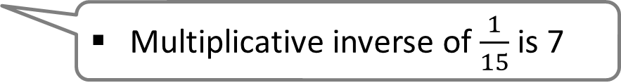
Step 2: Modular (Multiplicative) inverse
Determinants’ multiplicative inverse Modulo 26
Determinant | 1 | 3 | 5 | 7 | 9 | 11 | 15 | 17 | 19 | 21 | 23 | 25
Inverse Modulo 26 | 1 | 9 | 21 | 15 | 3 | 19 | 7 | 23 | 11 | 5 | 17 | 25
$$=\frac{1}{15}\left(\begin{matrix}11 & 18 \\ 15 & 7\end{matrix}\right) mod 26$$
Multiplicative inverse of $\frac{1}{15}$ is 7

Slide 83
Step 2: Multiply with adjoin of matrix
$$=7\left(\begin{matrix}11 & 18 \\ 15 & 7\end{matrix}\right)=\left(\begin{matrix}77 & 126 \\ 105 & 49\end{matrix}\right)=\left(\begin{matrix}25 & 22 \\ 1 & 23\end{matrix}\right) mod 26$$
$$=thus, if K=\left(\begin{matrix}7 & 8 \\ 11 & 11\end{matrix}\right) then K^{−1}=\left(\begin{matrix}25 & 22 \\ 1 & 23\end{matrix}\right)$$
X%Y = X-(X/Y)*Y
77%26 = 77-(77/26)*26
= 77-(2)*26
= 77-52
= 25

Slide 84
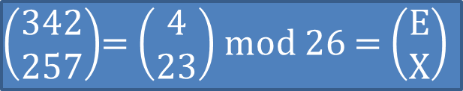

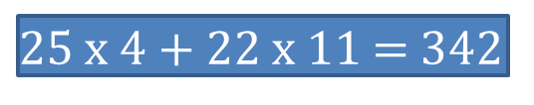
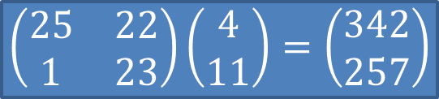
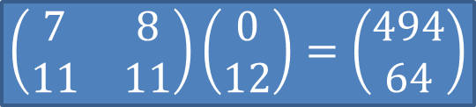
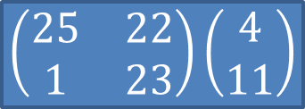
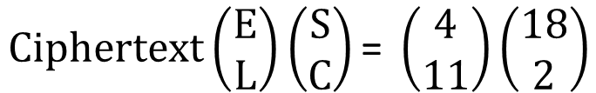
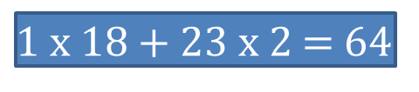
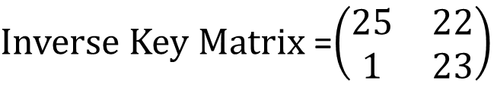
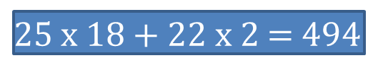
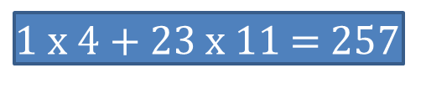
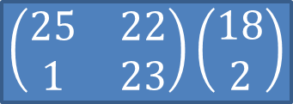
Hill Cipher Encryption (Cont…)
$Inverse Key Matrix$=$\left(\begin{matrix}25 & 22 \\ 1 & 23\end{matrix}\right)$
$$Ciphertext\left(\begin{matrix}E \\ L\end{matrix}\right)\left(\begin{matrix}S \\ C\end{matrix}\right)\text{= }\left(\begin{matrix}4 \\ 11\end{matrix}\right)\left(\begin{matrix}18 \\ 2\end{matrix}\right)$$
P=CK⁻¹ mod 26
$$\left(\begin{matrix}25 & 22 \\ 1 & 23\end{matrix}\right)\left(\begin{matrix}4 \\ 11\end{matrix}\right)$$
$$\left(\begin{matrix}25 & 22 \\ 1 & 23\end{matrix}\right)\left(\begin{matrix}18 \\ 2\end{matrix}\right)$$
$25$ x 4 + 22 x 11 = 342
$25$ x 18 + 22 x 2 = 494
$1$ x 4 + 23 x 11 = 257
$1$ x 18 + 23 x 2 = 64
$$\left(\begin{matrix}25 & 22 \\ 1 & 23\end{matrix}\right)\left(\begin{matrix}4 \\ 11\end{matrix}\right)=\left(\begin{matrix}342 \\ 257\end{matrix}\right)$$
$$\left(\begin{matrix}7 & 8 \\ 11 & 11\end{matrix}\right)\left(\begin{matrix}0 \\ 12\end{matrix}\right)=\left(\begin{matrix}494 \\ 64\end{matrix}\right)$$
$\left(\begin{matrix}342 \\ 257\end{matrix}\right)$= $\left(\begin{matrix}4 \\ 23\end{matrix}\right)$ mod 26 = $\left(\begin{matrix}E \\ X\end{matrix}\right)$
$\left(\begin{matrix}494 \\ 64\end{matrix}\right)$= $\left(\begin{matrix}0 \\ 12\end{matrix}\right)$ mod 26 = $\left(\begin{matrix}A \\ M\end{matrix}\right)$
Plaintext = “EXAM”

Slide 85
Hill Cipher Examples
Key: Hill Plaintext: short example
Ciphertext: APADJ TFTWLFJ
Key: ACBA Plaintext: DR GREER ROCKS (A=1, B=2, … )
Ciphertext: FZIFTOTBXGPO
Key:DACB Ciphertext: SAKNOXAOJ (A=1,B=2,…)
Plaintext: WELOVEMATH

Slide 86
Substitution Techniques
Caesar Cipher
Monoalphabetic Cipher
Playfair Cipher
Hill Cipher
Polyalphabetic Ciphers
One-Time Pad

Slide 87
Polyalphabetic Cipher
Monoalphabetic cipher encoded using only one fixed alphabet
Polyalphabetic cipher is a substitution cipher in which the cipher alphabet for the plain alphabet may be different at different places during the encryption process.
Vigenere cipher
Vernam cipher

Slide 88
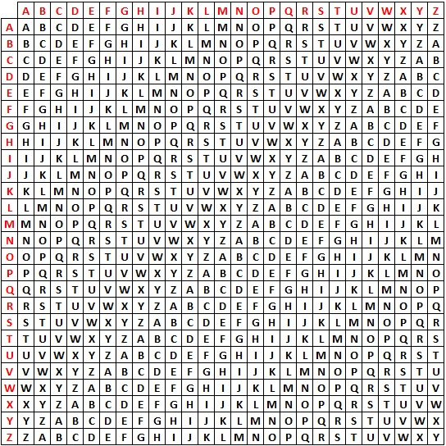
Plaintext
Key
PT = HELLO
KEY = GMGMG
CT = NQRXU

Slide 89
Vigenere Cipher
Keyword : DECEPTIVE
Key : DECEPTIVEDECEPTIVEDECEPTIVE
Plaintext : WEAREDISCOVEREDSAVEYOURSELF
Ciphertext : ZICVTWQNGRZGVTWAVZHCQYGLMGJ
Key must be as long as plaintext else repeat a keyword
$$C= \left(P_{1}+K_{1},P_{2}+K_{2}, …P_{m}+K_{m}\right)mod 26$$
$$P= \left(C_{1}−K_{1},C_{2}−K_{2}, …C_{m}−K_{m}\right)mod 26$$
An analyst looking at only the ciphertext would detect the repeated sequences VTW at a displacement of 9 and make the assumption that the keyword is either three or nine letters in length.
This system is referred as an auto key system
Keyword : DECEPTIVE
Key : DECEPTIVEWEAREDISCOVEREDSAV
Plaintext : WEAREDISCOVEREDSAVEYOURSELF

Slide 90
Vigenere Cipher
Multiple ciphertext letters for each plaintext letter.
Weakness is repeating, structured keyword.
Example:
Plaintext: internet technologies
Key: cryptography
Cipher using standard algorithm:
Cipher using auto key system:
kertkbkk ttjfpfjdzm
kertkbkk ttjfvbesxl

Slide 91
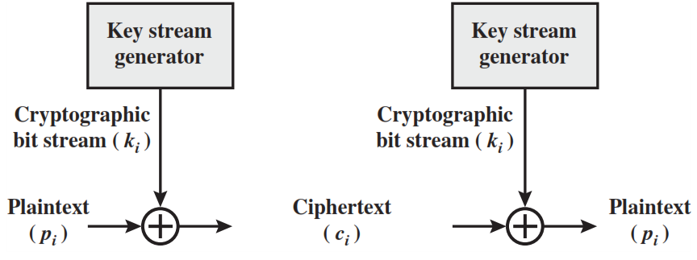
Vernam Cipher
The ciphertext is generated by applying the logical XOR operation to the individual bits of plaintext and the key stream.

Slide 92
Substitution Techniques
Caesar Cipher
Monoalphabetic Cipher
Playfair Cipher
Hill Cipher
Polyalphabetic Ciphers
One-Time Pad

Slide 93
One time pad
Similar to Vigenere, but use random key as long as plaintext.
Only known scheme that is unbreakable (unconditional security)
Ciphertext has no statistical relationship with plaintext.
Given two potential plaintext messages, attacker cannot identify the correct message.
Two practical limitations:
Diﬃcult to provide large number of random keys
Distributing unique long random keys is diﬃcult

Slide 94
One time pad
Attacker knows the ciphertext:
ANKYODKYUREPFJBYOJDSPLREYIUNOFDOIUERFPLUYTS
Attacker tries all possible keys.
Two examples:
key1: pxlmvmsydofuyrvzwctnlebnecvgdupahfzzlmnyih
Plaintext1: mr mustard with the candlestick in the hall
key2: mfugpmiydgaxgoufhklllmhsqdqogtewbqfgyovuhwt
Plaintext2: miss scarlet with the knife in the library
There are many other legible plaintexts obtained with other keys. No way for attacker to know the correct plaintext

Slide 95
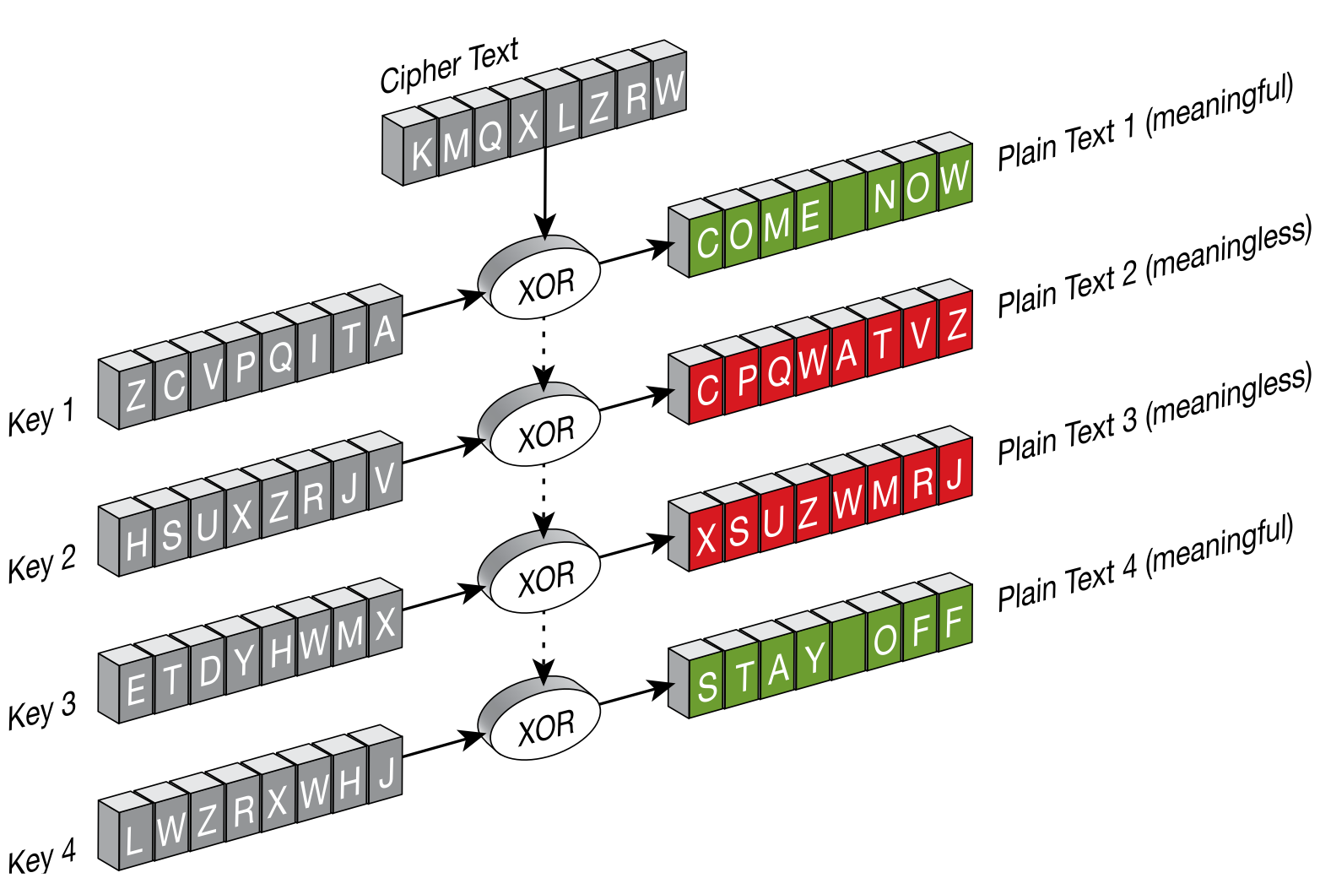

Slide 96
Transposition Techniques
A transposition cipher does not substitute one symbol for another, instead it changes the location of the symbols.
The simplest such cipher is the rail fence technique, in which the plaintext is written down as a sequence of diagonals and then read off as a sequence of rows.
For example, to send the message “Meet me at the park” to Bob, Alice writes
M
E
M
A
T
E
A
K
She then creates the ciphertext:
E
T
E
T
H
P
R
MEMATEAK
ETETHPR

Slide 97
Rail Fence Transposition
Easy to break: letter frequency analysis to determine depth.
Example:
Plaintext: internettechnology
Depth: 3
Cipher:
IRTNGNENTEHOOYTECL
I |  |  |  | R |  |  |  | T |  |  |  | N |  |  |  | G
 | N |  | E |  | N |  | T |  | E |  | H |  | O |  | O |  | Y
 |  | T |  |  |  | E |  |  |  | C |  |  |  | L

Slide 98
Rows/Columns Transposition
Plaintext letters written in rows.
Ciphertext obtained by reading column-by-column, but re-arranged.
Key determines order of columns to read.
Easy to break using letter frequency (try diﬀerent column orders)
Key: 4 3 1 2 5 6 7
Plaintext: A T T A C K P
O S T P O N E
D U N T I L T
W O A M X Y Z
Ciphertext:
TTNA
APTM
TSUO
AODW
COIX
KNLY
PETZ

Slide 99
Rows/Columns Transposition
Transposition ciphers can be made stronger by using multiple stages of transposition
Plaintext: securityandcryptography
Key: 315624
Ciphertext:
Transpose again using same key:
Ciphertext:
EYYARDOYSTRRICGCAPPUNTH
YYCURRAHEOIPDRPYSGNATCT

Slide 100
Cryptographic Algorithms
Cryptographic algorithms and protocols can be grouped into four main areas
Cryptographic algorithms and protocols
Symmetric encryption
Asymmetric encryption
Data integrity algorithms
Authentication protocols
Data integrity algorithms used to protect blocks of data, such as messages, from alteration.
Authentication Protocols are schemes based on the use of cryptographic algorithms designed to authenticate the identity of entities.
Symmetric encryption used to secure the contents of blocks or streams of data of any size, including messages, files, encryption keys, and passwords
Asymmetric encryption used to conceal small blocks of data, such as encryption keys and hash function values, which are used in digital signatures.

Slide 101
Threat and Attack
Threat: A potential for violation of security, which exists when there is a circumstance, capability, action, or event that could crack security and cause harm. That is, a threat is a possible danger that might exploit a vulnerability.
Attack: An violation on system security that derives from an intelligent threat; that is, an intelligent act that is a calculated attempt to avoid security services and violate the security policy of a system.

Slide 102


