Slide 1


UNIT-10 Web Security
Prof. Rupesh G. Vaishnav
rupesh.vaishnav@darshan.ac.in
94280-37452
Information & Network Security (2170709) Darshan Institute of Engineering & Technology

Slide 2
Outline
Web Security threats and approaches
SSL architecture
SSL Protocol
Transport layer security
HTTPS
SSH
Notes:
X.800 and RFC 2828
International Telecommunication Union (ITU)

Slide 3
Secure Socket Layer (SSL)
Secure Socket Layer (SSL) provides security services between TCP and applications that use TCP. The Internet standard version is called Transport Layer Service (TLS).
SSL/TLS provides confidentiality using symmetric encryption and message integrity using a message authentication code.
SSL/TLS includes protocol mechanisms to enable two TCP users to determine the security mechanisms and services they will use.
SSL is designed to make use of TCP to provide a reliable end-to-end secure service.

Slide 4
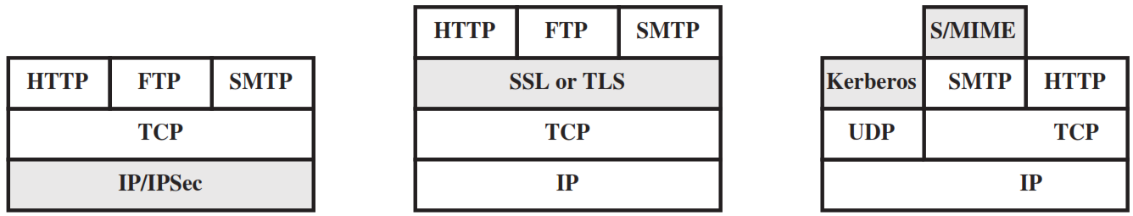
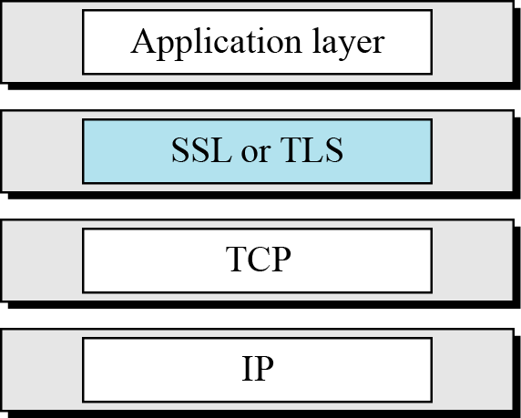
Relative Location of Security Facilities in the TCP/IP Protocol Stack

Slide 5
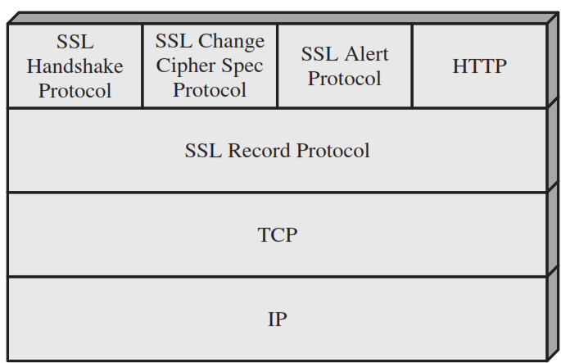
Secure Socket Layer (SSL) Architecture

Slide 6
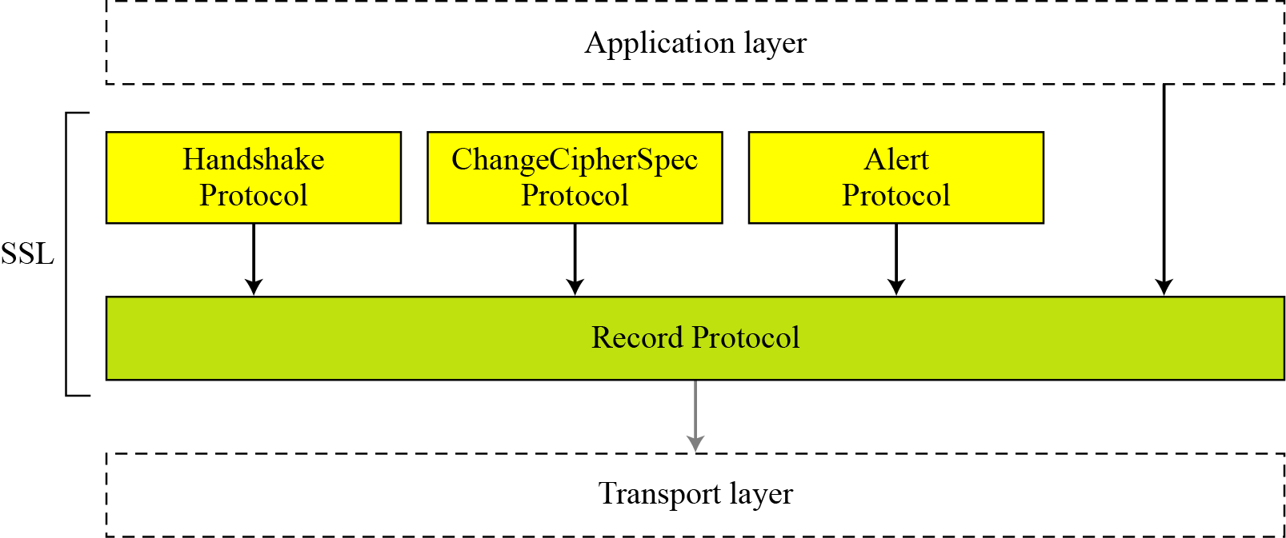
Four SSL Protocols

Slide 7
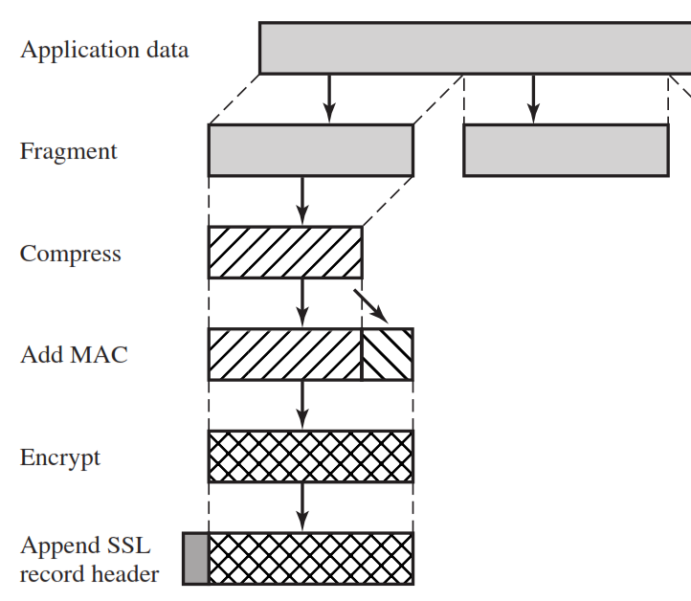
SSL Record Protocol
It provides two services for SSL connections
Confidentiality: The Handshake Protocol defines a shared secret key that is used for conventional encryption of SSL payloads.
Message Integrity: The Handshake Protocol also defines a shared secret key that is used to form a message authentication code (MAC).

Slide 8
SSL Record Protocol – Cont…
The Record Protocol takes an application message to be transmitted, fragments the data into manageable blocks, optionally compresses the data, applies a MAC, encrypts, adds a header, and transmits the resulting unit in a TCP segment.
Received data are decrypted, verified, decompressed, and reassembled before being delivered to higher-level users.

Slide 9
Change Cipher Spec Protocol
The Change Cipher Spec Protocol is one of the three SSL-specific protocols that use the SSL Record Protocol, and it is the simplest.
This protocol consists of a single message which consists of a single byte with the value 1.
The sole purpose of this message is to cause the pending state to be copied into the current state, which updates the cipher suite to be used on this connection.

Slide 10
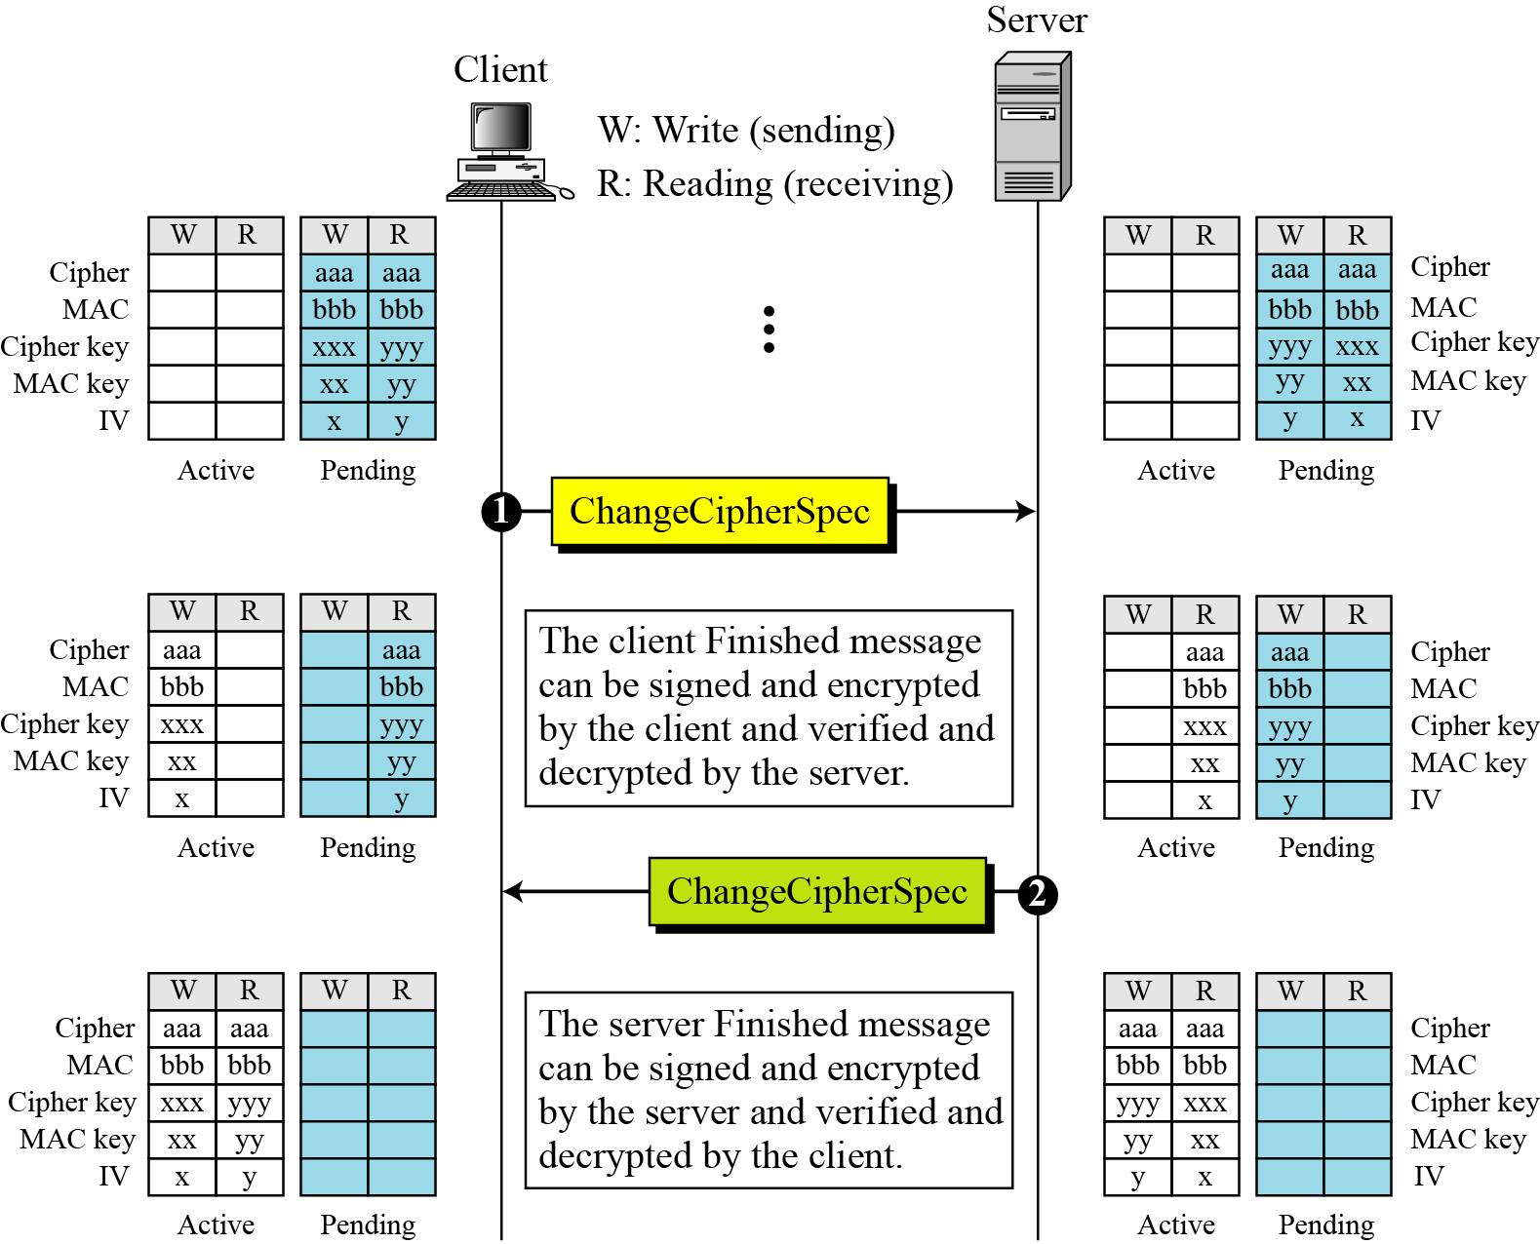
Change Cipher Spec Protocol – Cont…

Slide 11
Alert Protocol
The Alert Protocol is used to convey SSL-related alerts to the peer entity. As with other applications that use SSL, alert messages are compressed and encrypted, as specified by the current state.

Slide 12
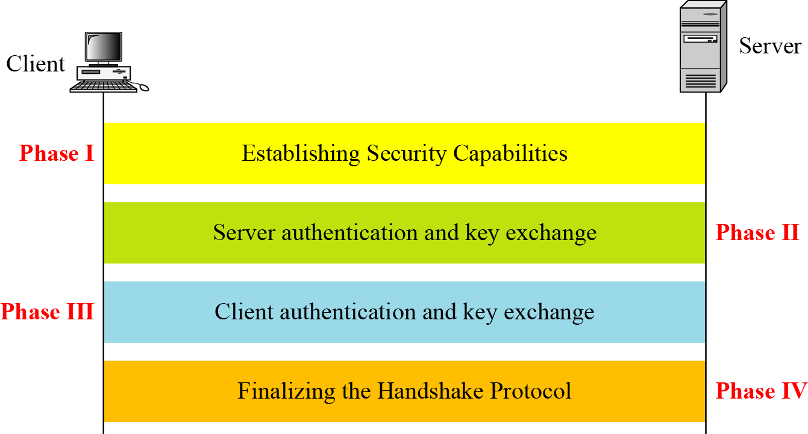
Handshake Protocol

Slide 13
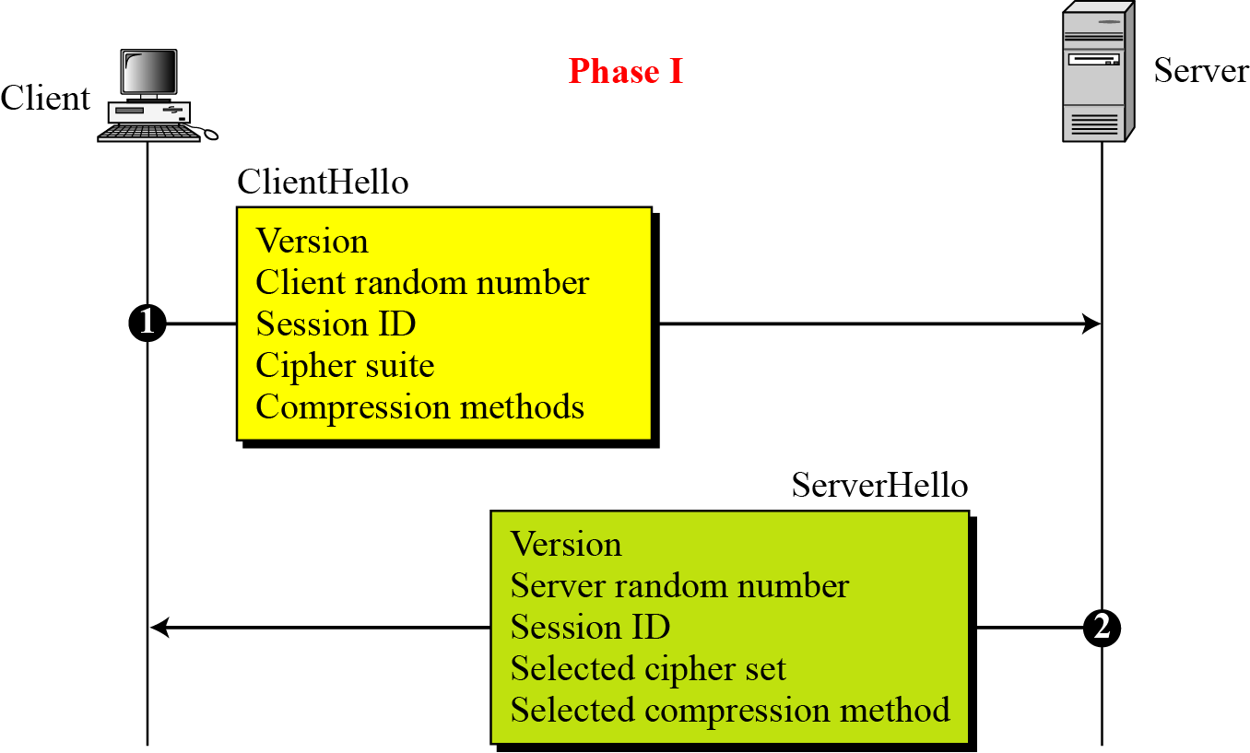
Handshake Protocol – Phase I

Slide 14
Handshake Protocol – Phase I
After Phase I, the client and server know the following:
The version of SSL
The algorithms for key exchange, message authentication, and encryption
The compression method
The two random numbers for key generation

Slide 15
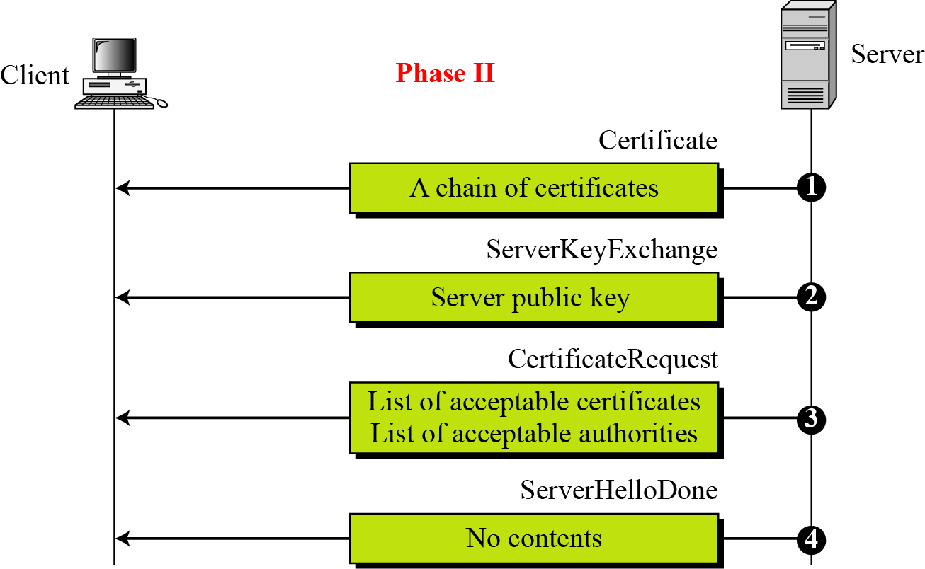
Handshake Protocol – Phase II

Slide 16
Handshake Protocol – Phase II
After Phase II
The server is authenticated to the client.
The client knows the public key of the server if required.

Slide 17
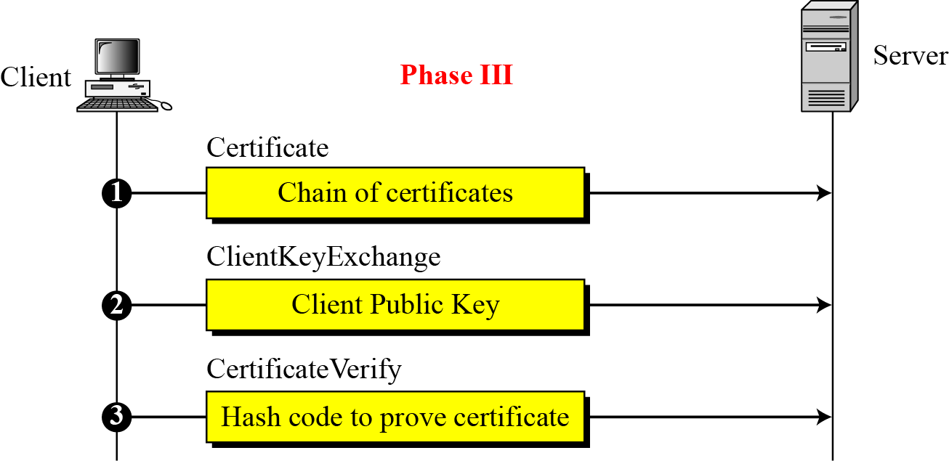
Handshake Protocol – Phase III

Slide 18
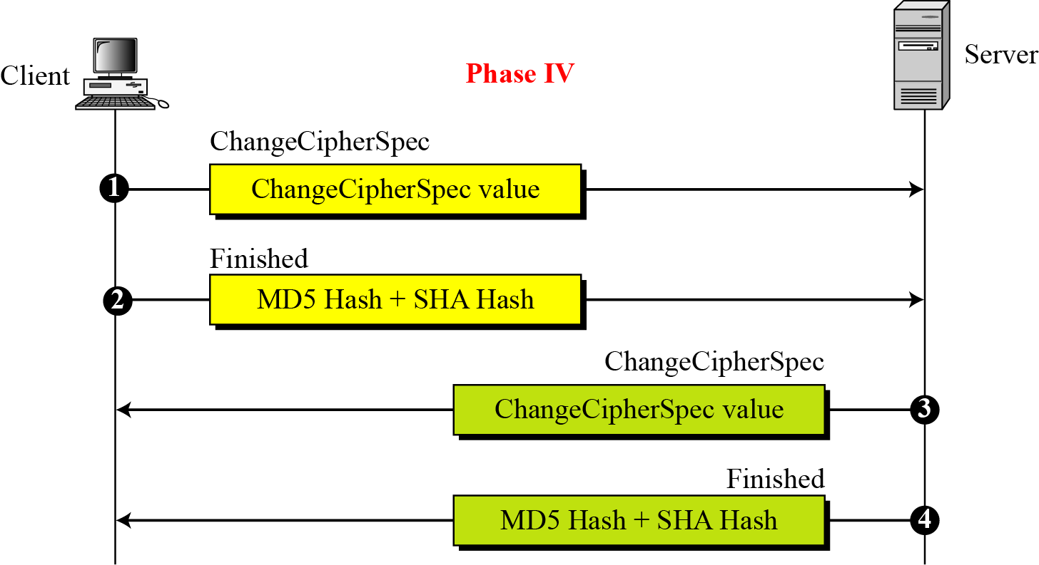
Handshake Protocol – Phase IV

Slide 19
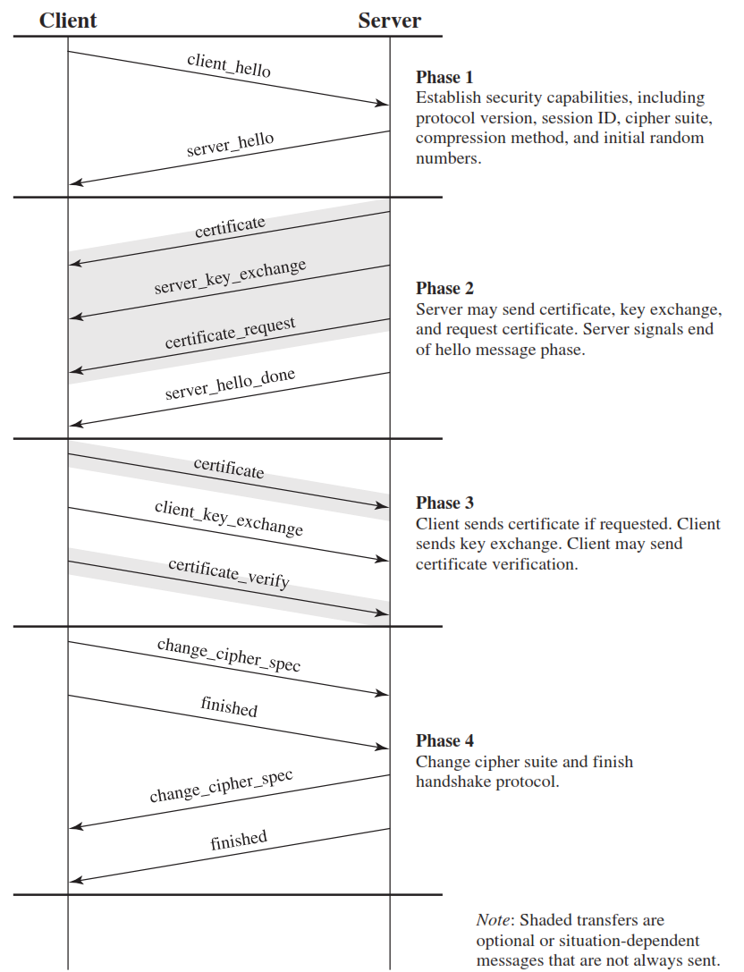
SSL Handshake Protocol Phases

Slide 20
HTTPS (HTTP over SSL)
HTTPS (HTTP over SSL) refers to the combination of HTTP and SSL to implement secure communication between a Web browser and a Web server.
When HTTPS is used, the following elements of the communication are encrypted:
URL of the requested document
Contents of the document
Contents of browser forms (filled in by browser user)
Cookies sent from browser to server and from server to browser
Contents of HTTP header

Slide 21
SSH (Secure Shell)
Secure Shell (SSH) is a protocol for secure network communications designed to be relatively simple and inexpensive to implement.
The initial version, SSH1 was focused on providing a secure remote logon facility to replace TELNET and other remote logon schemes that provided no security.

Slide 22
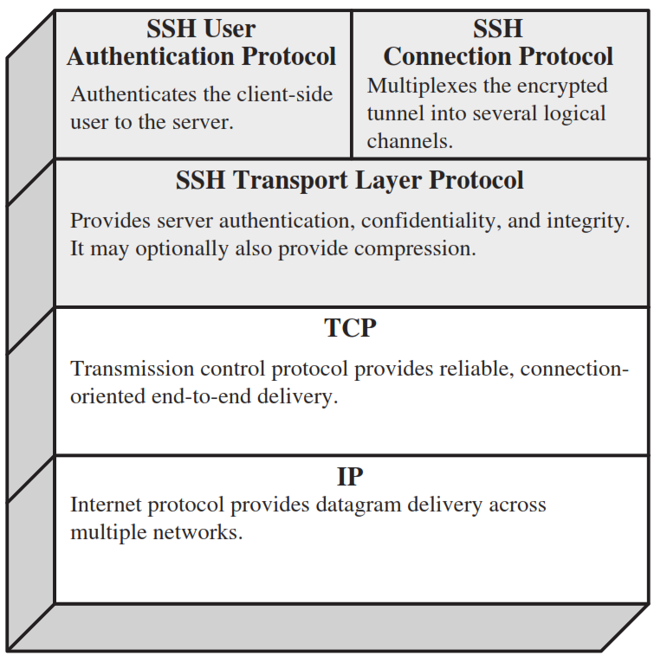
SSH (Secure Shell) – Cont…

Slide 23


