Slide 1


UNIT-2 Stream and Block Ciphers
Prof. R. K. Karangiya
rekha.karangiya@darshan.ac.in
Information & Network Security (2170709) Darshan Institute of Engineering & Technology

Slide 2
Outline
Stream ciphers and Block ciphers
Block cipher structure
Data Encryption Standard (DES)
Design principles of block cipher
AES with structure
AES transformation functions
Key expansion
Notes:
X.800 and RFC 2828
International Telecommunication Union (ITU)

Slide 3
Stream Cipher
A stream cipher is one that encrypts a digital data stream one bit or one byte at a time.
Examples:
Autokeyed Vigenère cipher
A5/1
RC4
Vernam cipher.

Slide 4


Stream Cipher
ENCRYPTION
DECRYPTION
Key(k_{i})
010101
Bit-stream
Generation
algorithm
Key(k_{i})
010101
Bit-stream
Generation
algorithm
K_{i}
K_{i}
Plaintext(p_{i})
100101
$$⊕$$
Ciphertext(c_{i})
110000
$$⊕$$
Plaintext(p_{i})
100101

Slide 5
Block Cipher
A block cipher is one in which a block of plaintext is treated as a whole and used to produce a ciphertext block of equal length.
Typically, a block size of 64 or 128 bits is used.
Examples:
Feistel cipher
DES
Triple DES
AES

Slide 6
Block Cipher
b bits
b bits
Plaintext
Ciphertext
Key
(K)
Encryption Algorithm
Key
(K)
Decryption Algorithm
Ciphertext
Plaintext
b bits
b bits

Slide 7
Diffusion and Confusion
Confusion
Confusion hides the relationship between the ciphertext and the key.
This is achieved by the use of a complex substitution algorithm.
Diffusion
Diffusion hides the relationship between the ciphertext and the plaintext.
This is achieved by changing one plaintext digit which affect the value of many ciphertext digits.
X1=0010 1011
Diffusion
Y1=1011 1001
Y2=0110 1100
X2=0000 1011
Single bit flip
Many bit flips

Slide 8
Plaintext (2w bits)
Feistel Cipher Structure Or Block Cipher Structure
L₀
w bits
w bits
R₀
Round 1
K₁
F
L₁
R₁
Round i
K_{i}
F
L_{i}
R_{i}
Round n
K_{n}
L_{n}
R_{n}
F
L_{n+1}
R_{n+1}
L_{n}
R_{n}
Ciphertext (2w bits)

Slide 9
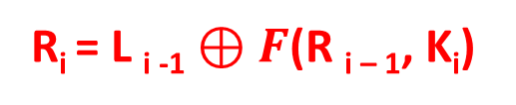
Plaintext (2w bits)
Feistel Cipher Structure Or Block Cipher Structure
L₀
w bits
w bits
R₀
Round 1
K₁
Plaintext is split into 32-bit halves L_{i} and R_{i}
F
L₁
R₁
R_{i} is fed into the function F.
The output of function F is then XORed with L_{i}
Round n
K_{n}
Left and right half are swapped.
F
L_{n}
R_{n}
R_{i} = L _{i -1} $⊕F$(R _{i – 1}, K_{i})
L_{n+1}
R_{n+1}
L_{i} = R _{i – 1}
Ciphertext (2w bits)

Slide 10
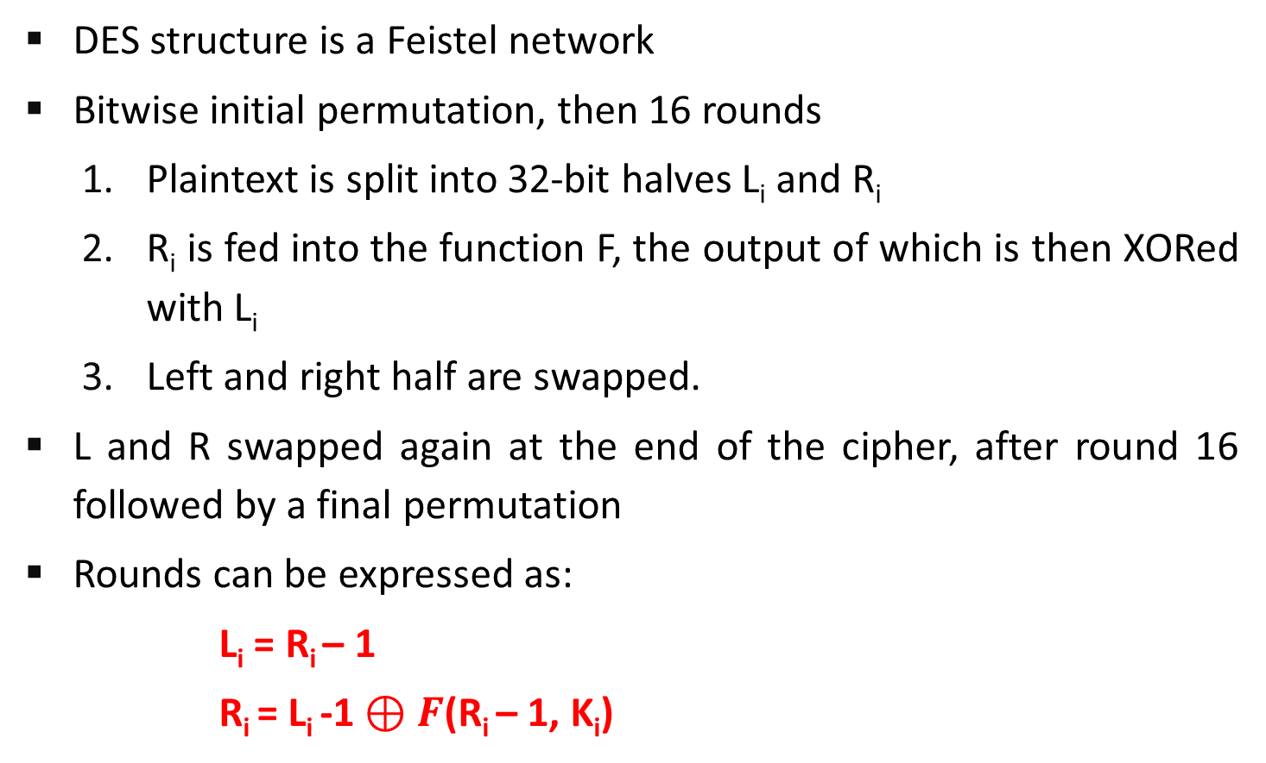
Feistel Cipher Structure
DES structure is a Feistel network
Bitwise initial permutation, then 16 rounds
Plaintext is split into 32-bit halves L_{i} and R_{i}
R_{i} is fed into the function F, the output of which is then XORed with L_{i}
Left and right half are swapped.
L and R swapped again at the end of the cipher, after round 16 followed by a final permutation
Rounds can be expressed as:
L_{i} = R_{i} – 1
R_{i} = L_{i} -1 $⊕F$(R_{i} – 1, K_{i})

Slide 11
Feistel Network Factors
Block size: Common block size of 64-bit. However, the new algorithms uses a 128-bit, 256-bit block size.
Key size: Key sizes of 64 bits or less are now widely considered to be insufficient, and 128 bits has become a common size.
Number of rounds: A typical size is 16 rounds.
Round function F: This phase consisting of sixteen rounds of the same function, which involves both permutation and substitution functions. Again, greater complexity generally means greater resistance to cryptanalysis.
Subkey generation algorithm: For each of the sixteen rounds, a different subkey (K_{i}) derived from main key by the combination of a left circular shift and a permutation. Greater complexity in this algorithm should lead to greater difficulty of cryptanalysis.

Slide 12
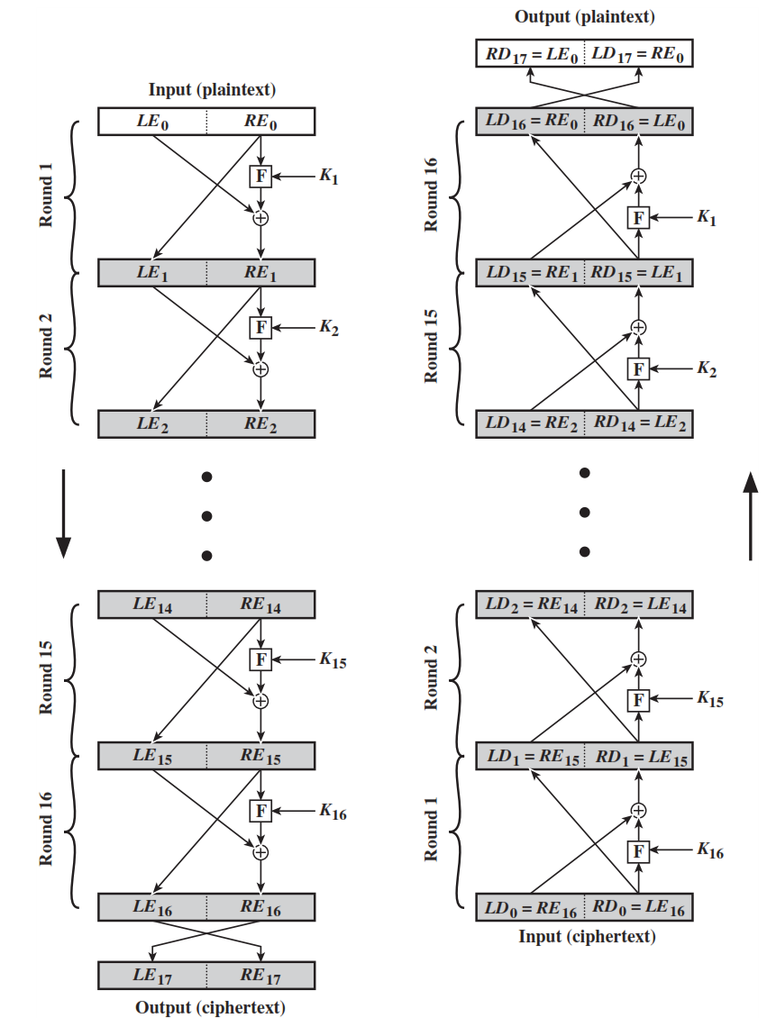
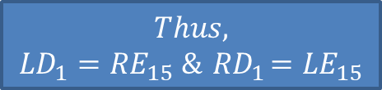

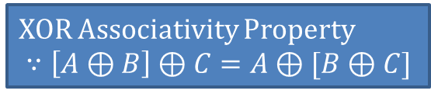





Feistel Encryption & Decryption
Prove that o/p of first round of Decryption is equal to 32-bit swap of i/p of 16th round of Encryption
LD₁=RE₁₅ & RD₁=LE₁₅
On Encryption Side:
$${LE}_{16}={RE}_{15}$$
$${RE}_{16}={LE}_{15} ⊕F({RE}_{15},K_{16})$$
On Decryption Side:
$${LD}_{1}={RD}_{0}={LE}_{16}={RE}_{15}$$
$${RD}_{1}={LD}_{0} ⊕F\left({RD}_{0},K_{16}\right)$$
$$={RE}_{16} ⊕F\left({RE}_{15},K_{16}\right)$$
$$={[LE}_{15} ⊕F\left({RE}_{15},K_{16}\right)] ⊕F\left({RE}_{15},K_{16}\right)$$
XOR Associativity Property
$$∵\left[A⊕B\right]⊕C=A⊕[B⊕C]$$
$$Thus,$$
$${LD}_{1}={RE}_{15} \&{ RD}_{1}={LE}_{15}$$

Slide 13
Data Encryption Standard (DES)
Type: Block Cipher
Block Size : 64-bit
Key Size: 64-bit, with only 56-bit effective
Number of Rounds: 16

Slide 14
64-bit plaintext
64-bit key
Initial Permutation
Permuted choice 1
64
56
Round 1
K₁
48
Permuted choice 2
56
Left circular shift
64
56
Round 2
K₂
48
Permuted choice 2
56
Left circular shift
Round 16
K₁₆
48
Permuted choice 2
56
Left circular shift
32-bit swap
64
DES Encryption Algorithm
Inverse
Initial Permutation
64-bit ciphertext

Slide 15
Data Encryption Standard
X
Initial Permutation
X
Encryption
Round 1
64
K₁
DES
56
K_{i}
64
Encryption
Round 16
K₁₆
Y
Final permutation
Y

Slide 16
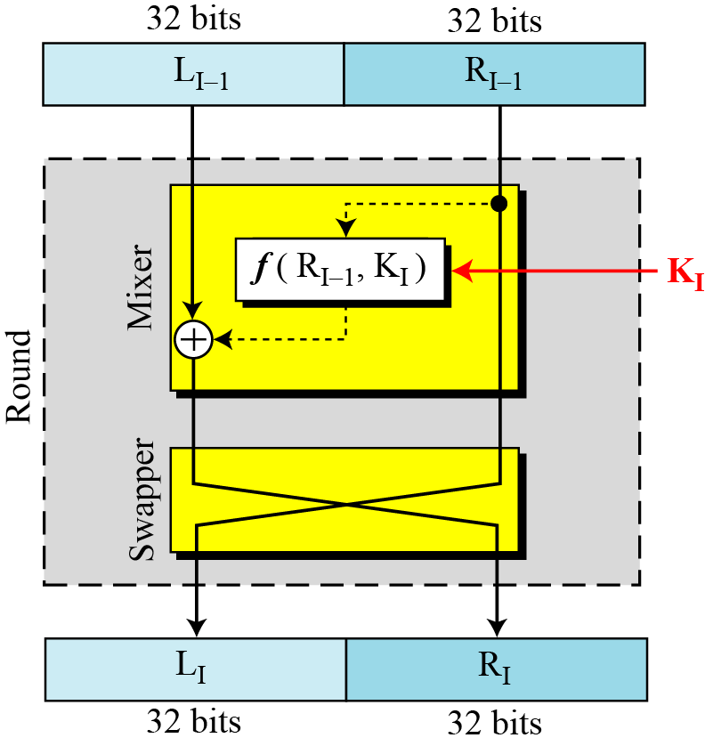
DES Single Round

Slide 17








32-bits
32-bits
28-bits
28-bits
$$L_{i−1}$$
$$R_{i−1}$$
$$C_{i−1}$$
$$D_{i−1}$$
Expansion/ permutation
(E table)
Left Shift
(S)
Left Shift
(S)
48
K_{i}
Permutation/ compression
(Permuted choice 2)
XOR
48
48
Substitution/choice
(S-box)
32
Permutation
(P)
32
XOR
$$L_{i}$$
$$R_{i}$$
$$C_{i}$$
$$D_{i}$$
Notes:
confusion step is the S-box substitution, while the diffusion step is where the output of the S-boxes is rearranged according to the P-box permutation rules.

Slide 18
DES Single Round (Cont…)
Key Transformation
Permutation of selection of sub-key from original key
Expansion Permutation (E-table)
Right half is expanded from 32-bits to 48-bits
S-box Substitution
Accepts 48-bits from XOR operation and produce 32-bits using 8 substitution boxes (each S-boxes has a 6-bit i/p and 4-bit o/p).
P-Box Permutation
XOR and Swap

Slide 19
DES Encryption Algorithm (Cont…)
First, the 64-bit plaintext passes through an initial permutation (IP) that rearranges the bits to produce the permuted input.
This is followed by a phase consisting of sixteen rounds of the same function, which involves both permutation and substitution functions.
Finally, the preoutput is passed through a permutation that is the inverse of the initial permutation function, to produce the 64-bit ciphertext.
The 56-bit key is passed through a permutation function.
For each of the sixteen rounds, a subkey (K_{i}) is produced by the combination of a left circular shift and a permutation.

Slide 20
DES Encryption Algorithm
Initial permutation: First, the 64-bit plaintext passes through an initial permutation (IP) that rearranges the bits to produce the permuted input.
The F function: This phase consisting of sixteen rounds of the same function, which involves both permutation and substitution functions.
Swap: L and R swapped again at the end of the cipher, i.e., after round 16 followed by a final permutation.
Inverse (Final) permutation: It is the inverse of the initial permutation.
Subkey generation: For each of the sixteen rounds, a different subkey (K_{i}) derived from main key by the combination of a left circular shift and a permutation.

Slide 21
Initial and Inverse Permutation
The initial permutation of the DES algorithm changes the order of the plaintext prior to the first round of encryption.
1
2
25
40
58
64
1
2
8
25
40
58
64
16 Rounds
The final permutation occurs after the sixteen rounds of DES are completed. It is the inverse of the initial permutation.
1
2
25
40
58
64
1
2
8
25
40
58
64

Slide 22
Initial and Final Permutation
IP
58 | 50 | 42 | 34 | 26 | 18 | 10 | 2
60 | 52 | 44 | 36 | 28 | 20 | 12 | 4
62 | 54 | 46 | 38 | 30 | 22 | 14 | 6
64 | 56 | 48 | 40 | 32 | 24 | 16 | 8
57 | 49 | 41 | 33 | 25 | 17 | 9 | 1
59 | 51 | 43 | 35 | 27 | 19 | 11 | 3
61 | 53 | 45 | 37 | 29 | 21 | 13 | 5
63 | 55 | 47 | 39 | 31 | 23 | 15 | 7
IP⁻¹
40 | 8 | 48 | 16 | 56 | 24 | 64 | 32
39 | 7 | 47 | 15 | 55 | 23 | 63 | 31
38 | 6 | 46 | 14 | 54 | 22 | 62 | 30
37 | 5 | 45 | 13 | 53 | 21 | 61 | 29
36 | 4 | 44 | 12 | 52 | 20 | 60 | 28
35 | 3 | 43 | 11 | 51 | 19 | 59 | 27
34 | 2 | 42 | 10 | 50 | 18 | 58 | 26
33 | 1 | 41 | 9 | 49 | 17 | 57 | 25

Slide 23
The F function
R_{i-1}
Main operation of DES
32
Expansion/permutation
(E table)
f-function inputs:
Ri-1 and round key ki
48
K_{i}
4 Steps:
Expansion E
XOR
48
48
XOR with round key
6
6
6
6
6
6
6
6
S-box substitution
Permutation
S1
S2
S3
S4
S5
S6
S7
S8
4
4
4
4
4
4
4
4
32
Permutation
(P)
32

Slide 24
The Expansion Function E
Main purpose: Increases diffusion
Since R_{i-1} is a 32-bit input and K_{i} is a 48-bit key, we ﬁrst need to expand R_{i-1} to 48 bits.
Input: (8 blocks, each of them consisting 4 bits) - 32 bits
Output: (8 blocks, each of them consisting 6 bits) – 48 bits
R_{i-1}
32
Expansion/permutation
(E table)
48
Expansion Table E
32 | 1 | 2 | 3 | 4 | 5
4 | 5 | 6 | 7 | 8 | 9
8 | 9 | 10 | 11 | 12 | 13
12 | 13 | 14 | 15 | 16 | 17
16 | 17 | 18 | 19 | 20 | 21
20 | 21 | 22 | 23 | 24 | 25
24 | 25 | 26 | 27 | 28 | 29
28 | 29 | 30 | 31 | 32 | 1

Slide 25
Add round key
XOR Round Key
After the expansion permutation, DES uses the XOR operation on the expanded right section and the round key.
Note that both the right section and the key are 48-bits in length now.
R_{i-1}
32
Expansion/permutation
(E table)
48
K_{i}
XOR
48
48

Slide 26
The DES S-Boxes
S-Box substitution.
Eight substitution tables.
6 bits of input
4 bits of output.
Convert 48 bits to 32 bits
Non-linear and resistant to differential cryptanalysis.
Crucial element for DES security!
Introduces confusion.
R_{i-1}
32
Expansion/permutation
(E table)
48
K_{i}
XOR
48
48
6
6
6
6
6
6
6
6
S1
S2
S3
S4
S5
S6
S7
S8
4
4
4
4
4
4
4
4
32

Slide 27
Role of S-box
The outer two bits of each group select one row of an S-box.
Inner four bits selects one column of an S-box.
S-box 1
Example:
Input
0 | 1 | 1 | 0 | 0 | 1
Output
1 | 0 | 0 | 1
Row
Column

Slide 28
The Permutation P
R_{i-1}
Permutation P
Bitwise permutation.
Introduces diffusion.
32
Expansion/permutation
(E table)
48
K_{i}
Permutation Table P
16 | 7 | 20 | 21 | 29 | 12 | 28 | 17
01 | 15 | 23 | 26 | 05 | 18 | 31 | 10
02 | 08 | 24 | 14 | 32 | 27 | 03 | 09
19 | 13 | 30 | 06 | 22 | 11 | 04 | 25
XOR
48
48
6
6
6
6
6
6
6
6
S1
S2
S3
S4
S5
S6
S7
S8
4
4
4
4
4
4
4
4
32
Permutation
(P)
32

Slide 29
Key schedule of DES
Derives 16 round keys (or subkeys) k_{i} of 48 bits each from the original 56 bit key.
The input key size of the DES is 64 bit: 56 bit key and 8 bit parity
Parity bits are removed in a first permuted choice PC-1: (note that the bits 8, 16, 24, 32, 40, 48, 56 and 64 are not used at all)
K
64
PC-1
56
Permuted choice (PC-1)
57 | 49 | 41 | 33 | 25 | 17 | 09 | 01
58 | 50 | 42 | 34 | 26 | 18 | 10 | 02
59 | 51 | 43 | 35 | 27 | 19 | 11 | 03
60 | 52 | 44 | 36 | 63 | 55 | 47 | 39
31 | 23 | 15 | 07 | 62 | 54 | 46 | 38
30 | 22 | 14 | 06 | 61 | 53 | 45 | 37
29 | 21 | 13 | 05 | 28 | 20 | 12 | 04

Slide 30
Key schedule of DES
Split key into 28-bit halves C₀ and D₀.
In rounds i = 1, 2, 9 ,16, the two halves are each rotated left by one bit.
In all other rounds where the two halves are each rotated left by two bits.
These shifted values are input to the next round.
K
64
PC-1
56
C₀
D₀
28
28
LS₁
LS₁
28
28
D₁
C₁
56
Round | 1 | 2 | 3 | 4 | 5 | 6 | 7 | 8 | 9 | 10 | 11 | 12 | 13 | 14 | 15 | 16
key | 1 | 1 | 2 | 2 | 2 | 2 | 2 | 2 | 1 | 2 | 2 | 2 | 2 | 2 | 2 | 1

Slide 31
Key schedule of DES
In each round i permuted choice PC-2 selects a permuted subset of 48 bits of C_{i} and Di as round key k_{i}.
K
64
PC-1
56
C₀
D₀
Permuted choice (PC-2)
14 | 17 | 11 | 24 | 01 | 05 | 03 | 28
15 | 06 | 21 | 10 | 23 | 19 | 12 | 04
26 | 08 | 16 | 07 | 27 | 20 | 13 | 02
41 | 52 | 31 | 37 | 47 | 55 | 30 | 40
51 | 45 | 33 | 48 | 44 | 49 | 39 | 56
34 | 53 | 46 | 42 | 50 | 36 | 29 | 32
28
28
Transform 1
LS₁
LS₁
28
28
PC-2
D₁
K₁
C₁
48
56

Slide 32
Subkey generation
K
64
PC-1
56
D₀
C₀
28
28
Transform 1
LS₁
LS₁
28
28
K₁
PC-2
D₁
C₁
48
56
28
28
LS₂
LS₂
LS₁₆
LS₁₆
28
28
K₁₆
PC-2
D₁₆
C₁₆
48
56

Slide 33
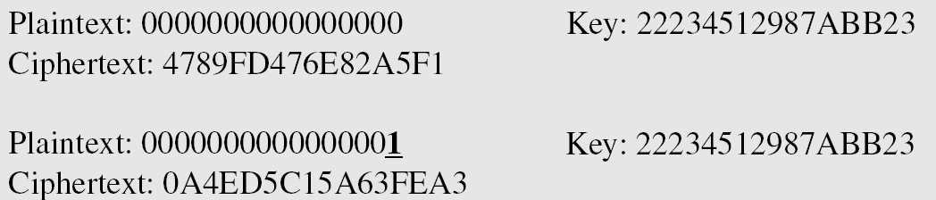
Avalanche Effect
Desirable property of any encryption algorithm is that a change in one bit of the plaintext or of the key should produce a change in many bits of cipher text.
DES performs strong avalanche effect.
Although the two plaintext blocks differ only in the rightmost bit, the ciphertext blocks differ in 29 bits.
This means that changing approximately 1.5 % of the plaintext creates a change of approximately 45 % in the ciphertext.

Slide 34
Strength of DES
The use of 56-bit keys: 56-bit key is used in encryption, there are 2⁵⁶ possible keys. A brute force attack on such number of keys is impractical.
The nature of algorithm: Cryptanalyst can perform cryptanalysis by exploiting the characteristic of DES algorithm but no one has succeeded in finding out the weakness.

Slide 35
AES (Advanced Encryption Standard)
The Rijndael proposal for AES defined a cipher in which the block length and the key length can be independently specified to be 128, 192, or 256 bits.
AES designed to have characteristics
Resistance against all known attacks
Speed and code compactness on a wide range of platforms
Design simplicity
Key size (words/ bytes/ bits) | 4/16/128 | 6/24/192 | 8/32/256
Block size (words/ bytes/ bits) | 4/16/128 | 4/16/128 | 4/16/128
Round key size (words/ bytes/ bits) | 4/16/128 | 4/16/128 | 4/16/128
Number of Rounds | 10 | 12 | 14

Slide 36
AES (Advanced Encryption Standard)
128 bits
Plaintext
AES
Key (128-256 bits)
Ciphertext
128 bits

Slide 37
AES (Advanced Encryption Standard)
128 bits Plaintext
AES
AddRoundKey
Cipher key
(128, 192 or 256 bits)
K₀
Round-1
K₁
Round-2
Key expansion
K₂
Round-N
(slightly different)
K₁₀
128 bits Ciphertext

Slide 38
Key
Plaintext
AddRoundKey
Round key 0
Notes:
One AddRoundKey is applied before the First round.
The third transformation is missing in the last round
SubBytes
ShiftRows
Round 1
MixColumns
AddRoundKey
Round key 1
SubBytes
ShiftRows
Round 10
AddRoundKey
Round key 10
Ciphertext

Slide 39
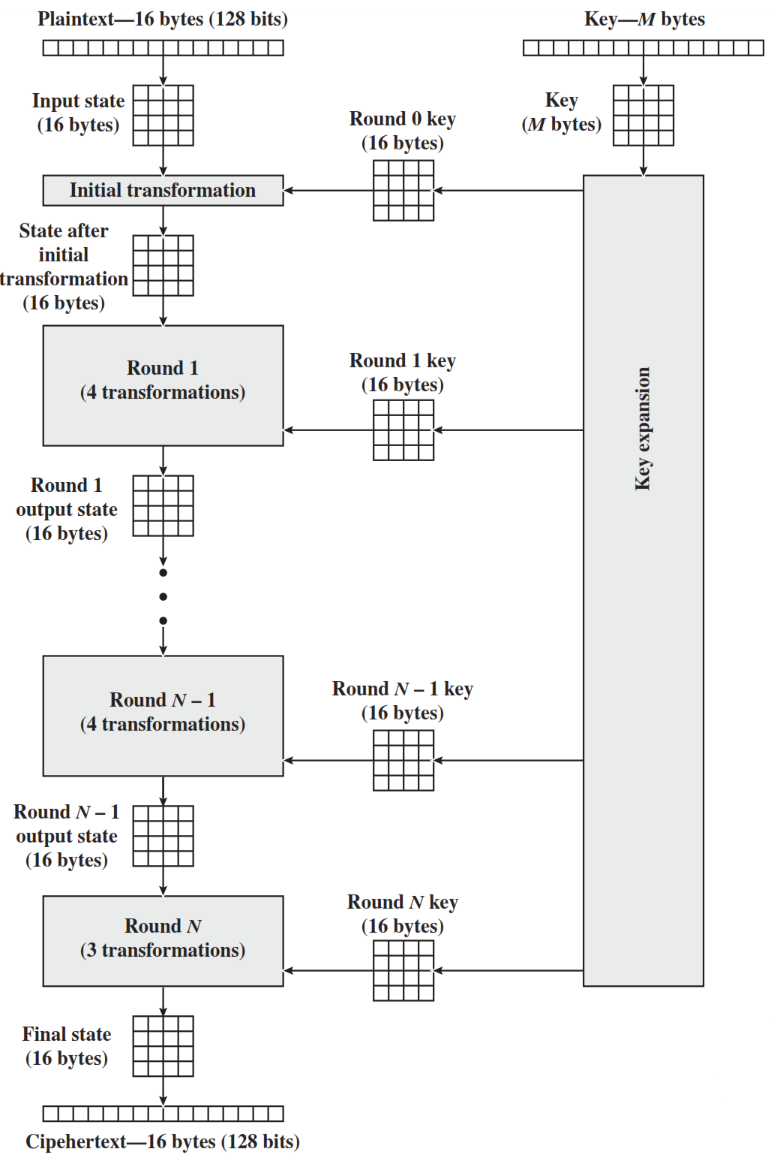
AES Structure
Initialization
Expand 16-byte key to get the actual key block to be used.
Initialize 16-byte plaintext block called as state.
XOR the state with the key block.
For each round
Apply S-box
Rotate rows of state
Mix columns
Add Round key: XOR the state with key block.

Slide 40
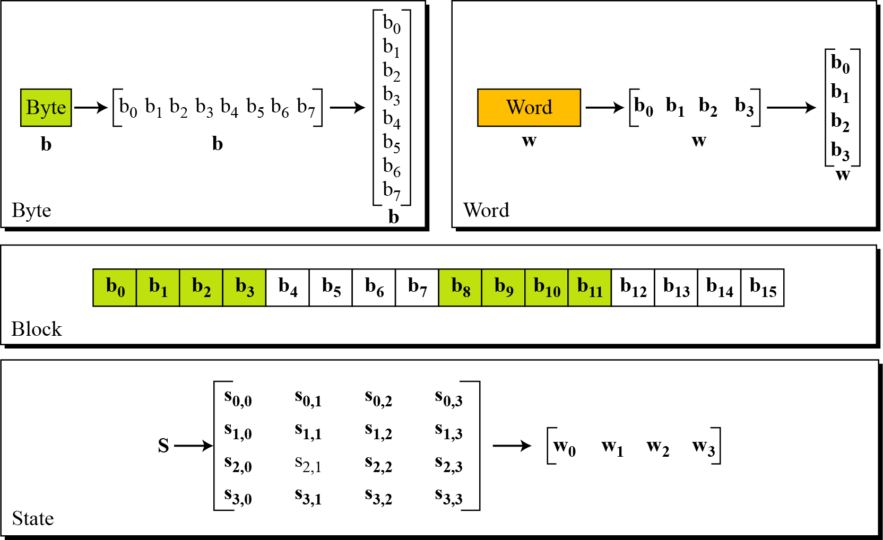
Data Units in AES

Slide 41
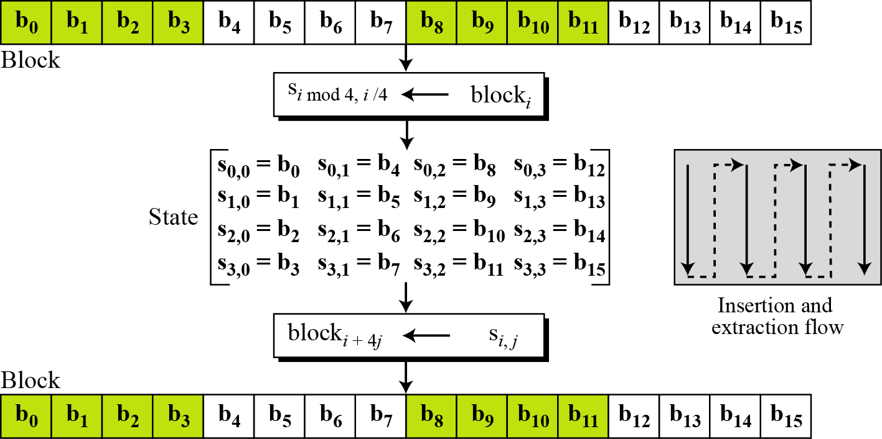
Block to State & State to Block

Slide 42
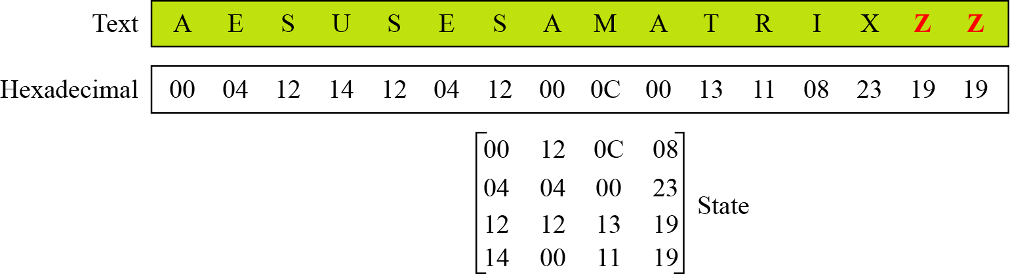
Plain Text to State

Slide 43
AES Structure
The first N-1 rounds consist of four distinct transformation functions.
SubBytes
The 16 input bytes are substituted using an S-box
ShiftRows
Each of the four rows of the matrix is shifted to the left
MixColumns
Each column of four bytes is now transformed using a special mathematical function.
AddRoundKey
The 16 bytes of the matrix are now considered as 128 bits and are XORed to the 128 bits of the round key.

Slide 44
AES structure
State:
Cipher key:
32 | 88 | 31 | e0
43 | 5a | 31 | 37
f6 | 30 | 98 | 07
a8 | 8d | a2 | 34
2b | 28 | ab | 09
7e | ae | f7 | cf
15 | d2 | 15 | 4f
16 | a6 | 88 | 3c

Slide 45


Initial transformation(AddRoundKey)
AddRoundKey:
input state
$$⊕$$
Cipher key
32 | 88 | 31 | e0
43 | 5a | 31 | 37
f6 | 30 | 98 | 07
a8 | 8d | a2 | 34
2b | 28 | ab | 09
7e | ae | f7 | cf
15 | d2 | 15 | 4f
16 | a6 | 88 | 3c
19 | a0 | 9a | e9
3d | f4 | c6 | f8
e3 | e2 | 8d | 48
be | 2b | 2a | 08
$$⊕$$
=

Slide 46
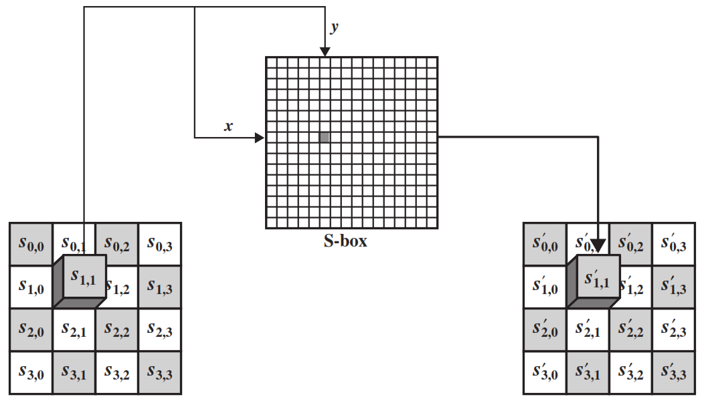
SubByte Transformation
The forward substitute byte transformation, called SubBytes, is a simple table lookup

Slide 47
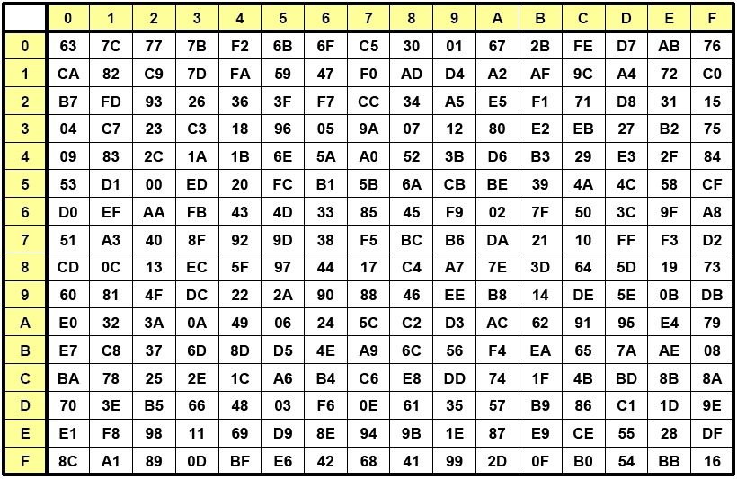
Input: 19
Output: D4
Row
Column

Slide 48
SubByte output
Input for SubByte
Output of SubByte
19 | a0 | 9a | e9
3d | f4 | c6 | f8
e3 | e2 | 8d | 48
be | 2b | 2a | 08
d4 | e0 | b8 | le
27 | bf | b4 | 41
11 | 98 | 5d | 52
ae | f1 | e5 | 30

Slide 49
ShiftRows
The first row of State is not altered.
For the second row, a 1-byte circular left shift is performed.
For the third row, a 2-byte circular left shift is performed.
For the fourth row, a 3-byte circular left shift is performed.
d4 | e0 | b8 | le
27 | bf | b4 | 41
11 | 98 | 5d | 52
ae | f1 | e5 | 30
No rotation
d4 | e0 | b8 | le
bf | b4 | 41 | 27
5d | 52 | 11 | 98
30 | ae | f1 | e5
Rotate 1 byte
Rotate 2 bytes
Rotate 3 bytes
Input for ShiftRows
Output of ShiftRows

Slide 50
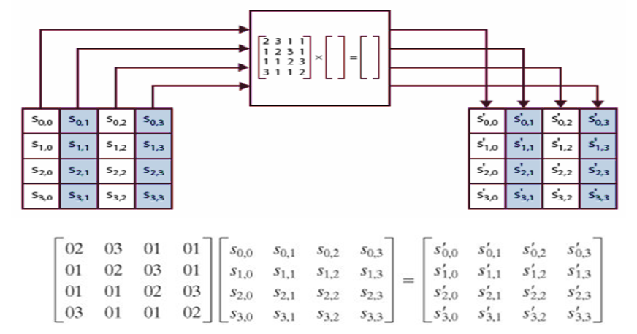
MixColumns
Each byte of a column is mapped into a new value that is a function of all four bytes in that column.
Constant matrices used by MixColumns.

Slide 51
MixColumns
d4 | e0 | b8 | le
bf | b4 | 41 | 27
5d | 52 | 11 | 98
30 | ae | f1 | e5
02 | 03 | 01 | 01
01 | 02 | 03 | 01
01 | 01 | 02 | 03
03 | 01 | 01 | 02
04 | e0 | 48 | 28
66 | cb | f8 | 06
81 | 19 | d3 | 26
e5 | 9a | 7a | 4c
=
02 | 03 | 01 | 01
01 | 02 | 03 | 01
01 | 01 | 02 | 03
03 | 01 | 01 | 02
d4
bf
5d
30
04
66
81
e5
=

Slide 52


AddRoundKey
In the forward add round key transformation, the 128 bits of State are bitwise XORed with the 128 bits of the round key.
04 | e0 | 48 | 28
66 | cb | f8 | 06
81 | 19 | d3 | 26
e5 | 9a | 7a | 4c
a0 | 88 | 23 | 2a
fa | 54 | a3 | 6c
fe | 2c | 39 | 76
17 | b1 | 39 | 05
A4 | 68 | 6b | 02
9c | 9f | 5b | 6a
7f | 35 | Ea | 50
F2 | 2b | 43 | 49
=
$$⊕$$
04
66
81
e5
a0
fa
fe
17
A4
9c
7f
F2
$$⊕$$
=

Slide 53
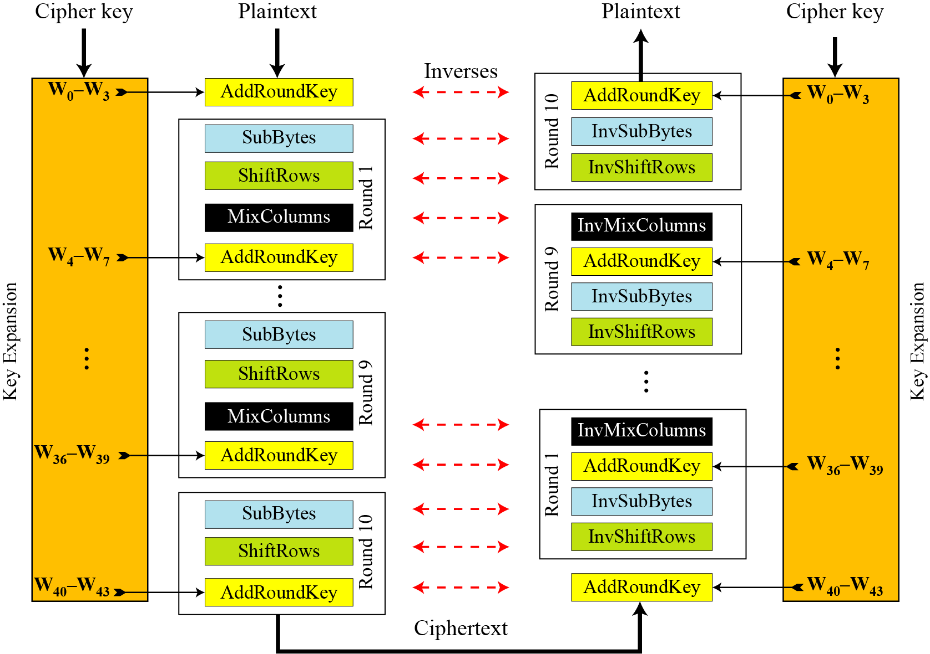
AES Overall Structure

Slide 54
AES key expansion
Words for each round
Round | Words
Pre-round | W₀ | W₁ | W₂ | W₃
Round 1 | W₄ | W₅ | W₆ | W₇
Round 2 | W₈ | W₉ | W₁₀ | W₁₁
. . . |  | . . .
Round N | W₄₀ | W₄₁ | W₄₂ | W₄₃

Slide 55








AES key expansion
K₀ | K₄ | K₈ | K₁₂
K₁ | K₅ | K₉ | K₁₃
K₂ | K₆ | K₁₀ | K₁₄
K₃ | K₇ | K₁₁ | K₁₅
The AES key expansion algorithm takes as input a four-word (16-byte) key and produces a linear array of 44 words (176 bytes).
Each added word w[i] depends on the immediately preceding word, w[i - 1].
In three out of four cases, a simple XOR is used.
W₀ | W₁ | W₂ | W₃
g
$$⊕$$
$$⊕$$
$$⊕$$
$$⊕$$
W₄ | W₅ | W₆ | W₇
$$⊕$$
$$⊕$$
$$⊕$$
$$⊕$$
W₄₀ | W₄₁ | W₄₂ | W₄₃

Slide 56

g function of key expansion
32
V0 | V1 | V2 | V3
V1 | V2 | V3 | V0
Rcon Table
1 | 2 | 3 | 4 | 5 | 6 | 7 | 8 | 9 | 10
01 | 02 | 04 | 08 | 10 | 20 | 40 | 80 | 1b | 36
00 | 00 | 00 | 00 | 00 | 00 | 00 | 00 | 00 | 00
00 | 00 | 00 | 00 | 00 | 00 | 00 | 00 | 00 | 00
00 | 00 | 00 | 00 | 00 | 00 | 00 | 00 | 00 | 00
S
S
S
S
$$⊕$$
RC[i]
32

Slide 57
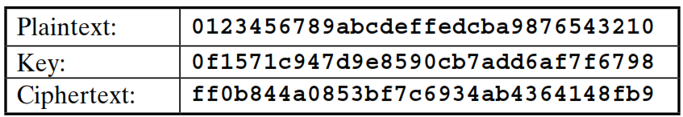
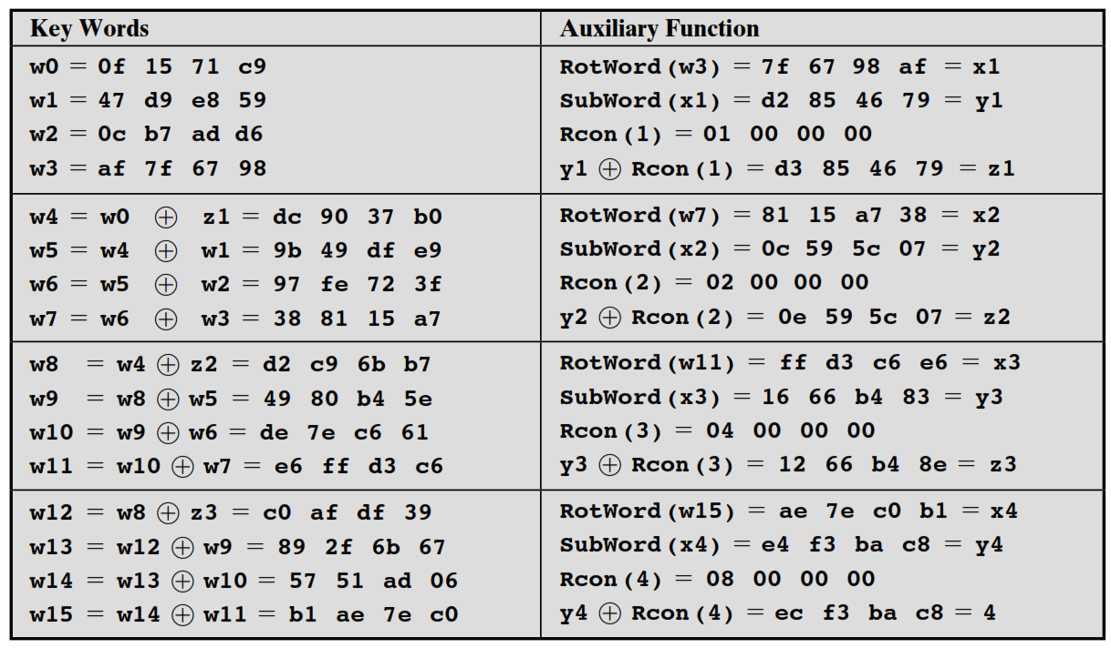
Key Expansion Example

Slide 58


